Slide 1
2020 Project Delivery Case Studies
COVID-19 Rapid Response Projects
July 16, 2020

Slide 2
CASE STUDIES:
Project Delivery in COVID-19 Era
The COVID-19 pandemic is unprecedented. It has pressed on rapid design response and instant construction delivery to serve the community.
The AIA Project Delivery Knowledge Community (PDKC) gathered case studies from a number of architects who worked on the front lines during the public health emergency. These case studies share their stories, what they’ve experienced and learned in delivering essential projects during the moments of crisis. What worked, traps to avoid, how to win cooperation, and the course of actions taken to successfully deliver the projects.
These case studies highlight architects’ work that will inspire and improve the visibility and awareness of project delivery in our profession. Such leadership role demonstrates the importance of project delivery and helps architects rise to the occasion.
Grace Lin, AIA
Chair of AIA PDKC

Slide 3

Case Study 1: COVID-19 Surge Facility
East Orange General Hospital
Mission: to assemble a comprehensive Design/Build + Project Management + Safety Team in 5 days to be ready to convert a closed and partially abandoned office building outside East Orange General Hospital into a 250-Bed Non-Acute Covid-19 Surge Patient Care Facility in 14 days from Notice to Proceed.
Client: New Jersey Department of Health
Operator: East Orange General Hospital
Contract: U.S. Army Corps of Engineers, Cutting Edge Group
Challenge: team required to rapidly assess conditions of the building, available space for 250 beds and program, systems and life safety status, and determine code compliance to achieve program goals with available materials, labor, trade talent, equipment and existing systems and complete the renovation in 14 days from Notice to Proceed.
Project GSF
80,000 GSF
Project Location
East Orange, New Jersey

Slide 4
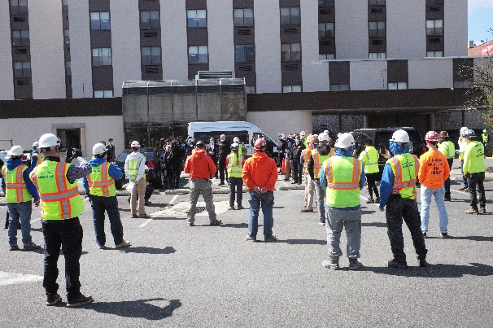
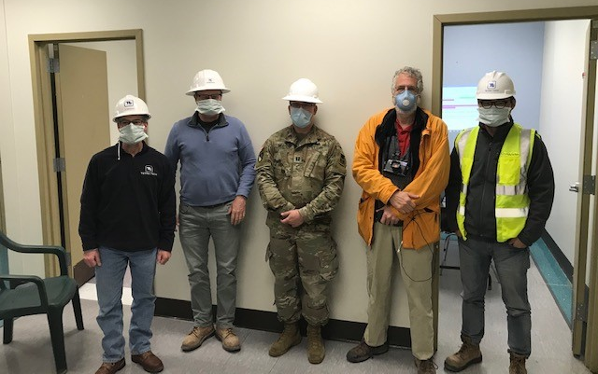


Case Study 1: COVID-19 Surge Facility
East Orange General Hospital
The Solution: rapid assessment of systems, infrastructure and assets w/in the building by each team member on Day One; quick formulation of program, work scopes and critical path schedules based on available materials, parts and equipment; rapid decisions, approvals and support from owners/Authorities Having Jurisdiction to maintain schedule; ongoing reviews of submittals, work in place and changes due to field conditions by all team members; continuous onsite presence of all principals; structured communication with integrated team through twice daily project team meetings to keep the process nimble and moving forward at the seemingly impossible pace required.
Accomplishments: Created 250 patient bed spaces for non-acute COVID-19 patients; Replaced/restored 123 sinks, 70 toilets, & 24 showers; Created/restored 13 nurse stations; Installed 30 miles of electrical cable and 30,000 sf of flooring; Constructed 420 linear feet of 6’-high partition walls; Polished & sealed 80,000 sf of flooring; worked 24,000 hours with ZERO lost time and ZERO recordable incidents with NO workers diagnosed with Covid-19
Client: U.S. Army Corps of Engineers
Constructors: Cutting Edge Group LLC/Archstone Group
Project Manager: Tetra Tech
Design Team: Jeffrey Berman Architect
Cosentini Associates Consulting Engineers
Construction Cost
$12,000,000
Completion Date
April 22, 2020
14 days

Slide 5
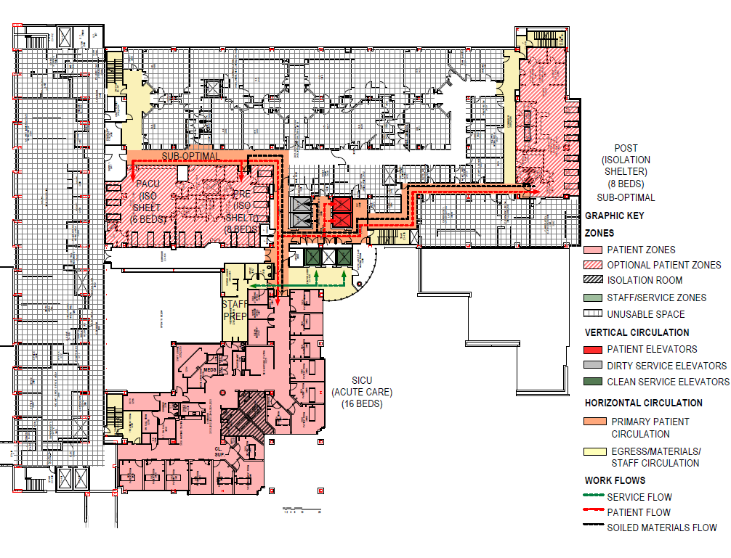
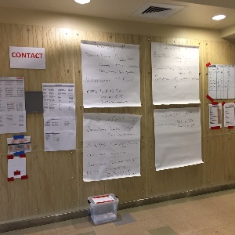
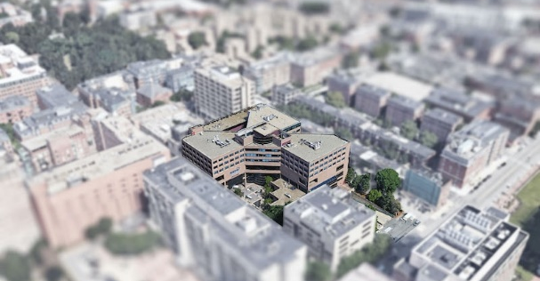
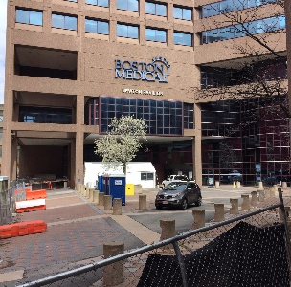
The S/L/A/M Collaborative
Architect of Record
Case Study 2: Newton Pavilion
COVID-19 Emergency Re-Occupancy
Project Overview
Newton Pavilion has been a shuttered hospital facility since October 29, 2018. SLAM and Gilbane were contracted by the current building owner, Massachusetts Division of Capital Asset Management & Maintenance (DCAMM), to assist them in assessing the building and devising an occupancy plan to convert the space for homeless patients who are not in need of acute hospitalization, yet test positive for the coronavirus, but are a-symptomatic or showing mild symptoms with orders to quarantine at home.
The coordination and focused effort to ready Newton Pavilion for occupancy on April 9, 2020, required full-day meetings over a 28-day period held between DCAMM, Boston Medical Center (BMC), Gilbane, and the SLAM design team. Following the Army Corps of Engineers review and swift approval of the occupancy plan demonstrating SLAM’s technical expertise and in-depth work in healthcare programming and planning, Gilbane was able to rapidly mobilize on-site and deliver the facility ahead of schedule.
“DCAMM was ahead of the curve when asked what it would take to temporarily re-open the “mothballed” facility” said Carol Gladstone, DCAMM Commissioner, “The project team quickly developed a very comprehensive and integrated execution plan that involved splitting construction scope between our internal team and Gilbane. I had extremely high confidence that we could rise to the challenge and deliver in a short timeframe.”
Owner & Stakeholders
Massachusetts Division of Capital Asset Management & Maintenance (DCAMM), City of Boston “Healthcare for Homeless Program”, Massachusetts Department of Public Health (DPH), Massachusetts Department of Corrections (DOC), and Boston Medical Center (facility operator)
The Challenge
Design, construct, and occupy a formerly shuttered hospital in four weeks to serve the underserved and homeless population of greater Boston dealing with COVID-19.
Project GSF
166,500
Project Location
Boston, MA

Slide 6
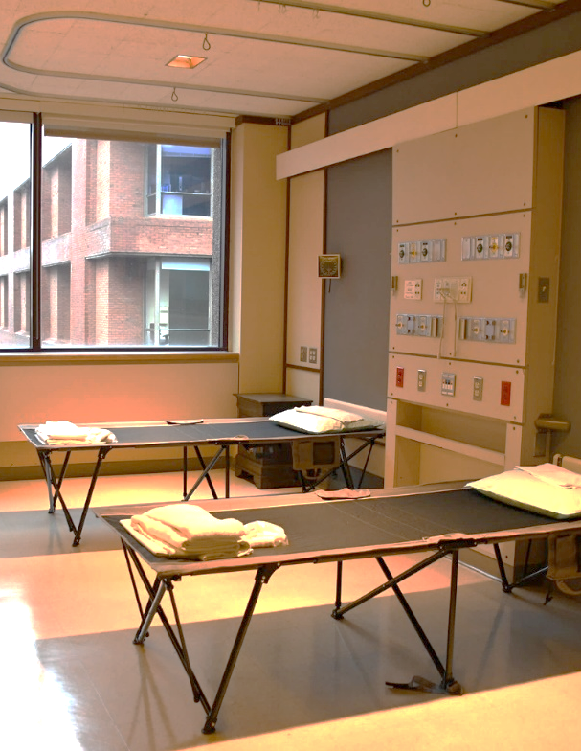
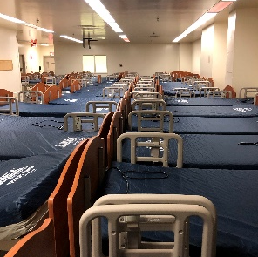
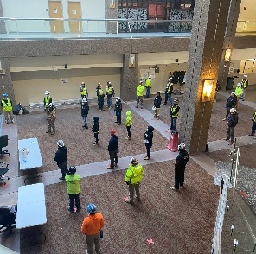
The S/L/A/M Collaborative
Architect of Record
Case Study 2: Newton Pavilion
COVID-19 Emergency Re-Occupancy
The Solution & Project Delivery Method
The process can be best defined as a Design-Assist project delivery method, with SLAM (the architect), WSP (the engineer) and Gilbane (the contractor) working together from day one. From design through construction, the team was on-call 24/7, with teams of staff working around the clock to see the project to completion.
Daily hour-long meetings, sometimes up to four times per day, were held in person and virtually. Each day, SLAM issued a revised systems narrative and diagrammatic facility plan. Circulation and code were reviewed throughout with a code consultant.
During the project, temporary cots were installed to get the facility open and operational as fast as possible. Meanwhile the design team assisted the Client in locating and procuring 270 new hospital beds to replace the temporary cots.
Accomplishments
The facility was designed and constructed in four weeks. The project secured City approvals and a building permit over the course of two, three-hour building official walk-throughs. During the first three weeks of operation, the facility saw and discharged over 700 patients.
Project Team
SLAM (Architect), WSP (MEP Engineer), Code Red (Code Consultant), Gilbane (Contractor)
Construction Cost
$3.5M
Completion Date
April 9, 2020

Slide 7
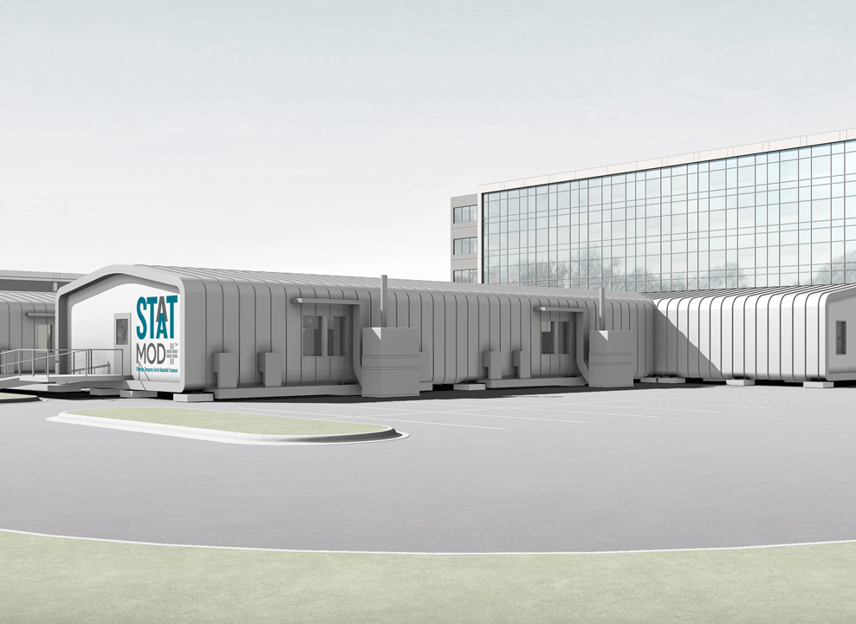
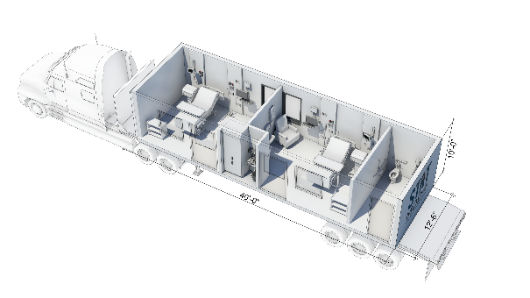
Hammel, Green and Abrahamson, Inc.
Case Study 3: STAAT Mod TM
Strategic, Temporary, Acuity-Adaptable Treatment Mods
Project Overview: The COVID -19 epidemic created a potential surge capacity crisis in the country for ICU capability. On March 17th, the first full day of HGA’s firmwide “Work from Home” directive, Kurt Spiering (healthcare sector leader at HGA) received a phone call from Ben Bruns , executive vice president for northern operations of The Boldt Company. He was asking if we would combine our talents and experience with modular and prefabricated construction to respond with facility solutions to the emerging healthcare crisis. What followed was several weeks of intense problem solving to meet a goal of Hospital Quality Care with Speed to Market for an Airborne Infection Isolation ICU Room. Drawing upon a collaborative and committed team of over 80 people working remotely and virtually we were able to rapidly prototype and model a solution in virtual reality, fabricate and ship the first order to Adventist HealthCare, Fort Washington Medical Center
The first modules were designed to ship commercially using an existing 12.6 x 40 x 10 module. Since speed without sacrifice to clinical quality was the key objective, the original modules relied on some code and jurisdictional waivers that had been provided during the early phases of the SARS-COV2 pandemic. The systems were also designed to utilize readily available “off the shelf” material as supply chain was a barrier to speed of delivery. Since that time of immediate surge capacity crisis, the design and fabrication team has had the ability to evolve the STAAT Mod solution to comply with all FGI guidelines and increase the useful life of the units using higher quality materials more appropriate for healthcare. Because the life of the units was lengthened, the aesthetic of the design evolved to match the longer-term use and presence on hospital campuses.
Photo / Image / Floor Plan
Project GSF
7,000 BGSF
Project Location
Fort Washington, Maryland
Owners &
Stakeholders
No stakeholders initially, but the team was contacted by Jensen and Partners, an Owner’s Rep for the State of Maryland DGS.
Create Modular, Negative Pressure ICU’s using off the shelf system components to provide Hospital Quality Care with Speed to Market; 80 people working remotely and virtually.
Challenges:

Slide 8
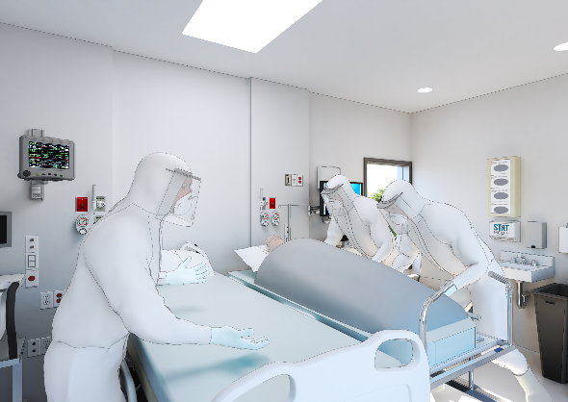
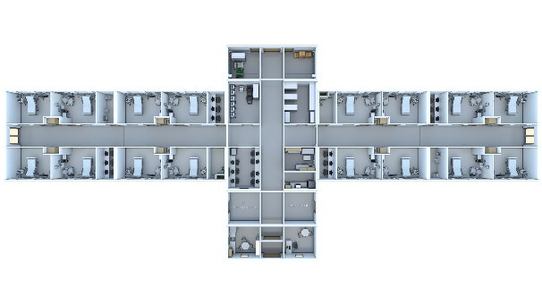
Hammel, Green and Abrahamson, Inc.
Case Study 3: STAAT Mod TM
Strategic, Temporary, Acuity-Adaptable Treatment Mods
Solution / Project Delivery: The STAAT Mod™ system is the only prefabricated solution that delivers hospital quality critical care to address the safety of patients and healthcare workers affected by COVID-19. Other modular or temporary solutions provide capacity, but do not include highly engineered, Airborne Infection Isolation Room (AIIRs) modules as recommended by the CDC for infectious patients undergoing aerosol-generating procedures, using readily available components. The modules are designed with flexibility to be deployed inside a convention center or other structure, serve as either a self-sufficient, stand-alone facility, or where connect to existing infrastructure. The room features are driven by years of Evidence-based Design research that have been proven to increase staff and patient safety and improve clinical outcomes. The design provides ample space to provide care with access to equipment. The isolation room also provides enough clearance around the bed to safely transfer a patient and reduce staff injuries. A key element to patient recovery is the recliner in the room. Getting the patient vertical improves clinical outcomes and shortens length of stay, which has the added benefit of optimizing room utilization.
Accomplishments:
16 private ICU rooms with isolation and adequate support space was deployed at Adventist Fort Washington Medical Center. They are the first hospital in the country to receive this ICU-level of care unit.
HGA architecture, design, project mgmt., MEP eng., structural, evidence-based design, process eng., medical planning, digital simulation, and interior design.
THE BOLDT COMPANY provided construction management, fabrication, cost estimating, constructability and were our partner.
TWEET/GAROT MECHANICAL were the mechanical design assist trade partner providing the mechanical, med gas and plumbing fabrication
FAITH TECHNOLOGIES provided electrical design assist trade partner providing electrical fabrication.
IMEG provided equipment planning insight and an ability to procure FF&E.
Project Team:
Construction Cost
$4.4 million
Completion Date
May 23, 2020

Slide 9
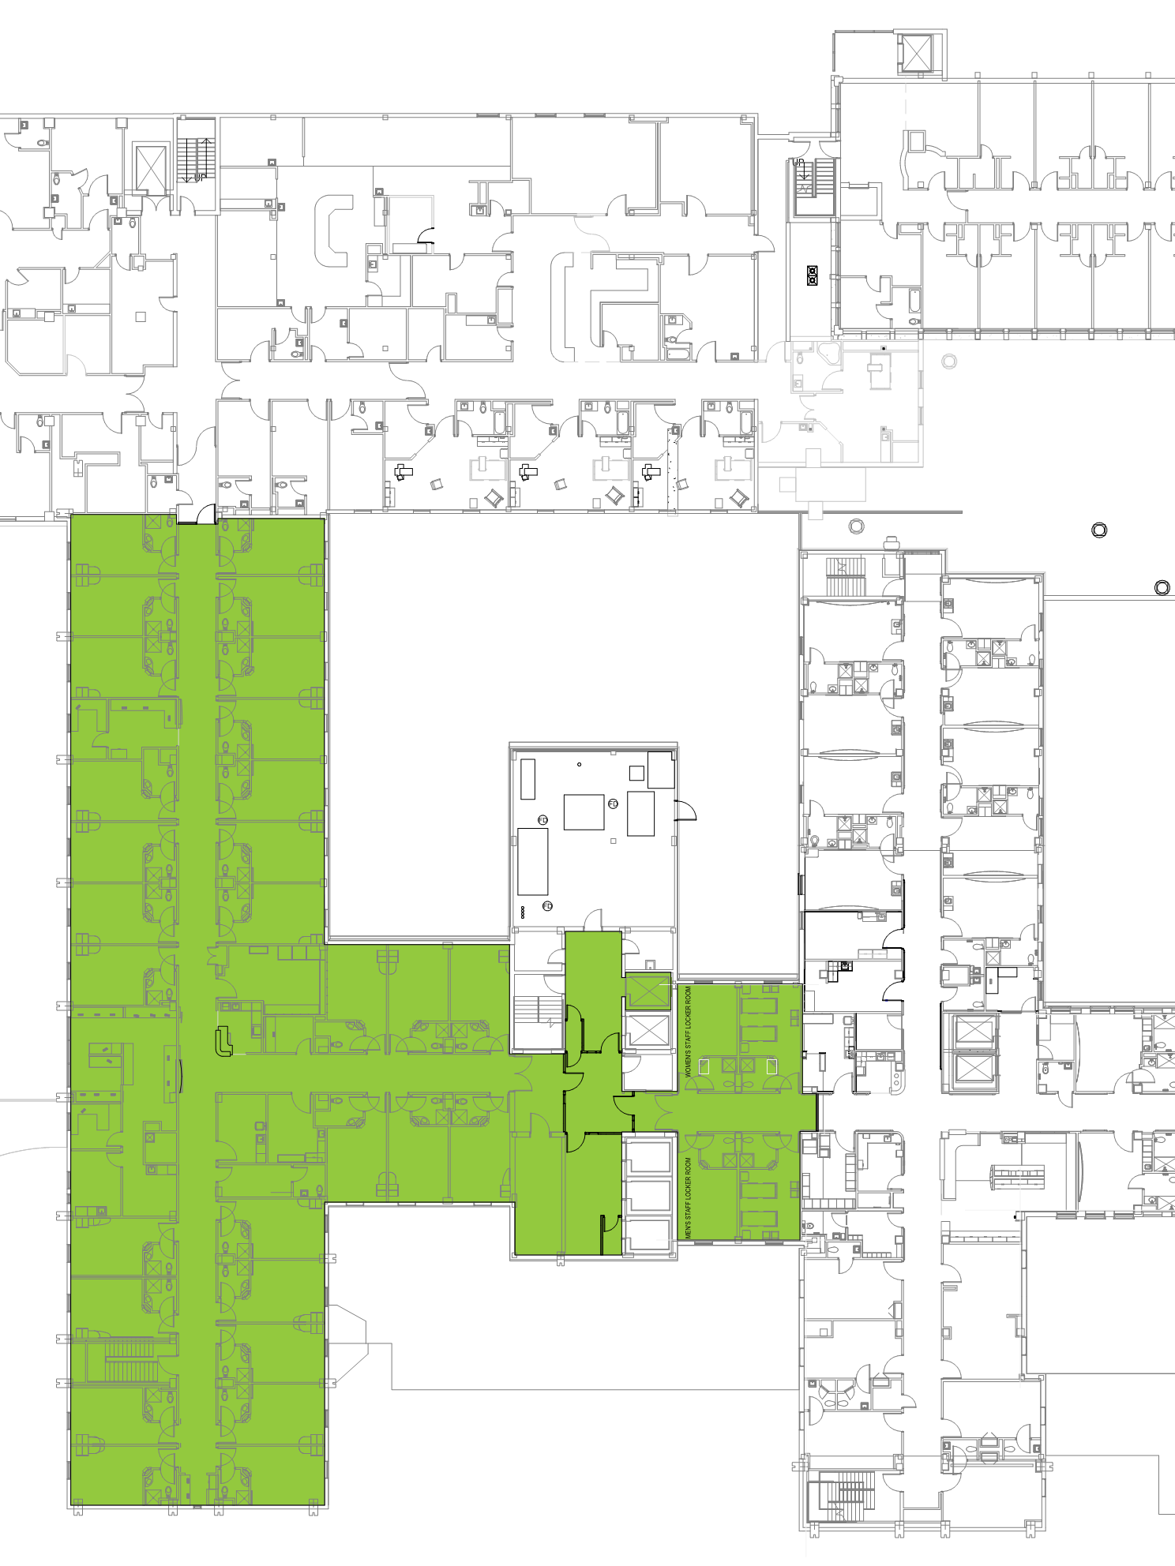
Rohrbach Associates PC
Case Study 4: Mercy Hospital
COVID-19 Inpatient Unit
Mercy Iowa City is an acute care hospital and regional referral center that draws patients from throughout southeast Iowa. To accommodate the anticipated surge of COVID-positive patients, Mercy identified an inpatient unit with a dedicated air handling unit which could be independently tuned to offer a negative pressure environment throughout.
Mercy Hospital, Iowa City, is an affiliate of the Midwest’s MercyOne network.
Despite having an existing dedicated AHU, the patient wing still had to undergo physical upgrades to ensure negative pressures could be maintained, and patient, staff, and material flows could be adequately controlled.
Photo / Image / Floor Plan
Project GSF
16,200 SF
Project Location
Iowa City, IA

Slide 10
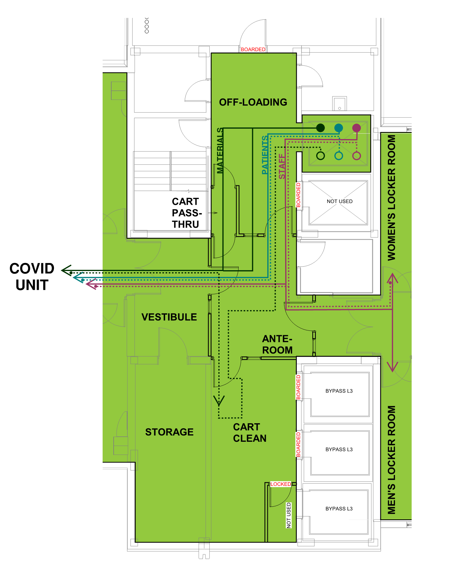
Will Downing
AIA ACHA
wdowning@rohrbachassociates.com
Case Study 4: Mercy Hospital
COVID-19 Inpatient Unit
To minimize the infiltration of air into the COVID Unit and help protect adjacent spaces, connections to adjacent wings were limited to emergency egress only. The elevator lobby serving the COVID Unit was divided into Off-Loading, Ante-Room, Vestibule, and Cart Clean to ensure the wing would not lose pressure upon entering. These additional rooms also served to control flow of staff, and processing of soiled carts prior to returning to the general hospital. All work (design and construction) was conducted on a Time-and-Materials basis, by trusted consultants.
Mercy Iowa City was able to effectively isolate COVID-positive patients, significantly reducing cross-contamination and maintaining a safe working environment for providers and staff, both inside the COVID wing and in the hospital at large. The air handling system controls were modified to create an “isolation wing” preset, where, with the push of a button, the systems can go to 100% outdoor air mode and full exhaust, with fan speeds reset to maintain the pressure relationships required.
Rohrbach Associates PC (Architecture)
Design Engineers PC (Mechanical/Electrical Engineer)
McComas Lacina Construction (General Contractor)
Universal Climate Control (Mechanical Contractor)
Northwest Automation & Controls (Controls Contractor)
Photo / Image / Floor Plan
Construction Cost
$96,300
Completion Date
3/20/20

Slide 11
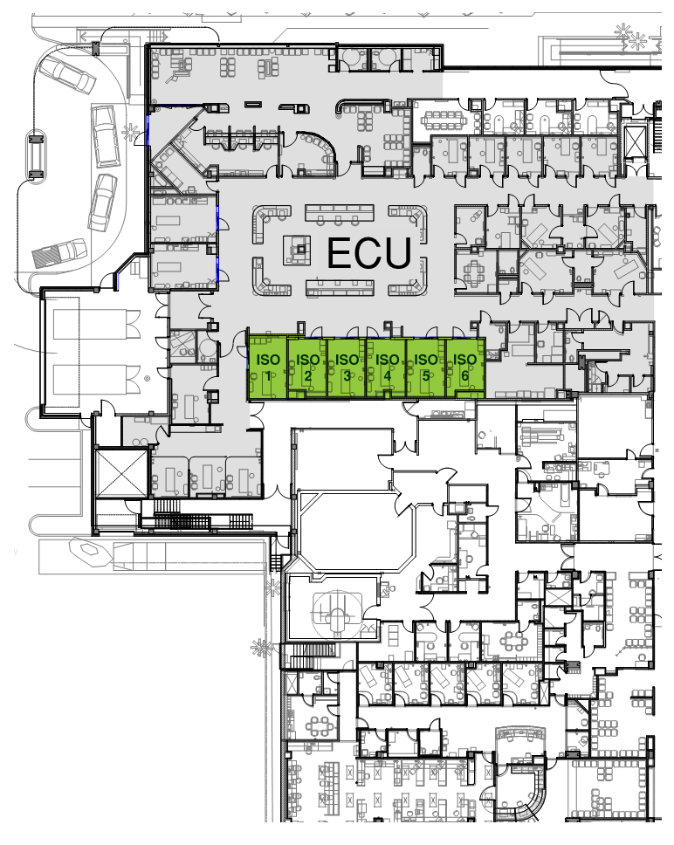
Rohrbach Associates PC
Case Study 5: Mercy Hospital
Critical Care Conversions
Mercy Iowa City sought to provide as many negative-pressure beds as possible to mitigate the spread of COVID-19 among patients and staff. Interventions were conducted in the Intensive Care Unit, the Emergency Care Unit, and the Surgery Suite to address aerosolized contagion, primarily through direct exhaust and negative pressure.
Mercy Hospital, Iowa City, is an affiliate of the Midwest’s MercyOne network.
Existing air handling equipment, even when operated at full capacity, was not sufficient to provide 100% outside air and 100% exhaust in a negative pressure environment.
Photo / Image / Floor Plan
Project GSF
ICU = 9800 SF
Project Location
Iowa City, IA
ECU = 1200 SF
OR = 2250 SF

Slide 12
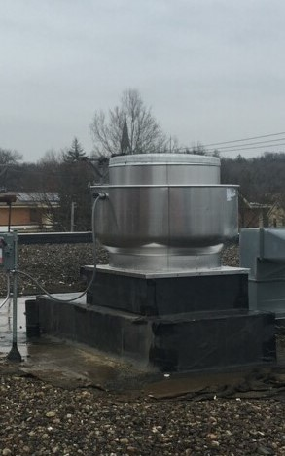
Will Downing
AIA ACHA
wdowning@rohrbachassociates.com
Case Study 5: Mercy Hospital
Critical Care Conversions
Three dedicated exhaust fans were added to: 1)allow the Intensive Care Unit to operate as a negative-pressure wing, 2) increase the isolation room count within the Emergency Care Unit, and 3) create a negative-pressure ante-room to two operating rooms within the Surgery Suite for intubation/extubation to occur outside of the ORs themselves. All work (design and construction) was conducted on a Time-and-Materials basis, by trusted consultants.
Mercy Iowa City was able to manage COVID-positive patients of all acuity levels. Although the exhaust fans and their concomitant ductwork, monitors, and the like were installed under short order to specifically address COVID, they are long-term solutions which can be switched between normal and isolation modes granting the facility future flexibility in combatting similar contagions should they arise.
Rohrbach Associates PC (Architecture)
Design Engineers PC (Mechanical/Electrical Engineer)
McComas Lacina Construction (General Contractor)
Universal Climate Control (Mechanical Contractor)
Northwest Automation & Controls (Controls Contractor)
Photo / Image / Floor Plan
Construction Cost
ICU = $59,400
Completion Date
ICU: 3/30/20
ECU: 4/29/20
OR: 4/1/20
ECU = $58,600
OR = $49,000
TOTAL = $167K

Slide 13
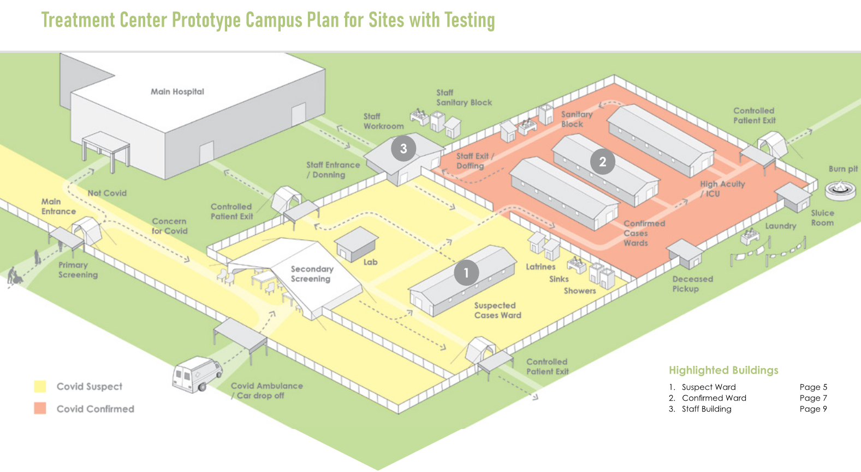
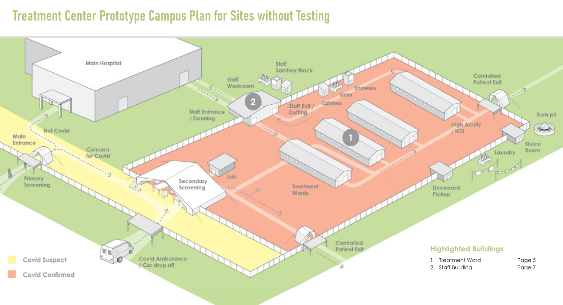

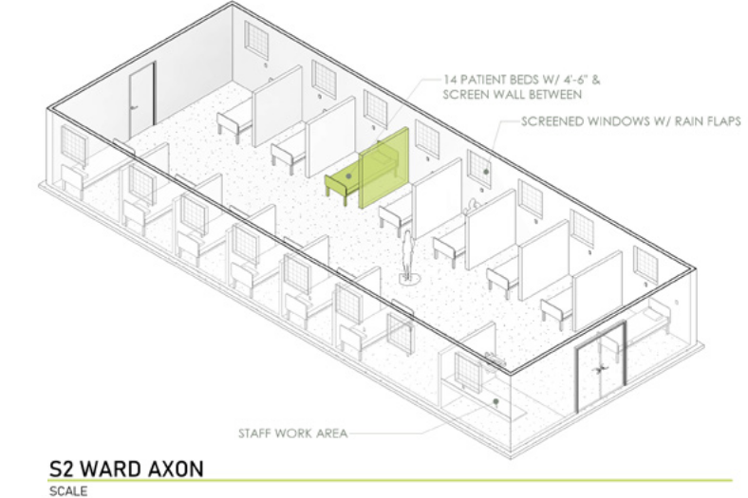
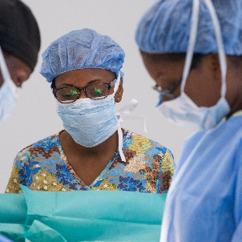
Build Health International
Case Study 6: COVID-19 treatment centers for low-resource settings
Project Overview
This project began as a prototype of a COVID-19 Treatment Center for low-resource settings with and without testing ability and has since been adapted and built at three sites (2 wards in Fond-des-Blancs, Haiti; 3 wards and staff workroom in Mirebalais, Haiti; and 4 wards in Mbarara, Uganda).
The prototype consists of construction drawings of wards and a staff workroom and illustrations of the overall campus plan and clinical flow.
Owners & Stakeholders
Partners in Health (Zanmi Lasante), Health Equity International, Mbarara Regional Referral Hospital, Center for Global Health, Massachusetts General Hospital
The Challenge
As COVID-19 cases continue to increase globally, fragile health systems already facing challenges with health system infrastructure may be left with few options to effectively care for acutely ill patients.
Fig. 1
Fig. 2
Photo / Image / Floor Plan
Fig. 1: Campus Plan with testing
Fig. 2: Campus Plan without testing
Fig. 3: Suspect Ward Design
Fig 3
Project GSF
Project Location
Mirebalais, Haiti: 5539sf
Fond-des-Blancs, Haiti:
2880sf
Mbarara, Uganda: 6356sf
Built: Mirebalais, Haiti, Fond-des-Blancs, Haiti, Mbarara, Uganda
Prototype Development: Beverly, MA

Slide 14
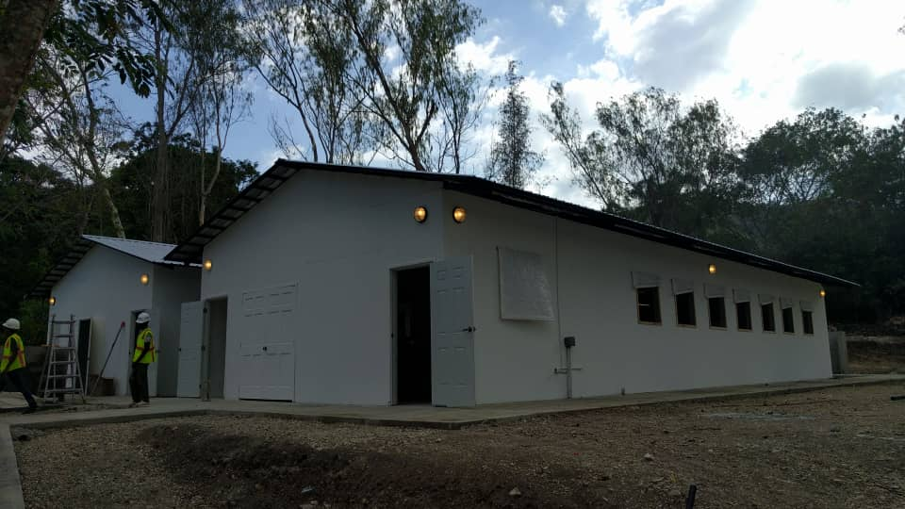
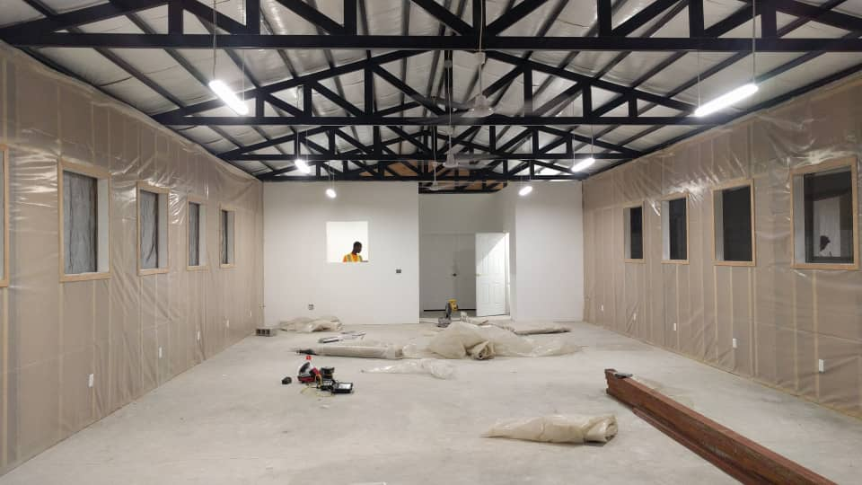
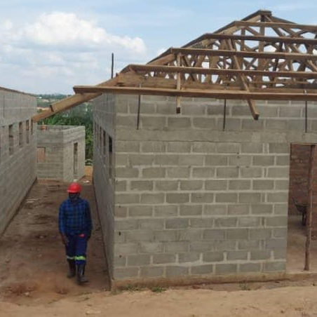
Build Health International
COVID19@buildhealthinternational.org
Case Study 6: COVID-19 treatment centers for low-resource settings
The Solution & Project Delivery Method
Rapid and affordable construction in these low-resource settings was achieved by:
- Designing while the site was being prepped
- Using modular designs that could be built out of plywood or other easily sourced local materials
- Using local workforce with remote site supervision - Through on-job training and collaboration over the years, BHI has relationships with a skilled Haitian workforce making projects like this possible.
- Placing plumbing in discrete and centralized locations to make construction faster
- Selecting faster construction methods, i.e. rapid stud construction over typical masonry. We trained local contractors in stud construction as needed.
Accomplishments
Built treatment centers at three sites (Fond-des-Blanc, Haiti; Mirebalais, Haiti; Mbarara Uganda) BHI has also made all their COVID-19 resources available at: https://www.buildhealthinternational.org/covid-infrastructure-resources/
In June 2020, BHI’s designs were published in the American Journal of Tropical Medicine and Hygiene. The paper is available at: https://www.ajtmh.org/content/journals/10.4269/ajtmh.20-0681
Project Team
Rob Raymond, David Walton, Jim Ansara, Thomas Darr, Sophie Hicks, Samantha Modder, Andrew Jones, Caitlin Candee, Noah Hudleson, Omar Hernandez, Jimmy Forest, Edouard LeBrun, Alex Otheniel, Barnaby Riche, Jimmy Bernard, Jamsky Charles, Sanel Lisse, James Dorvil, Jean Alex Paul, Jean D’Honneur, Kenzy Maigna
Photo / Image / Floor Plan
Fig. 1: Finished Ward (Exterior), Fond-des-Blancs, Haiti
Fig. 2: Finished Ward (Interior), Fond-des-Blancs, Haiti
Construction Cost
Completion Date
Mirebalais, Haiti:$450,000
Fond-des-Blancs, Haiti:
$120,000
Mirebalais, Haiti:Mid-July 2020
Fond-des-Blancs, Haiti: March 2020

Slide 15

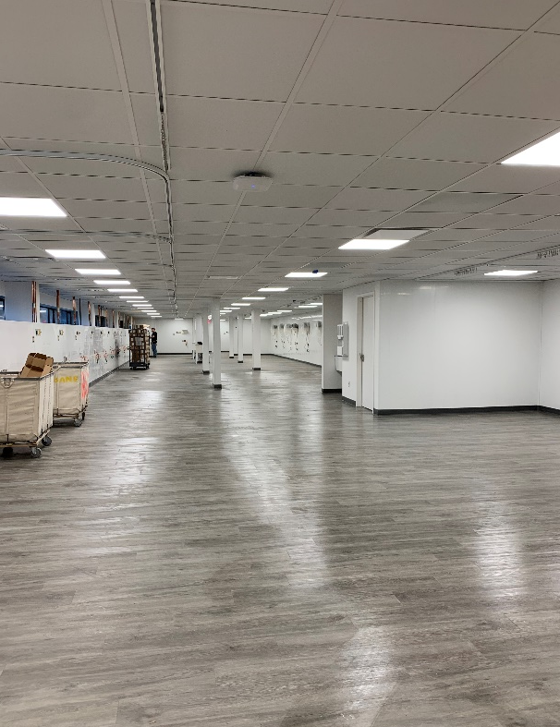
Case Study 7: PACU conversion
Northwell Health fast track COVID Ward
A shell space meant for a PACU was quickly converted into a 65-bed COVID 19 Ward. This will serve as the dedicated space for COVID patients allowing the other facilities within the system to resume normal operation.
Northwell Health
In addition to servicing the client remotely, the team had 48 hrs to design and 2 weeks for construction.
Project GSF
10,000
Project Location
New Hyde Park, NY

Slide 16
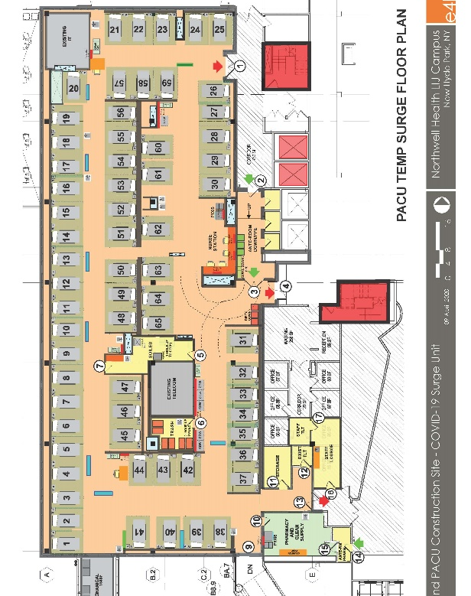
Case Study 7: PACU conversion
Northwell Health fast track COVID Ward
IPD
48 hour design
2 week construction implementation
E4H Environments for Health Architecture
Gilbane
Lizardos
Construction Cost
$3.2M
Completion Date
April 25, 2020

Slide 17
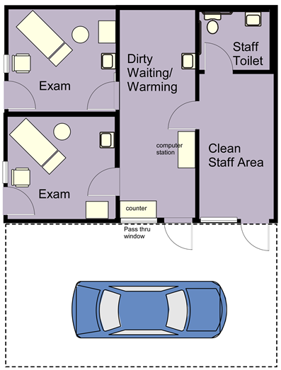
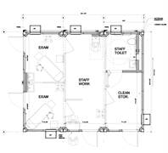
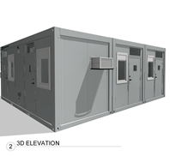
Case Study 8: Modular Testing Building
The client had erected a series of drive up Covid testing tents at various clinic locations. As the need for testing continues, the requirement for a more temperature-controlled and severe weather resistant environment for staff called for a different solution that would meet the needs for drive up testing.
Bassett Healthcare Network
Develop a solution that is compact, quick to deploy, and provides a temperature-controlled environment.
Photo / Image / Floor Plan
Project GSF
480 SF per location
Project Location
Multiple Locations

Slide 18
Case Study 8: Modular Testing Building
The solution was to work with clinical staff to design a modular building that would fit their needs. In addition to staff space they also found that they needed patient encounter exam space for some patients who arrived at the testing locations. Two exam rooms were added to the design to accommodate this function.
Over a span of 2-3 weeks and several meetings a plan was generated and passed along to the modular building manufacturer who prepared plans for fabrication.
E4H Environments for Health Architecture
Sage Engineering Associates, LLP
McCarthy Construction
WillScot Corporation
Construction Cost
TBD
Completion Date
Testing Tent Fabrication is 8-10 weeks

Slide 19
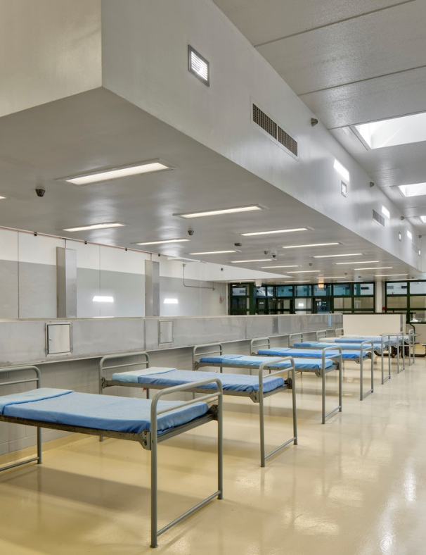
Hammel, Green and Abrahamson, Inc.
Case Study 9: Milwaukee House of Correction, Alternative Care Facility
Contracted by the United States Army Corps of Engineers (USACE), Gilbane, HGA and subcontractors planned, designed and converted an existing prison dormitory into an alternative care facility (ACF) at the Milwaukee County House of Correction to respond to the surge demand in the state prison population.
The team used their healthcare design expertise to convert the unused prison dormitory into a space to treat COVID positive inmates in a safe and secure facility in 20 days.
Owner & Stakeholders: United States Army Corps of Engineers, State of Wisconsin Department of Corrections and Milwaukee County.
The Challenge: Plan, design, procure and construct a prison ACF within 20 days.
Project GSF
37,250 SF
Project Location
Franklin, Wisconsin

Slide 20
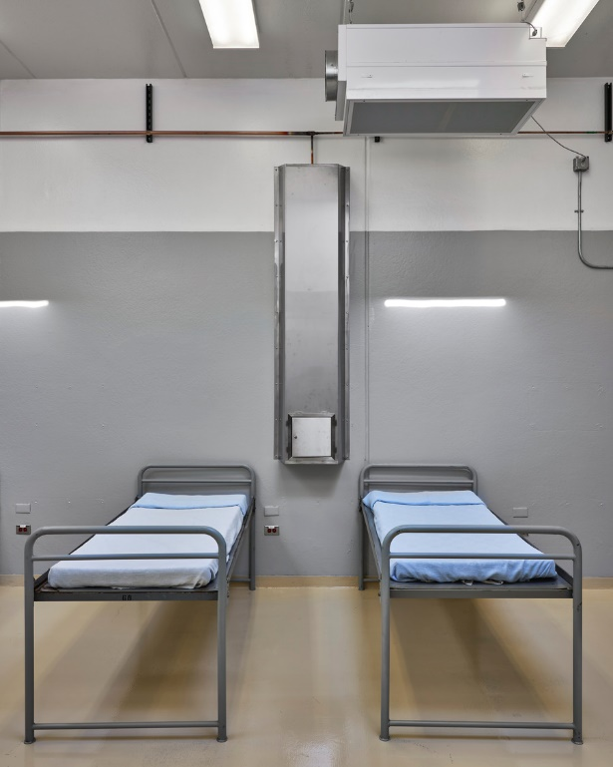
Hammel, Green and Abrahamson, Inc.
Case Study 9: Milwaukee House of Correction, Alternative Care Facility
The Solution & Project Delivery Method: Through integrated project delivery in a design-build delivery method, the facility transformation was completed in just 20 days. The ACF can currently house 120 non-acute COVID-19 positive prisoners in the currently unused Lotter Building reducing the potential strain and security risk of adding prisoners to the patient population of local healthcare facilities.
Organized within four existing dormitories, each housing 30 prisoners, the design involved the installation of piped oxygen in one higher acuity dorm, modifications and updates to the electrical power (with 100% backup using emergency generators), HVAC system modifications to provide negative pressure dorms, and a wireless nurse call system all while observing prison protocols for prisoner security and staff safety.
HGA leveraged its deep operational planning expertise to develop a plan that emphasized operational efficiency, safety and security.
Accomplishments: Delivered a safe and secure prison COVID facility on time and on budget.
Project Team: United States Army Corps of Engineers, Gilbane and HGA
Construction Cost
Completion Date
$4.5M
May 20, 2020

Slide 21
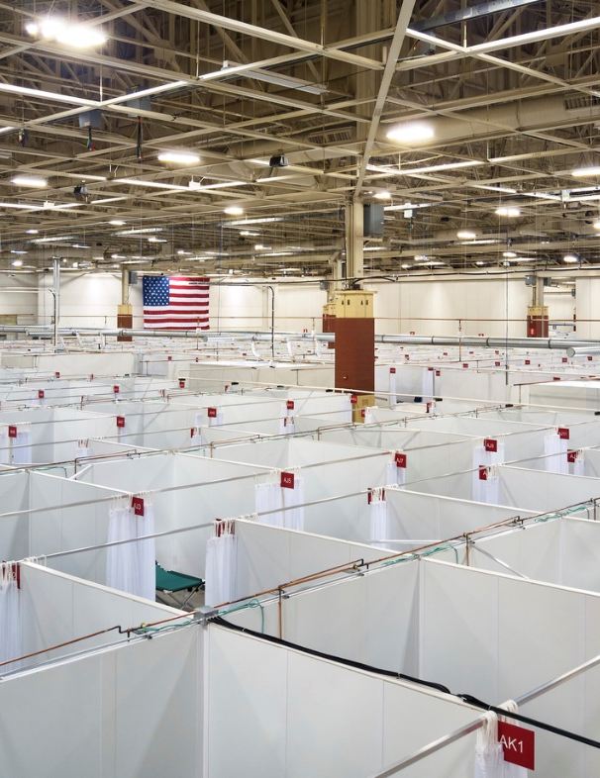
Hammel, Green and Abrahamson, Inc.
Case Study 10: Wisconsin State Fair Park Exposition Center, Alternative Care Facility
Contracted by the United States Army Corps of Engineers (USACE), Gilbane, HGA and subcontractors planned, designed, procured and built an alternative care facility (ACF) at the Wisconsin State Fair Park Exposition Center to respond to the surge demand at local hospitals.
The team used their experience and expertise of clinical best practices to enhance the USACE’s early concept into a scalable plan that allowed the client to make decisions based on best value and current COVID-19 projections.
Owner & Stakeholders: United States Army Corps of Engineers, State of Wisconsin, Milwaukee County and local healthcare organizations.
The Challenge: Plan, design, procure and construct an ACF within 10 days.
Project GSF
278,000 SF
Project Location
Milwaukee, Wisconsin

Slide 22
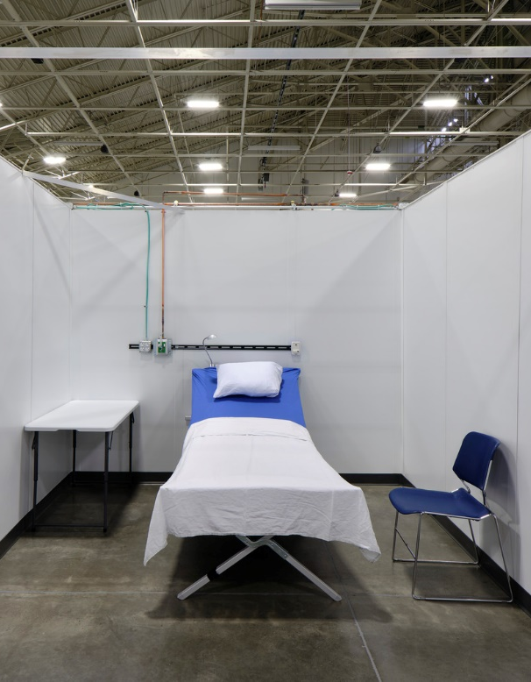
Hammel, Green and Abrahamson, Inc.
Case Study 10: Wisconsin State Fair Park Exposition Center, Alternative Care Facility
The Solution & Project Delivery Method: Through integrated project delivery the facility transformation was completed in just 10 days. The ACF can currently house 530 non-acute COVID-19 patients, with capacity for up to 750 patients. Each 10-foot by 10-foot patient room has three 8-foot-high hard walls, a curtain for the fourth wall, and is open to the ceiling to use the existing Exposition Center lighting.
Organized within three of the Center’s existing halls, the scalable design involved the installation of piped and bottled oxygen designated for specific areas, modifications to the electrical power (with 100% backup using emergency generators), a plumbing system, and a wireless nurse call system.
HGA enhanced the USACE early design concept into a scalable plan. Leveraging operational planning expertise, HGA developed a plan that emphasized operational efficiency while placing a premium on the patient and staff experience with the ultimate expectation of delivering the best possible patient outcomes in this temporary care facility.
Accomplishments: Delivered a scalable, patient and staff focused environment on time and on budget.
Project Team: United States Army Corps of Engineers, Gilbane and HGA.
Construction Cost
$14.9 M
Completion Date
April 18, 2020

Slide 23

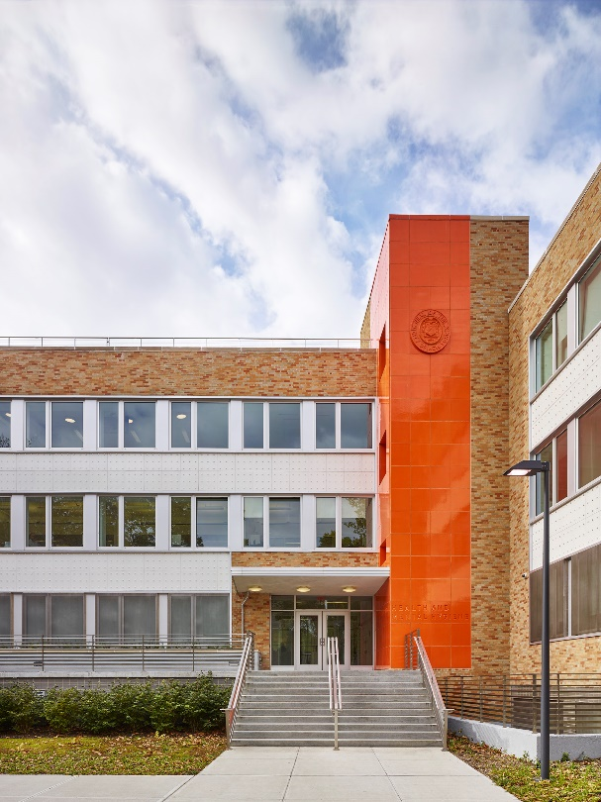


Case Study 11: Riverside Health Center COVID-19 Testing Lab
Architect of Record:
Public Facility for Community-Based Testing
Project Overview
As part of New York City’s coordinated program to increase testing facilities, an existing office suite within the NYC DOHMH Riverside Health Center was converted into a full-service COVID-19 testing lab. An adjacent clinic space was repurposed to function as a self-testing facility with a reception area, socially distanced seating, and 13 testing rooms where patients are guided with electronic devices to self-administer tests. Conceived as a response to the COVID-19 crisis, the new facility is designed to remain as a permanent installation that can adapt to the city’s future health testing needs.
Owner & Stakeholders
Owner: NYC Department of Health & Mental Hygiene (DOHMH)
Project Manager: NYC Department of Design & Construction (DDC)
The Challenge
Emergency Response: The project was initiated at the peak of NYC’s COVID-19 outbreak to address the immediate need for testing facilities. The project goal was to design, bid, and construct the project within a 6- to 8-week timeframe including obtaining all required approvals from the NYC Department of Buildings, FDNY, and the Public Design Commission.
Coordination and Communication: With New York City and neighboring states under stay-at-home orders, the design team worked remotely and communicated electronically.
Procurement: COVID-19 shutdowns affected availability and lead-times for products and materials. Research into availability was required for all design decisions and product selections.
Integration into existing facility: The testing lab was designed to fit within a functioning health center that already houses multiple programs. Complex mechanical and electrical systems for the lab, including a dedicated outside air system with negative-pressure exhaust system, had to be coordinated with existing building systems.
Project GSF
Project Location
  3,400 SF
  160 W 100th Street, New York, NY

Slide 24
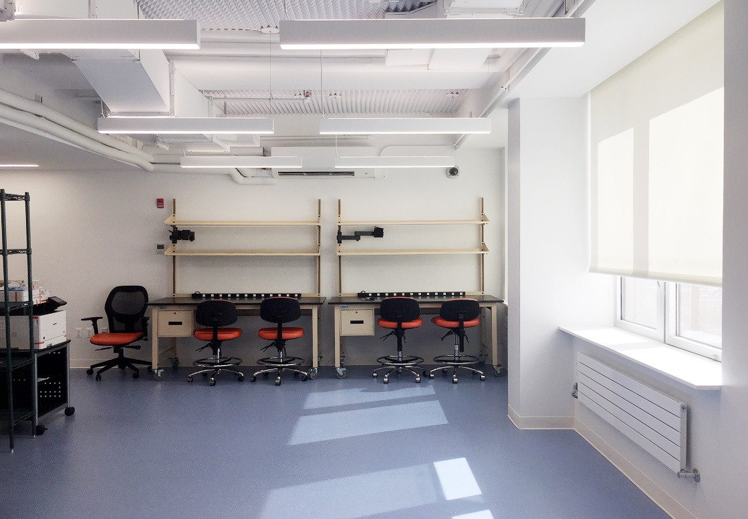
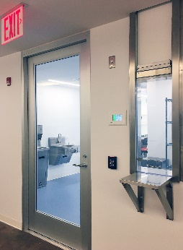
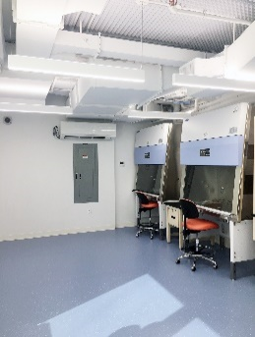
Case Study 11: Riverside Health Center COVID-19 Testing Lab
Architect of Record:
Public Facility for Community-Based Testing
The Solution & Project Delivery Method
Integrated Design-Bid-Build delivery method on a tightly compressed schedule, facilitated by AECOM as construction manager.
Active participation by multiple city and state agencies and representatives (including the NYC DDC, DOHMH, DOB, FDNY, PDC, and NYS DOH) to facilitate and expedite the process.
Integration of readily available products and equipment into the design.
Effective daily real-time communication among all members of the design team, stakeholders Construction Manager and General Contractor.
Accomplishments
The project was delivered on schedule, including all approvals.
The new facility is seamlessly integrated into the existing building without any impact of other programming and uses.
Complex mechanical and electrical systems for the lab were installed with minimal disruption to surrounding spaces and functions.
Circulation was rearranged to address use of shared space and incorporation of social distancing requirements.
Project Team:
Architect: 1100 Architect
MEP Engineer: JFK&M Consulting Group
Structural Engineer: Silman Associates
Code Consultant / Expeditor: William Vitacco Associates
Construction Manager: AECOM
General Contractor: SLS/Sweet Construction
Construction Cost
Completion Date
  $1,200,000
  June 17, 2020

Slide 25
Case Study 11: Riverside Health Center COVID-19 Testing Lab
Architect of Record:
Public Facility for Community-Based Testing

Slide 26

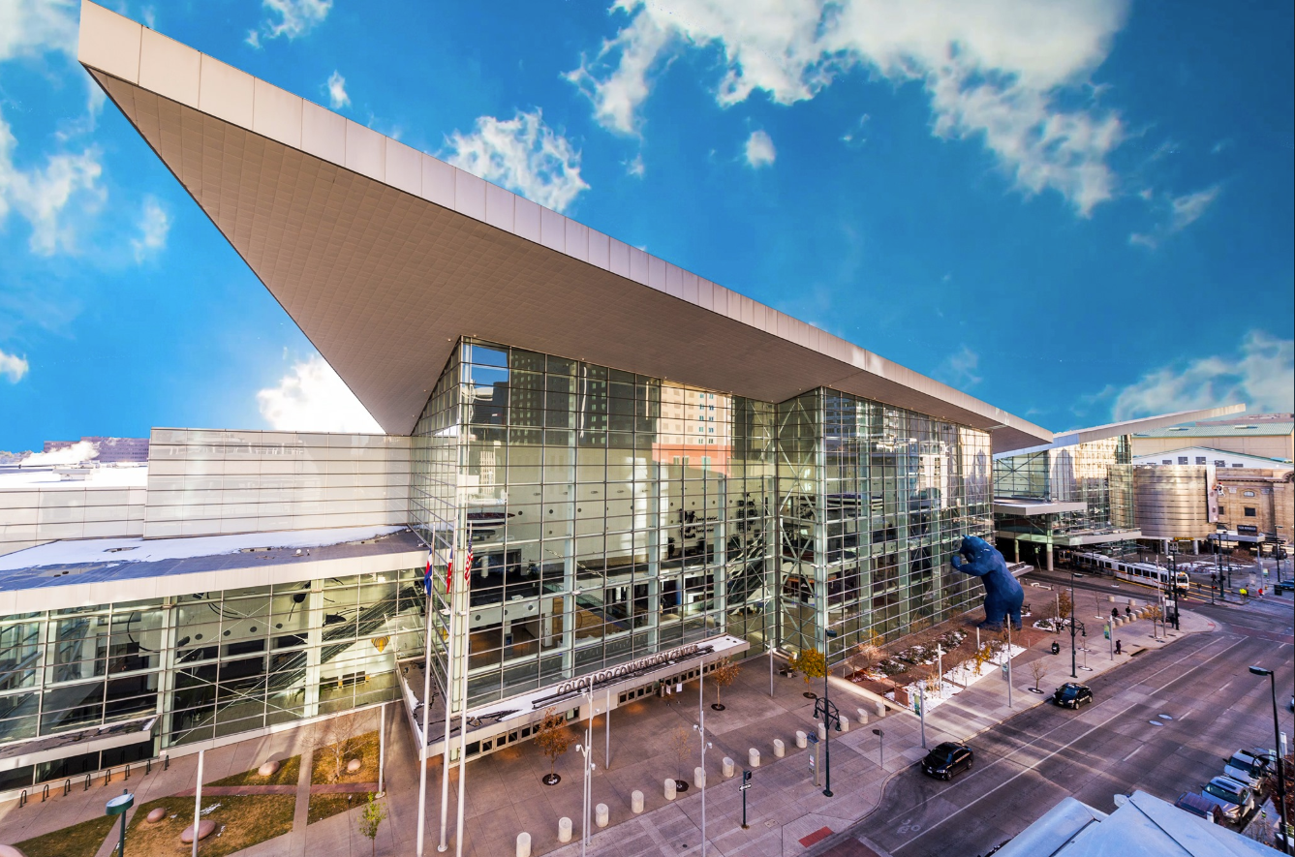
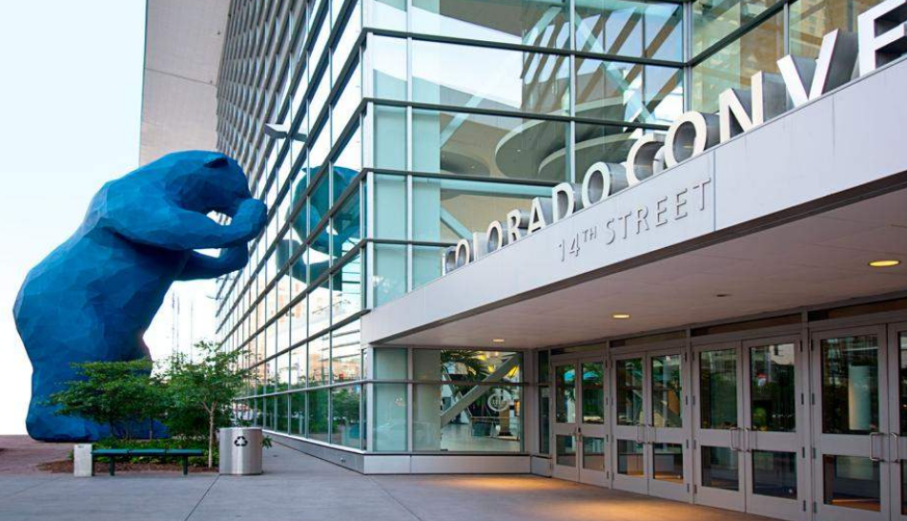

Davis Partnership Architects
https://davispartnership.com/
Case Study 12: Alternative Care Facility
Colorado Convention Center
Owner & Stakeholders:
United States Army Corps of Engineers, Omaha District
The Challenge:
Assemble a team, design and build this Rapid Disaster Infrastructure facility to be operational within 26 days of project kick-off.
Project Overview:
Adapt the Exhibit Hall level of the Colorado Convention Center into a 2,000-bed alternate care facility. This will house and support COVID positive patients who are in stable condition prior to fully discharging them to their homes.
Project GSF
~577,000 SF
Project Location
Denver, CO

Slide 27
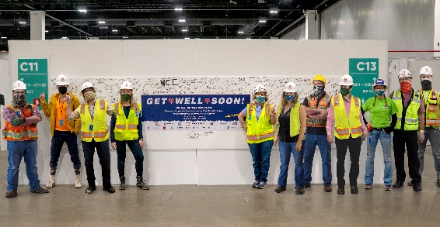

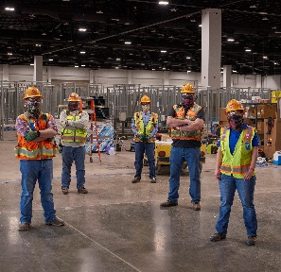


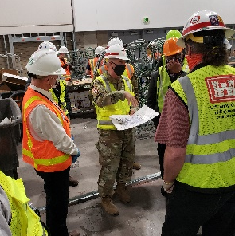
Ann H. Adams, AIA, ACHA, EDAC, LEED GA Ann.Adams@davispartnership.com
Case Study 12: Alternative Care Facility
Colorado Convention Center – Denver, CO
The Solution & Project Delivery Method
The pace of this project required a hands-on design build delivery method. The design was modular using 10’x10’ patient bays located adjacent to central nurse stations. Supplies and support spaces were at the ends of each patient row, and patient showers were installed in each Exhibit Hall. A small centrally located pharmacy was fed by a main pharmacy on the lower level of the Convention Center. Existing atrium spaces were re-purposed for Staff Lounges, and Exhibit Hall F was used for staff lockers and staff shower facilities.
Accomplishments:
Project designed in 2 days, constructed in 14 days using drywall and steel studs, 6 miles of piped oxygen, nurse call and emergency power. Project completely framed 2,000 beds before the project was rescoped to finish 1,243 beds.
Project Team:
US Army Corps of Engineers, ECC, Hensel Phelps, Davis Partnership Architects, Fentress Architects, RMH Group, Maxson Engineering
Construction Cost
Completion Date
04/24/2020
Confidential

Slide 28
Copyright notice
This presentation is protected by US and International Copyright laws. Reproduction, distribution, display and use of the presentation without written permission of the AIA is prohibited.
© The American Institute of Architects 2020

