Slide 1
AEC Integration
Thru Digital Collaboration and Data Delivery
Accelerate the Process
Robert K. Otani, PE LEED AP
Chief Technology Officer

Slide 2
LOCATIONS

Slide 3
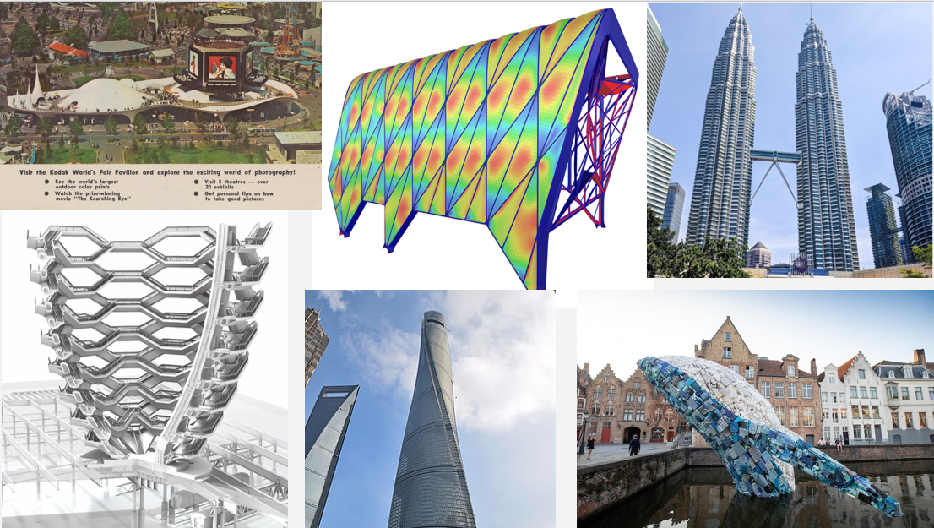
PROJECTS

Slide 4
PRACTICE

Slide 5
LEARNING OBJECTIVES
After participating in this webinar attendees will:
1. Know how architects create new workflows to benefit the contractor.
2. How contractors create new workflows to benefit the design team.
3. Understand how contractors are using Computational Design to perform constructability reviews, BIM Model fidelity reviews, , and more accurate estimating.
4. Use Computational Design to create new ways of project delivery.

Slide 6
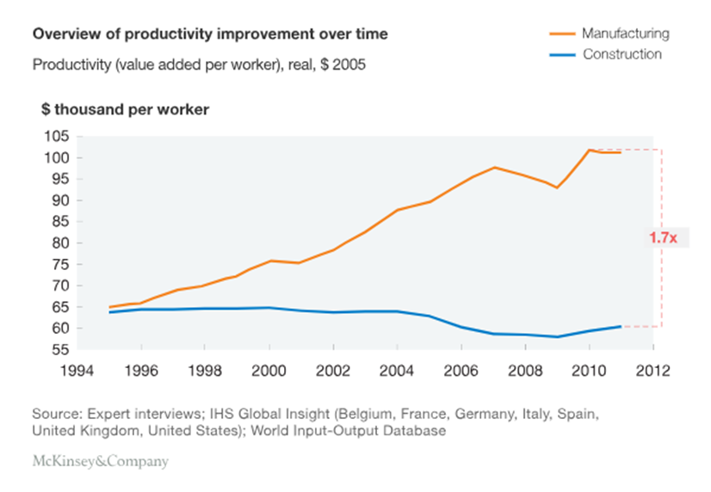
THE STATE OF THE PROFESSION
CAD + DRAFTING
BIM ADOPTION
BIM INTRODUCED

Slide 7
WHY HASN’T OUR INDUSTRY KEPT PACE?
WE HAVE A MIX OF ANTIQUATED WORKFLOWS ALONGSIDE NEW TECHNOLOGIES THAT WORK AGAINST EACH OTHER AND CREATE MISALIGNMENT OF EXPECTATIONS AND INFORMATION...THE OUTCOME IS WORSE THAN IF WE HAD JUST USED ANTIQUATED WORKFLOWS.
TODAY’S STANDARD OF CARE WAS DEVELOPED IN THE EARLY 1900’S
BUT OUR TECHNOLOGY IS CHANGING EVERY DAY

Slide 8
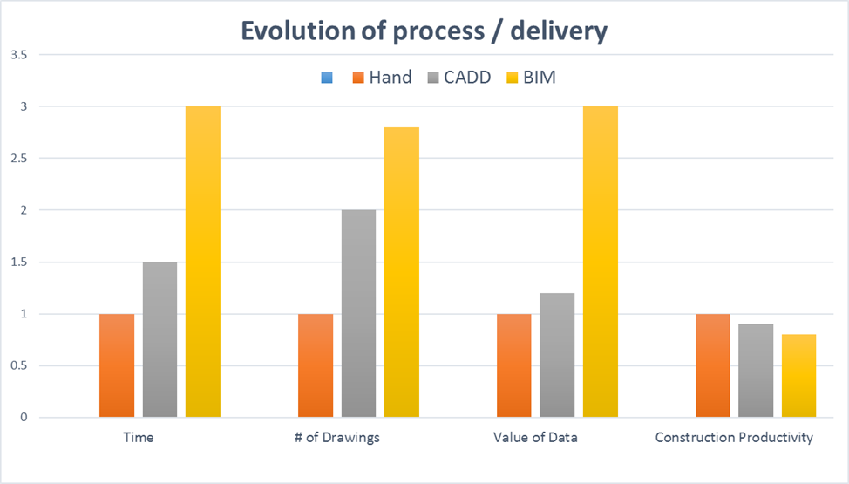
DESIGN TEAMS ARE DOING MORE WORK! MUCH MORE….
PAPER
DATA / MODELS

Slide 9
Disruption in AEC
Design
Changes + Complexity
Communication
Analysis
Documentation
Delivery
In-person and telephone
Manual + 2D Models
Manual + Cadd
2D Documents
1995
QUANTITY
# OF CALCULATIONS
TIME SPENT
AMOUNT OF DATA
QUANTITY
# OF OCCURRENCES
In-person, telephone, email, skype, Teams
Manual, 2D + 3D Models
BIM
2D Documents and 3D Models
2020

Slide 10
LEVERAGE
BIM
DELIVERY

Slide 11
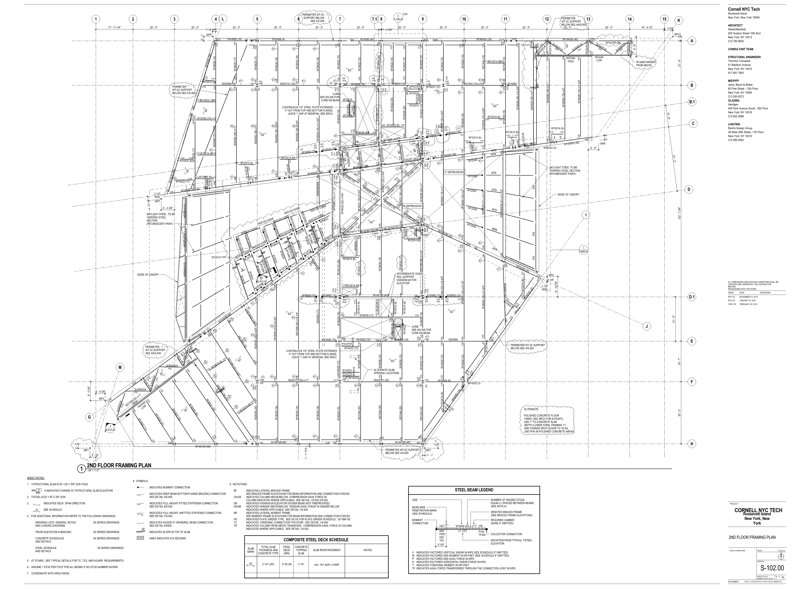
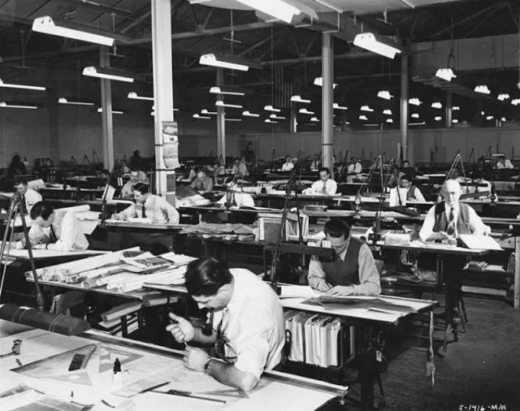
THE PROMISE OF BIM WILL NEVER BE REALIZED WHEN THE STANDARD OF CARE IS ARCHAIC

Slide 12
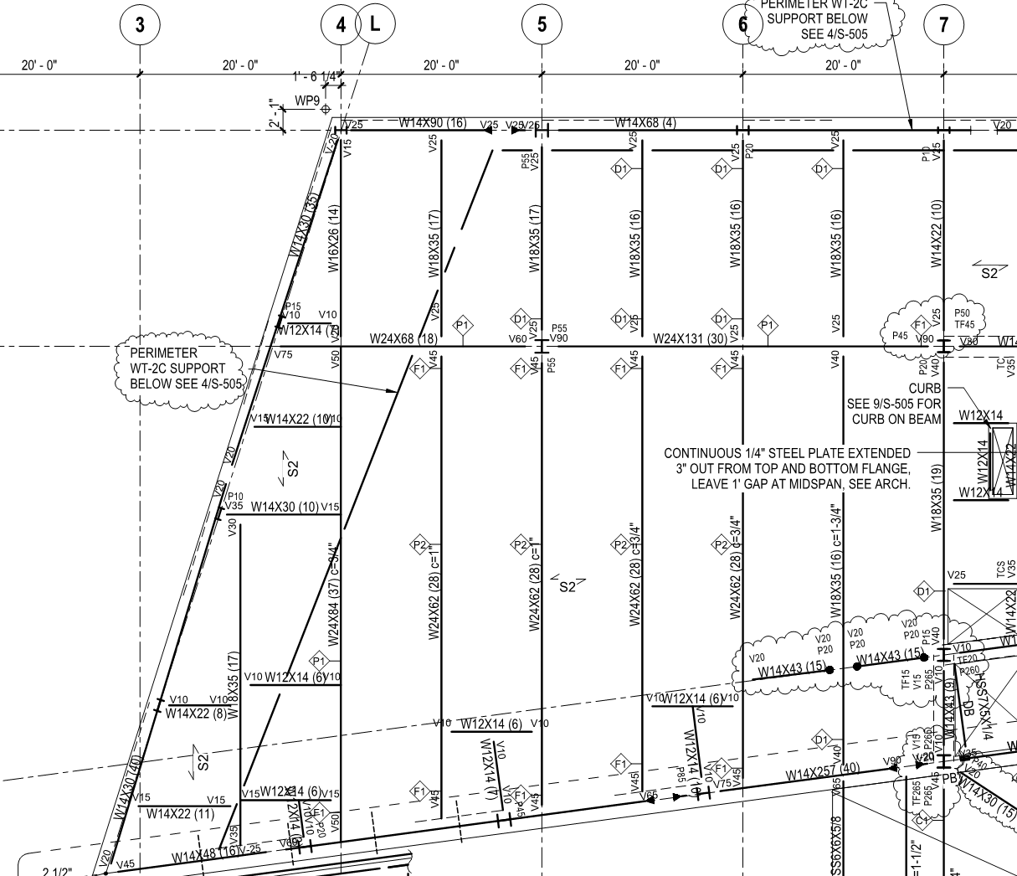
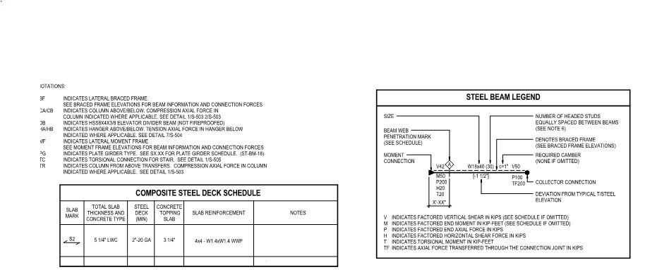
2D DRAWINGS ARE REPRESENTATIONS OF THE 3D OBJECTS USING SYMBOLOGIES TO INTERPRET 2D TO 3D
WITH SYMBOLS AND NOTES TO INTERPRET LINES AND ANNOTATIONS TO CONSTRUCTION OBJECTS
2ND FLOOR PART PLAN
PLANS SHOW SIZES, DIMENSION, MATERIALS, FORCES, METADATA, ETC

Slide 13
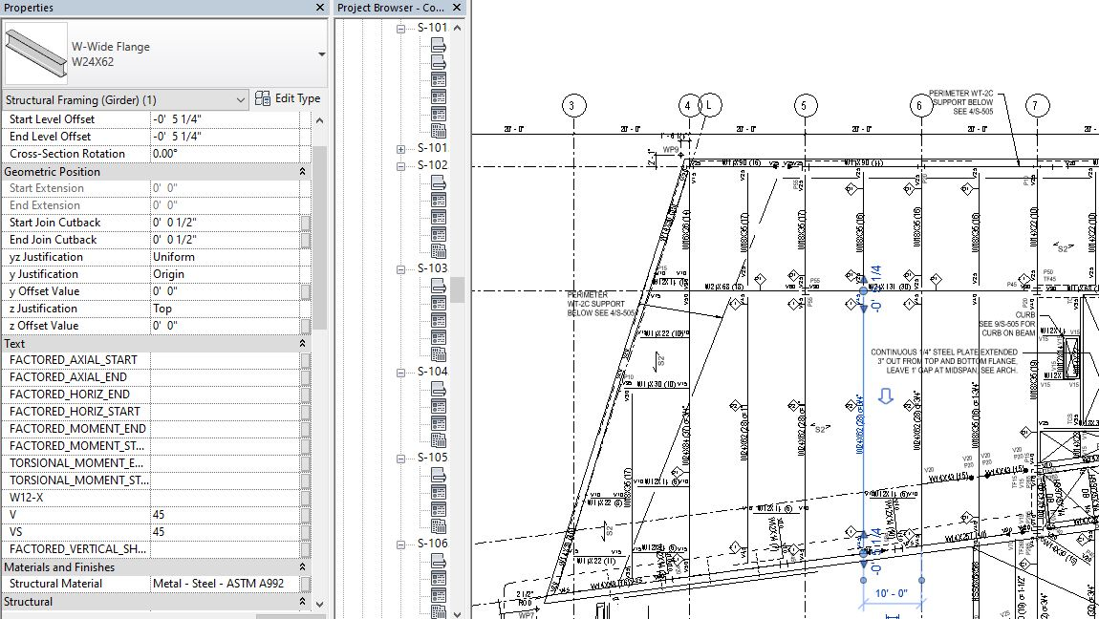
BUT WAIT, WE ALREADY HAVE ALL THAT INTELLIGENT INFORMATION EMBEDDED IN THE 3D BIM MODEL

Slide 14
AND WE CAN SEAMLESSLY SHARE THE MODEL TO ANY COLLABORATOR IN A DATA CENTRIC WAY

Slide 15
CHANGE
THE
PROCESS

Slide 16
Find Waldo!
TRADITIONAL AEC PROCESS
Constr-
uction
Finish Constr-
uction
Project
SD
DD
CD
Bid
Arch/Engineer
Contractor
TIME
60%
RISK
40%
Information (DATA)
DESIGN DATA
FAB/BUILD DATA

Slide 17
PROPOSED AEC PROCESS
SHARE DIGITAL DATA THROUGHOUT THE DESIGN PROCESS – ELIMINATES QUESTIONS OF DESIGN INTENT
DELIVER A ‘TRADE SPECIFIC’ DIGITAL MODEL VIEW OF DATA IN A SINGULAR VIEW – ELIMINATES AMBIGUITY OF A,S,M,E,P,C………..
SHARE GEOMETRIC MODEL SPECIFIC TO TRADES – ELIMINATES “MISSING” DATA REFERENCE POINTS
ALLOW SUBCONTRACTORS TO SEE/VIEW/READ BIM MODELS EARLY IN DESIGN – ENABLES SUBCONTRACTORS TO BE ON A LEVEL PLAYING FIELD, UNDERSTAND THE PROJECT, AND REQUEST SPECIFIC INFORMATION NECESSSARY TO ACCURATELY BID THE PROJECT

Slide 18
PROPOSED AEC PROCESS
Constr-
uction
Finish Constr-
uction
Project
SD
DD
CD
Bid
Arch/Engineer
SCHEDULE IMPROVEMENT
Contractor
TIME
50%
RISK
50%
Information (DATA)
DESIGN DATA
FAB/BUILD DATA

Slide 19
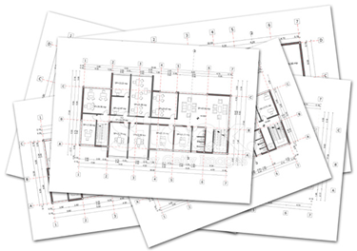
PROJECT DELIVERY - PROPOSED CHANGES
WHAT THE CONTRACTOR HAS TO INTERPRET FROM THE 2D DRAWINGS AND PRODUCE LOD 500 (3D FABRICATION MODELS)
TODAY’S STANDARD OF CARE
GEOMETRY (TRADE SPECIFIC)
MEANS AND METHODS OF CONSTRUCTION
DEPENDENCIES OF SUBS
CRITICAL PATH
SHOP DRAWINGS
METADATA FOR EACH TRADE
SYSTEM TESTING REQUIREMENTS
TRADE COORDINATION
PDF DRAWINGS FROM LOD 300 BIM

Slide 20
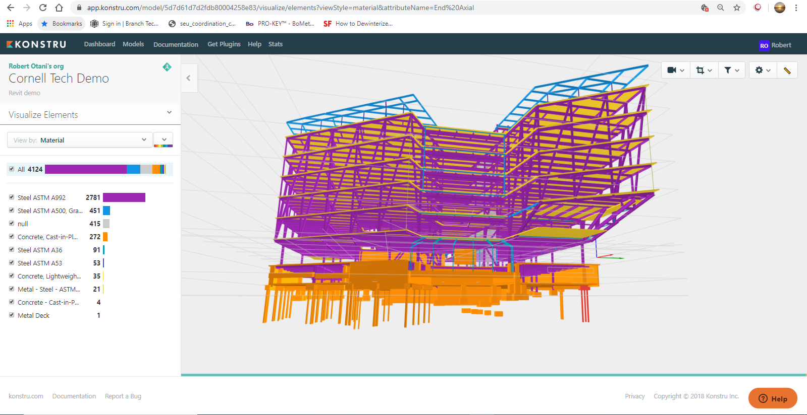
PROPOSED STANDARD OF CARE
3D MODEL IN AN UN-EDITABLE FORMAT
METADATA EMBEDDED IN BIM ELEMENTS
ACCURATE GEOMETRY
COORDINATED MODELS

Slide 21
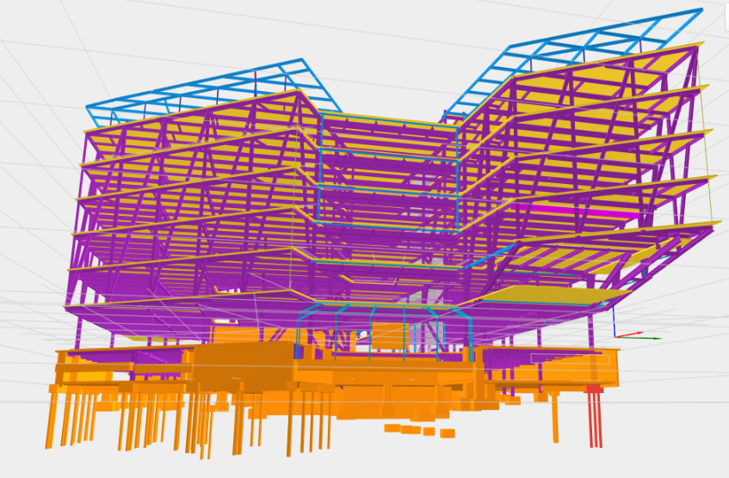
PROJECT DELIVERY - PROPOSED CHANGES
WHAT THE CONTRACTOR HAS TO INTERPRET FROM THE 2D DRAWINGS AND PRODUCE LOD 500 (3D FABRICATION MODELS)
PROPOSED STANDARD OF CARE
GEOMETRY (TRADE SPECIFIC)
MEANS AND METHODS OF CONSTRUCTION
DEPENDENCIES OF SUBS
CRITICAL PATH
SHOP DRAWINGS
METADATA FOR EACH TRADE
SYSTEM TESTING REQUIREMENTS
TRADE COORDINATION
GEOMETRIC MODEL, BIM MODEL, REFERENCE DRAWINGS

Slide 22
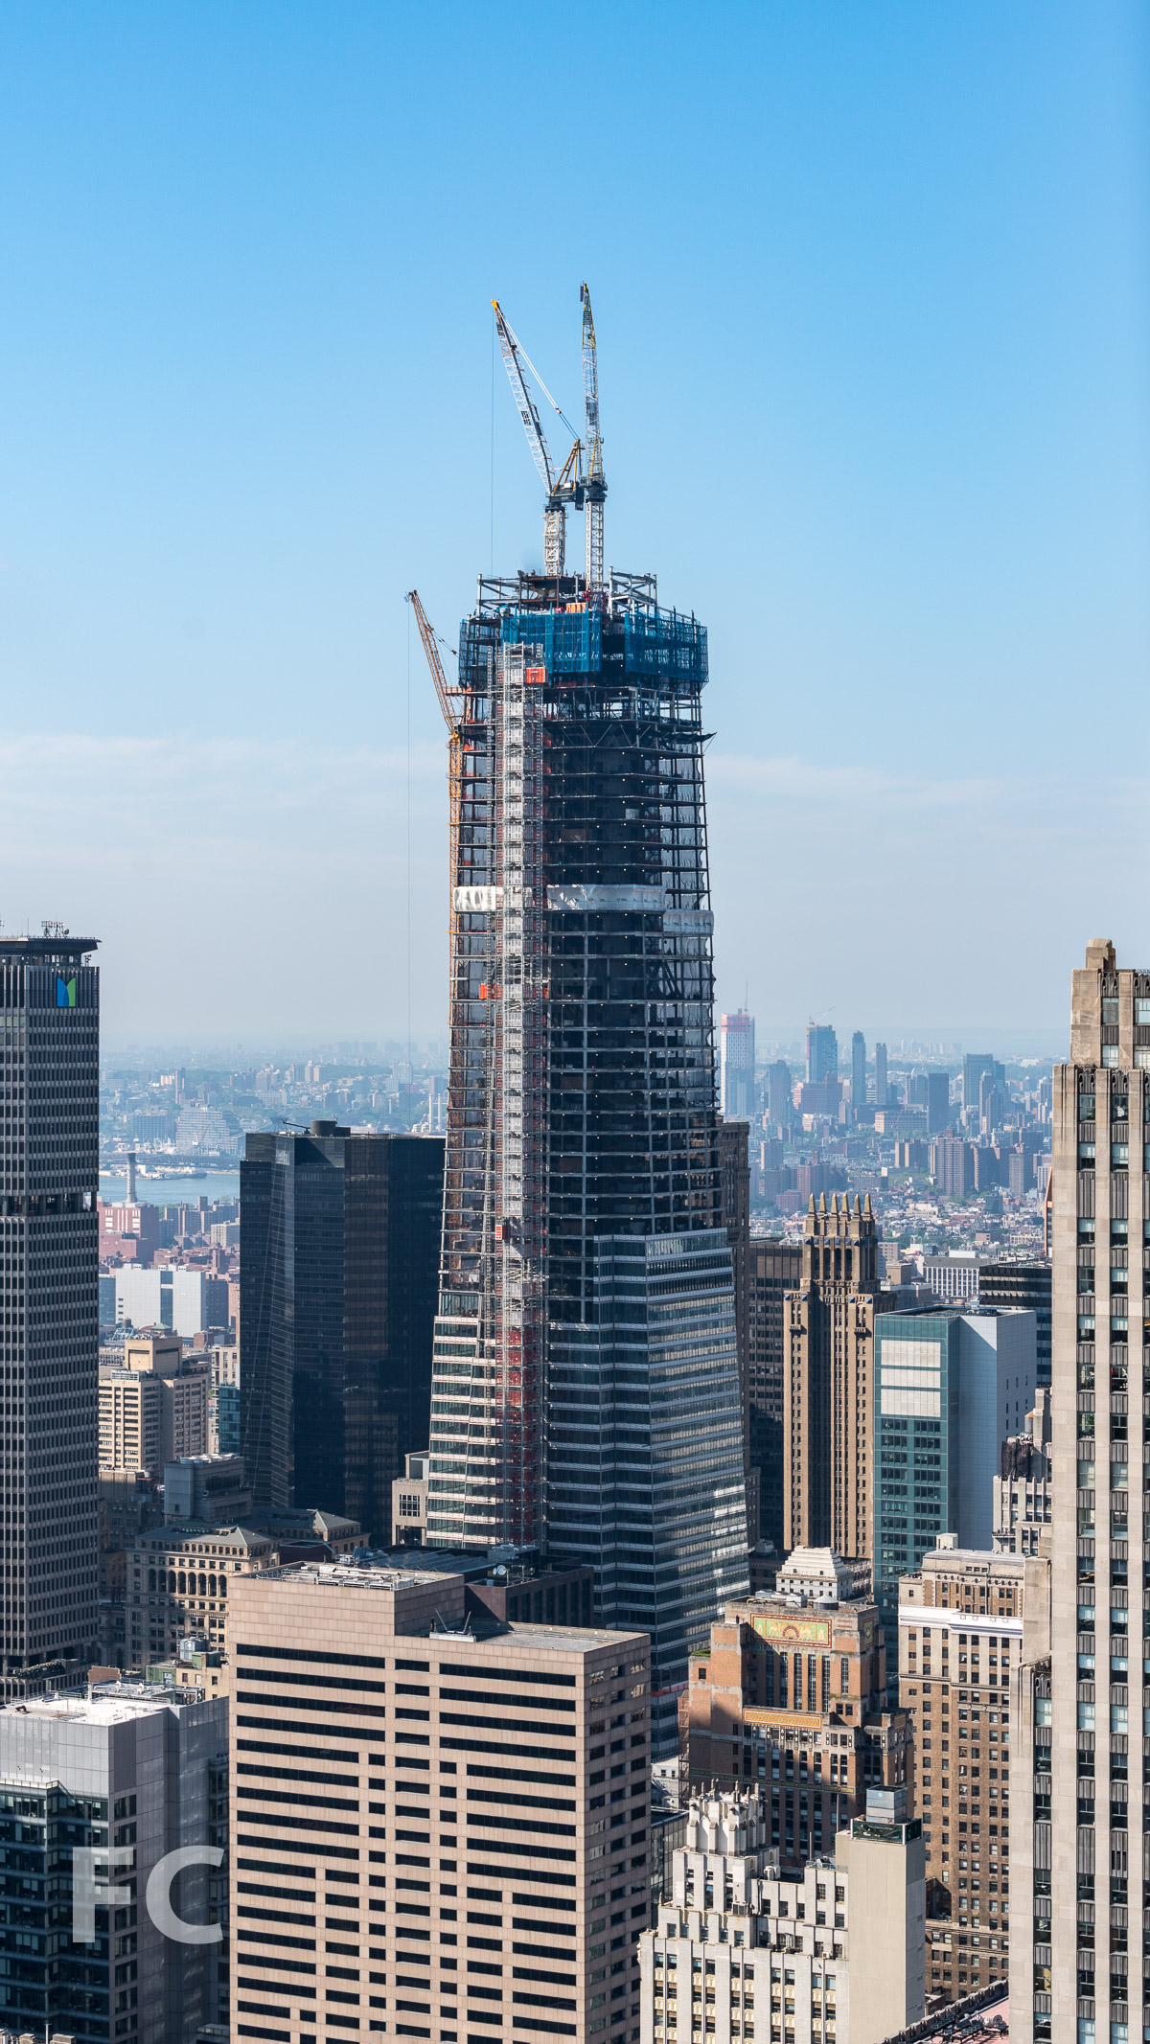
ADVANCED
PROJECT
DELIVERY

Slide 23
Schedule Savings using APD
Traditional process without TEKLA as Deliverable
Process with TEKLA as Deliverable
SD
DD
CD
BID
Preliminary Input
PHASE I
Potential Delay ??
Conn. Design Consulting
CONN. DESIGN
Potential Delay ??
MILL ORDER
Potential Delay ??
PHASE II
Potential Delay ??
Steel detailing actually begins in the Design Phase, shortening schedule
Delivering intelligent data DE-RISKS the deliverable
PHASE III
Potential Delay ??
FABRICATE
Potential Delay ??
ERECT
Time
savings
Plus Avoided
Delays
Notes:
3 months plus savings. Getting involved in the model and connection design months before a fabricator would.

Slide 24
Case Study – ONE VB
Mill Order RFD Tonnage
8/2017 10/2017 2800T
5/2017 8/2017 2600T
4/2017 6/2017 3000T
2/2017 4/2017 2900T
1/2017 2/2017 2200T
10/2016 12/2016 4000T
10/2016 10/2016 7000T
8 months saved from schedule!

Slide 25
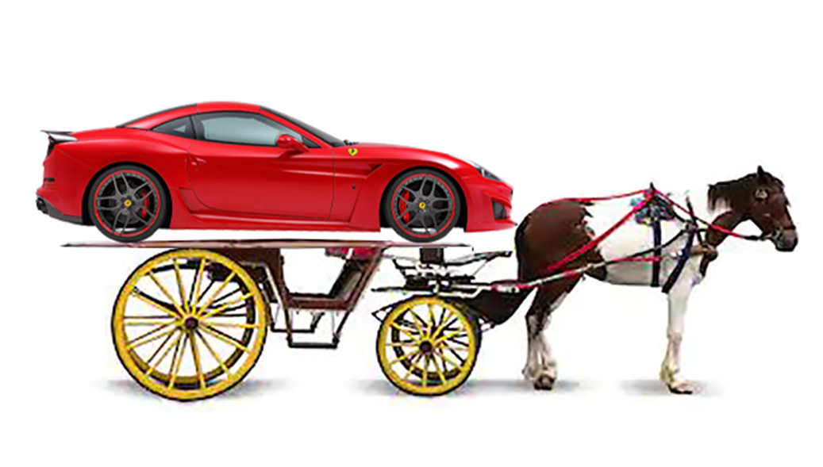
WE CAN’T KEEP THE STATUS QUO!

Slide 26
THANK YOU!
ROTANI@THORNTONTOMASETTI.COM
@OTANI_ROB

