Slide 1
Academy of Architecture for Health On-line Professional Development
Holding Ourselves to Higher Standards:
Healthy Materials Every Time
Beyond the Basics Series
12 February, 2019
2:00 pm – 3:00 pm ET
1:00 pm – 2:00 pm CT
12:00 am – 1:00 pm MT
11:00 am – 12:00 pm PT
Presenters
Jean Hansen, FIIDA, LEED Fellow, CID, EDAC, AAHID
HDR
Anne Hicks Harney, FAIA, LEED Fellow, CSI CCS
Long Green Specs
Tanya Mejia, AICP, LEED AP BD+C, WELL AP
Perkins Eastman
Susan Kaplan, CCS, LEED AP BD+C
HLW
Moderator
Rita Ho, LEED AP

Slide 2
Academy of Architecture for Health On-line Professional Development
Holding Ourselves to Higher Standards:
Healthy Materials Every Time
Beyond the Basics Series
12 February, 2019
2:00 pm – 3:00 pm ET
1:00 pm – 2:00 pm CT
12:00 am – 1:00 pm MT
11:00 am – 12:00 pm PT
Presenters
Jean Hansen, FIIDA, LEED Fellow, CID, EDAC, AAHID
HDR
Anne Hicks Harney, FAIA, LEED Fellow, CSI CCS
Long Green Specs
Tanya Mejia, AICP, LEED AP BD+C, WELL AP
Perkins Eastman
Susan Kaplan, CCS, LEED AP BD+C
HLW
Moderator
Rita Ho, LEED AP

Slide 3
Beyond the Basics Series
The Academy’s multi-channel on-line approach provides emerging professionals, journeymen, and master professionals with convenient and economical opportunities to develop their chosen area of interest.
Beyond the Basics Series sessions are tailored to provide healthcare design professionals with sufficient exposure to jump-start interest in wanting to learn more.

Slide 4
Copyright Materials
This presentation is protected by US and International Copyright laws. Reproduction, distribution, display and use of the presentation without written permission of the speaker is prohibited.
© The American Institute of Architects 2019

Slide 5
Compliance Statement
“AIA Knowledge” is a Registered Provider with The American Institute of Architects Continuing Education Systems (AIA/CES). Credit(s) earned on completion of this program will be reported to AIA/CES for AIA members. Certificates of Completion for both AIA members and non-AIA members are available upon special request.
This program is registered with AIA/CES for continuing professional education. As such, it does not include content that may be deemed or construed to be an approval or endorsement by the AIA of any material of construction or any method or manner of handling, using, distributing, or dealing in any material or product.

Slide 6
AIA/CES Reporting Details
All attendees will be eligible to receive: 1 AIA LU/HSW (AIA continuing education)
In order to receive credit, each attendee must complete the webinar survey/report form at the conclusion of the presentation.
Follow the link provided:
in the Chat box at the conclusion of the live presentation;
in the follow-up email you (or the person who registered your site) will receive one hour after the webinar.

Slide 7
Questions?
Submit a question to the moderator via the chat box.
Content-related questions will be answered during the Q&A portion at the end as time allows.
Tech support questions will be answered by AIA staff promptly.

Slide 8
Presenters
Holding Ourselves to Higher Standards:
Healthy Materials Every Time
Tanya Mejia, Assoc. AIA, AICP, LEED AP BD+C, WELL AP
Associate, Sustainability Specialist
Perkins Eastman
AIA Materials Knowledge Working Group
Jean Hansen, FIIDA, LEED Fellow, CID, WELL AP, EDAC, AAHD
Sustainable Principal
HDR Architecture, Inc
AIA Materials Knowledge Working Group
Anne H. Harney, FAIA,
LEED Fellow
Principal and Founder
Long Green Specifications
AIA COTE Advisory Group
Susan Kaplan, CCS, LEED AP BD+C
Director of Materials Technology
HLW International

Slide 9
Holding Ourselves to Higher Standards:
Healthy Materials Every Time

Slide 10
Safe v Legal

Slide 11
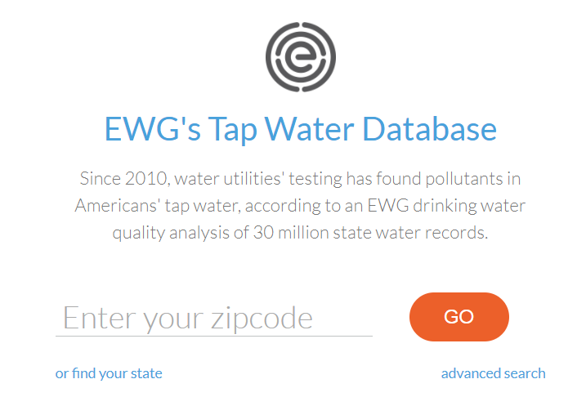
Safe v Legal
“Architects have a greater ability to improve public health than medical professionals.”
Dr. Claudia Miller, Assistant Dean, University of Texas School of Medicine
HKS Architects GreenWeek 2013

Slide 12
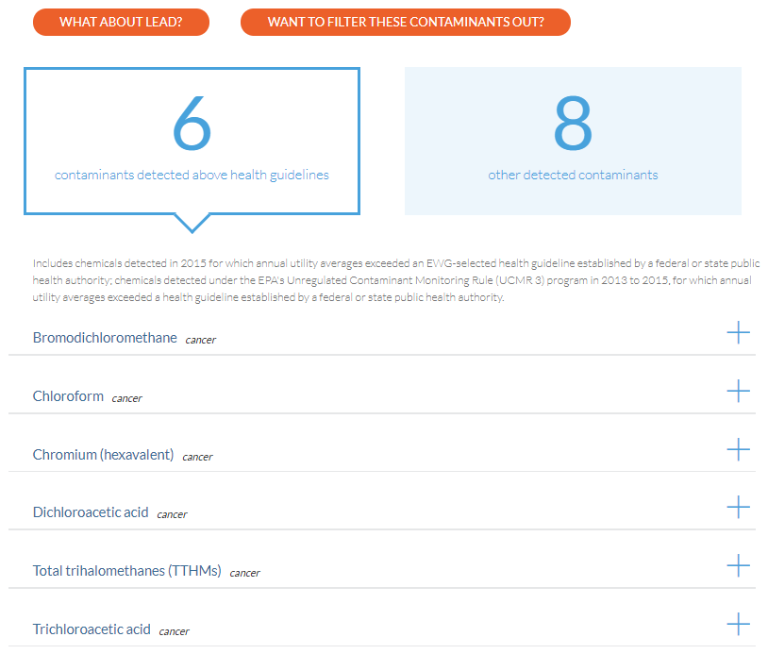
Safe v Legal
…tap water provided by this water utility is in compliance with federal health-based drinking water standards.

Slide 13
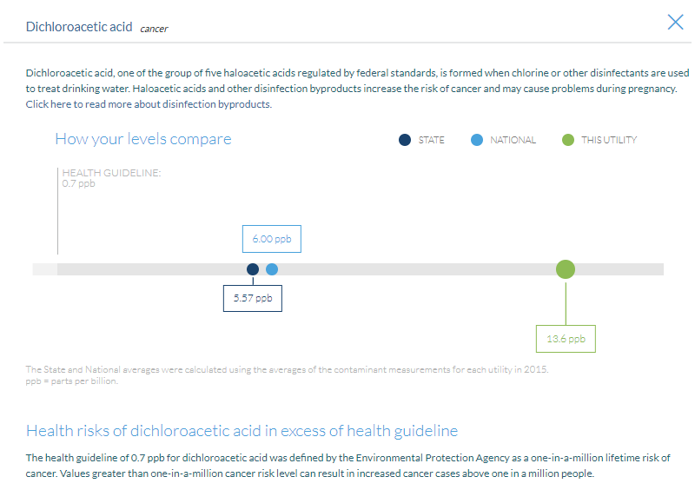
Safe v Legal

Slide 14
The Rating Systems

Slide 15
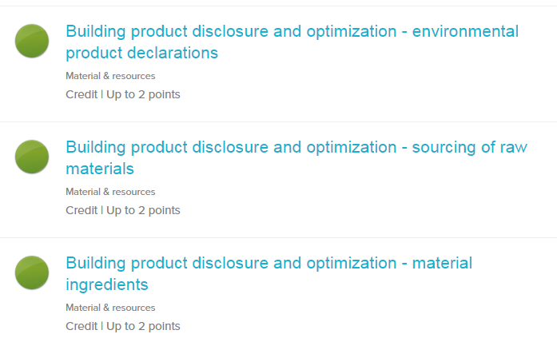

Slide 17
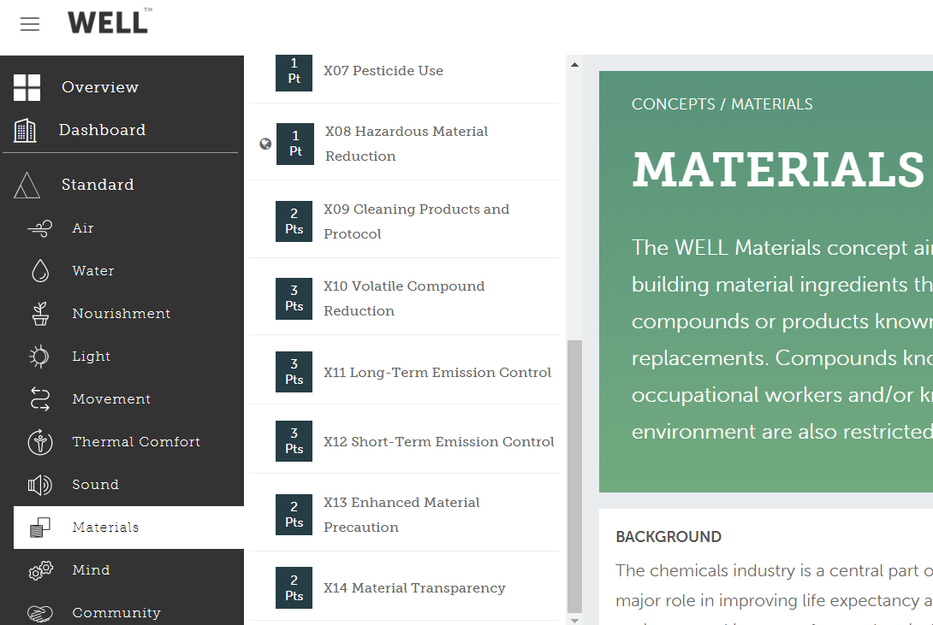

Slide 18
Commonalities
VOC Requirements:
CDPH
SCAQMD Rule 1113
SCAQMD Rule 1168

Slide 19
Commonalities
VOC Requirements:
CDPH
SCAQMD Rule 1113
SCAQMD Rule 1168
FSC Wood

Slide 20
Commonalities
VOC Requirements:
CDPH
SCAQMD Rule 1113
SCAQMD Rule 1168
FSC Wood
Material Transparency
Declare labels
Cradle to Cradle Certification
Health Product Declarations

Slide 21
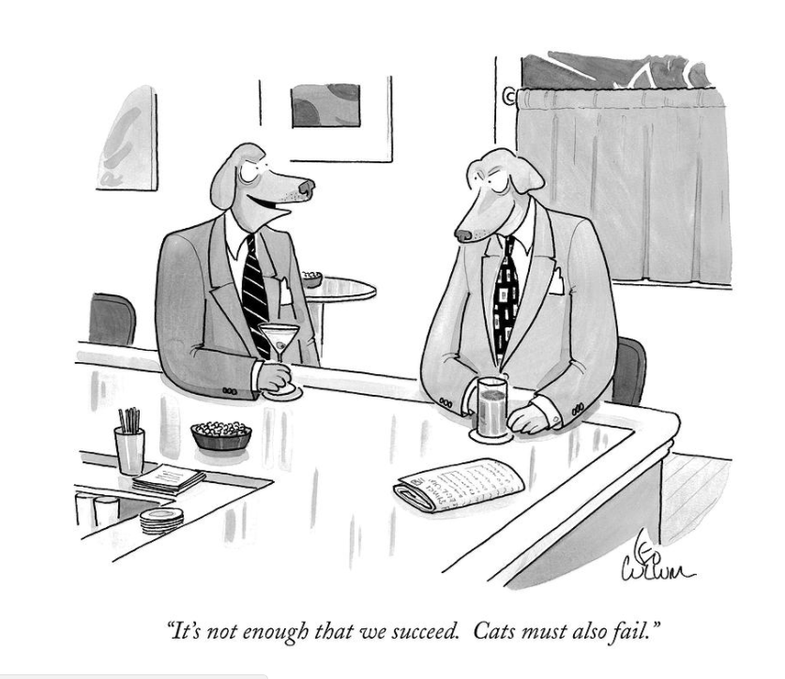

Slide 22
Organize an Approach

Slide 23
We are ALL Exposed
CDC’s ongoing analysis of 200 + environmental chemicals in blood and urine
Demonstrates widespread exposure to many chemicals
Biomonitoring of 20 health care workers
PBDEs
Mercury
PFCs
Phthalates
Triclosan
BPA

Slide 24
Multiple Routes of Exposure
Inhalation
Most Americans spend up to 90% of time indoors
U.S. EPA: Indoor air can have higher levels of pollutants than outside levels
Cross placenta transfer
Breast feeding
Dermal
Ingestion

Slide 25
Approach
Product Comparisons or Building Design
VOC / Emissions
Ecolabels / Standards
Content / Transparency
Sustainable Attributes, i.e.: Recycled
Designed for Reuse / Disassembly
Installation Methods
Maintenance / Green Cleaning
Warranty

Slide 26
Standards, Drivers, and Tools
LEED Materials Credits (MR)
Red List – Living Building Challenge
WELL Building Standard
BIFMA “level”
Perkins + Will “Precautionary List”
“Six Classes”
Health Product Declaration (HPD)
Cradle to Cradle (C2C)
Declare

Slide 27
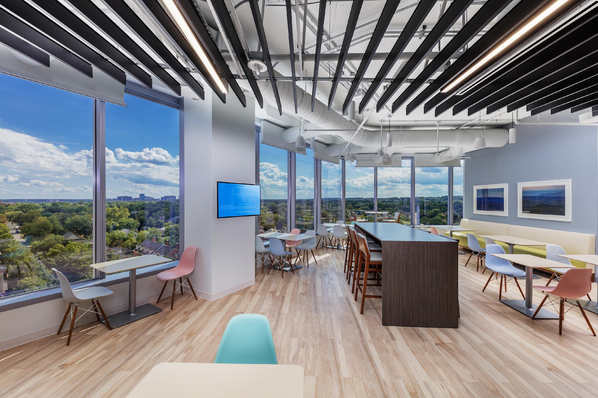
Project Focus
Where are we and what are we doing here?

Slide 28
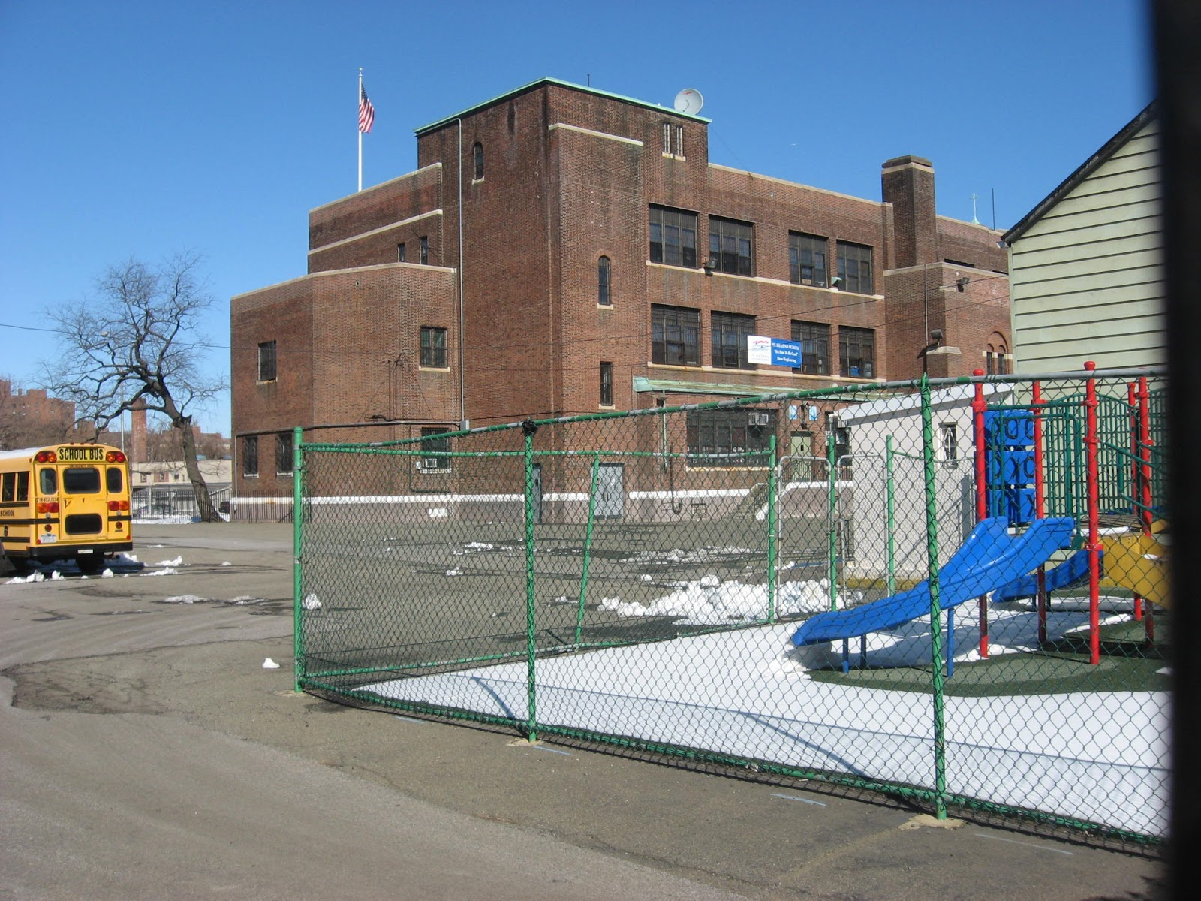
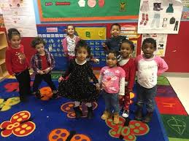
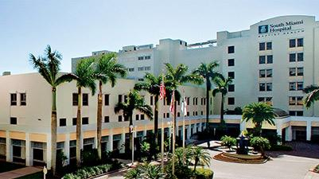
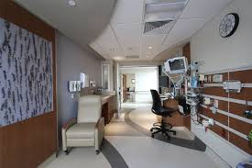
How does this affect product choice?
Kindergarten In Bronx, NY?
Hospital in Miami, FL?

Slide 29
Example:
Starting to select a healthy flooring product for a Day Care Center in Florida
Conditions |  | Functionality | Health | Aesthetics
Who | Young children | Durable yet safe | Low in neurotoxins | Cheerful
Activities | Walking/crawling/playing | Easily washable | Low in SVOC
Basic climate | Hot/humid | Easy to dry | Not prone to mold | Light colors
Community | Diverse/Latin American |  |  | Colors and textures
Economics | Low budget | May make these the most important
All bets are not off when you are selecting healthier products.
They still must function.

Slide 30
Practice Area Application

Slide 31
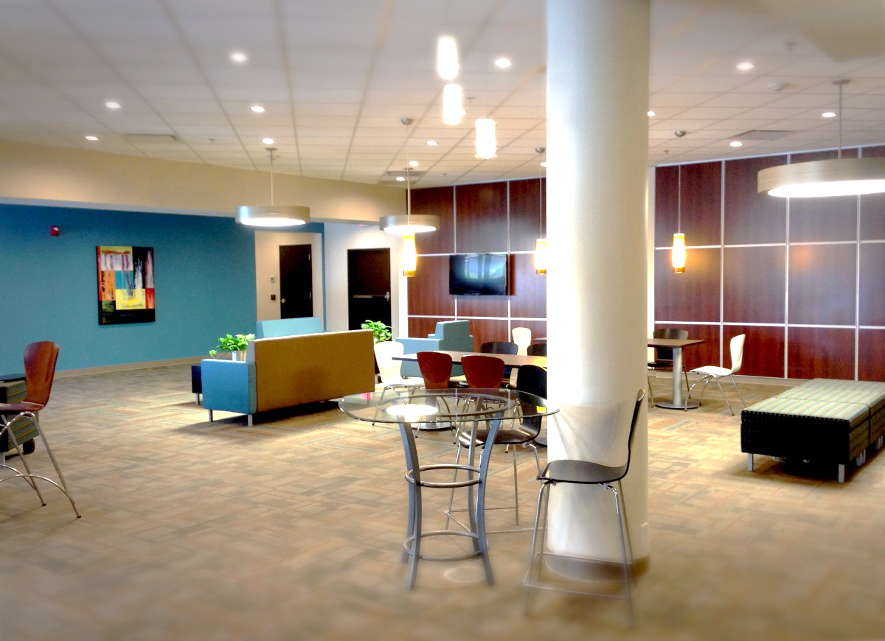
Common Materials
Antimicrobials
(possible hormone disruption, antibiotic resistance)
Formaldehyde
(carcinogen, reproductive & developmental toxicity)
Phthalates
(endocrine disruptors, developmental toxicity)
Flame Retardants
(endocrine disruptors, neurodevelopmental problems)
Perfluorinated Compounds (PFCs)
(endorine disruptor, carcinogen, reproductive & developmental toxicity)
Isocyanates
(asthmagen)

Slide 32
Potential Effects
Material | Common Products | Potential Effects | Guidance
Flame Retardants | Upholstered furniture, insulating foam, textiles, wall coverings | Developmental toxicity, endocrine disruptor | Products that do not contain chemical flame retardants
Phthalates | Coated fabrics, PVC flooring, carpet backings, wall coverings | Developmental toxicity, endocrine disruptor, suspected asthmagen, (PVC carcinogenic in manufacture) | Avoid PVC, confirm phthalate-free
Formaldehyde | Furniture (particleboard, MDF, etc), laminated fabrics, adhesives, wallboard | Respiratory & reproductive toxicant, carcinogen | Products that meet CA Section 01350, Greenguard Gold, SCS Indoor Advantage Gold
Antimicrobials | Furniture, fabrics, countertops, door handles | Possible hormone disruption, antibiotic resistance | No added antimicrobials, No triclosan, triclocarban
Isocyanates | Paints, varnishes, flooring finishes, Polyurethane systems (insulation, foam cushions, carpet backing) | Asthmagen, anticipated to be a carcinogen | Avoid in renovations, insulation, carpet backing and foam cushions
Perfluorinated Compounds (PFCs) | Furniture, fabrics, carpeting | Endocrine disruptor, carcinogen, reproductive & developmental toxicant | No stain/water repellant treatments that contain PFCs

Slide 33
Practice Area 1 - Healthcare

Slide 34
Growing Concern for Healthy Interiors
Flame retardants
Formaldehyde
Perfluorinated chemicals
PVC (vinyl) and phthalates
Antimicrobials
Heavy metals
Chromium (hexavalent or trivalent)

Slide 35
Healthier Hospitals
Over 1307 hospitals enrolled nationally
25% of hospitals committed to Safer Chemicals Challenge

Slide 36
Healthier Hospitals (HH): Healthy Interiors Goal
Ensure that 30% of the annual volume of furnishings and furniture purchases (based on cost) eliminate the use of:
Flame Retardants
PVC (Vinyl)
Formaldehyde
Perfluorinated Compounds (PFCs)
Antimicrobials

Slide 37
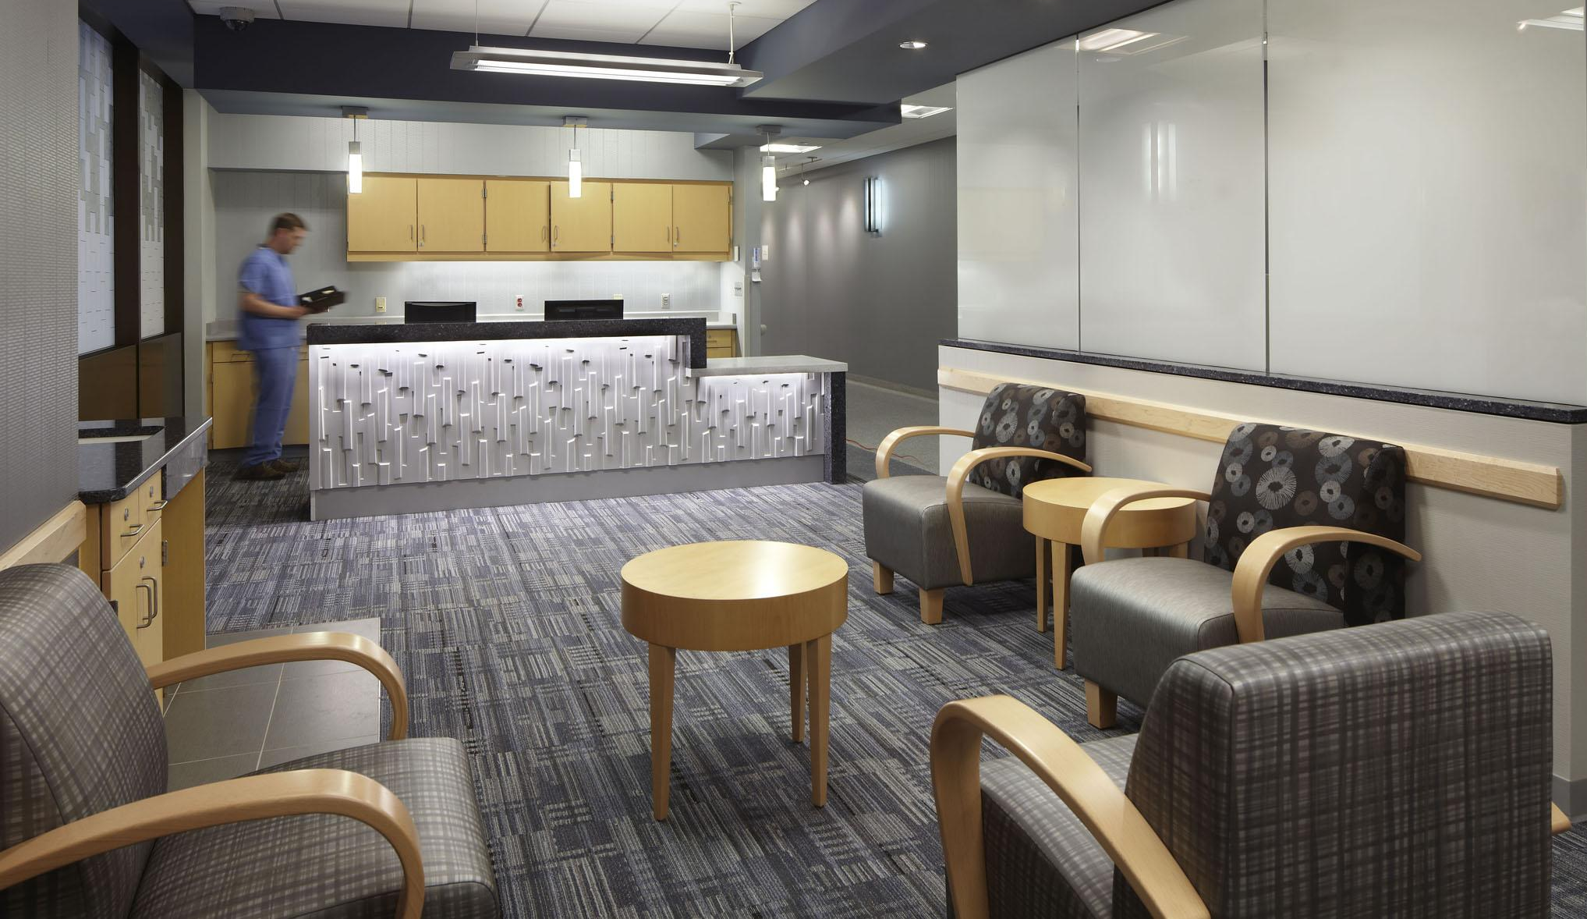
Chemicals Found in Health Care (HHI)
Flame Retardants
Electronics, building insulation, upholstered furniture, fabrics, wires & cabling
PVC
Furniture, fabrics, flooring, wall coverings
Formaldehyde
Furniture, fabrics, adhesives
PFCs
Furniture, fabrics, carpeting
Antimicrobials
Furniture, fabrics, flooring, countertops

Slide 38
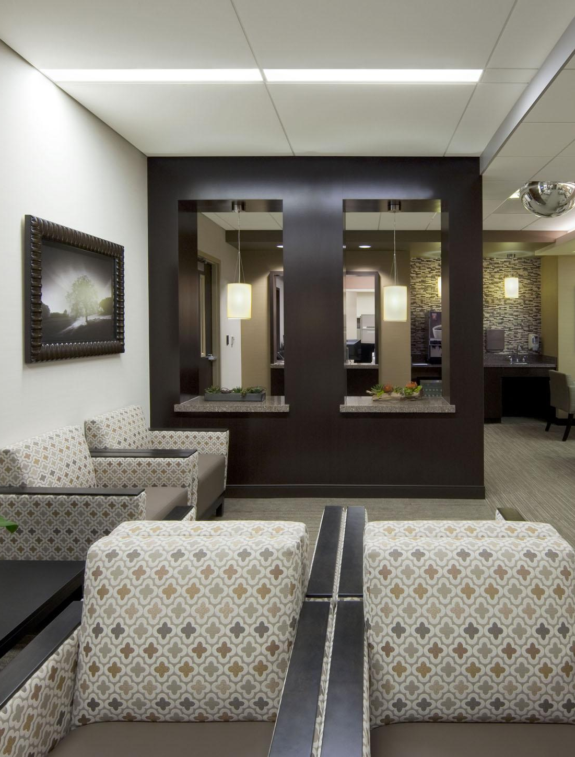
Flame Retardants
Rationale
Known health effects of well-studied flame retardants
Reproductive, neurocognitive, and immune system impacts
Persistence, bioaccumulation, toxicity throughout life cycle
Emerging health and safety concerns about alternatives
Very significant data gaps
Flame retardants showing up in dust
Guidance
Purchase furniture meeting TB 117-2013 that does not contain flame retardants

Slide 39
Polyvinyl Chloride (PVC) or Vinyl
Rationale
Can create persistent, bioaccumulative, and toxic byproducts in manufacture and at end of life
Carcinogenic and highly toxic chemicals in manufacture
Requires use of additives (lead, phthalates)
Guidance
Products must not contain PVC
Small components exemption: > 1% of product by weight

Slide 40
Formaldehyde
Rationale
Known human carcinogen
Gastrointestinal or liver toxicant
Reproductive toxicant
Respiratory toxicant, asthma trigger
Prop 65 carcinogen
Guidance
Meet CA Section 01350
CA Department of Public Health (CDPH): Standard Method for Testing and Evaluation of Volatile Organic Chemical Emissions from Indoor Sources using Environmental Chambers) or equivalent standard

Slide 41
Perfluorinated Compounds (PFCs)
Rationale
Moved from C8 to C6 chemistry (Shorter-Chain PFCs)
Persistent in environment, bioaccumulative in people, wildlife
Long half-life in animals, not known for humans
Kidney and testicular cancer, thyroid disruption, elevated total cholesterol, obesity
Emerging Health Information
Endocrine disruptors, Carcinogenic, Reproductive and developmental toxicant
Guidance
Don’t use stain/water repellant treatments that contain PFCs

Slide 42
Antimicrobials
Rationale
Very limited evidence that addition of antimicrobials to furnishings reduces rate of hospital-acquired infections
Emerging research on efficacy of copper on high-touch surfaces
Can have toxic properties without adequate data on health impacts
Can lead to development of antimicrobial resistant organisms that may pose greater hazards
Guidance
Must not contain triclosan, triclocarban, or antimicrobials without evidence of demonstrated efficacy
Requires evidence in clinical setting of HAI reduction

Slide 43
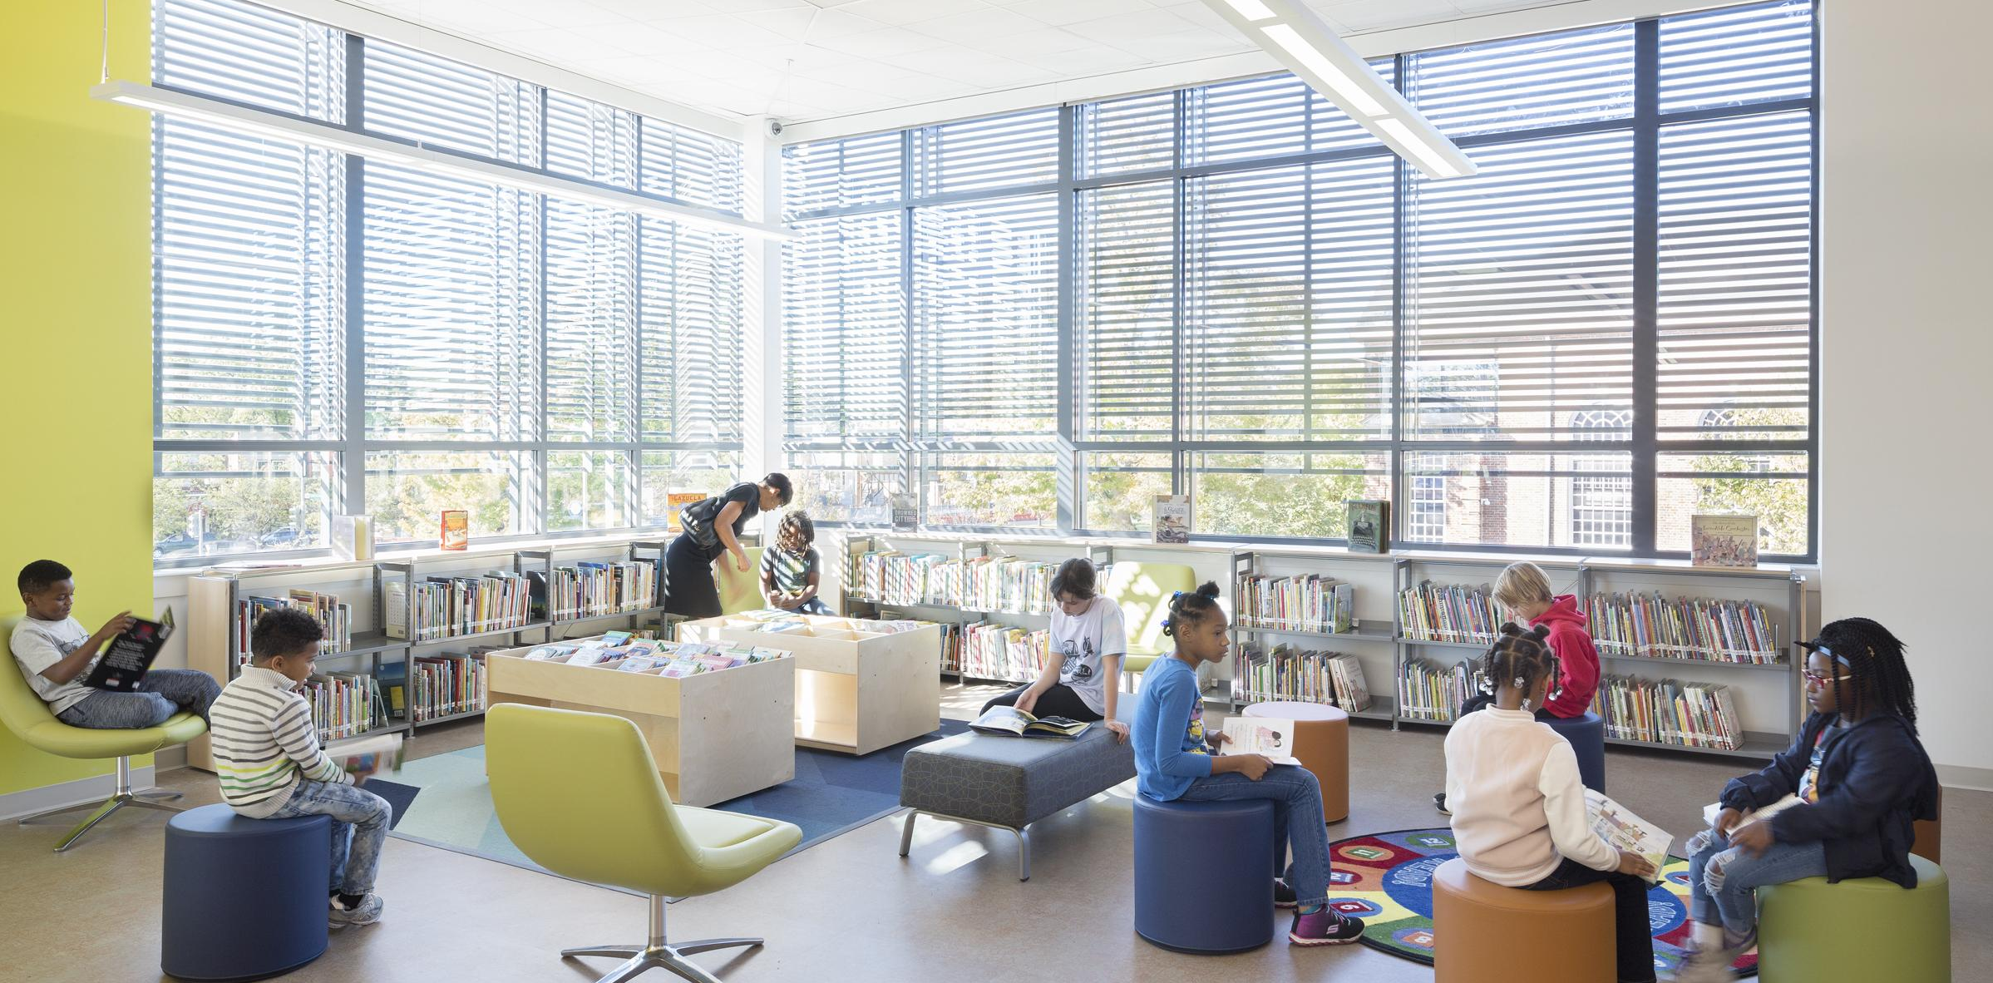
Practice Area: K-12 Schools

Slide 44
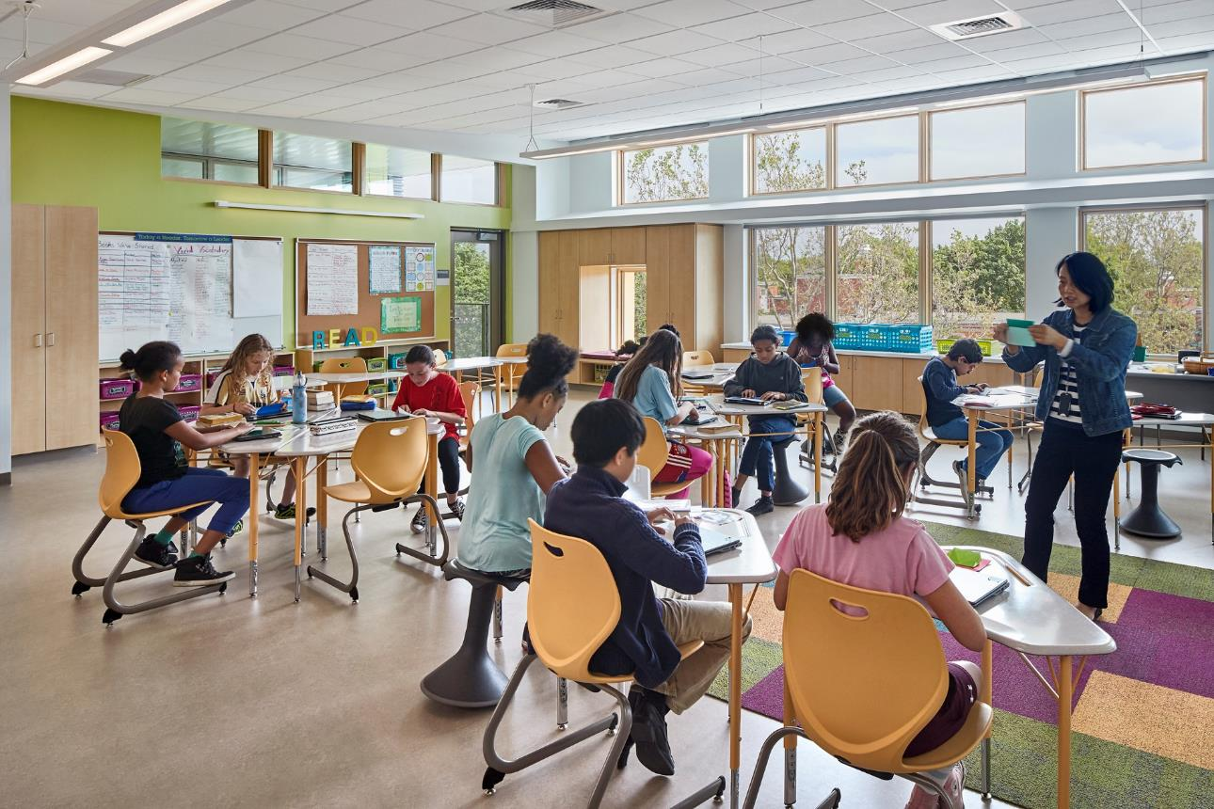
Vulnerable Populations
“Children are not little adults: they have special vulnerabilities to the toxic effects of chemicals.”
– World Health Organization
Toxic chemicals may be triggering recent increases in neurodevelopmental disabilities among children
– Harvard School of Public Health, 2014
Schools impact entire communities

Slide 45
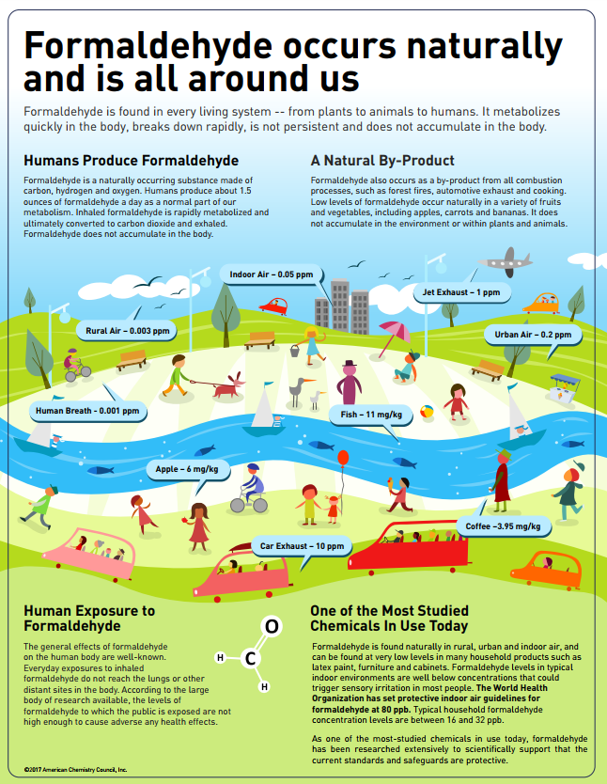
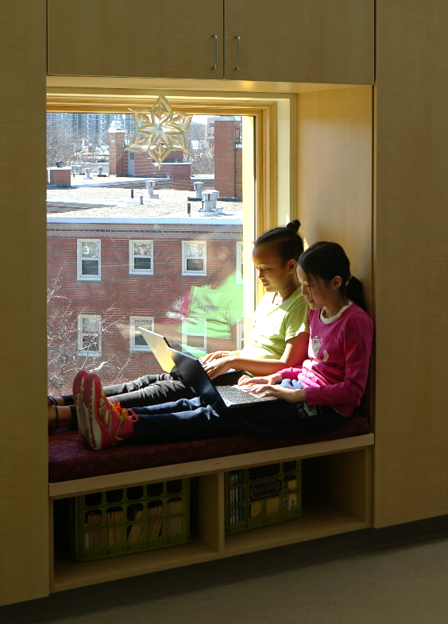
Targeted Advertising
TOO much information
CONFLICTING information
Trending topics – where to focus?

Slide 46
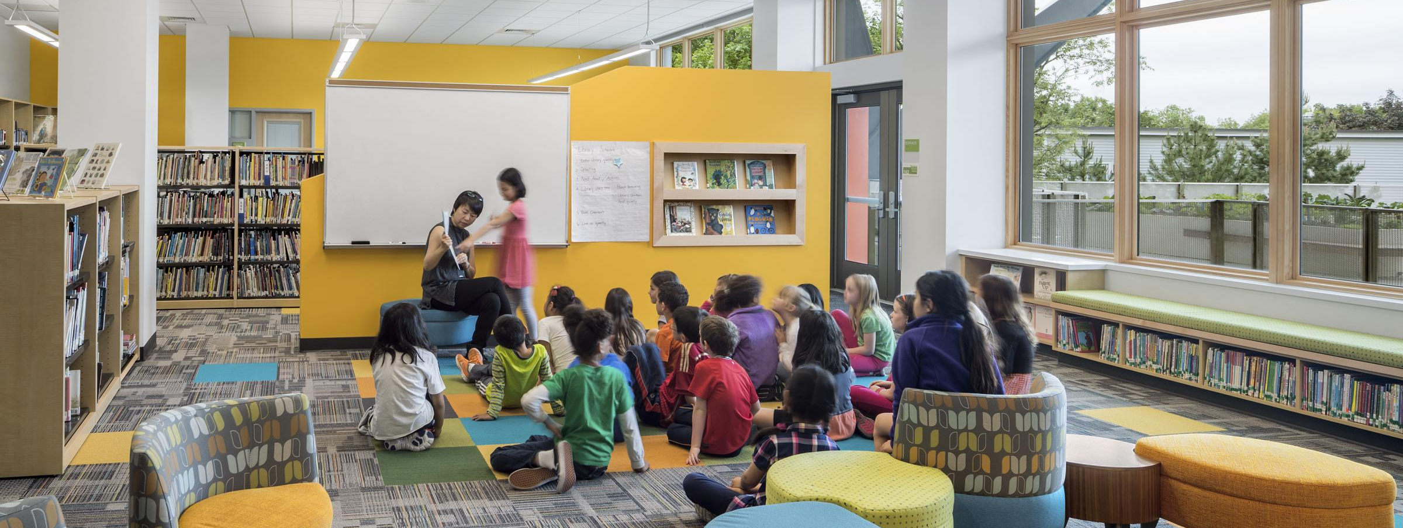
Focus on Impact
TOUCH: Furniture, textiles, flooring, finishes
BREATHE: Paints, coatings, adhesives, flooring

Slide 47
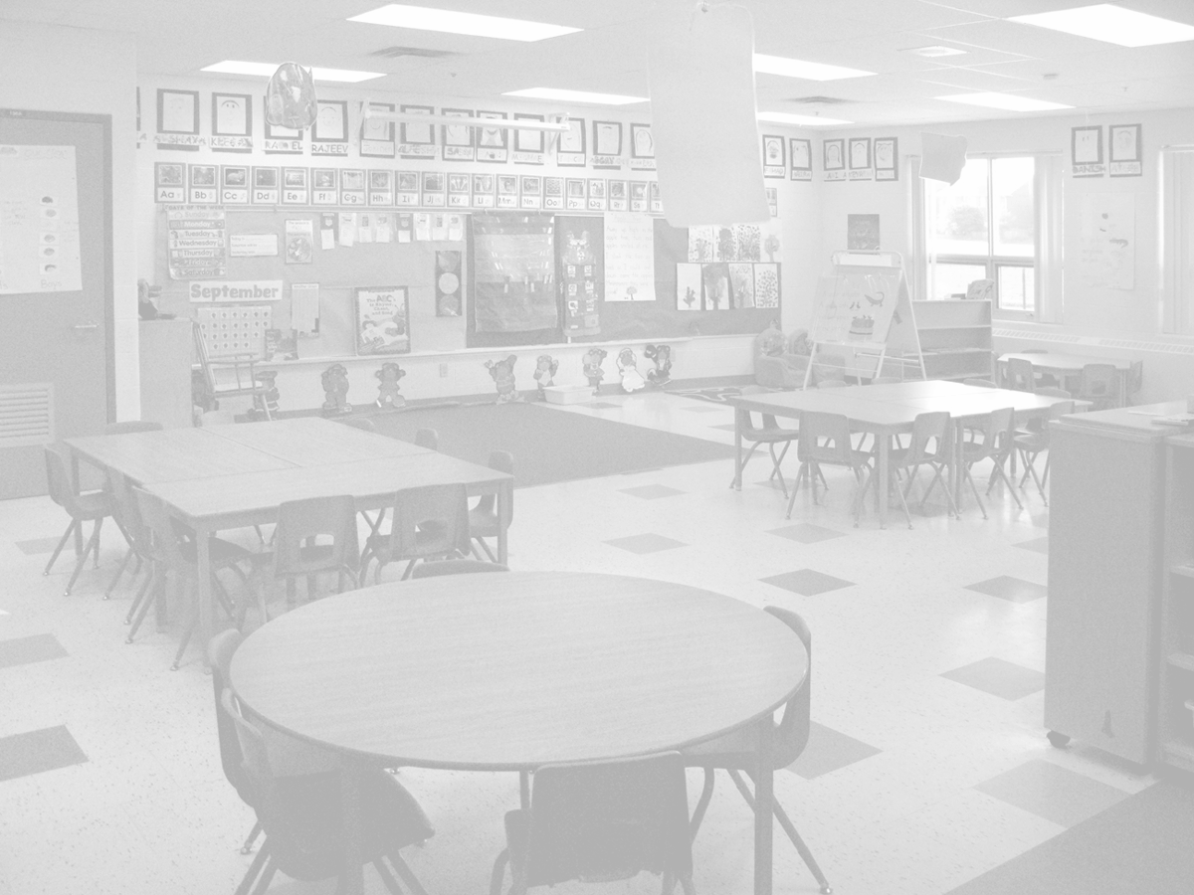
Renovation Challenges
Asbestos Containing Material (ACM)
(carcinogen, mesothelioma)
Lead
(reproductive & developmental toxicity, anemia, high blood pressure)
Polychlorinated Biphenyls (PCBs)
(endocrine disruptor, carcinogen)
Flame Retardants
(endocrine disruptors, neurodevelopmental problems)
Phthalates
(endocrine disruptors, developmental toxicity)
Formaldehyde
(carcinogen, reproductive & developmental toxicity)

Slide 48
Practice Area 3 - College & University

Slide 49
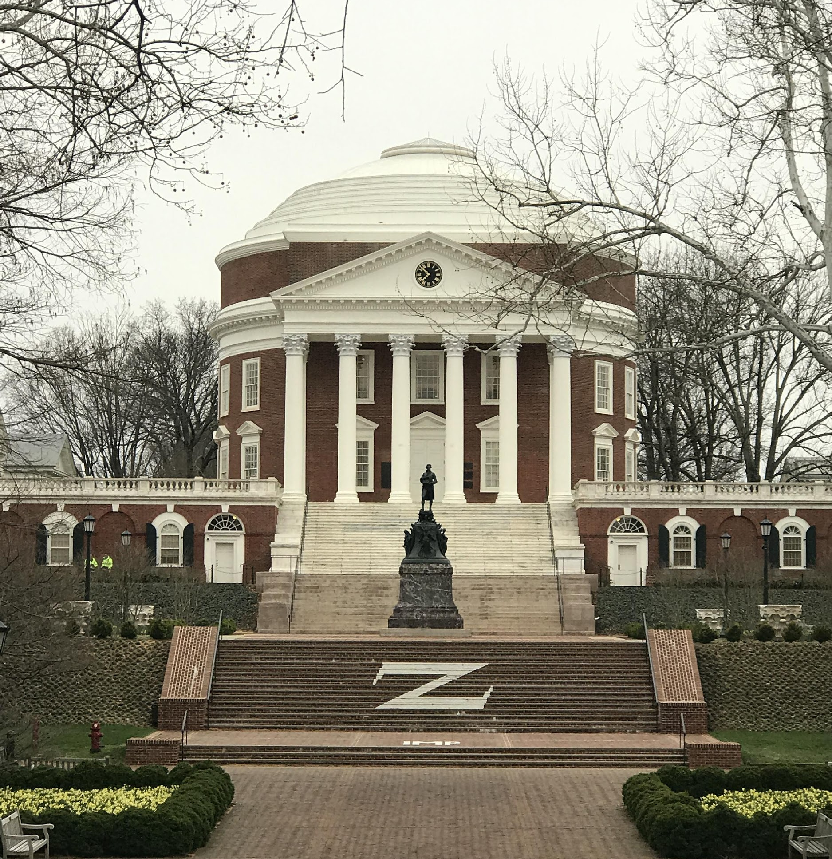
Building Ownership and Budget

Slide 50
Science based Standards

Slide 51
Science based Standards

Slide 52
Science based Standards

Slide 53
Science based Standards

Slide 54
Student Body Influence

Slide 55
Upcoming Break for Questions and Comments
Submit a question to the moderator via the chat box.

Slide 56
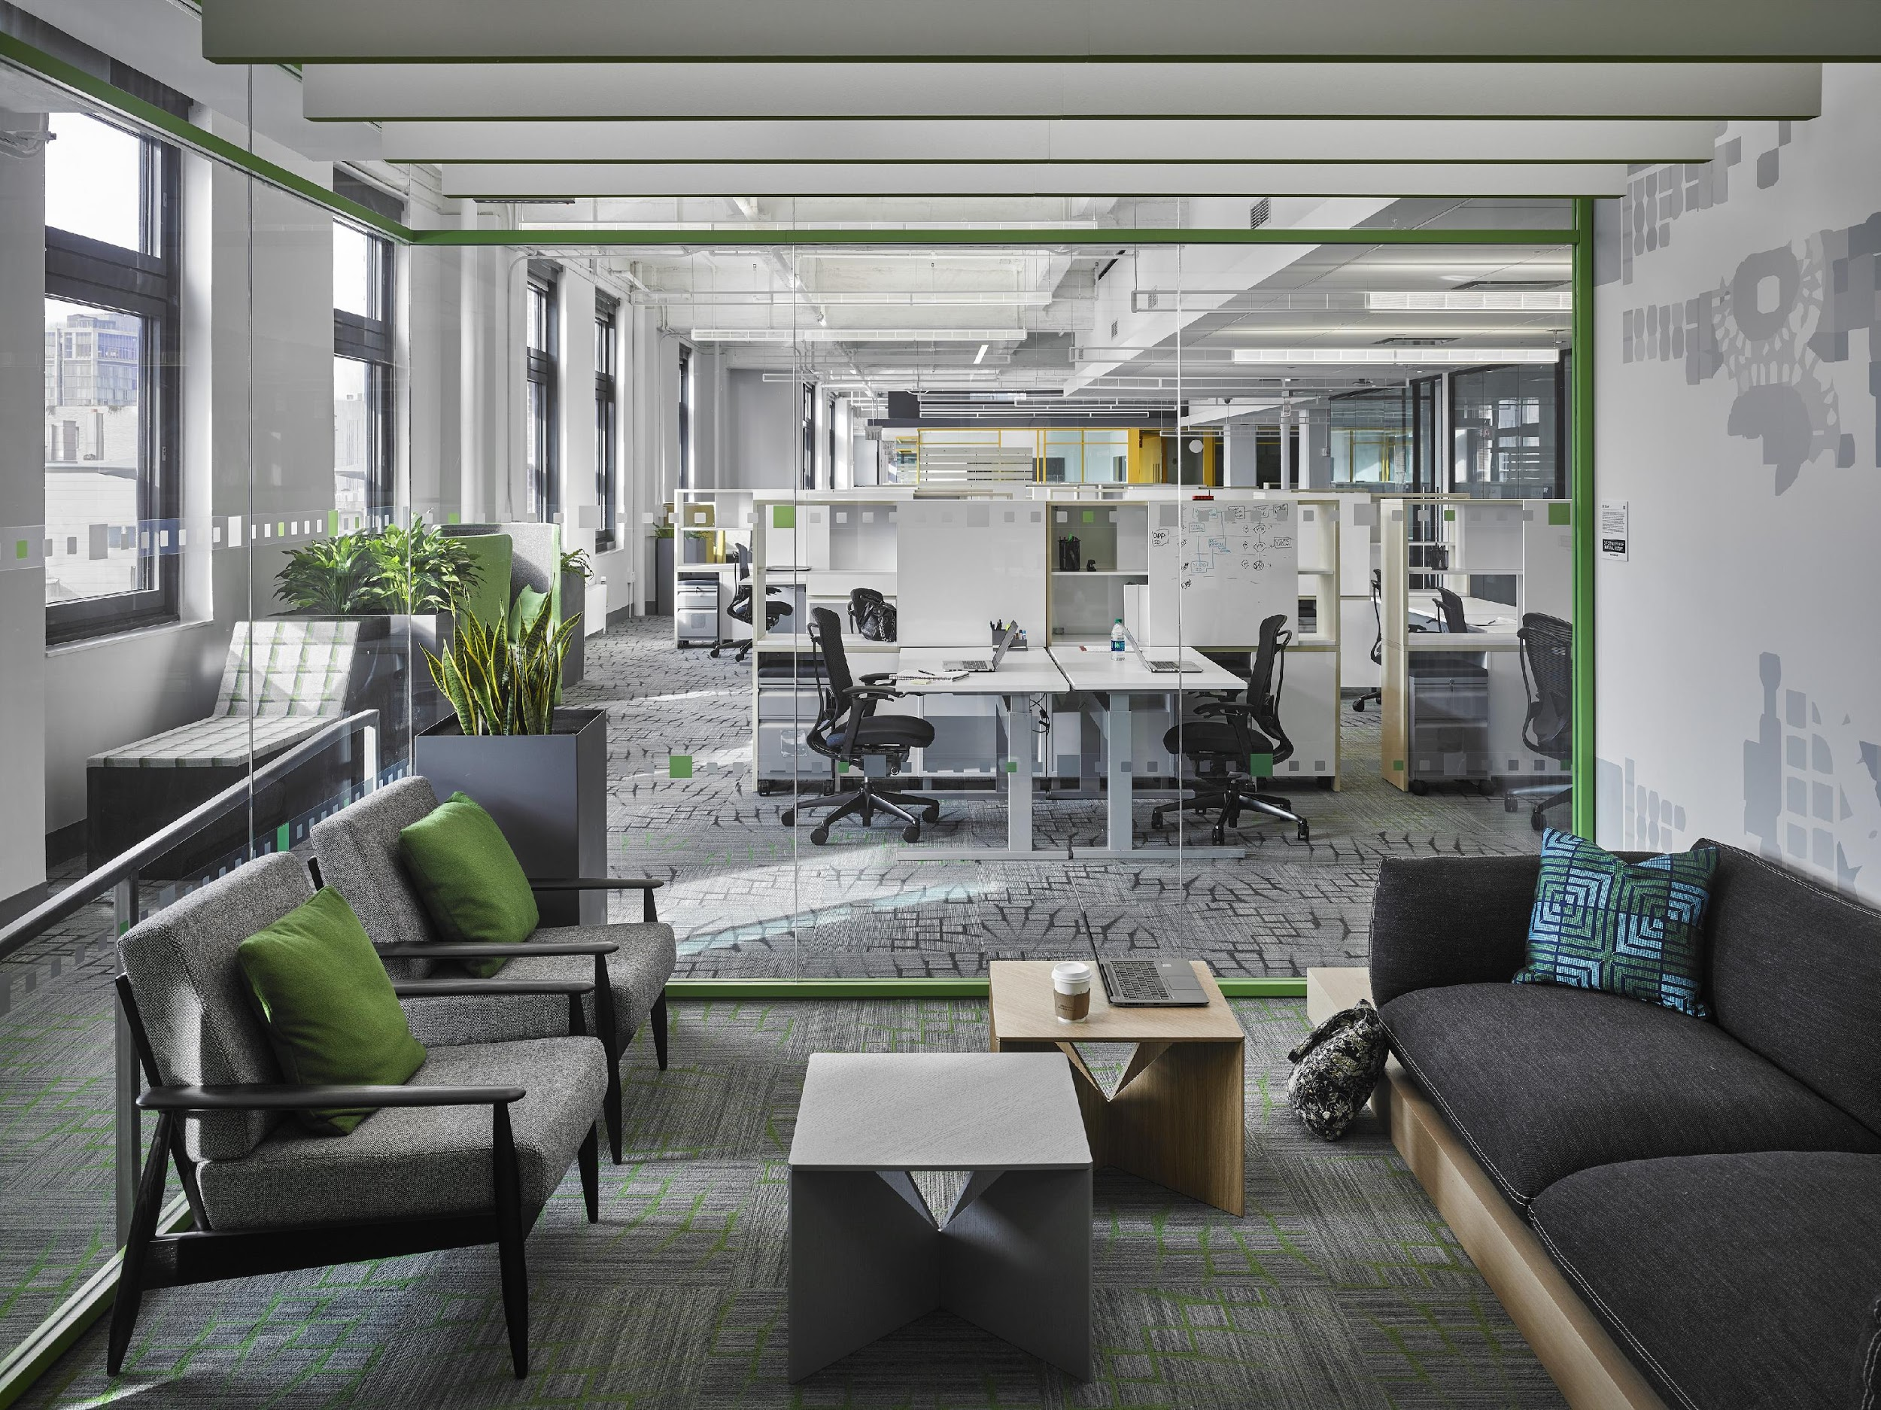
Practice Area 4 - Commercial

Slide 57
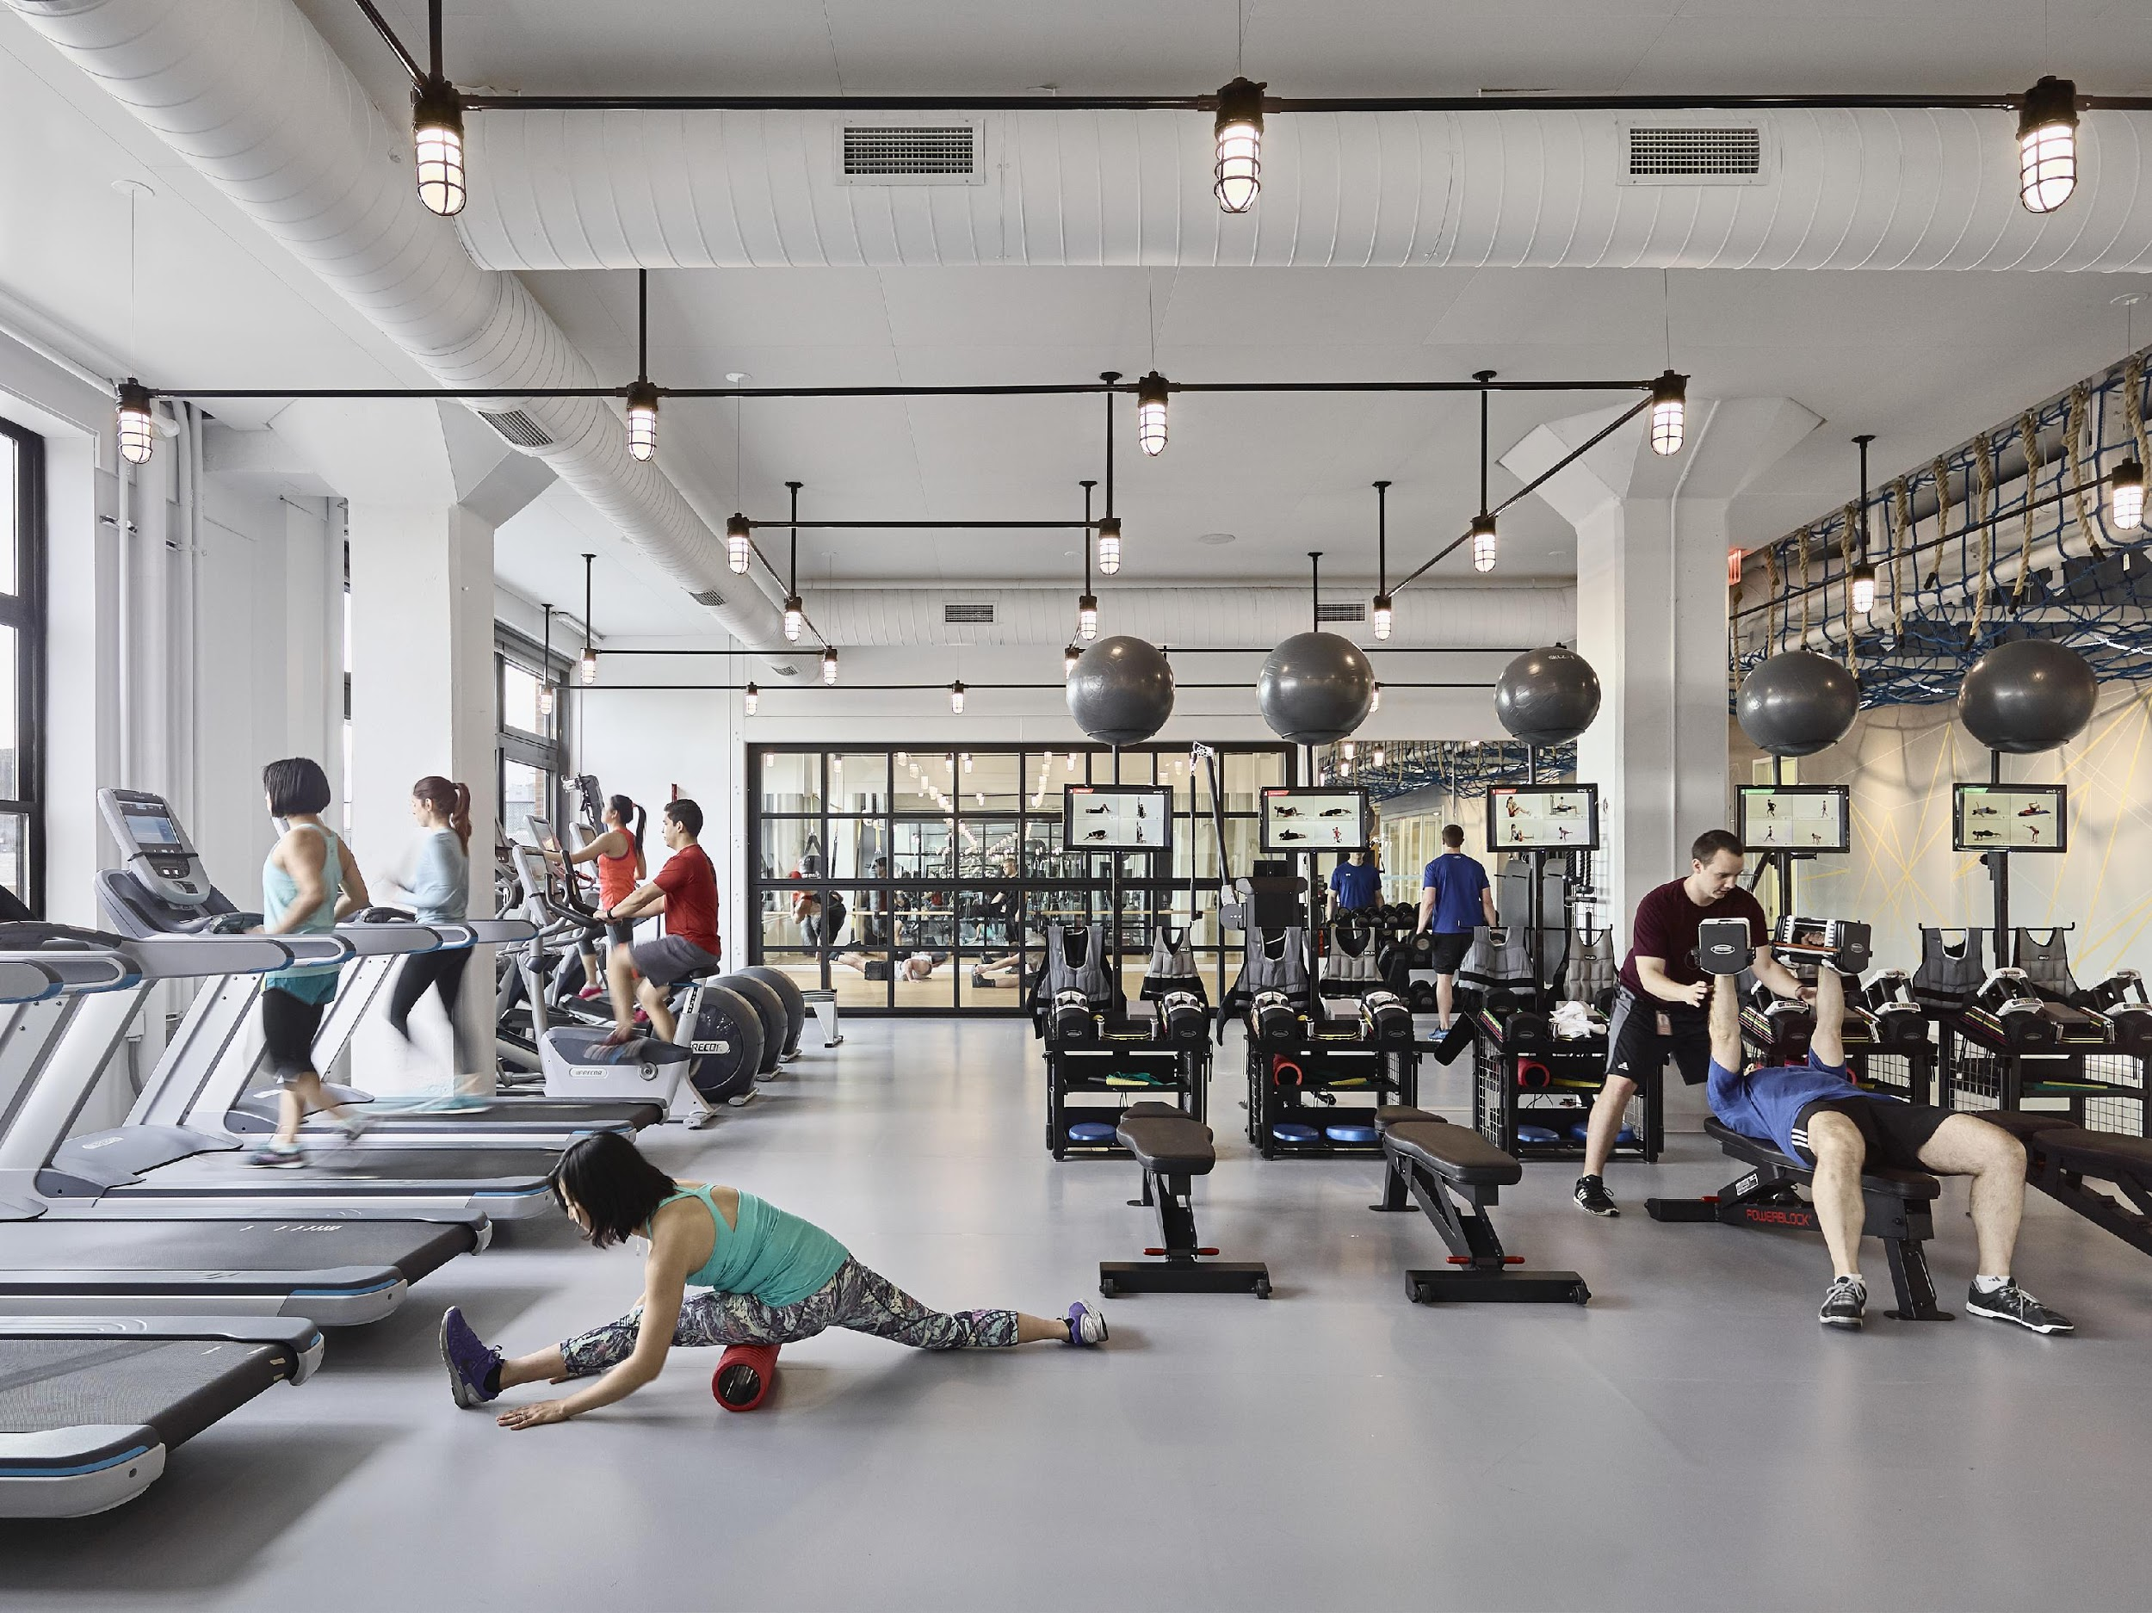
Population: Aware of Health Issues
Expectations:
Not being harmed by materials in space.
Spaces that increase wellness

Slide 58
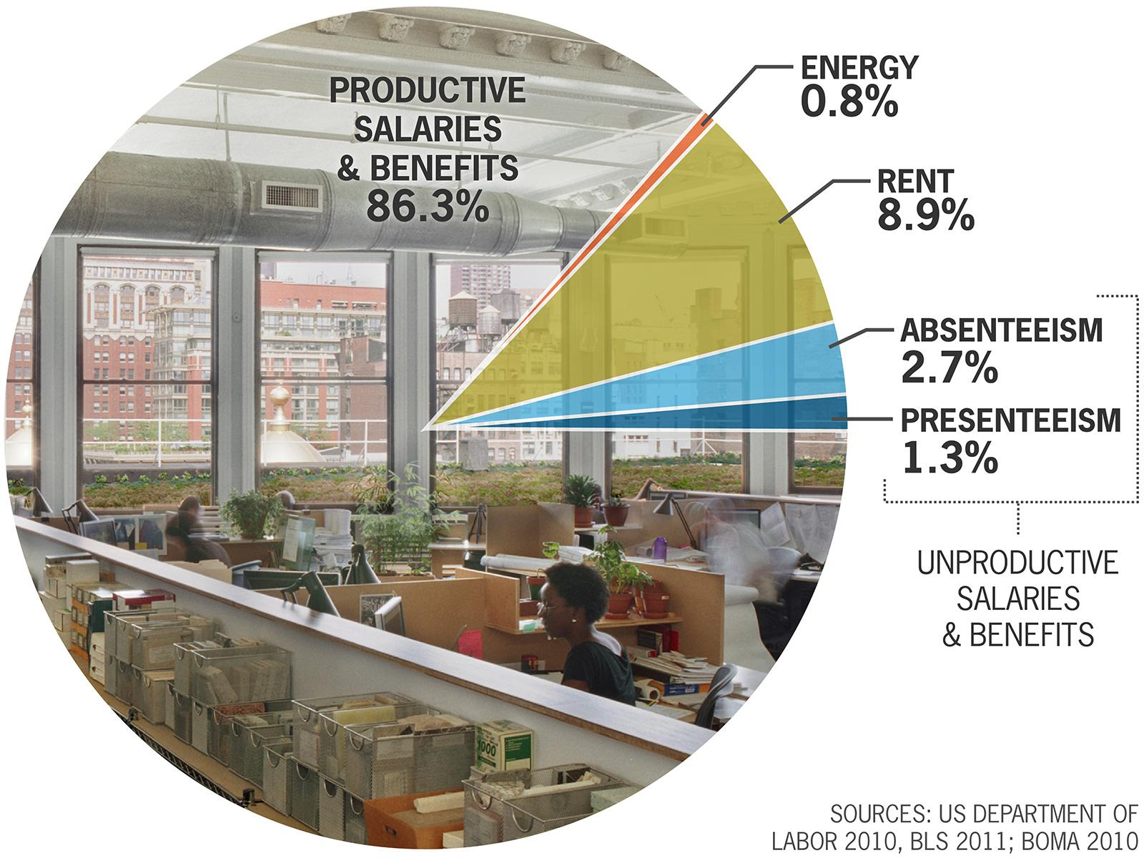
Clients: Aware of Potential Cost Reductions
Increased employee health and worker productivity were cited as the two most important social reasons to build green in every international market to participate in a recent McGraw-Hill survey.
People in the U.S. spend about 90% of their time indoors.
EPA studies indicate indoor levels of pollutants may be up to ten times higher than outdoor levels.
LEED-certified buildings are designed to have healthier, cleaner indoor environmental quality, which means health benefits for occupants.²⁵

Slide 59
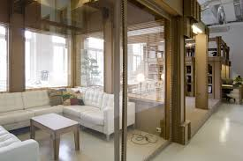
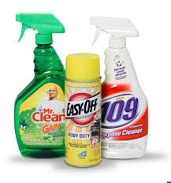
Specific Problems
Tenants do not necessarily have control over mechanical system, and maintenance systems
Emphasis on aesthetics over health

Slide 60
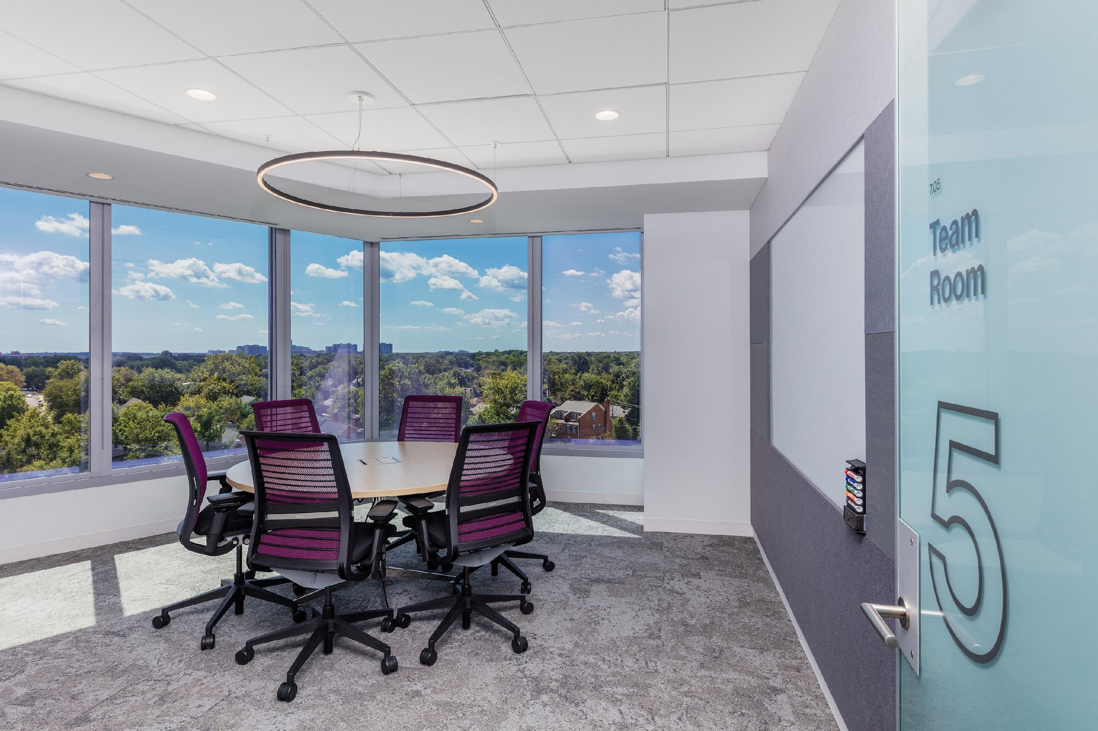
Specific Mitigation
Leases: Attempt to secure as much control as possible over mechanical system, cleaning, and maintenance system
Emphasis on high-volume, high percentage materials
ACT ceiling
Gypsum board
Carpet

Slide 61
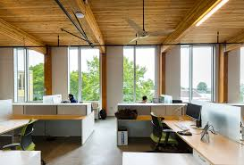
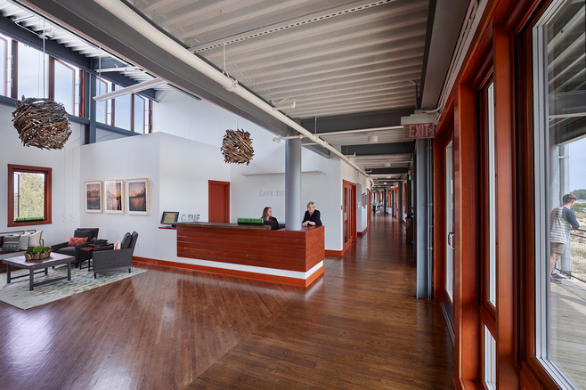
Specific Mitigation
Healthier material and design feedback loop: LBC projects have more limited palettes

Slide 62
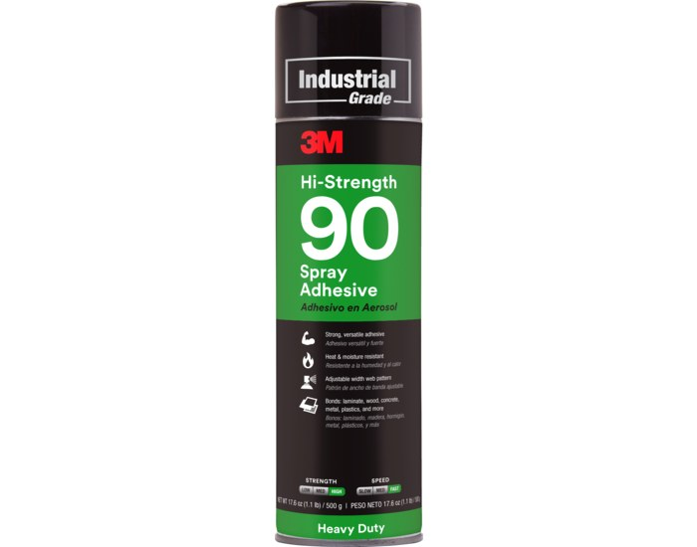
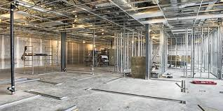
Specific Problems
The worst part of materials can be the means of attachment
Frequent change of design

Slide 63
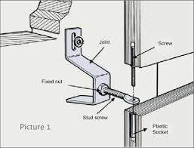
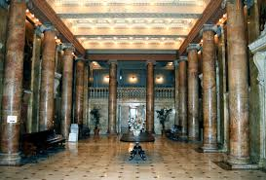
Specific Mitigation
Change ways of attaching materials from adhesives to mechanical
Appropriate durability, maintenance

Slide 64
Materials Transparency and Risk for Architects

Slide 65
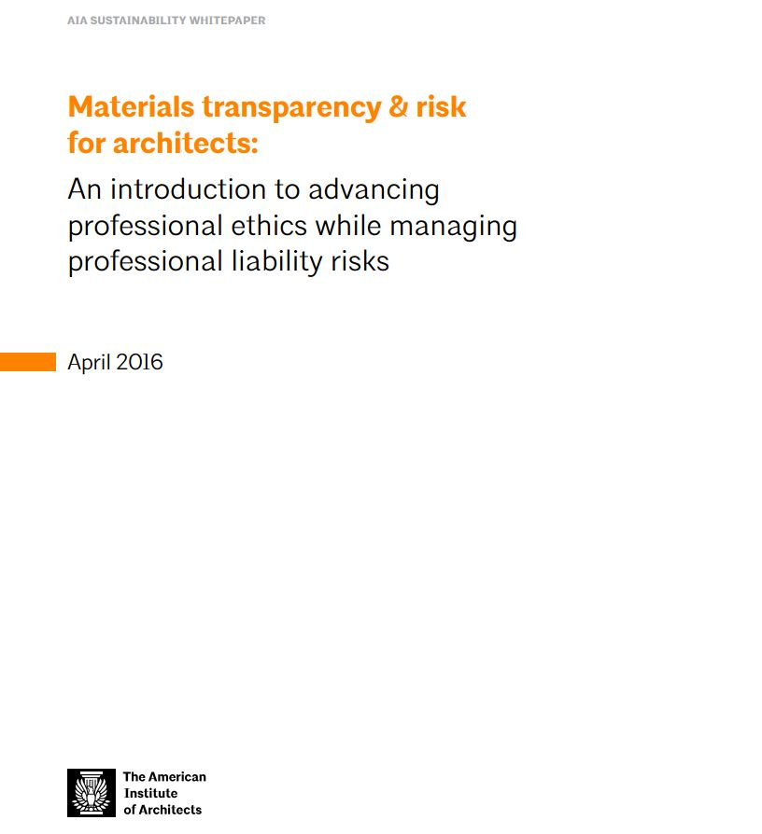

Slide 66
Best Practices
Be UNAMBIGUOUS
about your intent
Use recognized 3rd party documents
Present materials content as one factor AMONG MANY
Make NO GUARANTEES re: actual materials content
Do NOT claim to have expertise you don’t have

Slide 67
Best Practices
“We are unable to evaluate whether or not there is a risk of harm.”

Slide 69
Resources
Healthier Hospitals Initiative: http://healthierhospitals.org/
Healthy Building Network: https://healthybuilding.net/
HPD Collaborative: https://www.hpd-collaborative.org/
Six Classes: http://www.sixclasses.org/
P+W Precautionary list: https://transparency.perkinswill.com/lists/precautionary-list
Declare: https://living-future.org/declare/
C2C: https://www.c2ccertified.org/

Slide 70
Contact Information
Jean Hansen, FIIDA, LEED Fellow, CID, WELL AP, EDAC, AAHD
jean.hansen@hdrinc.com
Anne Hicks Harney, FAIA, LEED Fellow
anne@longgreenspecs.com
Tanya Mejia, Assoc. AIA, AICP, LEED AP BD+C, WELL AP
t.mejia@perkinseastman.com
Susan Kaplan, CCS, LEED AP BD+C
skaplan@hlw.com

Slide 71
Time for Questions and Comments
???-!!!
Moderator
Rita Ho, LEED AP

Slide 72
CES Credit
All attendees are eligible to receive: 1.0 HSW/CEU (AIA continuing education)
Attendees at your site can submit for credit by individually completing the webinar’s survey and report form. The survey closes Friday, February 15, 2019 at 12:30 am EDT.
The URL to the webinar survey/form https://www.research.net/r/AAH1901 will be emailed to the person who registered your site.
More continuing education questions? Email . . . knowledgecommunities@aia.org.

Slide 73
Join us at The Academy of Architecture for Health!
• Receive Academy Update newsletters
• Access to resources
Knowledge Repository
Webinars
Award programs
Scholarships, Fellowships
Emerging professionals benefits
National and regional conferences and events
Social media, publications, blogs and Twitter

Slide 74
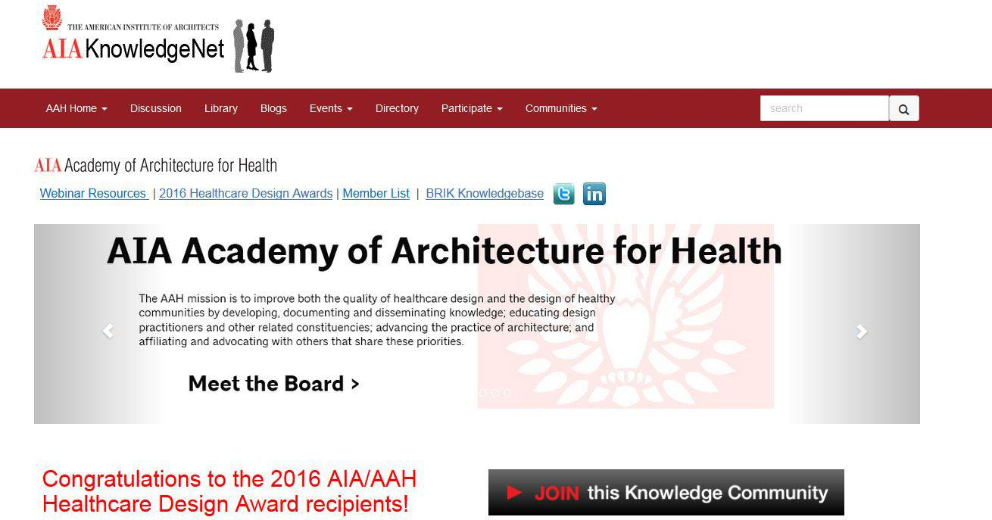
To join us or update your account go to . . .
www.aia.org/aah
Click here

Slide 75
Upcoming Webinars*
Date | Series | Topic
03/12 | HC 101 Series | From Ancillary to Essential: Technology’s New Role in Healthcare Design Operations
04/09 | Beyond the Basics Series | AAH/Center for Health-Design Knowledge Repository: How to Use and Example Application
05/14 | HC 101 Series | Pharmacy Standards: USPS 795 & 800
*Dates and topics are subject to change
Visit www.aia.org/aah for more information and to register.

