Slide 1
SESSION 3: ANALYTICS VS. COMPUTATIONAL DESIGN
TAP BUILDING CONNECTIONS CONFERENCE
JANUARY 13, 2020

Slide 2
?

Slide 3
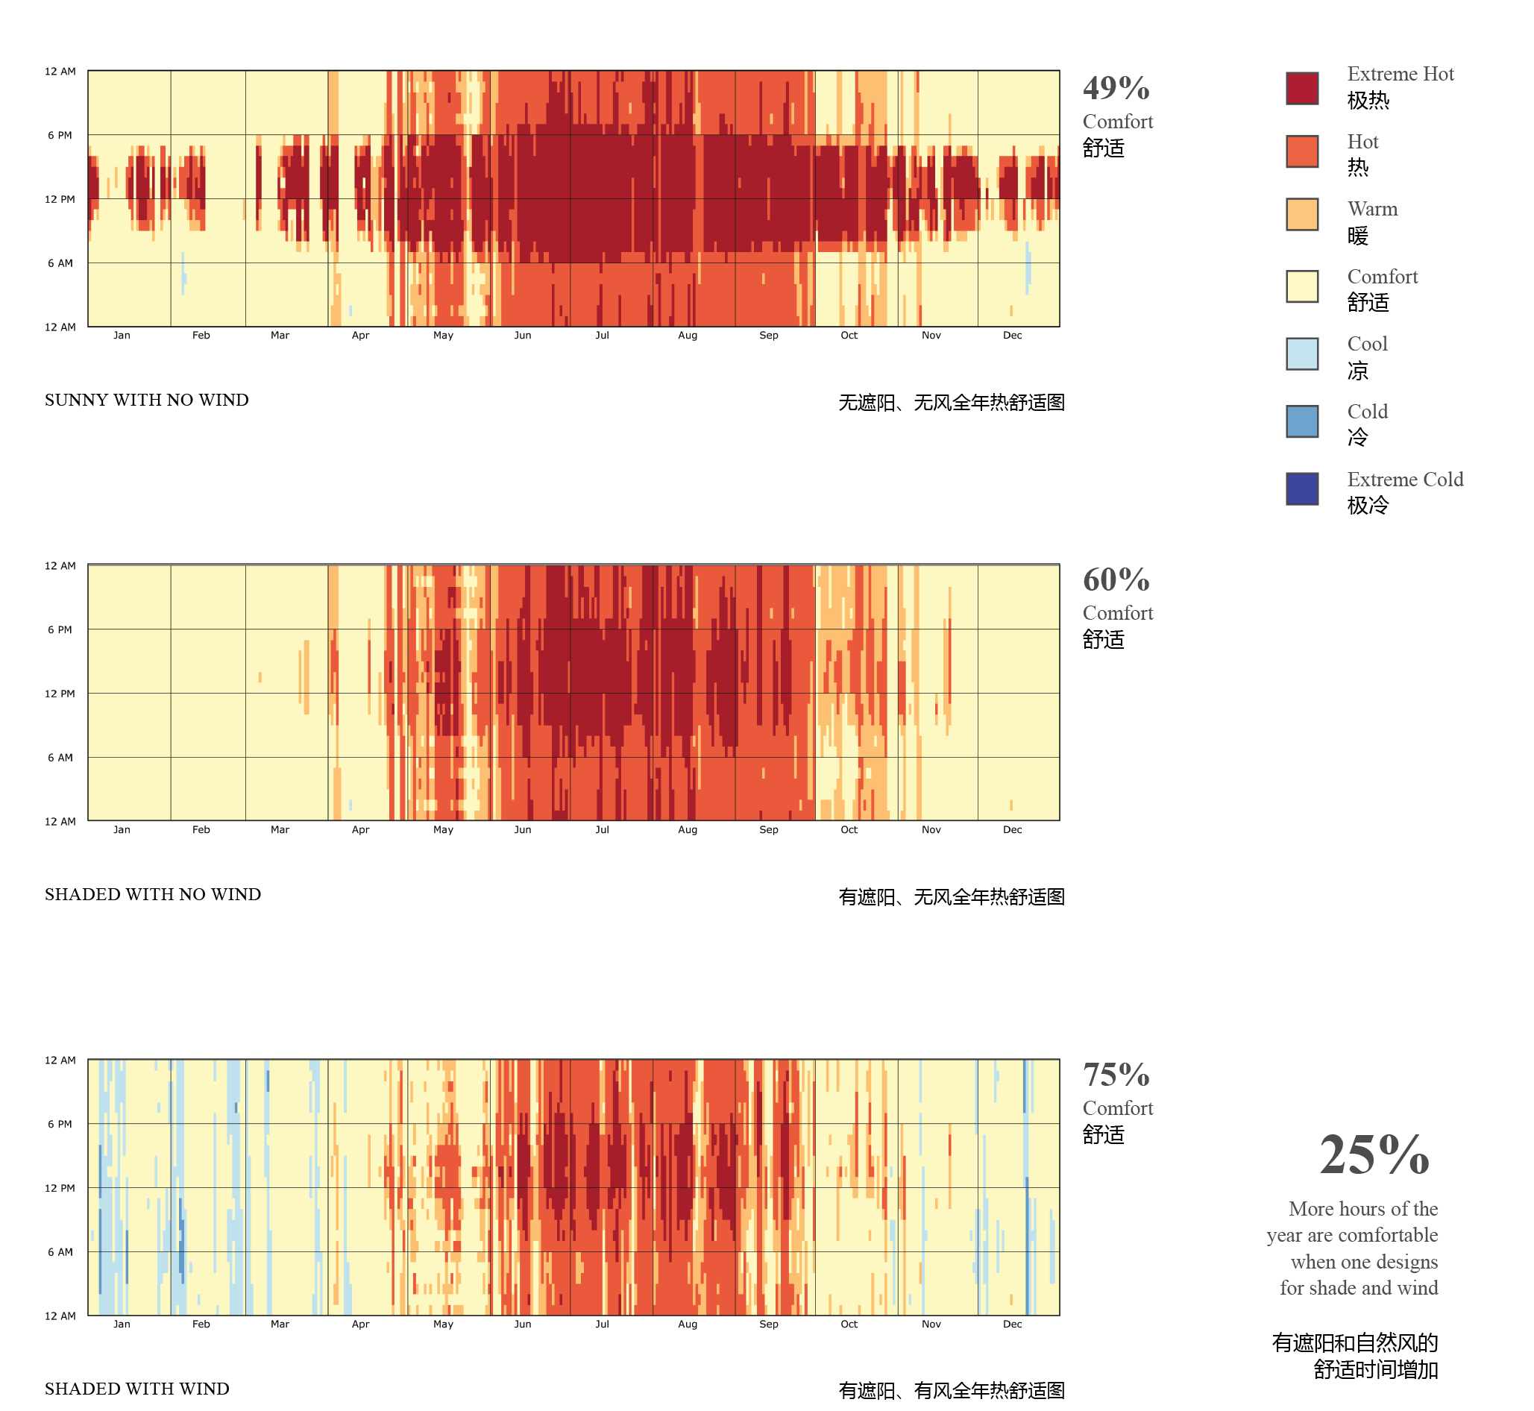
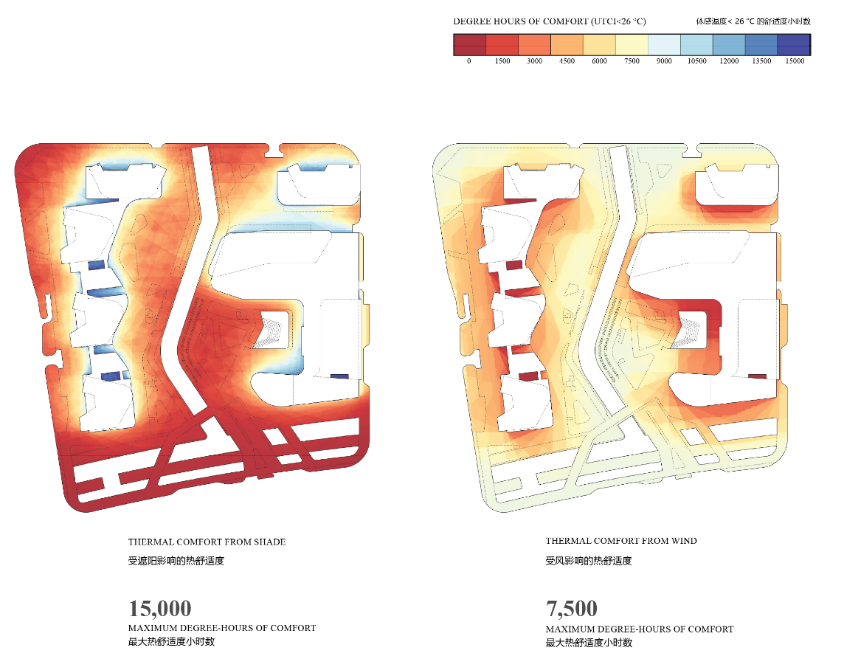
HOW CAN WE MAKE A MORE COMFORTABLE SITE?
Sunny with no Wind
Thermal Comfort From Shade
Thermal Comfort From Wind
Shaded with no Wind
Shaded with Wind

Slide 4
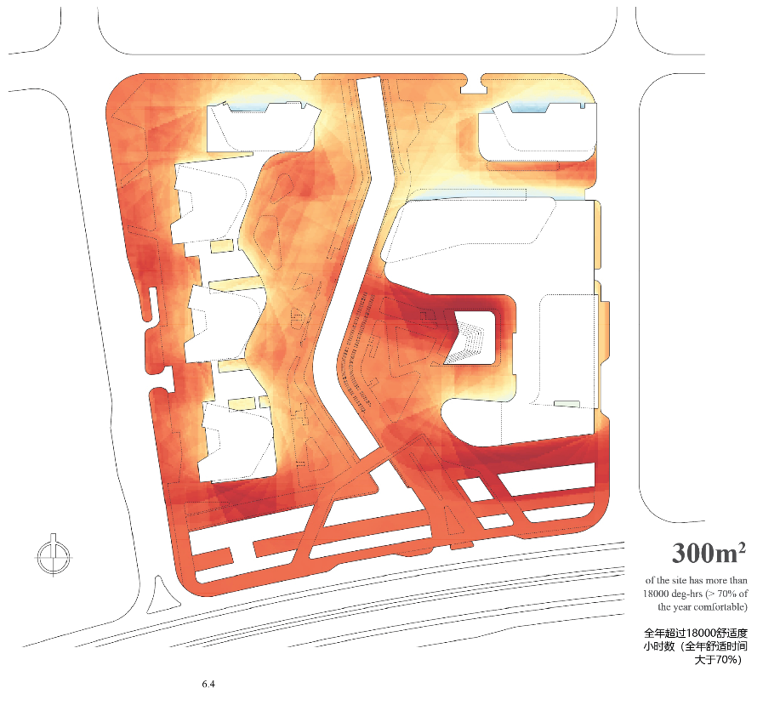
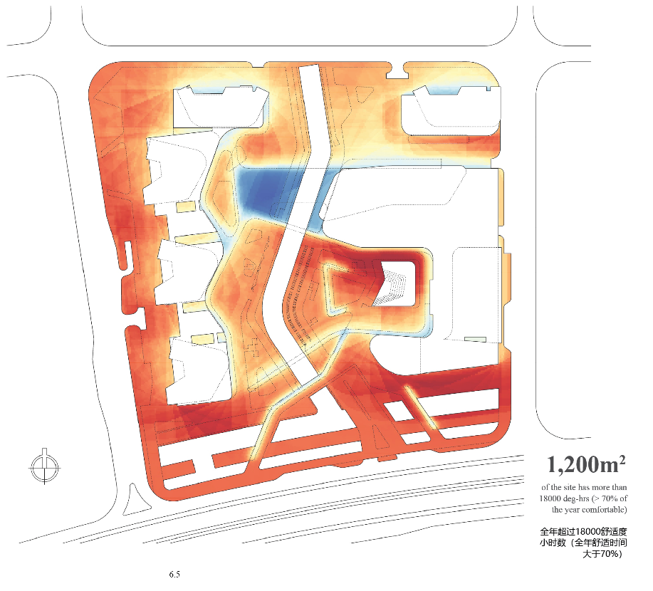
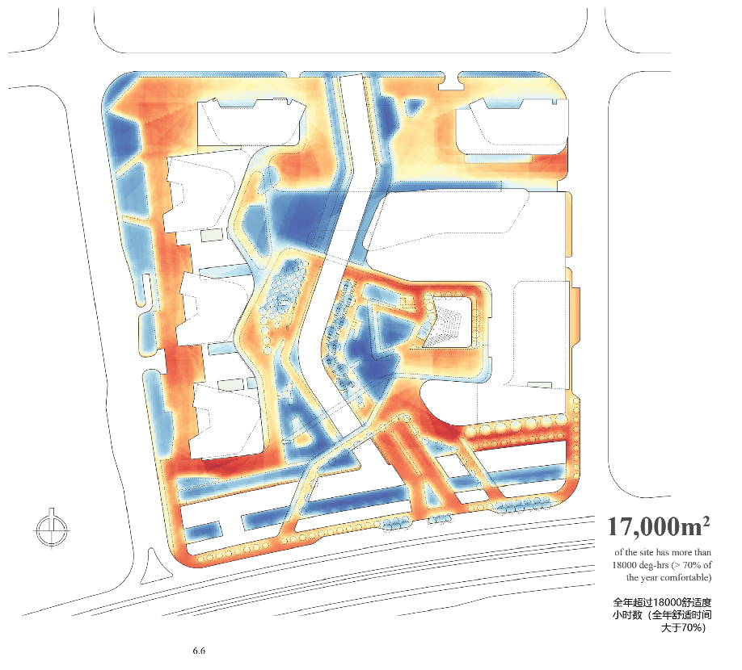
HOW CAN WE MAKE A MORE COMFORTABLE SITE?

Slide 5
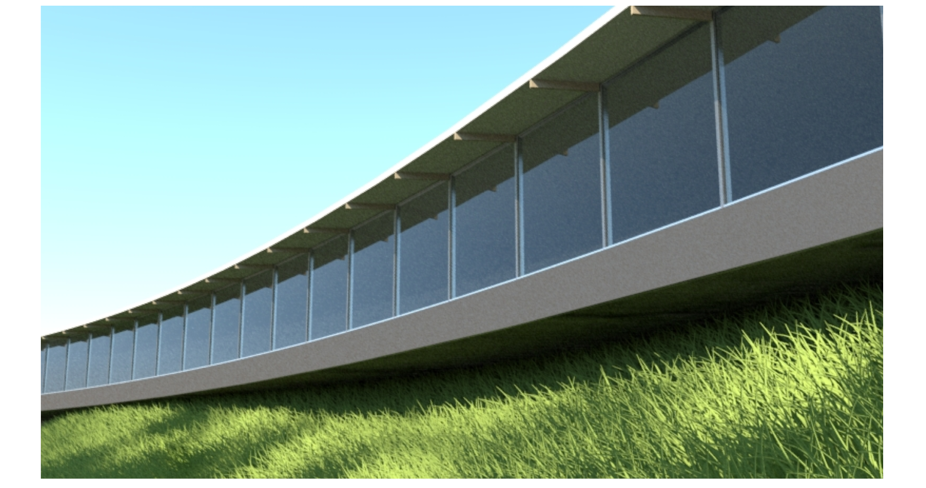
HOW CAN WE MANIPULATE A FAÇADE TO IMPROVE COMFORT AND REDUCE ENERGY?
Overhang
Depth
Overhang Angle
Sill
Height
Window Height

Slide 6
HOW CAN WE MANIPULATE A FAÇADE TO IMPROVE COMFORT AND REDUCE ENERGY?

Slide 7
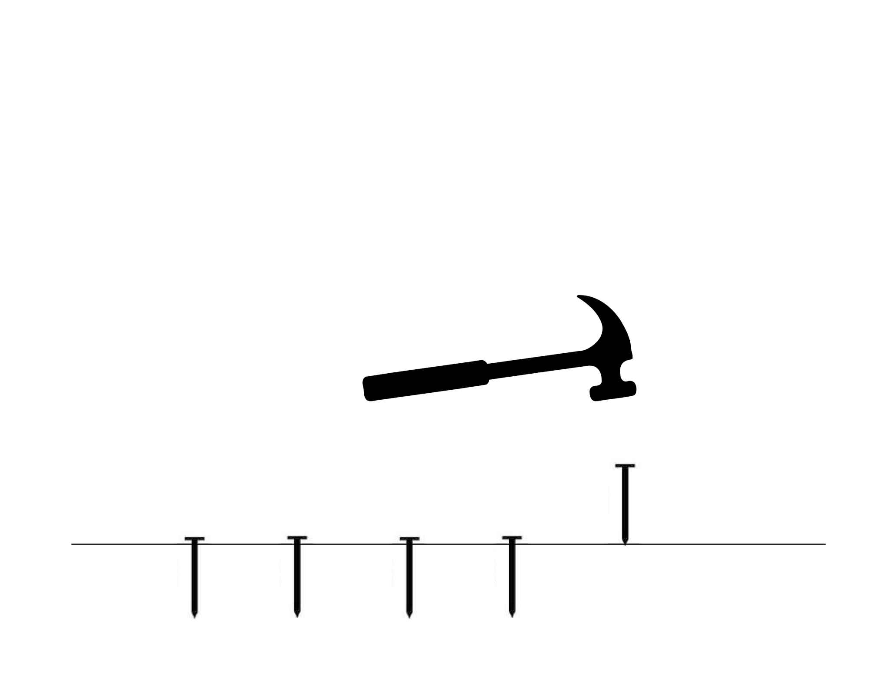

Slide 9
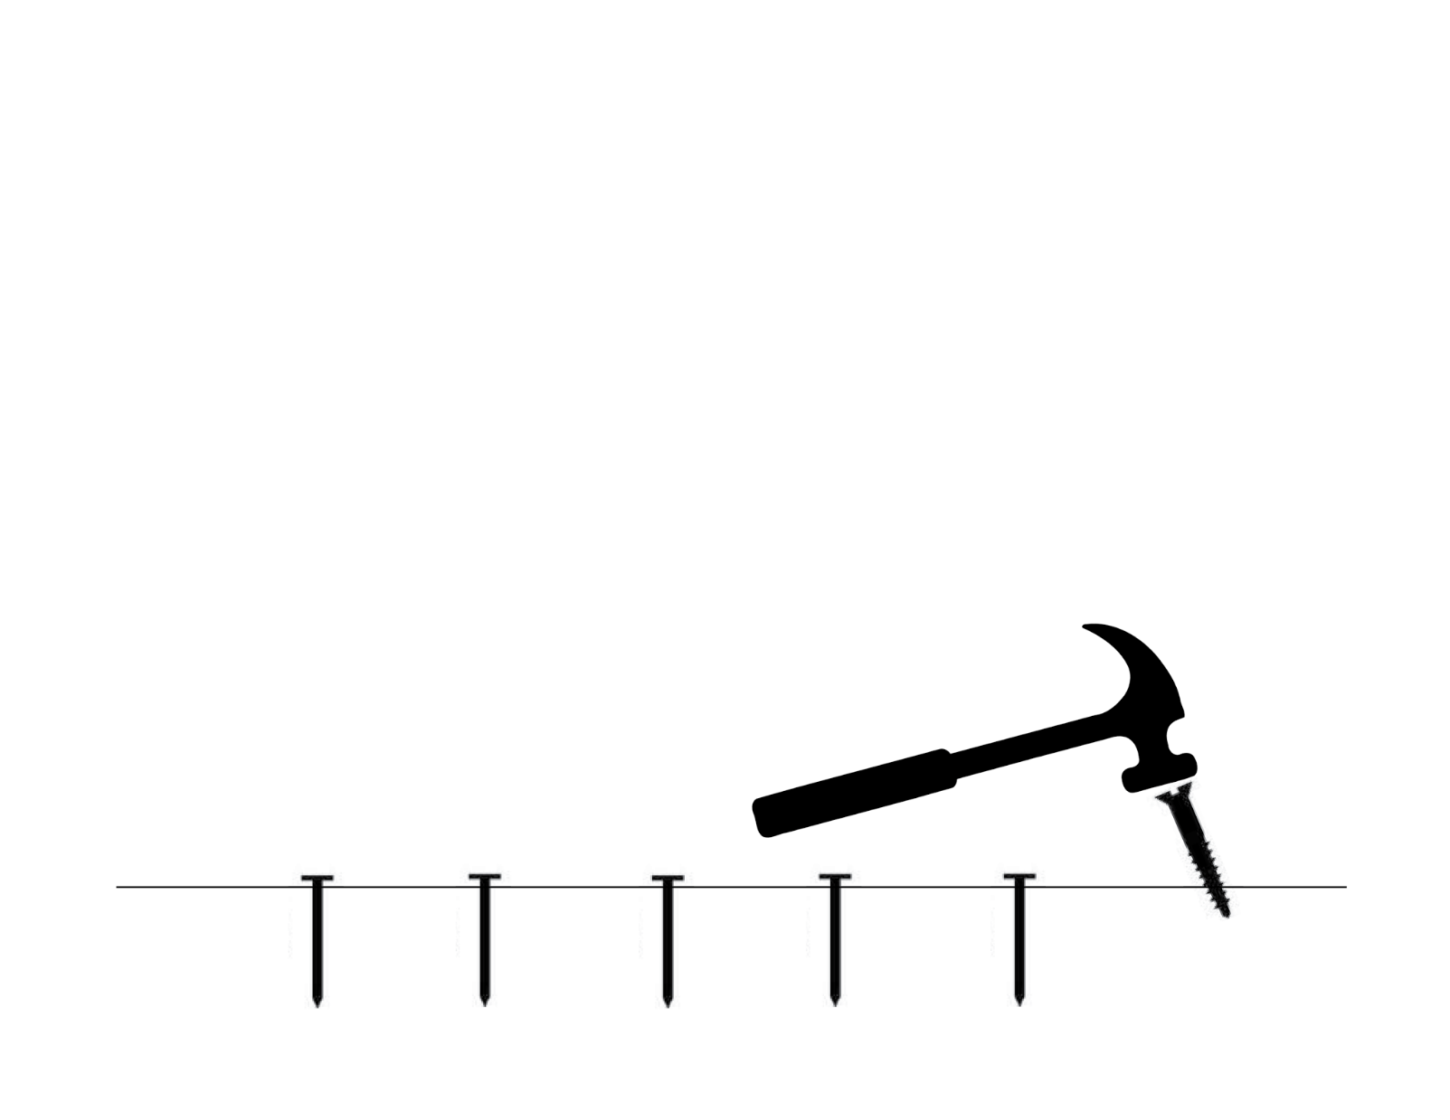

Slide 10
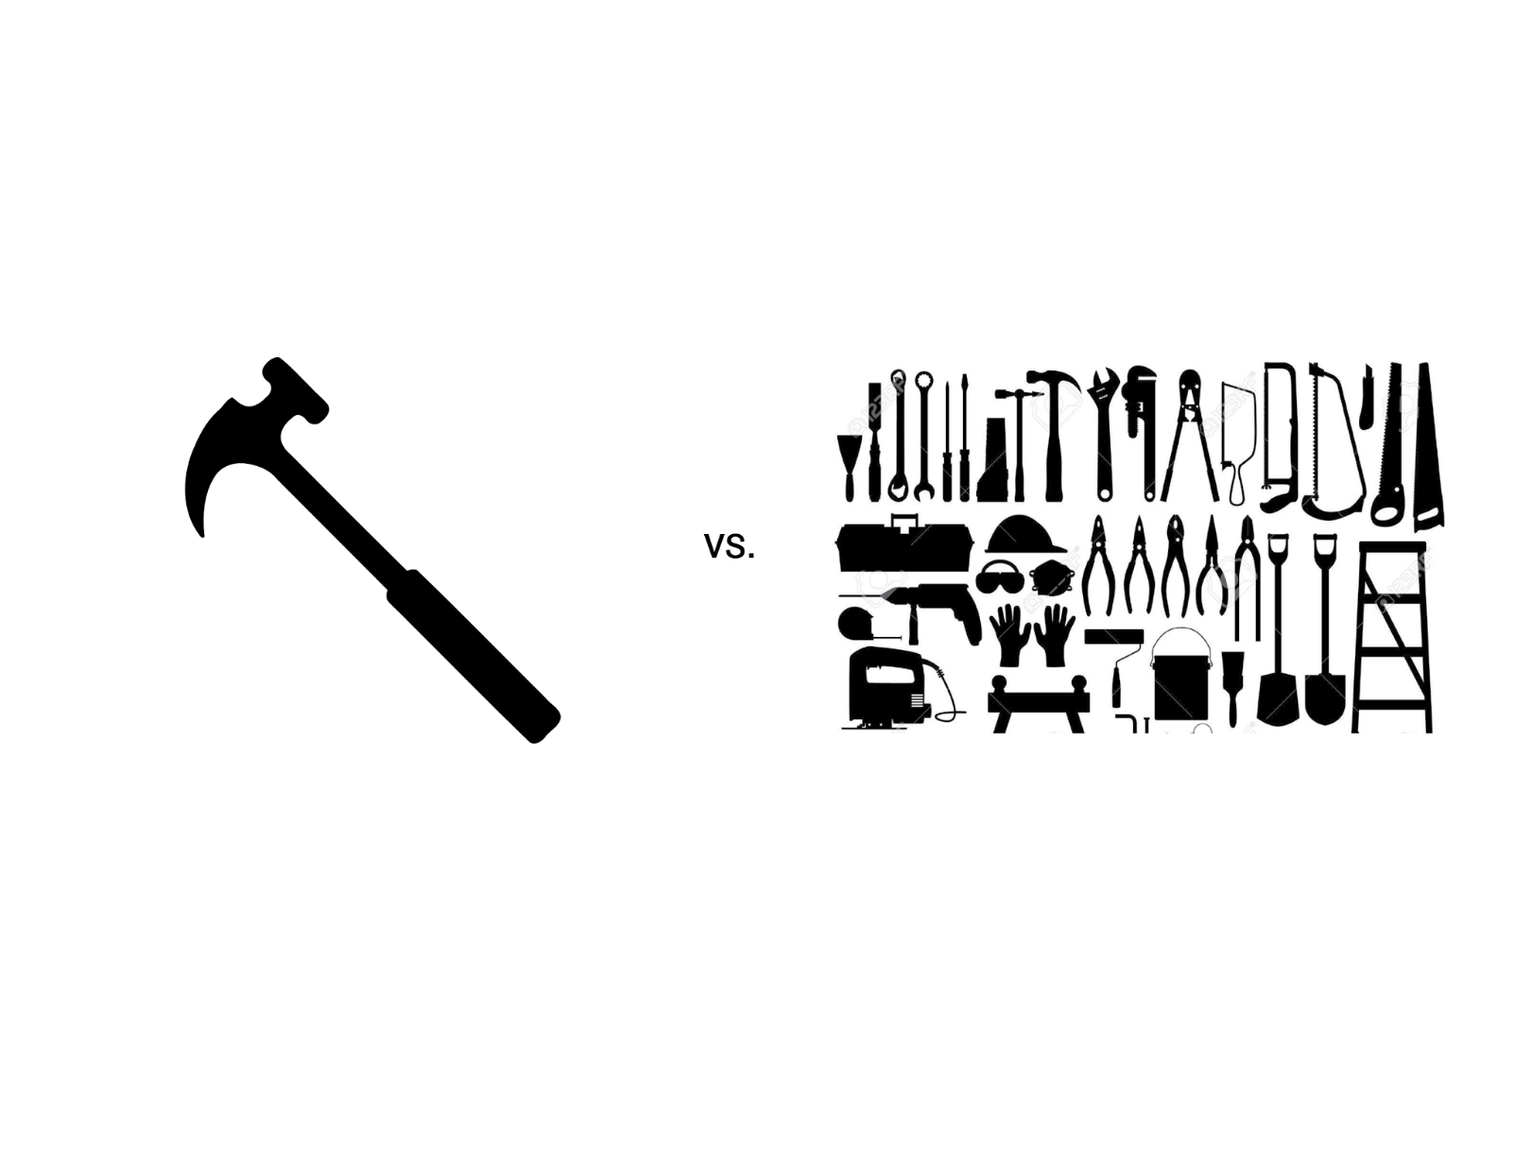
Notes:
Toolkit v.s. Tool
Options v.s. Ease
Personality v.s. Automation
Community vs Pyramid
Integrating data with geometry

Slide 11
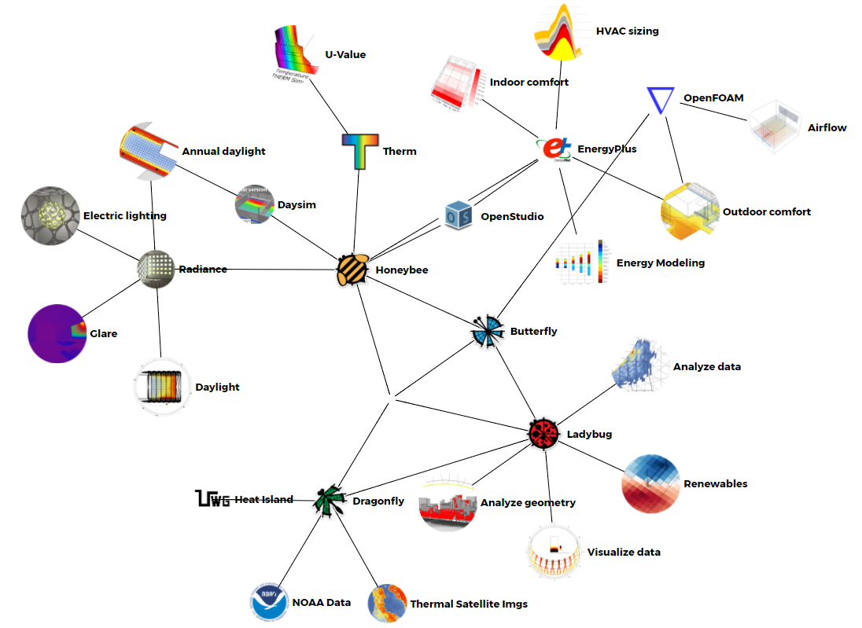
SIMULATION ECOSYSTEM
HOW CAN WE MAKE DECISIONS TO REDUCE ENERGY BEFORE WE HAVE A BUILDING?

Slide 13
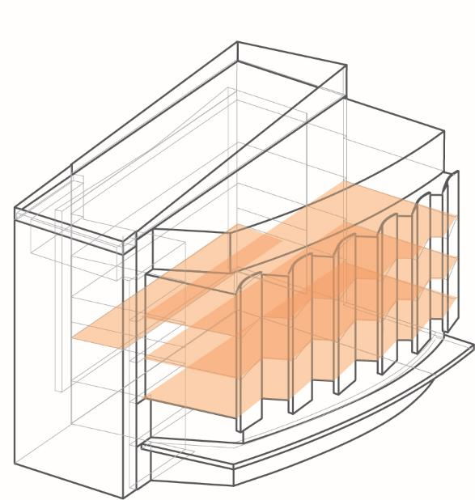
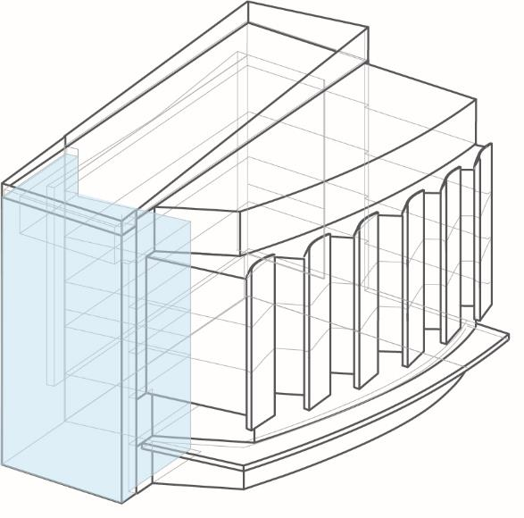
THERMAL COMFORT - TWO WAYS
RADIANT FLOORS
NATURALLY VENTILATED ATRIUM

Slide 14
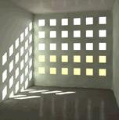
TOOL KIT
Architect
Engineer
LADYBUG
AMBIENS
OPENSTUDIO
ENERGYPLUS
ENERGYPLUS
HONEYBEE
IES VIRTUAL ENVIRONMENTS
TRANE TRACE
RADIANCE
COLIBRI
THERM

Slide 15
PEAK SOLAR LOADS ON SLAB

Slide 16
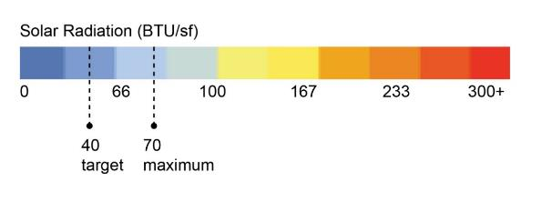
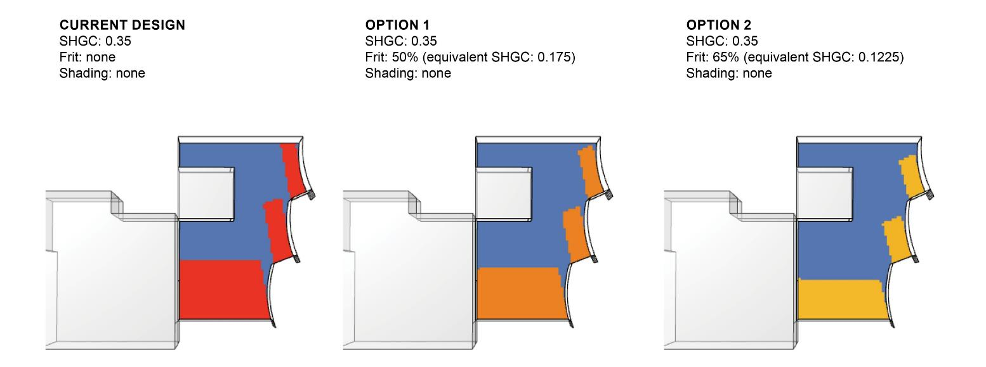
PEAK SOLAR LOADS ON SLAB

Slide 17
FEEDBACK LOOPS
WHAT SYSTEMS SHOULD WE CONSIDER FOR THE BUILDING?
AND LET’S OPTIMIZE OCCUPANCT COMFORT AND EXPERIENCE!
Energy & Mechanical
LEED & EUI
Thermal Comfort
Daylighting
Building Envelope
FOR RADIANT SYSTEMS, WHAT ARE THE LIMITING FACTORS FOR ENVELOPE, INTERNAL GAINS AND SOLAR HEAT GAIN?
HOW DO WE OPTIMIZE ENERGY EFFICIENCY OF THE CENTRAL PLANT FOR THE RADIANT SYSTEMS?
Notes:
Payette – envelope – code vs passive house thermal requirements, glazing selections
Payette – therm parametric study – loads
BHE – interaction re energy and mechanical loads and cap on solar radiation = target
Payette – daylight/ solar heat gain studies
BHE – fine-tuning , mechanical design (loads, zoning, space allocations, heating/ cooling dominated)
Payette and BHE – joint energy model, technology issues with IES, shared files/ tools

Slide 18
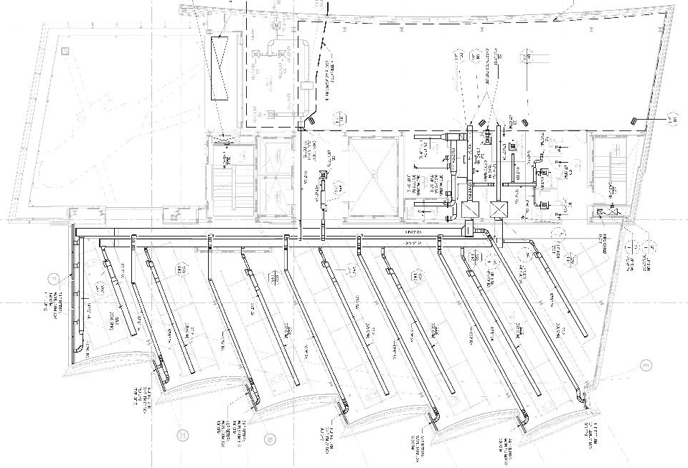
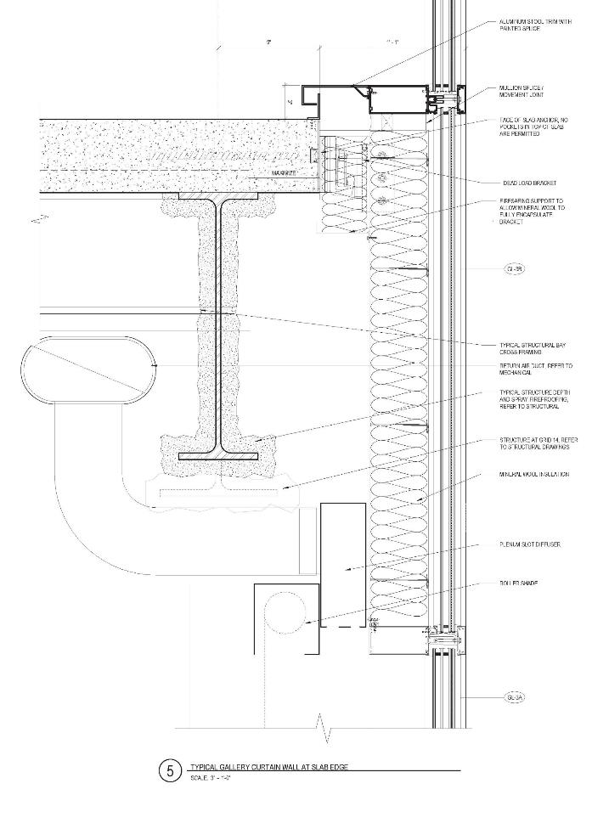
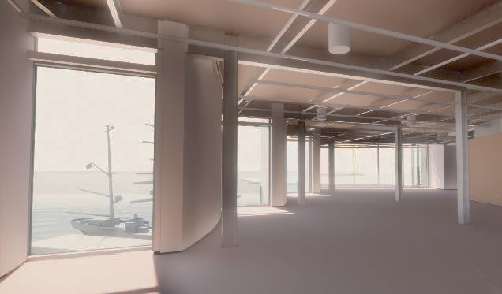
SHADE POCKET SOLUTION

Slide 19
THERMAL COMFORT - TWO WAYS
RADIANT FLOORS
NATURALLY VENTILATED ATRIUM

Slide 20
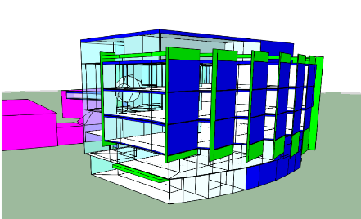
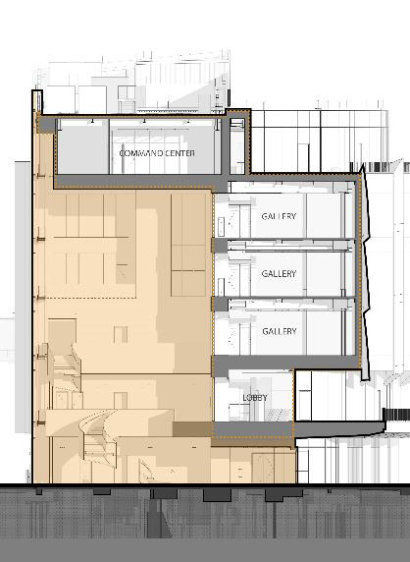
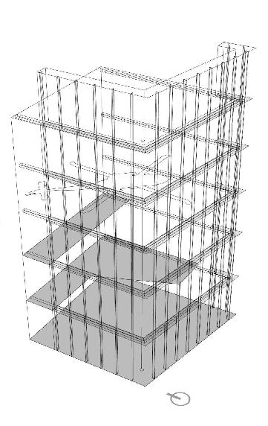
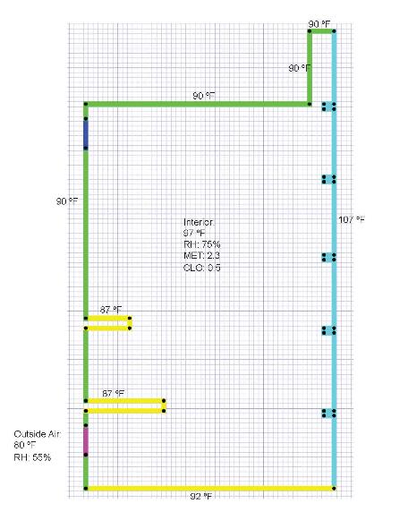
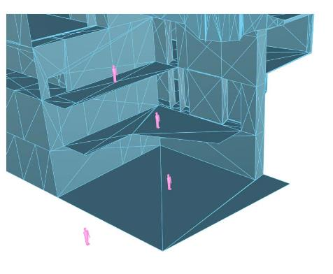
ATRIUM COMFORT PROCESS
DESIGN
ENERGYPLUS MODEL
CFD - TAS AMBIENS MODEL
IES VIRTUAL ENVIRONMENTS
Architect / Building Scientist
Engineer
Notes:
EnergyPlus model to pull out surface temperatures for design conditions (was July 20th, then September 10th)
Ladybug/Honeybee used to find solar adjusted surface temperatures with EnergyPlus model and microclimate map analysis
CFD study in TAS Ambiens with these values

Slide 21
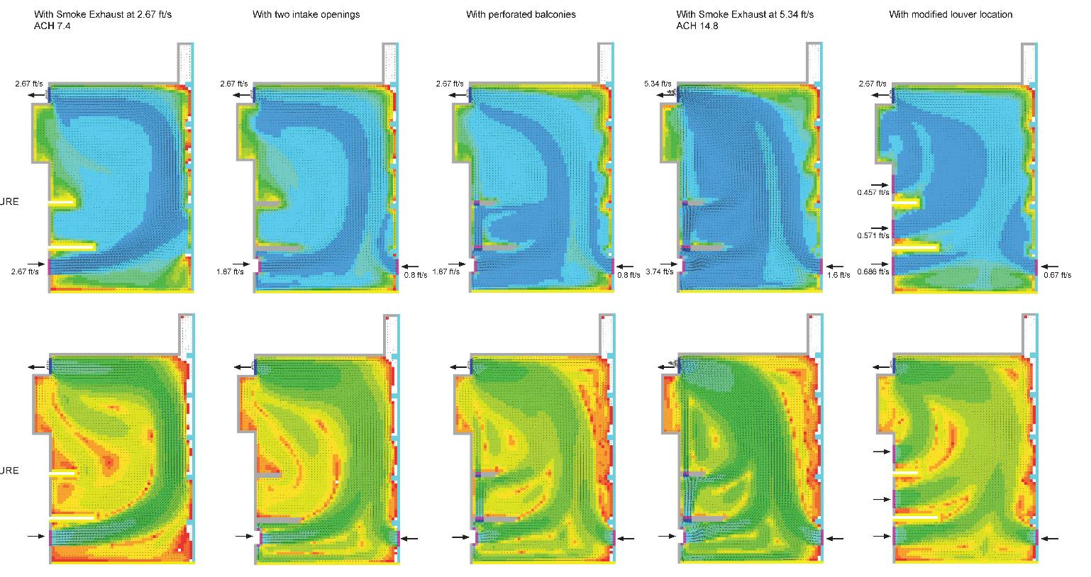
ATRIUM COMFORT CFD
AIR TEMPERATURE
(DRY BULB)
OPERATIVE TEMPERATURE
Notes:
2.67 ft/s approx. highest acceptable air speed

Slide 22
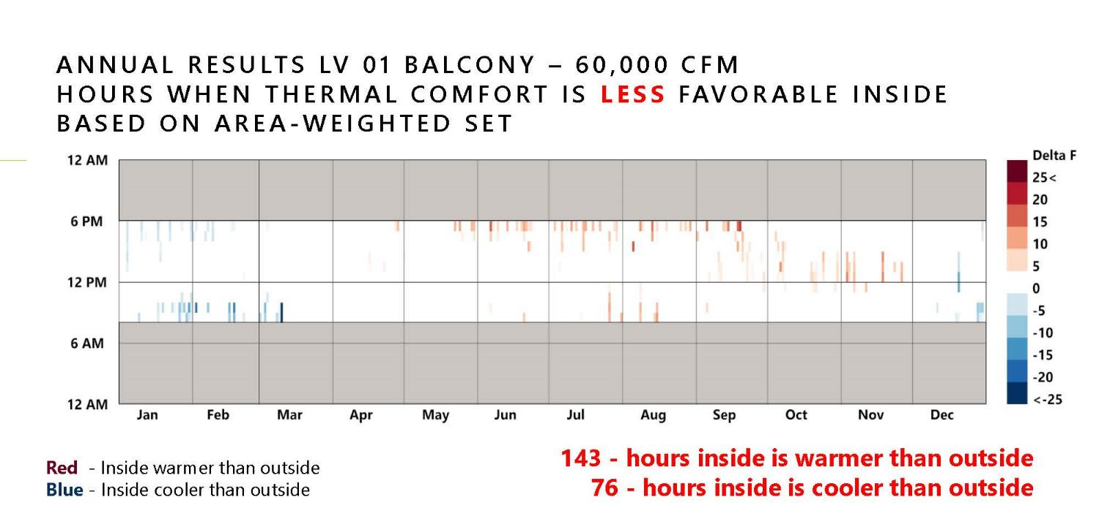
QUANTIFYING COMFORT

Slide 23
A Museum for the National Coast Guard

Slide 24
EARLY INTUITION

Slide 25
EARLY INTUITION

Slide 26
EARLY, PARAMETRIC PERFORMANCE MODELING
Notes:
2.67 ft/s approx. highest acceptable air speed

Slide 27
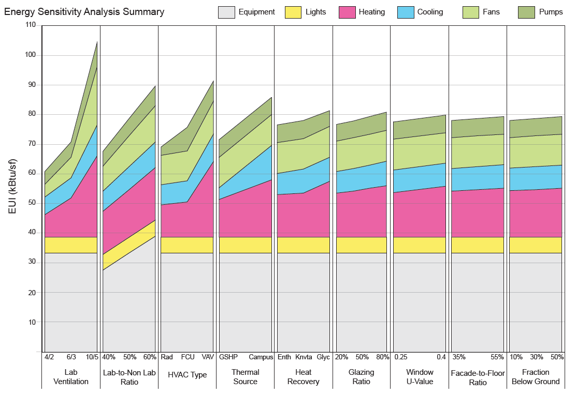
EARLY, PARAMETRIC PERFORMANCE MODELING
Notes:
2.67 ft/s approx. highest acceptable air speed

Slide 28
DETAILED DESIGN STUDIES
8’ CHILLED BEAM CAPACITY
8’ CHILLED BEAM CAPACITY

Slide 29
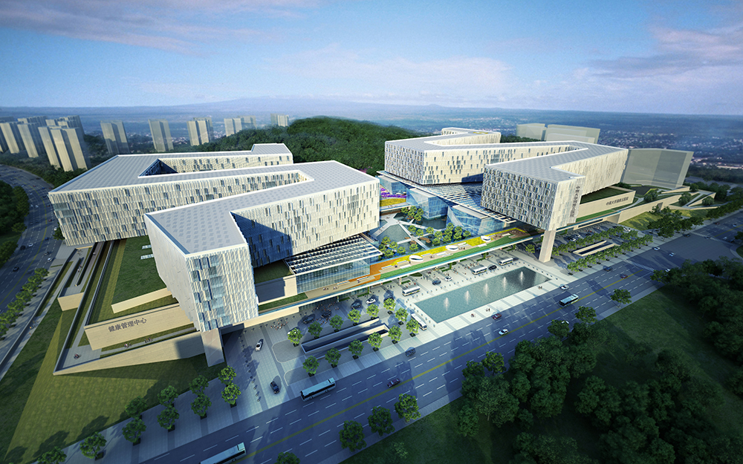
Central South University – Fifth XiangYa Hospital
2015 AIA National Healthcare Design Award, Unbuilt

Slide 30
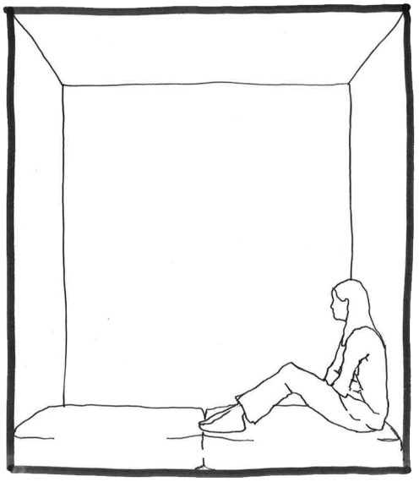
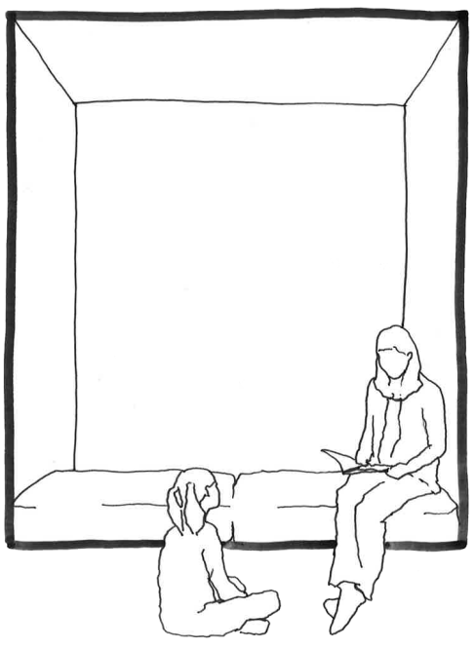
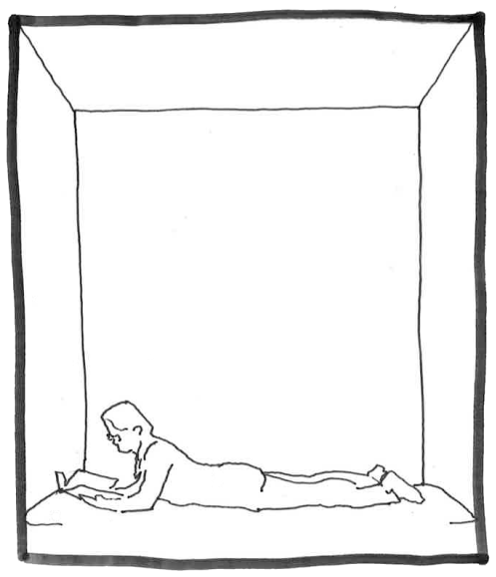
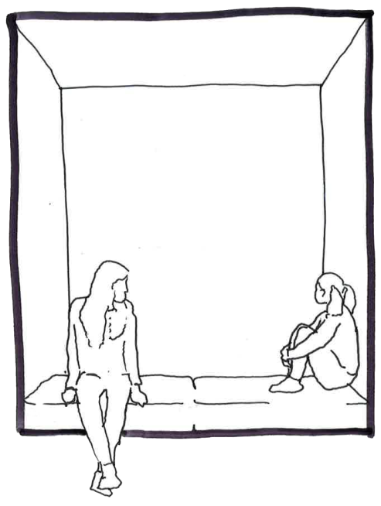
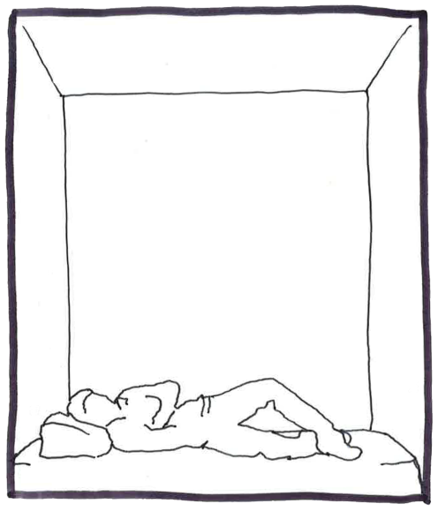
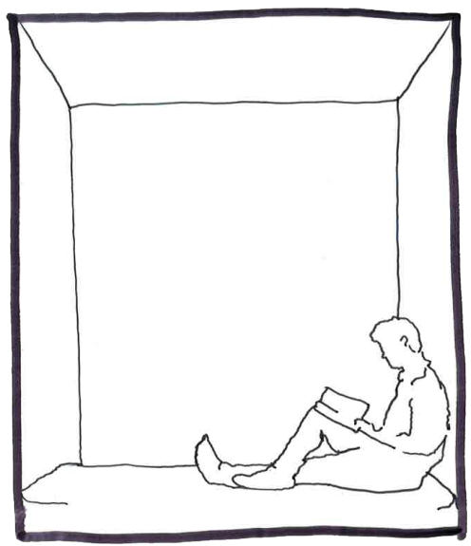

Slide 31
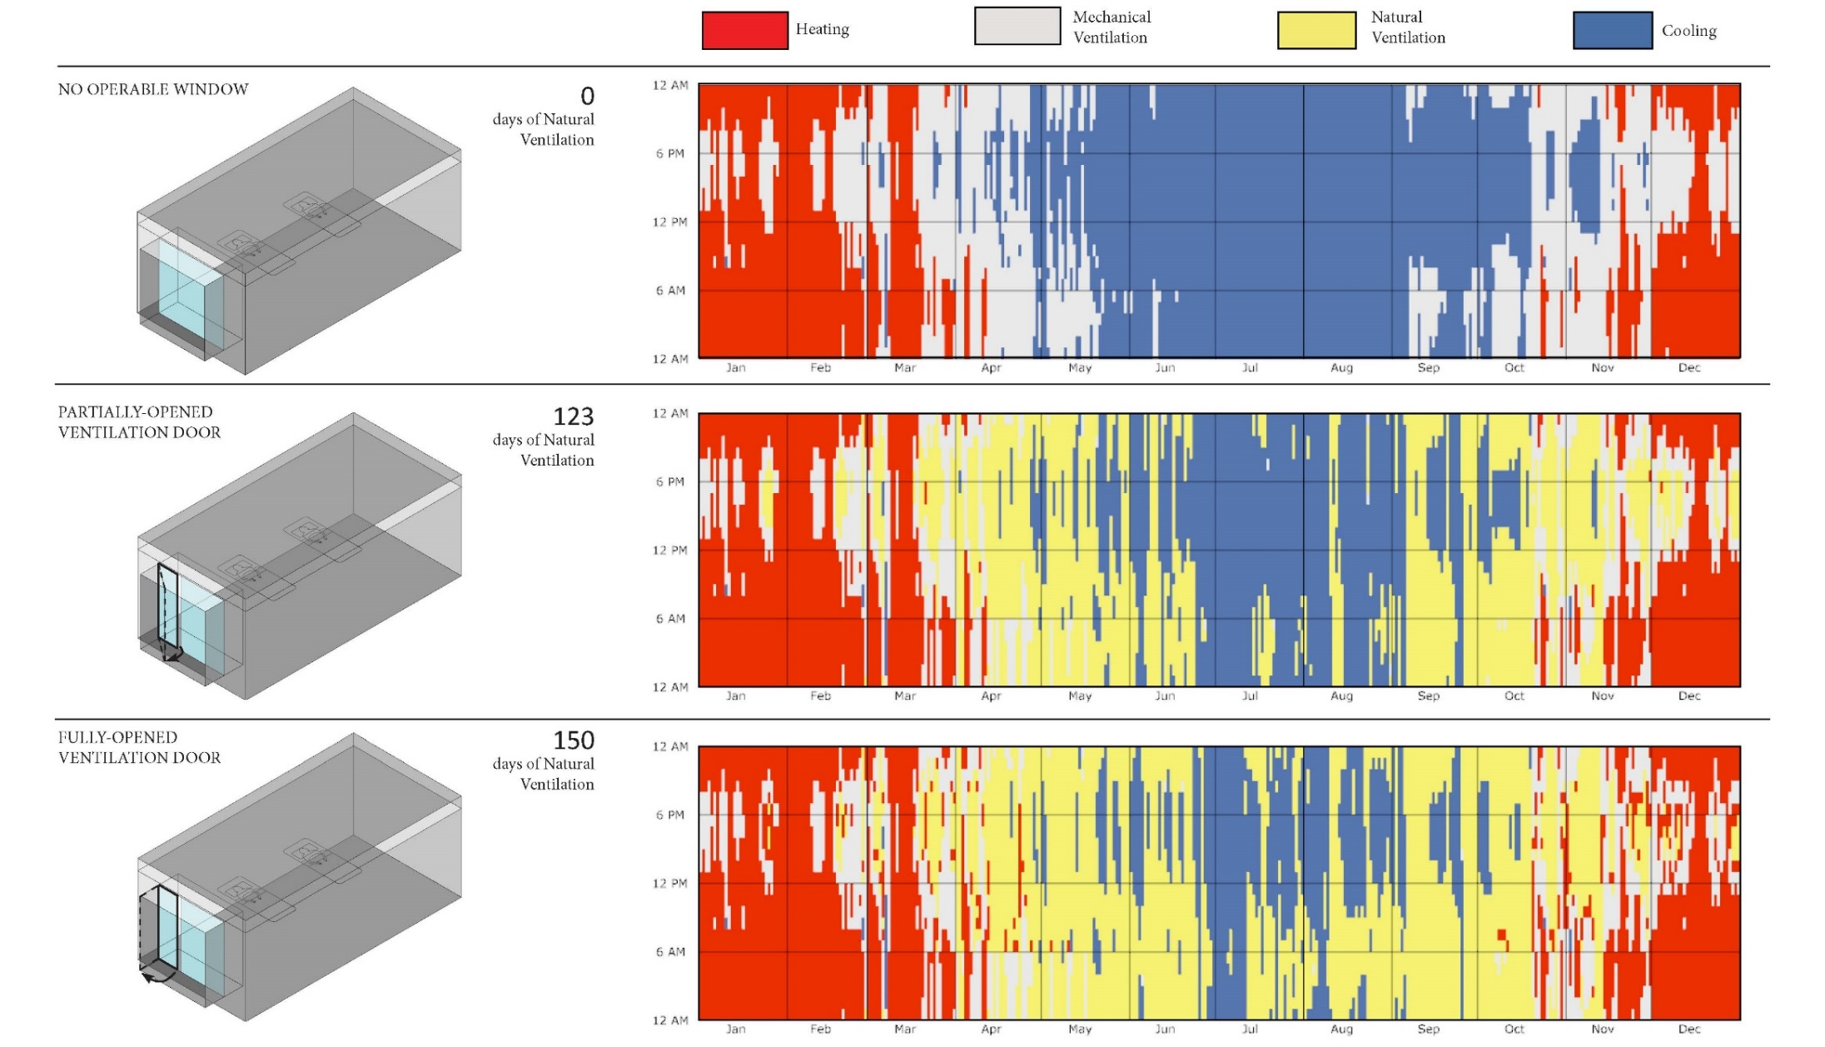
CAN WE NATURALLY VENTILATE THE HOSPITAL FOR 10 MONTHS OF THE YEAR?

Slide 32
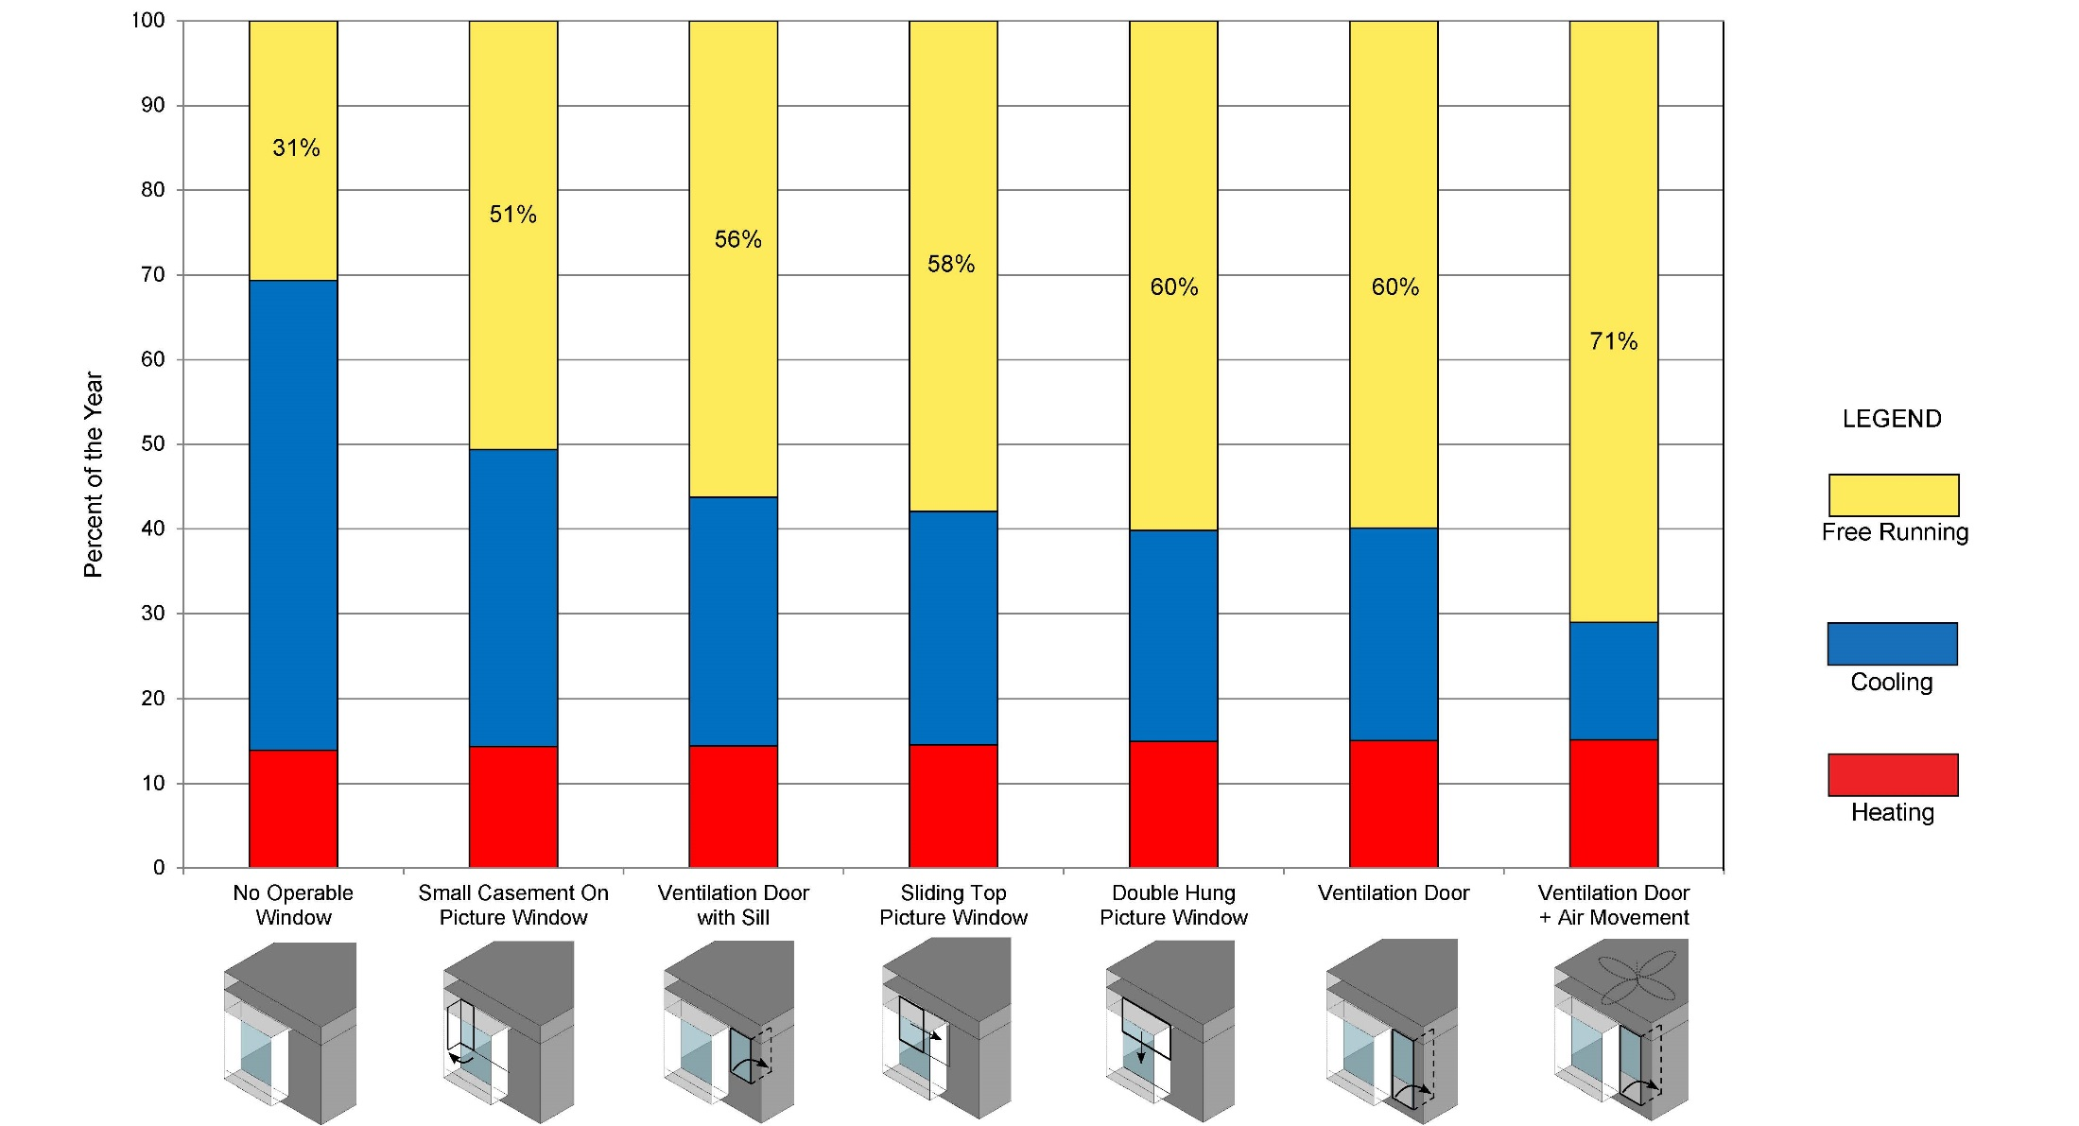
CAN WE NATURALLY VENTILATE THE HOSPITAL FOR 10 MONTHS OF THE YEAR?

Slide 33
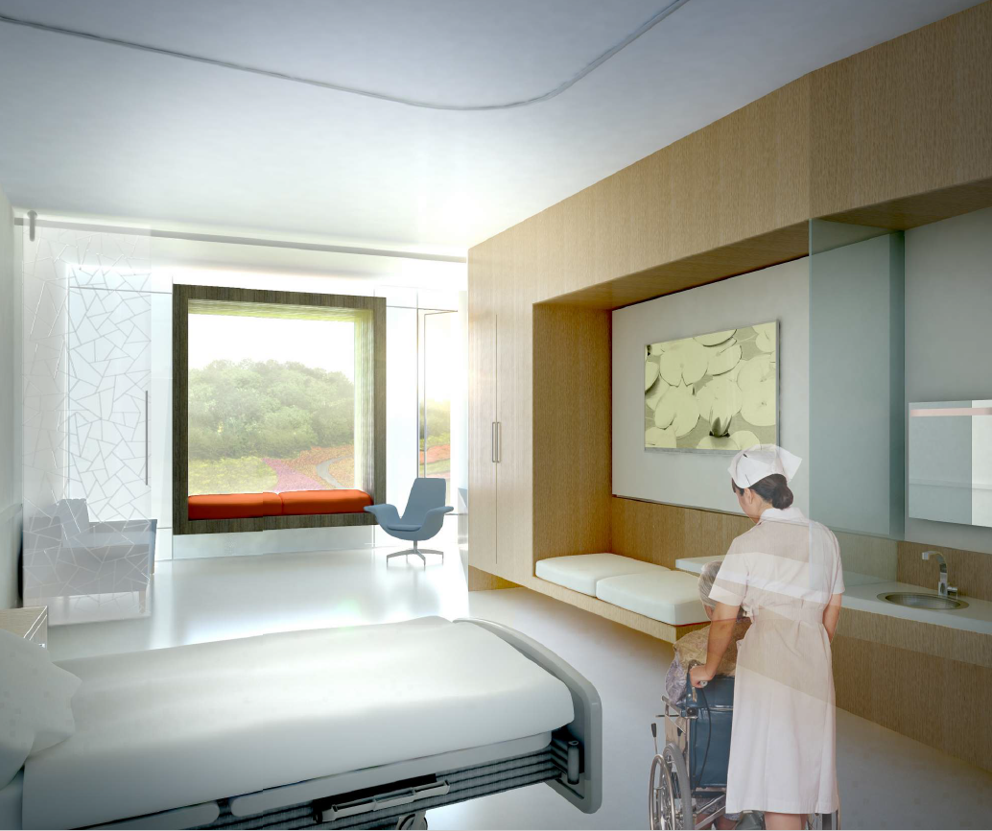
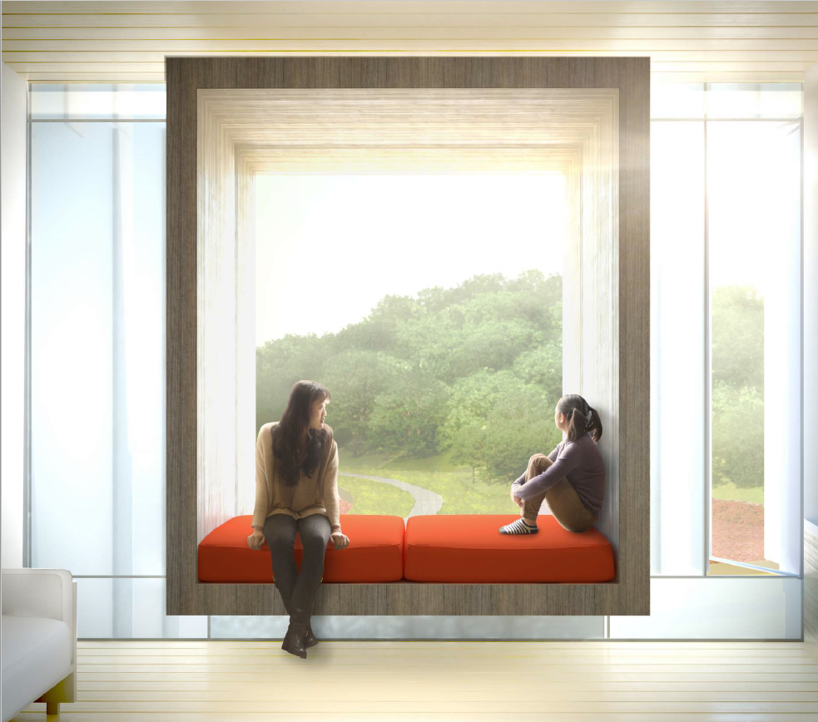
CAN WE CREATE A COMFORTABLE EXPERIENCE IN THE WINDOW BOX?

Slide 34
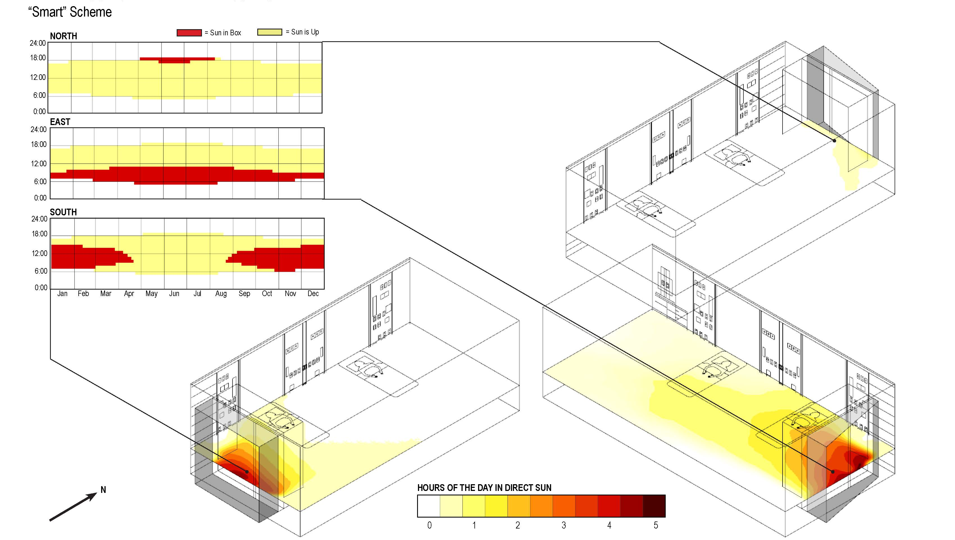
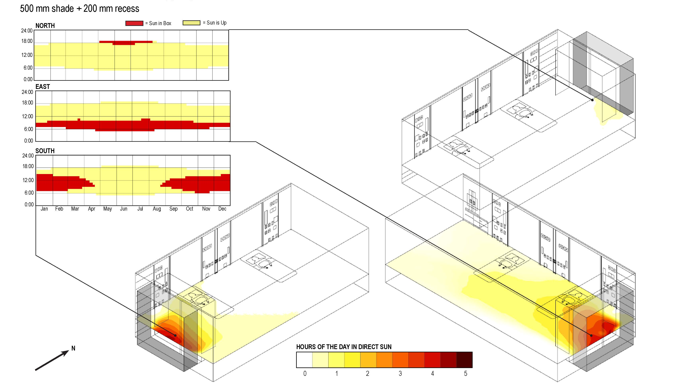
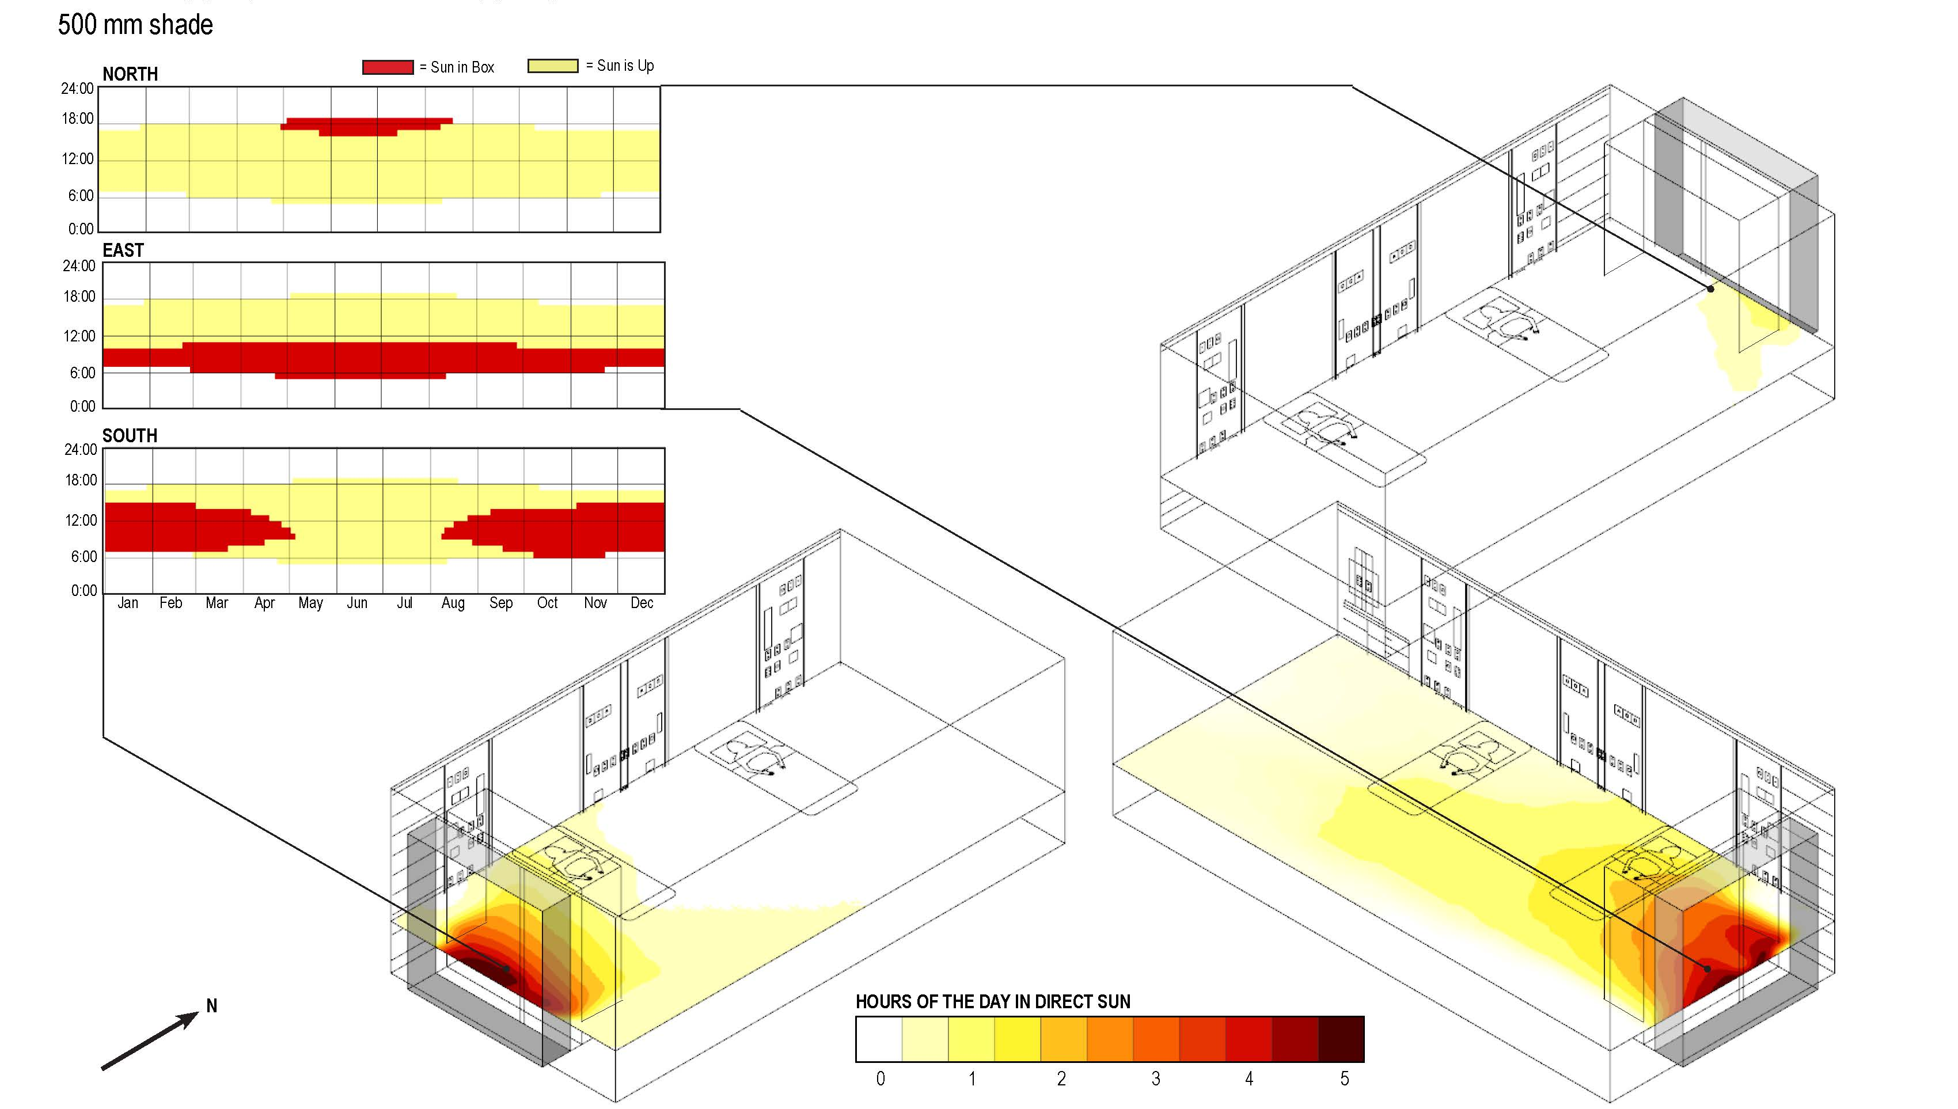
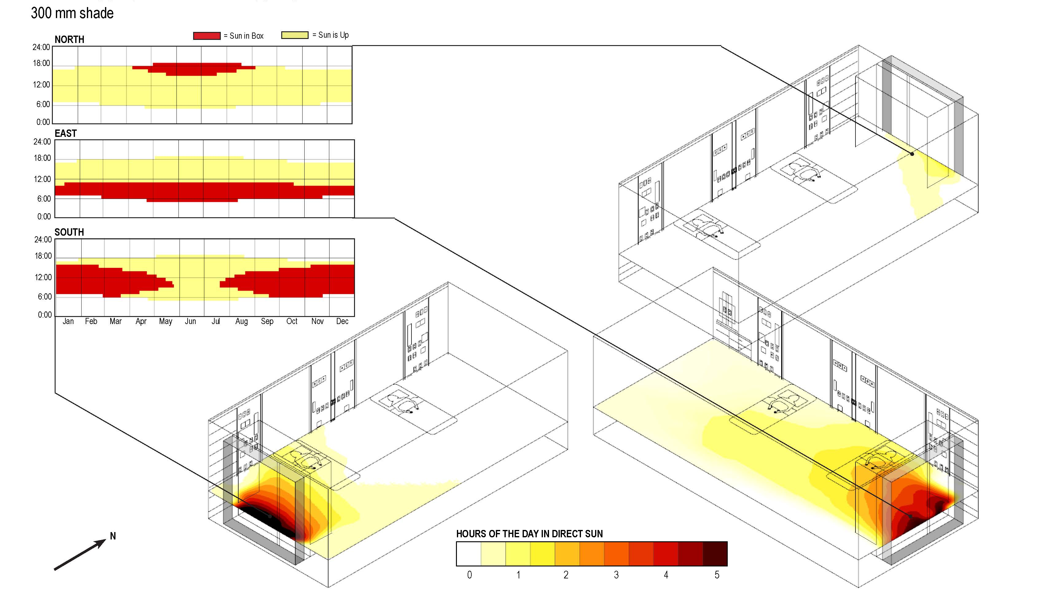
CAN WE CREATE A COMFORTABLE EXPERIENCE IN THE WINDOW BOX?
Direct Sun Study

Slide 35
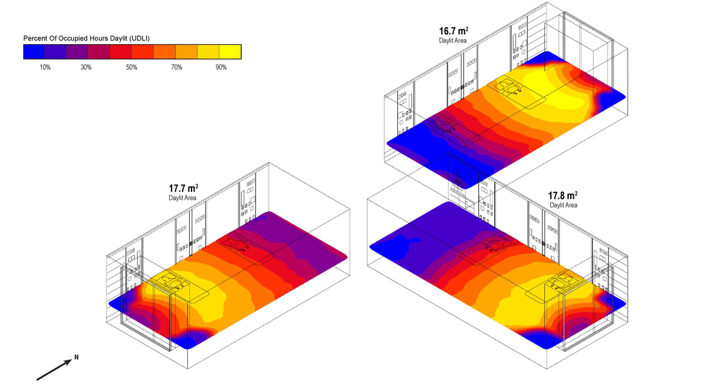
CAN WE CREATE A COMFORTABLE EXPERIENCE IN THE WINDOW BOX?
Daylight

Slide 36
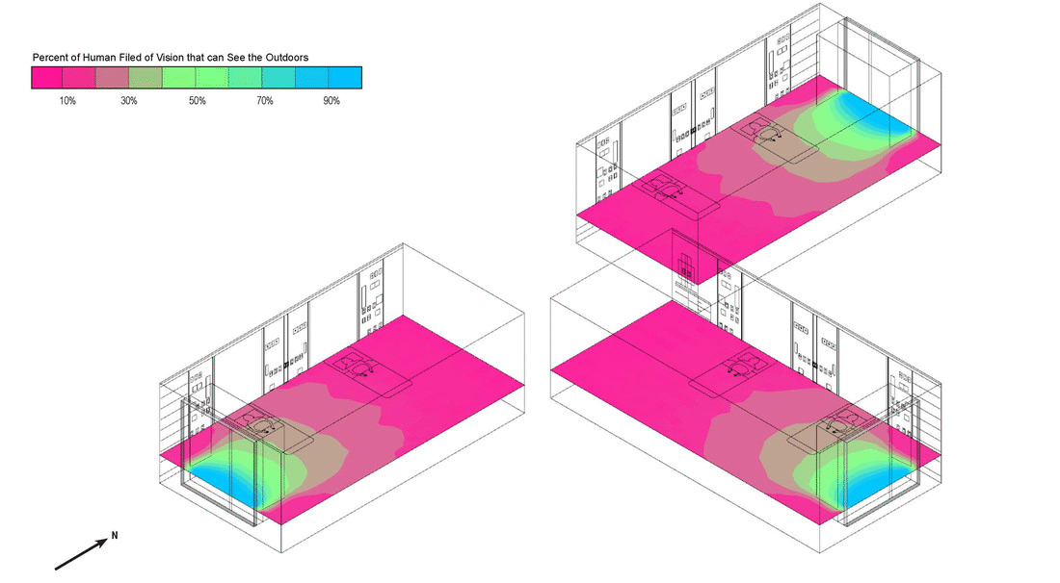
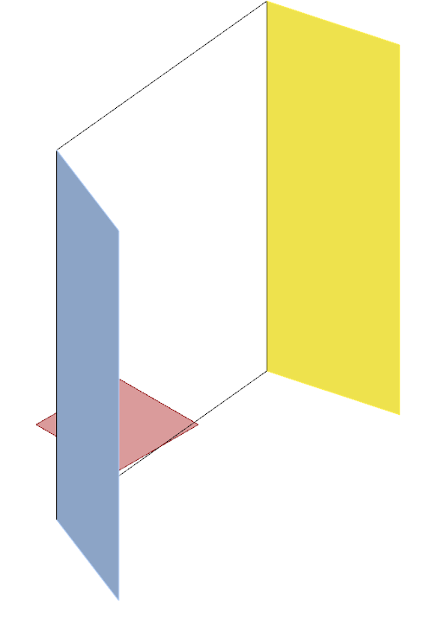
CAN WE CREATE A COMFORTABLE EXPERIENCE IN THE WINDOW BOX?
45
vectors blocked
6
vectors blocked
Sun Vectors
Occupant Location
Views

Slide 37
HOW CAN WE PROTECT PERFORMANCE AND DESIGN IN VALUE ENGINEERING?

Slide 38
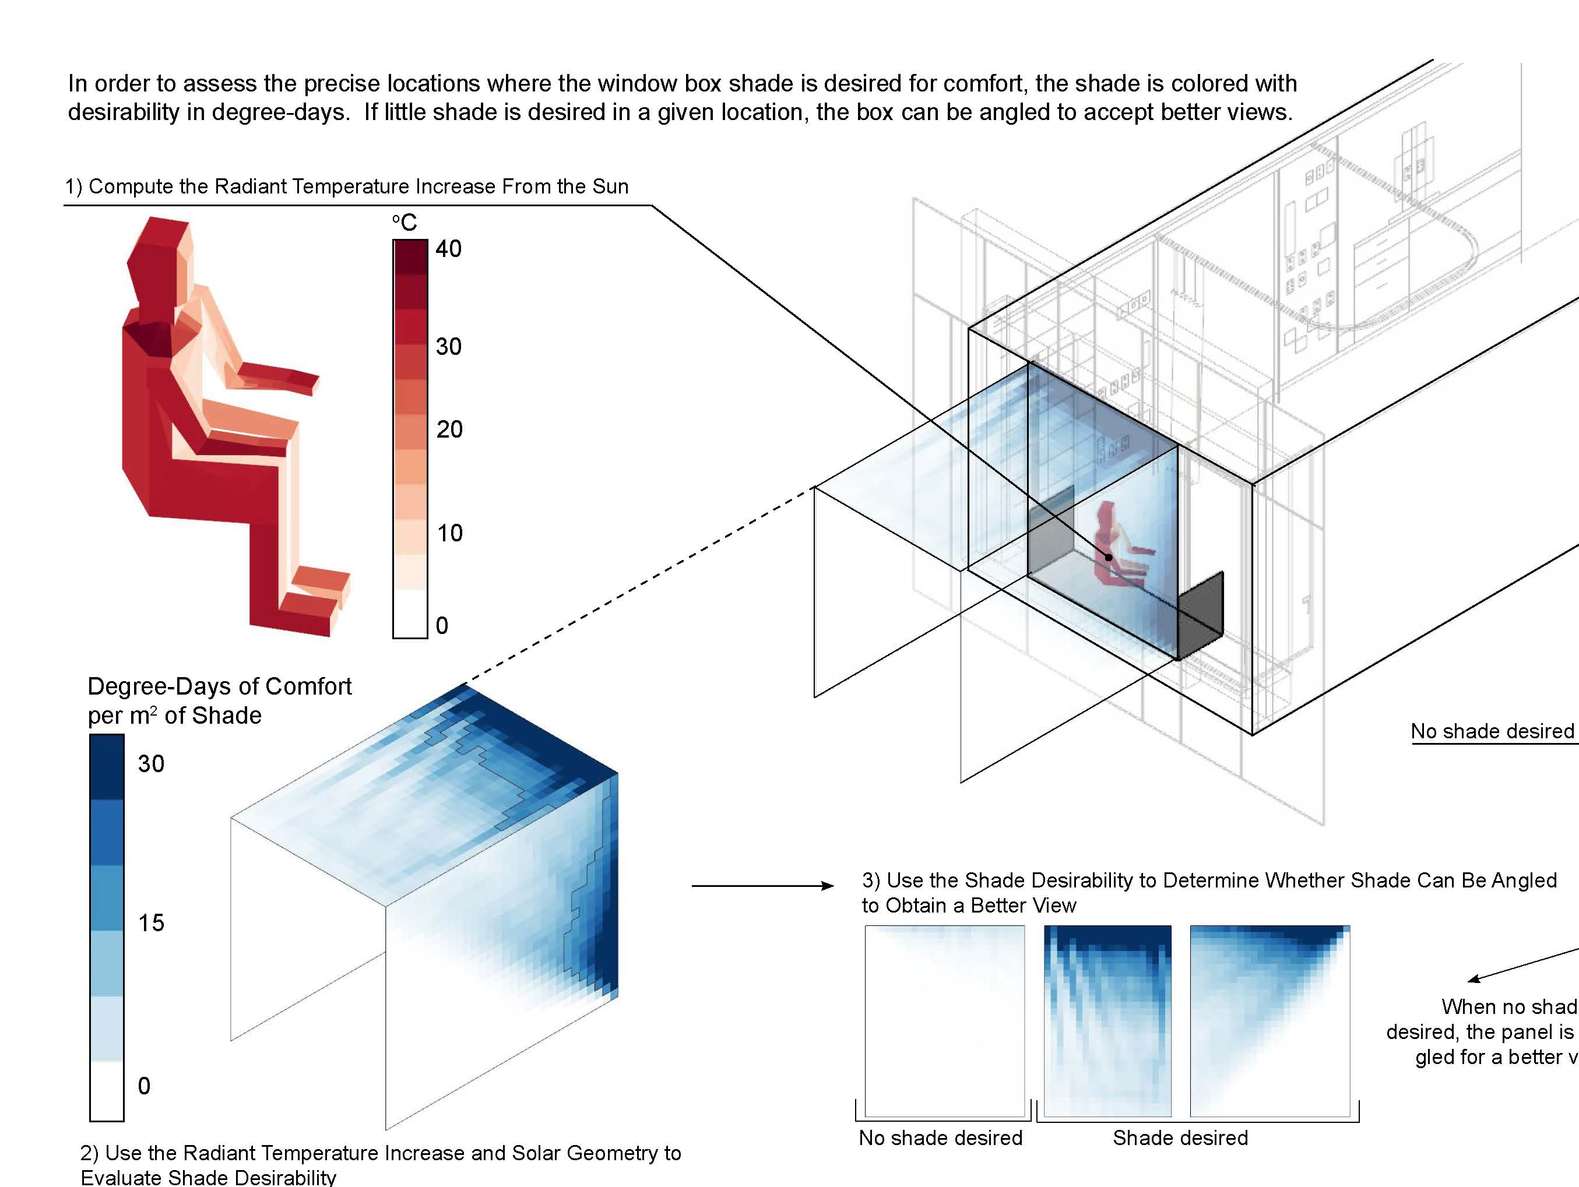
HOW CAN WE PROTECT PERFORMANCE AND DESIGN IN VALUE ENGINEERING?

Slide 39
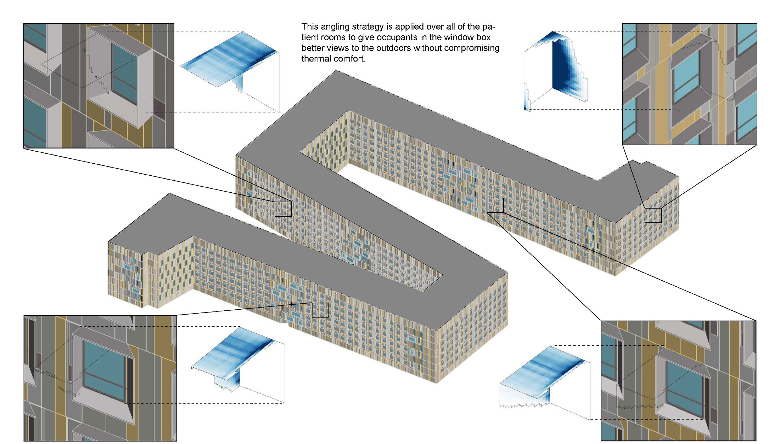
HOW CAN WE PROTECT PERFORMANCE AND DESIGN IN VALUE ENGINEERING?

Slide 40
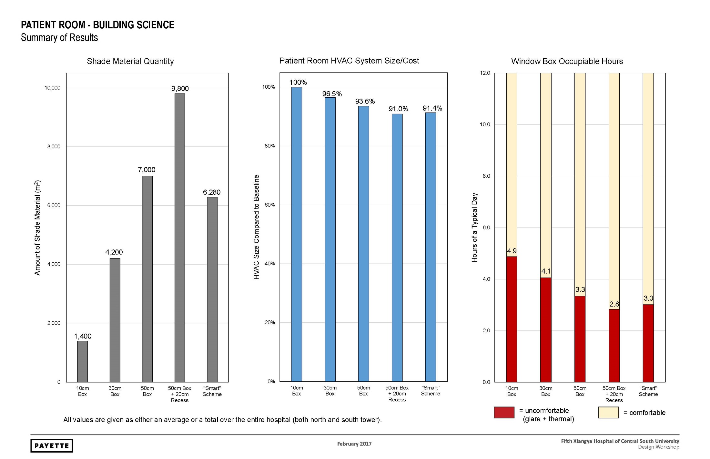
HOW CAN WE PROTECT PERFORMANCE AND DESIGN IN VALUE ENGINEERING?
Shade Material Quantity
HVAC System Size / Cost
Window Box Comfort
10 cm
30 cm
50 cm
70 cm
“smart”
10 cm
30 cm
50 cm
70 cm
“smart”
10 cm
30 cm
50 cm
70 cm
“smart”

Slide 41
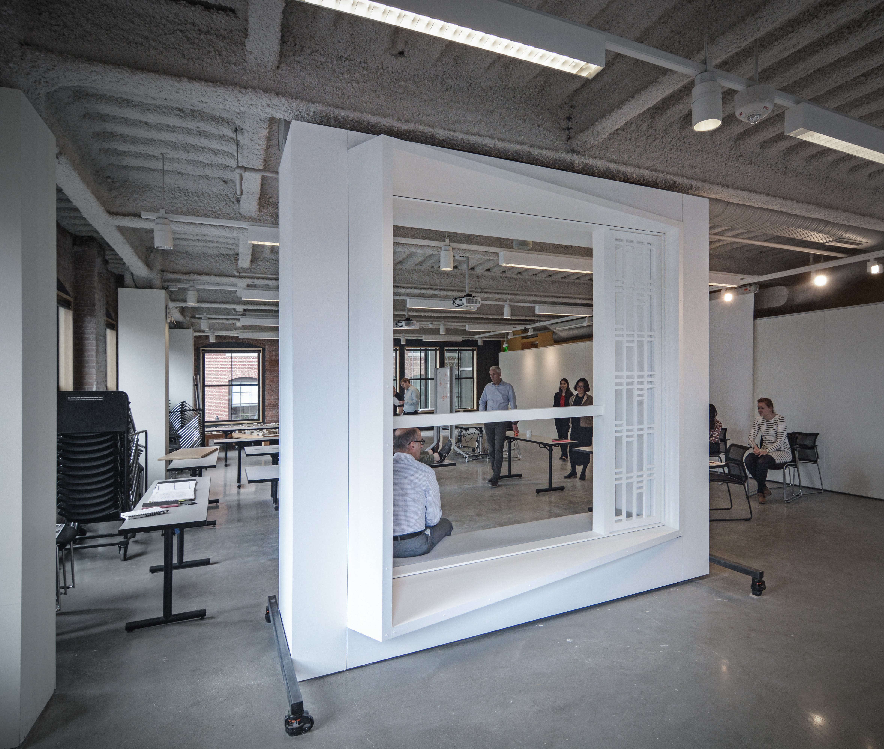
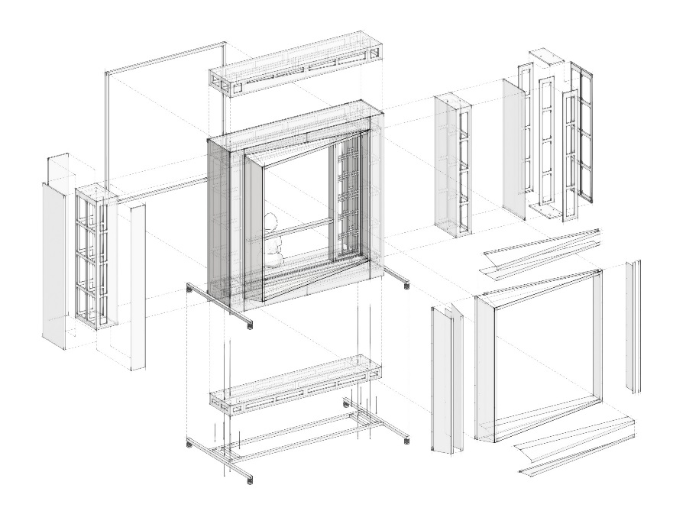

Slide 42
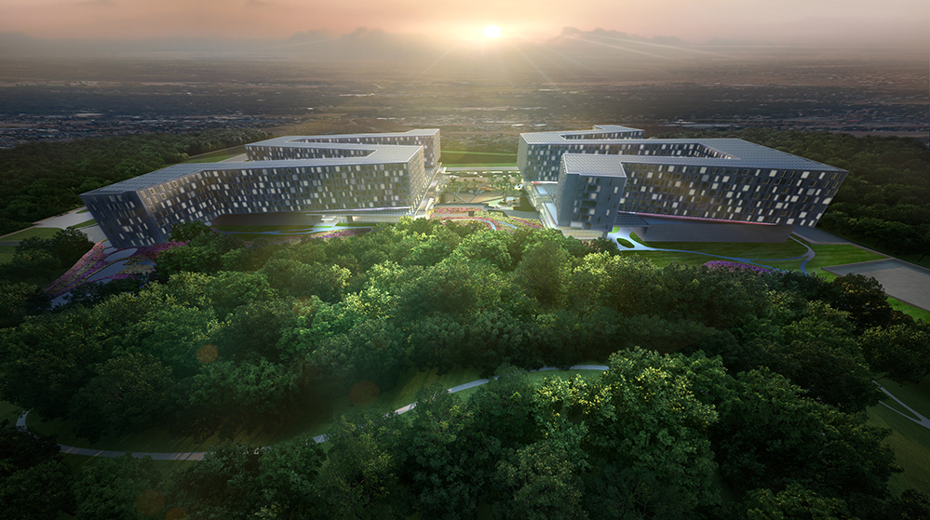
100%
97%
60%
of required energy generated cleanly on site
of the year natural ventilation for patient rooms
of annual non-potable water demand supplied by on-site wastewater treatment plant

Slide 43
Questions?

