Slide 1
Lara Engineering
And architecture
Helping Build Your Dream
Jake Lara
Founder and CEO

Slide 2
The Problem
Engineering is an ever-changing, ever-expanding, and innovative field with an increasing demand for greener architecture.
There are also a large number of people that are hesitant to become green, in fear of the initial costs and in some cases the “Lifestyle”

Slide 3
A Little History
I have wanted to be an architect since I was six years old
I am going to school for:
BS in Architectural Engineering
BS in Business Administration
BS in Architecture
I never thought to become a green architect, but after talking to some potential customers and a few architects, it appears that is the field to go into.

Slide 4
The Solution
Design green homes
Educate potential clients on the benefits of going green
Lara Engineering
And architecture

Slide 5
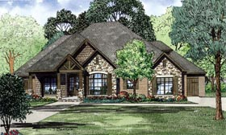
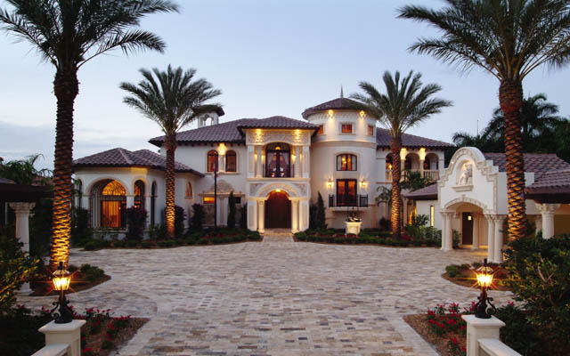
Lara Engineering
And architecture
The primary goal of my company is to design green homes and educate those that are hesitant to make the switch
I feel that this is a smart niche in architecture, because technology is always changing, and architectural engineers are finding more ways and materials in which they can construct green homes.

Slide 6
Lara Engineering
And architecture
With me being sole employee for a few years, I will make projects very personal.
When a family hires an architect, they want someone:
They know they can trust
That will do the job in the cheapest way possible
That will educate them in the areas they do not understand
That is where my company is different than its competitors

Slide 7
Lara Engineering
And architecture
Everyone wants a place to come home to that feels like home.
My company slogan is to Help Build Your Dream.
Lara Engineering and Architecture will work with those that are making the move toward a greener home or business. And it will show them that being green isn’t just a lifestyle, but there are building technologies that will help you live a cheaper and healthier life.

Slide 8
Lara Engineering
And architecture
Sales
Sales will be billed by the hour
Typical architects and engineers charge $175+/HR for their projects

Slide 9
Lara Engineering
And architecture
Marketing
Based in Las Angeles, CA
California, Arizona, and Nevada are becoming states with more and more greener homes and technology.
Facebook-Social media has become a huge aspect of advertising for a lot of businesses
Word of mouth
Register at AIA Events, local events, BE PERSONAL

Slide 10
Lara Engineering
And architecture
Revenue Model
Every engineering project is different.
There will be a few huge expenses in the beginning
With only me working the first few years, I will keep all profit

Slide 11
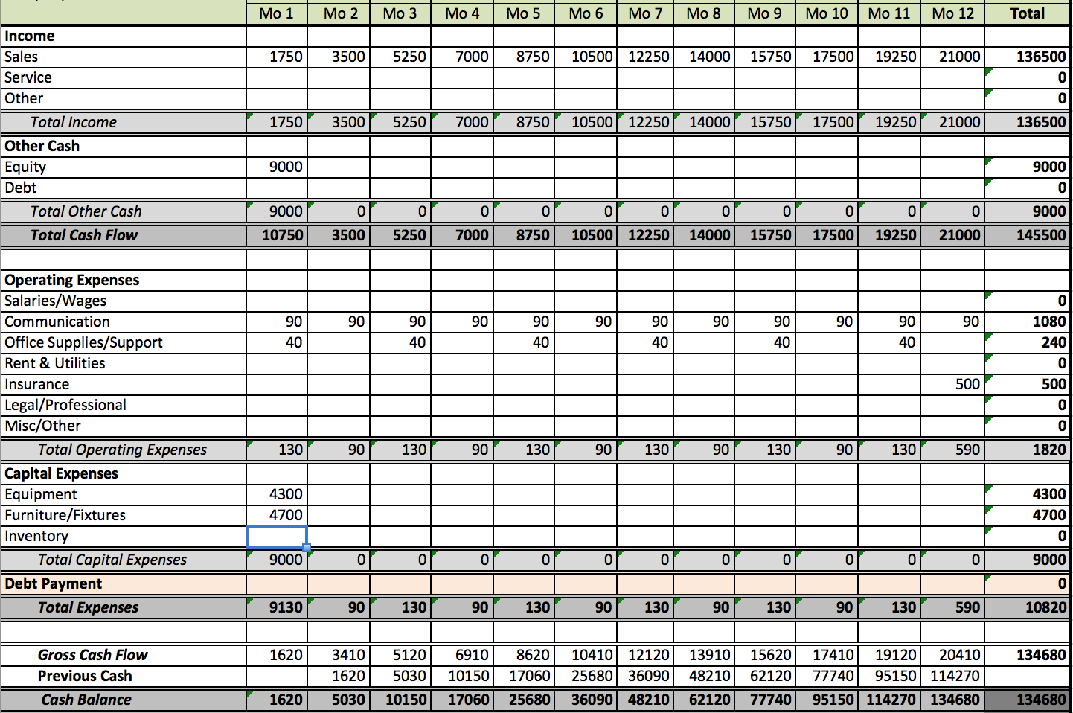

Slide 12
Lara Engineering
And architecture
Start-Up
Be Yourself
Start SMALL.
Fund with private and family donors
Register with the Local Business Enterprise
Expand business by picking up more projects
Around 10 more hours per month and do Pro-bono work
Be INNOVATIVE
Advertise “Green Architecture”

Slide 13
Lara Engineering
And architecture
Start-Up
Enter competitions
OWN your projects
Partner with bigger firms
Network with everyone

Slide 15
http://www.familyhomeplans.com/plan_details.cfm?PlanNumber=82162
http://www.design2buildoc.com/residential-commercial-design/residential-design/luxury-home-design/
http://messagenote.com/exterior/11-contemporary-skyscrapers
https://uminfopoint.umsystem.edu/media/fa/management/facilities/docs/Architectural%20and%20Engineering%20Basic%20Services%20Fee%20Estimating%20Guidelines%20v4.pdf
http://architizer.com/blog/how-to-start-your-own-firm/
http://www.aia.org

