Slide 1
From Ancillary to Essential: Technology’s Role in Healthcare Design and Operations
March 12, 2019
Liz Schmitz AIA, EDAC, LEED AP
Stantec

Slide 2
From Ancillary to Essential: Technology’s Role in Healthcare Design and Operations
March 12, 2019
Liz Schmitz AIA, EDAC, LEED AP
Stantec

Slide 3
HC 101 Series
As part of the Academy’s multi-channel, on-line approach, these sessions provide emerging and experienced professionals with convenient and economical opportunities to develop their chosen area of interest.
The HC 101 series provides new members of healthcare centric practices with exposure to healthcare design fundamentals.

Slide 4
Copyright notice
This presentation is protected by US and International Copyright laws. Reproduction, distribution, display and use of the presentation without written permission of the speaker is prohibited.
© The American Institute of Architects (2019)

Slide 5
Compliance Statement
“AIA Knowledge” is a Registered Provider with The American Institute of Architects Continuing Education Systems (AIA/CES). Credit(s) earned on completion of this program will be reported to AIA/CES for AIA members. Certificates of Completion for both AIA members and non-AIA members are available upon special request.
This program is registered with AIA/CES for continuing professional education. As such, it does not include content that may be deemed or construed to be an approval or endorsement by the AIA of any material of construction or any method or manner of handling, using, distributing, or dealing in any material or product.

Slide 6
AIA/CES Reporting Details
In order to receive 1 AIA LU/HSW credit, each attendee must complete the webinar survey at the conclusion of the presentation.
A link will be provided in the chat box and included in a follow-up email one (1) hour after the webinar to the individual who registered your site.

Slide 7
Questions?
Submit a question to the moderator via the chat box.
Content-related questions will be answered during the Q&A portion, at the end of the presentation, as time allows. Any questions not answered during Q&A, will be answered and posted online within two (2) weeks.
Tech support questions will be answered by AIA staff promptly.

Slide 8
Liz Schmitz, AIA, EDAC, LEED AP
Stantec

Slide 9
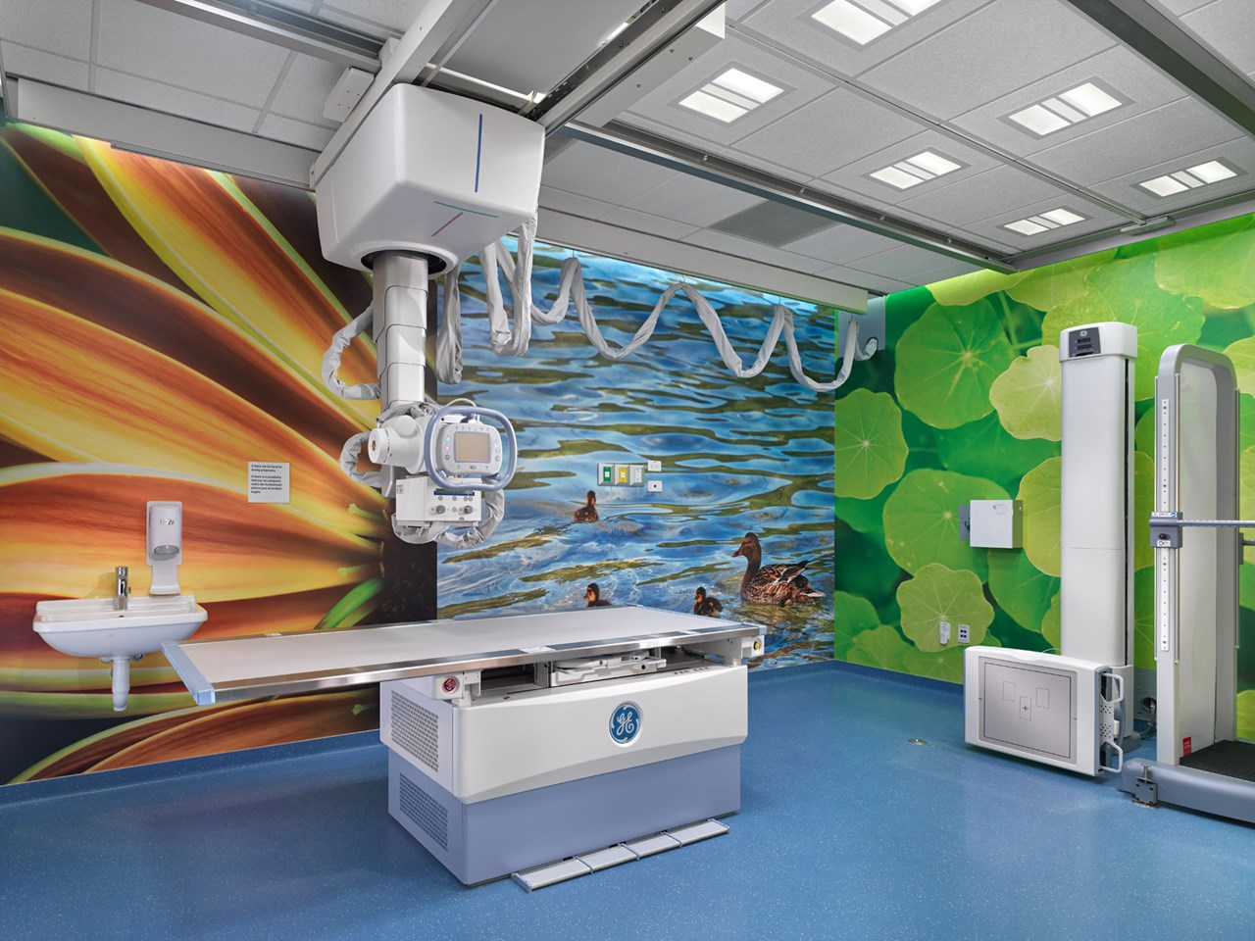
From Ancillary to Essential: Technology’s Role in Healthcare Design and Operations

Slide 10
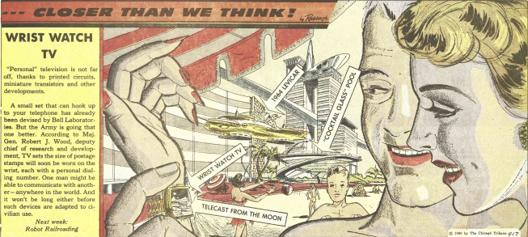
Then…
Arthur Radebough, 1950’s Illustrator

Slide 11
Now…

Slide 12
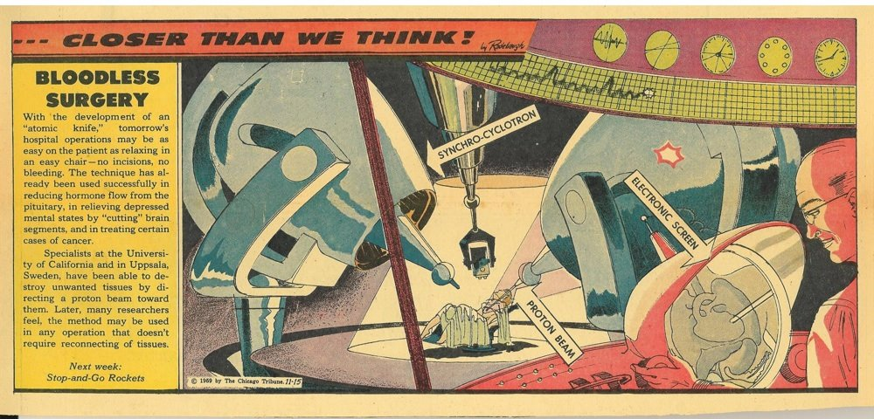
Then…then
Arthur Radebough, 1950’s Illustrator
Arthur Radebaugh, 1950’s illustrator

Slide 13
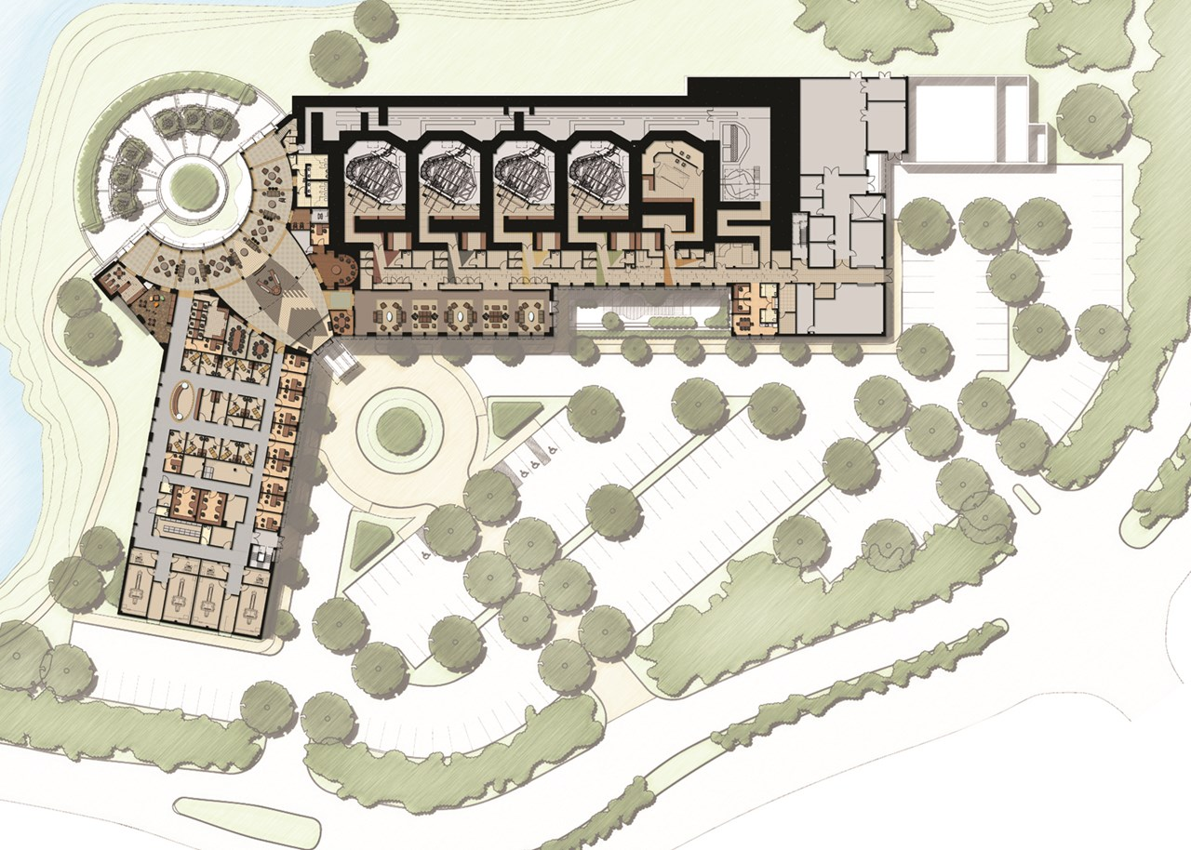
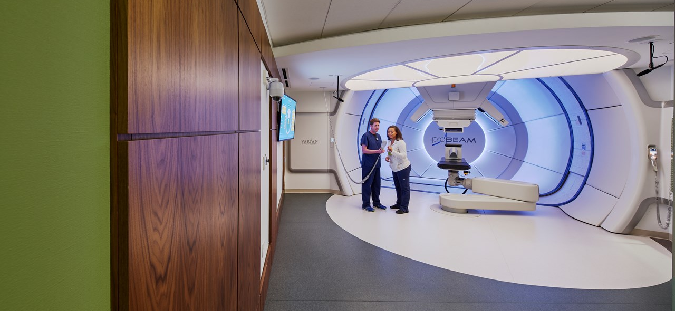
Now…
Emory University Proton Therapy Center

Slide 14
Then…
Arthur Radebough, 1950’s Illustrator

Slide 15
Now…

Slide 16
Then…
Facility Master Plan
Technology

Slide 17
Now…
Facility Master Plan
Technology Master Plan

Slide 18
Now…
Equipment
Infrastructure
User Experience
Operations
Facility Master Plan
Technology Master Plan

Slide 19
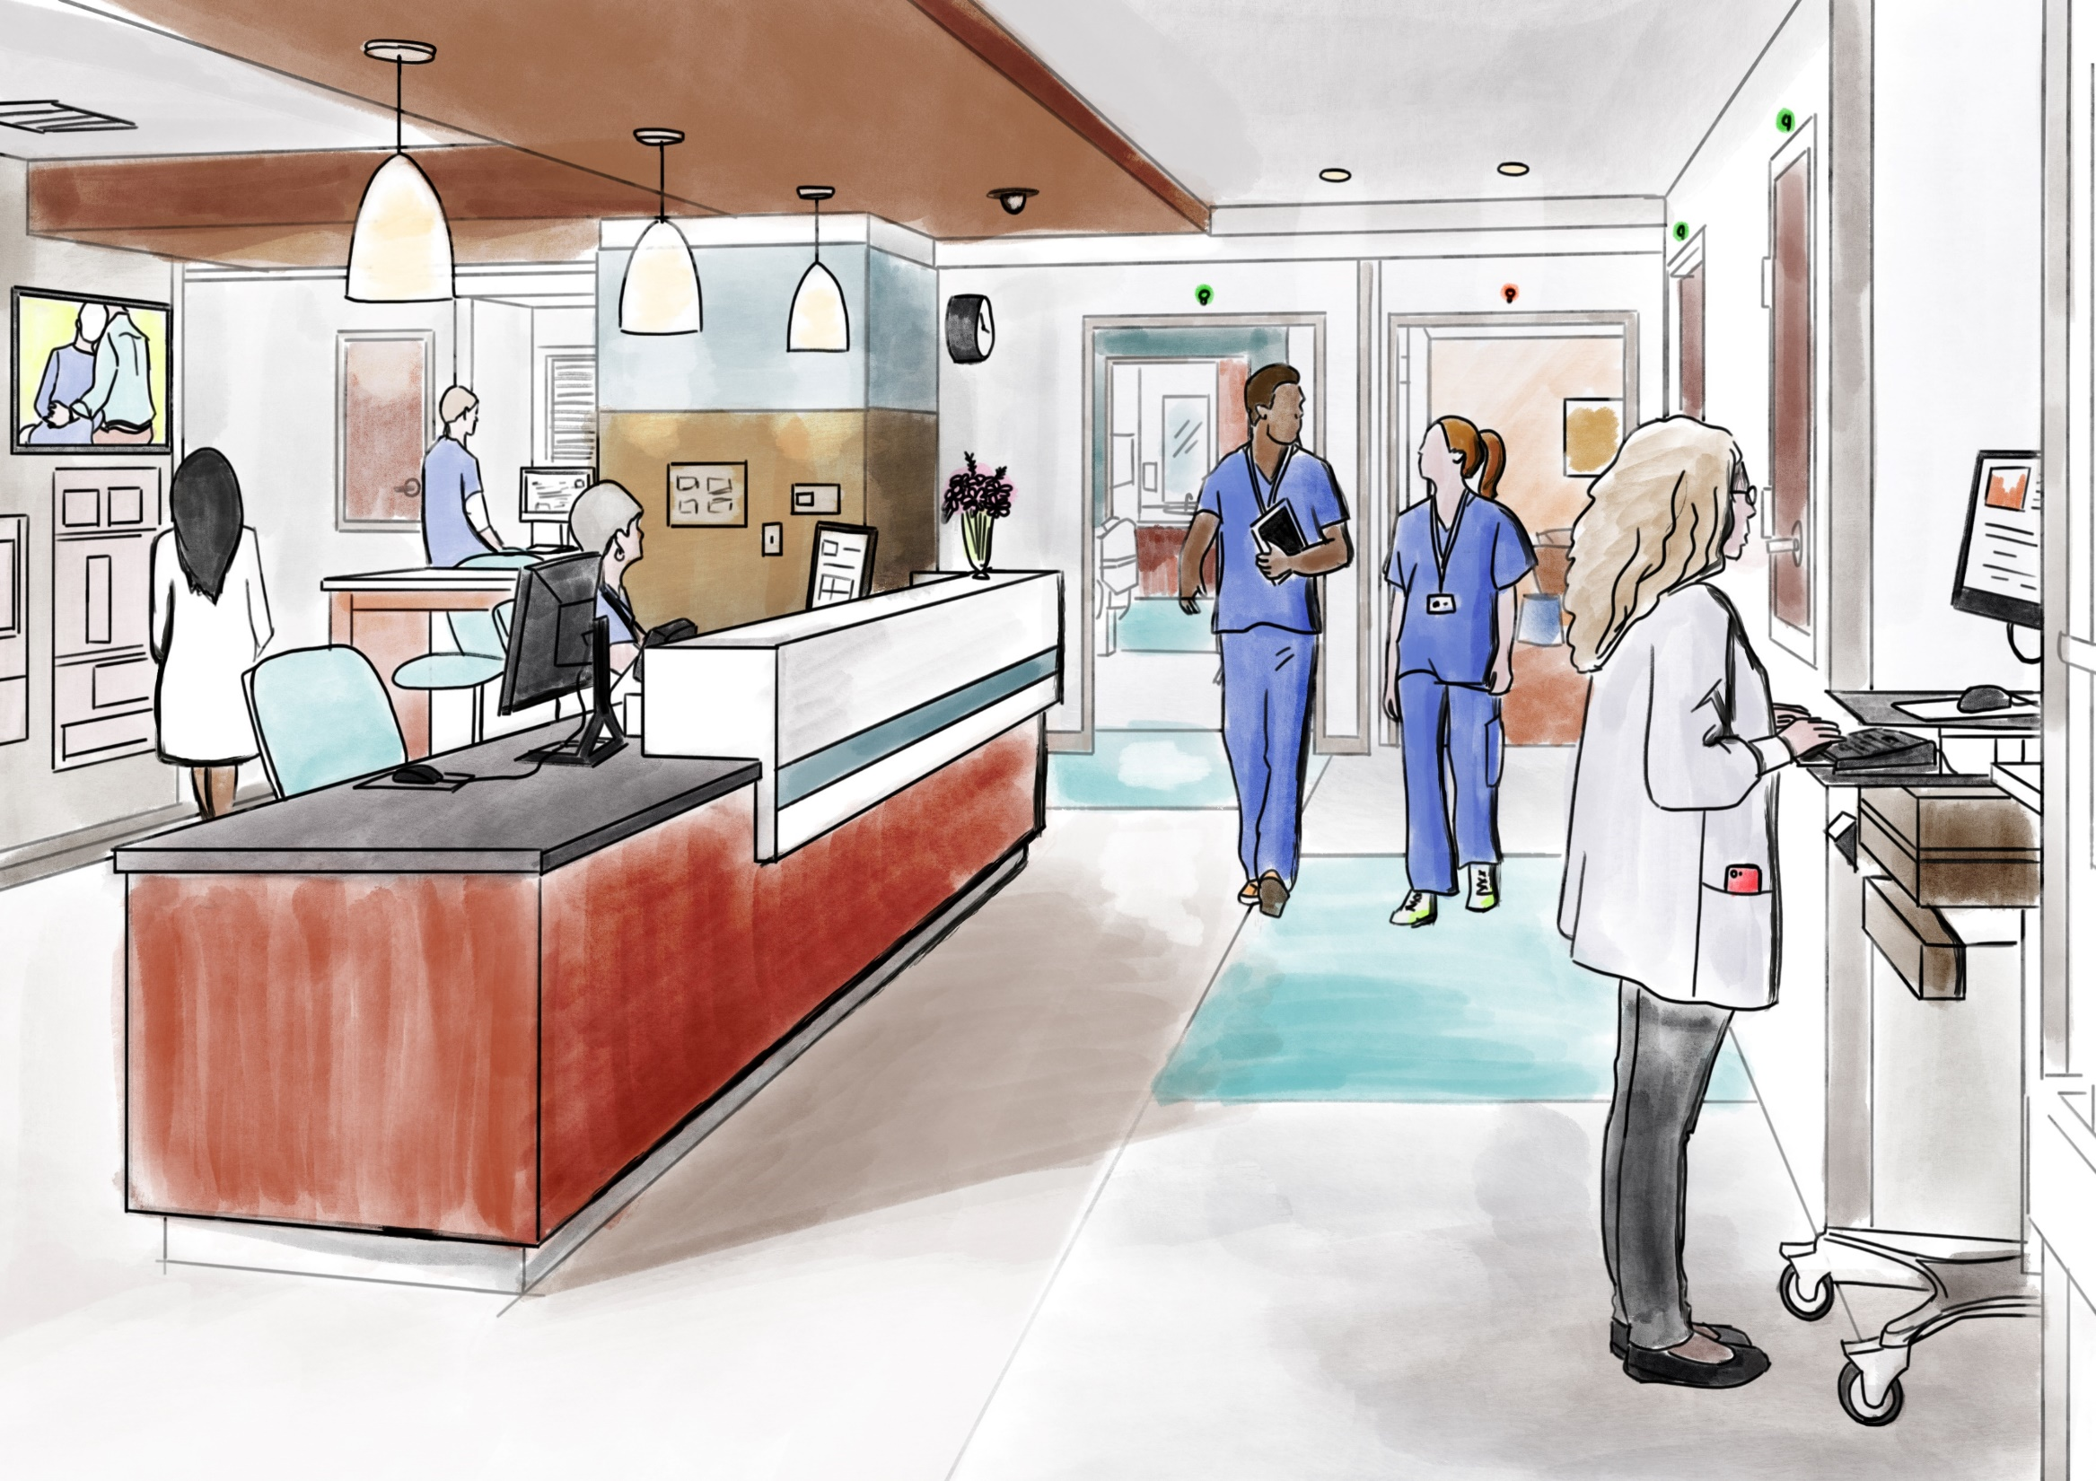
Quiz
How many pieces of technology do you see?

Slide 20
Technology from Three Perspectives:
Patient
Operations
Care Providers

Slide 21
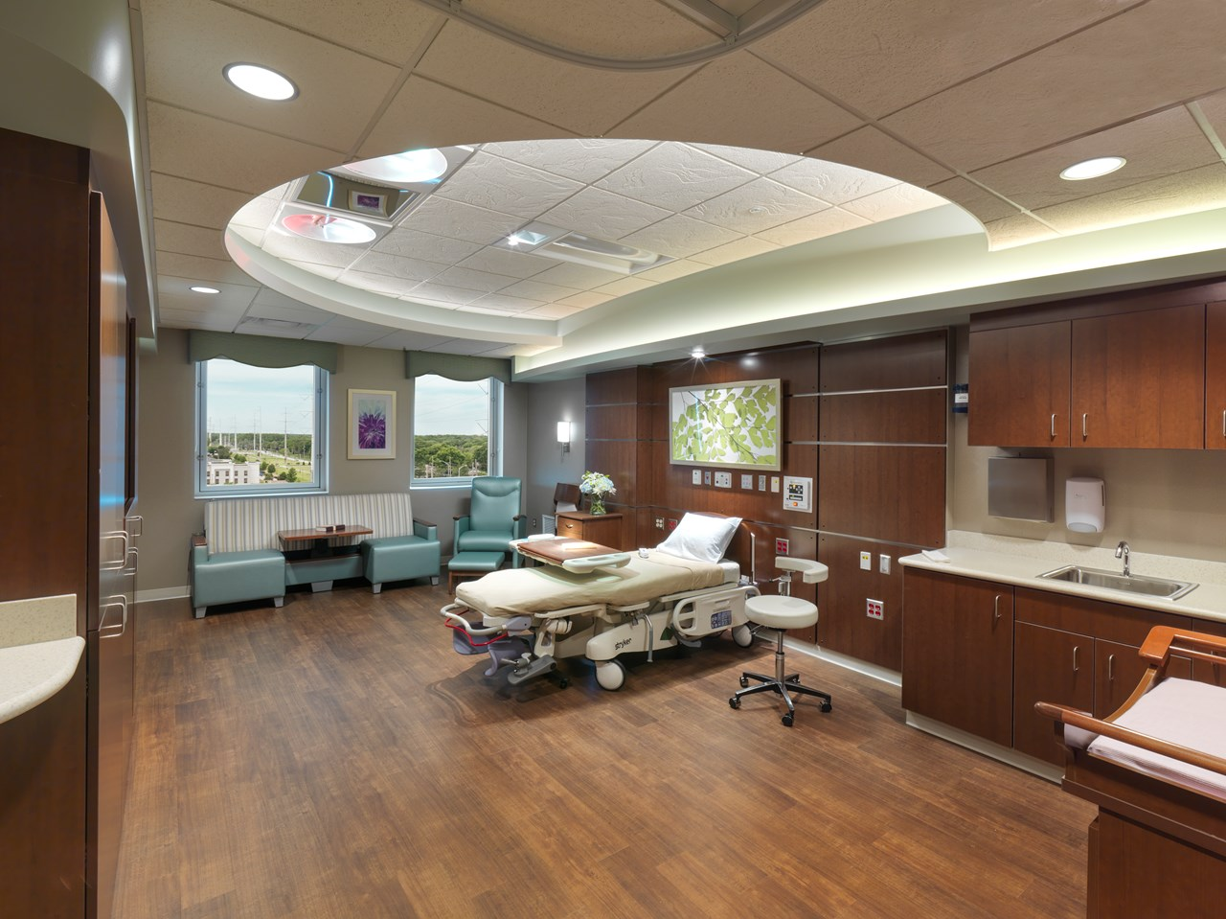
Technology from the Patient’s Perspective
Virtual
Care Environment
Outpatient / Community Setting
Hospital
Setting

Slide 22
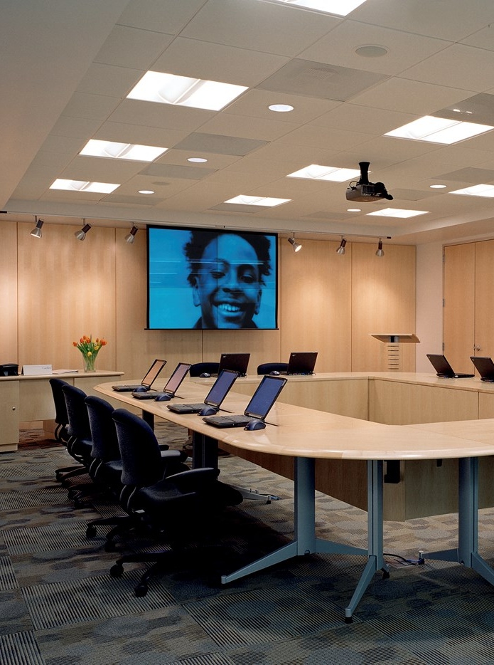
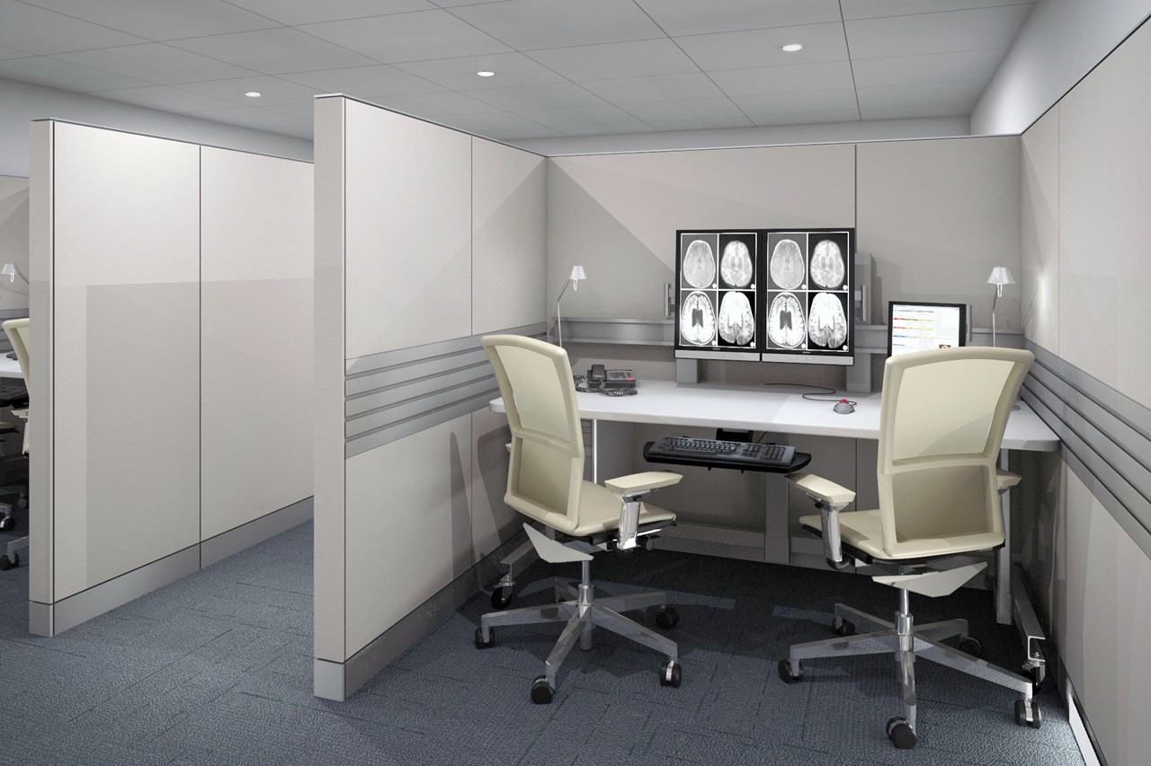
Virtual Medicine
Telehealth
Charleston Area Cancer Center

Slide 23
Technology from the Patient’s Perspective
Virtual
Care Environment
Outpatient / Community Setting
Hospital
Setting

Slide 24
Community Wellness Center
Higher Acuity:
Sicker Patients
Older Demographic
Complex Care
Charleston Area Cancer Center

Slide 25
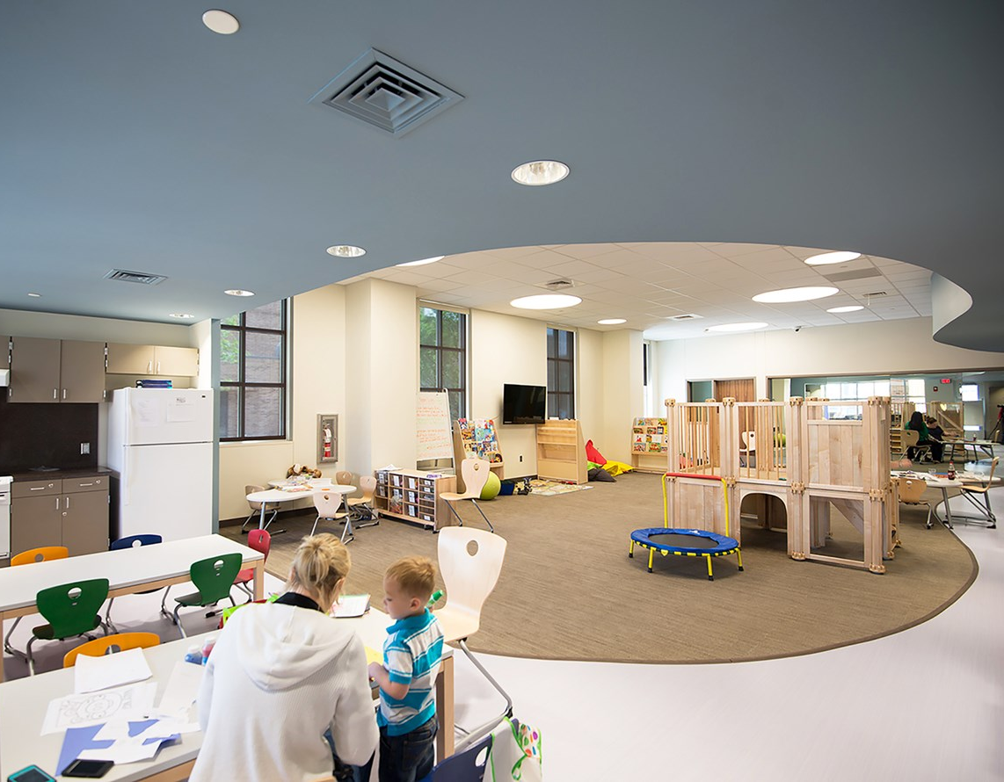
Community Wellness Center
Autism Treatment
Evidence-Based Design Goal:
1
Control stimuli from lights & windows in design for Autism
Burkhart Center for Autism Education and Research

Slide 26
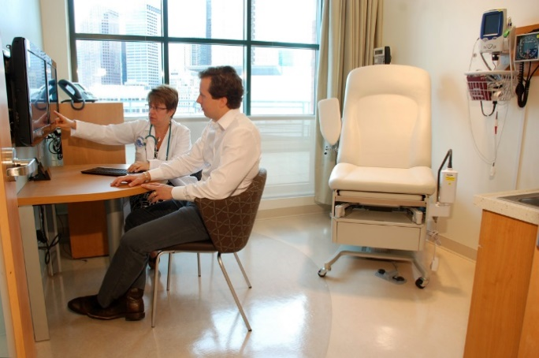
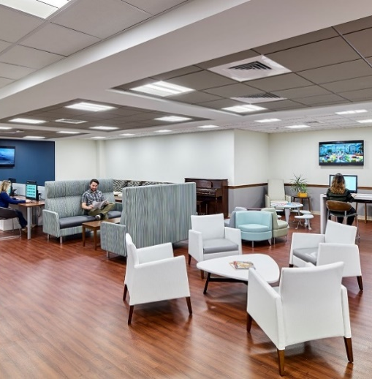
Community Wellness Center
Constant Technology Integration

Slide 27
Technology from the Patient’s Perspective
Virtual
Care Environment
Outpatient / Community Setting
Hospital
Setting

Slide 28
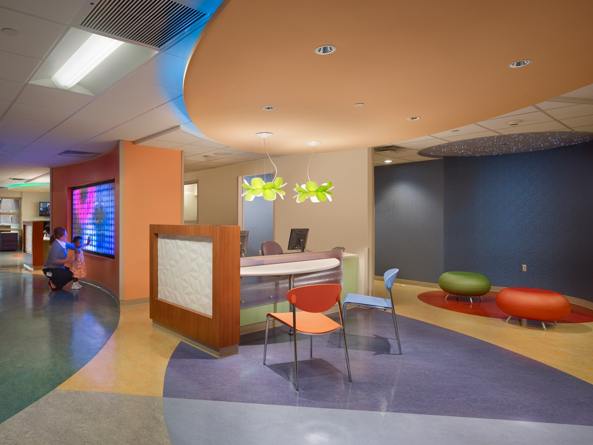
Hospital
Patient Expectations:
Integrated Technology
Enhanced Communication
Higher Quality of Care
Children’s Specialized Hospital Long Term Care Unit
Mountainside, New Jersey

Slide 29
Case Study:
The Childbirth Experience

Slide 30
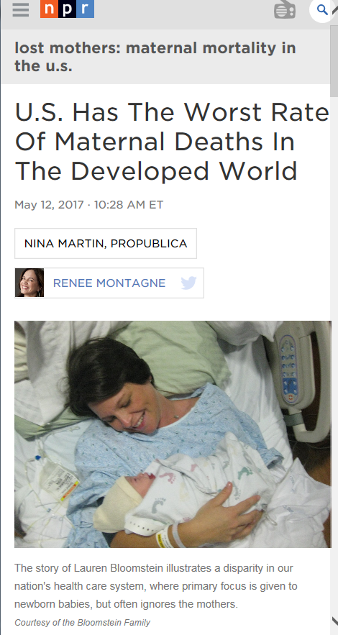
?
Fear
Limited
Mobility
1
Anxiety
Arrival at Hospital
Patient Experience
Pain
Poorer
Outcomes for
Mother & Baby
Sights,
Sounds, Lack
of Control
Challenges with Childbirth in the US

Slide 31
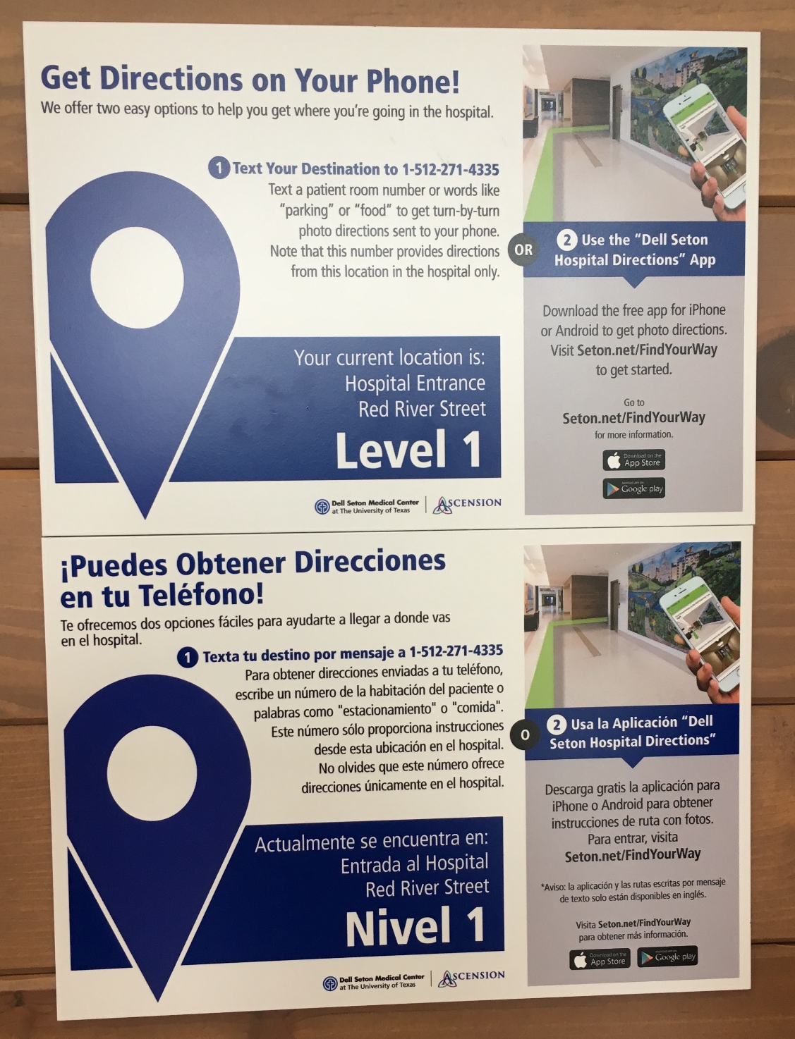
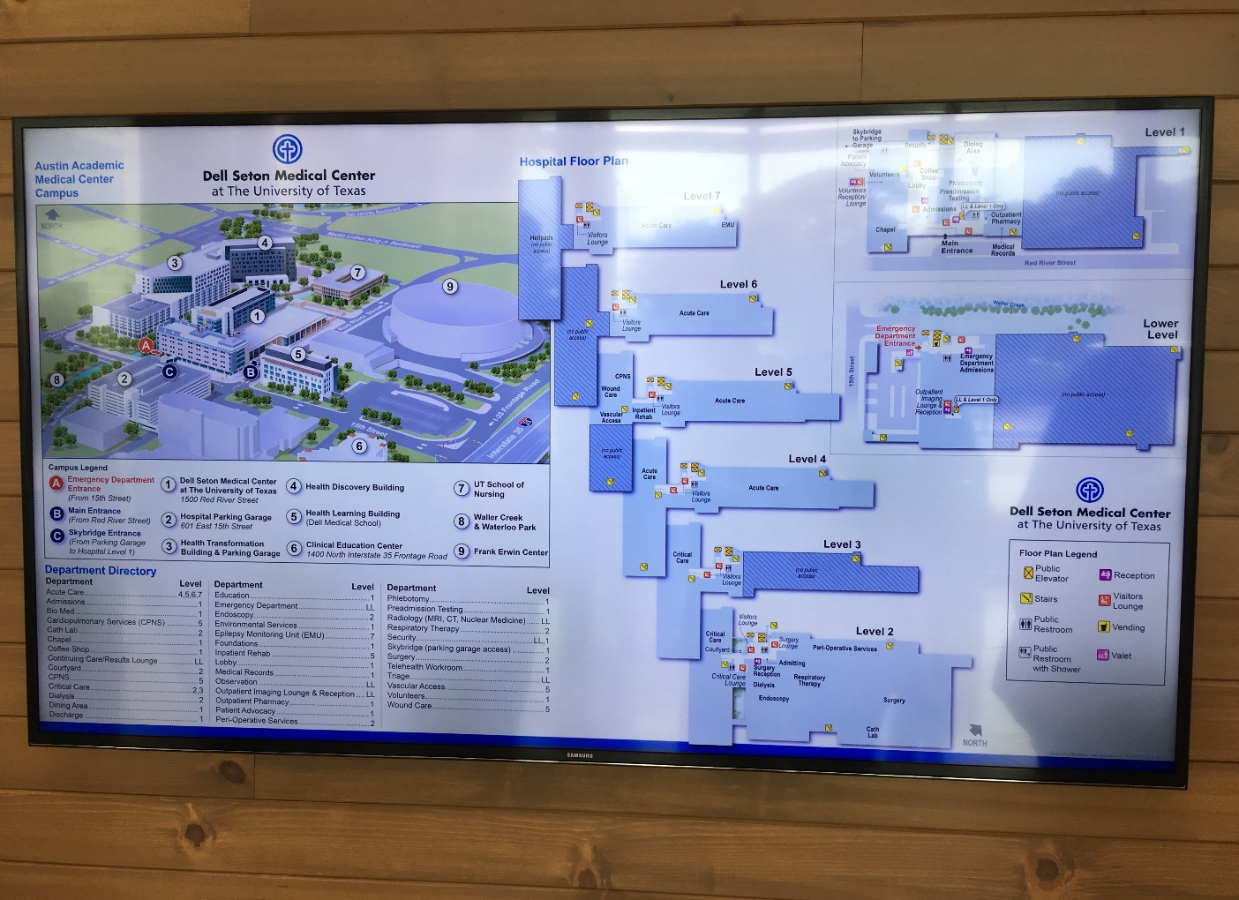
Digital Wayfinding
1
Arrival at Hospital
Evidence-Based Design Goal:
3
Provide for wayfinding to reduce stress

Slide 32
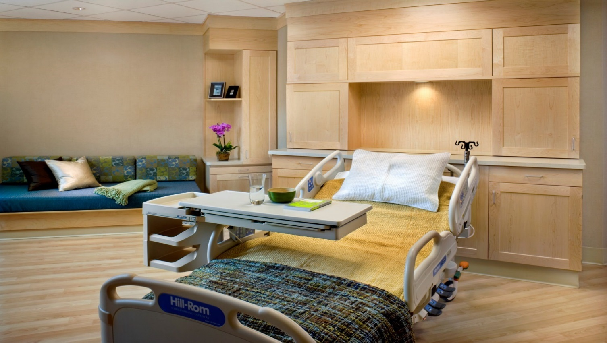
Conceal Medical Equipment
1
Sights, Sounds, Lack of Control

Slide 33
Provide for Positive Distraction
1
Herning Hospital in Jutland, Denmark
https://modos.dk/delivery-room/
Sights, Sounds, Lack of Control
Evidence-Based Design Goal:
2
Provide positive distraction to reduce pain

Slide 34
Patient Control of Environment
1
Sights, Sounds, Lack of Control
Operable blinds
Adjustable lighting
Music options
Temperature controls
Evidence-Based Design Goal:
4
Provide patient with a sense of control

Slide 35
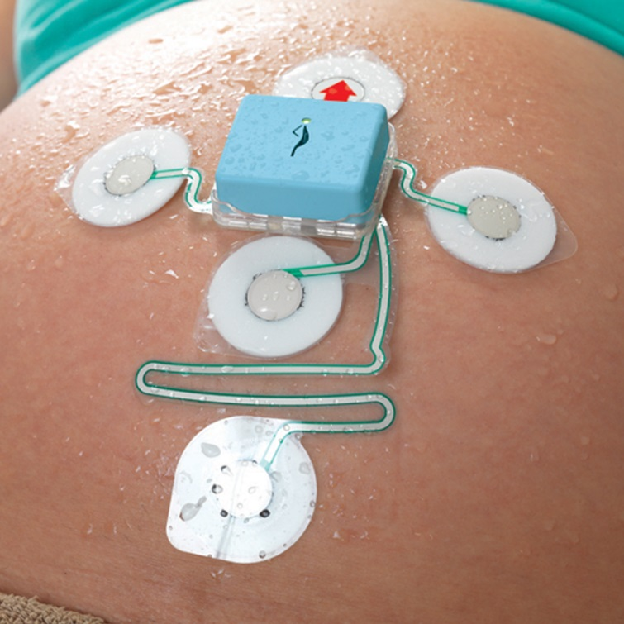
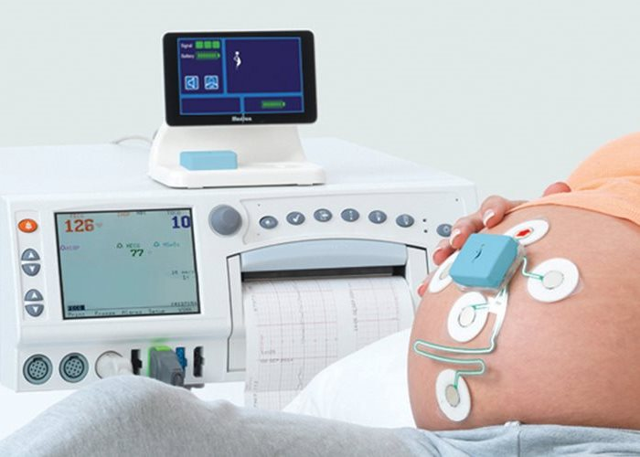
Enable Mobility
1
Sights, Sounds, Lack of Control
Photo credit: https://www.gehealthcare.com/en/products/maternal-infant-care/fetal-monitors/monica-novii-wireless-patch-system
Evidence-Based Design Goal:
5
Enable mobility to speed up labor and reduce interventions

Slide 36
Customized
Experience
Improved
Mobility
1
Less
Anxiety
Arrival at Hospital
Patient Experience
Greater
Comfort
Better
Outcomes for
Mother & Baby
Sights,
Sounds, Sense
of Control
Chipping Away at the Challenges with Childbirth in the US

Slide 37
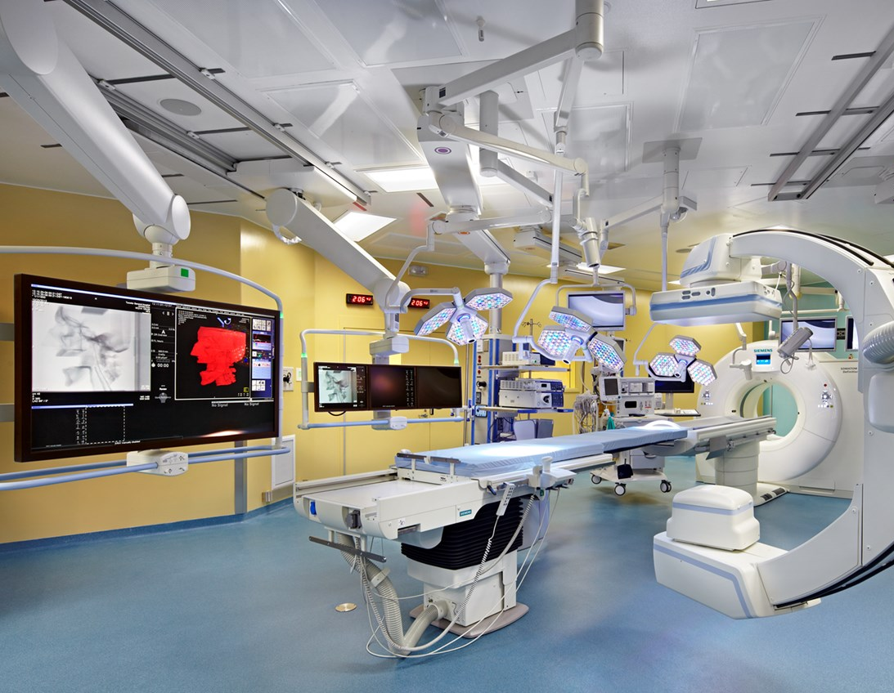
1
Mother as Brand Ambassador
HCAPS
(Hospital Consumer Assessment of Healthcare Providers and Systems)
Social Media
Florida Hospital for Women
Orlando, FL
Toronto General Hospital – Translational Research Image Guided Operating Room

Slide 38
What are some issues on our client’s minds?
Case Study: Patient Perception of Care
Safety & Security
Equipment Procurement in a World of Constant Change
Technology in Design & Construction
Applications of AI
Case Study: Staff Retention

Slide 39
What are some issues on our client’s minds?
Case Study: Patient Perception of Care
Security & Safety
Equipment Procurement in a World of Constant Change
Technology in Design & Construction
Applications of AI
Case Study: Staff Retention

Slide 40
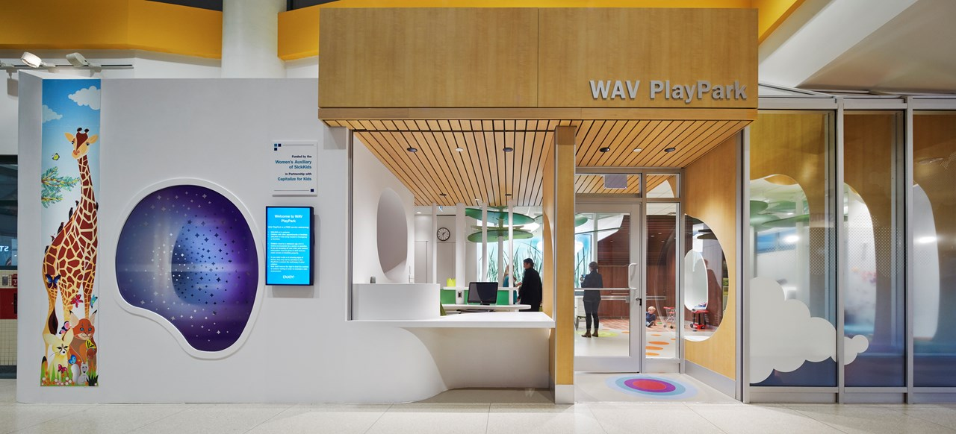
Physical Building Security
Access Controls
Security Cameras

Slide 41
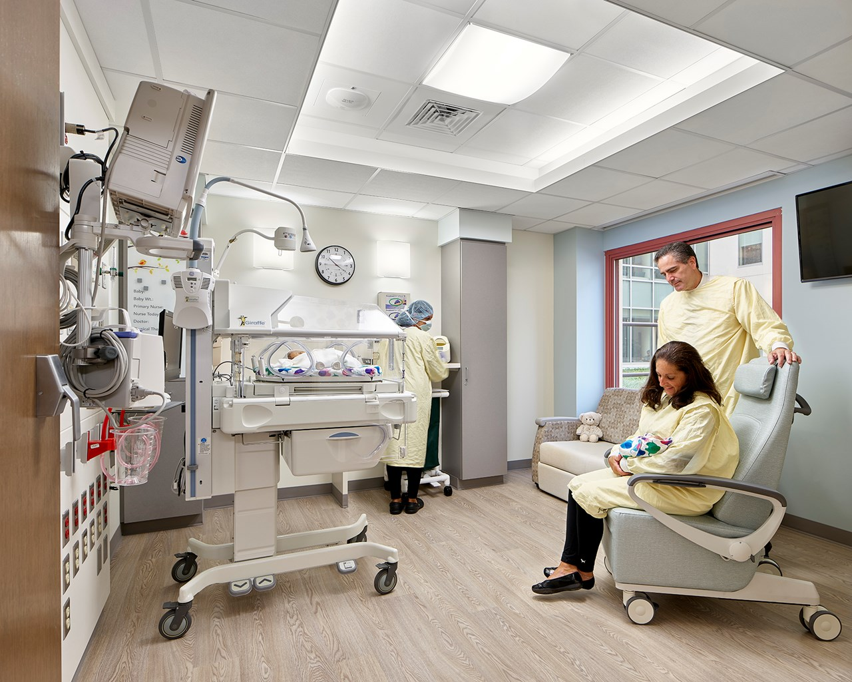
Physical Building Security
Children & Infants
RFID
Penn Medicine
Chester County Hospital NICU

Slide 42
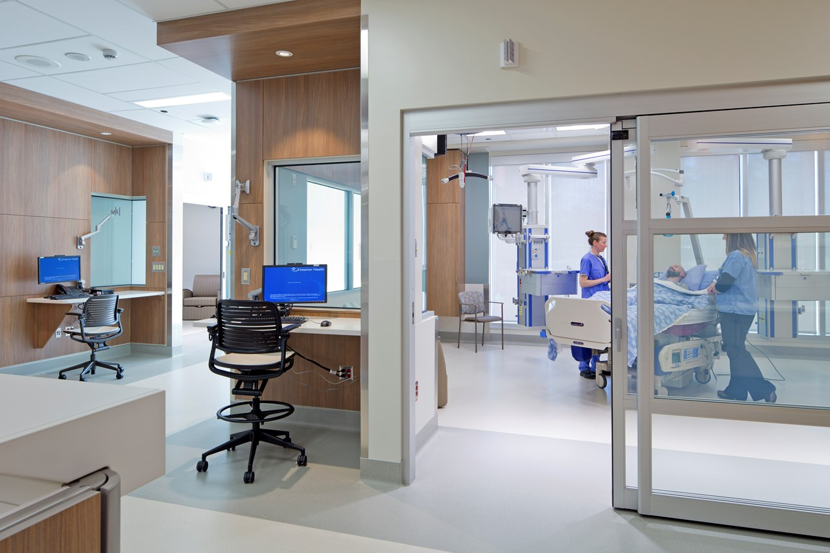
Infection Control
Switchable Privacy Glass-
ON
Reducing Nosocomial (Hospital Acquired) Infections
E-Glass
Switchable Privacy Glass-
OFF
Evidence-Based Design Goal:
7
Reduce infection risks from privacy curtains

Slide 43
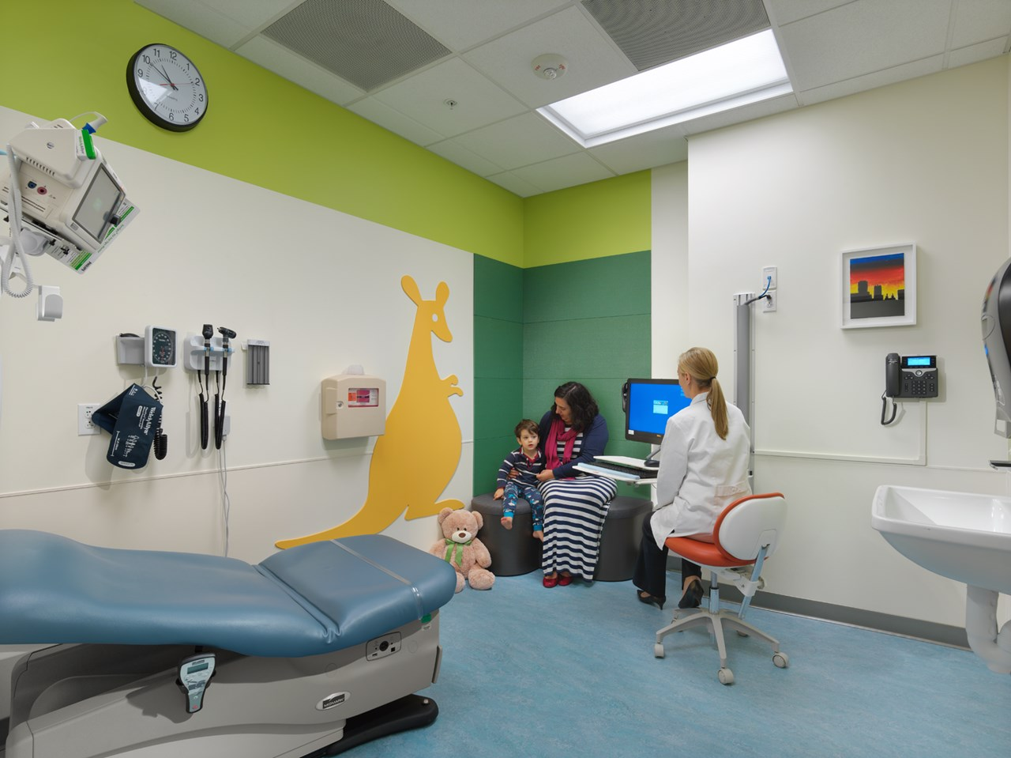
Infection Control
Handwashing Compliance
Evidence-Based Design Goal:
8
Prompts to improve hand-washing compliance

Slide 44
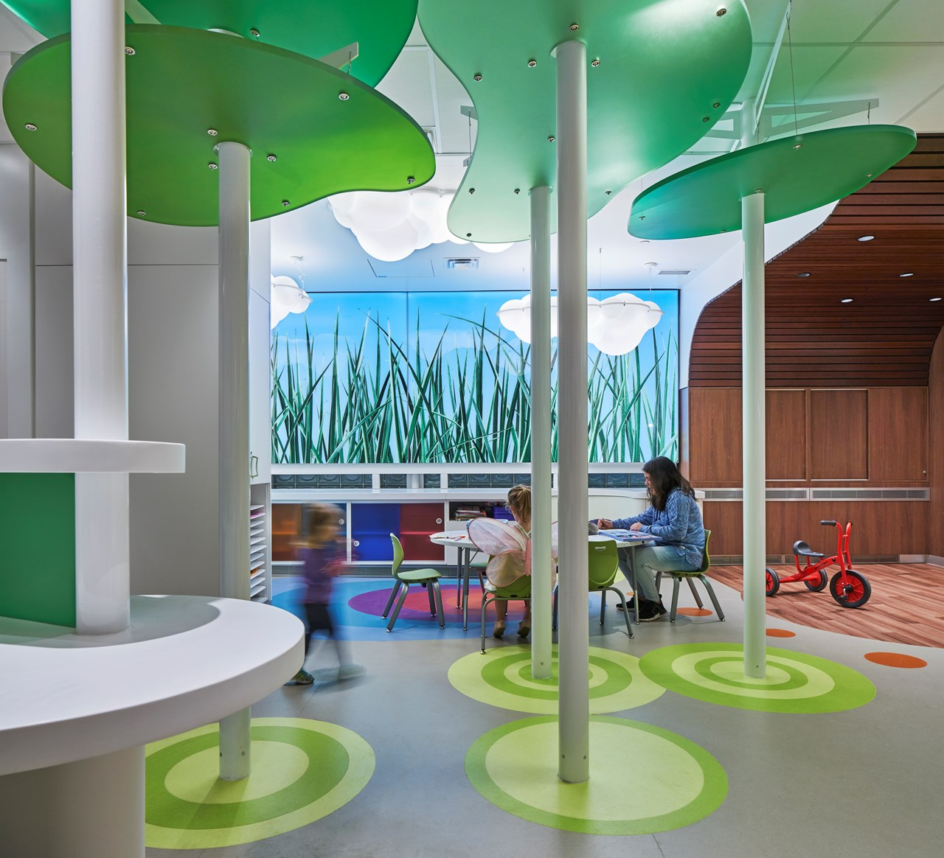
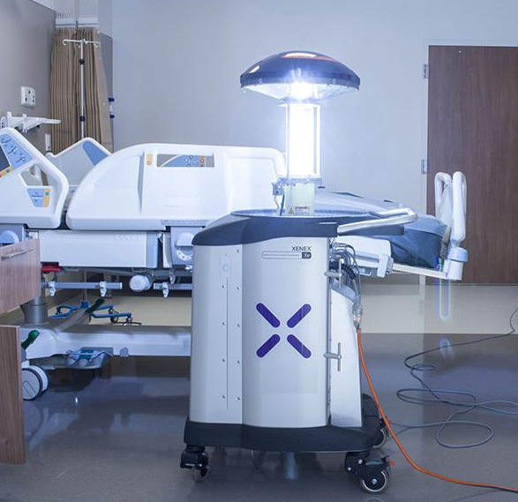
Infection Control
UV Sterilization
Evidence-Based Design Goal:
6
Use UV light to prevent the spread of germs

Slide 45
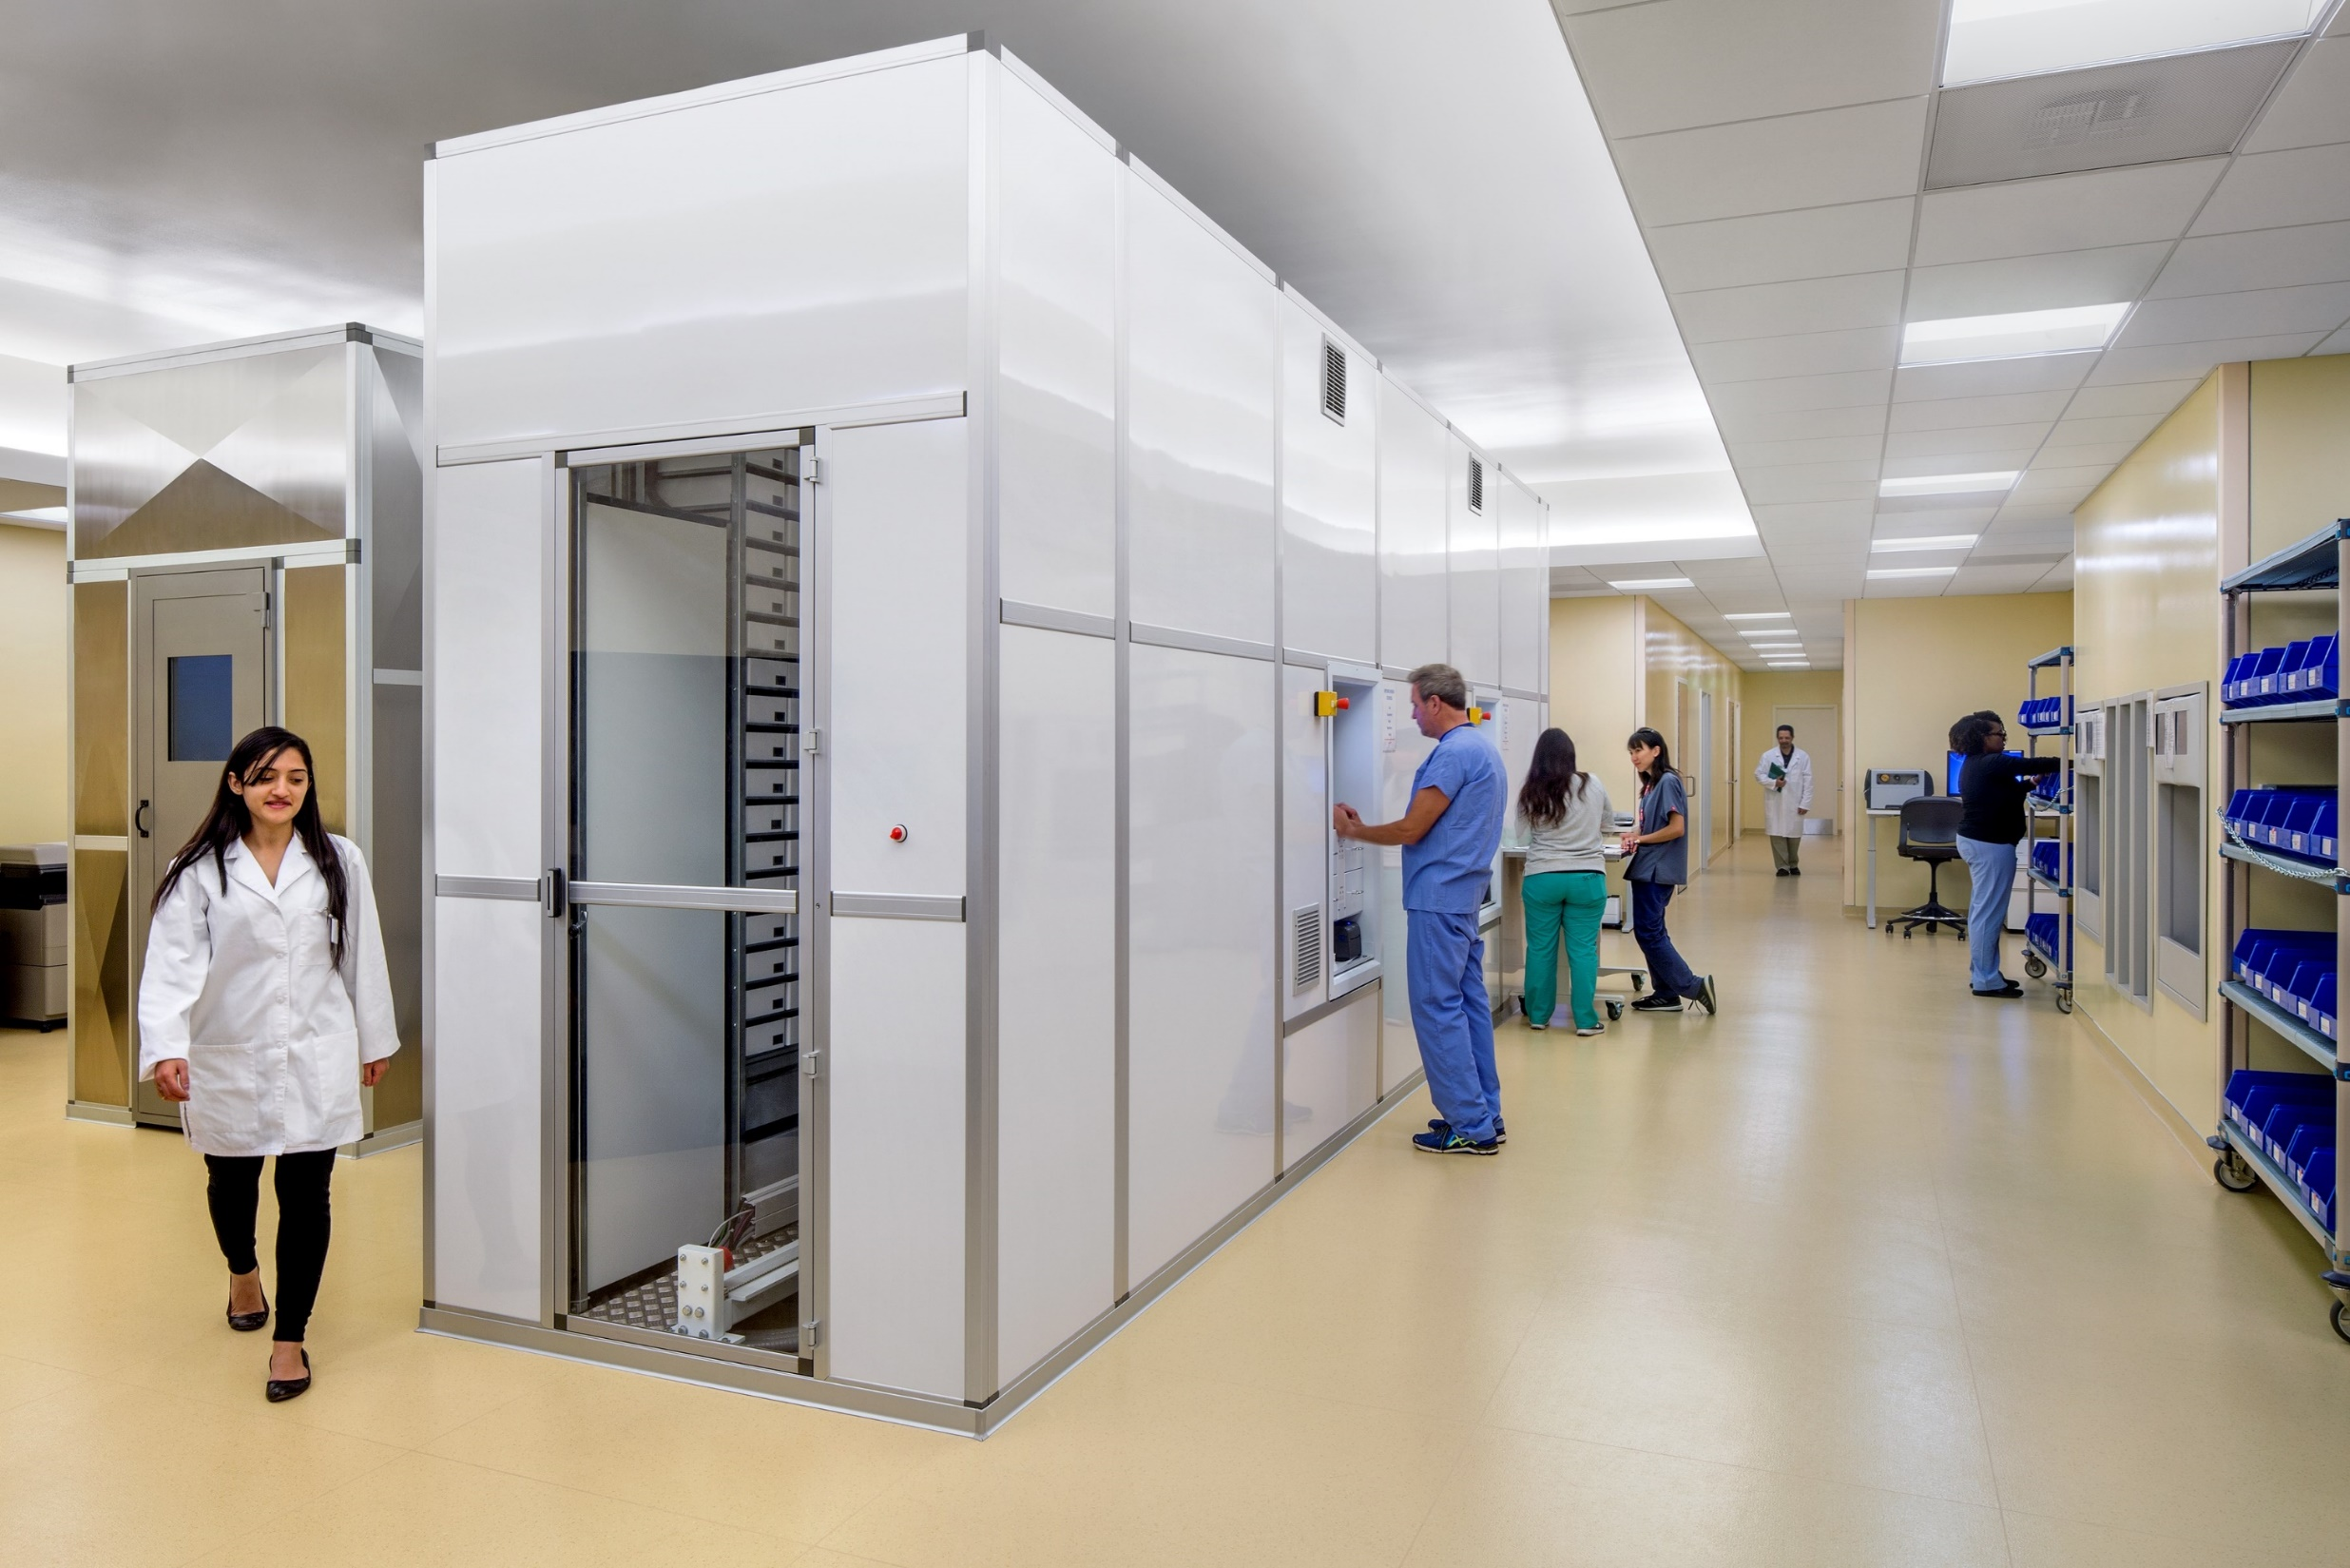
Preventing Medication Errors
Robotic Pharmacy Picking
Pneumatic Tube Systems for Medication Delivery
Evidence-Based Design Goal:
9
Leverage technology to help prevent medical errors
Sobrasoto Pavilion

Slide 46
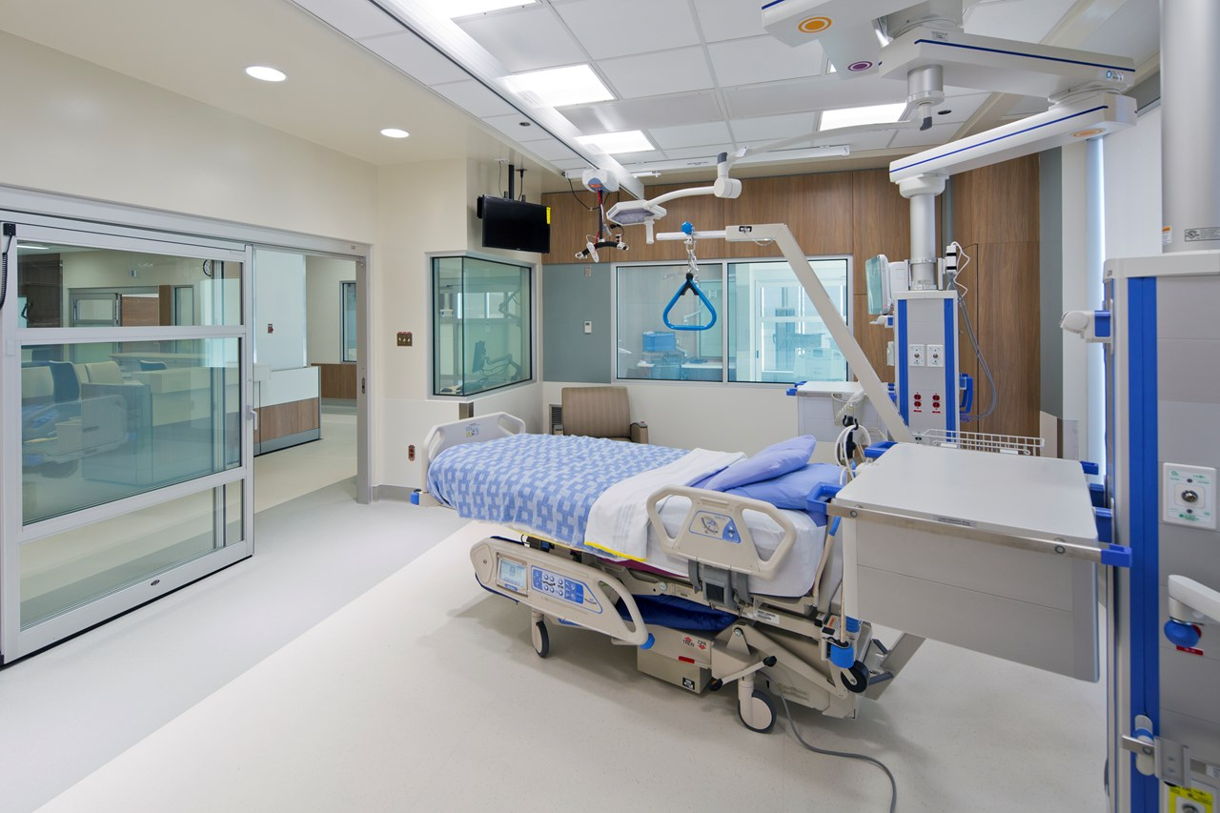
Preventing Medication Errors
Bar Code Scanners at the Patient Bed
Evidence-Based Design Goal:
9
Leverage tchnology to help prevent medical errors

Slide 47
Question Reminder
Submit your questions and comments via the chat box.

Slide 48
What are some issues on our client’s minds?
Case Study: Patient Perception of Care
Safety & Security
Equipment Procurement in a World of Constant Change
Technology in Design & Construction
Applications of AI
Case Study: Staff Retention

Slide 49
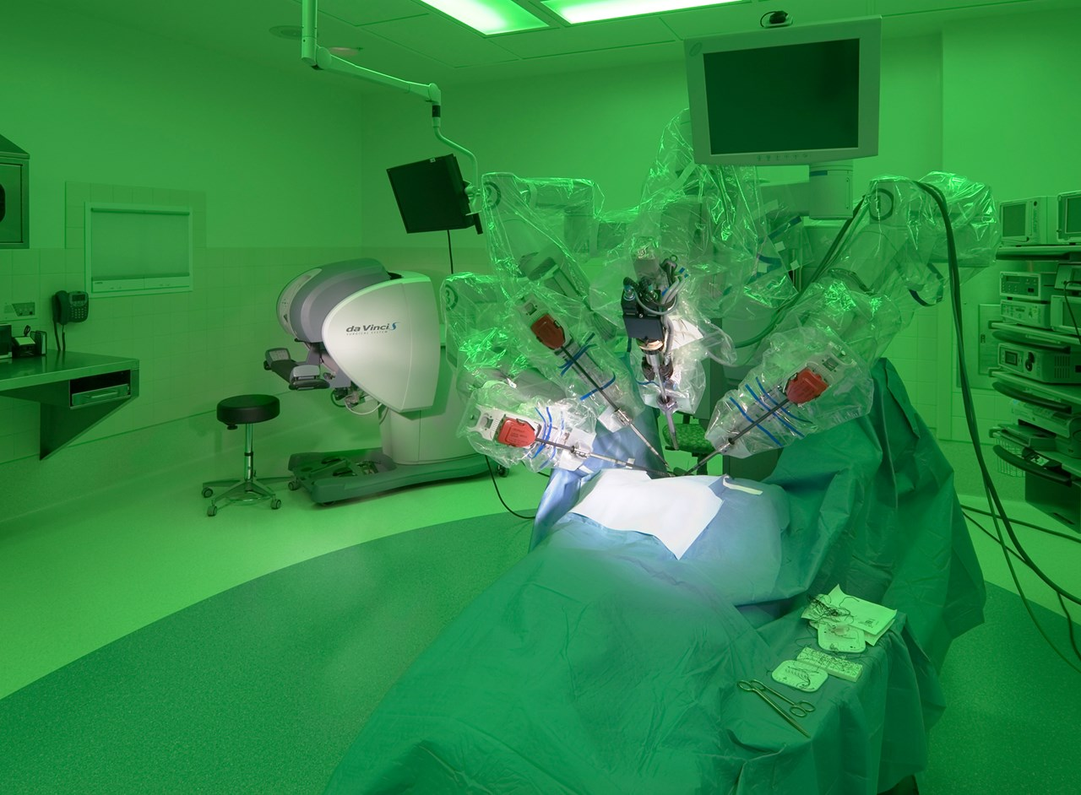
Established Technology
Robotic Surgery
Minimally Invasive

Slide 50
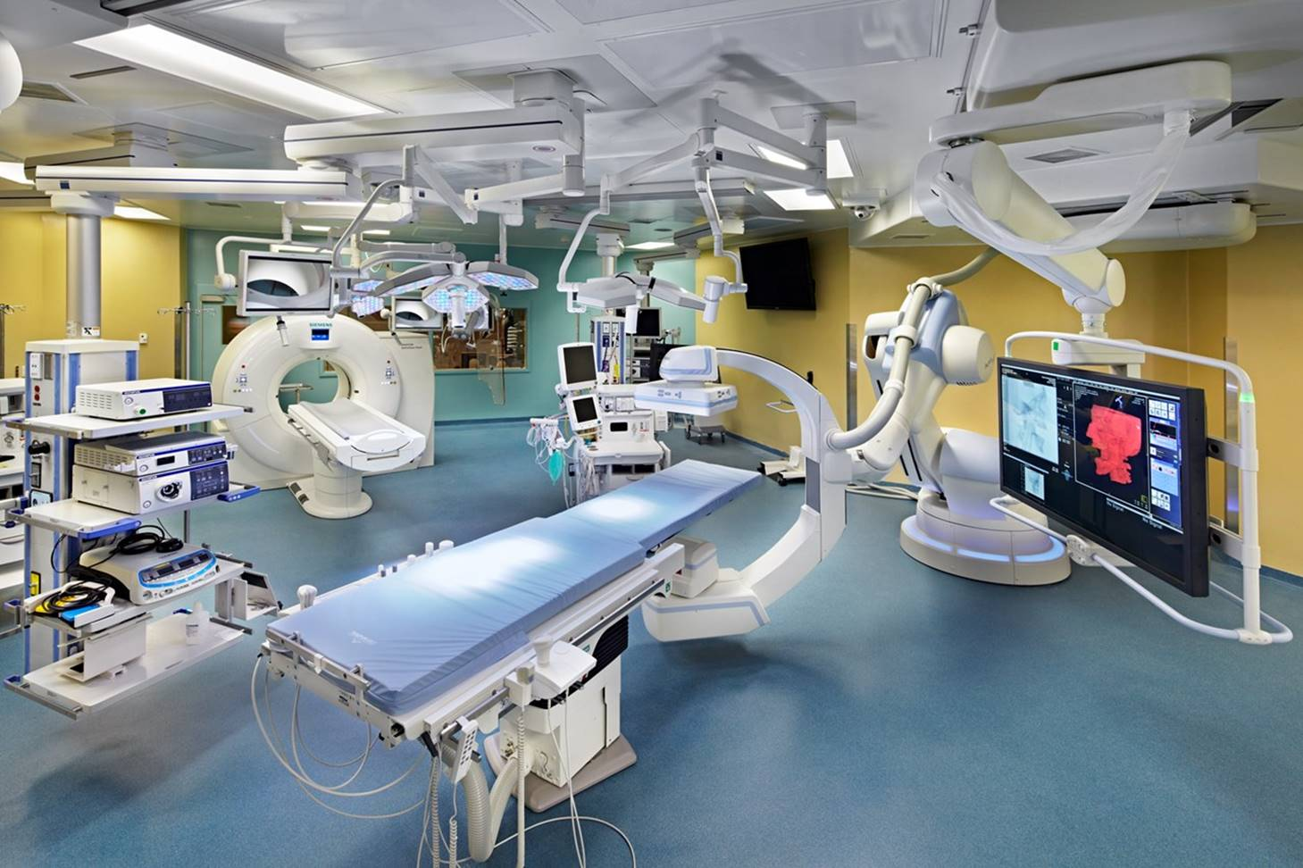
Newer Technology
Hybrid Operating Rooms:
Imaging
Surgery

Slide 51
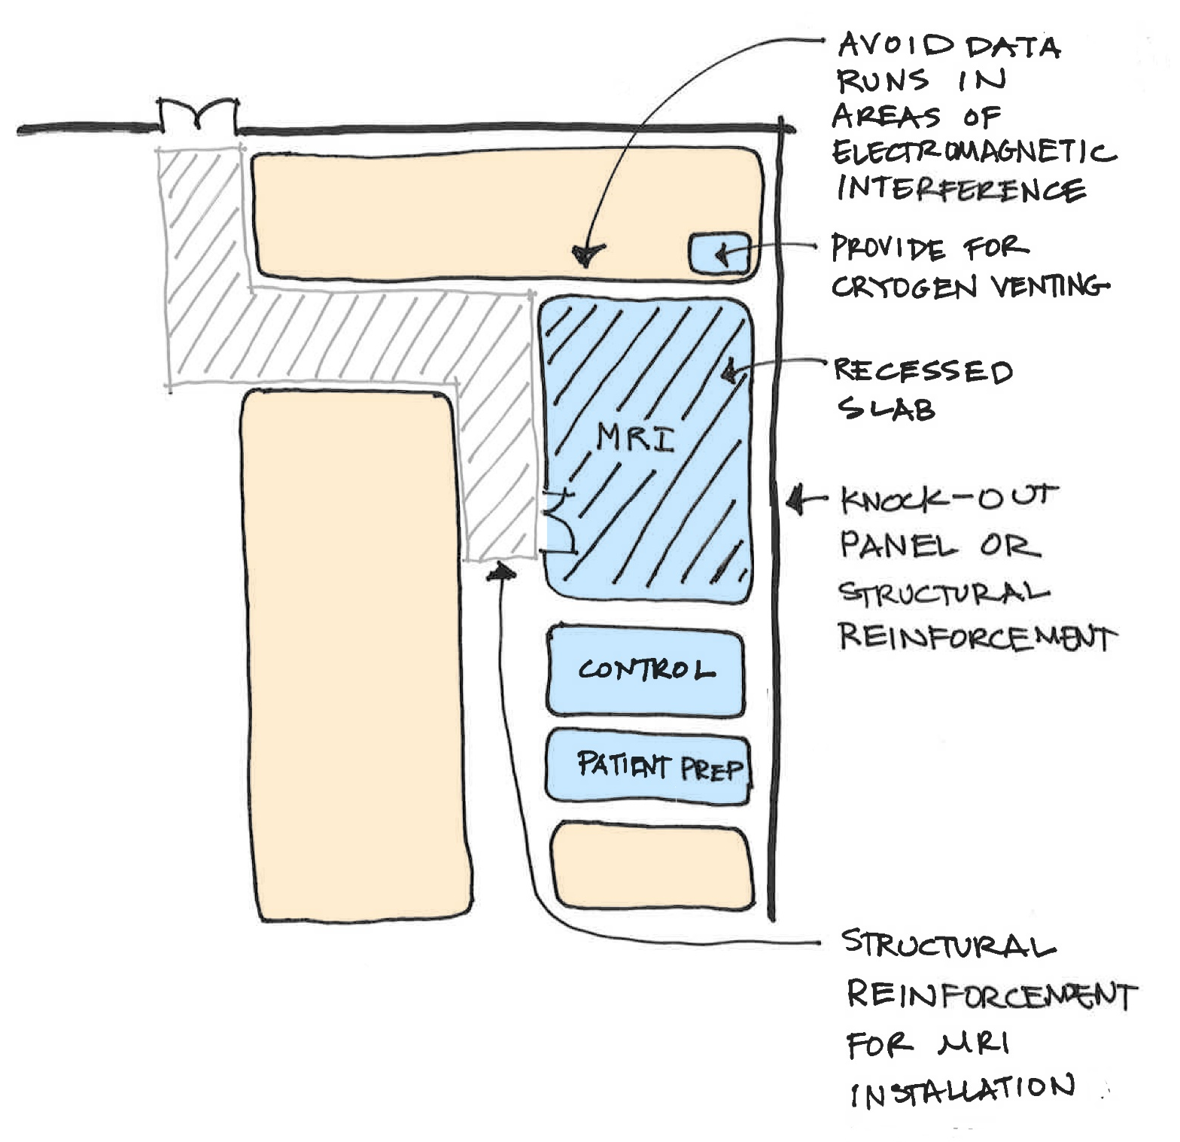
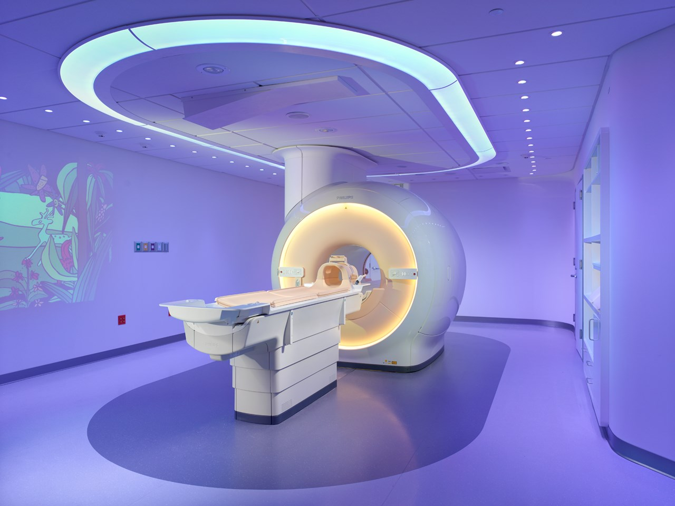
Future Technology
Shell space for future technology
Future purchase
Unknown technology
Example: MRI Design Considerations

Slide 52
What are some issues on our client’s minds?
Case Study: Patient Perception of Care
Safety & Security
Equipment Procurement in a World of Constant Change
Technology in Design & Construction
Applications of AI
Case Study: Staff Retention

Slide 53
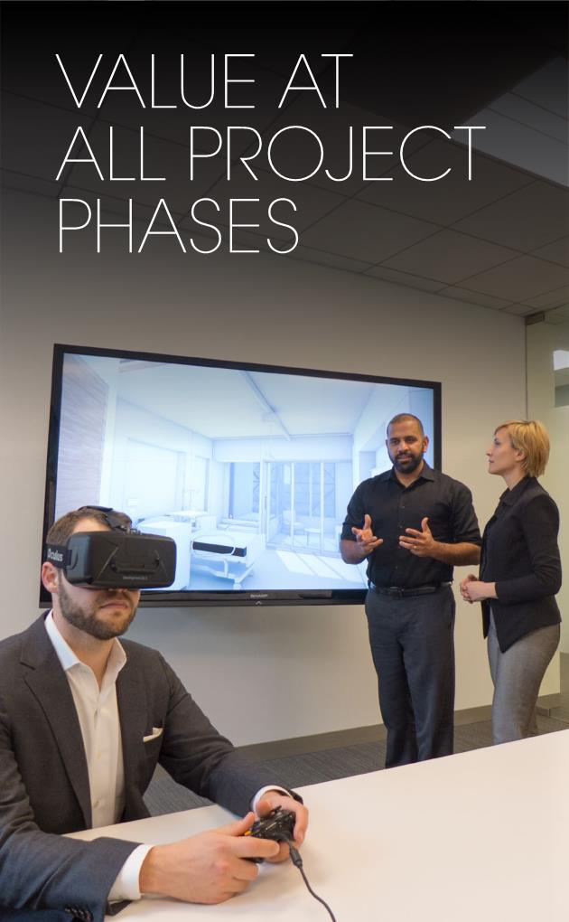
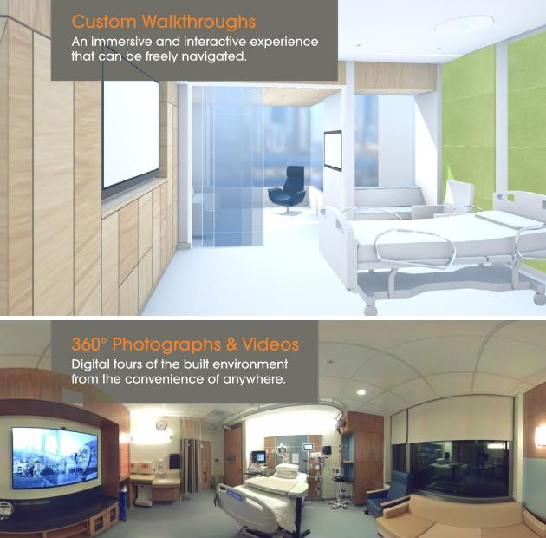
Virtual Reality
Frequent visualization of project at all stages
Philanthropy

Slide 54
Drones
Construction Observation

Slide 55
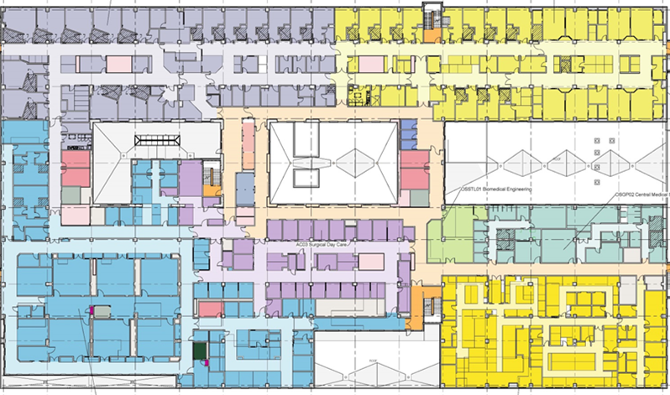
BIM Tools
Useful beyond construction
North Island Hospital
Campbell River and Comox Valley, Vancouver Island, BC

Slide 56
What are some issues on our client’s minds?
Case Study: Patient Perception of Care
Safety & Security
Equipment Procurement in a World of Constant Change
Technology in Design & Construction
Applications of AI - Analytics
Case Study: Staff Retention

Slide 57
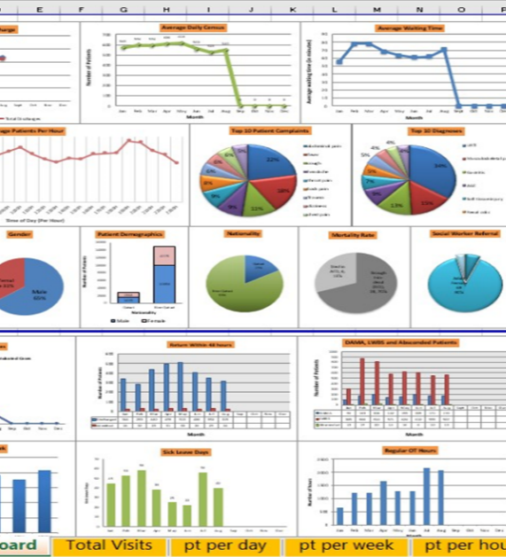
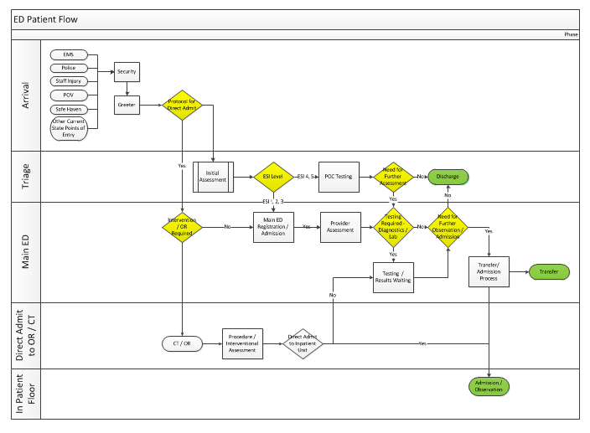
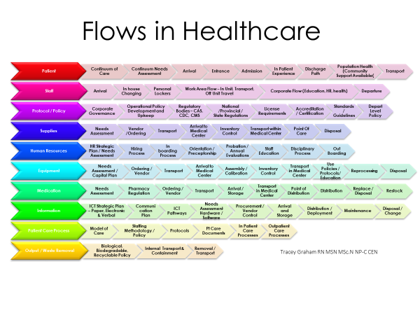
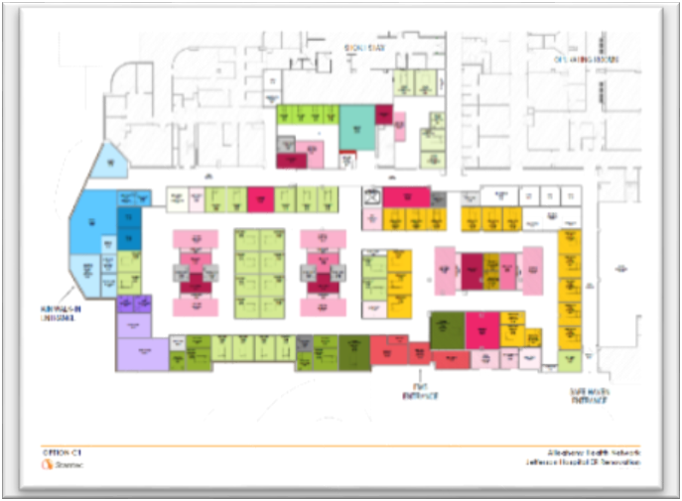
Data Analytics & Lean Driven Strategic Planning

Slide 58
What are some issues on our client’s minds?
Case Study: Patient Perception of Care
Safety & Security
Equipment Procurement in a World of Constant Change
Technology in Design & Construction
Applications of AI
Case Study: Staff Retention

Slide 59
Case Study:
The Care Provider Experience

Slide 60
Stress
1
Limited Time with Patient
Injury
Lack of
Mentorship
Beginning of Shift
Not Meeting Expectations
Fatigue
!
Burnout
10,000
Hunting for Supplies, Isolation, Alarms
Daily Challenges of Caregivers

Slide 61
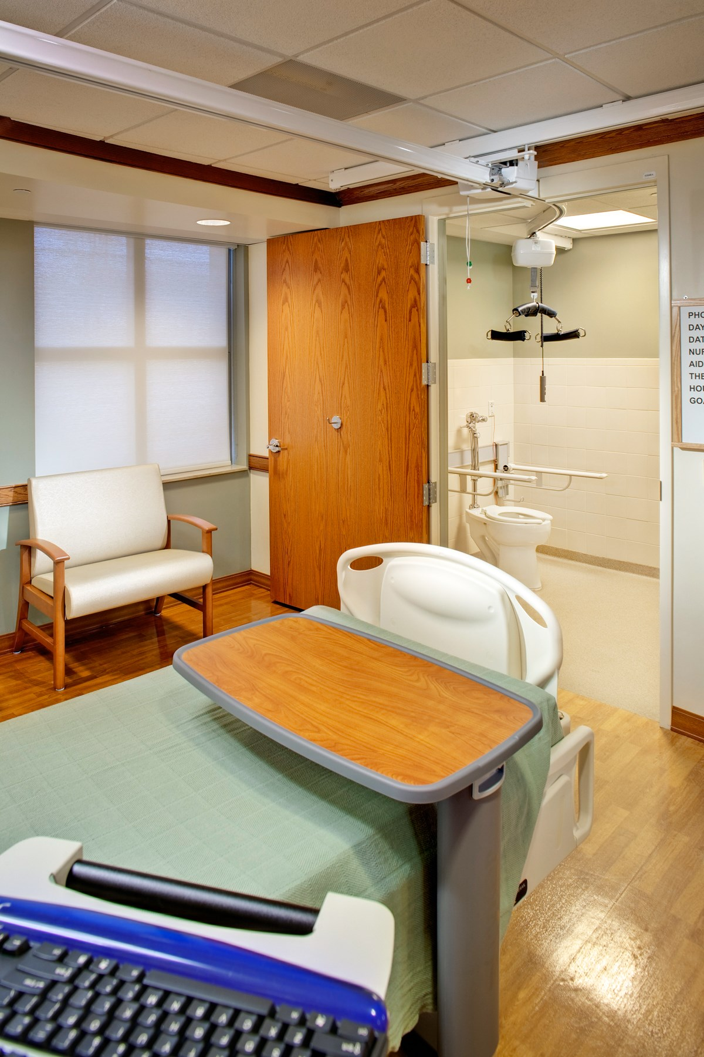
Protecting Staff from Injury
Patient Lifts
Evidence-Based Design Goal:
10
Reduce work-related injuries to caregivers

Slide 62
Robotic Delivery Systems
AGVs can enable caregivers to spend more time with their patient
Evidence-Based Design Goal:
11
Enable nurses to focus on the joy of patient care

Slide 63
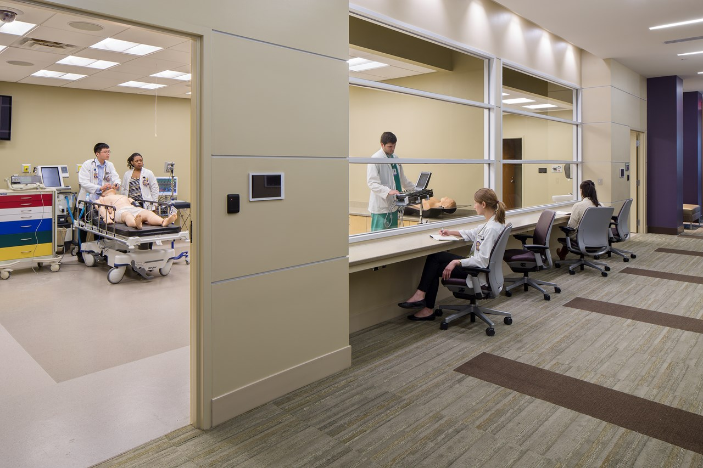
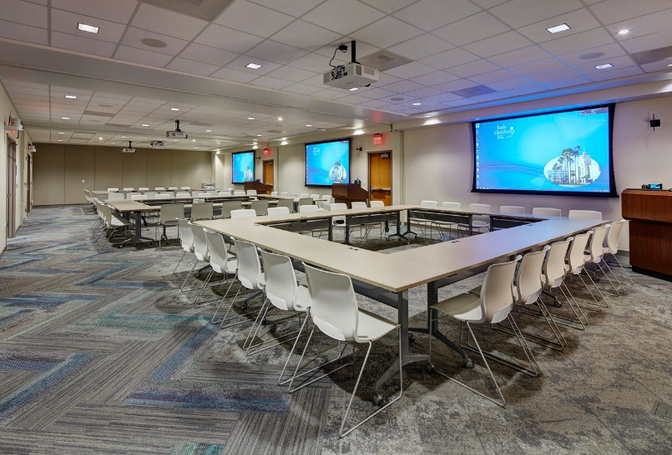
Education
Simulation & Remote Classrooms
Evidence-Based Design Goal:
12
Employ simulation as a training tool

Slide 64
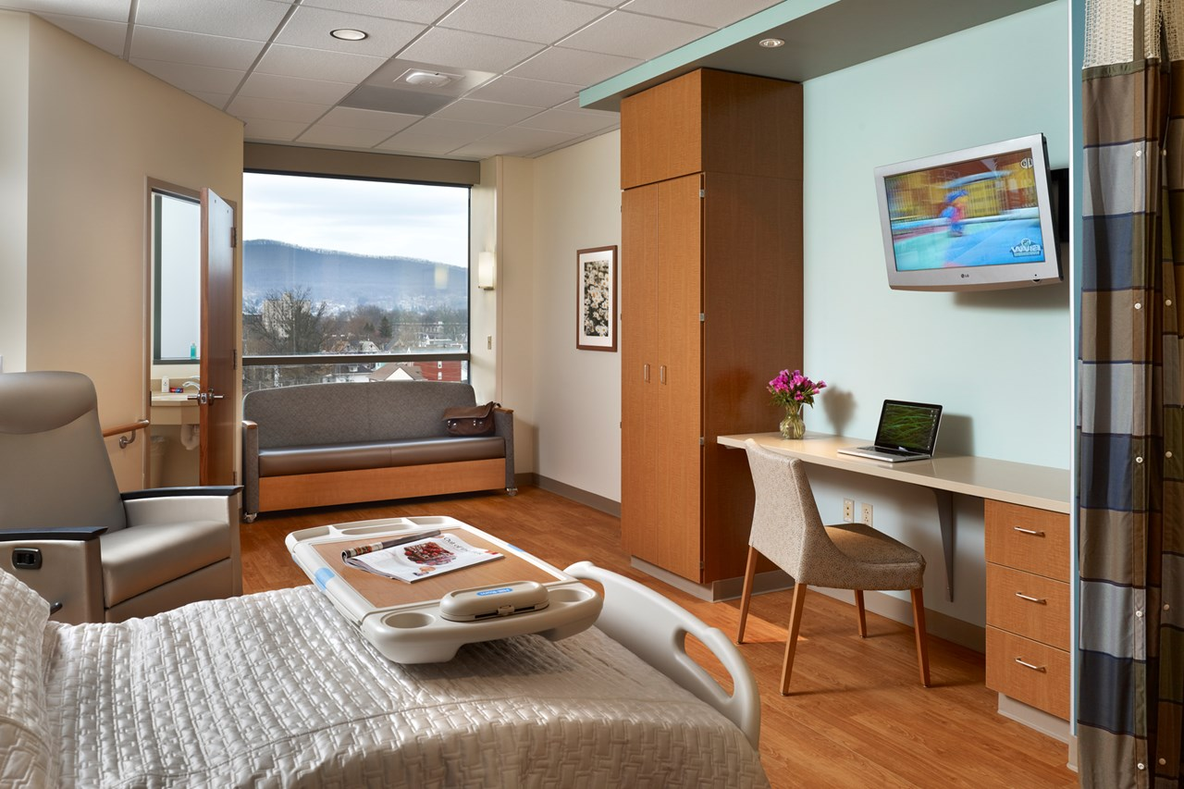
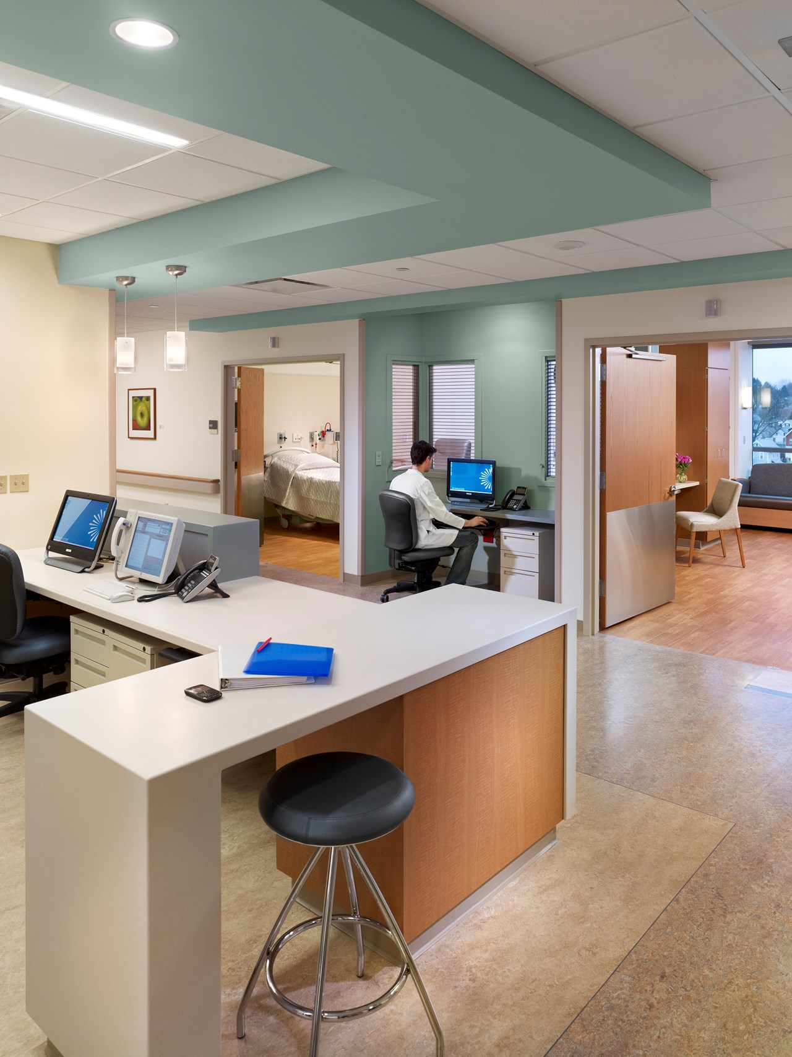
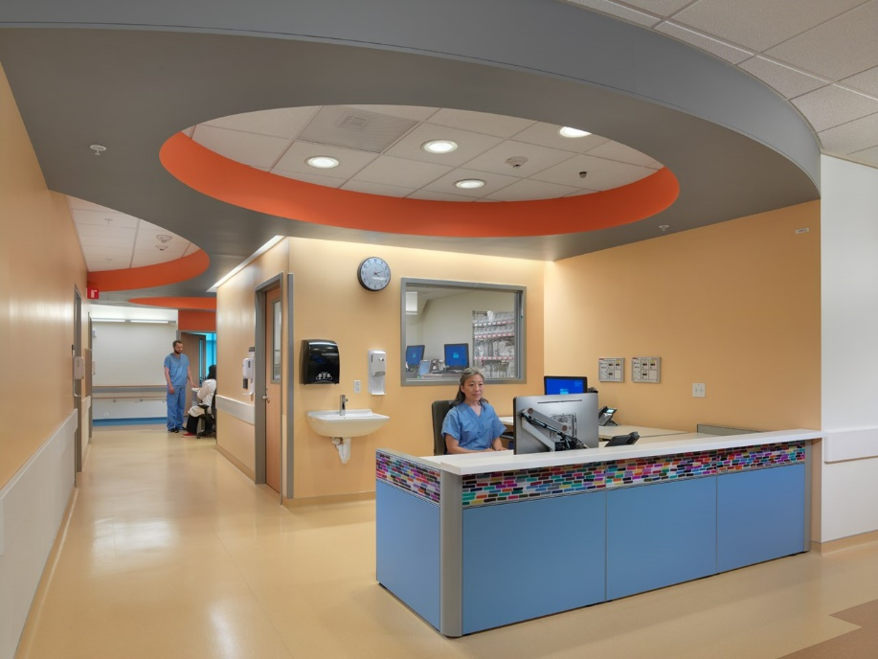
Promoting Collaboration
PHOTO
Care team stations
Charting alcoves
Informal meeting spaces
Private spaces to ensure HIPPA compliance
Evidence-Based Design Goal:
13
Promote collaboration and teamwork to reduce attrition
Susquehanna Health
UCSF
Mission Bay

Slide 65
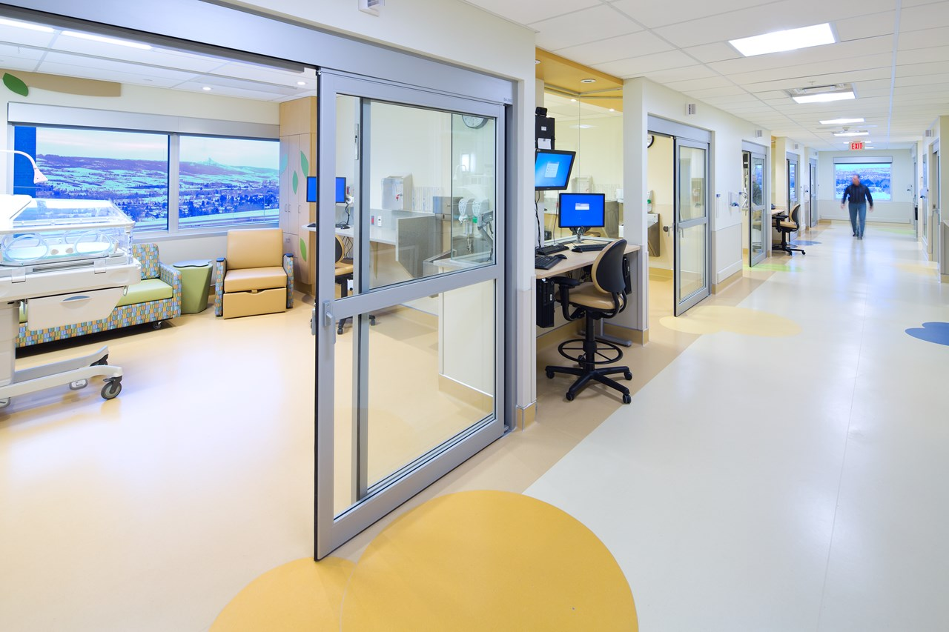
Engaging Staff in Technology Solutions
Medical Device Alarm Fatigue
Evidence-Based Design Goal:
14
Reduce alarm fatigue to improve patient safety

Slide 66
Less
Stress
1
Team
Environment
More Time with Patient
Beginning of Shift
Joy in Caregiving
Rested &
Healthy
More Likely
To Stay in
Nursing Field
Collaboration, Education,
Support
Chipping Away at
Daily Challenges of Caregivers

Slide 67
Quiz

Slide 68
Quiz
9
6
3
Digital Art Display
Pneumatic Tube
Dimmable LED lighting
Smart Building Controls
Switchable Privacy Glass
Security Camera
Timeclock
Nurse Call Indicator
Distributed Antenna System
Tablet
Digital Patient Dashboard
RFID Badge
Cell Phone (Nurse Call)
Barcode Scanner
Workstation on Wheels (WOW)
Patient Vitals Monitor
LED Light with UV Disinfection
Robotic Sensing Technology
Patient Lift
And counting….
17
18
7
8
19
1
5
11
4
2
10
15
12
16
13
14

Slide 69
References
Mostafa, M. (2014) Architecture for Autism: Autism ASPECTSS™ in School Design” Archnet-IJAR, 8(1), 143-158.
Ulrich, R. S. et al.(2008) A review of the research literature on evidence-based healthcare design. Health Environments Research & Design Journal, 1(3), 61-125.
Ulrich, R. S. et al.(2008) A review of the research literature on evidence-based healthcare design. Health Environments Research & Design Journal, 1(3), 61-125.
Douglas C and Douglas, M. (2004) Patient‐friendly hospital environments: exploring the patients’ perspective. Health Expectations, 7(1): 61–73.
Ondeck M. (2014) Journal of Perinatal Education, 23(4),188-93.
Yang, J., Wu, U., Tai, H. and Sheng, W. (2015) Effectiveness of an ultraviolet-C disinfection system for reduction of healthcare-associated pathogens. Journal of Microbiology, Immunology and Infection. https://doi.org/10.1016/j.jmii.2017.08.017
DeAngelis, D. and Khakoo, R. Hospital Privacy Curtains: Cleaning and Changing Policies - Are We Doing Enough? (2013) American Journal of Infection Control. 41(6), Supplement, Page S33.
Diefel-Vacek L and Ryan, C. (2016) Promoting Hand Hygiene with a Lighting Prompt. Health Environments Research & Design Journal, 10(1), 65-75.
Godshall, M and Reihl, M. (2018)Preventing medication errors in the information age. Nursing2018, 48(9), 56-58.
Worker Safety in Your Hospital. Caring for Our Caregivers, OSHA 3689 - 09/2013.
2018 Press Ganey Nursing Special Report “Optimizing the Nursing Workforce: Key Drivers of Intent to Stay for Newly Licenses and Experienced Nurses”
Al-Elq, A. (2010) Simulation-based medical teaching and learning. Journal of Family and Community Medicine. 17(1), 35-40.
2018 Press Ganey Nursing Special Report “Optimizing the Nursing Workforce: Key Drivers of Intent to Stay for Newly Licenses and Experienced Nurses”
Winters, B. et. Al. (2018) Technological Distractions (Part2): A Summary of Approaches to Manage Clinical Alarms With Intent to Reduce Alarm Fatigue. Critical Care Medicine 46(1), 130-137.

Slide 70
Time for Questions and Comments
???-!!!

Slide 71
CES Reminder
The URL to the webinar survey: https://www.research.net/r/AAH1902 will be emailed to the individual who registered your site.
The survey closes Friday, March 15, 2019 at 12:30am ET.
For questions, please email knowledgecommunities@aia.org

Slide 72
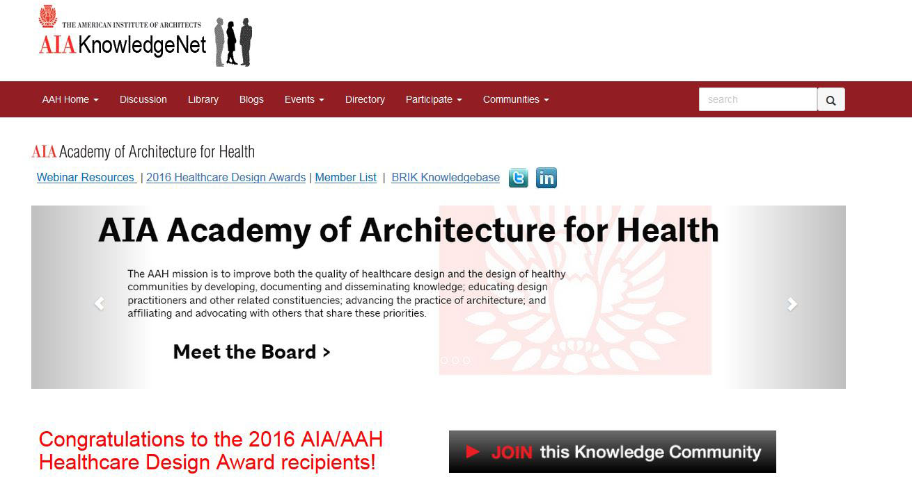
To join us or update your account go to . . .
www.aia.org/aah
Click here

Slide 73
Upcoming Webinars
Date | Series | Topic
4/9 | Beyond the Basics | AAH/Center for Health Design Knowledge Repository – How to Use and Example Application
5/14 | HC 101 Series | USPS 797 and 800: Update on Design Requirements for Sterile and Non-Sterile Pharmacy Compounding Facilities
6/11 | HC 101 Series | IMEG Webinar (Medical Equipment Planning)
Dates & topics are subject to change

