Slide 1
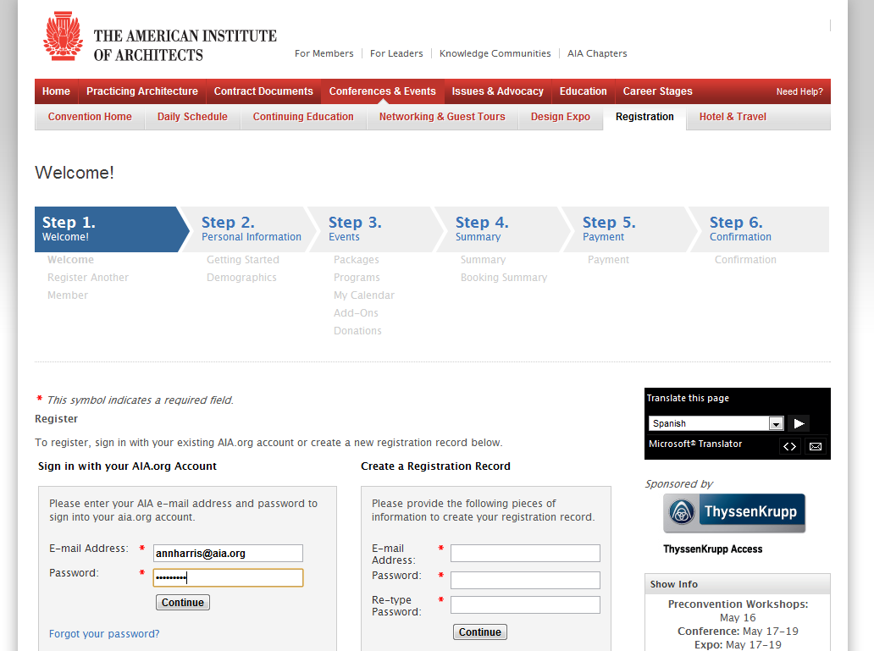
Add your convention workshops and seminars to your Outlook calendar
Step One:

Slide 2
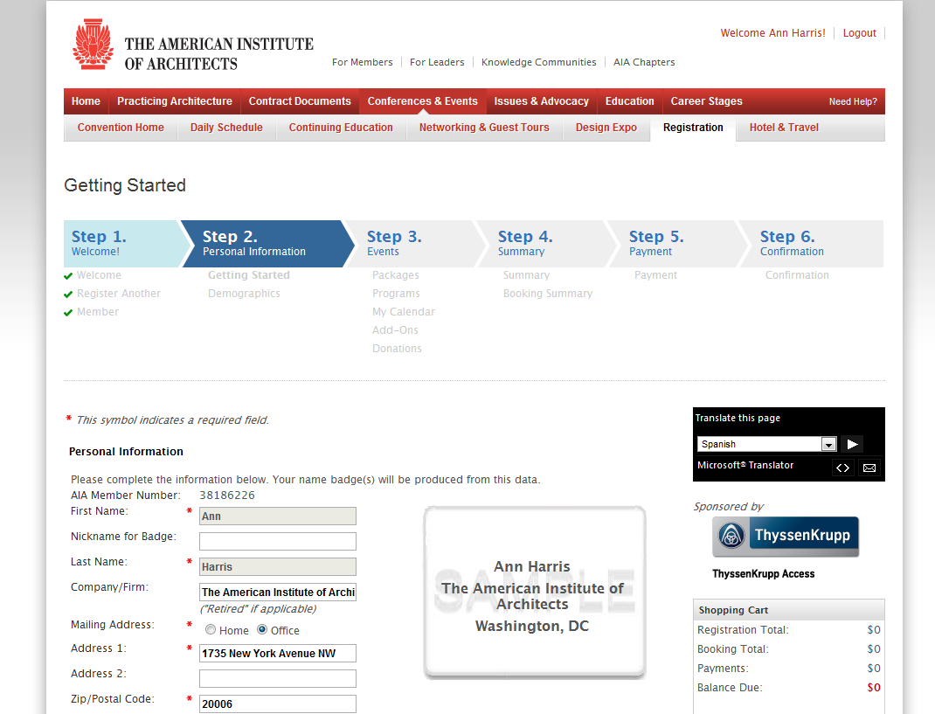
Step Two:

Slide 3
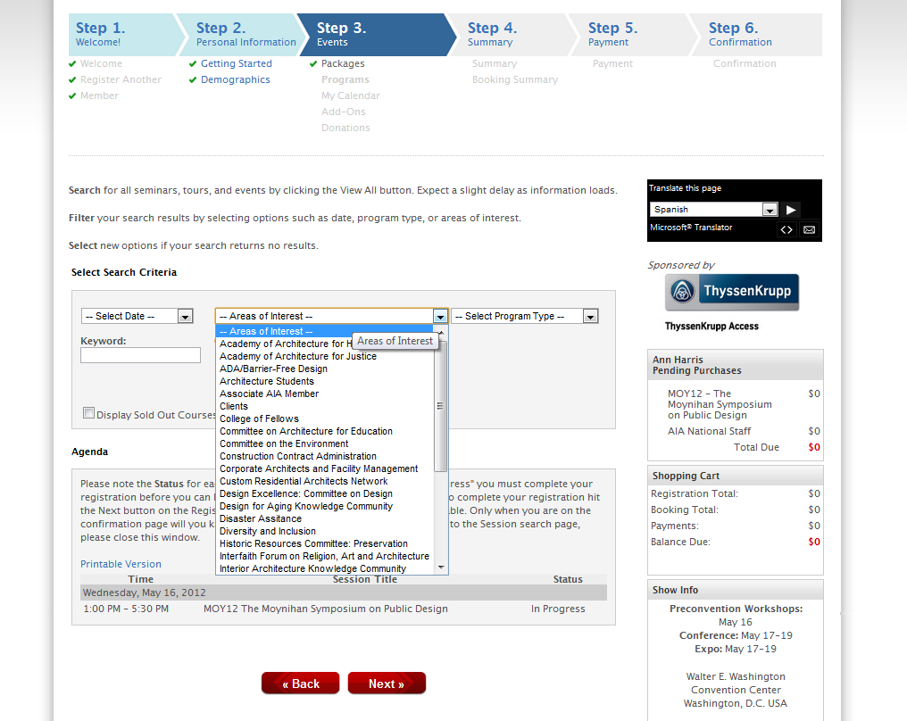
Search for workshops in your interest area.
Step Three:

Slide 4
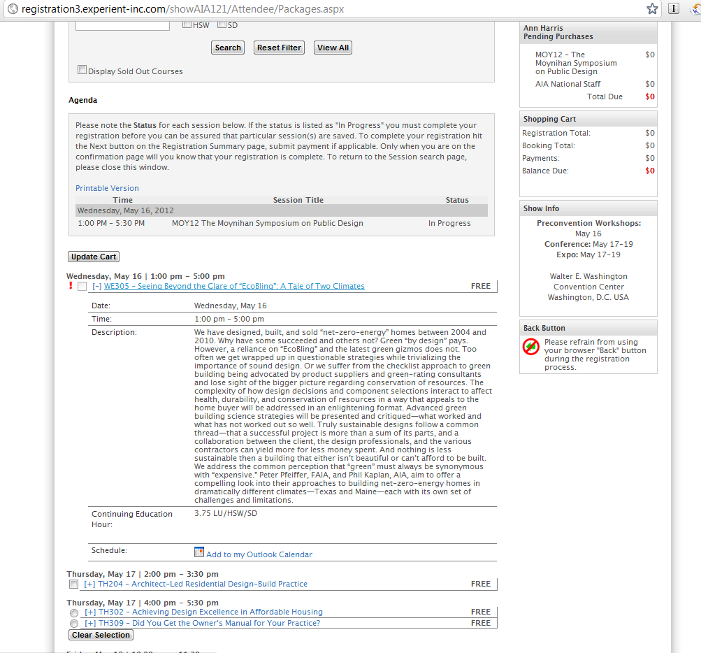
Expand the description of the event by clicking on the title.
Step Four:

Slide 5
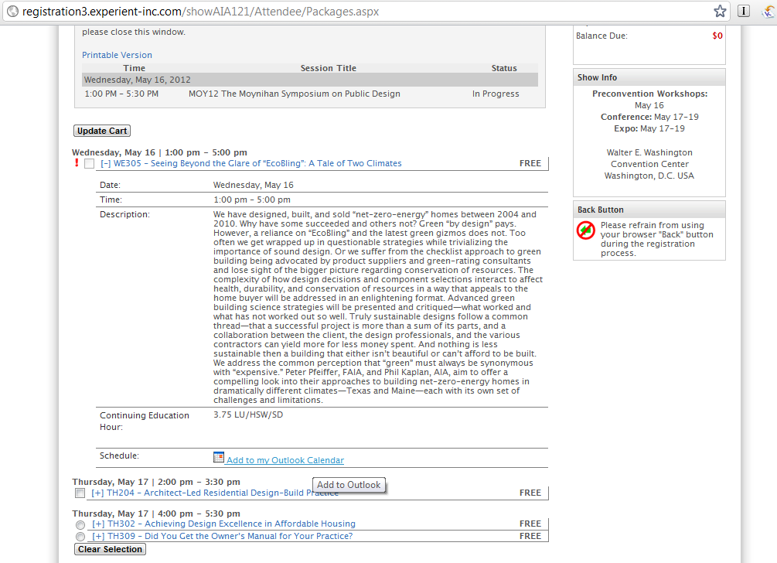
Click “Add to Outlook Calendar” to download a .ICS appointment file.
Step Five:

Slide 6
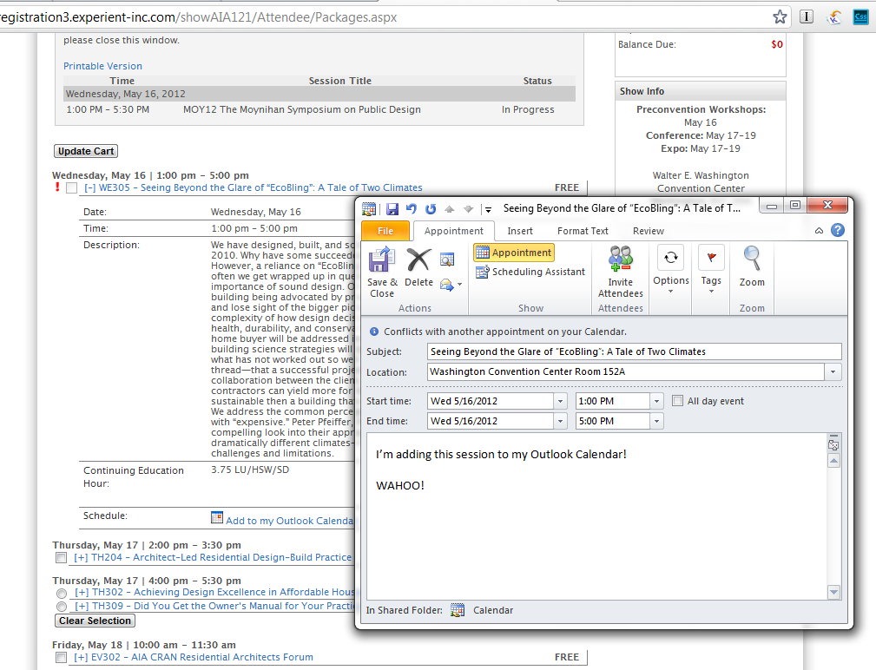
Edit the appointment with your own notes and recurring alerts.
Save to apply to your calendar.
Step Six:

Slide 7
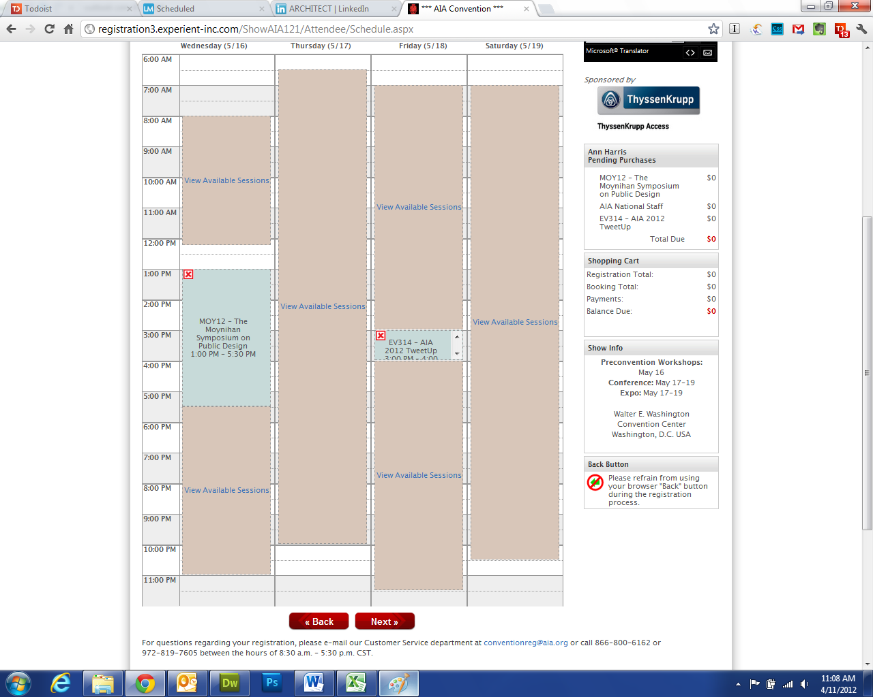
The next page of registration will show your convention schedule!
Finished!

