Slide 1
Digital Transformation
CRAN Newsletter – February 2016 Issues
Notes:
WELCOME EVERYONE!
<start recording>
Introduce presenters:
Ann Novakowski
Brian McLaren
Bill Richards
If you have questions, use the raise hand feature.
After the webinar, you will be getting a survey.
Also, we are recording this webinar and will post it to the DT website that you can reach via the For Leaders page.
NEXT SLIDE

Slide 2
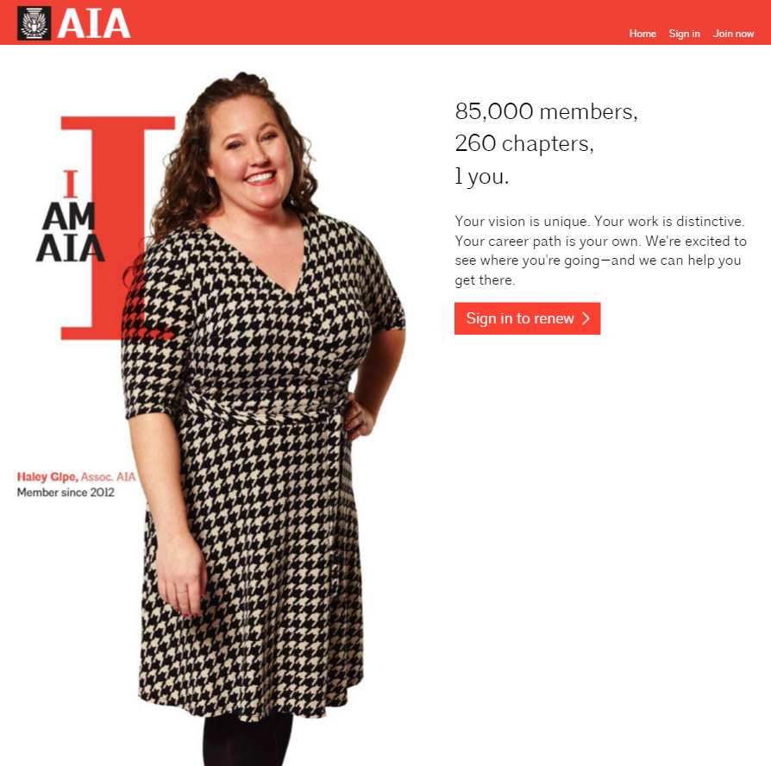
What is going on?
Release 1
Success!
Notes:
Successful launch of the new online renewal experience!
NEXT SLIDE

Slide 3
What is going on? Average Member Renewal Speed
10
10
5
15
5
15
0
20
0
20
Time
minutes to complete
Before
Time
minutes to complete
After
Notes:
Most importantly, we’ve sped up the process as promised.
CLICK
Members used to take over 10 minutes for renewal, and that doesn’t include supplemental dues. Those with supplemental dues could take up to 20 minutes to complete a renewal.
CLICK
Now it takes the average member a little over 4 minutes to complete the process from start to finish.
CLICK
NEXT SLIDE

Slide 4
What is going on?
Usability Testing & Member Feedback
Bug fixes based on live user results (24/7 site monitoring)
Post-Renewal Review: System Usability Scale
Primary Navigation and Subnavigation Testing
Heatmap and click testing of design concepts
Notes:
We are also following up with members through individual satisfaction surveys to get feedback on how the renewal experience was for them.
And because this is agile, we’ll be taking their feedback and updating the experience through patches. We’re currently working on version 1.04 so already bug fixes and user feedback have been deployed 3 times since we launched last month.
NEXT SLIDE

Slide 5
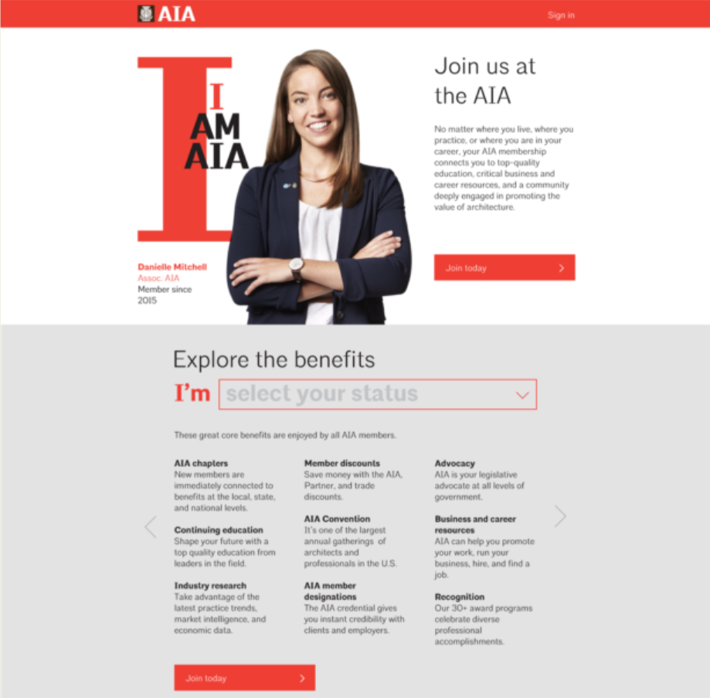
Release 1
Next!
Notes:
We’re working on JOIN next.
It won’t launch until after the Renewal cycle finishes so we can focus on our current members.
We have tried to keep things clean and friendly.
No big words, minimum legalese.
NEXT SLIDE

Slide 6
Introducing… Topic A
Notes:
Topic A aka Topic Architecture
What is it?
Public facing website.
Audience is public: students, aficionados, people who love design and might hire an architect.
The working name has been AIA Quarterly which you might see in the demo, but the actual name will be Topic Architecture.
Will come out quarterly.
Each issue is around a theme.
Launch will be around Water:
Resilience
Water penetration
Water as a life sustainer
Etc.
Other topics coming up would be Craft, Energy, Light, etc.
Each article will frame the theme around how that it is important to architecture and how architects are the best ones to come to for sensitive design based on water, craft, energy, etc.
About a dozen articles will be in each issue. ½ published at launch, and ½ coming throughout the rest of the quarter shared on social media and through e-mail to readers who sign up for notifications.
There will always be two links available on every page:
Becoming an architect
Working with an architect
The Digital Transformation team has handed off the new platform to the AIA’s Communications department, which will create and test content for this new audience. The AIA Communications and Public Relations team are charged with developing a publicity campaign and a launch plan for introducing the new site to target audiences in the new year.

Slide 7
Coming soon: Release 3
Notes:
Now that Topic-A is ready to launch, we’re ramping up for Release 3: the new member logged in site.
This is really a BIG DEAL. There is a lot of foundational work from over the last 9 months.
We’ve combed through over 4000 pages of the existing AIA website
Identified the most used pages
We are rewriting most everything so that it speaks in a new tone & voice that is friendly and clear.
We are using technology to make the site dynamic, so:
Leadership lists pull from NetForum (from the latest committee code or chapter officer list)
Chapter finder information always has the right address (or whatever is in your NF Chapter record)
Calendar items are shown by the users geography (Tennessee people see items in Tennessee)
Member directory comes from NetForum (and has the information that the member tells us is most accurate)
Content will be tagged with topics and those topics will be surfaced to members who are interested in them the most
We’ve got some amazing work being done on big data and how we are making personalized content recommendations. If you want to know the details of that… let me know, I’d love to get into it. If there’s enough interest we can dig deeper into that in another call.
NEXT SLIDE

Slide 8
Process
Discovery
Information Architecture
Requirements & Story-writing
Wireframes
Creative Comps
Development
Testing
Notes:
What we’re going to show you are a combination of wireframes and creative comps.
These are NOT the webpages, this are sort of the blueprints that our developers use to program the website.
The steps in our development process for R3 is:
Discovery: figure out what we have and what is worth keeping
Information Architecture: figure out a way to navigate and explore the site, store and share content in a standardized way
Requirements: meet with content owners and develop functional stories and content requirements
Wireframes: Block out the basic parts of the page and annotate what the functions are
Creative: We are working with Pentagram to then take the wireframes and apply an “AIA Style” to them
Development: Then the development team takes those stories and the wireframes and comps and they actually make the website.
UAT: User testing to make sure everything works.
Right now R2 is in UAT
NEXT SLIDE

Slide 9
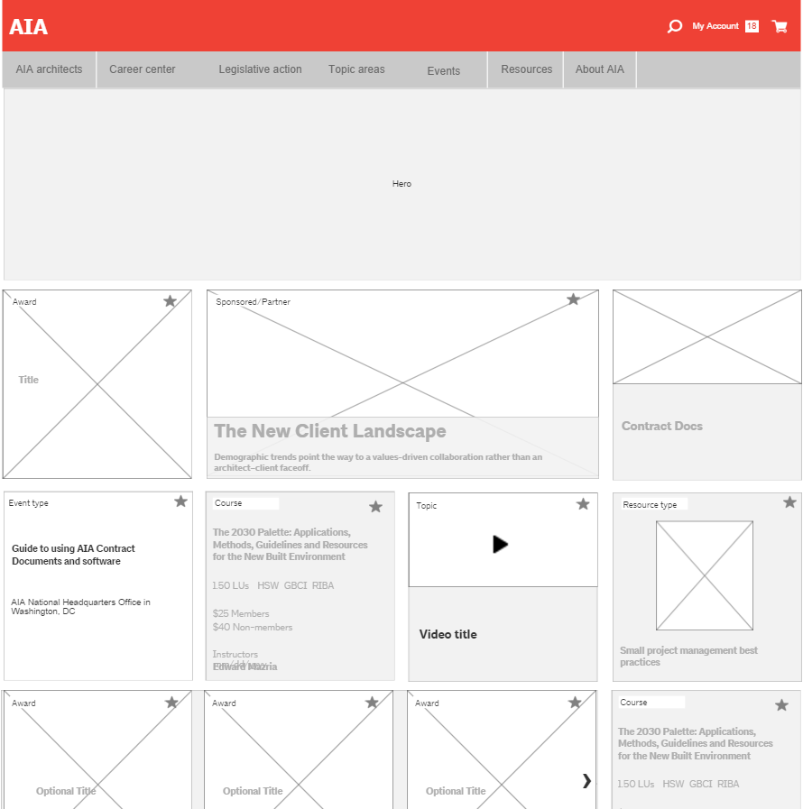
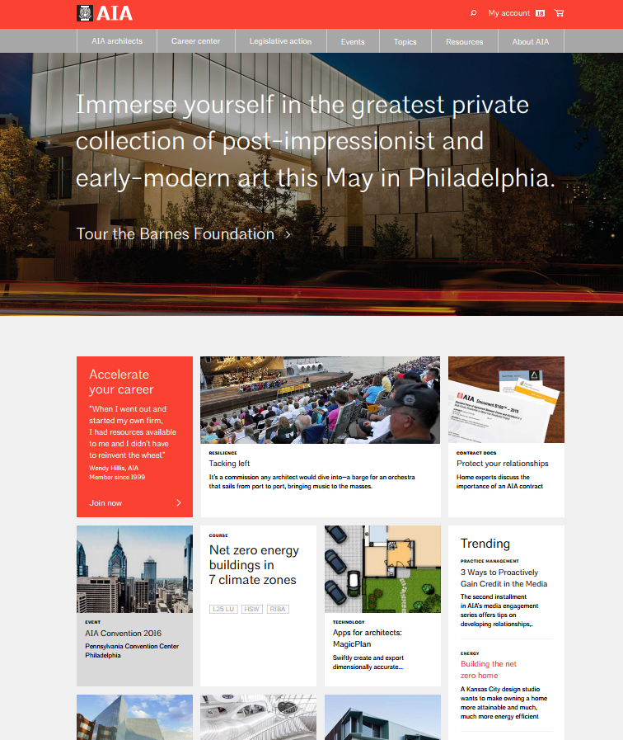
Wireframe and Creative
Release 3
Next!
Notes:
We’ve broken up R3 into about 40 different wireframes & page templates.
On each of those pages there are about the same number of unique tiles that we are going to use to display information.
Stuff like:
other articles you might like
Sponsorship tiles
Upcoming events
Contact information
Special notice boxes
Etc.
So what we’re seeing here is the wire and comp for the home page.
This is a highly customized page.
Every member that comes to the site will see something that is different and specific to them and their interests.
If we know that Ann is an architect who works on commercial projects and we know that she has taken mostly sustainable education courses, we’ll focus on surfacing the latest articles and resources in those areas.
Additionally, the next time she comes to the site, we’ll surface other things so that each time she comes back we’re showing her something new and useful for her specific interests, location, and career stage.
We’re working on the actual words used in the navigation.
Everything we do we are user testing.
So while “Advocacy” might make sense to us, we’re finding that members think about advocacy in terms of “advocating or elevating for the profession” and that words like “policy” or “Legislative issues” might work better.
NEXT SLIDE

Slide 10
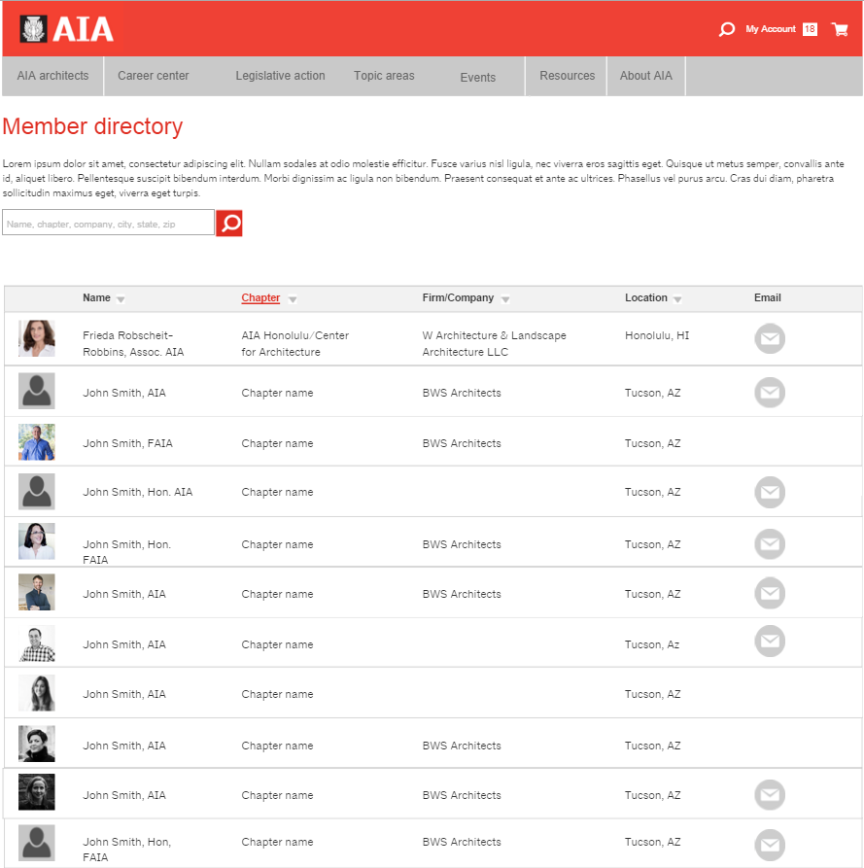
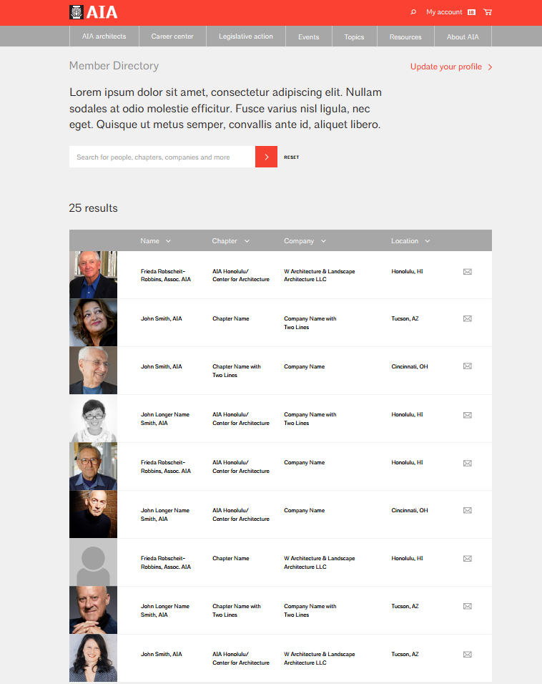
Wireframe and Creative
Release 3
Next!
Notes:
Here’s what the member directory is looking like.
This type of list is going to be reused a lot.
We’re using a lot of search features to surface all kinds of data.
Our search technology is going to make all kinds of pages possible.
Best practices
Member directory (that will be filterable all kinds of ways, by state, chapter, etc.)
Committees & board of directors (in component sites)
Firm directory (in a later release)
Member discounts
Events (which we’ll show you up close in a bit)
Awards
Scholarships
FAQ’s and Help
The new search feature is going to power a lot of pages that before were either manual or didn’t exist at all.
NEXT SLIDE

Slide 11
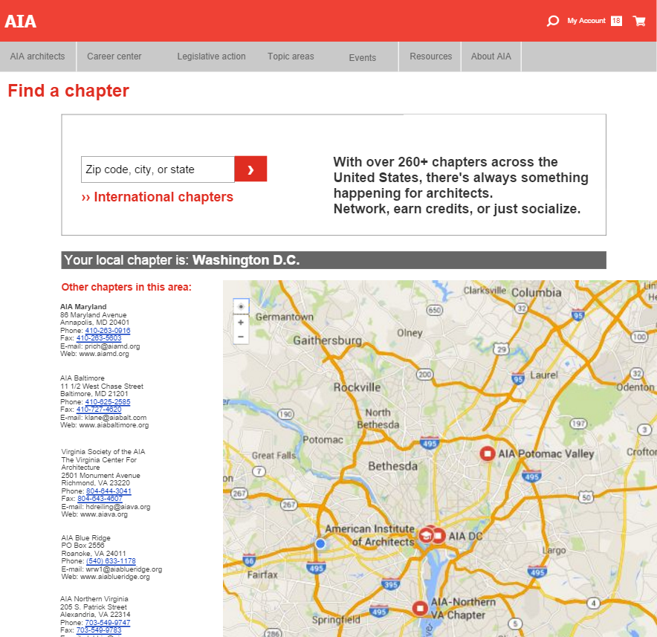
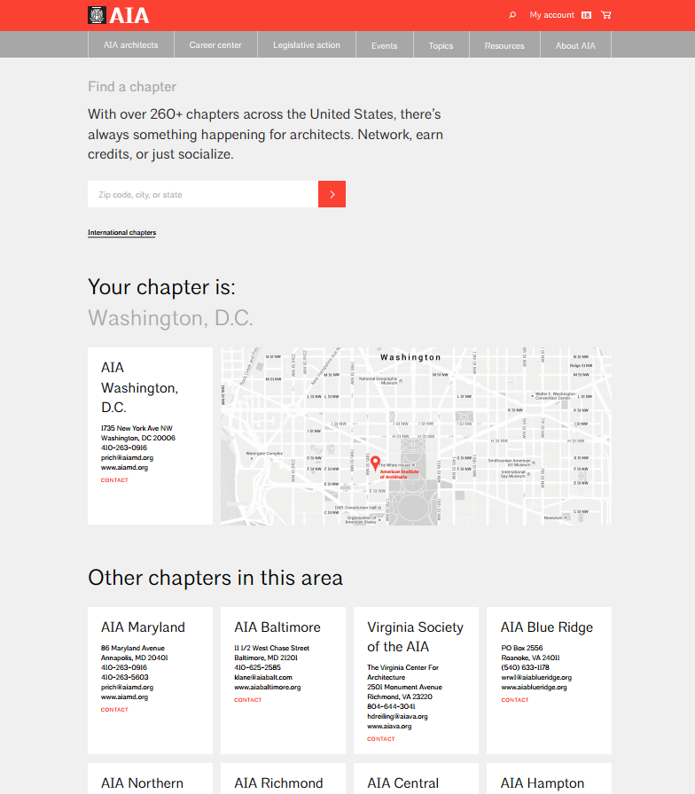
ê
Home Page
ê
ê
Find a Chapter
ê
ê
Member Directory
ê
Notes:
You can see, that the wireframe is a good starting point and gives the idea of what the final page might look like.
But you can also see that when the creative team at Pentagram makes the creative comp, the page really gets a clean and ‘designed’ look.

