Slide 1
Advancement of the Profession
BSA Small Practices Network
AIA Small Firm Round Table
National Associates Committee
Young Architects Forum
AIA CRAN
AIA Small Project Practitioners
2.21.13

Slide 2
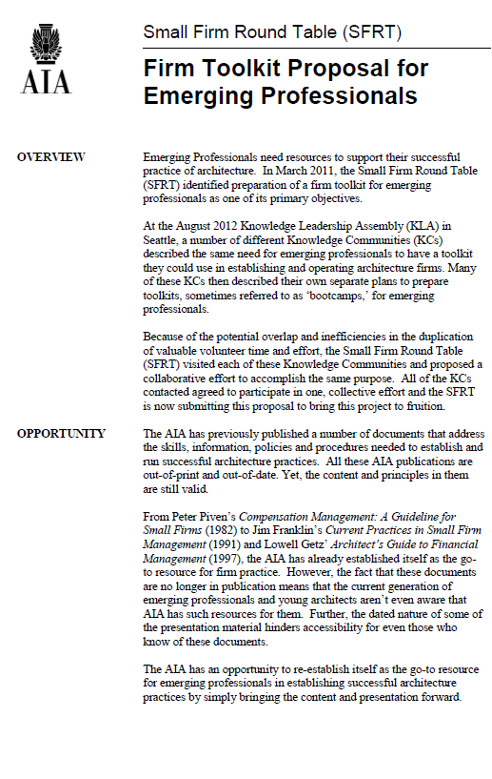
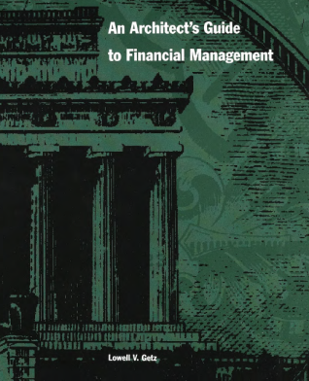
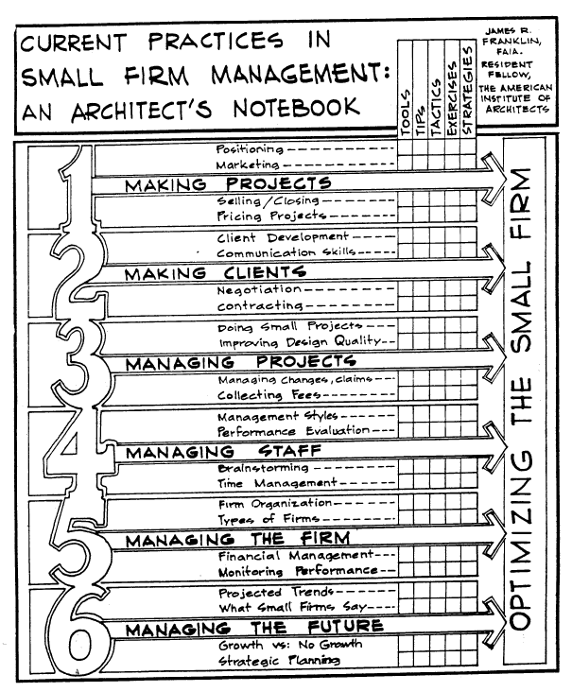
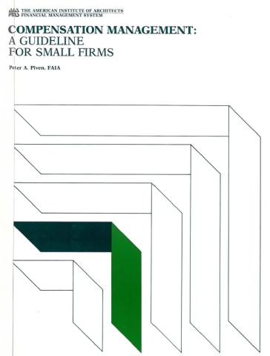

Slide 4
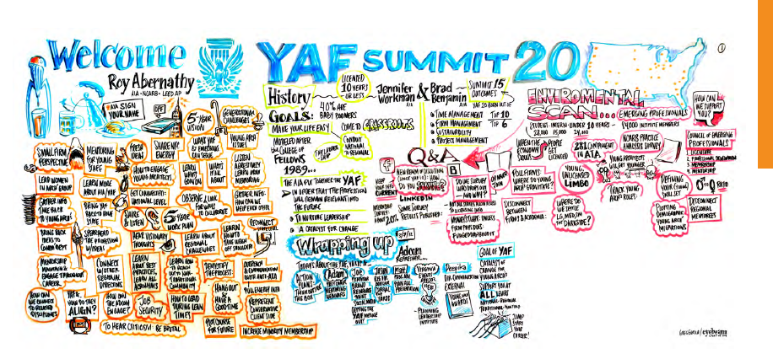

Slide 5
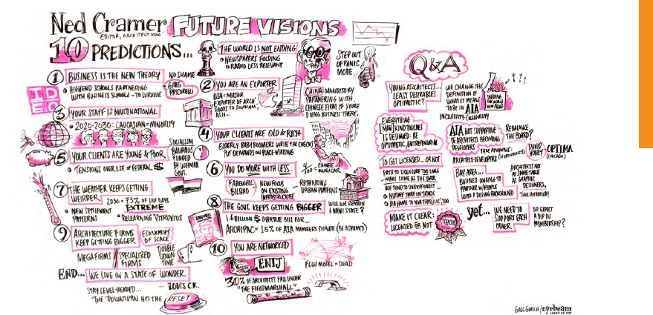

Slide 8
Advancement of the Profession Redefine traditional role and public perception of the Architect by educating public to the added value of our diverse skillset
Impacts
Individual
Increase application of diverse skillset
Employability
Marketability
Increased job satisfaction
Firm
Increased revenue stream
Broader opportunities
Better retention of qualified professionals
More collaboration with allied fields
Profession
Adding perception of value
Strengthen our brand
Enhances integrity of what we do
Broader influence
Community
Building a broader influence
Turning ‘luxury’ into ‘necessity’
More well designed neighborhoods
More universal application of sustainable issues

Slide 9
Advancement of the Profession Redefine traditional role and public perception of the Architect by educating public to the added value of our diverse skillset
Outcomes
Increased
Billings, salaries, hiring, leadership, placement of graduates in viable jobs, community and civic involvement by Architects, Architect involvement in code and legislative development, architects engaging in communities
Placement
Licensed Architects in broadened range of service sectors
Architects in alternate career paths in role of leadership at AIA, institutions and local regulatory
Greater diversification of what Architects do across industries
Promote and celebrate awareness of alternate career paths
Change the way Architects are educated (higher and continually)

Slide 10
Advancement of the Profession Redefine traditional role and public perception of the Architect by educating public to the added value of our diverse skillset
Actions
Mentorship
Expand mentorship programs including non-traditional paths
Webinar: Architects do more than buildings
Collaborate: mentorship programs like ACE (high school) Build relationship with AIAS
Leadership
Publish YAF mission statement
Create ad campaign
YAF membership placement on board committees
‘Check the box’ get involved

Slide 11
Advancement of the Profession Redefine traditional role and public perception of the Architect by educating public to the added value of our diverse skillset
What the BSA is already doing….
Practice / Creating better architects, one program at a time
AIA + 2030 Professional Series
ArchitectureBoston Expo (ABX)
ARE Success Teams
Business of Architecture
Client Conversations
Codes workshops
Research Grants in Architecture
Rotch Travelling Scholarship/Rotch Travelling Studio
Young Designers Professional Development Institute (YDPDI)
FAIA Mentorship of Emerging Professionals

Slide 12
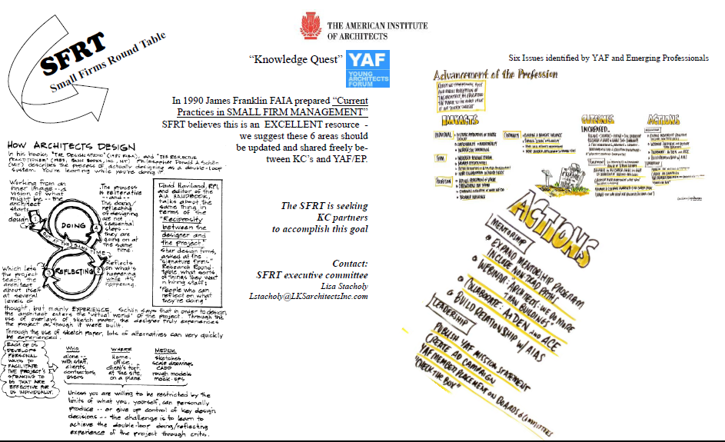

Slide 13
Advancement of the Profession Redefine the role and public perception of the Architect by educating public to the added value of our diverse skillset

