Slide 1
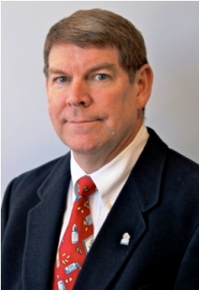
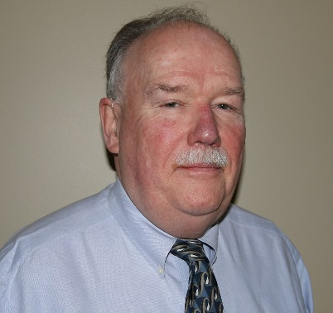
USPS 795, 797 and 800: Update on Design Requirements for Sterile and Non-Sterile Compounding Facilities
May 14, 2019 Bill Mixon, RPh, Ms
Gates Healthcare
Bob Falkum
Gates Healthcare
Notes:
[#1 is a static slide – Manual advance to start the session]
Time Budget:
01:25 FOR 6 OPENING SLIDES (#2, 3, 4, 5, 6, & 7)
01:30 AVAILABLE FOR PRESENTER(S) INTRODUCTION (#8)
00:10 FOR AUDIENCE Q&A PROMPT (AT LAST ¼ OF PRESENTATION)
10:00 RESERVED FOR Q&A
01:55 FOR 4 CLOSING SLIDES
15:00 TOTAL NON-PRESENTATION TIME
45:00 TOTAL PRESENTATION TIME
1:00:00

Slide 2
USPS 795, 797 and 800: Update on Design Requirements for Sterile and Non-Sterile Compounding Facilities
May 14, 2019
Moderated by: Gregg Ostrow, AIA
Notes:
Welcome to “USPS 795, 797 and 800: Update on Design Requirements for Sterile and Non-Sterile Compounding Facilities” – part of the Academy of Architecture for Health’s webinar series.
I’m Gregg Ostrow, today’s moderator . . .
[Auto advance in 15 seconds after start]

Slide 3
HC 101 Series
As part of the Academy’s multi-channel, on-line approach, these sessions provide emerging and experienced professionals with convenient and economical opportunities to develop their chosen area of interest.
The HC 101 series provides new members of healthcare centric practices with exposure to healthcare design fundamentals
Notes:
This is one of the five Academy continuing education webinar series – this being the HC 101 series.
The HC 101 series provides new members of healthcare centric practices with exposure to healthcare design fundamentals.
[Auto advance in 15 seconds]

Slide 4
Copyright notice
This presentation is protected by US and International Copyright laws. Reproduction, distribution, display and use of the presentation without written permission of the speaker is prohibited.
© The American Institute of Architects (year)
Notes:
[Nothing said at this slide – Auto advance in 2 seconds]

Slide 5
Compliance Statement
“AIA Knowledge” is a Registered Provider with The American Institute of Architects Continuing Education Systems (AIA/CES). Credit(s) earned on completion of this program will be reported to AIA/CES for AIA members. Certificates of Completion for both AIA members and non-AIA members are available upon special request.
This program is registered with AIA/CES for continuing professional education. As such, it does not include content that may be deemed or construed to be an approval or endorsement by the AIA of any material of construction or any method or manner of handling, using, distributing, or dealing in any material or product.
Notes:
[Nothing said at this slide – Auto advance in 3 seconds]

Slide 6
AIA/CES Reporting Details
In order to receive 1 AIA LU/HSW credit, each attendee must complete the webinar survey at the conclusion of the presentation.
A link will be provided in the chat box and included in a follow-up email one (1) hour after the webinar to the individual who registered your site.
Notes:
To obtain AIA credit see the person who registered your site – this person will be receiving directions by email. Each attendee must complete the survey/report individually to receive AIA/CES credit.
Once completed, you will have access to an AIA Knowledge Community folder that will include a PDF of this presentation, and a transcript of attendee questions with presenter response.
[Auto advance in 30 seconds]

Slide 7
Questions?
Submit a question to the moderator via the chat box.
Content-related questions will be answered during the Q&A portion, at the end of the presentation, as time allows. Any questions not answered during Q&A, will be answered and posted online within two (2) weeks.
Tech support questions will be answered by AIA staff promptly.
Notes:
Submit your questions via the chat box.
Content related questions will be answered during the Q & A portion at the end of the presentation. Questions not answered will be answered and posted online within 2 weeks.
Tech support questions will be answered by AIA staff promptly.
[Auto advance in 20 seconds]

Slide 8
Bill Mixon, RPh, MS
Gates Healthcare
Bob Falkum
Gates Healthcare
Notes:
Bill Mixon is the former owner of The Compounding Pharmacy in Hickory, North Carolina. He received his BS degree from the Medical University of South Carolina in 1977, and his MS degree from UNC Chapel Hill in 1983. He has completed two hospital pharmacy residencies, has been a Certified Diabetes Educator and a Certified Geriatric Pharmacist.
Mr. Mixon is a Fellow of the International Academy of Compounding Pharmacists and the American College of Apothecaries. He has served on the USP Expert Committee for Compounding since 2010. He also serves as the non-voting industry representative to the FDA Pharmacy Compounding Advisory Committee. Mr. Mixon is a member of the NC Board of Pharmacy, teaches sterile compounding at the Kennedy Center for Pharmacy Innovation, is a senior associate with Gates Healthcare Consultants, and is a pharmacy surveyor for the Accreditation Commission for Healthcare.
Memberships include NCAP, APhA, NCPA, NABP, ASPL and ACVP. He and his wife Jan live in Hickory, NC.
Robert Falkum is an Associate of Gates Healthcare Associates, focusing on HEPA filtration systems and designs for compounding clients. Before joining Gates Healthcare, Bob had over three decades of cleanroom systems experience providing project design assistance and application engineering for major HEPA manufacturing filtration groups throughout North America.
Since 2005 Mr. Falkum has focused entirely on USP <795>, <797> and <800>, designing, certifying, and compliance consulting to compounding facilities throughout the greater North America.
I now present you Bill Mixon and Bob Falkum
[Auto advance in 60 seconds]

Slide 9
(USP 797 USP 795 USP 800) Pharmaceutical Compounding Update on USP Standards affecting construction of pharmacy areas - Slide 1
The United States Pharmacopeia (USP) sets minimum practice standards for pharmacy compounding for the US and 145 other nations worldwide.
The USP Expert Committee for Compounding is comprised of experts in the field.
The Compounding Expert Committee published USP <800> Hazardous Drugs in Healthcare Settings February 2018 with an extended implementation date of December 1, 2019
Gates Healthcare Associates, Inc. www.gateshealthcareassociates.com

Slide 10
(USP 797 USP 795 USP 800) Pharmaceutical Compounding How does this affect me? - Slide 2
All hospitals have pharmacies that compound sterile and non-sterile preparations
Compounding of sterile preparations occurs in many other clinical settings such as ambulatory surgery centers and physicians’ offices.
The USP through its expert committee sets minimum standards for compounding that must be followed
Gates Healthcare Associates, Inc. www.gateshealthcareassociates.com

Slide 11
(USP 797 USP 795 USP 800) Pharmaceutical Compounding Who enforces USP Standards? – Slide 3
Federal law (e.g. The Drug Quality and Security Act of 2013
State Boards of Pharmacy require compliance with USP Standards
OSHA and state OSHA agencies have workplace safety requirements
HCFA requires compliance with USP Standards as a condition of participation for billing government agencies
JCAHO requires compliance with USP Standards
Attorneys who will represent clients who were harmed after working with hazardous drugs will certainly use non-compliance in their favor.
Gates Healthcare Associates, Inc. www.gateshealthcareassociates.com

Slide 12
(USP 797 USP 795 USP 800) Pharmaceutical Compounding Preparations –Slide 4
USP Compounding Expert Committee has finalized all chapters listed above with December 1, 2019 official date.
USP 800 Hazardous products finalized available now.
USP 797 Sterile Compounding finalized available June 1,2019
USP 795 Non-Sterile Compounding finalized available June,2019
Gates Healthcare Associates, Inc. www.gateshealthcareassociates.com

Slide 13
(USP 797 USP 795 USP 800) Pharmaceutical Compounding Hazardous Products used in healthcare - Slide 5
The National Institute for Occupational Safety and Health (NIOSH) maintains a list of Hazardous Products.
Hazardous Drugs (HDs) must be handled under conditions that promote patient safety, worker safety, environmental protection, and infection prevention.
Access to areas where HDs are handled must be restricted to authorized personnel to protect persons not involved in HD handling.
HD handling areas must be located away from breakrooms and refreshment areas for personnel, patients, or visitors to reduce risk of exposure.
Signs designating the hazard must be prominently displayed before the entrance to the HD handling areas.
Gates Healthcare Associates, Inc. www.gateshealthcareassociates.com
Notes:
The abbreviation HDs is used here for the first time. I think it should be spelled out as) the first time its used.
Plus, in the interest of time I think a slide on the NIOSH list is extra and isn’t worthy of its own slide.

Slide 14
(USP 797 USP 795 USP 800) Pharmaceutical Compounding Hazardous Products used in healthcare Slide 6
HDs must be stored in a manner that prevents spillage or breakage if the container falls.
Do not store HDs on the floor
Avoid storage in areas prone to natural disasters (e.g., earthquakes) The manner of storage must meet applicable safety precautions, such as secure shelves with raised front lips
Storage room of HDs shall be minimum of 12 ACPH and differential negative pressure of 0.01” to 0.03” water column and HD products must be in a spill proof tote or surrounded by a spill lip.
Gates Healthcare Associates, Inc. www.gateshealthcareassociates.com
Notes:
Add a bullet: HD’s must be stored under negative pressure
Suggest bullet 3 say: (eg earthquakes).

Slide 15
(USP 797 USP 795 USP 800) Pharmaceutical Compounding Hazardous Products used in healthcare Slide 7
Sterile and nonsterile HDs may be stored together. with at least 12 ACPH.
HDs may be stored within a negative pressure buffer room with at least 12 ACPH, however, only HDs used for sterile compounding may be stored in the negative pressure buffer room.
Refrigerated antineoplastic HDs must be stored in a dedicated refrigerator in a negative pressure area with at least 12 ACPH [e.g., storage room, buffer room, or containment segregated compounding area (C-SCA)].
If a refrigerator MUST be placed in a negative pressure sterile buffer room, an exhaust located adjacent to the refrigerator’s compressor and behind the refrigerator should be considered.
Some states will not allow placement in a buffer room and should be avoided if possible, this applies to a double door units also.
Gates Healthcare Associates, Inc. www.gateshealthcareassociates.com
Notes:
Add a bullet: HD’s must be stored under negative pressure
Suggest bullet 3 say: (eg earthquakes).

Slide 16
Example: Non-Sterile Compounding Facilities <795> & <795>+<800> non Sterile - Slide 8
Gates Healthcare Associates, Inc. www.gateshealthcareassociates.com
Notes:
Add a bullet: HD’s must be stored under negative pressure
Suggest bullet 3 say: (eg earthquakes).

Slide 17
Compounding Primary Engineering Control (PEC) <795>Non-Sterile Non-HD Single HEPA PEC - Slide 9
Non-Sterile Non-Hazardous C-PEC Single HEPA Containment Ventilated Enclosure (s) (CVE) no thimble assembly shall be located in a secondary engineering control room (C-SEC).
Gates Healthcare Associates, Inc. www.gateshealthcareassociates.com

Slide 18
Example: Non-Sterile Compounding Facilities <797> & <797>+<800> Sterile - Slide 10
Gates Healthcare Associates, Inc. www.gateshealthcareassociates.com
Notes:
Add a bullet: HD’s must be stored under negative pressure
Suggest bullet 3 say: (eg earthquakes).

Slide 19
Example: Sterile Compounding Facilities Complete <795> <797> (<795>+<800>) (<797>+<800> - Slide 11
Gates Healthcare Associates, Inc. www.gateshealthcareassociates.com
Notes:
Add a bullet: HD’s must be stored under negative pressure
Suggest bullet 3 say: (eg earthquakes).

Slide 20
Sterile Compounding Primary Engineering Control <797> +<800> HVAC 1 - Slide 12
clean rooms shall utilize a closed loop ducted system, a sealed plenum system, or other similar contamination control system for HVAC systems supplying HEPA-filtered air to ISO Classified spaces.
Supply air provided to classified area(s) shall be provided exclusively through ceiling HEPA filters.
Each secondary engineering control shall have ducted air returns mounted low on the wall in order to create a general top-down dilution of room air with HEPA-filtered make-up air.
Gates Healthcare Associates, Inc. www.gateshealthcareassociates.com

Slide 21
Sterile Compounding Primary Engineering Control <797> +<800> HVAC 2 - Slide 13
Air flow shall be subject smoke studies during dynamic operating conditions that represent the most challenging compounding conditions encountered by compounding personnel in order to demonstrate that compounding personnel performing manipulations and/or equipment used in the direct compounding area inside of the ISO Class 5 environment are not disrupting the flow of first air (HEPA filtered air stream) over critical sites.
HVAC system shall be provided with a MERV 8 followed by a MERV 16 prefiltration system accessible away from the sterile labs.
Gates Healthcare Associates, Inc. www.gateshealthcareassociates.com

Slide 22
Non-Sterile Compounding Primary Engineering Control <797> +<800> HVAC 3 - Slide 14
The HVAC system shall be limited to compounding labs and storage of compounding drugs.
Maintain a not to exceed temperature of 77F and a suggested relative humidity of 65% monitored daily.
The closed loop designed shall not cross contaminate HD air and engineered to include sufficient air volume and velocity to pre-cool incoming air to proper humidity levels then reheat to satisfy the loads within the room.
Gates Healthcare Associates, Inc. www.gateshealthcareassociates.com

Slide 23
ISO Ratings Compounding Facilities Complete <795> <797> (<795>+<800>) (<797>+<800> - Slide 15
<797> Anteroom NO access to HD <800> Buffer – ISO-8
<797> <800>Anteroom with access to HD<800> Buffer – ISO-7
<797> Buffer room – ISO-7
<797> <800> Buffer room – ISO-7 include a line of demarcation to remove HD clothing before leaving room
<795> Buffer room – no IS0 requirements
<795> <800> Buffer room – no IS0 requirements
Gates Healthcare Associates, Inc. www.gateshealthcareassociates.com

Slide 24
Air Change Per Hour (ACPH) ISO Ratings Compounding Facilities <795> <797> (<795>+<800>) (<797>+<800> - Slide 16
<797> Anteroom NO access to HD <800> Buffer - 20 ACPH
<797> <800>Anteroom with access to HD<800> Buffer - 30 ACPH
<797>Buffer room - 30 ACPH with up to half from laminar flow hood(s) (in most states)
<797> <800> Buffer room – minimum 30 ACPH, Likely to be higher volume because of the discharge of all hoods, tumble assemblies, and added exhaust returns vented out doors via house exhaust per local codes and standards.
<795> Buffer room – no IS0 requirements except normal people conditioning
<795> <800> Buffer room with redundant HEPA filtered hoods – minimum 12 ACPH vented out doors from the room per local codes and standards
<795> <800> Buffer room – single HEPA hoods – minimum 12 ACPH, Likely to be higher volume because of the discharge of all hoods, tumble assemblies, vented out doors via house exhaust per local codes and standards.
Gates Healthcare Associates, Inc. www.gateshealthcareassociates.com

Slide 25
Pressure (inches of water gage) Sterile Compounding Facilities <795> <797> (<795>+<800>) (<797>+<800> - Slide 17
<797> Anteroom door enters NON-HD <797> Buffer room from non ISO area - Minimum 0.02” W.G. Positive to non ISO area
<797> + <800> Anteroom door enters <707> + <800> HD Buffer room from non ISO area - Minimum 0.02” W.G. Positive to non ISO area
<797> Non-HD buffer connects to <797> Anteroom- Minimum 0.02” W.G. Positive to Anteroom
<797> + <800> HD Buffer room 0.01” TO 0.03” W.G. Negative to Anteroom
<795> + <800> HD Buffer room 0.01” TO 0.03” W.G. Negative to ambient
New (797) standards will require continuous 24/7 monitoring of pressures Sterile only
Gates Healthcare Associates, Inc. www.gateshealthcareassociates.com

Slide 26
Temperature and Humidity recommendations Sterile Compounding Facilities <795> <797> (<795>+<800>) (<797>+<800> - Slide 18
<797> + <800> Rooms shall maintain a temperature of 68 degrees or less
<797> + <800> Recommended maintain a relative humidity of 65% or less with a probe sensor to measure temperature and humidity.
It is suggested humidity shall exceed 30% RH
<797> + <800> Mandated - secondary engineering control shall have a probe or sensor to measure temperature and humidity. Document the temperature and humidity and pressure of each secondary engineering control 24 hours per day, seven days per week, by a continuous recording device.
<795> + <800> Non-Sterile Maintain a not to exceed temperature of 77F and a suggested relative humidity of 65% monitored daily
Gates Healthcare Associates, Inc. www.gateshealthcareassociates.com

Slide 27
Sterile Compounding Facilities <795> <797> (<795>+<800>) (<797>+<800> - Slide 19
All equipment in an ante room, and buffer room shall be nonporous, non-shedding, impermeable, cleanable, and resistant to degradation by cleaning agents.
All counter tops, work surfaces, and racks, shall be constructed of stainless steel or other non-porous, non-shedding material.
<797> Sterile only - Utilize carts in ISO Classified areas that are constructed of stainless steel, molded plastic, or other non-shedding, non-porous material; and cleanable and resistant to degradation by cleaning agents.
Gates Healthcare Associates, Inc. www.gateshealthcareassociates.com

Slide 28
Sterile Compounding Facilities <795> <797> (<795>+<800>) (<797>+<800> - Slide 20
Anteroom or adjacent ISO 8 room prior to Anteroom shall have a stainless-steel sink that:
hands-free controls for water and soap dispensing
Has proper depth and capacity for hand washing up to the elbows;
designed or installed to prevent standing water
Located on the clean side of the line of demarcation away from the buffer room door
Minimizes splashing and dripping of water on adjacent walls and floor.
An anteroom sink may not have an aerator mechanism on the nozzle.
The sink shall be located 1 meter from the USP 797 USP 800 buffer room SEC.
Gates Healthcare Associates, Inc. www.gateshealthcareassociates.com

Slide 29
Sterile Compounding Facilities <795> <797> (<795>+<800>) (<797>+<800> - Slide 21
Utilize light fixtures designed for clean rooms in all areas and the exterior surface of ceiling lighting fixtures shall be smooth, mounted flush with the ceiling surface, and sealed.
Ceiling surfaces in shall be impervious and hydrophobic, ceiling panels, fixtures, and other penetrations through the ceiling or walls shall be smooth and sealed around the perimeter.
Sprinkler heads in all ISO Classified areas shall be recessed, covered, and easily cleanable.
The doors shall be constructed of a nonporous, smooth, non-shedding, impermeable material such as acrylic, polycarbonate or similar fiberglass-reinforced plastic, glass, high grade aluminum or stainless steel; free from cracks and crevices; and cleanable and resistant to degradation by cleaning agents. Doors shall include closures. Doors shall be provided with vision panels.
Gates Healthcare Associates, Inc. www.gateshealthcareassociates.com

Slide 30
Sterile Compounding Facilities <795> <797> (<795>+<800>) (<797>+<800> - Slide 22
Walls shall be made of solid surface, locking sealed panels, or epoxy-coated gypsum board and shall be impervious, cleanable, and non-shedding.
Floors shall be cleanable and composed of wide sheet vinyl that is heat sealed at seams, or other solid, smooth surface.
<797> Sterile only - Floors shall be coved at the wall or appropriately sealed.
Gates Healthcare Associates, Inc. www.gateshealthcareassociates.com

Slide 31
Sterile Compounding Facilities <795> <797> (<795>+<800>) (<797>+<800> - Slide 23
Recommend Anterooms and buffer rooms to be at least 100 square feet.
<797> Sterile only - A buffer room may not contain a sink, drain, or any other source of water.
Buffer room doors should be hands-free ( some states mandate it)
<797> Sterile only - Anteroom and buffer room shall be supplied with HEPA filtered air.
A buffer room shall be physically separated from the ante room by walls, doors, and pass-throughs.
Gates Healthcare Associates, Inc. www.gateshealthcareassociates.com

Slide 32
Sterile Compounding Facilities <797>Non-Hazardous or <797> + <800> Hazardous - Slide 24
<797> Sterile only - An anteroom shall have a line of demarcation that separates the less clean area from the more clean area.
Equipment for non-sterile compounding shall be commercial or pharmaceutical grade
A sink shall be included in or near lab to be available for hand washing as well as emergency access.
The sink shall have hot and cold water, soap or detergent, and low lint single-use towels
An eyewash station and/or other emergency or safety precautions that meet applicable laws and regulations must be provided removal of hazardous substances from eyes and skin
Gates Healthcare Associates, Inc. www.gateshealthcareassociates.com

Slide 33
Question Reminder
Submit your questions and comments via the chat box.
Notes:
Don’t forget to submit your questions using the chat box. We will be getting to them shortly!
[Auto advance in 10 seconds]
INSERT THIS SLIDE AT AN APPROPRIATE LOCATION SOMEWHERE IN THE LAST QUARTER OF THE PRESENTATION.

Slide 34
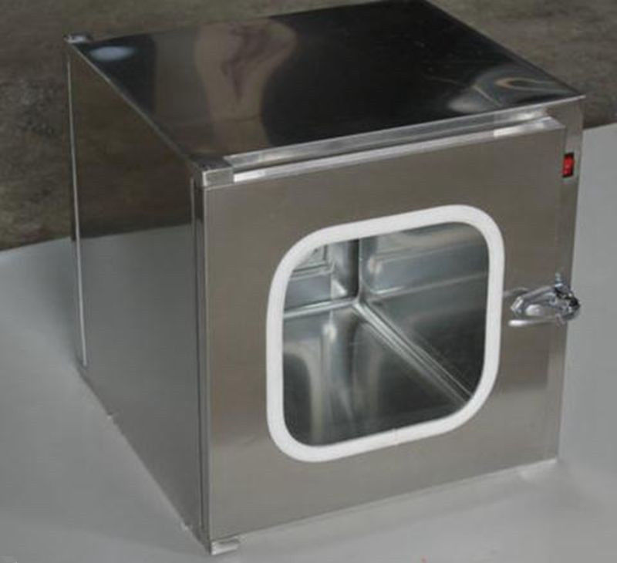
Pass Thru’s Sterile Compounding Facilities Sterile Compounding Facilities <795> <797> (<795>+<800>) (<797>+<800> - Slide 25
Be constructed of a nonporous, smooth, non-shedding, impermeable material such as acrylic, polycarbonate or similar fiberglass-reinforced plastic, glass, or stainless steel
Have an interlocking door design
Not be a refrigerator unit.
Gates Healthcare Associates, Inc. www.gateshealthcareassociates.com

Slide 35
Sterile Compounding Primary Engineering Control (PEC) <797>Non-Hazardous or <797> + <800> Hazardous - Slide 26
A containment primary engineering control (C-PEC) is a ventilated device designed to minimize worker and environmental HD exposure when directly handling HDs.
Containment secondary engineering controls (C-SEC) is the room in which the C-PEC is placed.
Supplemental engineering controls [e.g., closed-system drug-transfer device are adjunct controls to offer additional levels of protection
Sterile and nonsterile HDs must be compounded within a C-PEC located in a C-SEC.
Engineering controls are required to protect the preparation and worker from cross-contamination and microbial contamination during all phases of the compounding process
Gates Healthcare Associates, Inc. www.gateshealthcareassociates.com

Slide 36
Sterile Compounding Primary Engineering Control (PEC) <797>Non-Hazardous or <797> + <800> Hazardous - Slide 26
A containment primary engineering control (C-PEC) is a ventilated device designed to minimize worker and environmental HD exposure when directly handling HDs.
Containment secondary engineering controls (C-SEC) is the room in which the C-PEC is placed.
Supplemental engineering controls [e.g., closed-system drug-transfer device are adjunct controls to offer additional levels of protection
Sterile and nonsterile HDs must be compounded within a C-PEC located in a C-SEC.
Engineering controls are required to protect the preparation and worker from cross-contamination and microbial contamination during all phases of the compounding process
Gates Healthcare Associates, Inc. www.gateshealthcareassociates.com

Slide 37
Sterile Compounding Primary Engineering Control (PEC) <797>Non-Hazardous or <797> + <800> Hazardous - Slide 27
The C-PEC must operate continuously if used for sterile compounding or if the C-PEC supplies the negative pressure.
If there is any loss of power to the unit, or if repair or moving occurs, all activities occurring in the C-PEC must be suspended immediately
Gates Healthcare Associates, Inc. www.gateshealthcareassociates.com

Slide 38
Sterile Compounding Primary Engineering Control (PEC) <797>Non-Hazardous or <797> + <800> Hazardous - Slide 28
For entities that compound both nonsterile and sterile HDs, the respective C-PECs must be placed in segregated rooms, unless those C-PECs used for nonsterile compounding are sufficiently effective that the room can continuously maintain ISO 7 classification throughout the nonsterile compounding activity. (Difficult and not recommended) they must be placed at least 1 meter apart and particle-generating activity must not be performed when sterile compounding is in process.
A laminar airflow workbench (LAFW) or compounding aseptic isolator (CAI) must not be used for the compounding of an antineoplastic HD
A BSC or CACI used for the preparation of HDs must not be used for the preparation of a non-HD unless the non- HD preparation is placed into a protective outer wrapper during removal from the C- PEC and is labeled to require PPE handling precautions.
Gates Healthcare Associates, Inc. www.gateshealthcareassociates.com

Slide 39
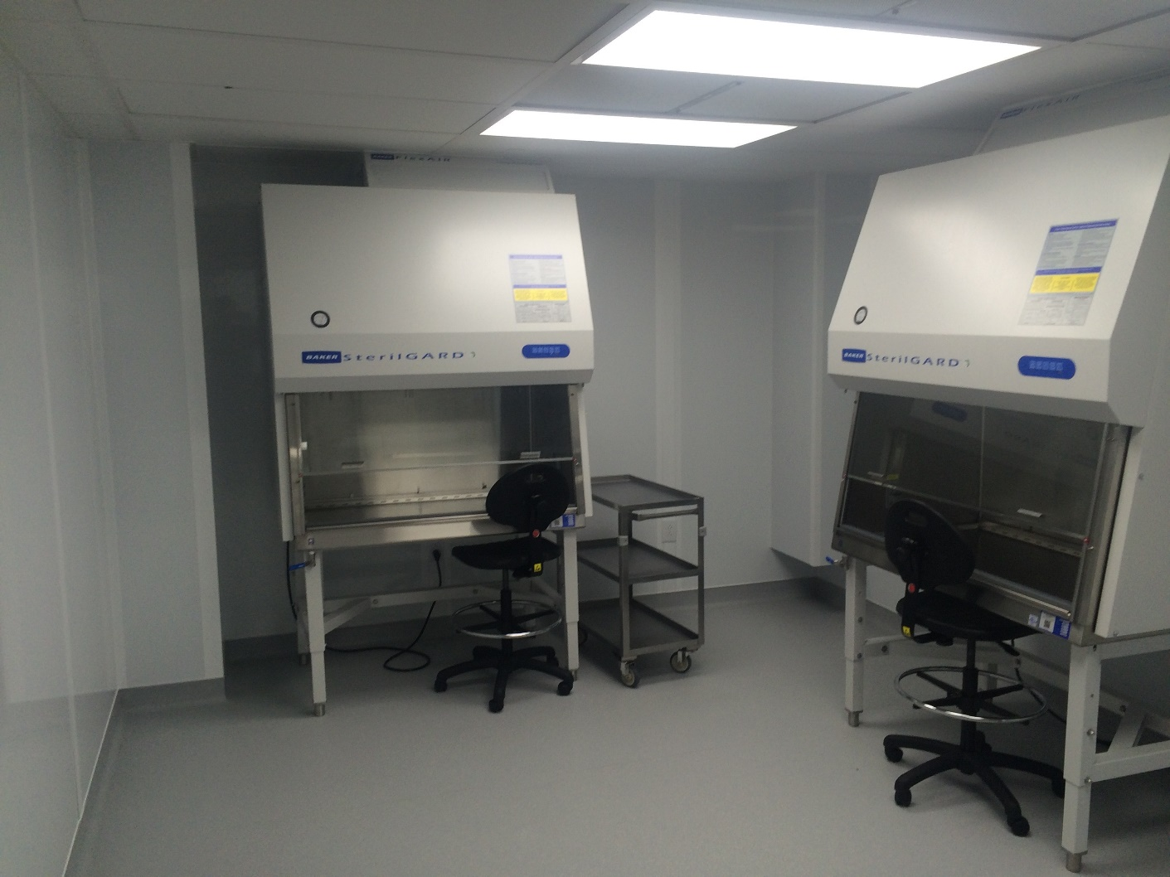
Sterile Compounding Primary Engineering Control (PEC) <797>Non-Hazardous or <797> + <800> Hazardous - Slide 29
Recommended overall floor to deck height = 12’ or greater
Pictured is estimated to be 8’ inside the room sitting only recommend a minimum of 8.5’
Placement of hoods should not be under a HEPA filter
Gates Healthcare Associates, Inc. www.gateshealthcareassociates.com

Slide 40
Sterile Compounding Primary Engineering Control (PEC) <797>Non-Hazardous Suggested PEC - Slide 30
Laminar airflow workbench ("LAFW") Horizontal or Vertical flow
Gates Healthcare Associates, Inc. www.gateshealthcareassociates.com

Slide 41
Sterile Compounding Primary Engineering Control (PEC) <797>Non-Hazardous Suggested PEC - Slide 31
Compounding Aseptic Containment
Isolator (CACI)
Gates Healthcare Associates, Inc. www.gateshealthcareassociates.com

Slide 42
Sterile Compounding Primary Engineering Control (PEC) <797>Non-Hazardous Suggested PEC - Slide 32
Laminar airflow workbench ("LAFW") Horizontal or Vertical flow
A laminar airflow workbench (LAFW) or compounding aseptic isolator (CAI) must not be used for the compounding of an antineoplastic HD
The C-PEC must be located in a C-SEC, which may either be an ISO Class 7 buffer room (preferred) or an unclassified containment segregated compounding area (C- SCA).
If the C-PEC is placed in a C-SCA, the beyond-use date (BUD) must be limited as defined in 797)
Gates Healthcare Associates, Inc. www.gateshealthcareassociates.com

Slide 43
Sterile Compounding Primary Engineering Control (PEC) <797> +<800> Hazardous Suggested PEC - Slide 33
Class II type B2 BSCs
Most Frequent for most known HDs, type A2 cabinets offer a simple and reliable integration with the ventilation and pressurization requirements of the C-SEC.
ClassII BSC or CACI Externally Vented to house air via a thimble assembly blending Buffer room air (approx. 15%) with the BSC exhaust.
Gates Healthcare Associates, Inc. www.gateshealthcareassociates.com

Slide 44
Sterile Compounding Primary Engineering Control (PEC) <797> +<800> Hazardous Suggested PEC - Slide 34
CII B2 BSC blower discharge assembly(s) shall be engineered to discharge outside the facility consistent within local requirements and codes. The blower system(s) shall be directly connected to the BSC discharging the required air volume as specified by the manufacturer. A second exhaust system shall be required to supplement the BSC discharge. Although not mandated 12 ACPH is suggested. The Blower shall be roof mounted keeping the ducting under negative pressure outside the building.
The roof mounted blower shall be placed subject to local codes for HD exhaust. HEPA filter discharge is not required.
Gates Healthcare Associates, Inc. www.gateshealthcareassociates.com

Slide 45
Sterile Compounding Primary Engineering Control (PEC) <795> <800> Non-Hazardous Suggested PEC - Slide 35
Containment Ventilated Enclosure (CVE) single HEPA Can be recirculated in non-hd room Requires to be exhausted into a thimble assembly to be collected by house air in HD conditions
Containment Ventilated Enclosure (CVE) Redundant HEPA Can be recirculated in a sterile-hd room as long as the room is exhausting a minimum of 12 acph. Replaces the need for a thimble assembly, easier to place and saves make up air energy.
Gates Healthcare Associates, Inc. www.gateshealthcareassociates.com

Slide 46
Sterile Compounding Primary Engineering Control (PEC) <795> Non-Sterile HD Suggested Redundant HEPA PEC - 36
Non-Sterile hazardous C-PEC redundant HEPA Method: Double HEPA Containment Ventilated Enclosure (s) (CVE) shall be located in a secondary engineering controls (C-SEC) hazardous (NIOSH) room and be recirculated within the HD SEC. The SEC room shall maintain a minimum 12 Air Changes per hour exhaust per hour.
The USP 800 USP 795 blower assembly(s) shall be engineered to discharge outside the facility consistent within local requirements and codes. The blower system(s) shall be designed to provide a minimum of 12 ACPH and differential negative pressure of 0.01” to 0.03” water column. The Blower shall be roof mounted keeping the ducting under negative pressure outside the building.
Gates Healthcare Associates, Inc. www.gateshealthcareassociates.com

Slide 47
Sterile Compounding Primary Engineering Control (PEC) <795>+<800> Non-Sterile HD Single HEPA PEC - Slide 37
The USP 800 USP 795 blower assembly(s)
Shall be engineered to discharge outside the facility consistent within local requirements and codes.
The blower system(s) shall be designed to provide a minimum of 12 ACPH and include the required exhausted volume of all Containment Ventilated Enclosure(s) (CVE) with thimble assemblies.
The system shall provide a differential negative pressure of 0.01” to 0.03” water column.
The Blower shall be roof mounted keeping the ducting under negative pressure outside the building.
Gates Healthcare Associates, Inc. www.gateshealthcareassociates.com

Slide 48
Time for Questions and Comments
???-!!!
Notes:
It’s time to check our Q&A in‐box. There is still time to type questions and comments in the text dialog box on your screen.
We will respond to all questions including those we might not have time to answer during the live session. You or the individual who registered your site will receive an email giving a link to the webinar Survey/Report Form. The form needs be completed individually to get AIA/CES credit. Once completed you will have access to an AIA Knowledge Community folder including a PDF of this presentation, and transcript of attendee questions with presenter response.
MODERATOR READS QUESTIONS / COMMENTS TO PRESENTER
That’s all the time we have today for Q&A. We will respond to all questions, including those we might not have time to answer during the live session. Bob, please advance the slides
[Manual advance at 58:00 – approximately 10 min. per time budget]

Slide 49
CES Reminder
The URL to the webinar survey https://www.surveymonkey.com/r/AAH1904 will be emailed to the individual who registered your site.
The survey closes Friday, May 17, 2019 at 12:30am ET.
For questions, please email knowledgecommunities@aia.org
Notes:
Thank you for joining us, and thanks to our presenter(s), Bob Falkum and Bill Mixon
See the person who registered your site – this person will receive an email with directions at the close of this session. You must take the survey individually to get credit.
[Auto advance in 25 seconds]

Slide 50
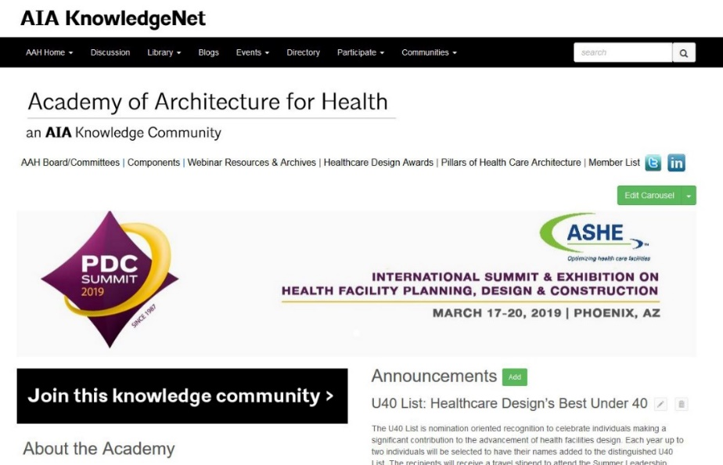
Join the Academy of Architecture for Health
www.aia.org/aah
Notes:
Here is how to join or update your account . . .
Membership in the Academy has many benefits including receipt of the Academy Newsletter, Access to our Knowledge Repository, and Award/Scholarship and Fellowship opportunities
(Auto advance in 15 seconds)

Slide 51
Upcoming Webinars
Date | Series | Topic
6/11 | HC 101 Series | IMEG Webinar (Medical Equipment Planning)
7/9 | Beyond the Basics | Pre-Post areas of Ambulatory Surgery
8/13 | Case Study Series | TBD
Dates & topics are subject to change
Notes:
Why not register now to attend our next session –
IMEG Webinar (Medical Equipment Planning)
Hope to see you then!
[Should start within 60 seconds of 1:00:00 session stop point]

