Slide 1
Academy of Architecture for Health On-line Professional Development
Design and Implementation of Secure Exam Rooms in Emergency Departments
Health Care 101 Series
December 4, 2018
2:00 pm – 3:00 pm ET
1:00 pm – 2:00 pm CT
12:00 am – 1:00 pm MT
11:00 am – 12:00 pm PT
Presenter
Joe Britton
LAVALLEE BRENSINGER ARCHITECTS
Moderator
Gregg D. Ostrow, AIA

Slide 2
Academy of Architecture for Health On-line Professional Development
Design and Implementation of Secure Exam Rooms in Emergency Departments
Health Care 101 Series
December 4, 2018
2:00 pm – 3:00 pm ET
1:00 pm – 2:00 pm CT
12:00 am – 1:00 pm MT
11:00 am – 12:00 pm PT
Presenter
Joe Britton
LAVALLEE BRENSINGER ARCHITECTS
Moderator
Gregg D. Ostrow, AIA

Slide 3
Health Care 101 Series
The Academy’s multi-channel on-line approach provides emerging professionals, journeymen, and master professionals with convenient and economical opportunities to develop their chosen area of interest.
The HC 101 Series sessions are tailored to provide budding healthcare design professionals with conceptual and practical primer-level knowledge.
Series topics include: Master planning; Programming; Ambulatory care; Clinical support services; Emergency; ICI-acute care; Imaging; Long-term care; Maternal care; Mental health; Surgery.

Slide 4
Copyright Materials
This presentation is protected by US and International Copyright laws. Reproduction, distribution, display and use of the presentation without written permission of the speaker is prohibited.
©2018 The American Institute of Architects

Slide 5
Compliance Statement
“AIA Knowledge” is a Registered Provider with The American Institute of Architects Continuing Education Systems (AIA/CES). Credit(s) earned on completion of this program will be reported to AIA/CES for AIA members. Certificates of Completion for both AIA members and non-AIA members are available upon special request.
This program is registered with AIA/CES for continuing professional education. As such, it does not include content that may be deemed or construed to be an approval or endorsement by the AIA of any material of construction or any method or manner of handling, using, distributing, or dealing in any material or product.

Slide 6
Questions?
Submit a question to the moderator via the chat box.
Content-related questions will be answered during the Q&A portion at the end as time allows.
Tech support questions will be answered by AIA staff promptly.

Slide 7
Design and Implementation of Secure Exam Rooms in Emergency Departments
Presenter Moderator
Joe Britton
LAVALLEE BRENSINGER ARCHITECTS
Gregg D. Ostrow, AIA

Slide 8
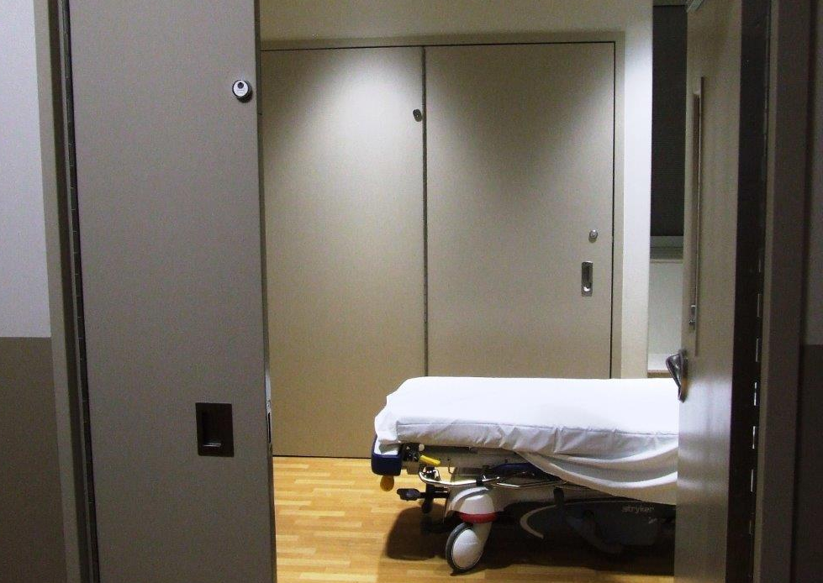
Design and Implementation of Secure Exam Rooms in Emergency Departments
Rutland Regional Medical Center

Slide 9
“With no placements in sight for Vermont State Hospital Patients, Officials say situation is now urgent.” Andrew Nemethy
“Irene kills off the State Hospital.”
Nathan Burgess
“Medical professionals say ER treatment for Psychiatric patients is woefully inadequate.”
Andrew Stein
“Vermont facing shortage of psychiatric beds for kids.”
Erin Mansfield
"Emergency room wait times for Vermont psychiatric patients hit a high.”
Andrew Stein
“2 years later, Vermont still recovering from Irene.”
Nancy Remsen, The Burlington (Vt.) Free Press
“New psychiatric facility hasn’t solved crisis in care.”
Tiffany Danitz Pache
“Shortage of mental health beds reaches crisis levels in Vermont.”
Vermont Medical Society
“Involuntary psychiatric hospitalizations at record high.”
Erin Mansfield

Slide 10
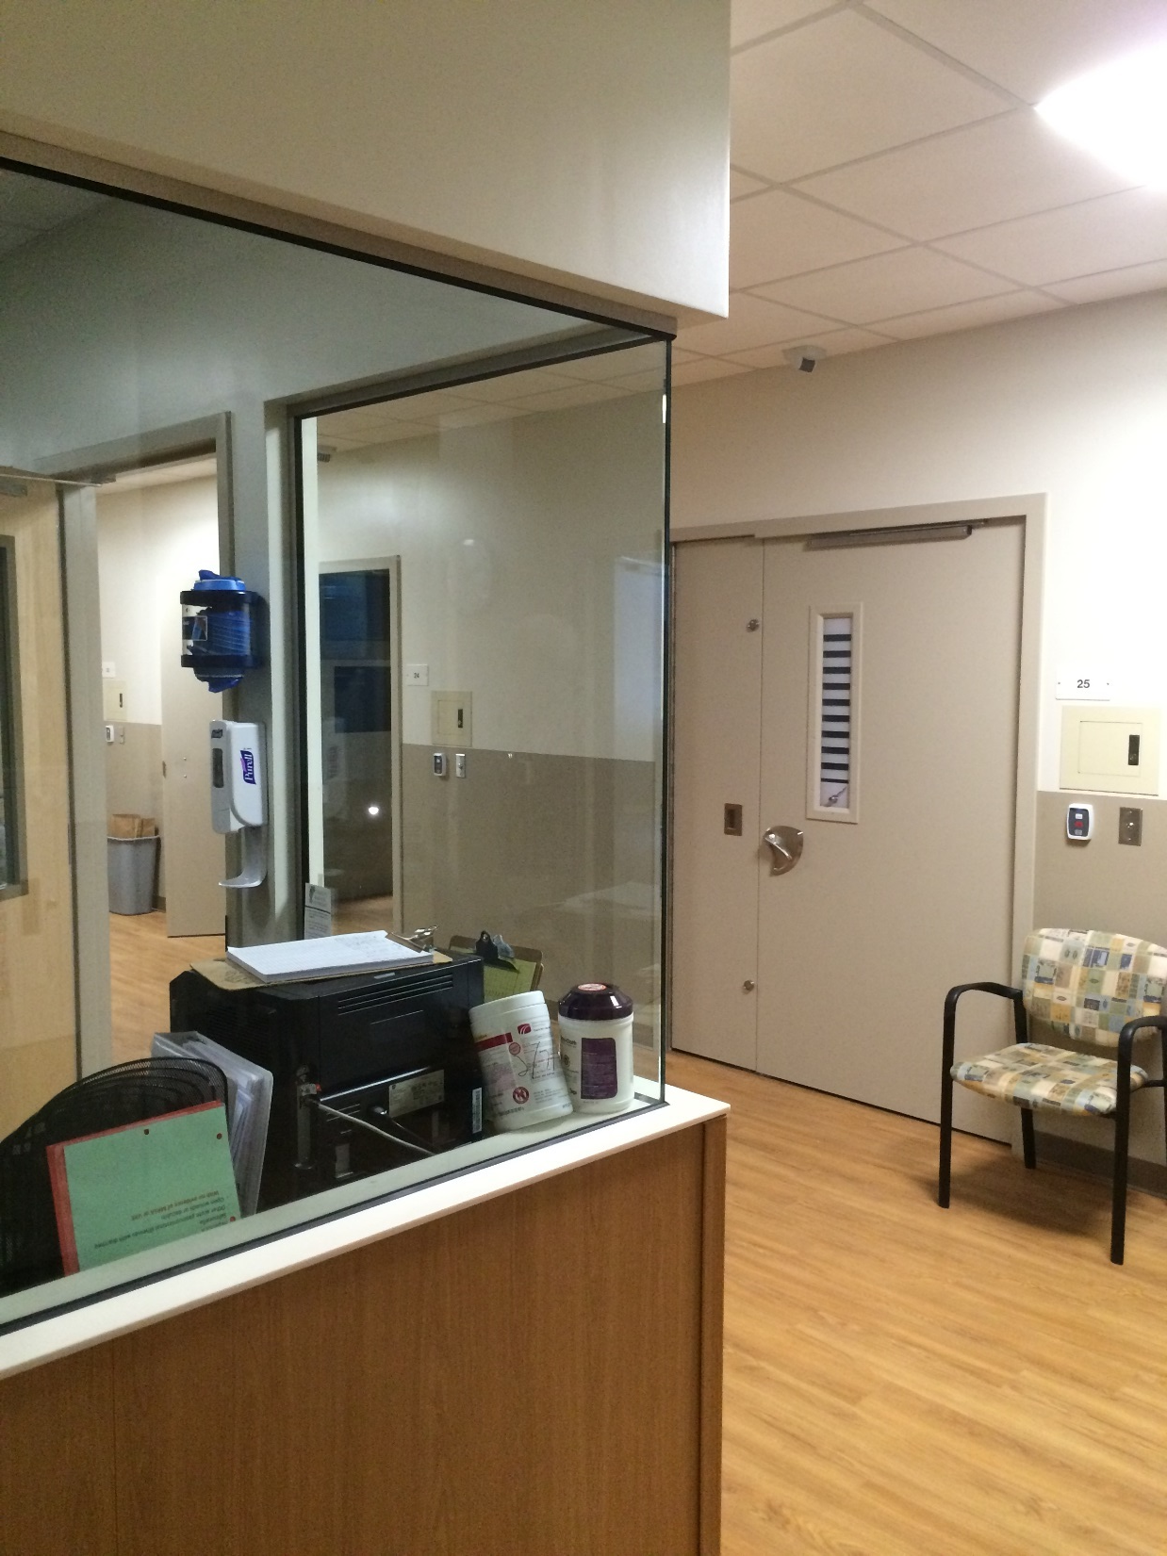
Patient Safety
Staff Safety
The Experience

Slide 11
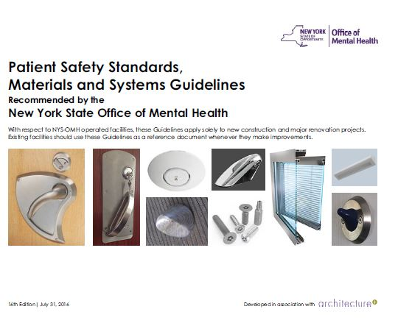
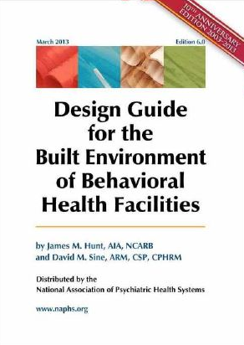
Resources
www.lbpa.com

Slide 12
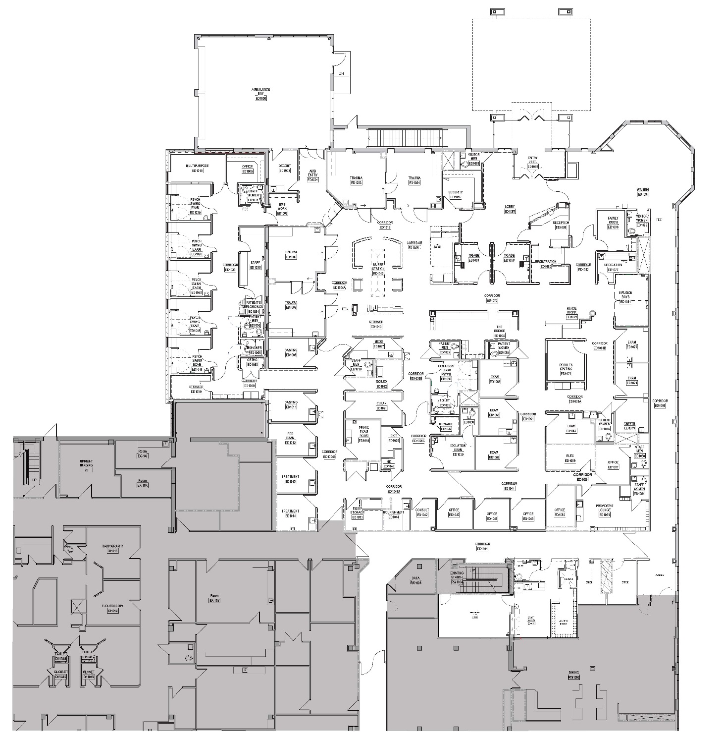
Location
Determinations
Unit
Room / Detail
www.lbpa.com

Slide 13
Emergency Department Process Analysis
Determinations
June 30, 2015

Slide 14
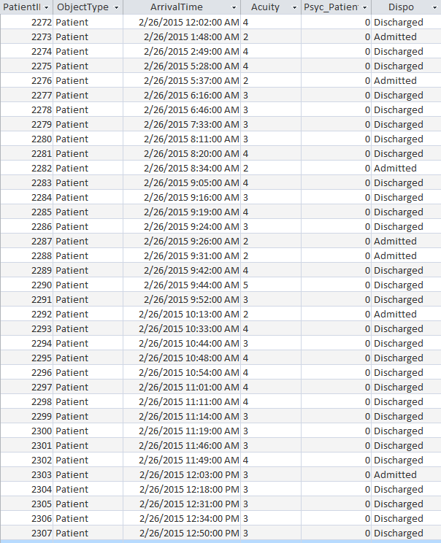
Basis of Analysis – Data & Variables
Historical Arrival, Acuity, MH Status, and Disposition

Slide 15
Mental Health Patients - Holding
Frequency
Hours

Slide 16
Basis of Analysis – Developing a Baseline

Slide 17
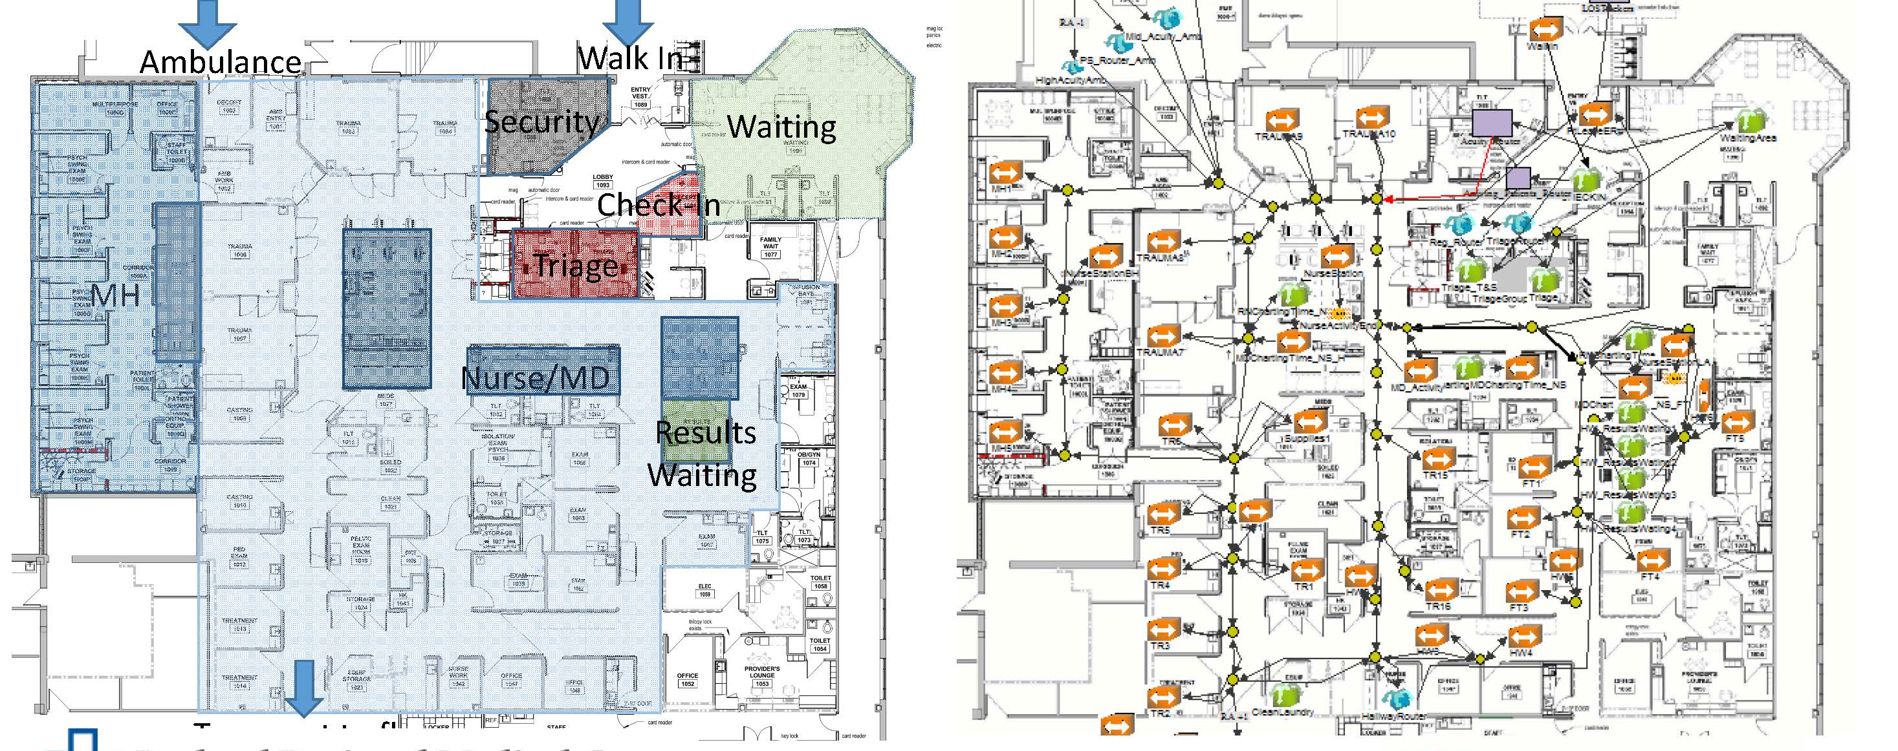
Proposed Plan

Slide 18
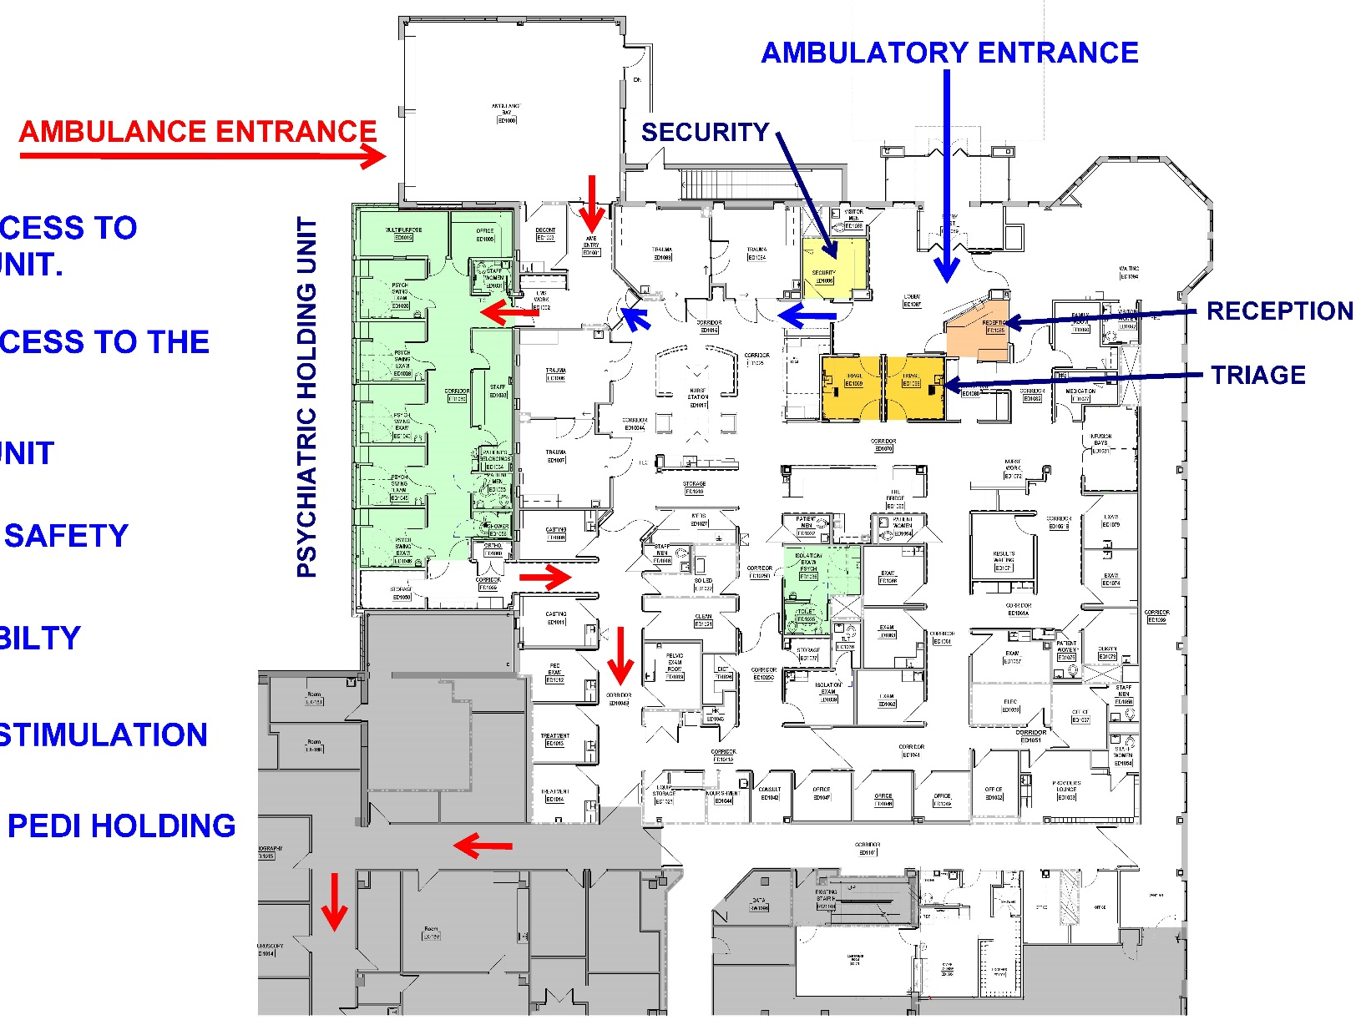
Location

Slide 19
Upcoming Break for Questions and Comments
Submit a question to the moderator via the chat box.

Slide 20
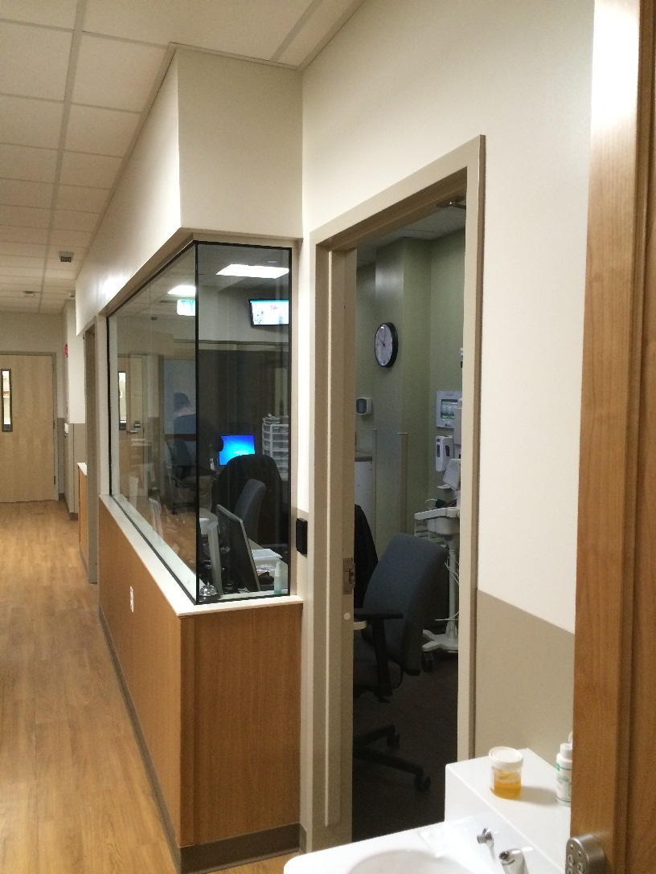
Unit
Psychiatric Holding Unit

Slide 21
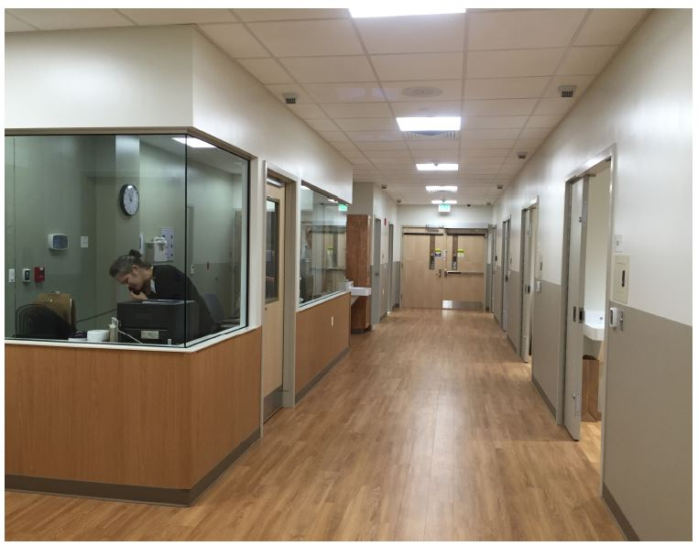
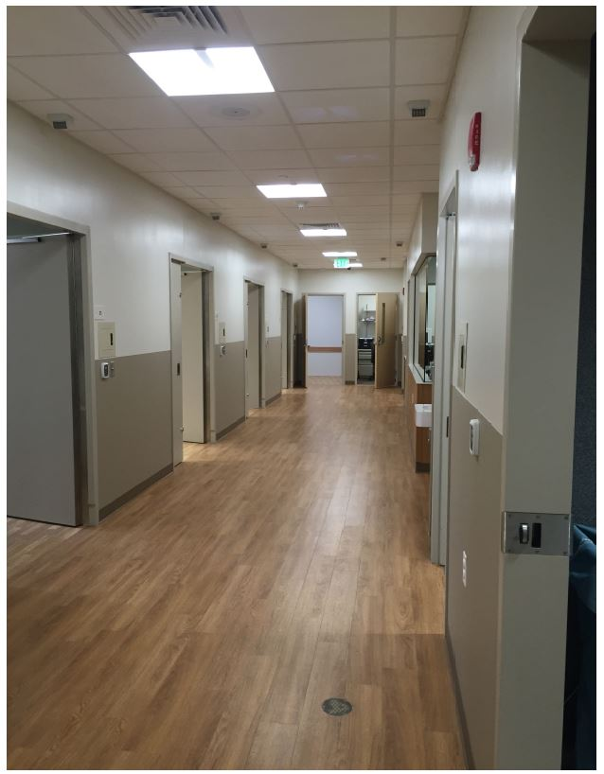

Slide 22
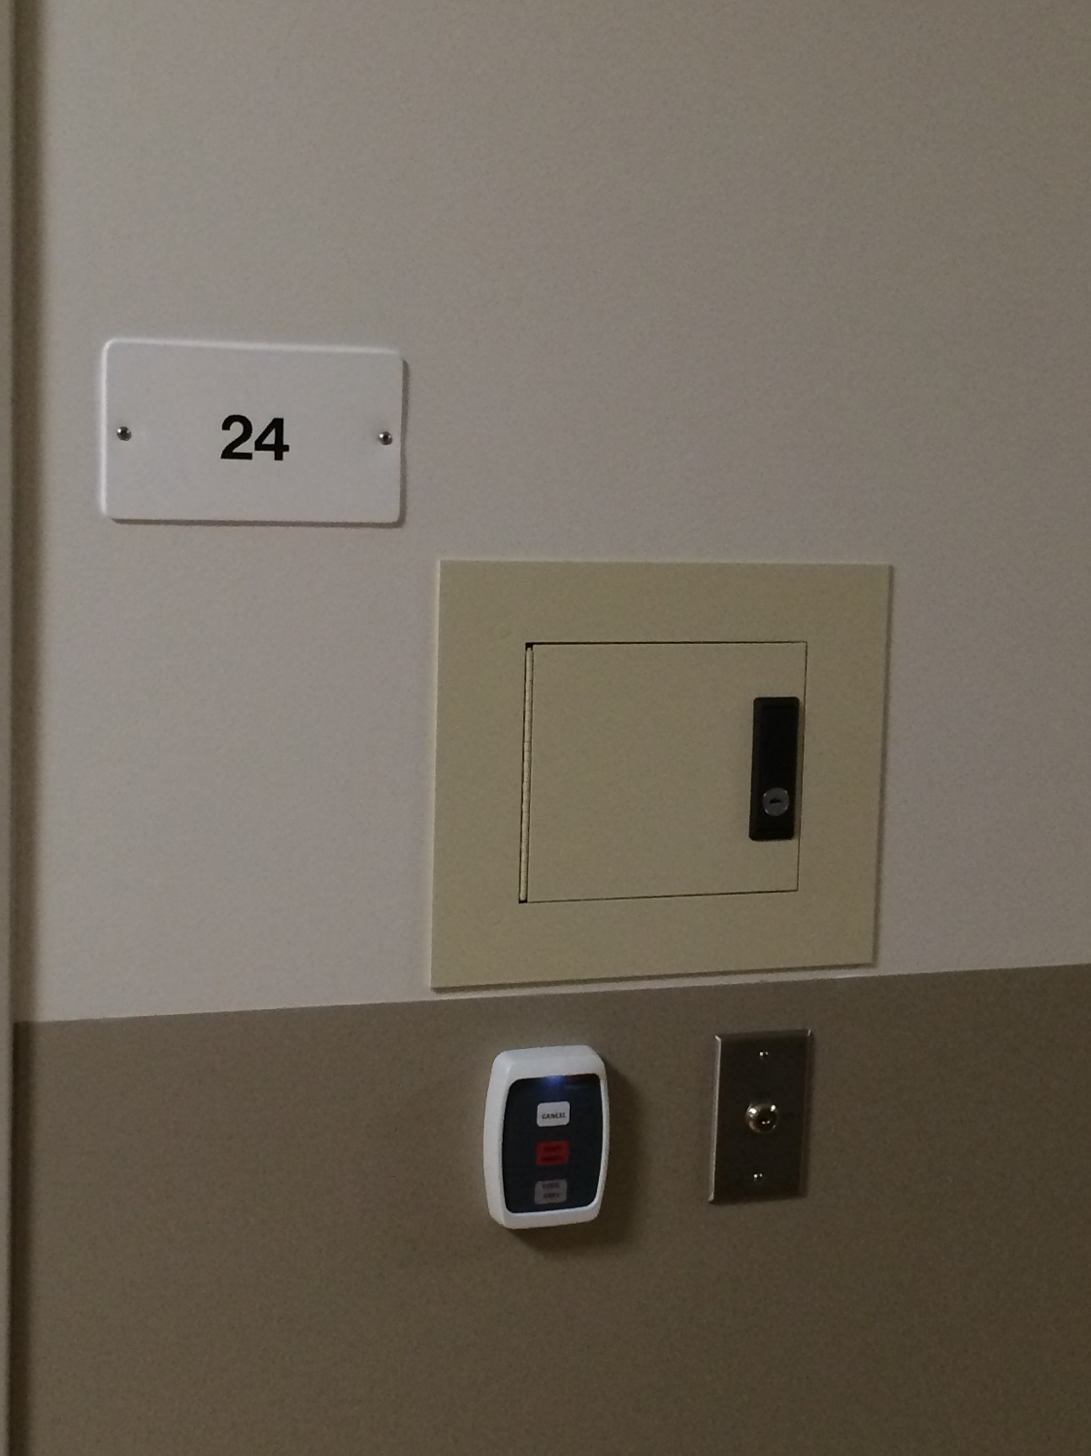
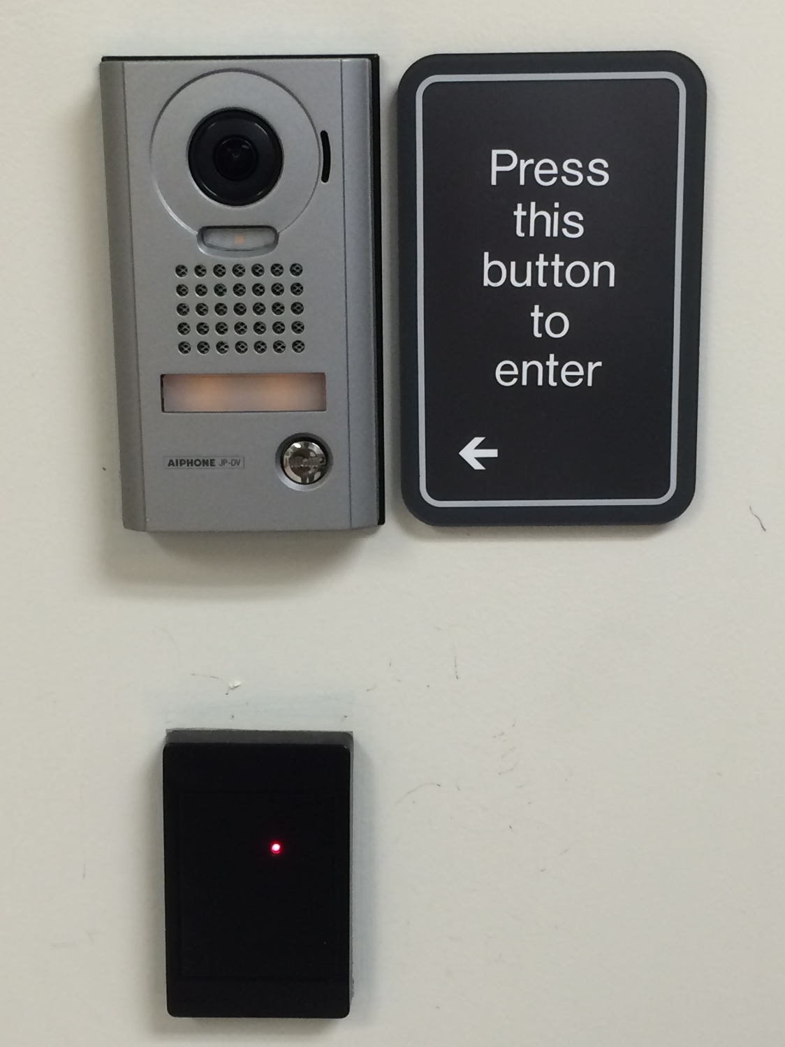

Slide 23
Room / Detail
Psychiatric Holding Room / Exam Room

Slide 24
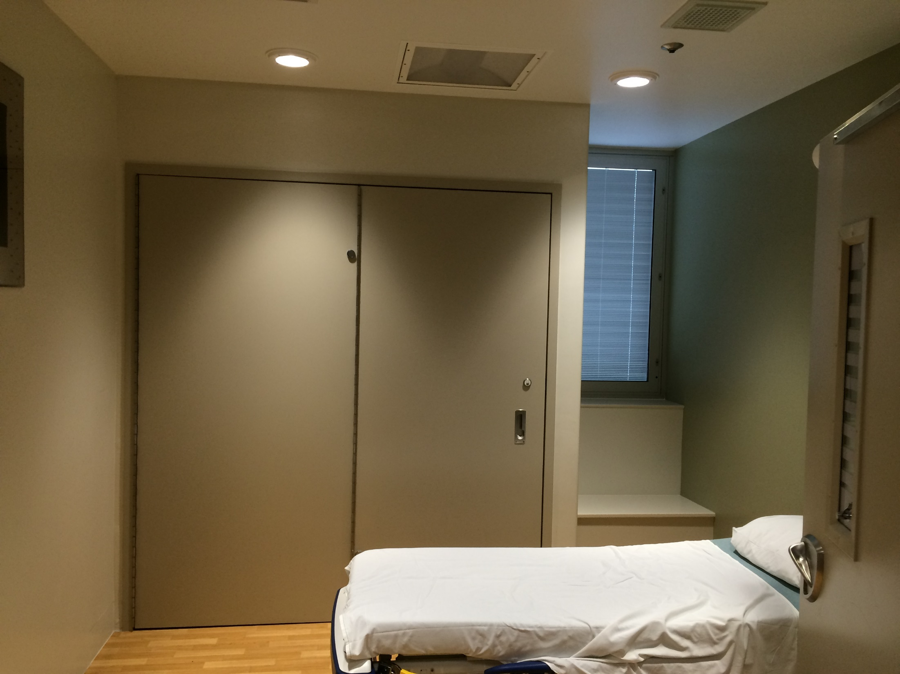

Slide 25
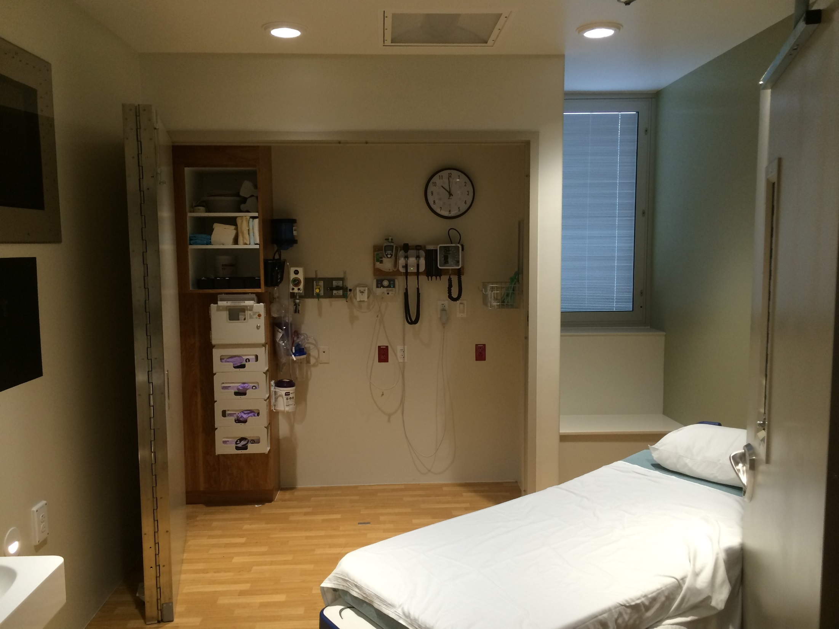

Slide 26
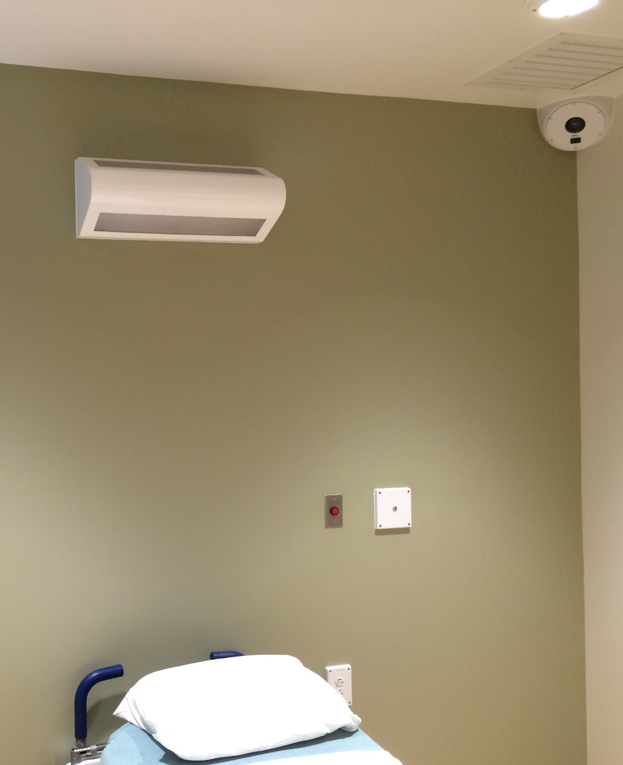
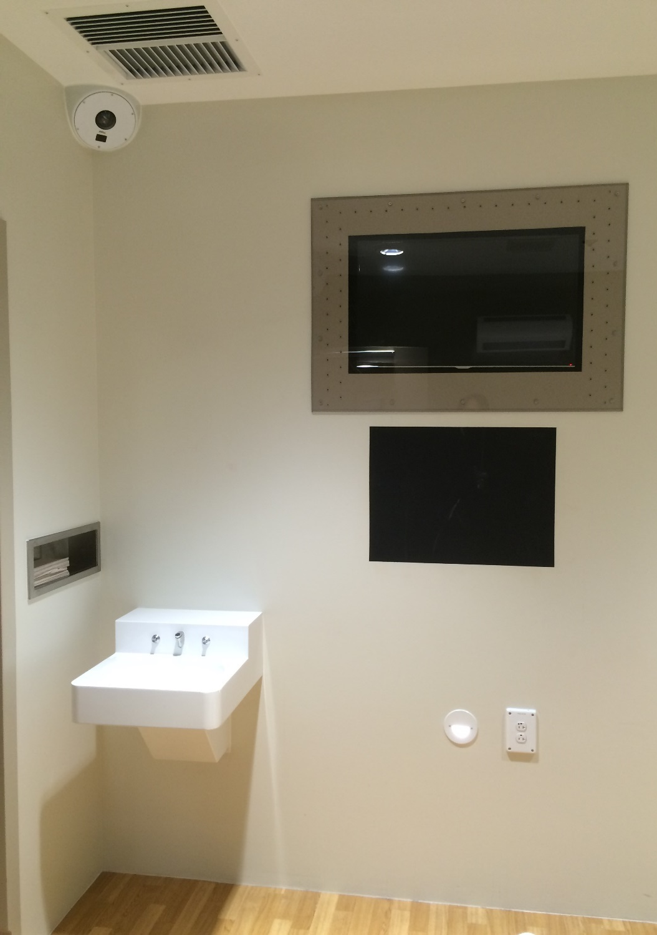

Slide 27
Q&A
Thank You!
Further questions please contact:
Joe Britton
603.622.5450 x115
joe.britton@lbpa.com
www.lbpa.com

Slide 28
CES Credit
All attendees are eligible to receive: 1.0 HSW/CEU (AIA continuing education)
Attendees at your site can submit for credit by individually completing the webinar’s survey and report form. The survey closes Friday, December 7, 2018 at 12:30 am EDT.
The URL to the webinar survey/form https://www.research.net/r/AAH1811 will be emailed to the person who registered your site.
More continuing education questions? Email . . . knowledgecommunities@aia.org.

Slide 29
Join us at The Academy of Architecture for Health!
• Receive Academy Update newsletters
• Access to resources
Knowledge Repository
Webinars
Award programs
Scholarships, Fellowships
Emerging professionals benefits
National and regional conferences and events
Social media, publications, blogs and Twitter

Slide 30
To join us or update your account go to . . .
www.aia.org/aah
Click here

Slide 31
Upcoming Webinars*
Date | Series | Topic
2/12 | Beyond the Basics | Holding Ourselves to Higher Standards: Healthy Materials Every Time
3/12 | HC101 | Ancillary to Essential: Technology’s New Role in Healthcare Design and Operations
4/9 | Beyond the Basics | AAH/Center for Health Design Knowledge Repository: How to Use and Example Application
*Dates and topics are subject to change
Visit www.aia.org/aah for more information and to register.

