Slide 1
BIM and Contract Administration: Building the Connection Between Design and Construction
SESSION ID: WE300
[Wednesday, 16 May 2012, 1:00 pm]

Slide 2
This presentation is protected by US and International Copyright laws. Reproduction, distribution, display and use of the presentation without written permission of the speaker is prohibited.

Slide 3
Acknowledgements/Credits
We would like to thank the following for the use of their images:
Swanke Hayden Connell Architects
Braun & Steidl Architects, Inc.
Perkins+Will
AutoDesk
BNBuilders

Slide 4
AIA/CES Quality Statement
This program is registered with the AIA/CES for continuing professional education. As such, it does not include content that may be deemed or construed to constitute approval, sponsorship or endorsement by the AIA of any method, product, service, enterprise or organization. The statements expressed by speakers, panelists, and other participants reflect their own views and do not necessarily reflect the views or positions of The American Institute of Architects or of AIA components, or those of their respective officers, directors, members, employees, or other organizations, groups or individuals associated with them. Questions related to specific products, publications, and services may be addressed at the conclusion of this presentation.

Slide 5
Learning Objectives
Discuss how BIM affects submittal preparation and review, systems coordination, document changes, and requests for interpretation
Discuss how the definition of "contract documents" is evolving in the new BIM-centered construction environment
Identify how architects' liabilities and risks are changing by using BIM in contract administration, and what can be done to mitigate them
Compare how architects and contractors can individually and collaboratively make the best use of BIM during construction

Slide 6
Moderator
Burton Roslyn, FAIA
Roslyn Consultants LLC

Slide 7
Panelists
Michael De Chiara, JD, AIA Adjunct Member
Zetlin & De Chiara, LLP
David Abramovitz, JD
Zetlin & De Chiara, LLP
Bill Schmalz, AIA
Perkins+Will
Charles Schreckenberger, AIA
Braun & Steidl Architects
Steven Shapiro, JD, Honorary AIA
The Whiting-Turner Contracting Company

Slide 8
Agenda
1:00–1:15
The Basics of Building Information Modeling (BIM)
1:15–2:00 Panel Discussion
BIM During Design and Construction
2:00–2:20 Breakout Session 1
How can BIM lead to integrated project delivery methods?
2:20–3:00 Panel Discussion
BIM and Project Delivery Methods

Slide 9
3:00–3:20 Breakout Session 2
What are your legal questions about BIM?
3:20–4:00 Panel Discussion
BIM, the Law, and the Contract Documents
4:00–4:20 Breakout Session 3
How do you want the AIA documents to address BIM?
4:20–4:50 Panel Discussion
BIM and the Client
4:50–5:00
Questions

Slide 10
Introduction
The Basics of BIM

Slide 11
Who is using BIM now?

Slide 12
Who is using BIM on every project?

Slide 13
Who believes that BIM is helping their projects?

Slide 14
What is Building Information Modeling?
Design tool
Decision-making tool
Visualization tool
Coordination tool
Collaboration tool
Integration tool
Marketing tool
Facilities management tool

Slide 15
Redefining CCA in the BIM age

Slide 16
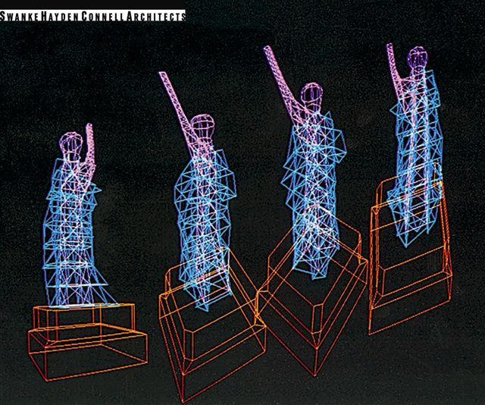
What is Building Information Modeling?
Statue of Liberty Restoration (1976)

Slide 17
Part 1
BIM During Design and Construction

Slide 18
BIM as a design tool
Notes:
Bill

Slide 19
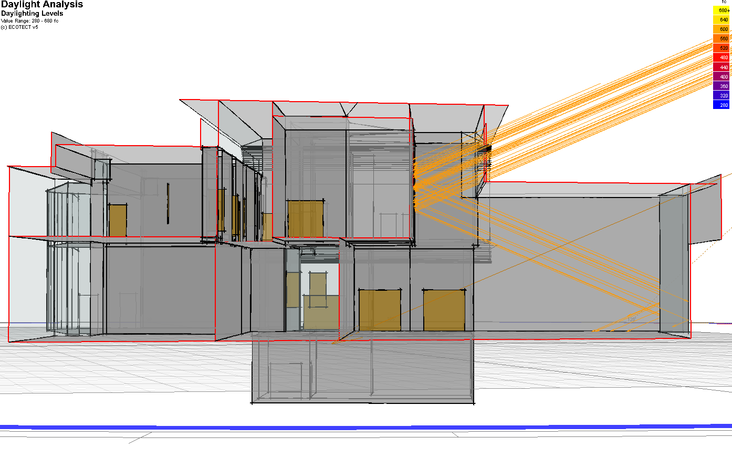
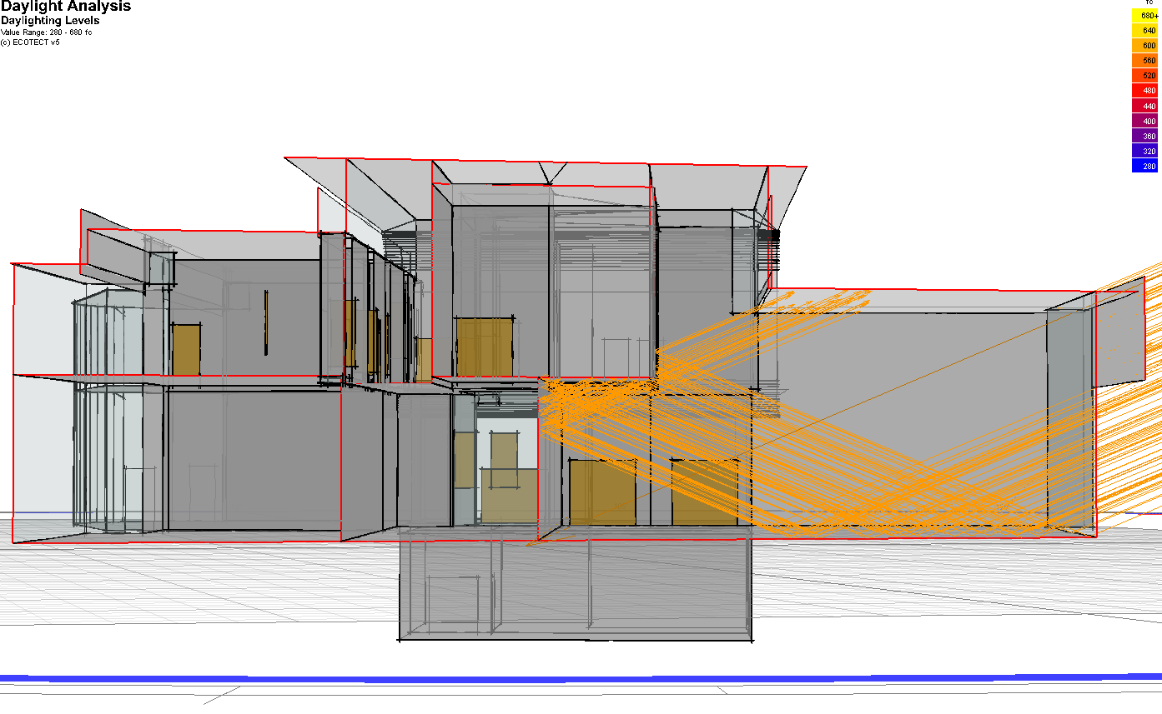
BIM as a design tool

Slide 20
BIM as a design tool

Slide 21
BIM as a visualization tool

Slide 22
BIM as a visualization tool

Slide 23
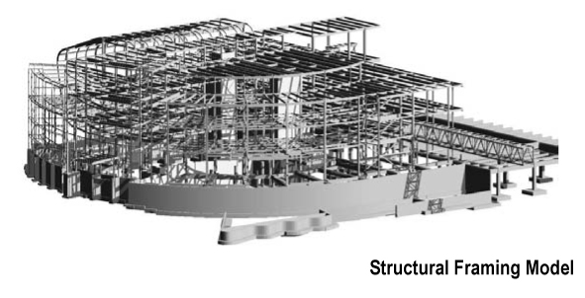
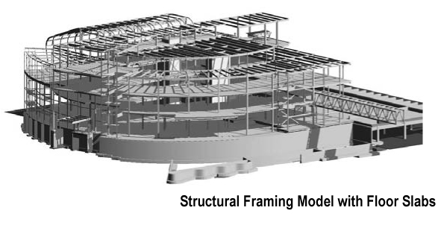
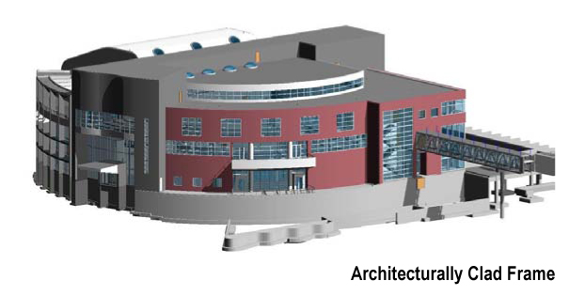
BIM and project phases

Slide 24
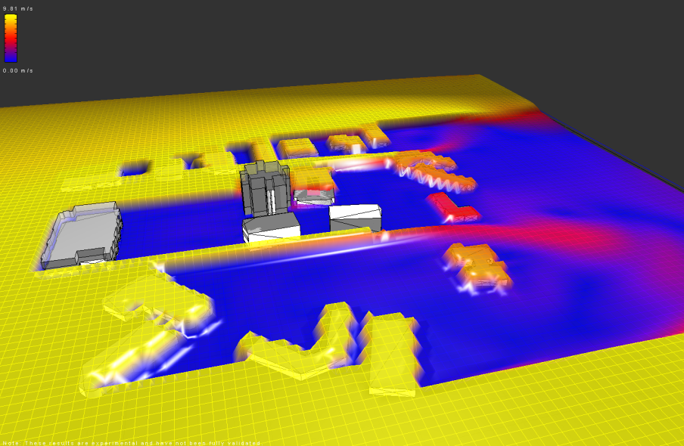
Helping small firms act like big firms

Slide 25
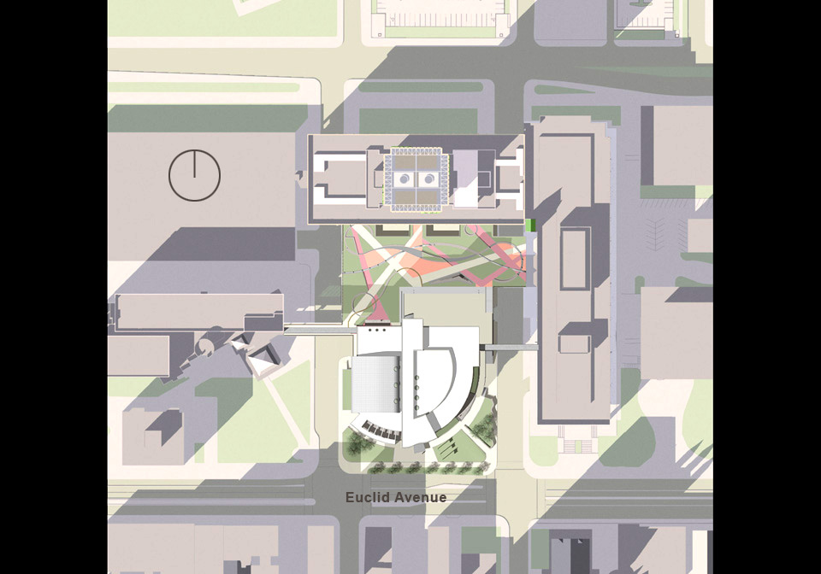
Helping small firms act like big firms

Slide 26
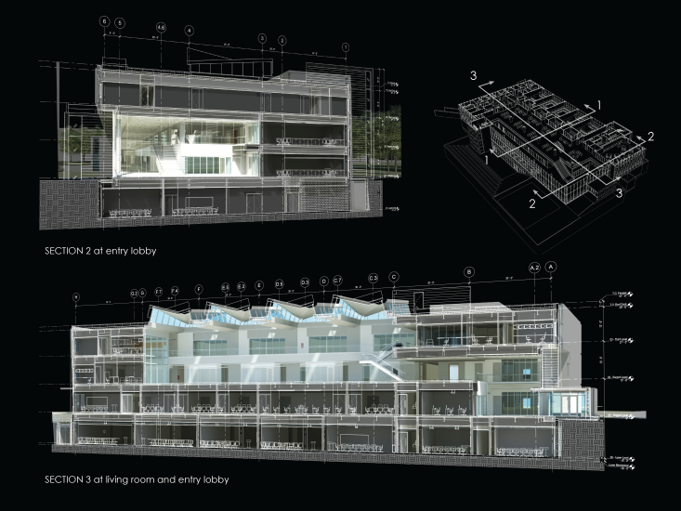
BIM model as Contract Document

Slide 27
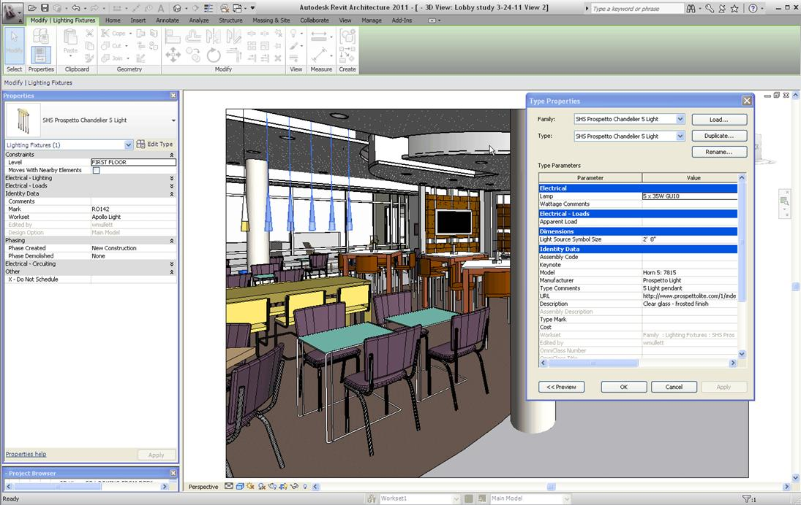
BIM model as Contract Document

Slide 28
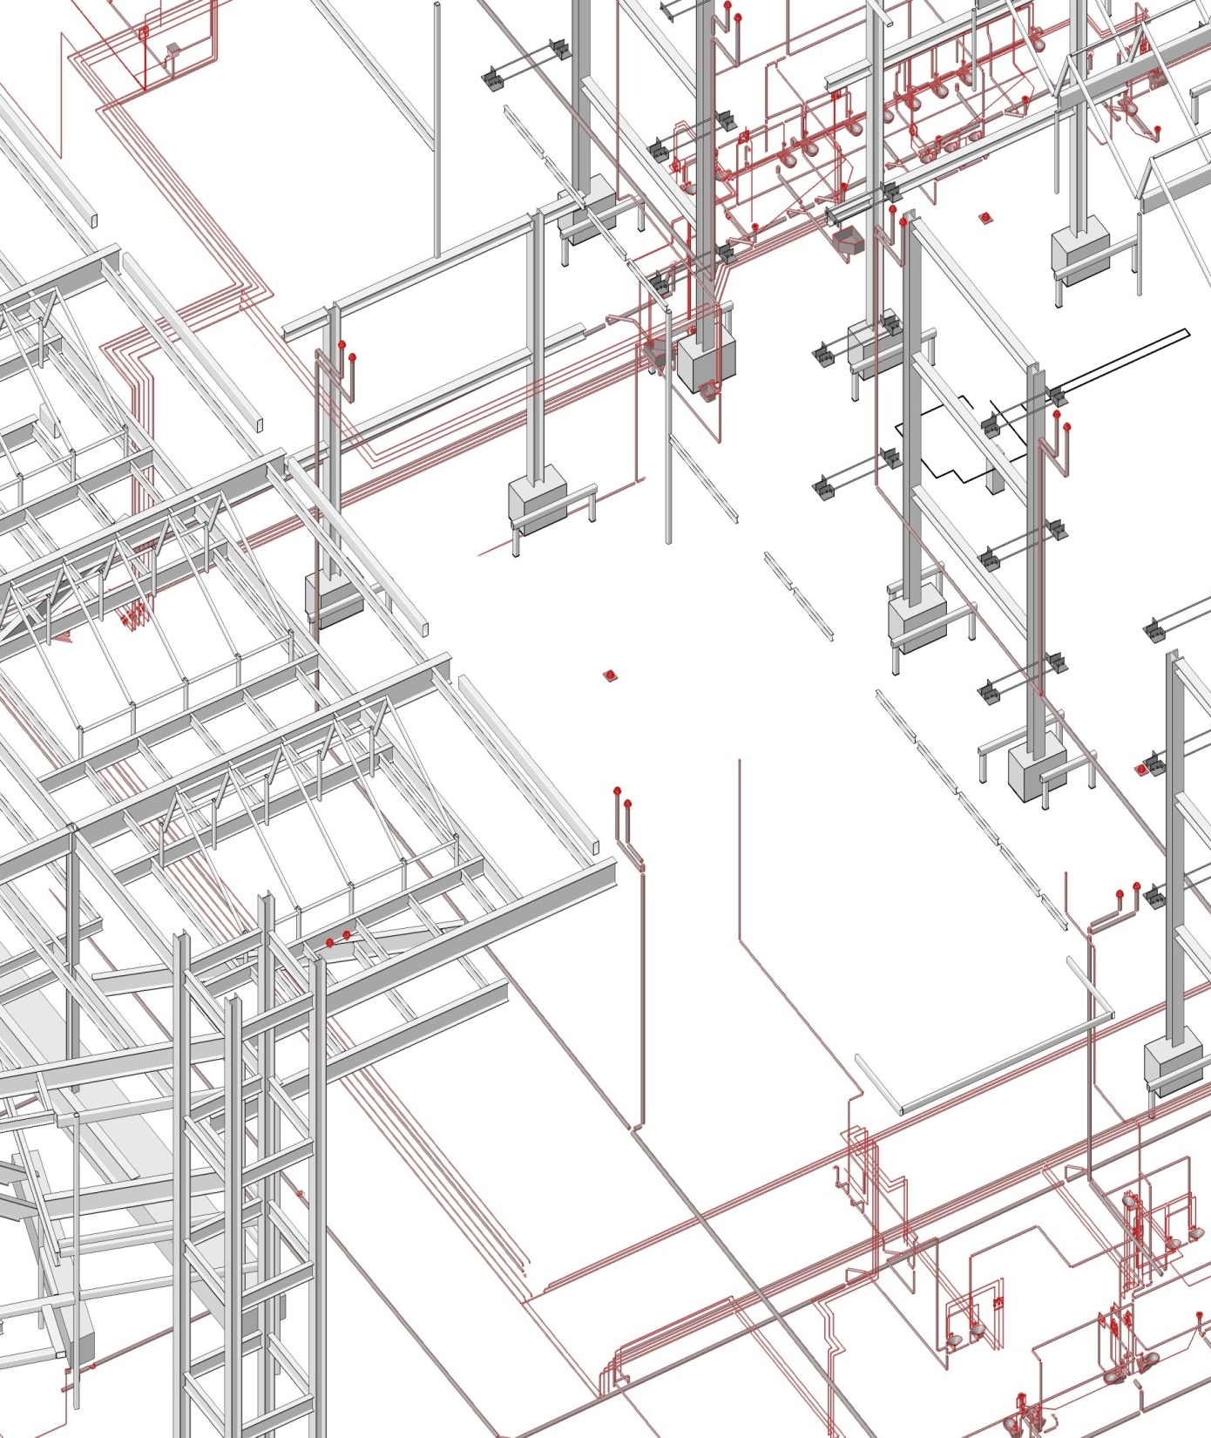
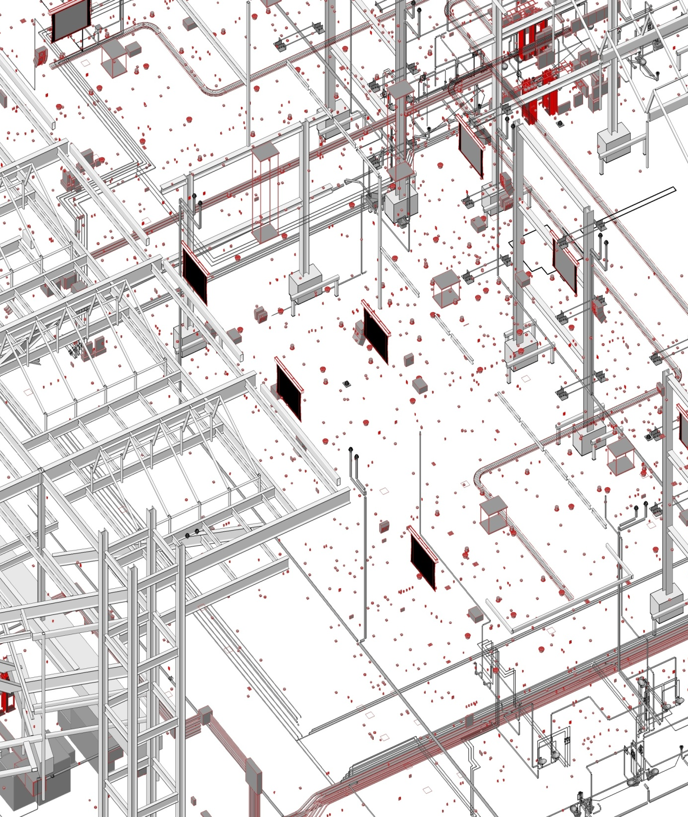
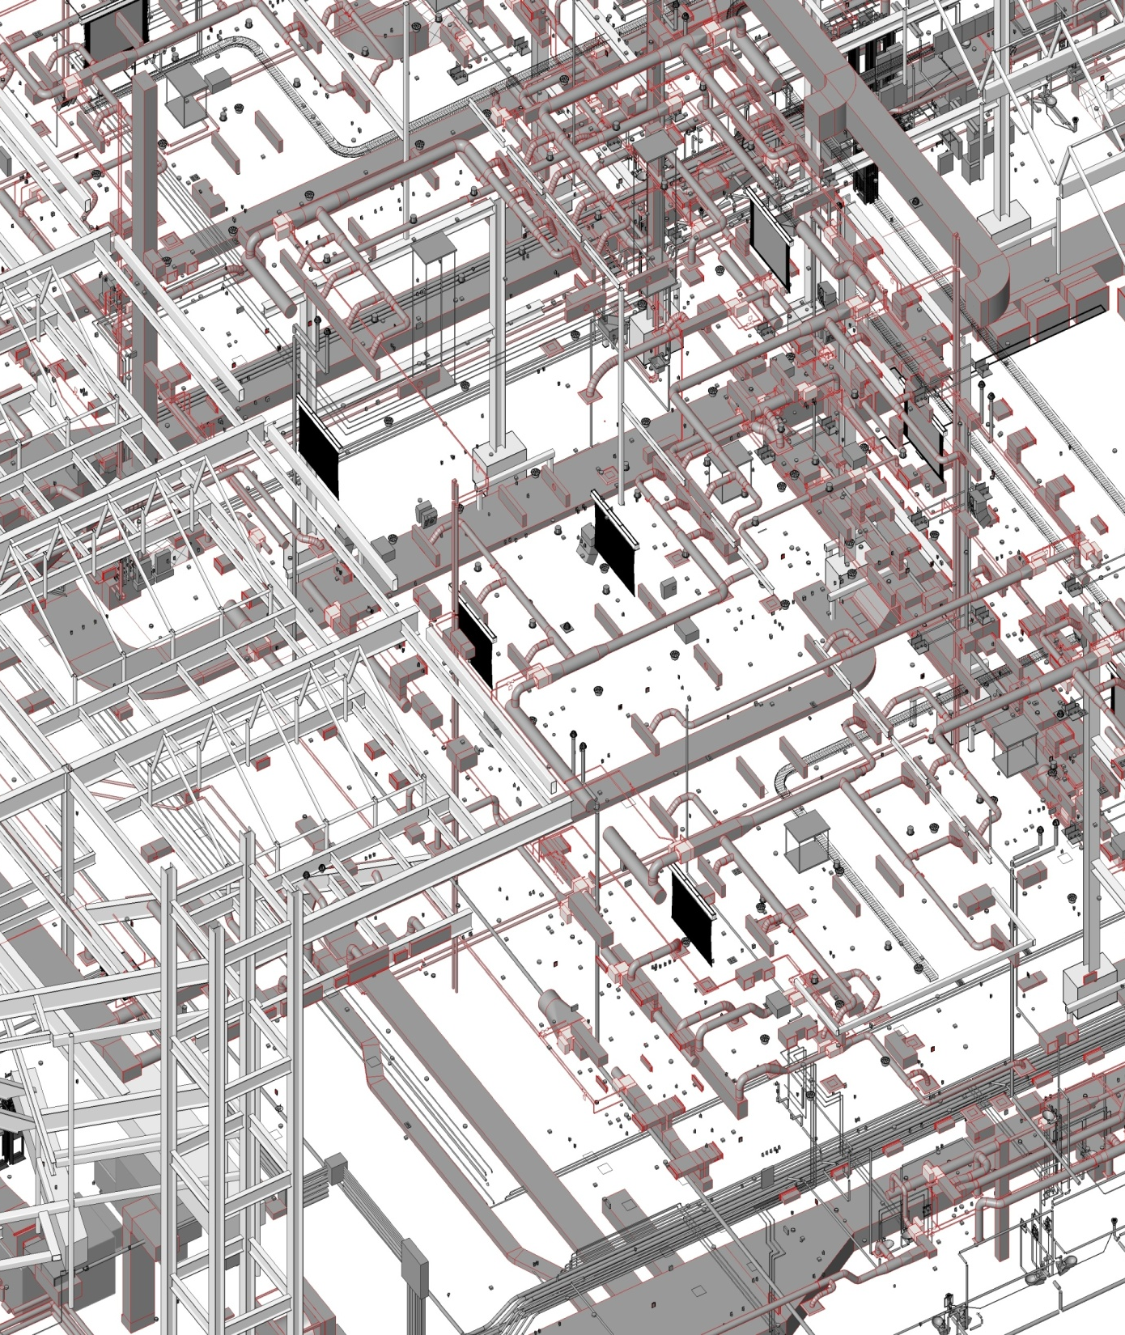
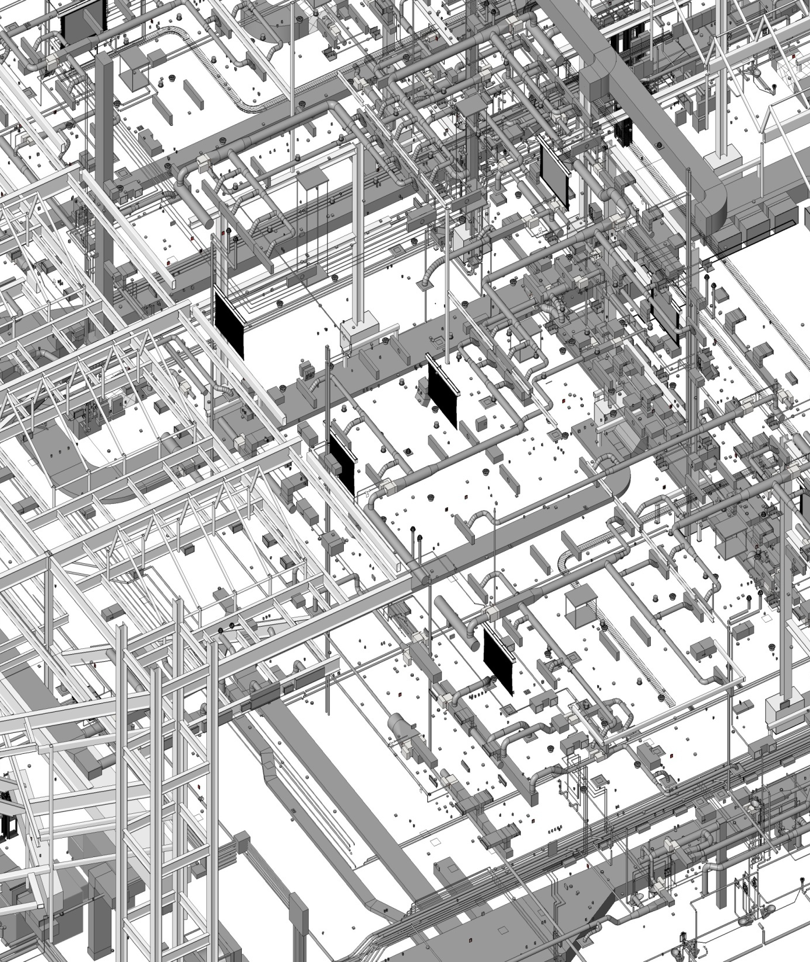
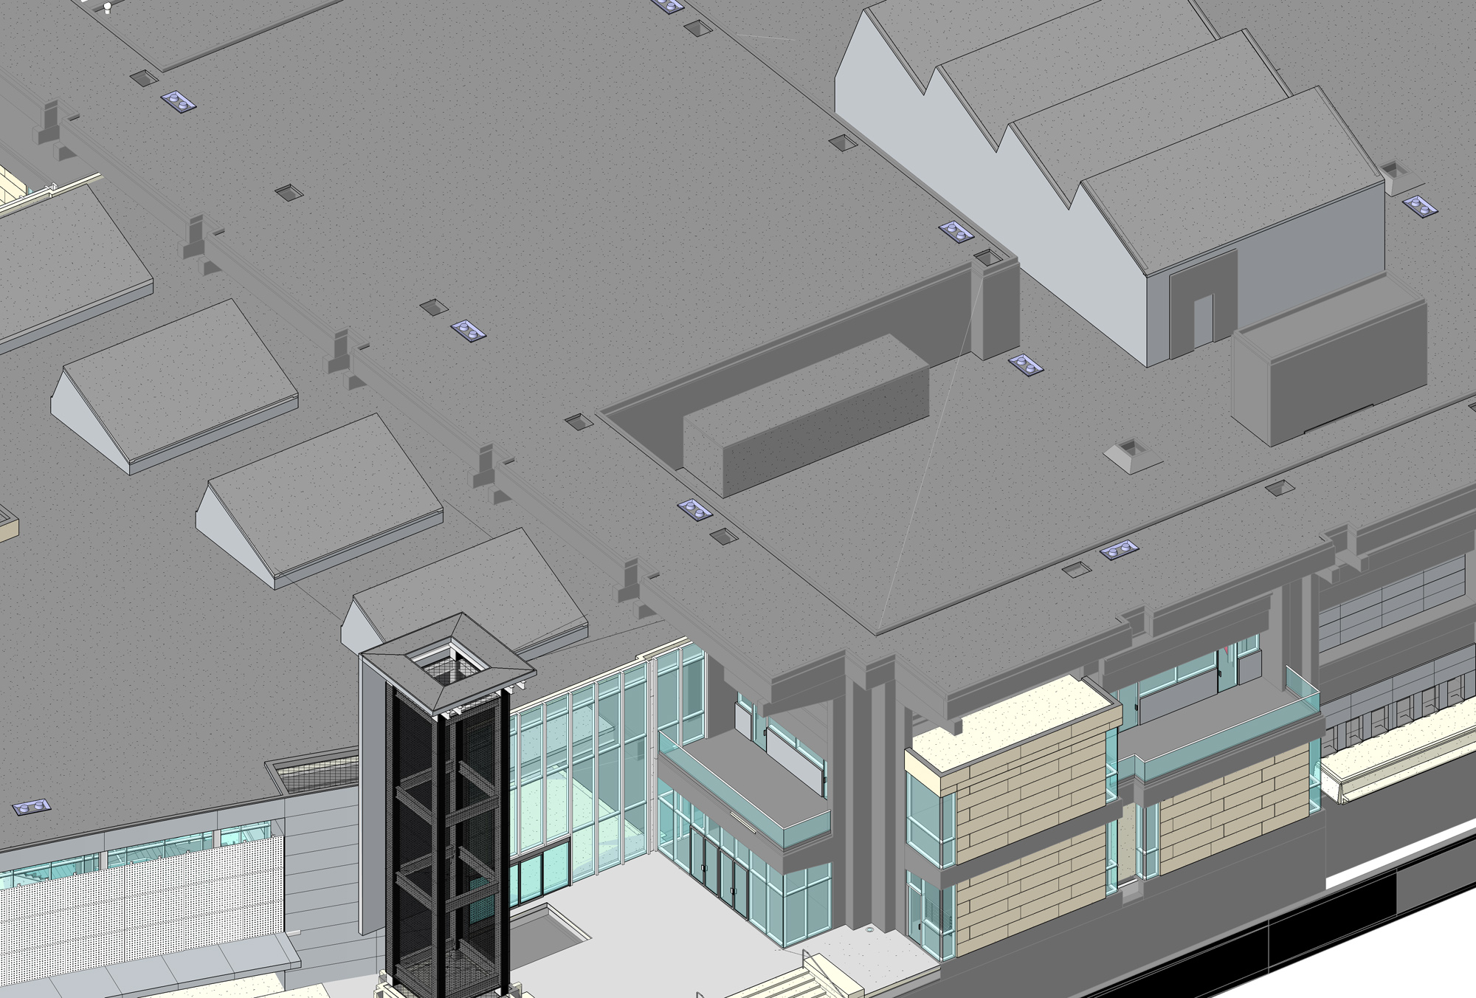
BIM as a coordination tool
San Jose State University Student Union San Jose, California
ELECTRICAL MODEL
MECHANICAL MODEL
COMPLETE BIM MODEL
COMPLETE BIM MODEL
STRUCTURAL MODEL
PLUMBING MODEL

Slide 29
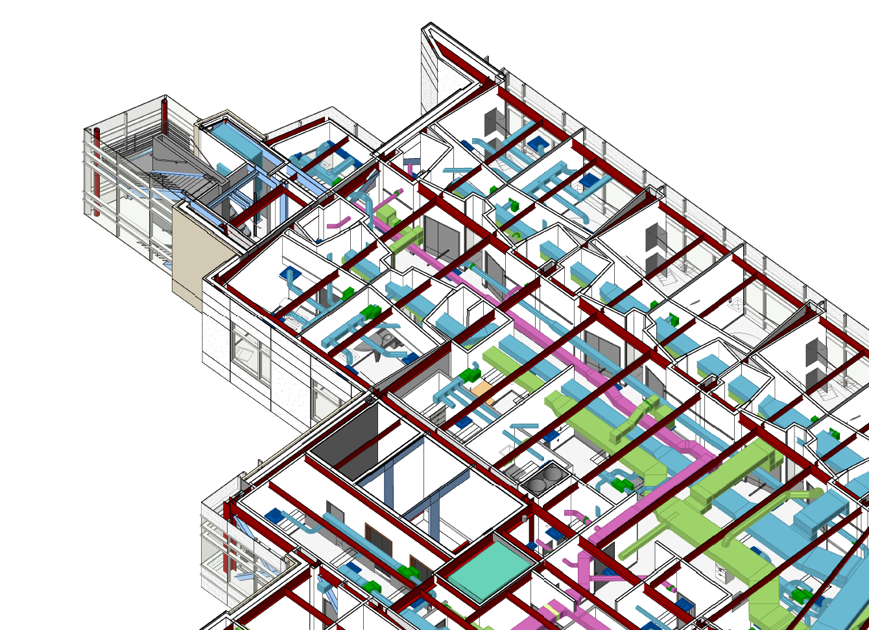
Finding BIM-savvy consultants

Slide 30
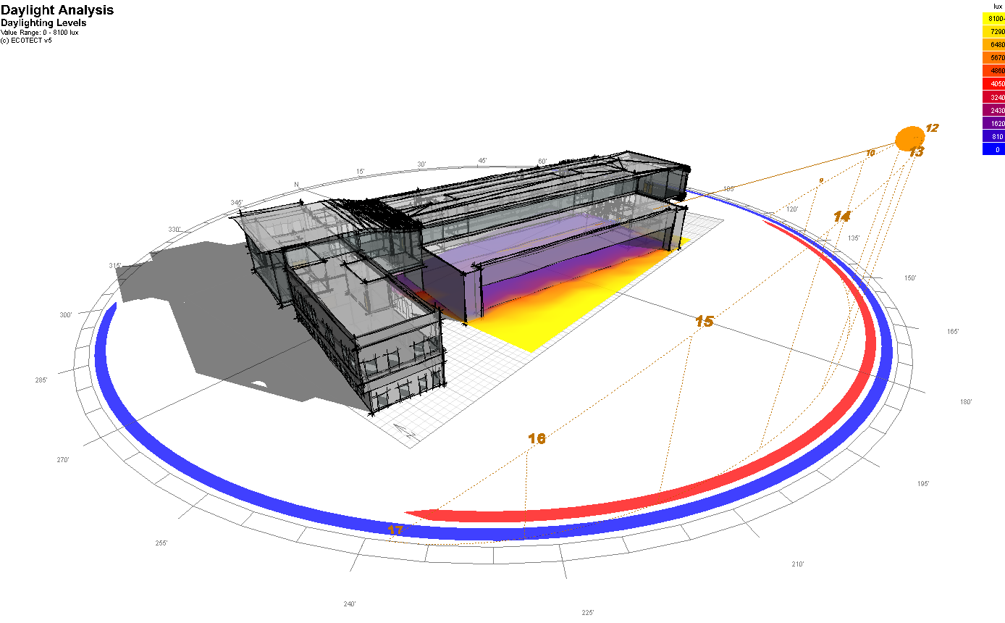
BIM and sustainable design

Slide 31
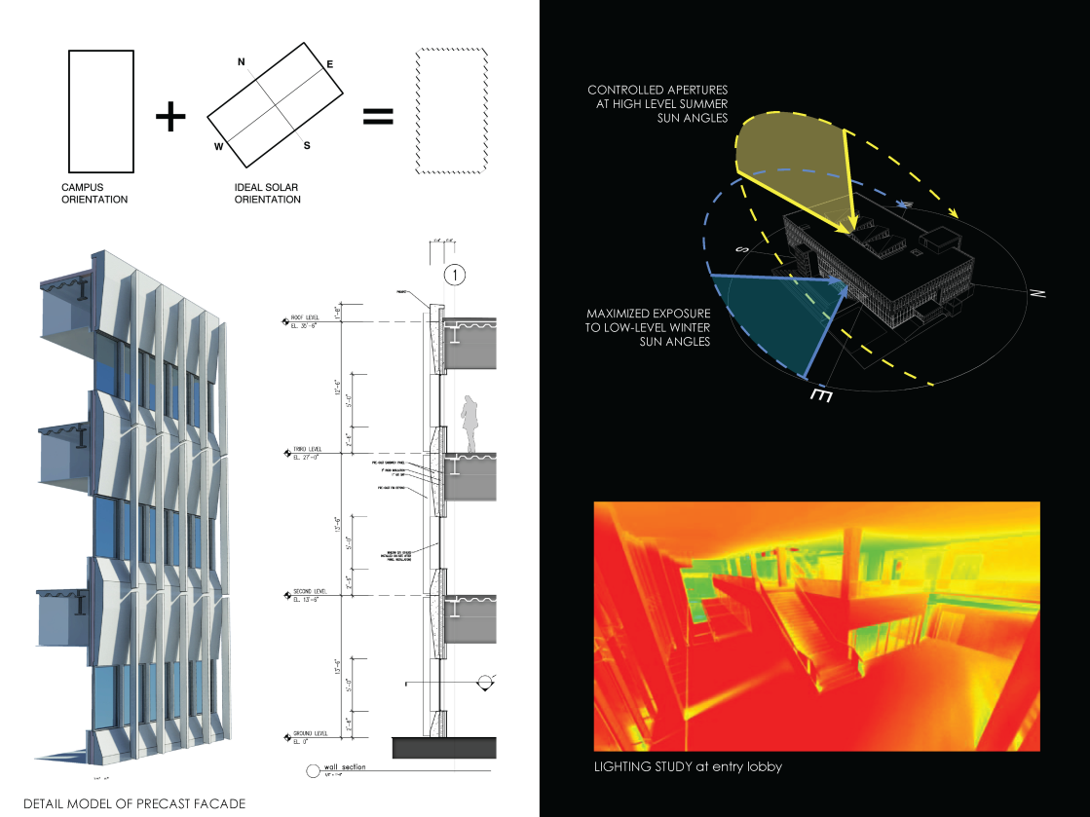
BIM and sustainable design

Slide 32
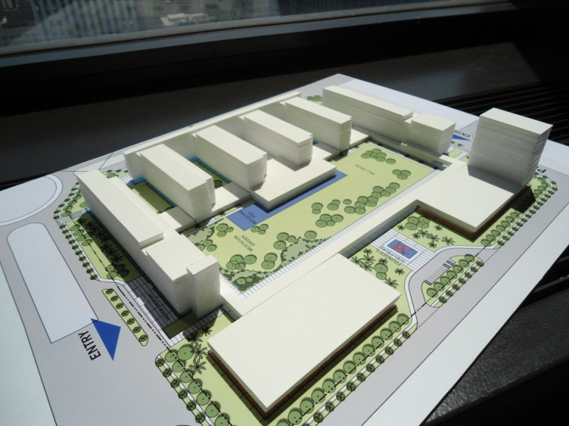
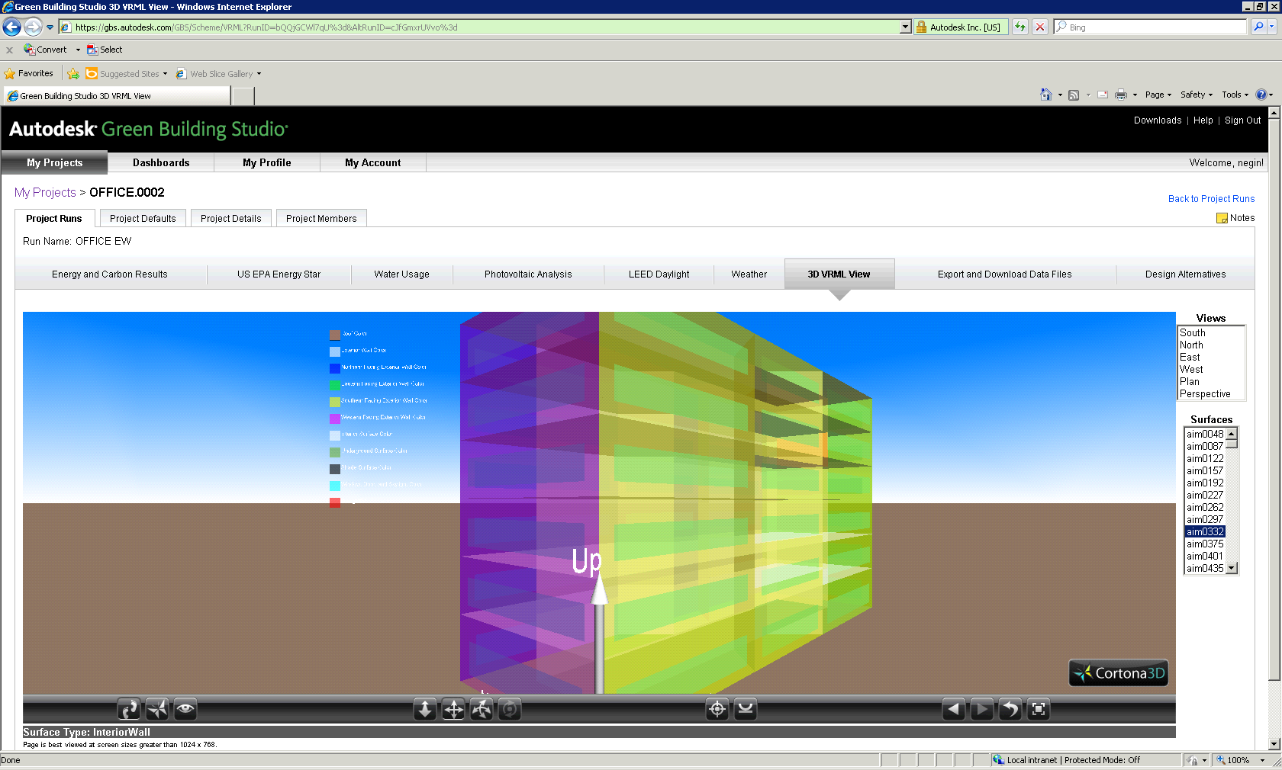
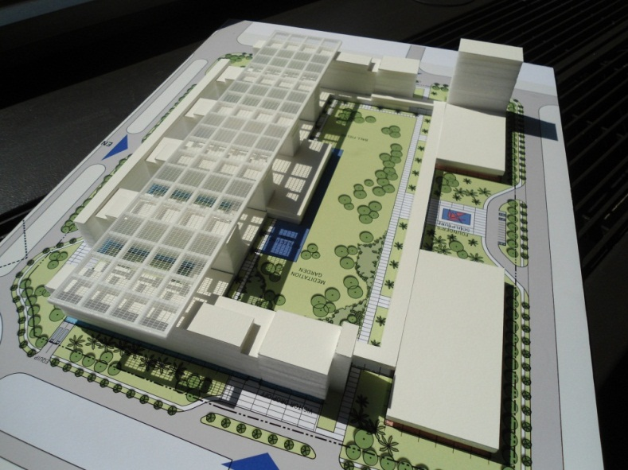
BIM and sustainable design

Slide 33
BIM and QA/QC

Slide 34
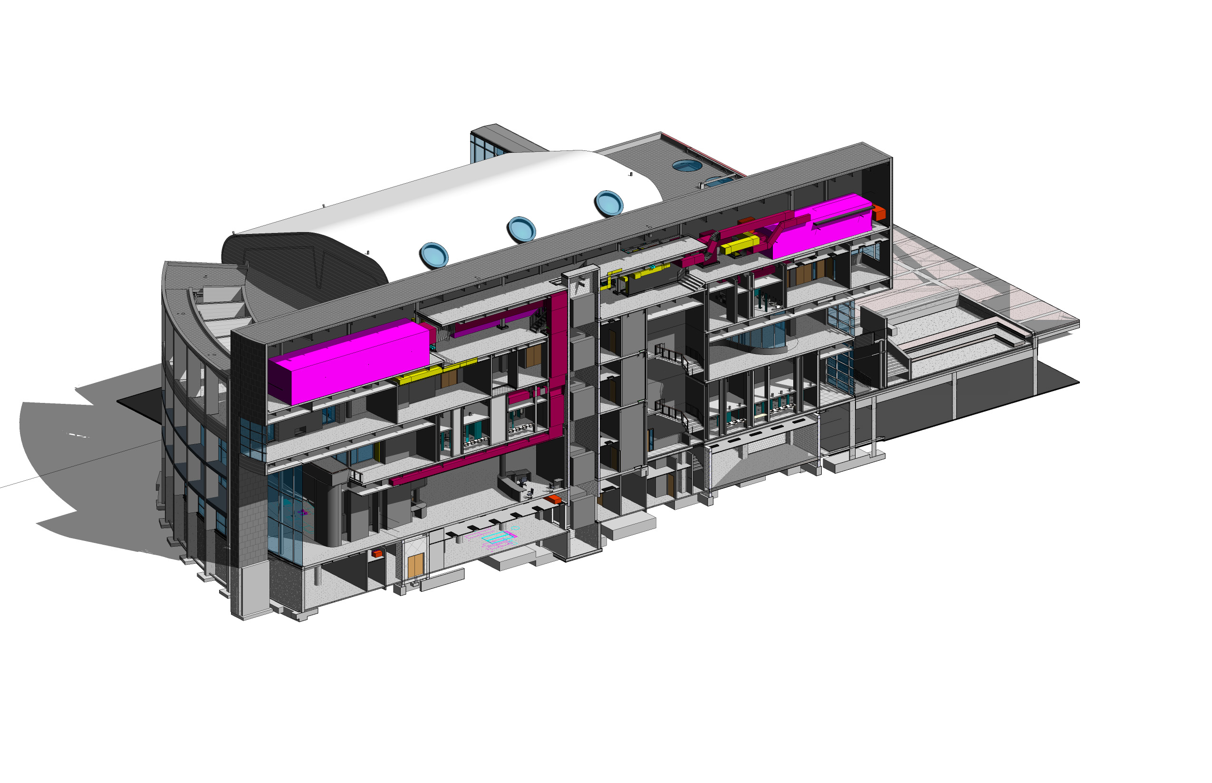
BIM and Clash Detection

Slide 35
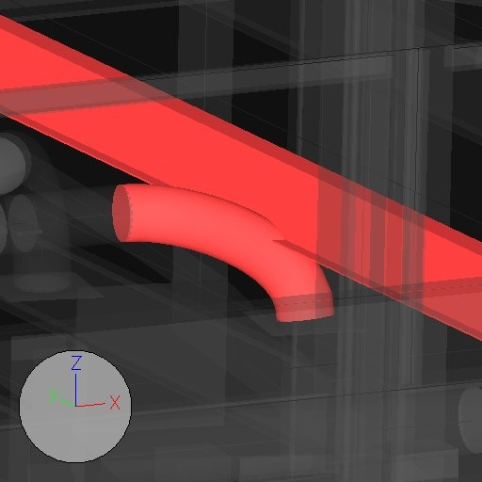
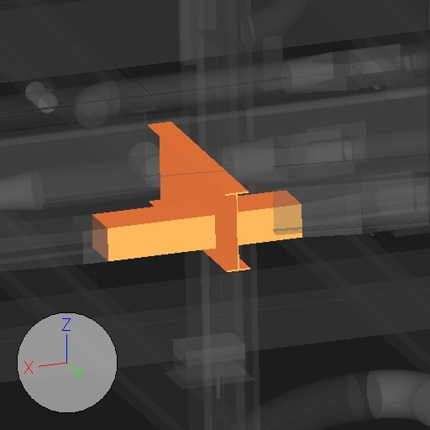
BIM and Clash Detection

Slide 36
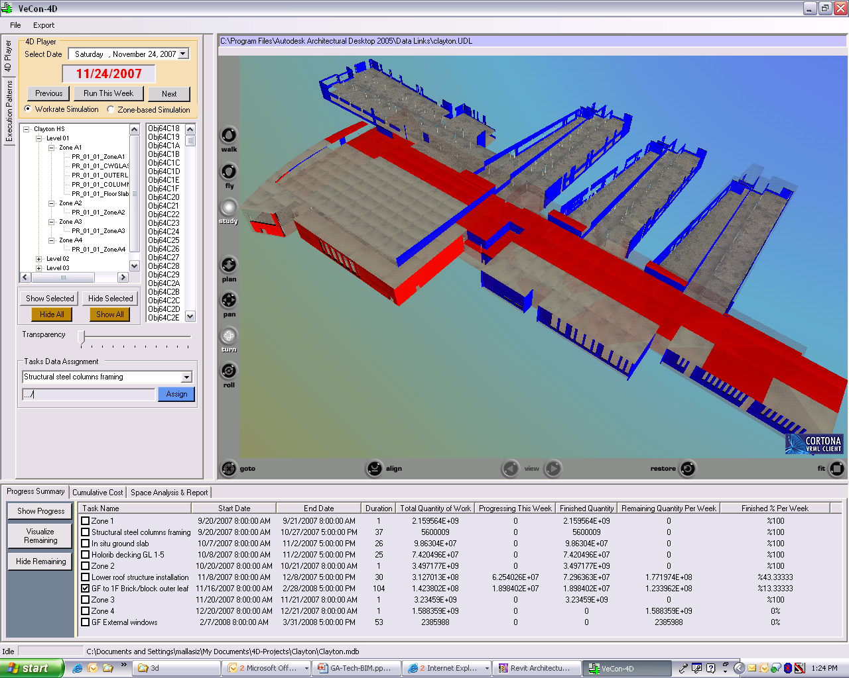
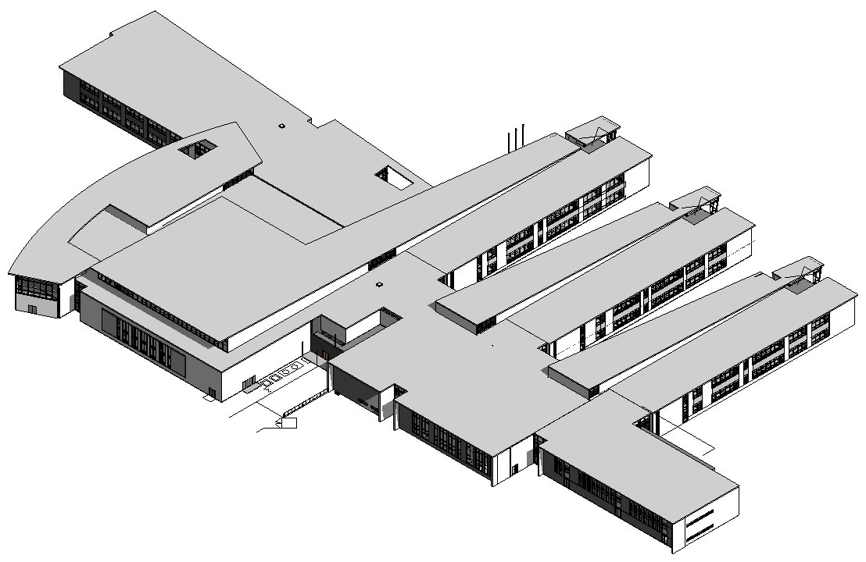
BIM in the 4th and 5th dimensions

Slide 37
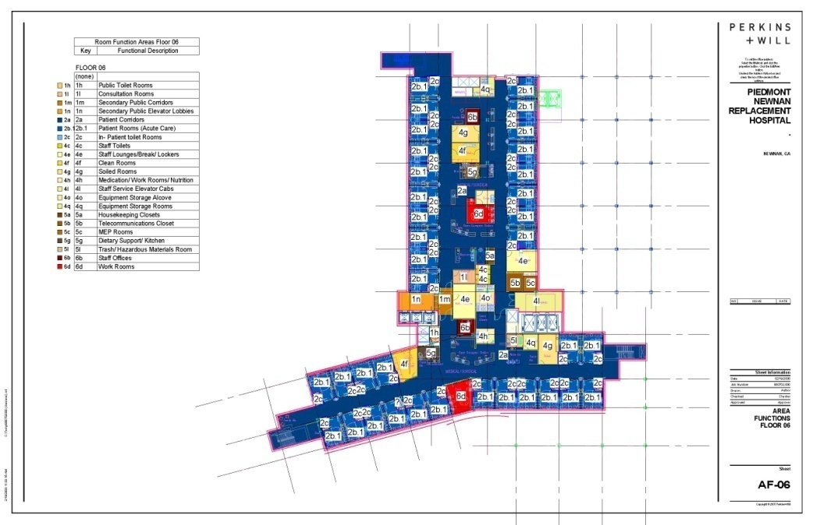
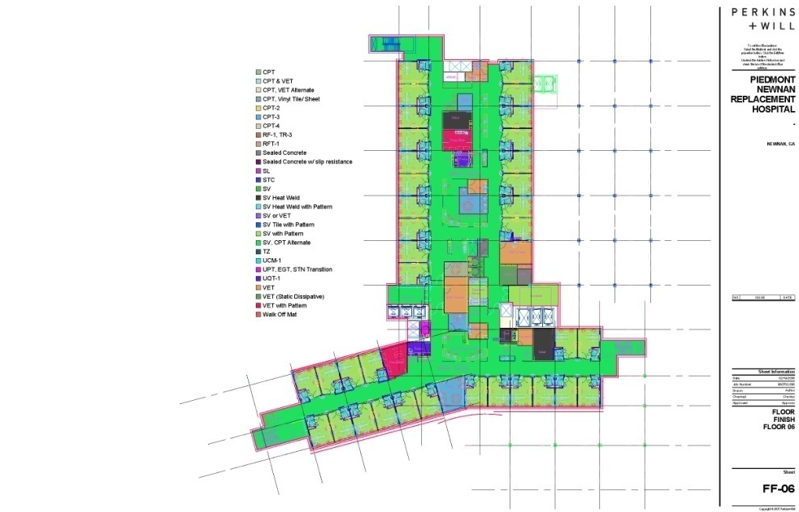
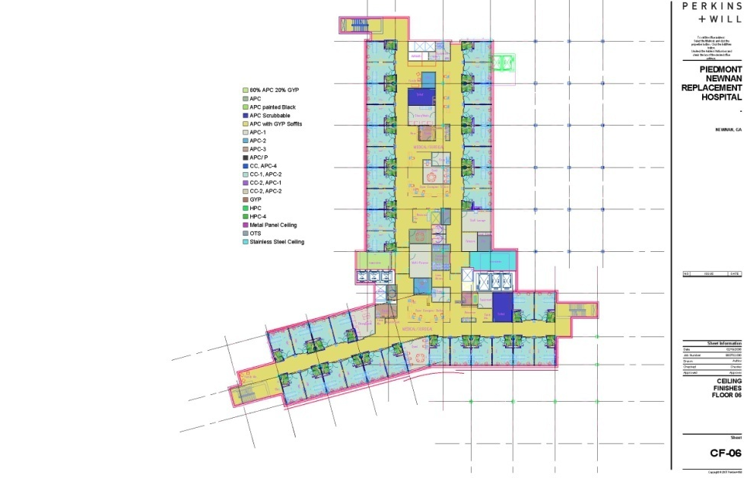
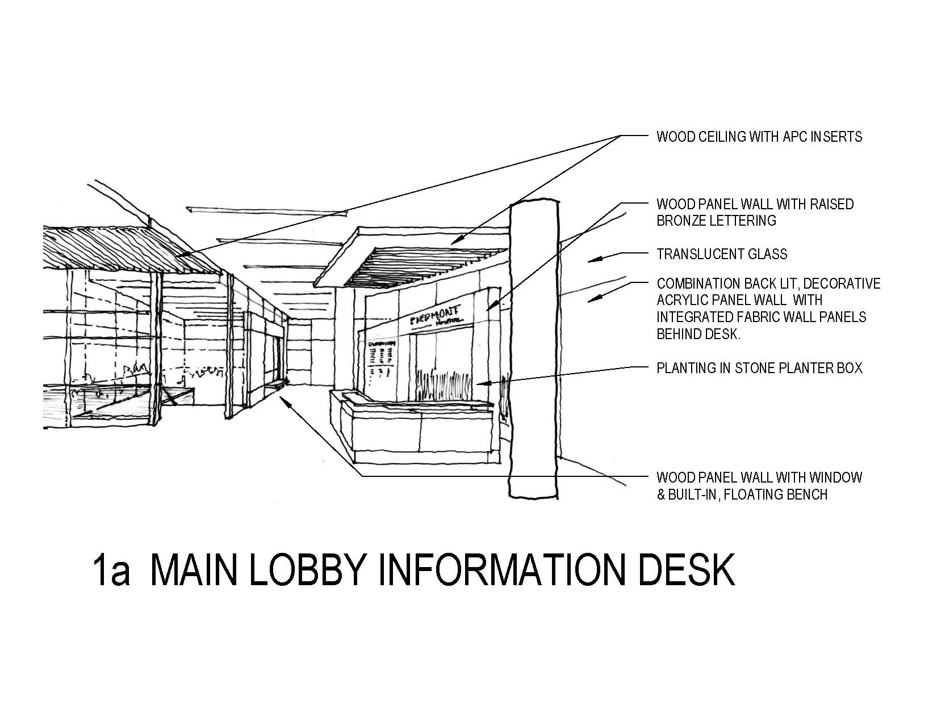
BIM and Cost Estimating

Slide 38
BIM and determining Life-Cycle Costs

Slide 39
BIM and Maintaining Design Iintent

Slide 40
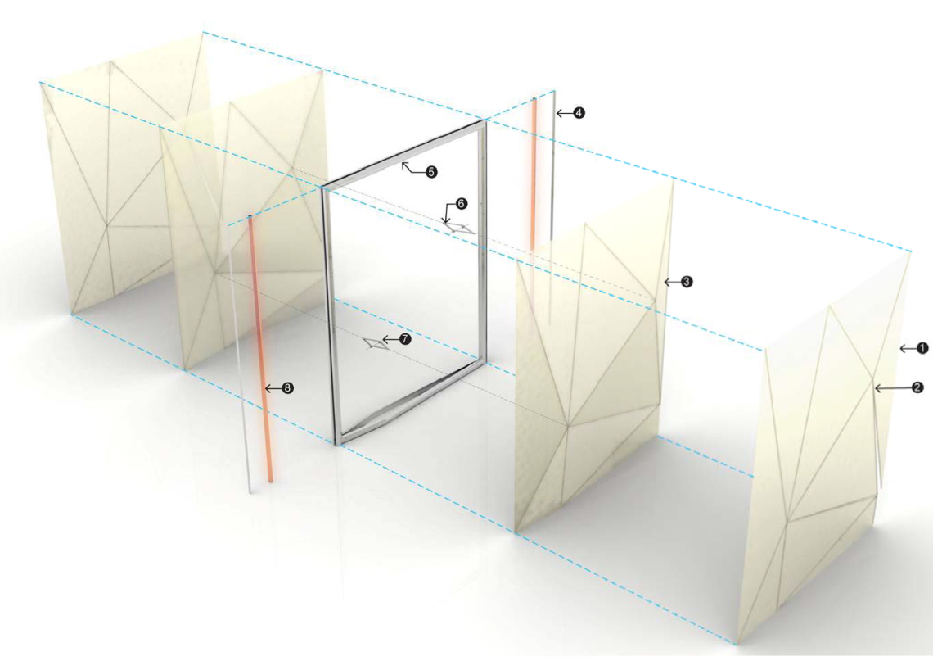
Architects’ models vs. shop drawings
The undersigned agrees that the request to provide the Model Files is purely for the convenience of the undersigned and does not constitute the rendering of professional services. The undersigned acknowledges that the Architect has not reviewed, and will not be reviewing the Model Files that are provided to determine if the Model Files are accurate or complete, or if the Model Files identify or contain any defect or anomaly with reference to the Project.

Slide 41
Architects’ models vs. shop drawings
The undersigned further acknowledges that the Architect has made no representations to the undersigned that the Model Files are suitable for any purpose …

Slide 42
Architects’ models vs. shop drawings
The undersigned further acknowledges that the Architect has made no representations to the undersigned that the Model Files are suitable for any purpose …
The undersigned also understands and agrees that the Model Files may be subject to anomalies, errors, viruses, malware, or other unintended defects …

Slide 43
BIM: Who models what, and when?

Slide 44
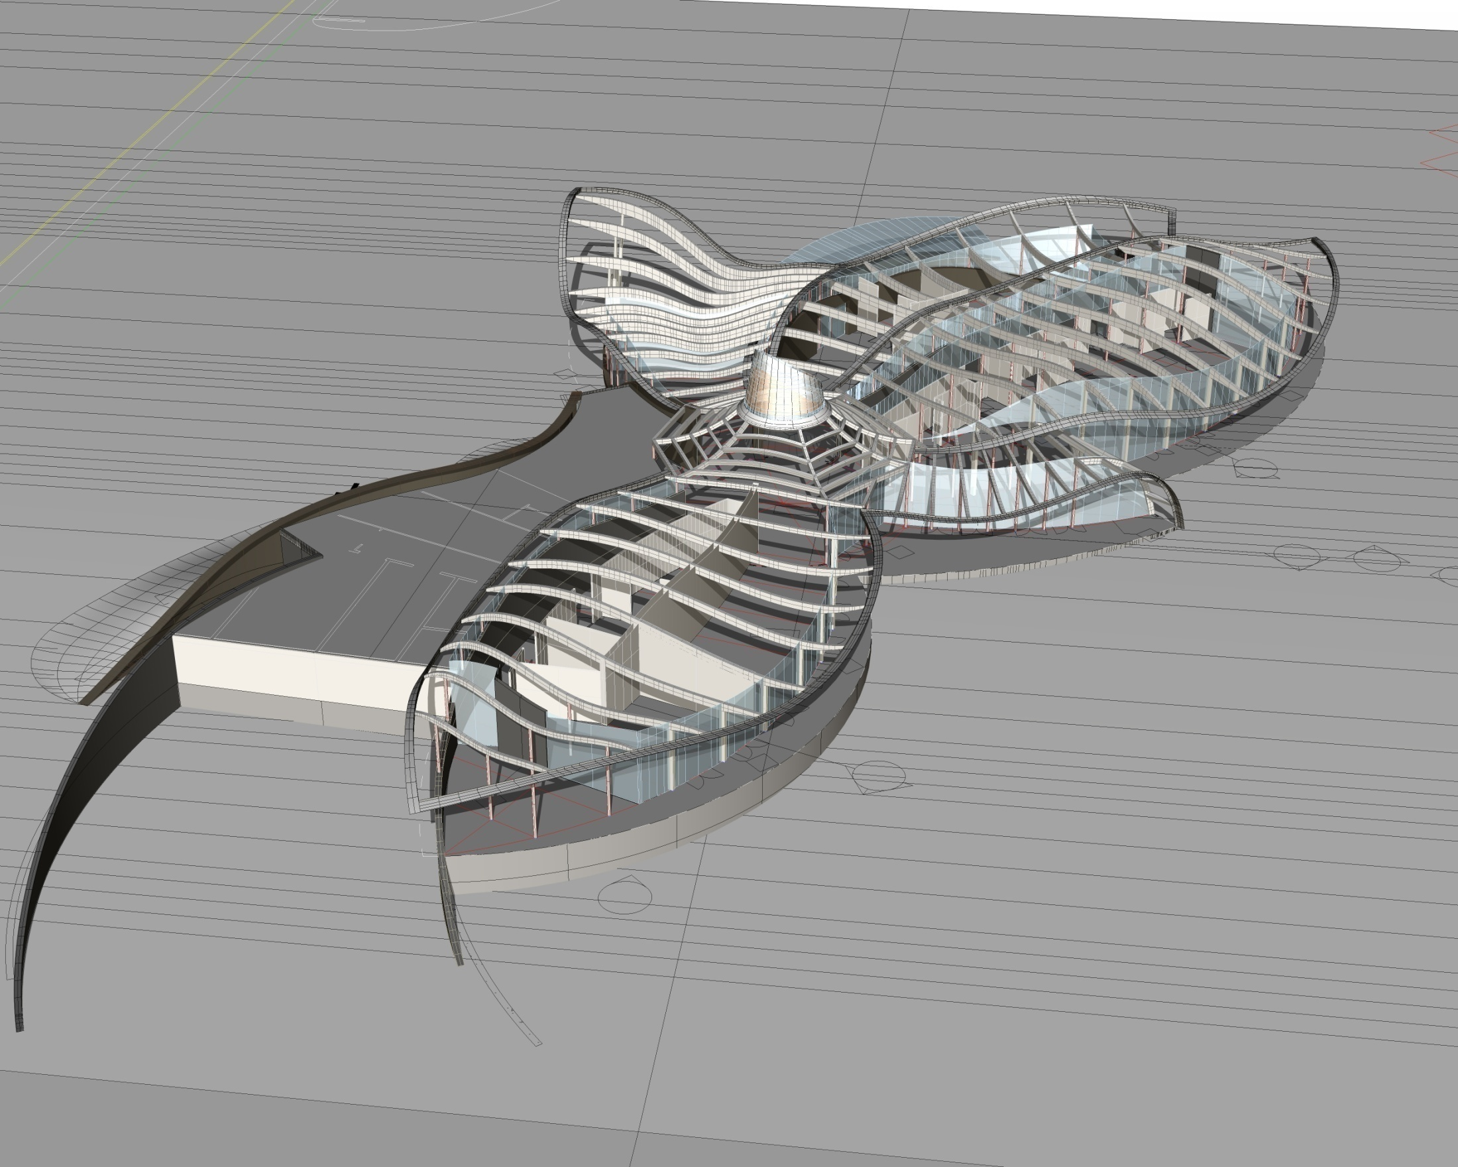
BIM: Who models what, and when?

Slide 45
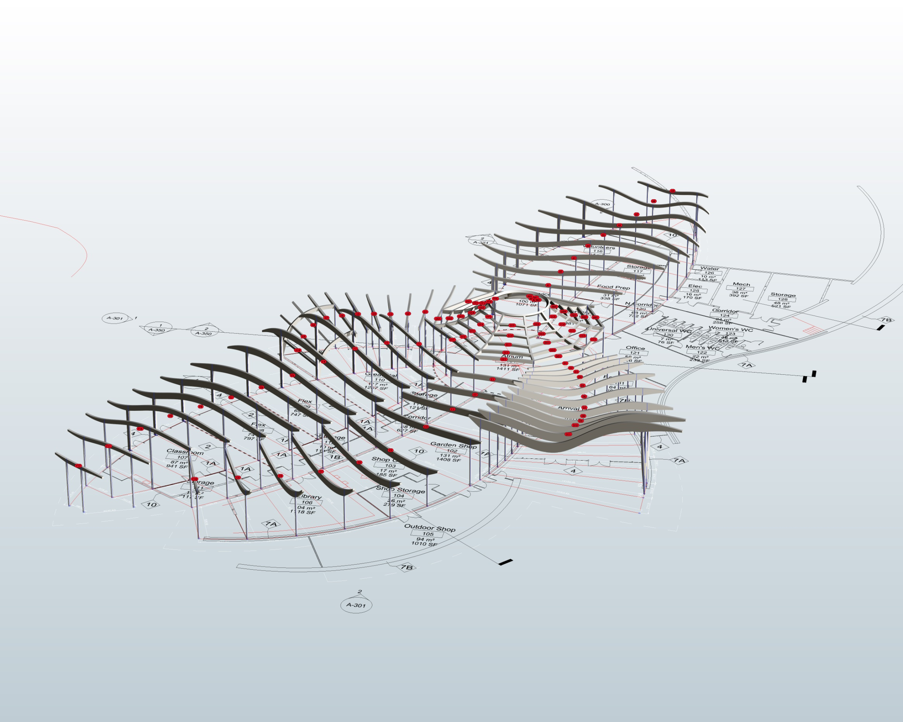
BIM: Who models what, and when?

Slide 46
BIM: Who models what, and when?

Slide 47
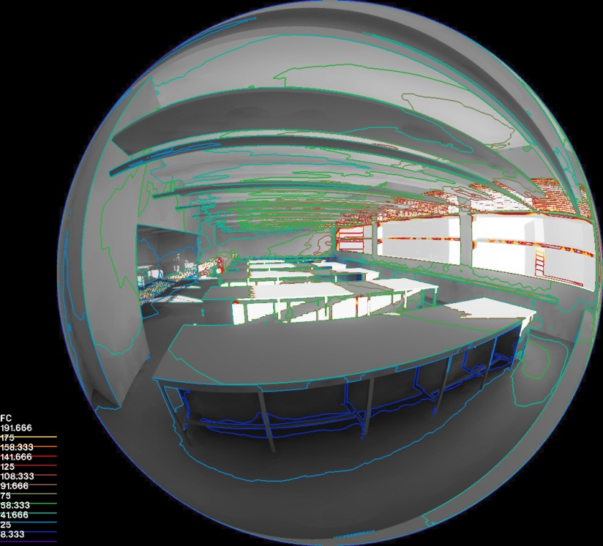
The future of BIM

Slide 48
Breakout Session 1
How can BIM lead to integrated project delivery methods?

Slide 49
Part 2
BIM and Project Delivery Methods

Slide 50
Project Delivery Methods
Design-Bid-Build
Multiple Prime Contractors
Construction Manager at Risk
Design-Build
Integrated Project Delivery

Slide 51
Design-Bid-Build
Content slides may not contain proprietary graphics or branding.

Slide 52
Multiple Prime Contractors

Slide 53
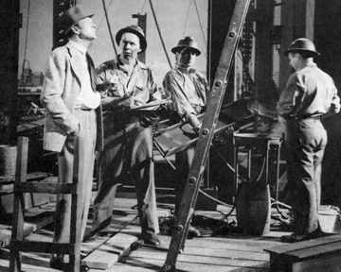
Construction Manager at Risk

Slide 54
Design-Build

Slide 55
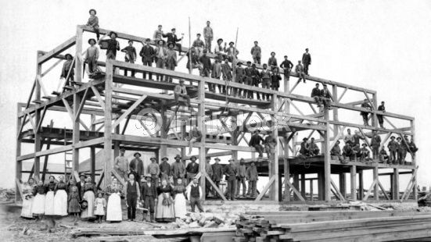
Integrated Project Delivery
Content slides may not contain proprietary graphics or branding.

Slide 56
Case Study
20-story high-rise hospital
$250 million
16 operating rooms
190 beds
Approximately 700,000 SF
Downtown Baltimore
Mercy Medical Center
Baltimore, MD
712,000
$230 million
Ayers Saint Gross Architects + Planners
BIM Software: Revit
Structural Engineer: Browder & LeGuizamon
MEP Engineer: Newcomb & Boyd
Notes:
56

Slide 57
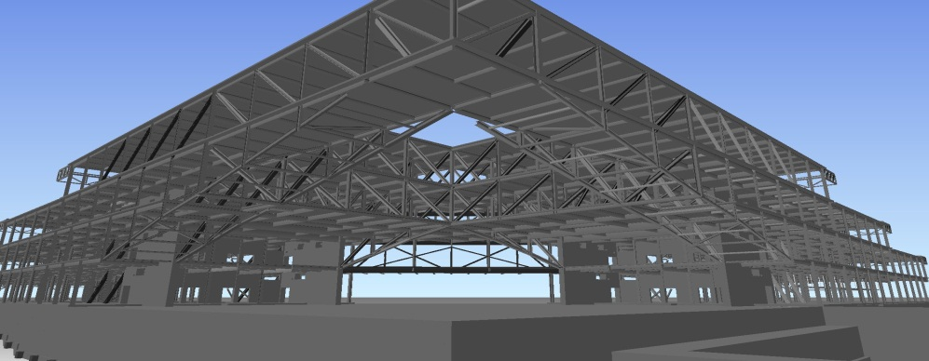
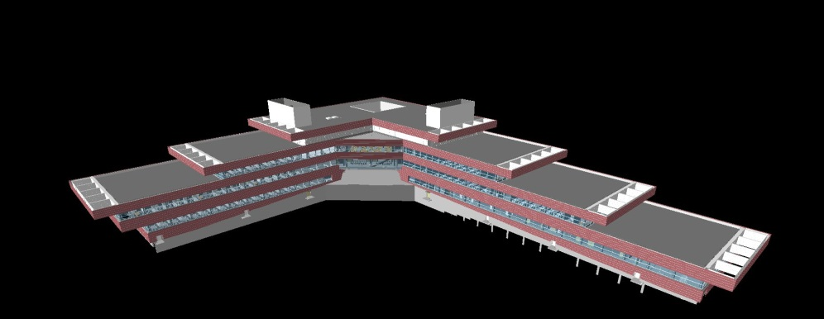
Penn State University Millennium Science Complex
Virtual Design Construction
MEP coordination
Skin / structure connection coordination
Quality control
Building layout & control
Logistics
4-D scheduling
Millennium Science Complex
275,000 sf life science and materials research lab
9,000 sf clean room
The Pennsylvania State University
State College, PA
$173 million
BIM Software: Revit
Architect: RVA
Structural Engineer: Thornton Tomasetti
MEP Engineer: Flack & Kurts
Penn State asked for help with VDC. WT convinced arch to provide model for construction use
Notes:
57

Slide 58
Breakout Session 2
What are your legal questions about BIM?

Slide 59
Part 3
BIM, the Law, and the Contract Documents

Slide 60
The AIA Documents and BIM
E202-2008
Building Information Modeling Protocol Exhibit
AIA’s first document specifically addressing BIM

Slide 61
The AIA Documents and BIM
E202-2008
Designed to address process, procedure and protocols
Consequently, it does not adequately address legal implications of BIM use

Slide 62
The AIA Documents and BIM E202-2008: An Overview of Key Provisions
Limited scope is exemplified by Article 1:
§ 1.1 This Exhibit establishes the protocols, expected levels of development, and authorized uses of Building Information Models on this Project and assigns specific responsibility for the development of each Model Element to a defined Level of Development at each Project phase.

Slide 63
The AIA Documents and BIM E202-2008: An Overview of Key Provisions
Article 1.2 Definitions:
A Building Information Model is a digital representation of the physical and functional characteristics of the Project.
“Building Information Modeling” means the process and technology used to create the Model.
There is, however, no single, legally-adopted definition of BIM

Slide 64
The AIA Documents and BIM
Article 1.2 Definitions:
“Level of Development” (LOD) describes the level of completeness to which a Model is developed.
A “Model Element” is a portion of the Building Information Model representing a component, system, or assembly within a building or building site.

Slide 65
The AIA Documents and BIM
Much of what the E202 seeks to do centers around the definition of the expected LOD of Model Elements at various stages of design or construction
The BIM definition of the different LOD’s, however, uses different terminology than is used to describe phases of design and construction in the traditional AIA contract documents

Slide 66
The AIA Documents and BIM
Section 1.2.4: “The Model Element Author is the party responsible for developing the content of a specific Model Element to the LOD required for a particular phase of the Project.”
This may include other licensed professionals and may also include non-licensed professionals and/or contractors
This may create legal issues for the professional and others

Slide 67
The AIA Documents and BIM: Information and Model Management
Information Management and Control Questions:
Who determines the management framework?
Who controls the model?
Who has authority to direct modifications or delegate responsibilities for the progression of the model?
Who bears the costs of model management?

Slide 68
The AIA Documents and BIM
E202 Approach to Information Management
Project architect undertakes IM from the inception of the Project (Section 2.4.1).
The information management responsibilities may be assigned to other parties at other project phases (Section 2.4.1).

Slide 69
The AIA Documents and BIM
E202 Approach to Model Management:
Section 2.4.2: “The party responsible for managing the Model shall facilitate the establishment of protocols for the following:”
Model origin, coordinate system, and units
File storage locations
Processes for transferring and accessing Model files
Clash detection
Access rights
Other protocols

Slide 70
The AIA Documents and BIM
E202 Approach to Model Management:
Section 2.4.3: “The party responsible for managing the Model shall have the following ongoing responsibilities:”
Collect incoming Models
Aggregate model files and make available for viewing
Perform clash detection
Maintain Model archives and backups
Manage access rights
Follow protocols

Slide 71
The AIA Documents and BIM
These provisions do not fully address the reality that multiple parties contribute to the Model
E202’s relegation of these issues to the Architect as a default scenario could require the Architect to assume responsibility for the work of other design and construction professionals outside of the architect’s area of practice, licensure and insurance

Slide 72
Understanding the legal risks of BIM

Slide 73
Legal Issues Related to BIM
Legal Issues Raised by Shift in the Traditional Conceptual Approach to Design Phases.
Unclear legal relationships among the parties and ultimate responsibilities to third parties for damages
Liability for the Architect’s own errors/omissions and those committed by others
Standard of care
Unclear how this will be applied where the Architect is required to collaborate in construction issues or where contractors or other unlicensed professionals are contributing to the BIM model before completion of the design.

Slide 74
Legal Issues Related to BIM
Licensing issues re: sharing design responsibility with non-licensed contractors
Ownership of intellectual property
Issues regarding insurability
Control and management of information
Software/Technical Interoperability and Related Issues

Slide 75
The AIA Documents and BIM
Article 4 Model Elements:
Model Element Table identifies LOD for each Model Element at the end of each Project phase, and the Model Element Author responsible for developing the Model Element to the LOD identified.

Slide 76
Who owns the BIM models?

Slide 77
Copyright and Ownership Questions
Does the Architect own the copyright for its portion of the design?
Do the construction team members and other professionals own the copyright for their respective contributions?
Who owns the Architect’s standard details if they are incorporated in the Model?
Who owns the final integrated design?

Slide 78
The AIA Documents and BIM
Section 2.2 is a critical clause. It deals with model ownership, as follows:
“In contributing content to the Model, the Model Element Author does not convey any ownership right in the content provided or in the software used to generate the content. Unless otherwise granted in a separate license, any subsequent Model Element Author’s and Model User’s right to use, modify, or further transmit the Model is specifically limited to the design and construction of the Project, and nothing contained in this Exhibit conveys any other right to use the Model for another purpose.”

Slide 79
Intellectual Property Stew
Section 2.2 does not have sufficient language to preserve the Architect’s traditional copyright interest in the design for the Project.
On the contrary, it creates an intellectual property stew, with each entity that contributes to the model owning the individual ingredient it contributed to the mix.

Slide 80
Licensing Issues Arising from Collaborative Design Input
Many States Have Outright Prohibitions on Any Entities, Other Than Licensed Professionals Determining the Technical Design
NY
IL
CA
FL

Slide 81
Example #1: California
Section 5582.1(a) of the Cal. Bus. & Prof. Code
Prohibits a licensed architect from “affix(ing) his or her signature to plans, drawings, specifications, or other instruments of service which have not been prepared by him or her, or under his or her responsible control.”
Section 5535.1 of the Cal. Bus. & Prof. Code
Defines responsible control as “that amount of control over the content of technical submissions during their preparation that is ordinarily exercised by architects applying the required professional standard of care.”

Slide 82
Example #2: Florida
Sections 481.225 and 481.227 of the Florida Statutes:
An architect is subject to discipline for, among other things:
“Delegating or contracting for the performance of professional responsibilities by a person when the licensee delegating or contracting for performance of such responsibilities knows, or has reason to know, such person is not qualified by training, experience, and authorization when required to perform them.”

Slide 83
Example #3: Illinois
Section 225 ILCS 305/14:
“An architect licensed under the laws of this jurisdiction shall not sign and seal technical submissions that were not prepared by or under the responsible control of the architect…”

Slide 84
Example #4: New York
Section 7302 of the NYS Education Law
Only a person licensed or otherwise authorized to practice under this article shall practice architecture or use the title "architect”.
Section 6509 of the NYS Education Law
“Each of the following is professional misconduct, and any licensee found guilty of such misconduct . . . shall be subject to the penalties prescribed in section sixty-five hundred eleven: . . . (7) Permitting, aiding or abetting an unlicensed person to perform activities requiring a license”

Slide 85
Potential Insurability Issues
Potential issues for the Architect
You might have assumed liability for contractors’ work which may fall outside the scope of your insurance.
You might have engaged in non-professional services which are outside the scope of your insurance.
In states that don’t allow the Architect to share design responsibility with non-licensed professionals, participation in the collaborative design could be deemed an illegal act, which might render your PL insurance null and void.

Slide 86
The AIA Documents and BIM: Accuracy of Data
E202-2008, Section 4.1.2:
“…Model Users and subsequent Model Element Authors may rely on the accuracy and completeness of a Model Element consistent only with the content required for the LOD [level of development] identified in Section 4.3.”

Slide 87
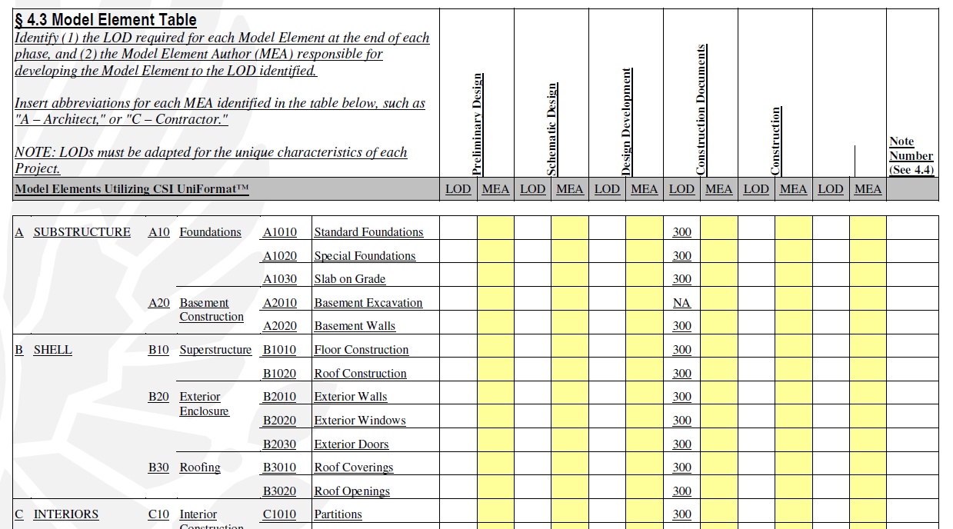
The AIA Documents and BIM: Accuracy of Data

Slide 88
The AIA Documents and BIM: Accuracy of Data
The E202’s treatment of this issue differs from the Architect’s traditional insistence that only the record hard copy of documents may be relied upon

Slide 89
The AIA Documents and BIM: Risk of Software Defects and Failures
Architects traditionally have sought contractual disclaimers of defects and deficiencies related to interoperability of systems and software
The E202-2008 does not address the issue
Together with the “reliability” language of Section 4.2, this raises the spectre of liability for technical problems over which the Architect has no control

Slide 90
With Great Power Comes Great Responsibility
How will the growing use and functionality of Building Information Modeling affect the design professional’s standard of care?
Will the growing use and functionality of Building Information Modeling lead courts to impose a heightened standard of care on design professionals more akin to a warranty obligation than traditional notions of negligence?

Slide 91
Who Knows What Tomorrow Brings
As with all new relationships, it may take years before the legal ramifications of BIM will be fully known.
Over time, judges and juries will provide interpretations that may surprise not only the lawyers but also project participants.

Slide 92
Breakout Session 3
How do you want the AIA documents to address BIM?

Slide 93
Part 4
BIM and the Client

Slide 94
BIM: involving the client

Slide 95
BIM: tenant visualization

Slide 96
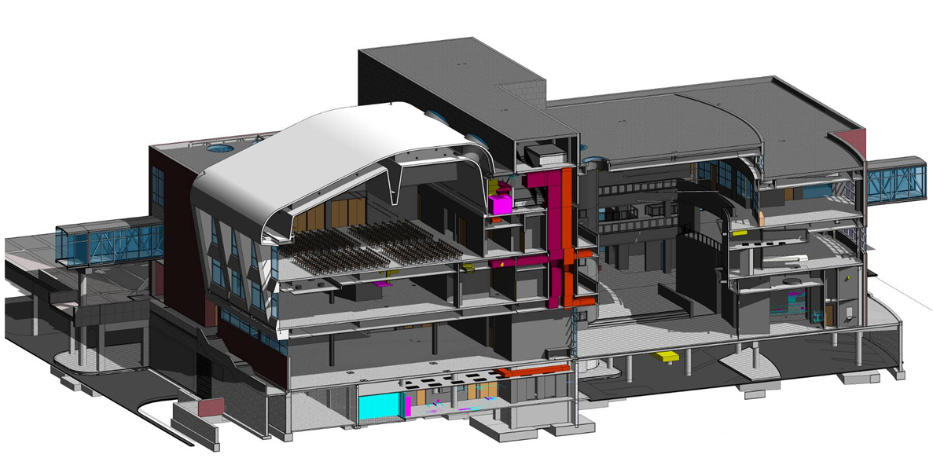
BIM and facility management

Slide 97
Redefining CCA in the BIM age

Slide 98
Questions?

Slide 99
Contact Information
Burton Roslyn, FAIA
broslyn@roslynconsultants.com
Michael De Chiara, JD, AIA Adjunct Member
mkd@zdlaw.com
David Abramovitz, JD
dabramovitz@zdlaw.com
Bill Schmalz, AIA
william.schmalz@perkinswill.com
Charles Schreckenberger, AIA
cschreckenberger@bsa-net.com
Steven Shapiro, JD, Honorary AIA
steven.shapiro@whiting-turner.com

