Slide 1
AKR
(Architect’s Knowledge Resource)
Step-by-Step

Slide 2
KNOWLEDGE COMMUNITIES
NETWORK
LEARN
LEAD
AIA KNOWLEDGE COMMUNITIES

Slide 3
Ready to Sign-In?

Slide 4
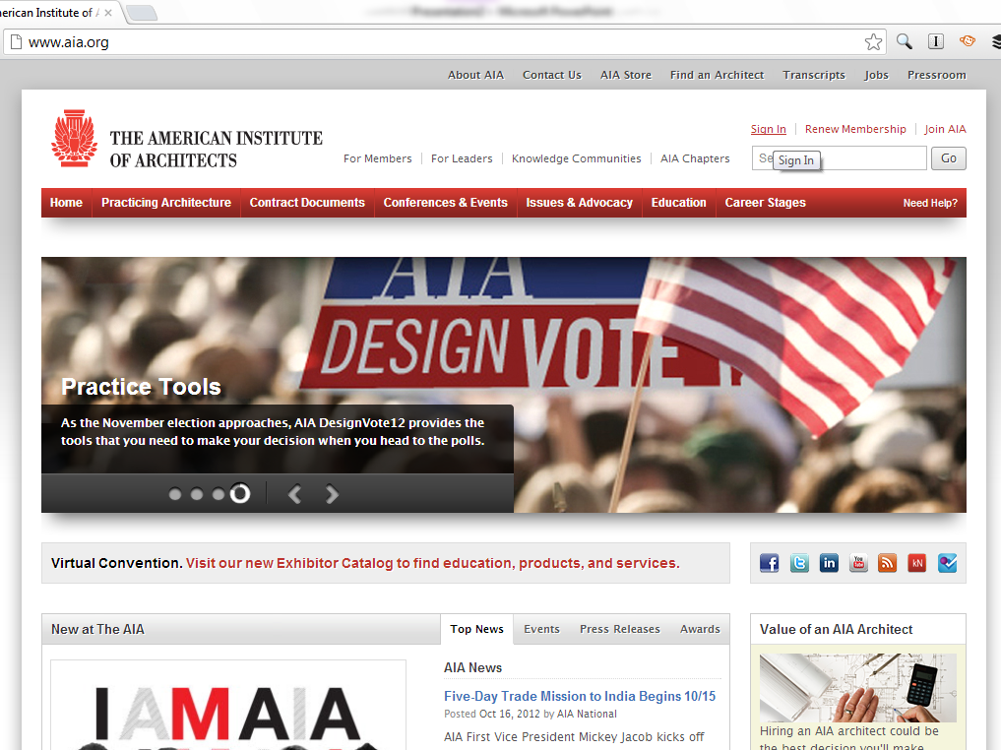

Slide 5
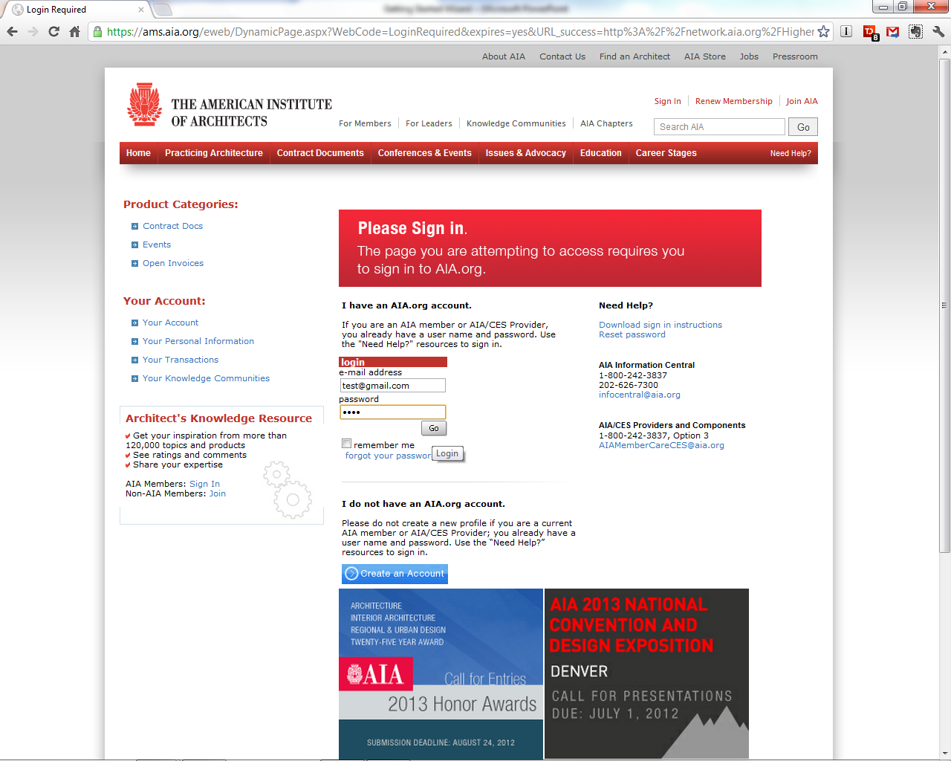

Slide 6
Accessing AKR
Click on the “Architect’s Knowledge Resource”
section of the AIA.org home page

Slide 7
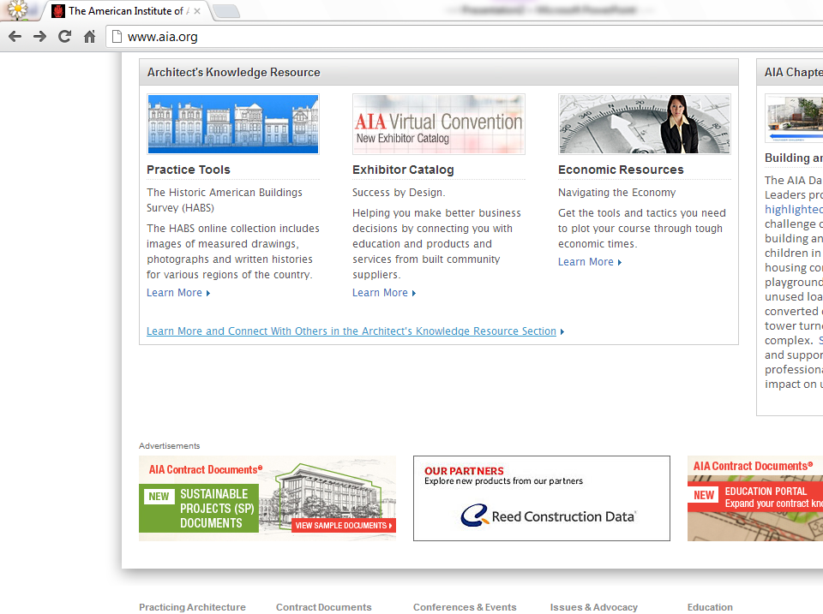

Slide 8
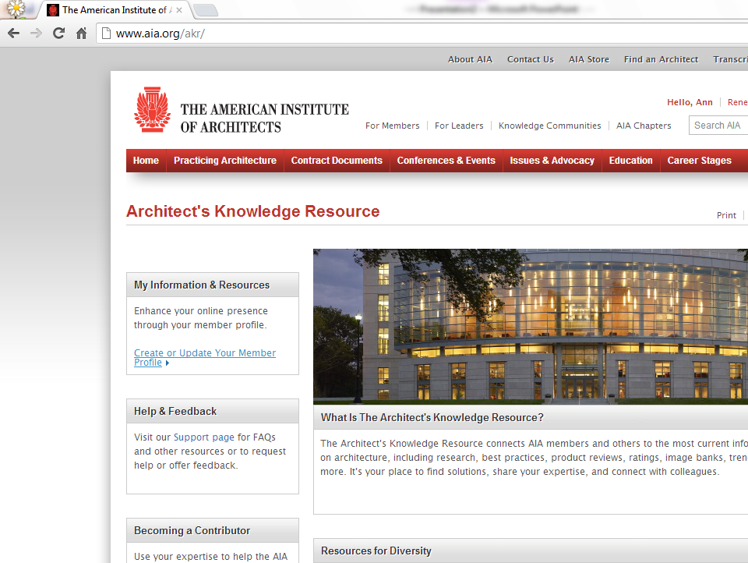

Slide 9
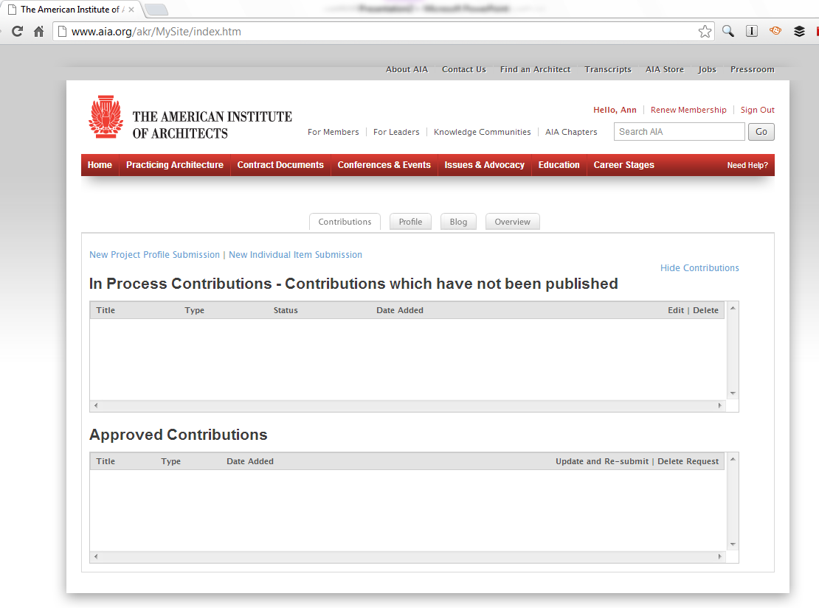
You will land on the “Contributions” tab.

Slide 10
New
Project Profile Submission

Slide 11
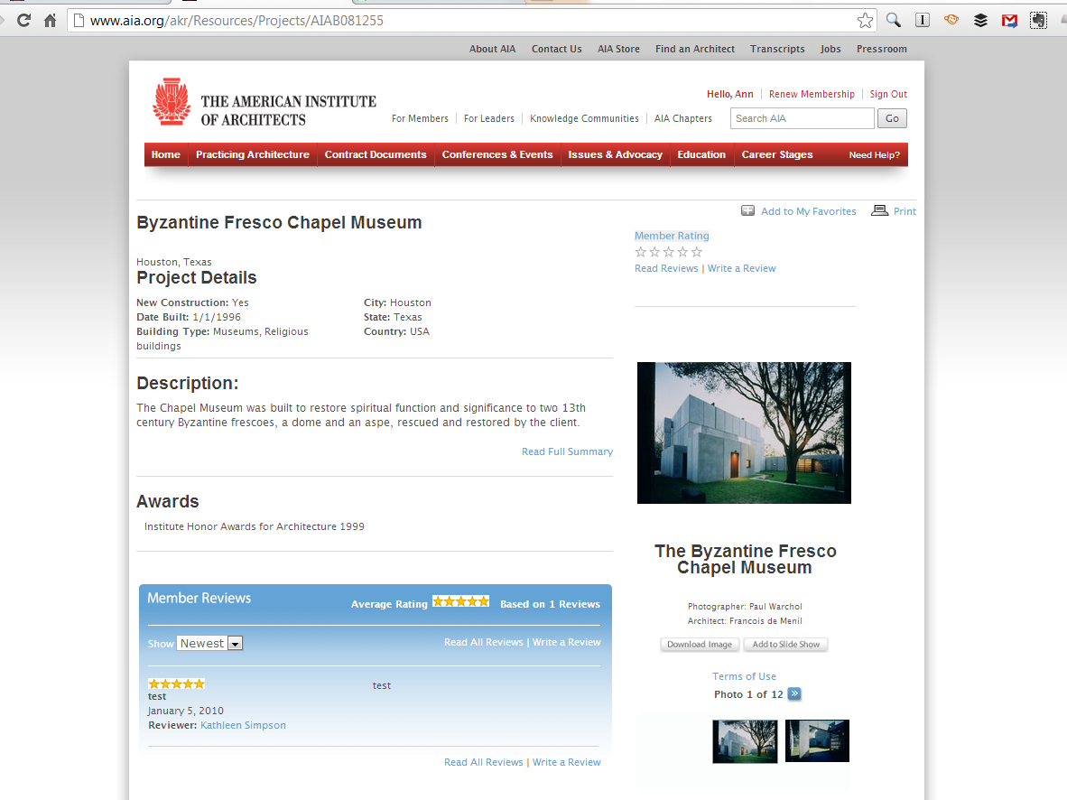
Example of a Project Profile
http://www.aia.org/akr/Resources/Projects/AIAB081255

Slide 12
Create an AIA.org record of your finished work by clicking on “New Project Profile Submission”

Slide 13
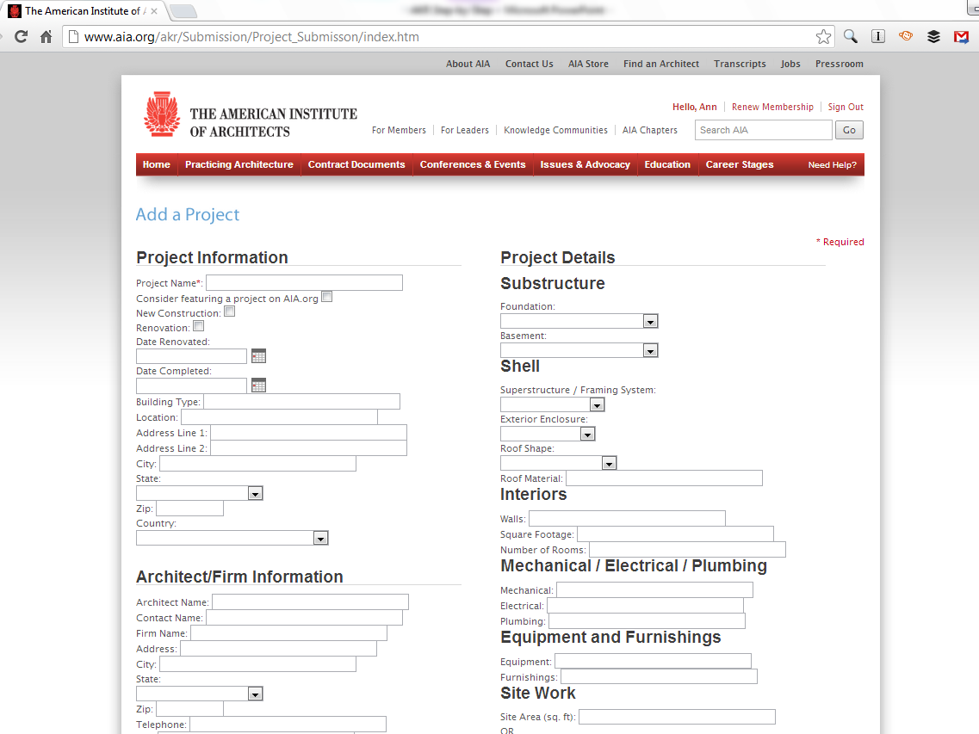
Complete the Project Information and Project Details forms

Slide 14
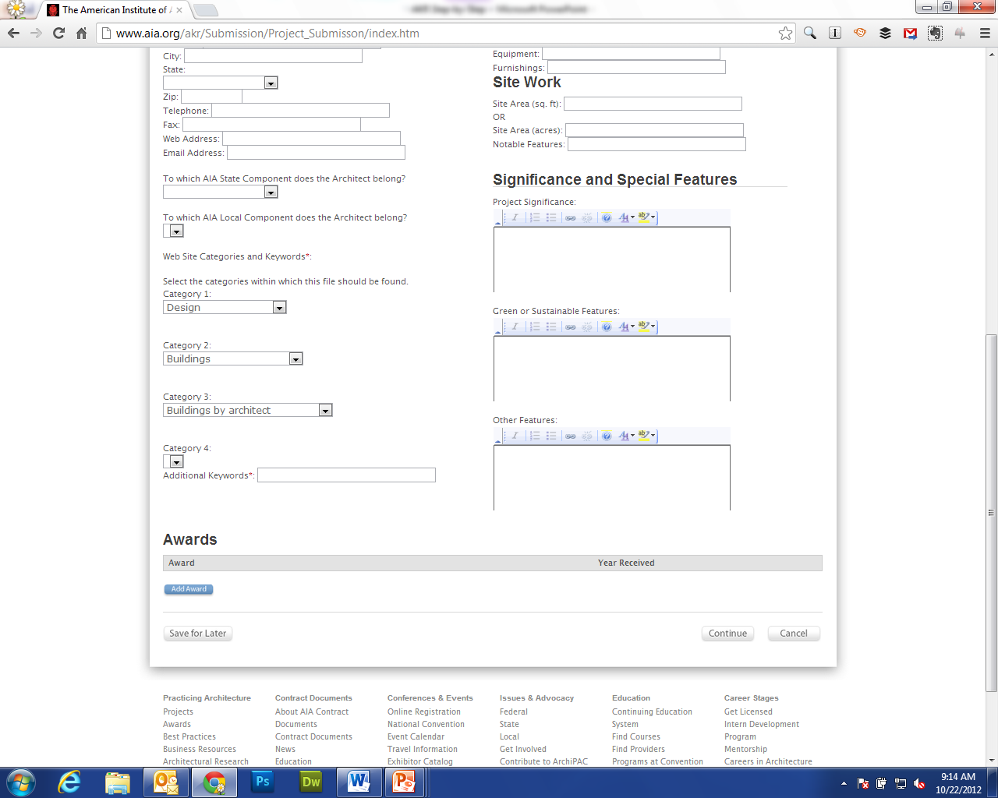
Select the appropriate categories and keywords for your project.
Include significant or special features such as notable insights or building innovations.

Slide 15
Add honors to an AIA award-winning project

Slide 16
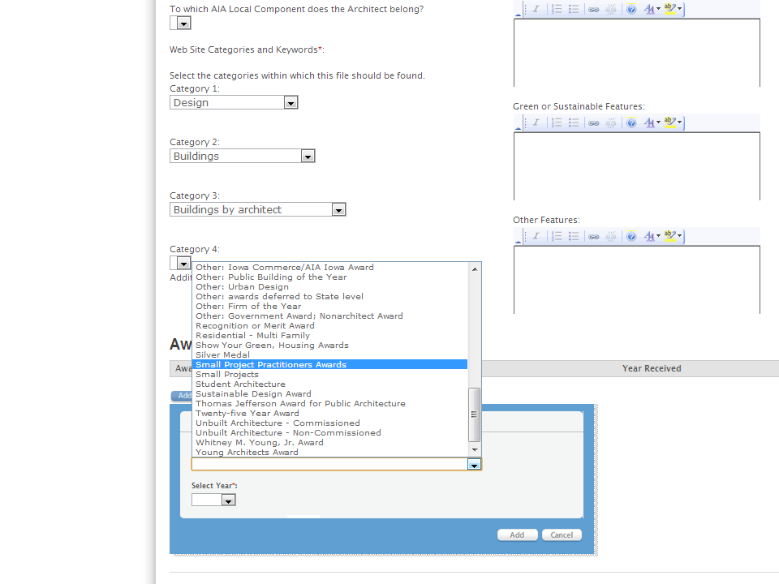
Select the award or honor and the year it was conferred

Slide 17
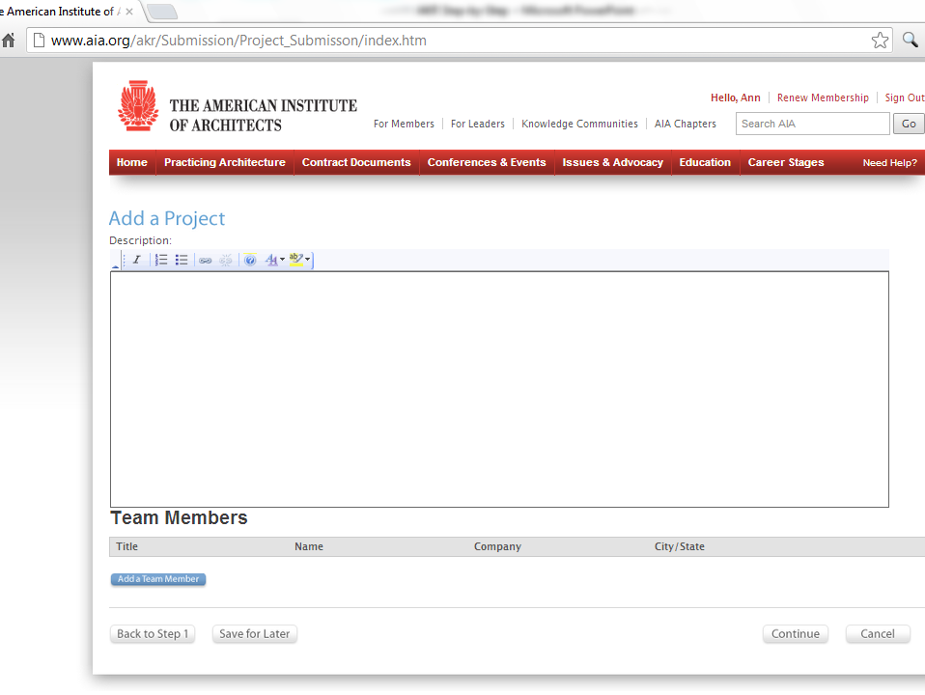
Type the project description and add team members

Slide 18
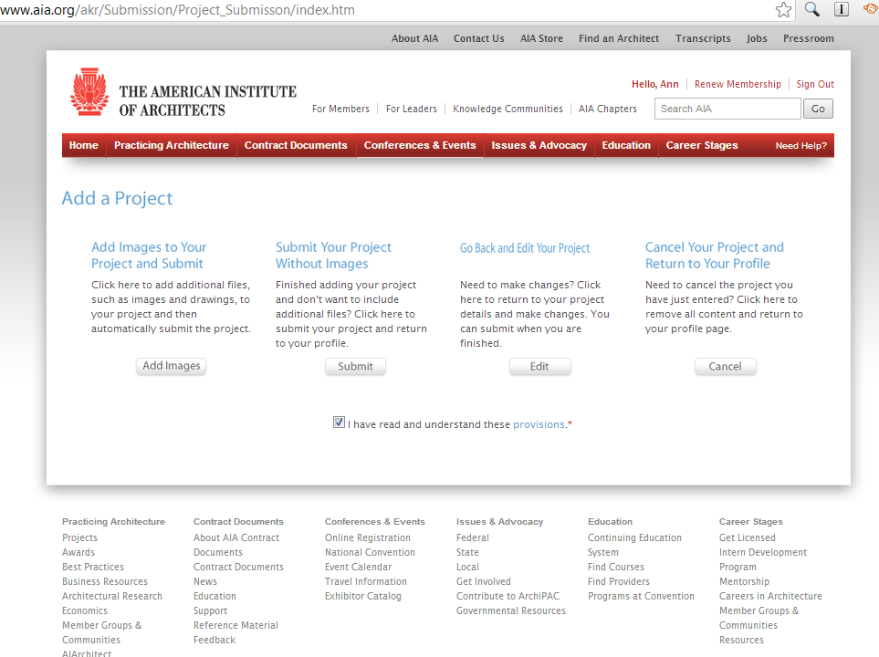
Add images of your project

Slide 19
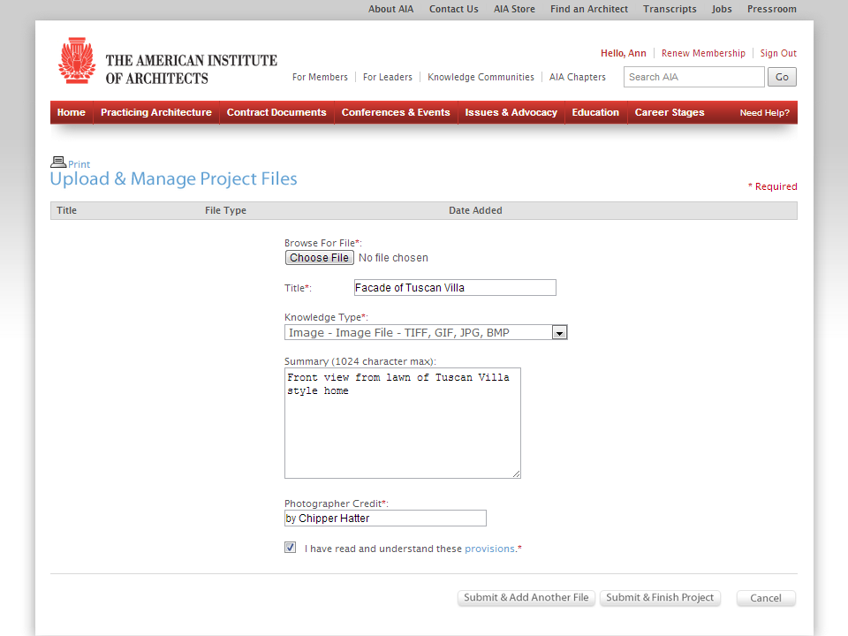
Include photo title, description, and the photographer credit in submission.

Slide 20
New
Individual Item
Submission

Slide 21
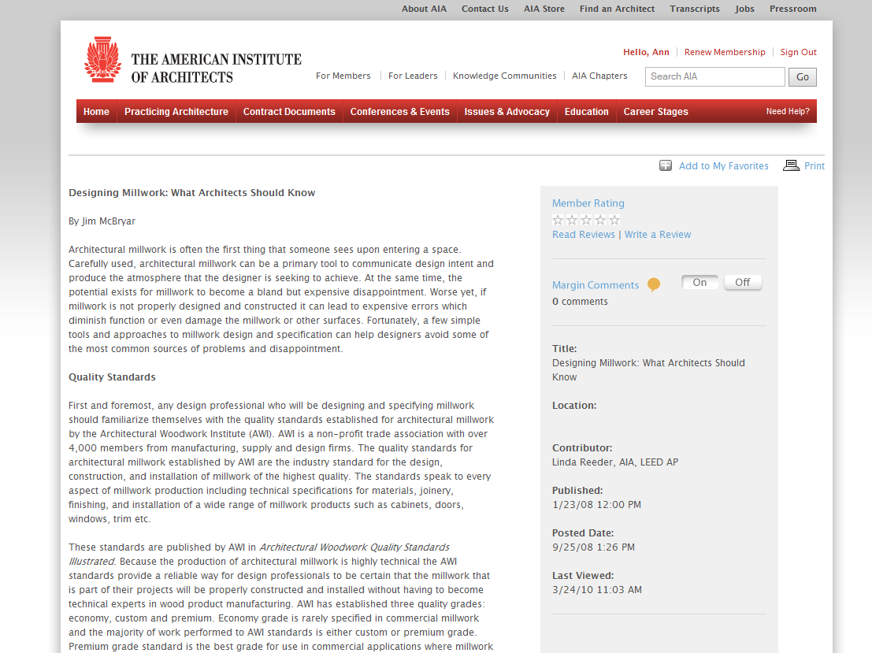
Example of an Individual Item
http://www.aia.org/akr/Resources/Documents/AIAP072830

Slide 22
Upload an article for your newsletter or blog by clicking on “New Individual Item Submission”

Slide 23
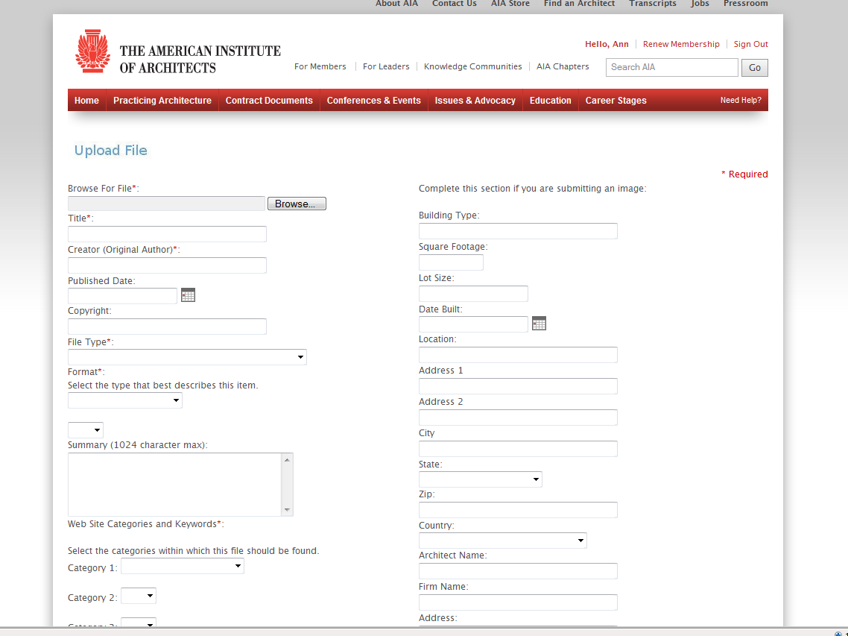
Upload Submission

Slide 24
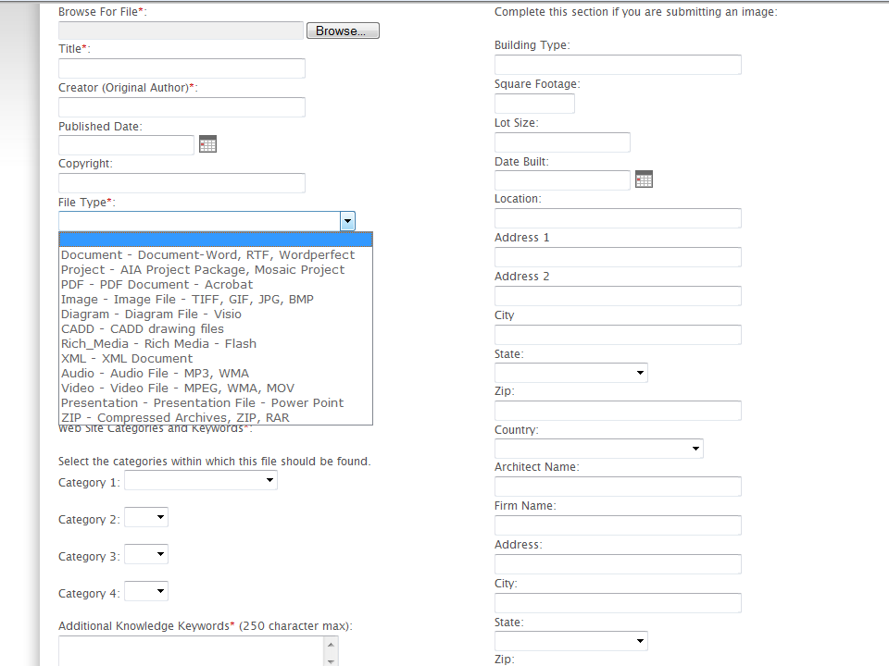
Specify file type/format

Slide 25
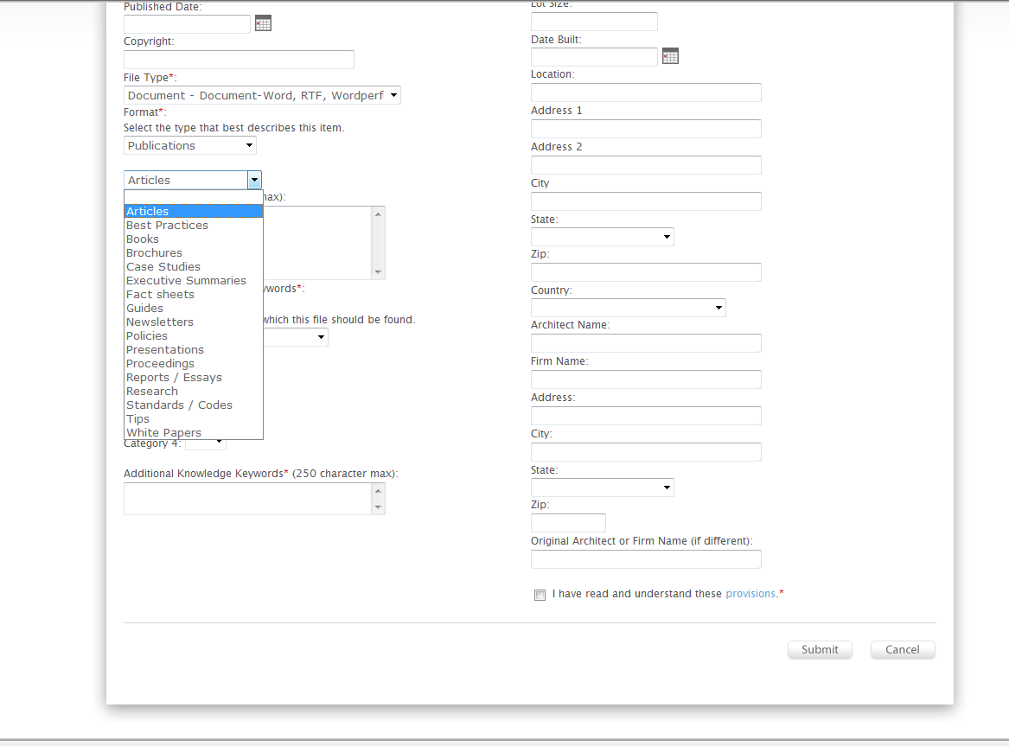
Select the publication format of submission such as article, best practices, or white paper

Slide 26
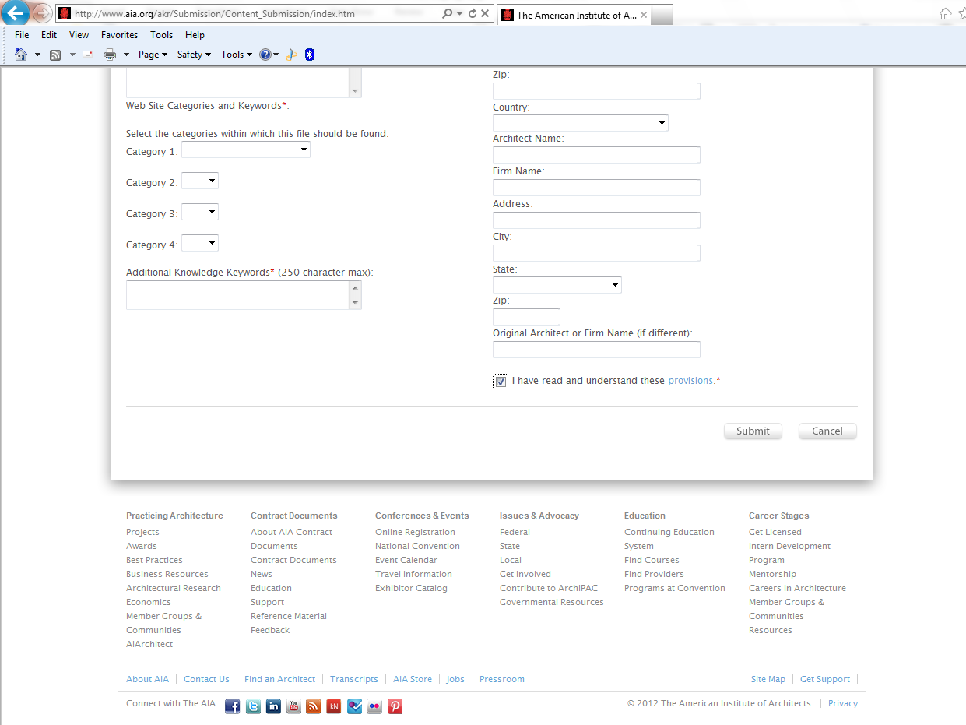
Accept the submission privacy and usage policy then click “Submit”

Slide 27
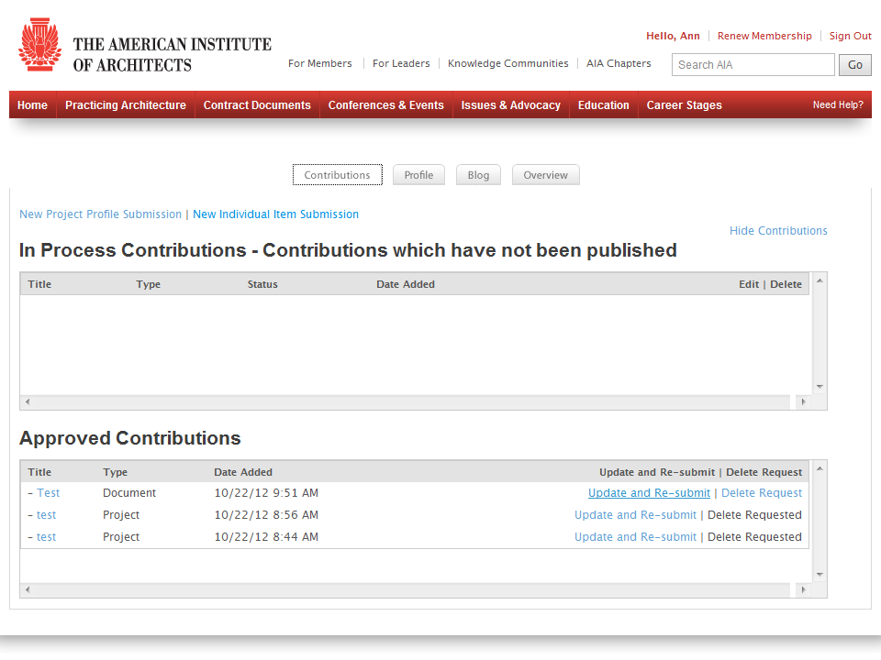
You will be taken back to the Contributions Tab screen. Refresh the browser and scroll down to see your new contribution.

Slide 28
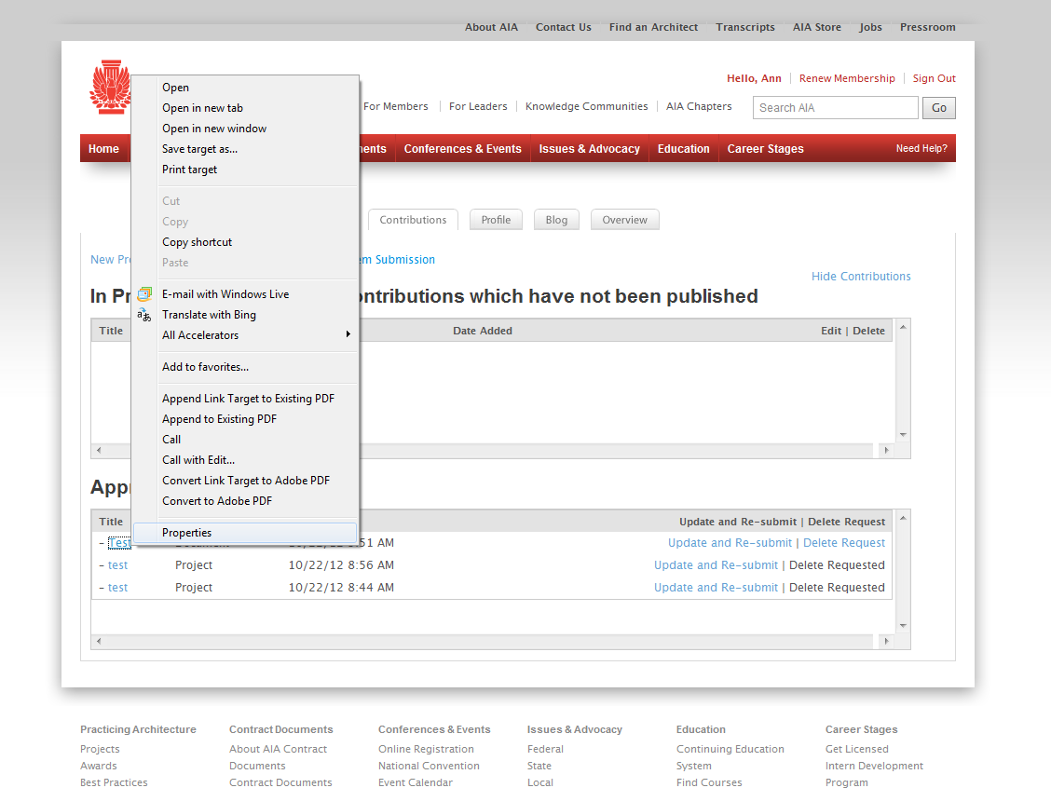
To retrieve the URL either Double Click on the title and it will be the address bar or Right Click over the title and select Properties.

Slide 29
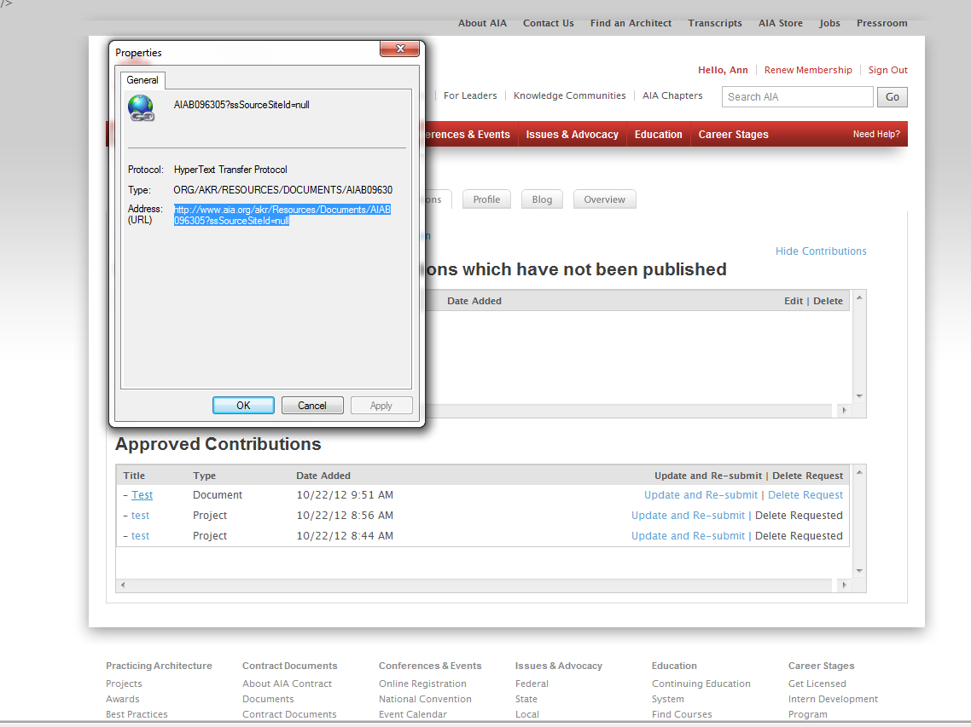
Highlight the URL with your cursor. Press CTRL+C to copy.
*You can remove the ?ssSourceSiteId=null portion of the URL to shorten it.

Slide 30
You can also update and re-submit the file.

