Slide 1
K-12 Educational Design for Safety and Security
Notes:
The first CAE Learning Environments webinar contributed current thinking about changes in learning, teaching and the educational process as introduction to the ethical charge to architecture to respond culturally in its research and design practice.

Slide 2
Learning Objectives
Identify elements related to site Design that affect the security of K-12 facilities
Be able to explain how the entrance and circulation of K-12 schools affects the safety of the building
Be able to explain how transparency makes facilities safer.
Identify three topics to consider when addressing the safety of an existing facility.

Slide 3
Agenda
K-12 School Site Design
K-12 School Entrance and Circulation
Transparency in K-12 Schools and the role that it plays in security
K-12 Existing buildings and Active Security Systems
Questions and Answers

Slide 4
K-12 School Site Design
Paul D. Winslow, FAIA

Slide 5
School Site Design Approach
Campus Style
• Single building
• Multi-building Campus
Different security approach to each
First line of defense
Caution Zone
First line of defense
Caution Zone

Slide 6
School Site Design Approach
Pickup and Drop-off
Play
Play
Bus
Parent
Bus
Parent
Supervision Points
Before the bell
Security
After the bell

Slide 7
School Site Design Approach
Building as buffer
Play
Play
Bus
Parent
Bus
Parent
Supervision Points
Before the bell
Security
After the bell

Slide 8
School Site Design Approach
Landscape - Visibility
• Trees, not shrubs
• Away from the building
• Avoid blind spots

Slide 9
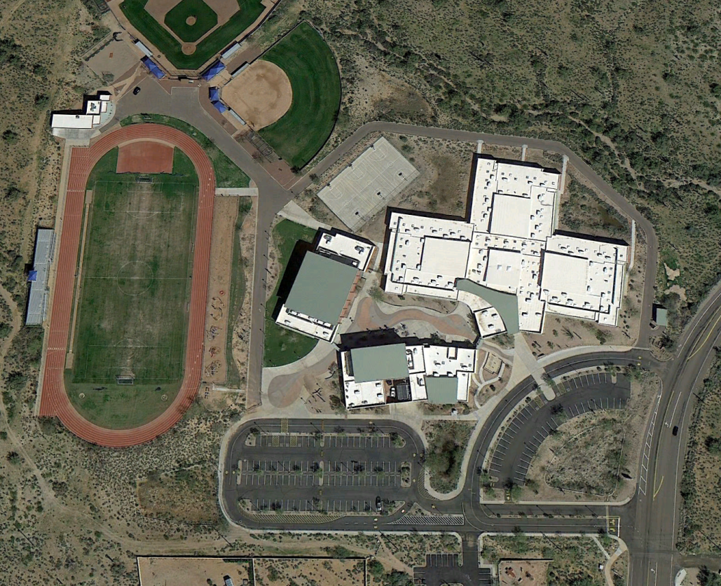
School Site Design Approach
Example: Fountain Hills Middle School

Slide 10
School Site Design Approach
Example: Fountain Hills Middle School
Supervision Point
Before School
Bus
During School
Parent
Secondary escape route
Parent
• Pickup and Drop-off
Before and after school

Slide 11
School Site Design Approach
Example: Fountain Hills Middle School
Buffer from parking

Slide 12
School Site Design Approach
Example: Fountain Hills Middle School
Supervision Point
Before School
During School
Buffer area
View from Office
• Pickup and Drop-off
Before and after school

Slide 13
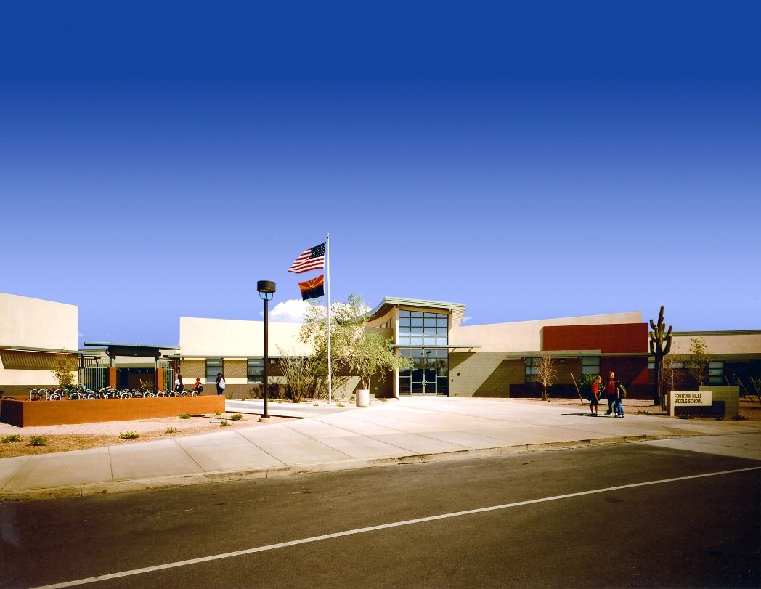
School Site Design Approach
Example: Fountain Hills Middle School
Main Entry During School
Roll-Down Screen Gate – Open Before and After School
Bus drop-off
• Pickup and drop-off entry
before and after school

Slide 14
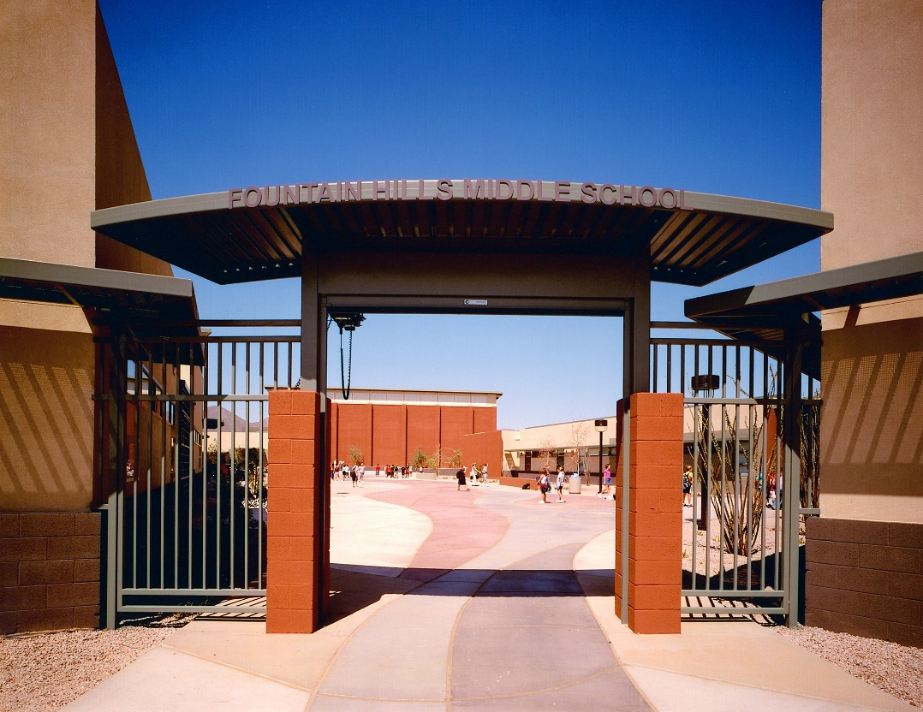
School Site Design Approach
Example: Fountain Hills Middle School
Roll-Down Screen Gate
• Bus pickup and drop-off entry
before and after school

Slide 15
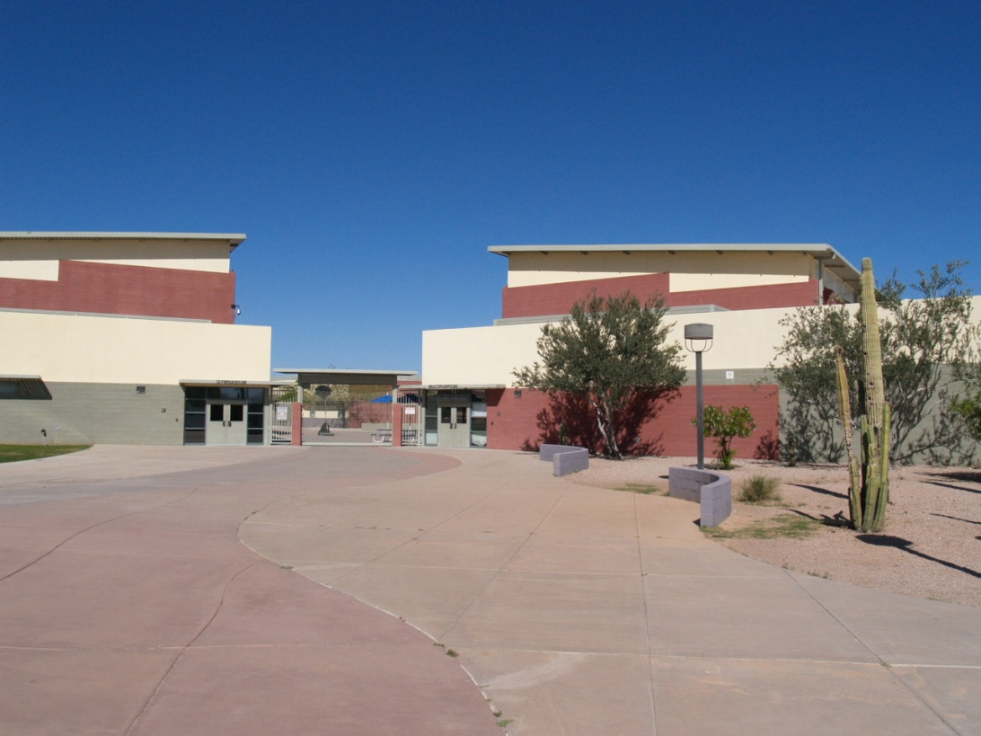
School Site Design Approach
Example: Fountain Hills Middle School
Cafeteria before school program
Roll-Down Screen Gate
Gym before school program
• Parent pickup and drop-off entry
before and after school

Slide 16
K-12 School Entrance and Circulation Design
Susan Baker, AIA

Slide 17
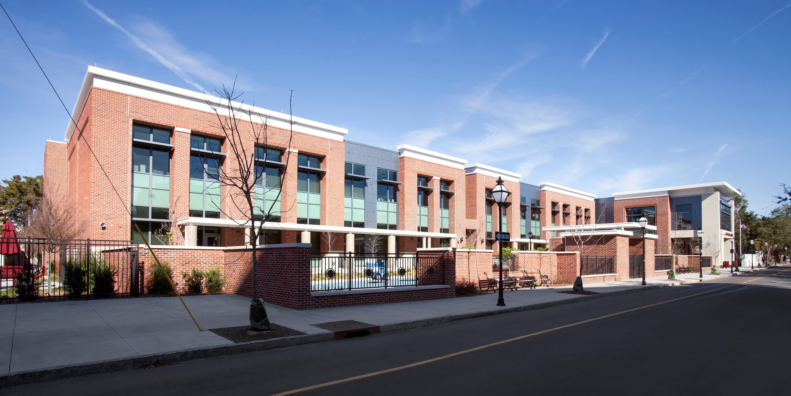
Concentric rings of protection

Slide 18
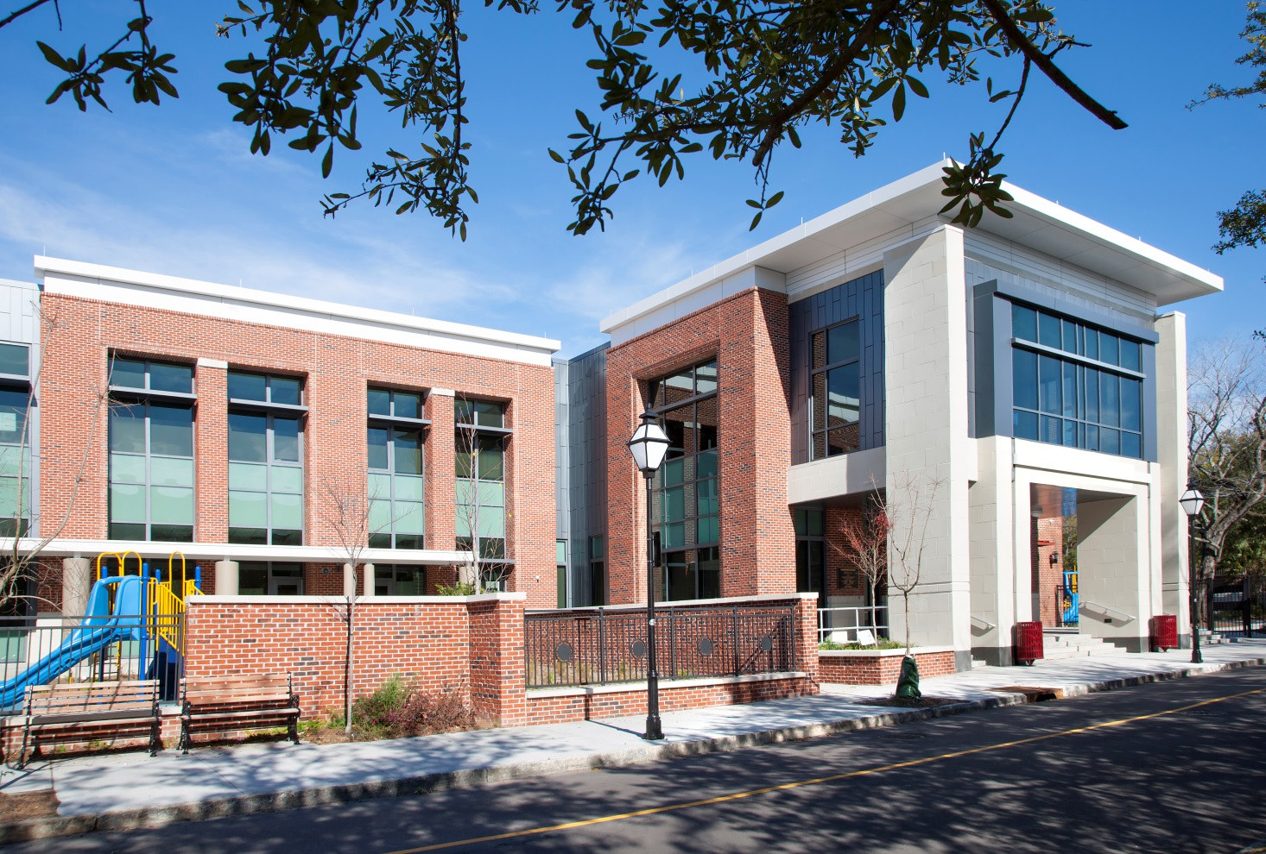
Protect exterior entrances

Slide 19
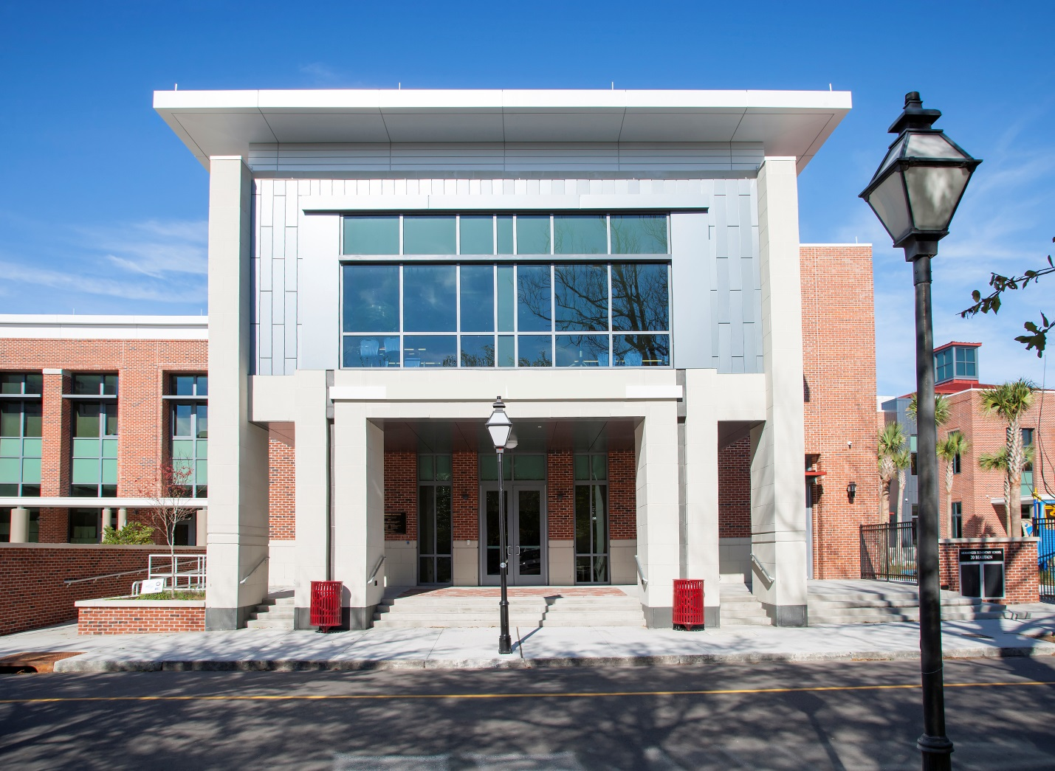
Easily identifiable main entrance

Slide 20
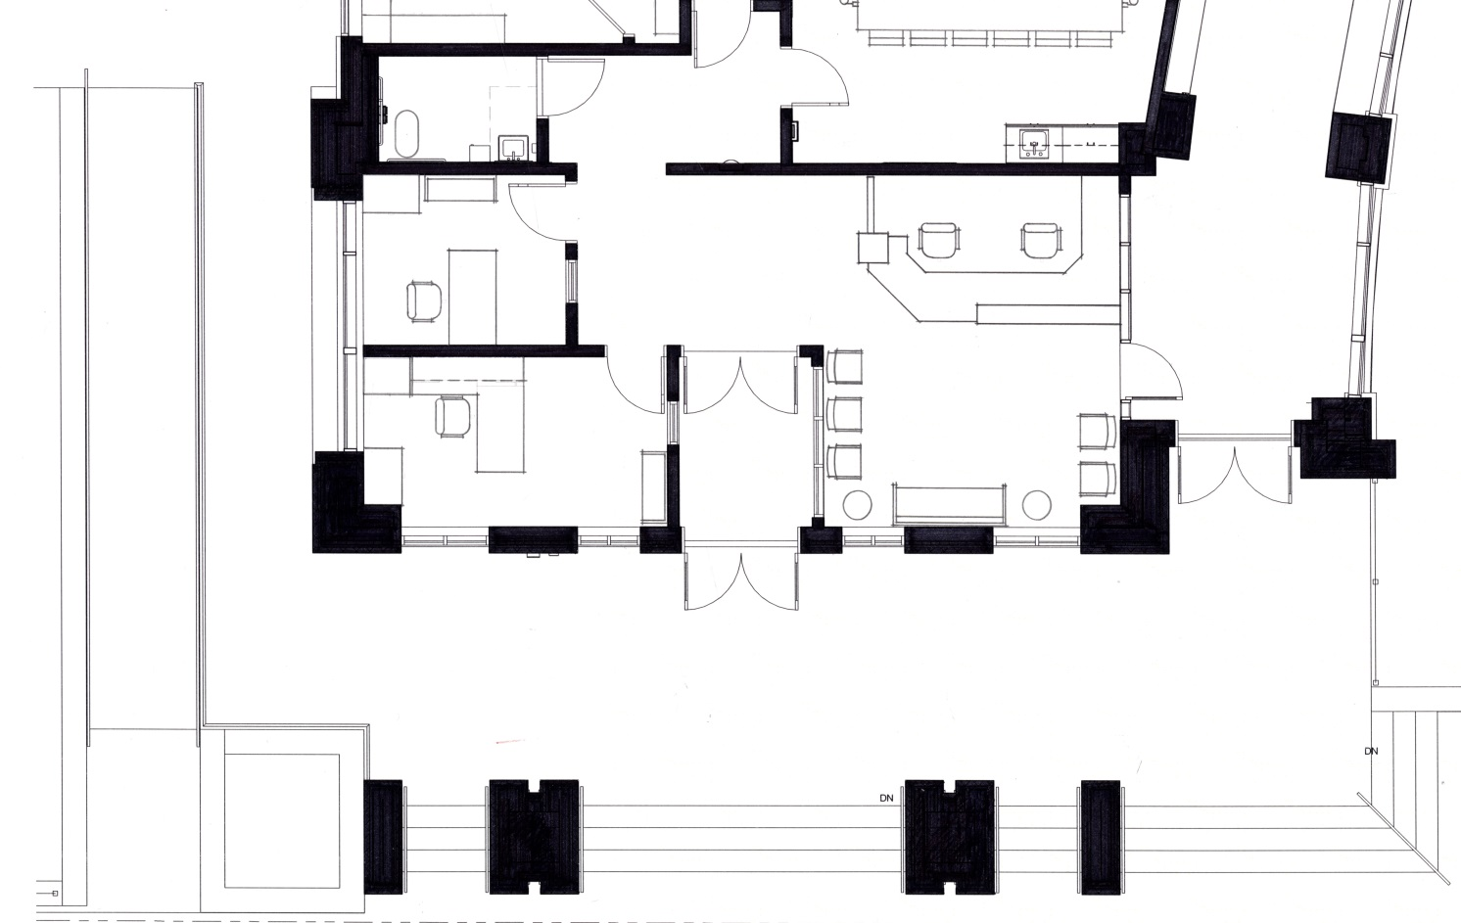
Main Entrance
Lines of sight

Slide 21
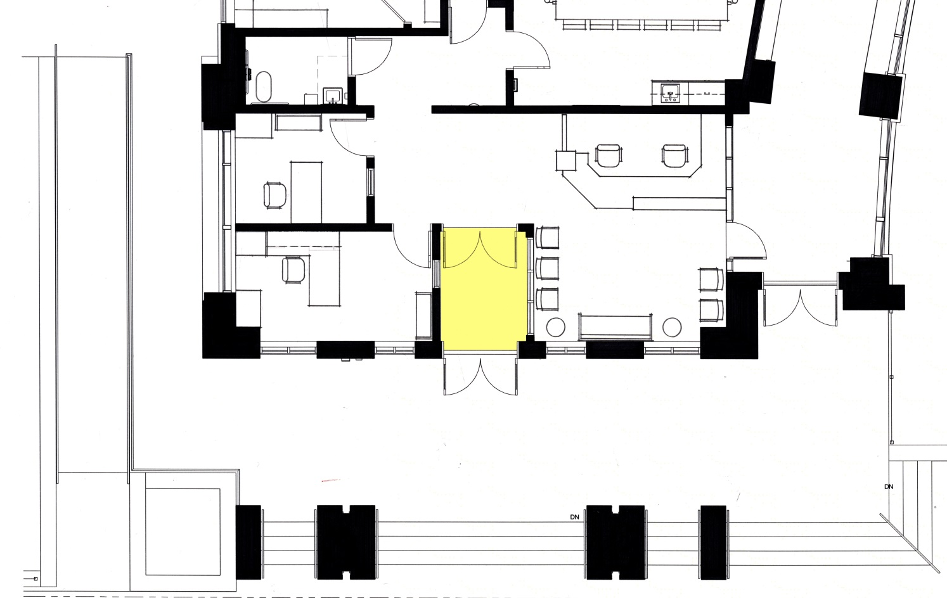
Toilet
Conference
Book
Reception
Data
Waiting
Locked doors – student access in mornings
Secure Vestibule
Main Entrance
Secure entry vestibule

Slide 22
Toilet
Conference
Book
Reception
Data
Waiting
Pan-Tilt-Zoom Cameras

Slide 23
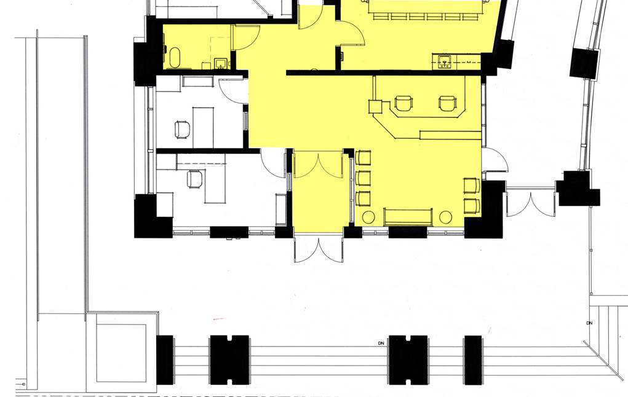
Toilet
Conference
Book
Reception
Data
Waiting
Visitors’ Center

Slide 24
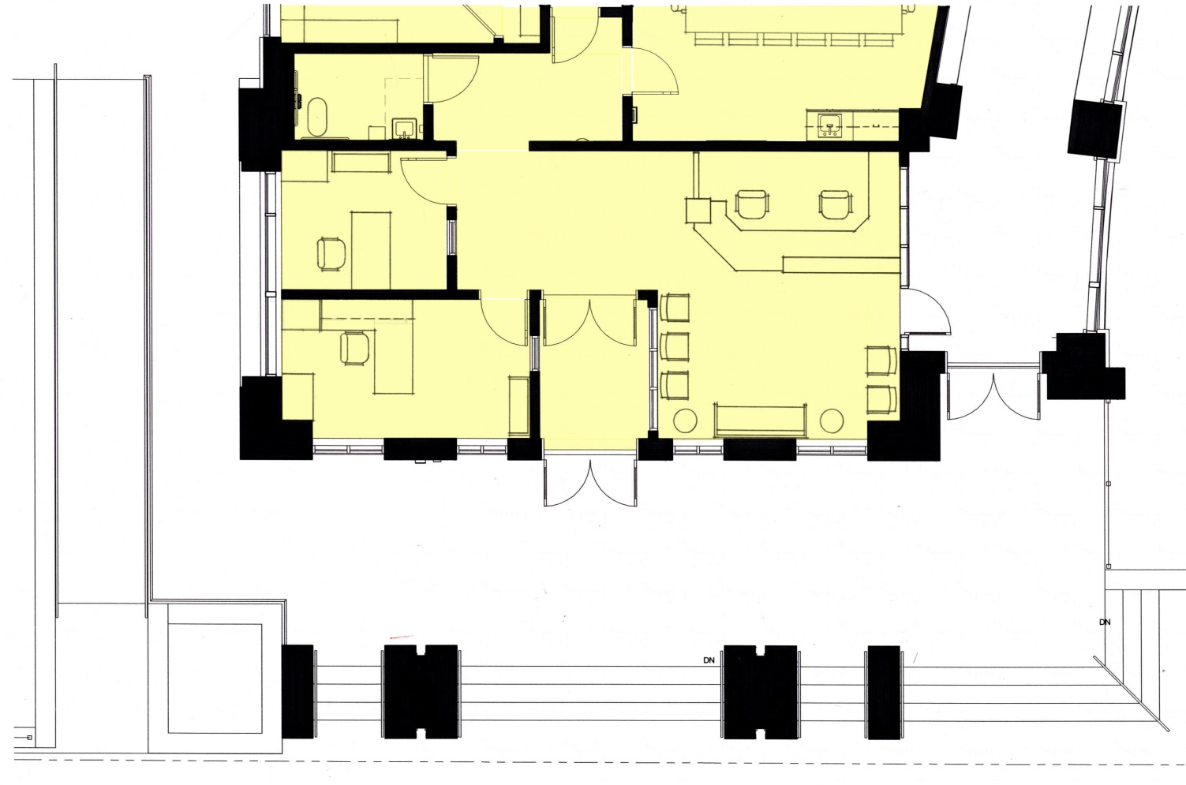
Administration

Slide 25
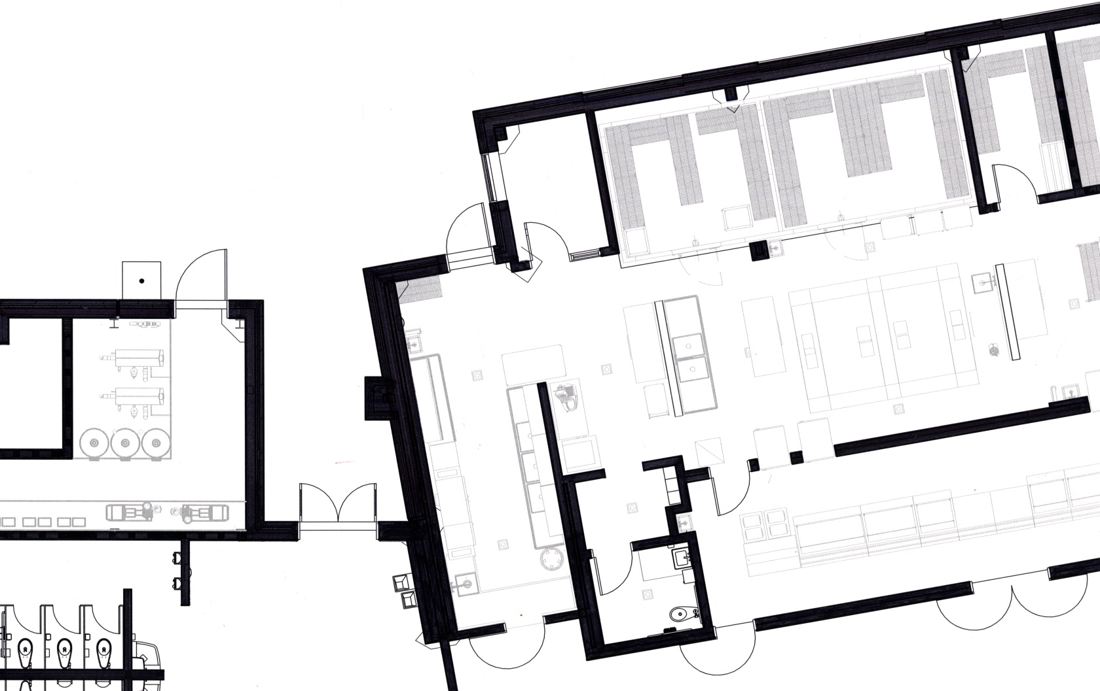
Loading area lines of sight

Slide 26
Loading area PTZ cameras

Slide 27
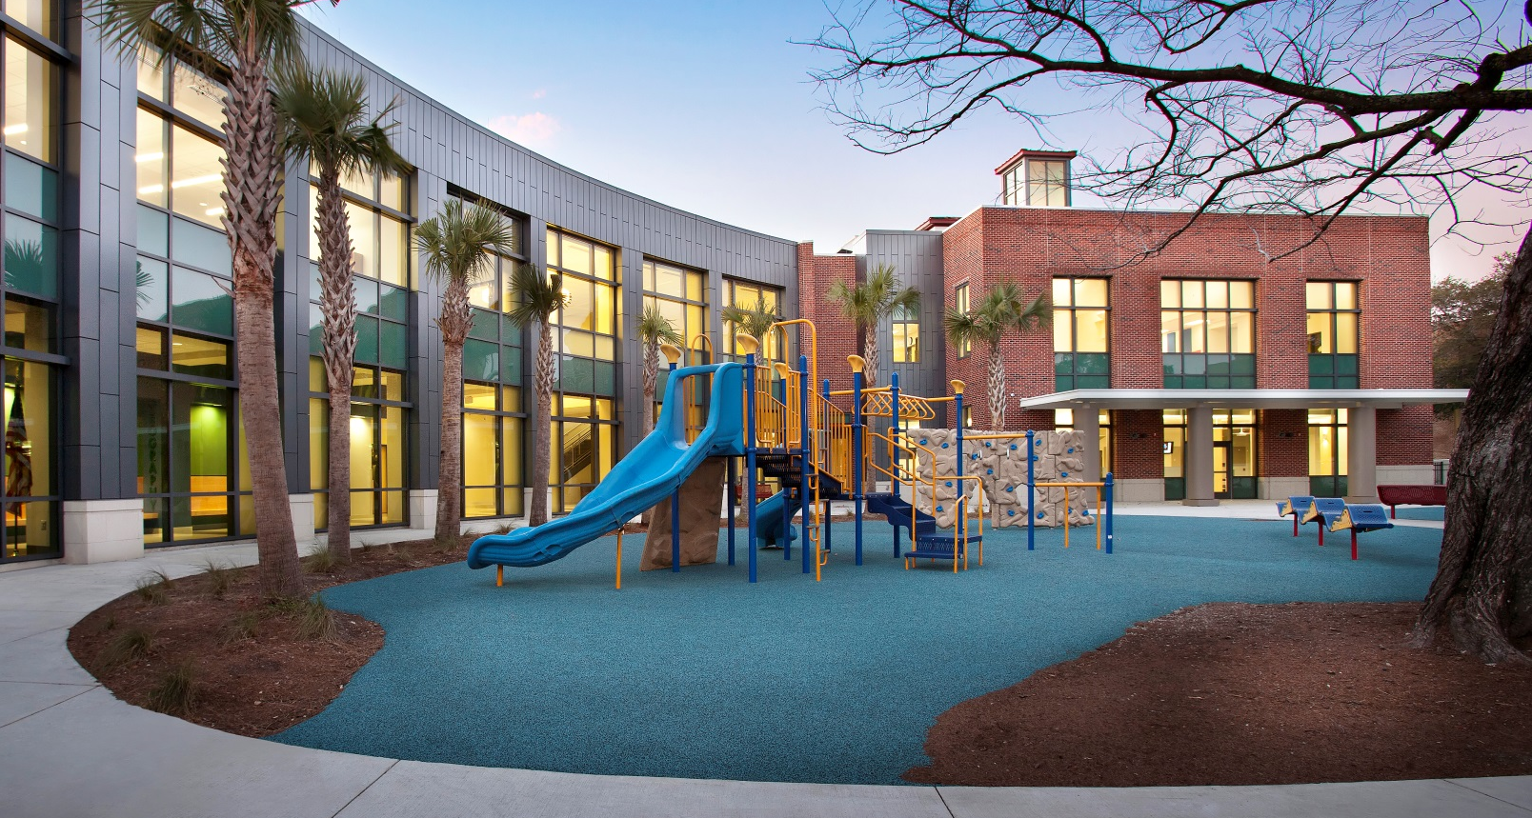
Lighting

Slide 28
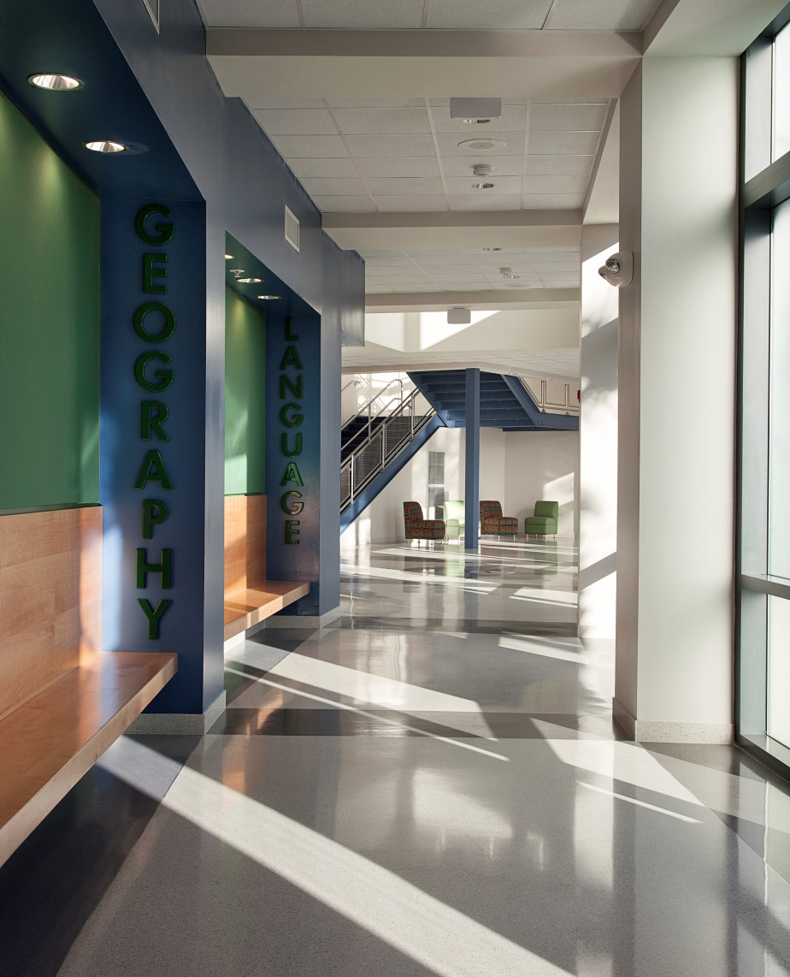
Natural surveillance with good sightlines

Slide 29
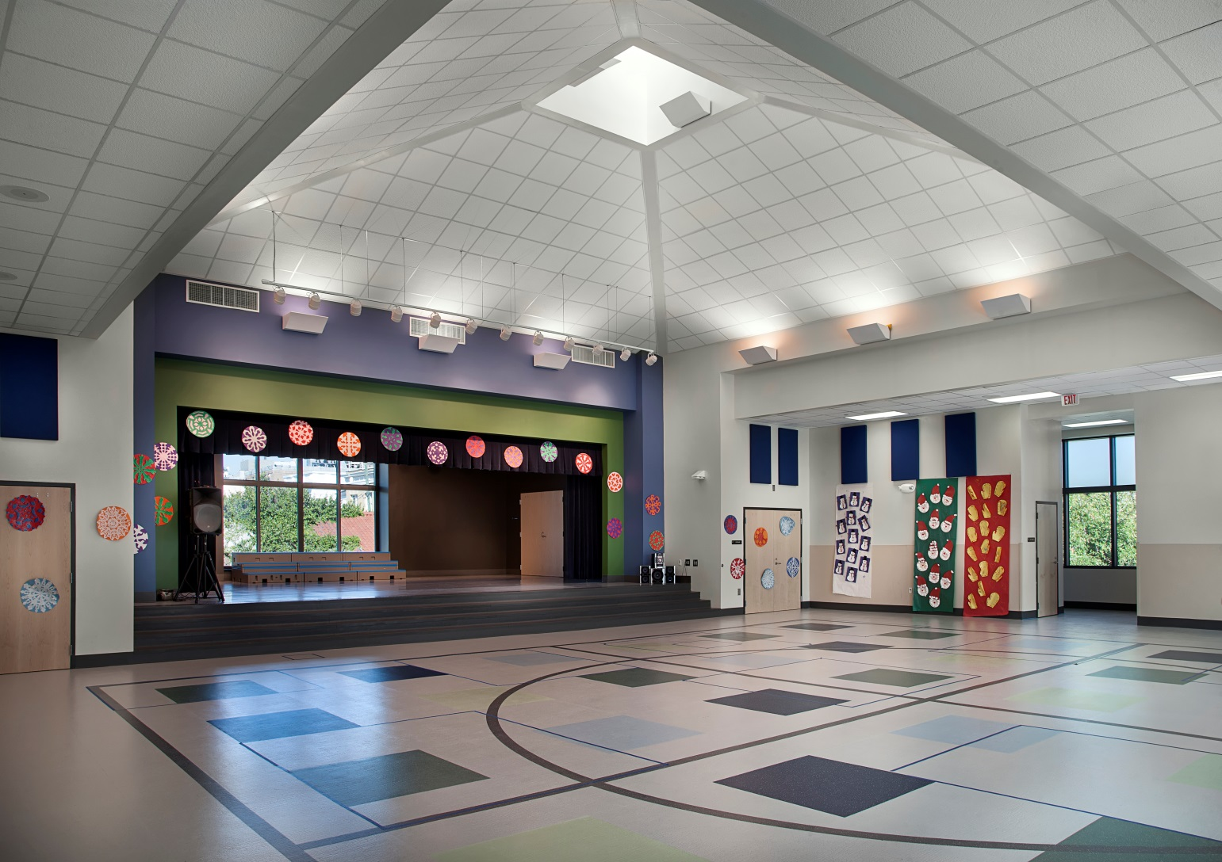
Community Use

Slide 30
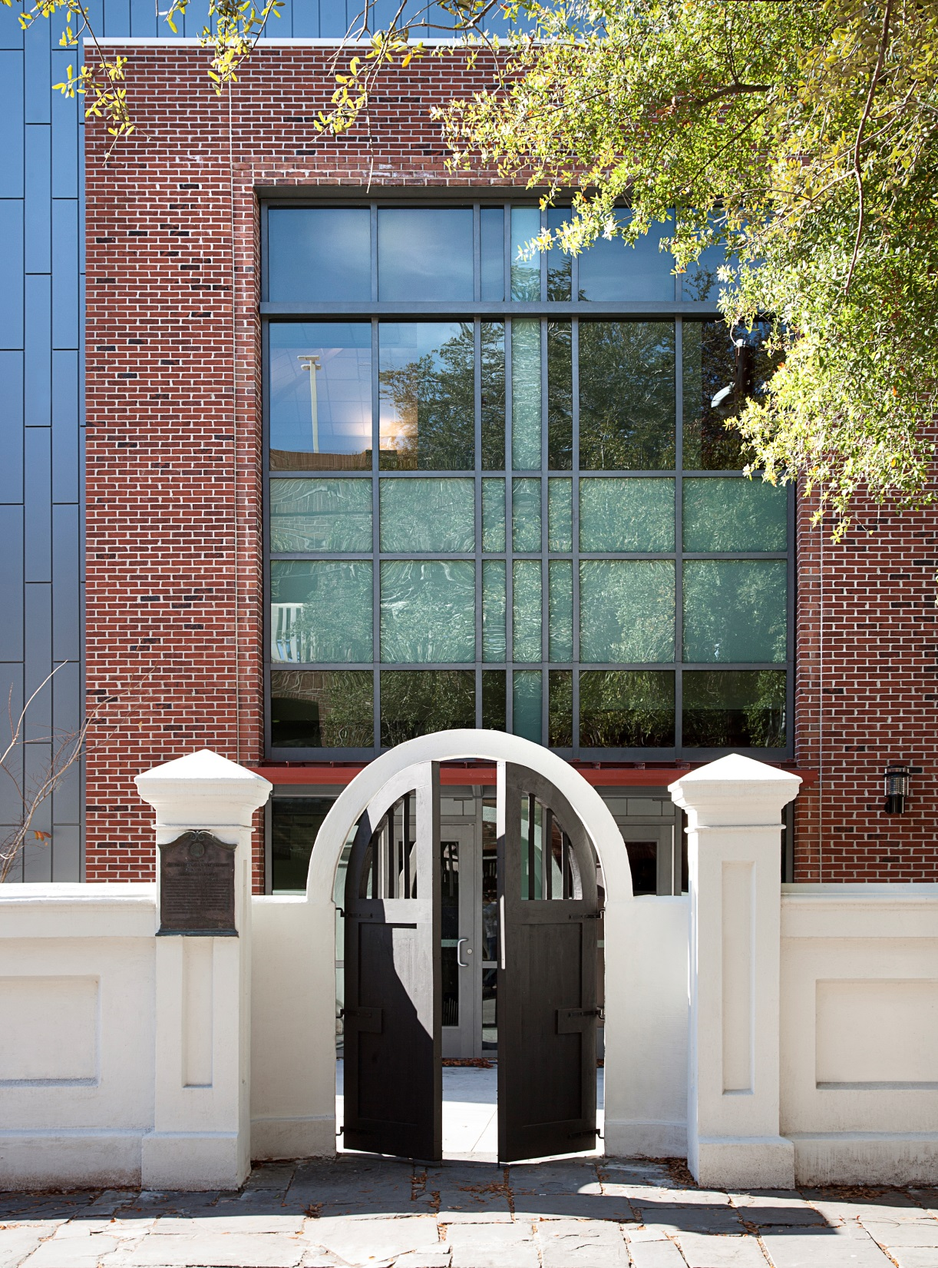

Slide 31
Transparency in K-12 Design
Scott M. Rose, LEED AP

Slide 32
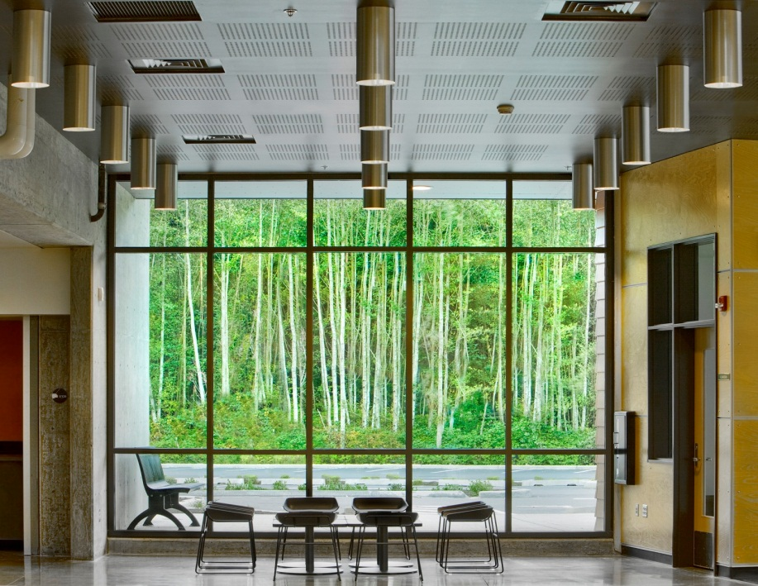
Transparency as Balance
Reactions to violent crimes in schools are trending toward less visibility with hardened, opaque walls. This is wrong. To maintain an environment of learning, a balance of open and captured space is critical . . . and safer.

Slide 33
C.P.T.E.D.
“SEE and BE SEEN”
Natural surveillance occurs by designing the placement of physical features, activities and people in such a way as to maximize visibility and foster positive social interaction among legitimate users of private and public space.
21st Century Learning
Learning spaces must motivate learners, promote learning as an activity, and support collaboration. While formal practice or rigor is essential, 21st century learning spaces must also create a personalized and inclusive environment, and be flexible to the changing landscape.

Slide 34
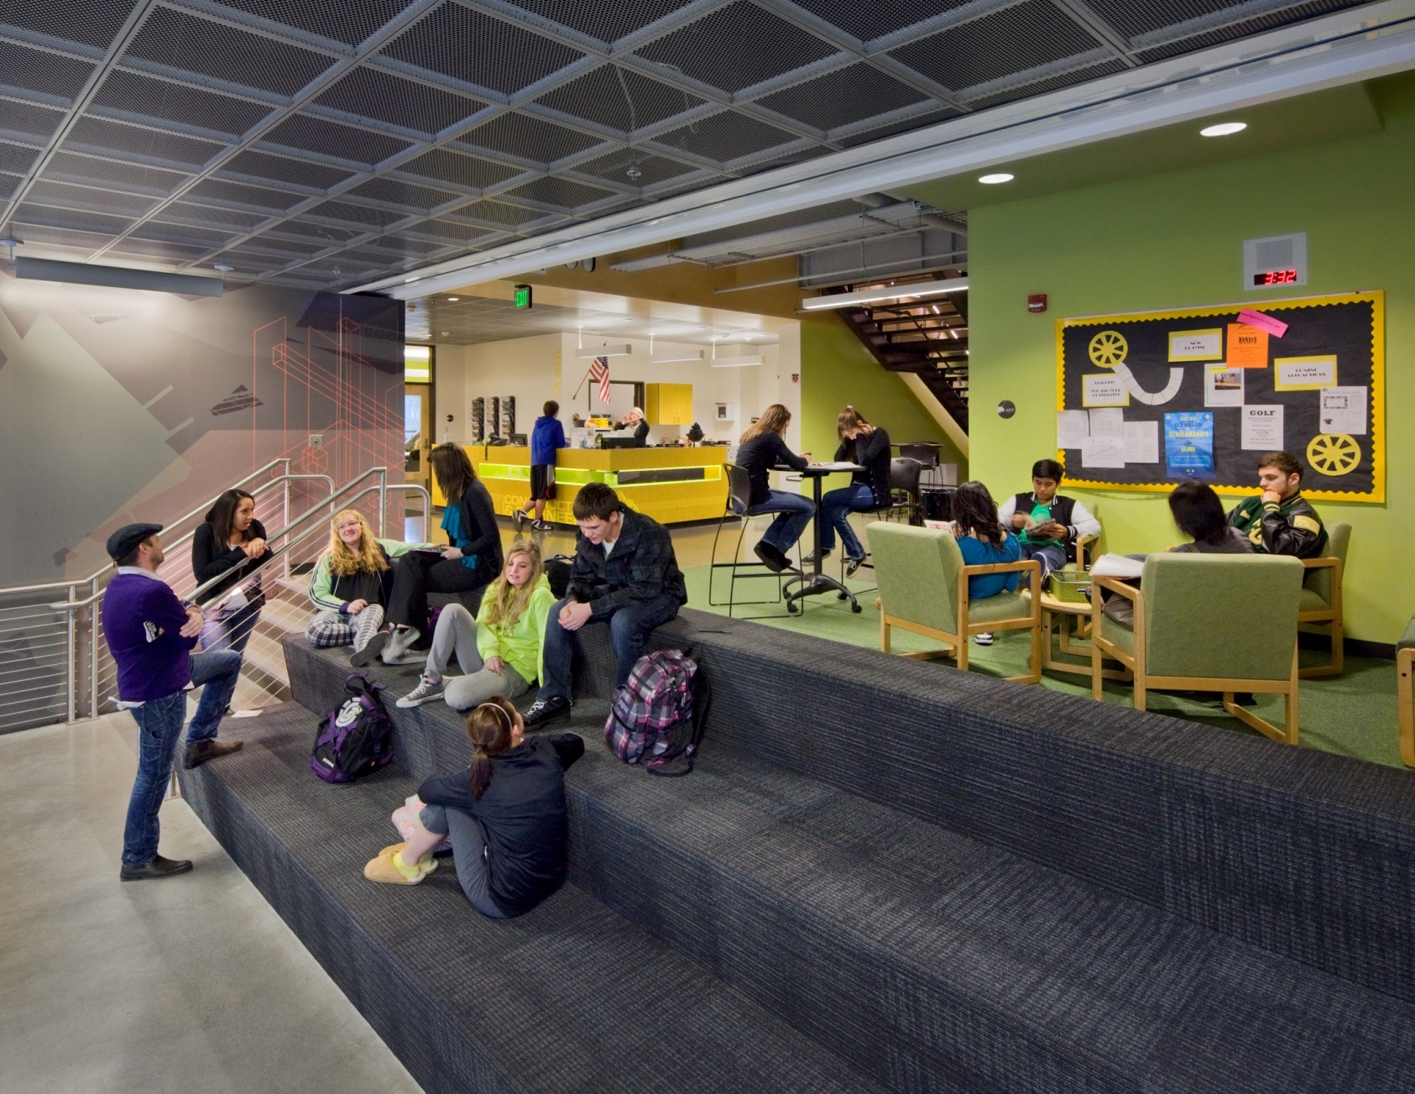
Educational Goals
Daylighting
Visible Learning
Collaboration
Flexibility

Slide 35
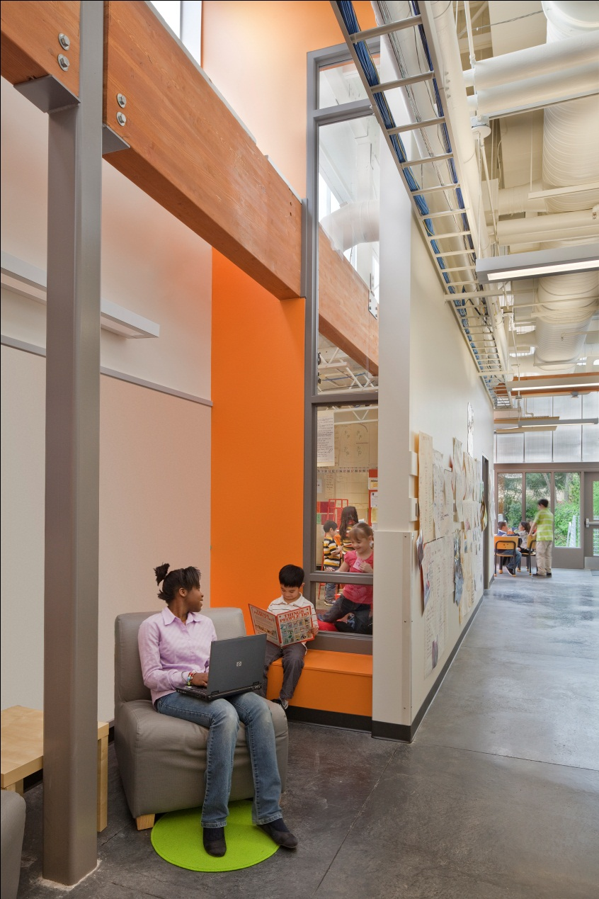
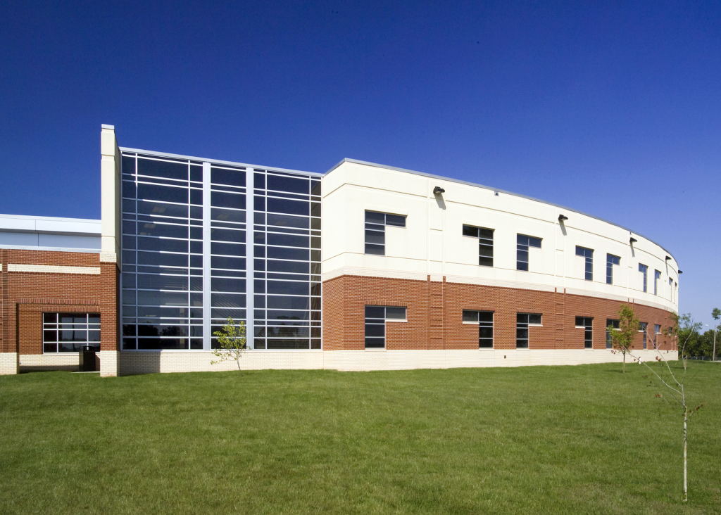
Daylighting
Diffused
Varied View Patterns
Borrowed Light

Slide 36
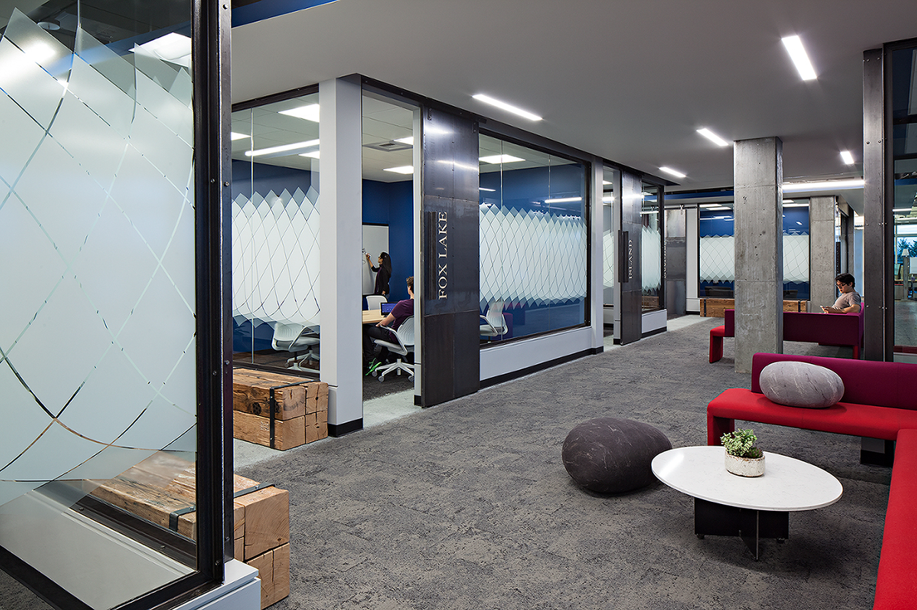
Visible Learning
Learning spaces as interactive as professional work spaces

Slide 37
Visible Learning
Outdoor Connections

Slide 38
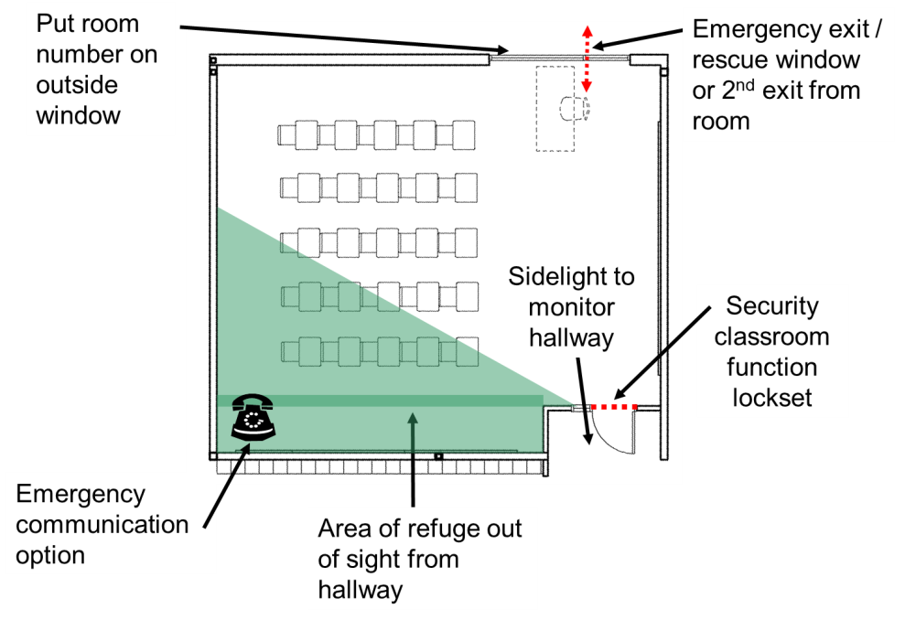
The “Safer” Traditional Classroom

Slide 39
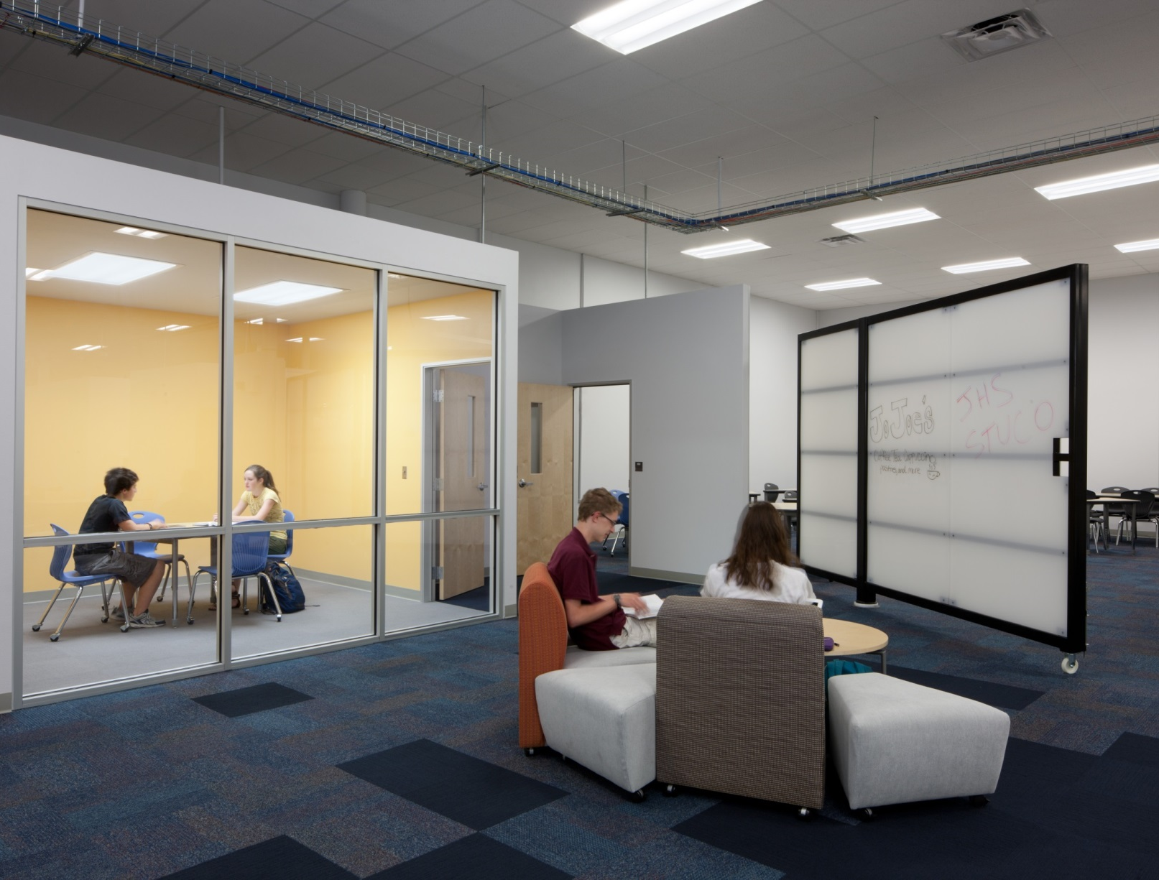
Collaboration
Adaptable Furnishings
Near Cores
Clear Lines of Sight

Slide 40
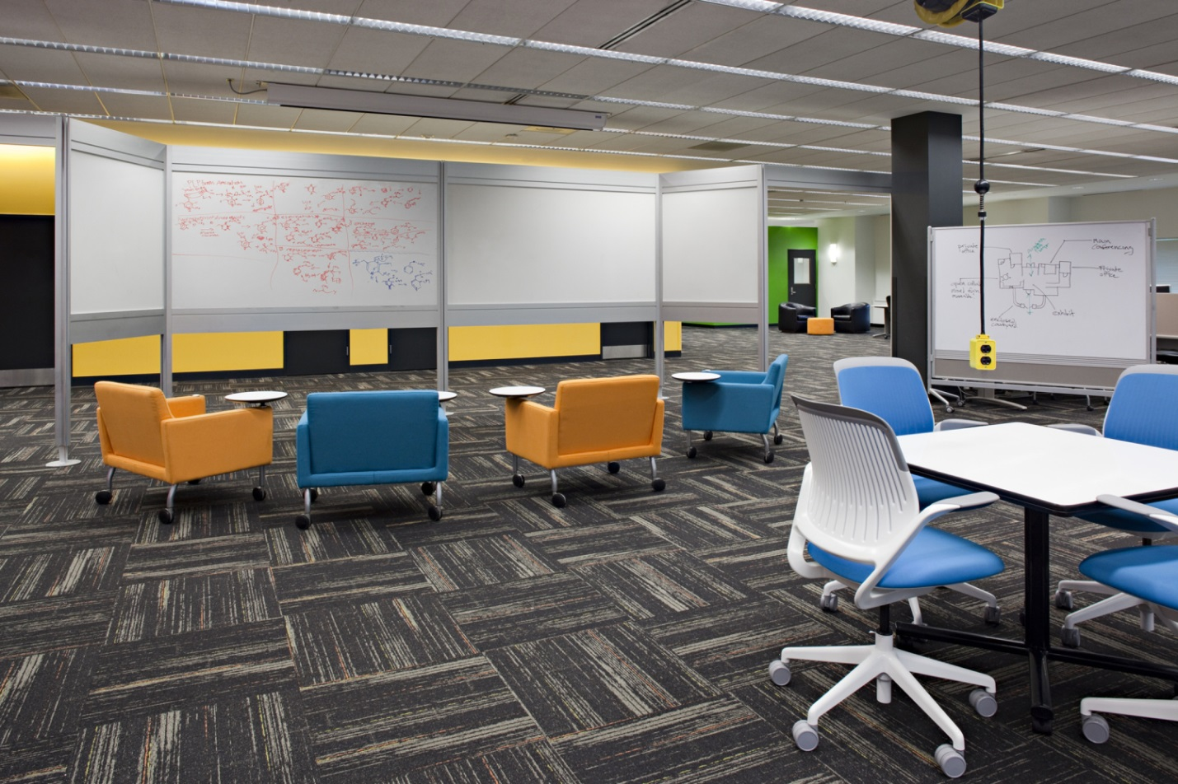
Collaboration
Adaptable Furnishings
Near Cores
Clear Lines of Sight

Slide 41
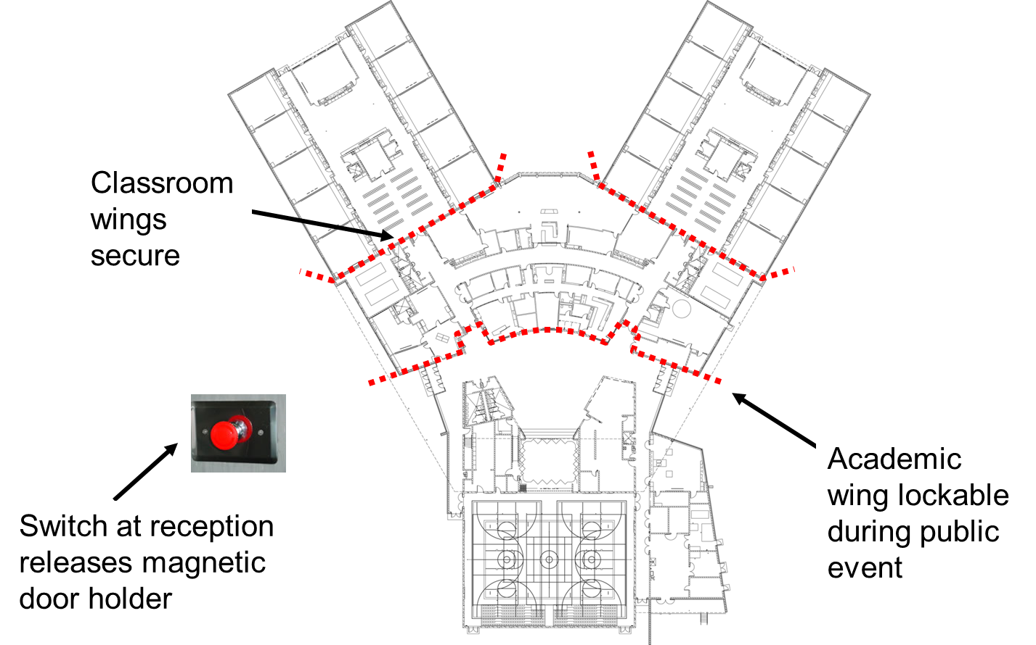
Collaboration
Pull out areas maintained with cross-corridor doors to shut down pods and buy time for refuge
COLLABORATION AREAS

Slide 42
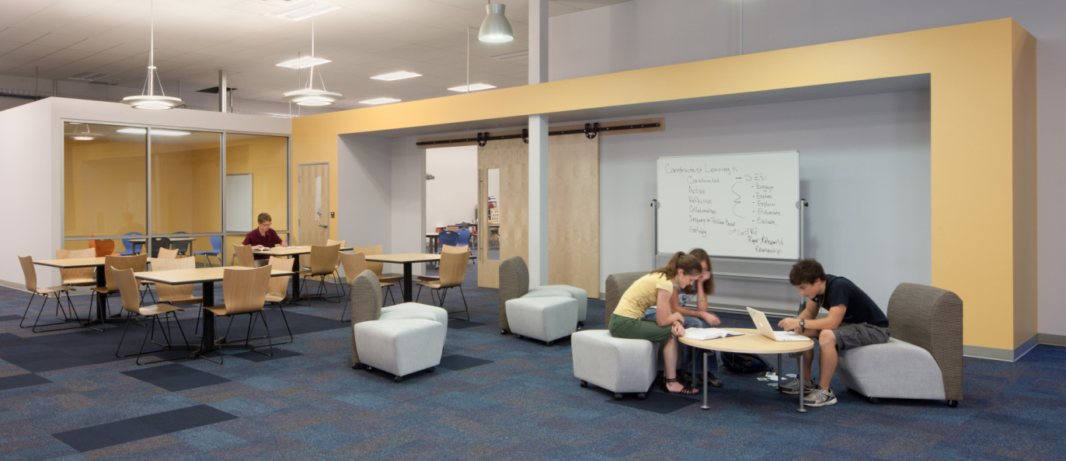
Flexibility
Open environments with audible privacy (think tank) and easily closed off (sliding doors) with adjacent areas of refuge. Avoid “all or nothing” transparency

Slide 43
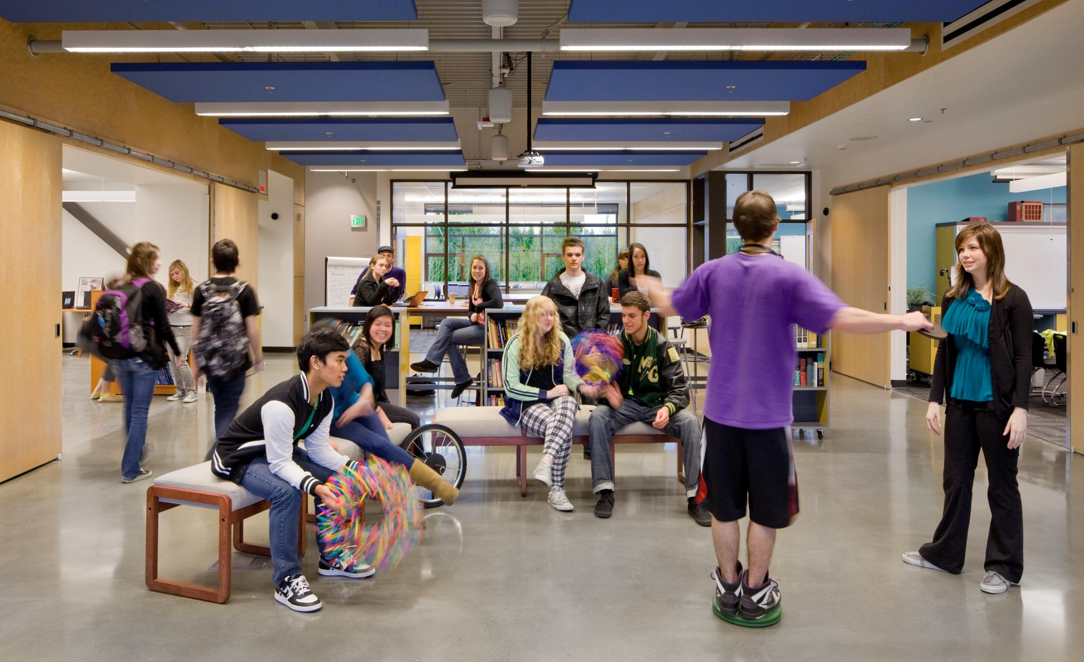
Flexibility

Slide 44
Assessing Existing Facilities

Slide 45
Assessing Existing Facilities
What is the site assessment?
When should it be performed?
Who should perform it?
Notes:
Site assessments provide an increased understanding of the potential impact of man-made threats and natural hazards in the school buildings or on school grounds. The assessment includes, but is not limited to, a review of building access and egress control measures, visibility around the exterior of the building, structural integrity of the building (performed by a licensed structural engineer), compliance with applicable architectural standards for individuals with disabilities and others with functional and access needs, and emergency vehicle access.
The purpose in performing the assessment is to educate the team so they better understand the risks and vulnerabilities facing the staff, students and the school buildings and grounds. This is critical in the development of an effective and well developed EOP. This is a learning process that should be repeated on an annual schedule in order to be the most effective.

Slide 46
Assessing Existing Facilities
Selecting the right team
School Staff – Administrators, Receptionists, Janitorial Staff, Nurse, Counselors, Teachers, Special Needs Instructors;
Campus Police or School Resource Officers;
Athletics and Fine Arts Directors;
Technology, Transportation and Maintenance Directors;
Finance Director;
Local Emergency Responders and Neighbors;
Others as deemed necessary
Notes:
Before you can begin the process of performing a site assessment you must first need to consider the team that will be charged with leading the overall assessment. They must be prepared to distinguish the man-made threats and natural hazards faced by the campus and they must understand exactly what the site assessment means to the school, their community and to the implementation of their emergency operations planning.
The team leader may be determined by who may provide and perform the following criteria:
1 Assign responsibilities and reporting structures:
2 Set timelines and establish a communication structure within the team.
3 Coordinate with the campus principals and other leadership as needed

Slide 47
Assessing Existing Facilities
Man-made Threats and Natural Hazard Identification:
Man-made threats: Man-made threats are anything that could adversely affect the safety and security of the assets or function of a campus or facility.
Natural hazards: A natural hazard is any real or potential condition that can cause degradation, injury, illness, loss of equipment or property damage.
Notes:
Please stress that these lists are neither exhaustive nor exclusive, and that these are just some examples.
Once the team is assembled they should consider the types of man-made threats and natural hazards that can be found on or around the campus property.
Read the definition of a man-made threat.
Man-made threats have a wide range of possible sources but they all originate as a human caused event. Man-made threats can be adversarial (the custody battle or gang violence) to incidental (suicide, fire) in nature. A campus elementary with a high threat of custody battles will need to assess the ability of the staff to observe people walking toward the campus during the day, do they have systems in place that can help staff identify parents who are under barred from entering the campus under court order and how quickly can they secure the building and the student if an incident occurs.
Read the definition of the natural hazard as defined by the Operational Risk Management method used by the FAA. For example, a fertilizer processing facility located near a school may contain materials that could potentially create a explosion leading to the loss of life and destruction.

Slide 48
Assessing Existing Facilities
Examples of Man-made Threats:
Fire
Active shooters
Criminal threats or actions
Gang violence
Bomb threats
Domestic violence and abuse
Cyber attacks
Suicide
Notes:
Read through the list of examples of man-made threats

Slide 49
Assessing Existing Facilities
Examples of Natural Hazards:
Severe weather & lightning strikes
Tornados
Hurricanes
Floods
Earthquakes
Wildfires
Ice Storms and blizzards
Tsunami
Volcano
Notes:
Read through some of the list of examples of natural hazards.

Slide 50
Assessing Existing Facilities
Examples of Biological Hazards:
Infectious diseases, such as pandemic influenza, extensively drug-resistant tuberculosis, staphylococcus aureus, and meningitis
Contaminated food outbreaks, including salmonella, botulism, and e. coli
Toxic materials present in school laboratories
Notes:
Read through the list of examples of biological hazards shorten the disease names to:
Diseases such as the flu, tuberculosis, Staph infections and meningitis

Slide 51
Assessing Existing Facilities
Examples of Technological Hazards:
Explosions or accidental release of toxins from industrial plants
Accidental release of hazardous materials from within the school, such as gas leaks or laboratory spills
Hazardous materials releases from major highways or railroads
Radiological releases from nuclear power stations
Dam failure or water failure
Power failure
Notes:
Read through the list of examples of technological hazards.

Slide 52
Assessing Existing Facilities
Visit the site during the day and at night
Review floor plans and aerial site plans
Camera
Notes:
Visiting the site during the day will allow the team to observe the interaction of staff, students, parents and law enforcement if applicable. Pay attention to the paths taken by the student walkers, walk the routes they take to understand the exposure to man-made threats or natural hazards that they may face. Where are the parents picking up their kids? What doors are
Visiting the campus at night will allow the team to understand the quality of the lighting on the property. Are the gates all secured? Are the doors or windows? Are the blinds drawn shut to prevent people from seeing inside the classrooms? Don’t forget to look around the area too – are the neighbors sitting outside during a nice evening? Can the neighbors observe your facility at night?
Floor plans and aerial site plans allow the team to make notes and record information in specific locations of the property or building. Where are the gaps in the fence line, what area of the property is unobservable by the staff? Where are hiding places such as wood lines, large road drains or depressions or drainage areas that can mask the movement of a stranger on campus?
Photos and video help capture specific examples that can be shown to other decision makers not attending the walkthrough.

Slide 53
Assessing Existing Facilities
Visit the site during the day and at night
Review floor plans and aerial site plans
Camera
Notes:
Visiting the site during the day will allow the team to observe the interaction of staff, students, parents and law enforcement if applicable. Pay attention to the paths taken by the student walkers, walk the routes they take to understand the exposure to man-made threats or natural hazards that they may face. Where are the parents picking up their kids? What doors are left unlocked or are accessible on your building?
Visiting the campus at night will allow the team to understand the quality of the lighting on the property. Are the gates all secured? Are the doors or windows? Are the blinds drawn shut to prevent people from seeing inside the classrooms? Are the neighbors sitting outside during a nice evening? Can the neighbors observe your facility at night?
Floor plans and aerial site plans allow the team to make notes and record information in specific locations of the property or building. Where are the gaps in the fence line, what area of the property is unobservable by the staff? Where are hiding places such as wood lines, large road drains or depressions or drainage areas that can mask the movement of a stranger on campus?
Photos and video help capture specific examples that can be shown to other decision makers not attending the walkthrough.

Slide 54
Planning for Security Systems

Slide 55
Planning for Security Systems
Examples of Security Systems
Surveillance
Access Control
Intrusion
Metal Detectors
Door Intercom Systems
Building Intercom Systems – Mass Communication
Two way radio
Notes:
As with performing assessments the decision on the type of security systems

Slide 56
Planning for Security Systems
Team Structure
Technology Director
Security Director
Transportation Director
Facilities Director
Superintendent
Local or campus law enforcement
Campus administrators
Custodial
Notes:
As with performing assessments the decision on the type of security systems should not rely on one person or one specific group of people. The following personnel are one suggestion to who should make up the team:

Slide 57
Planning for Security Systems
Team Structure
Technology Director
Security Director
Transportation Director
Facilities Director
Superintendent
Local or campus law enforcement
Campus administrators
Custodial
Notes:
As with performing assessments the decision on the type of security systems should not rely on one person or one specific group of people. The following personnel are one suggestion to who should make up the team:

Slide 58
Planning for Security Systems
Consider the system impact on technology infrastructure
Cabling infrastructure
Network electronics
Where will the surveillance storage be kept
Backups
Access rights
Phone and intercom system interoperability
Notes:
Many of the physical security systems today are going to require the support of the District technology department. Surveillance cameras will require a strong cabling infrastructure and a robust network electronics system capable of supporting multiple PoE platforms. The logistics and processing power required to support video storage will be critical. Creating access control systems requires understanding the flexibility of the system and its impact on the operations of the school. Intercom systems will need to be tied into the phone systems of the campus creating an powerful tool that can be used in any room at any time to provide direction during an emergency.
Selecting a new security system or planning on upgrading an older system should always be carefully considered and all options need to be examined. Deciding on a new IP based surveillance system without first taking into consideration the age of the cabling infrastructure and network electronics will mean the difference between

Slide 59
Planning for Security Systems
Consider the system impact on the facility and the staff
Access control systems and door hardware
Surveillance and facility lighting
The trained staff
Creating a culture of awareness
Notes:
Additional systems will require the support of non-technological systems such as door hardware for access control and planning on placing your surveillance cameras where the lighting creates the best opportunity can help avoid a foolish investment. Not all security systems require capital investment however. The strength of an informed and empowered staff cannot be ignored.
Despite the technological advances and the information that is available to us through these systems none of them can make a decision for you. Only a well trained staff, having learned to maintain a culture of awareness and armed with the knowledge and confidence of being able to make the importance decisions when it matters most will make all the difference in helping to save lives.

