Slide 1
Big Firm, Little Firm
Best Practices
Sunday, September 9, 2012
Newport, Rhode Island

Slide 2
Today’s Panelists

Slide 3
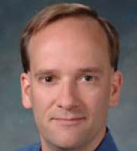
Rob Heselbarth
Editorial Director
Residential Design+Build
Arlington Heights, Ill.
Moderator

Slide 4
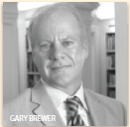
Gary Brewer, AIA
Partner
Robert A.M. Stern Architects
New York
Large firm

Slide 5
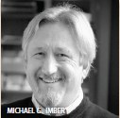
Michael Imber, FAIA
President
Michael G. Imber Architect
San Antonio, Texas
Medium firm

Slide 6
Allan Shope, AIA
President Allan Shope Architect Wassaic, N.Y.
Small firm

Slide 7
Robert A.M. Stern Architects

Slide 9
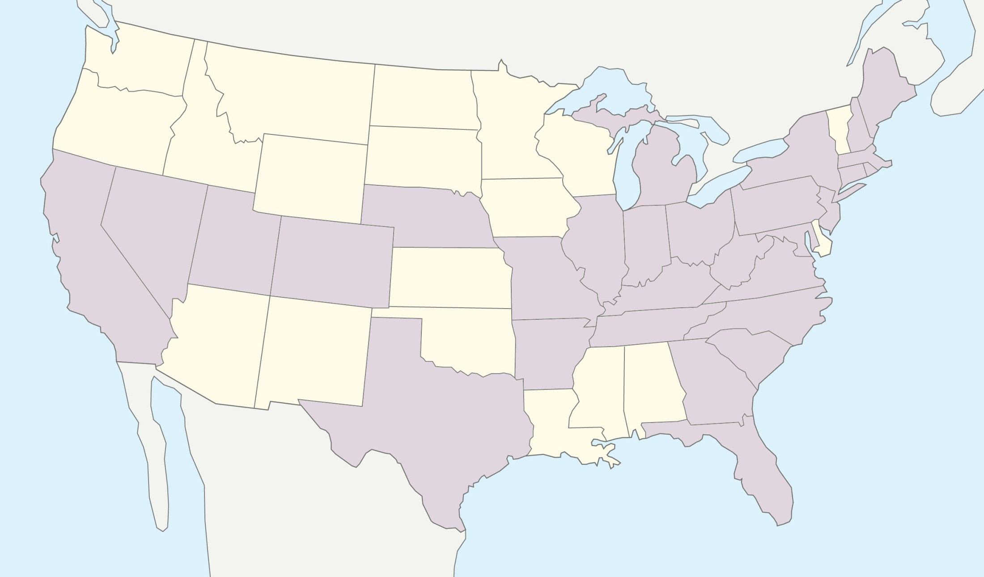
Experience in the United States
Projects in 30 states

Slide 10
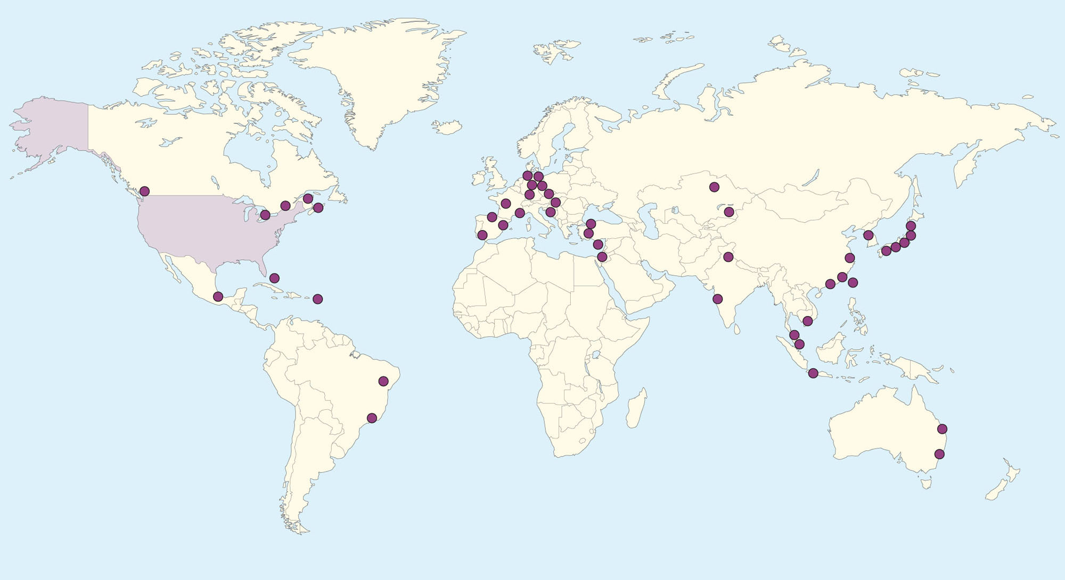
An International Practice
Projects in over 30 countries

Slide 11
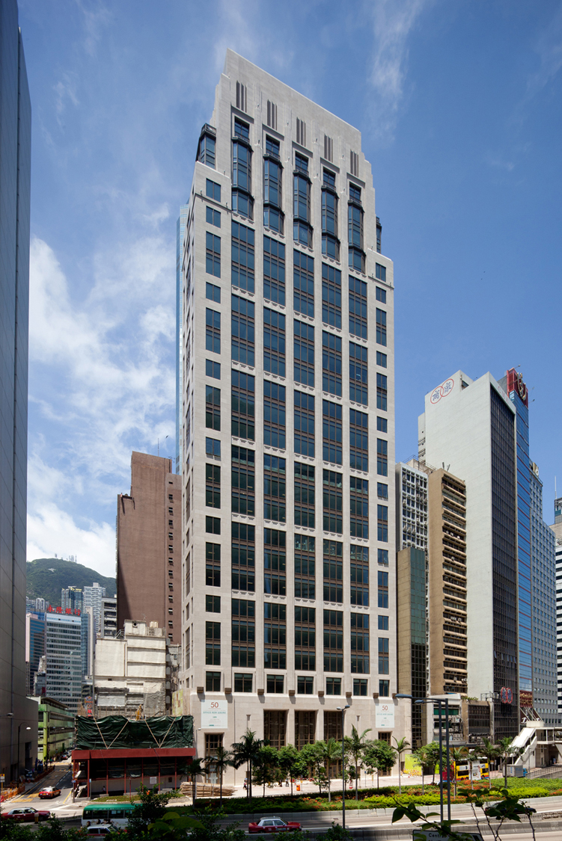
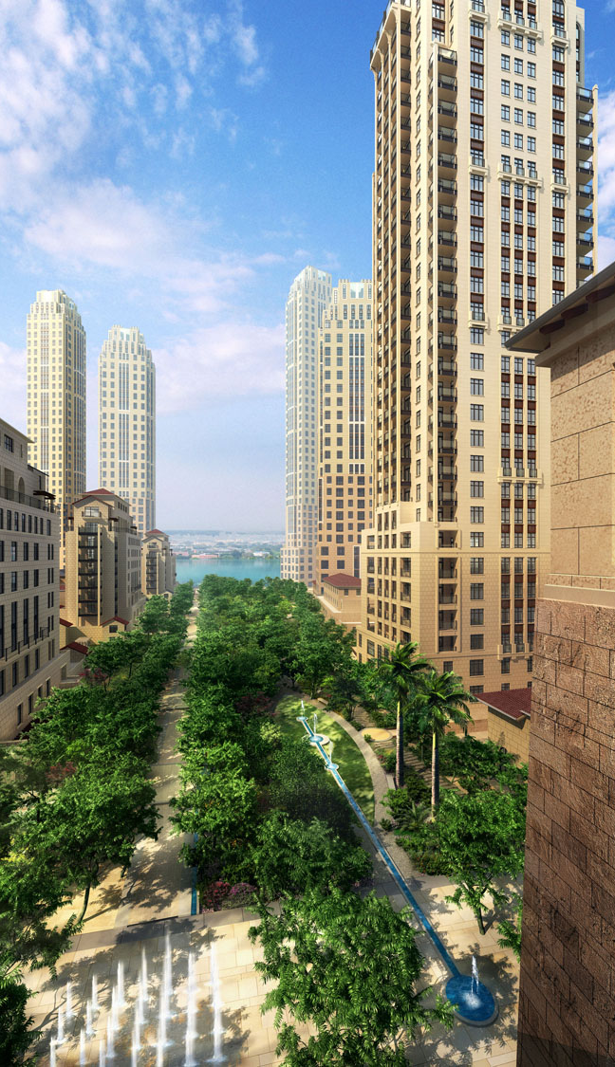
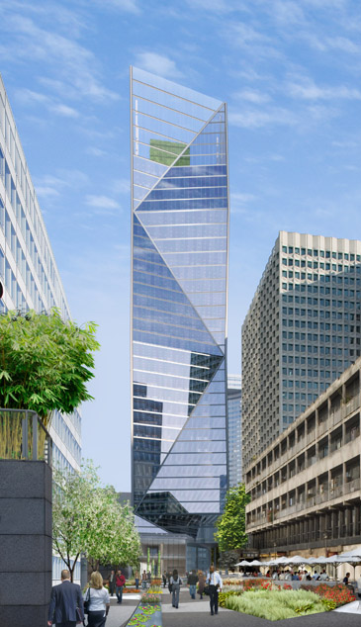
An International Practice
50 Connaught Road Central, Hong Kong
Heart of Lake, Xiamen, China
Tour Carpe Diem, Courbevoie, France

Slide 12
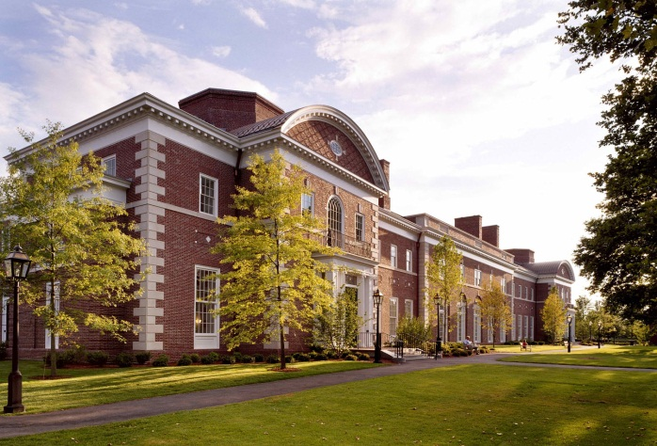
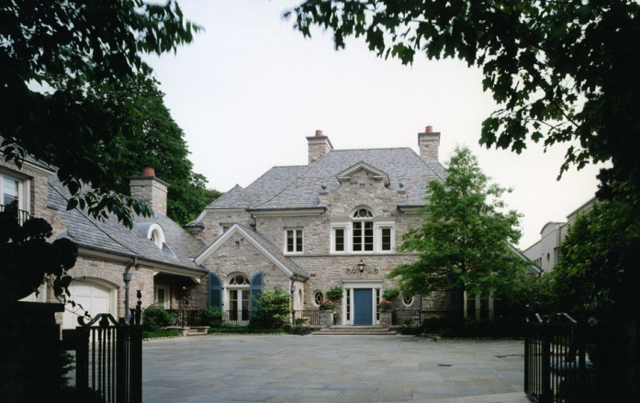
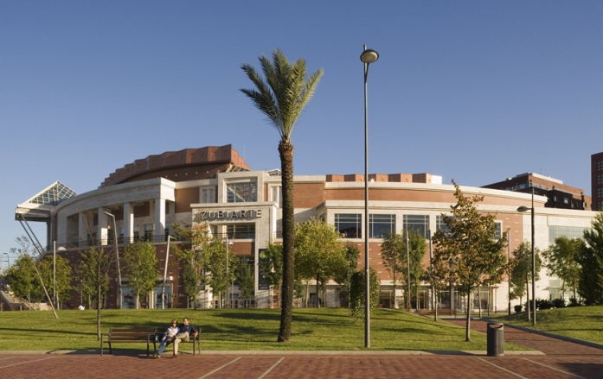
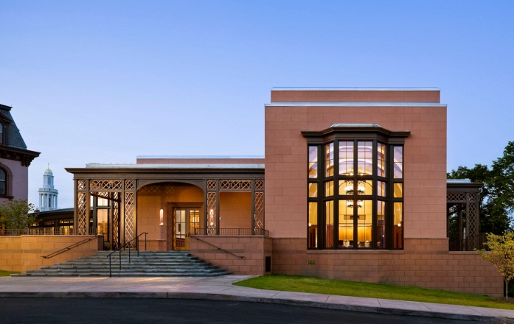
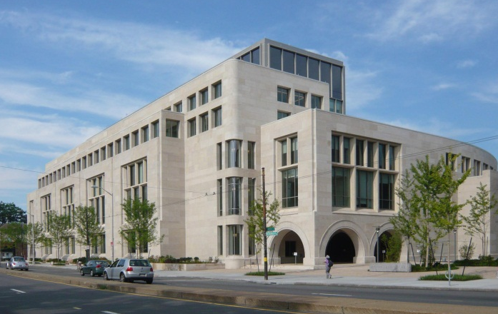
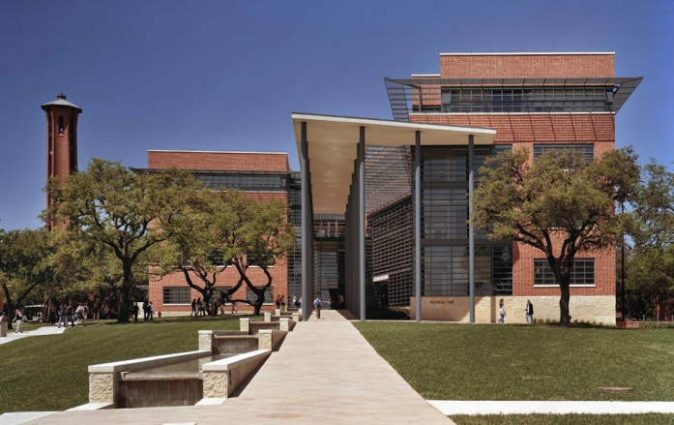
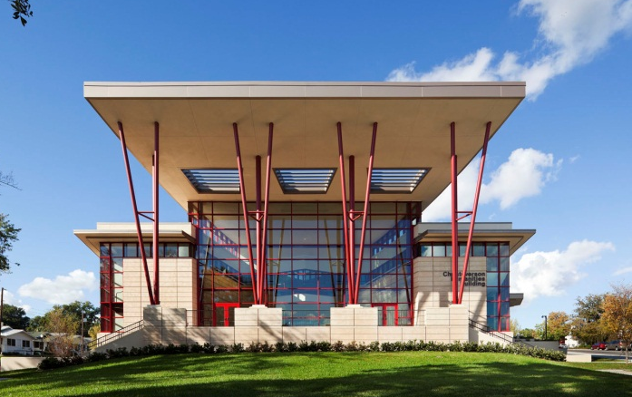
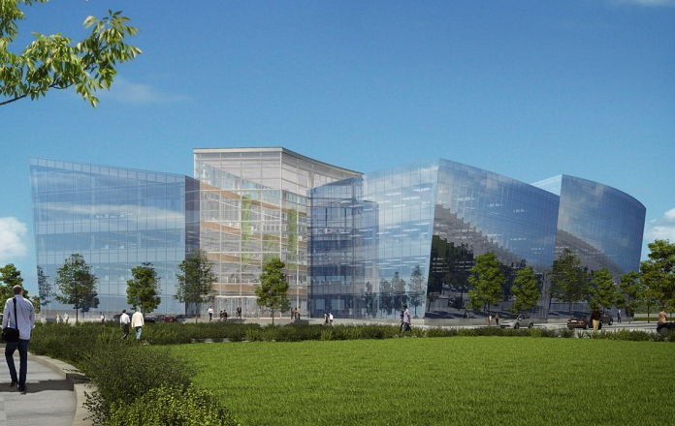
A Range of Styles
Traditional
Spangler Campus Center, HBS
Kiawah Ocean Course Clubhouse, SC
Residence in North York, Toronto, Ontario
Transitional
Zubiarte Retail Center, Bilbao, Spain
Greenberg Conference Center, Yale
Northwest Corner Building, Harvard Law
Modern
Northrup Hall, Trinity University
Christoverson Humanities Building, FSC
Five Crescent Drive, Philadelphia Navy Yard

Slide 13
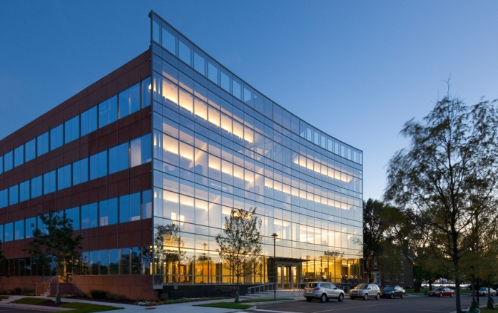
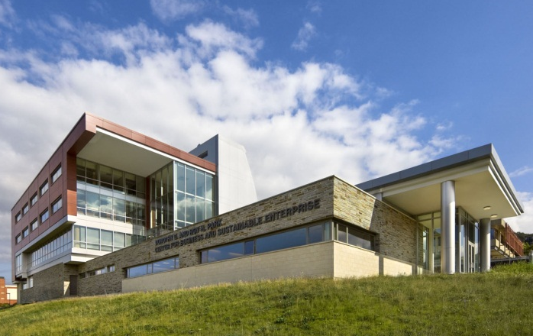
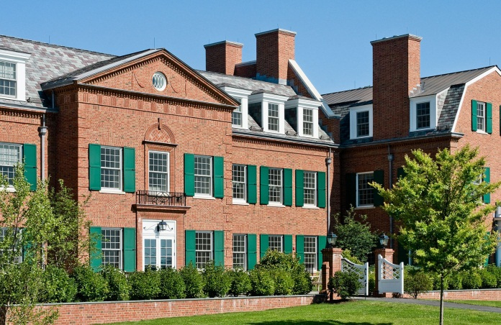
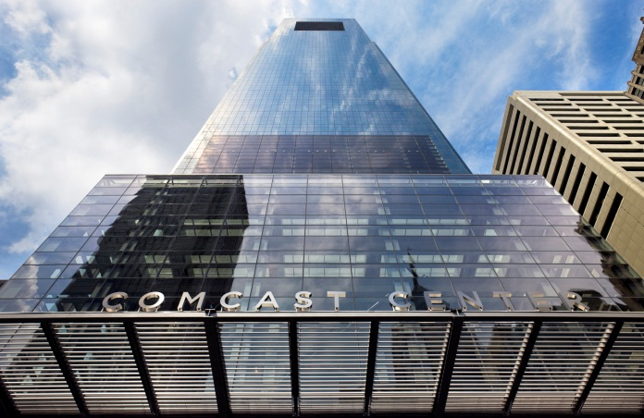
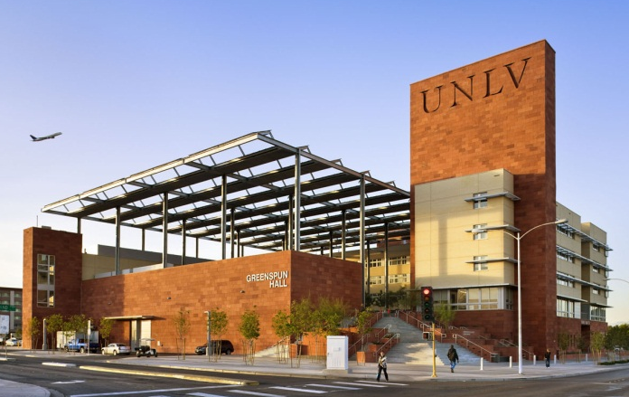
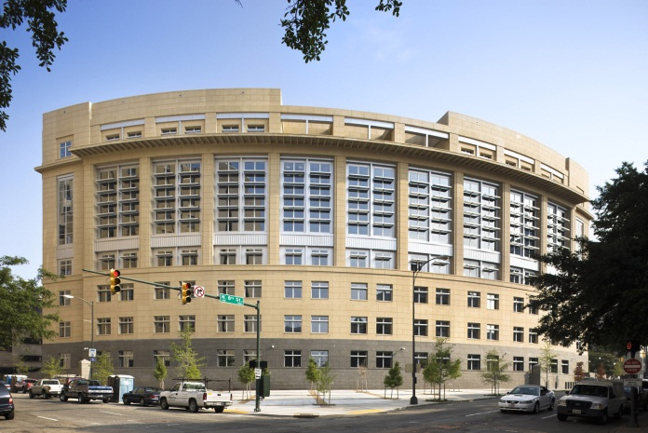
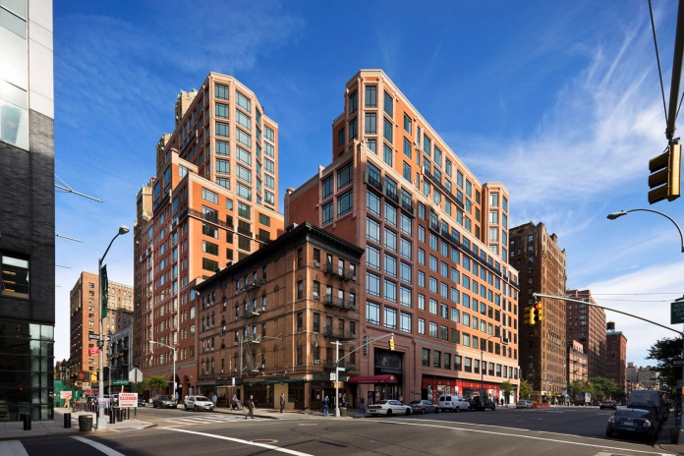
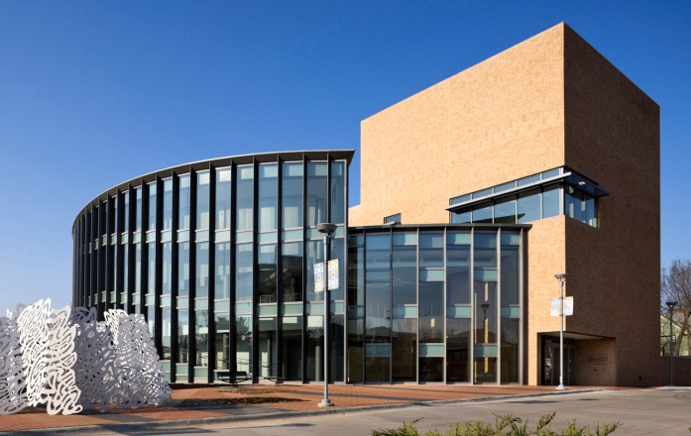
Sustainability is not a Style
Platinum
One Crescent Drive, Philadelphia Navy Yard
George W. Bush Presidential Center, SMU
Park Center for Business, Ithaca College
Gold
Flinn and Edelman Halls, Hotchkiss School
Comcast Center, Philadelphia
Greenspun College of Urban Affairs, UNLV
Silver
Robinson and Merhige Courthouse, Richmond
The Harrison, New York
International Quilt Study Center and Museum

Slide 14
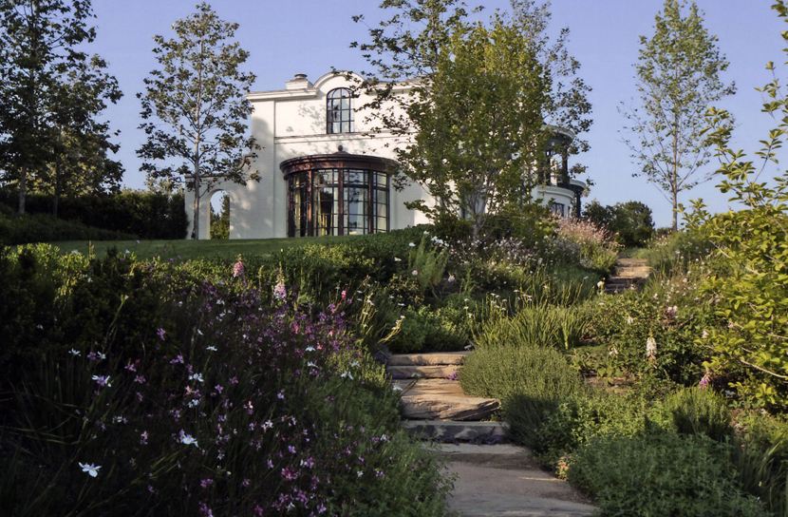
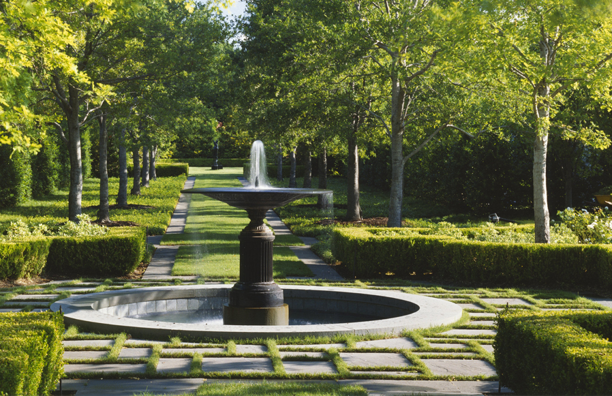
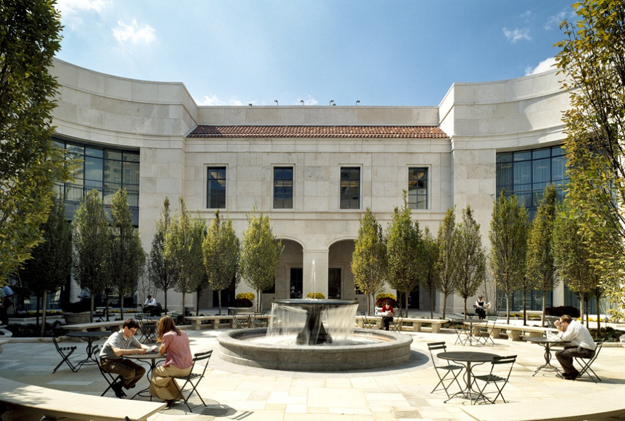
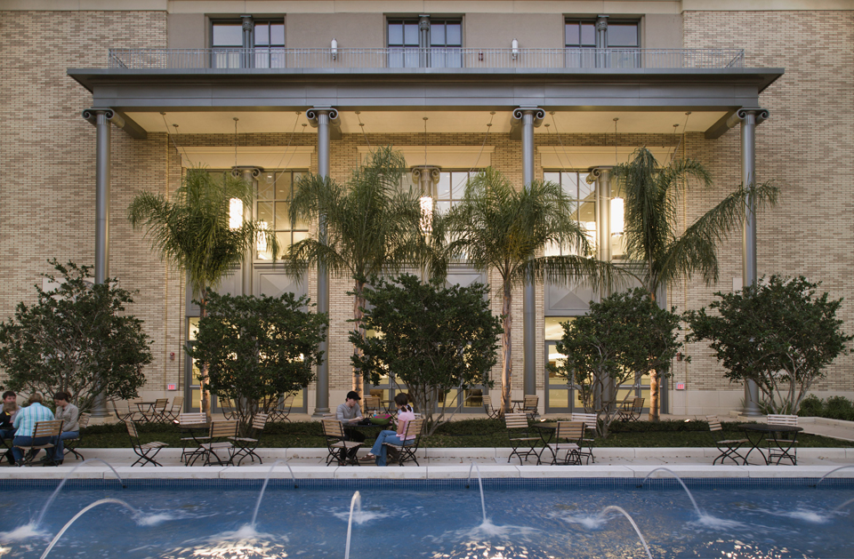
RAMSA Landscape
Residential
Institutional

Slide 15
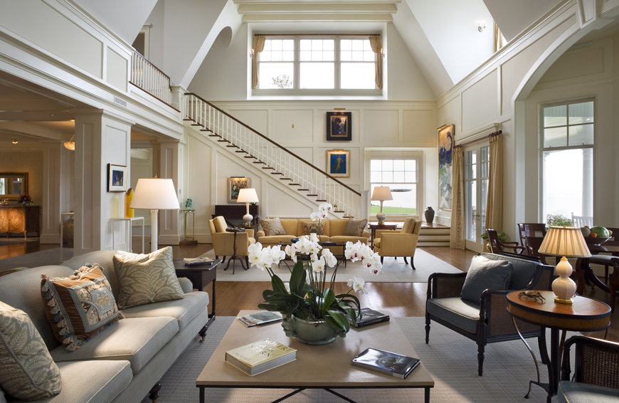
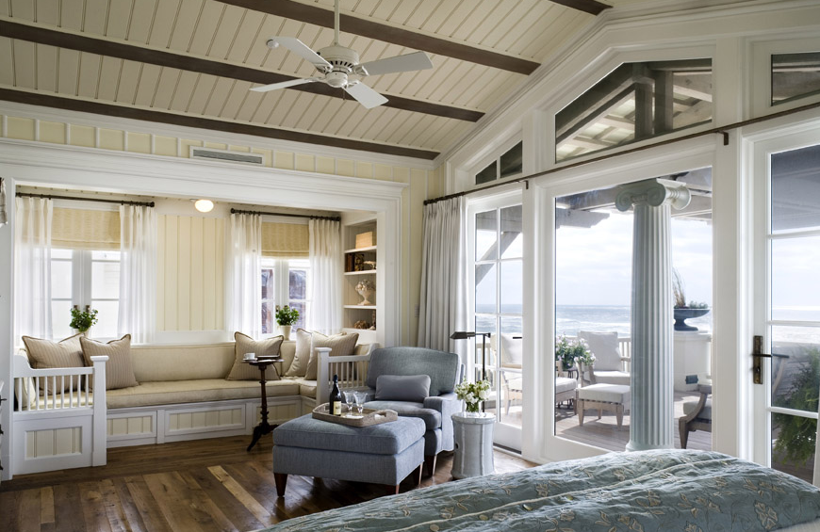
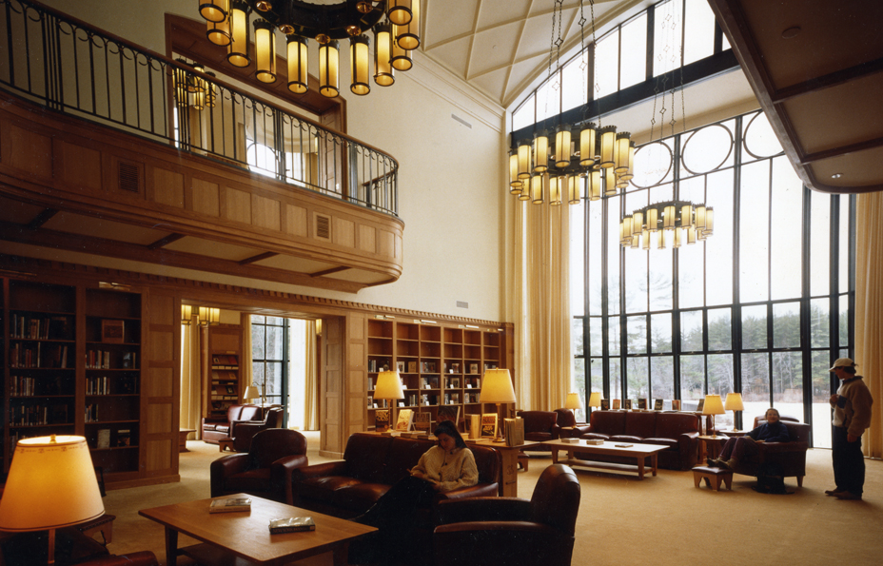
RAMSA Interior Design
Residential
Institutional

Slide 16
Product Design

Slide 17
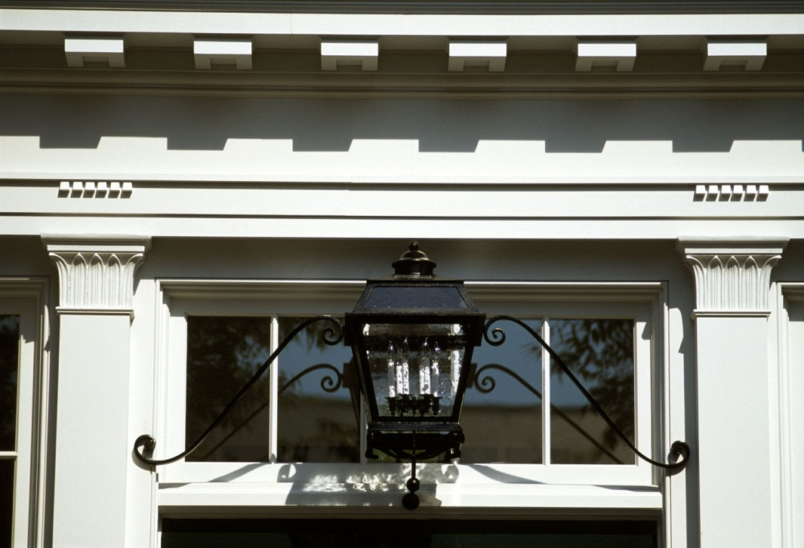
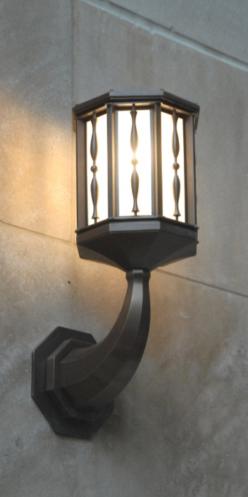
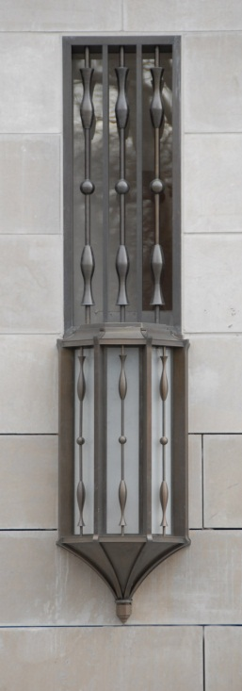
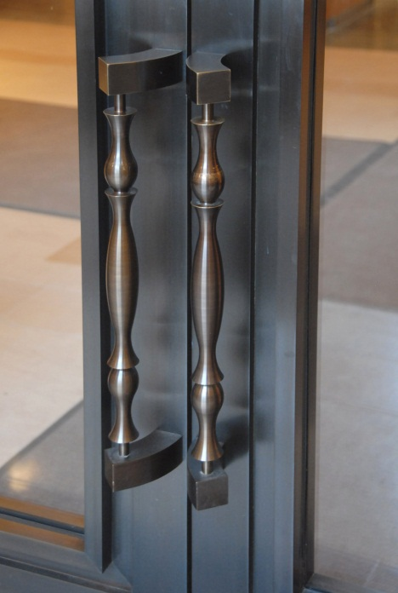
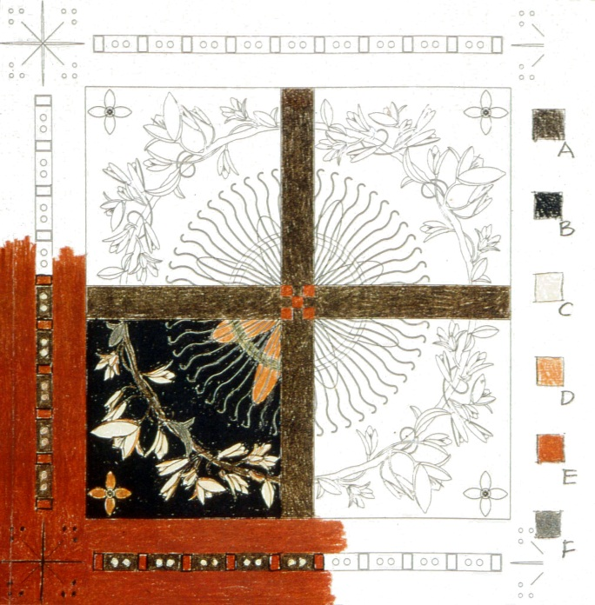
Custom Products
Custom lighting, Spangler Campus Center
Custom lighting and handles, Fifteen Central Park West
Custom carpet, Nashville Public Library
Custom carpet, Jacksonville Public Library

Slide 18
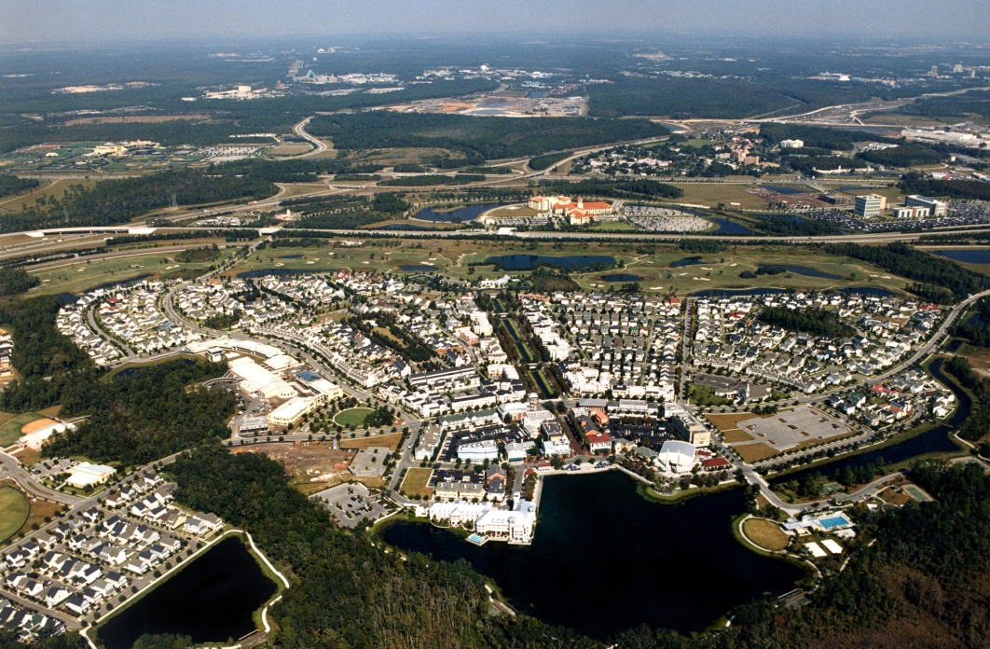
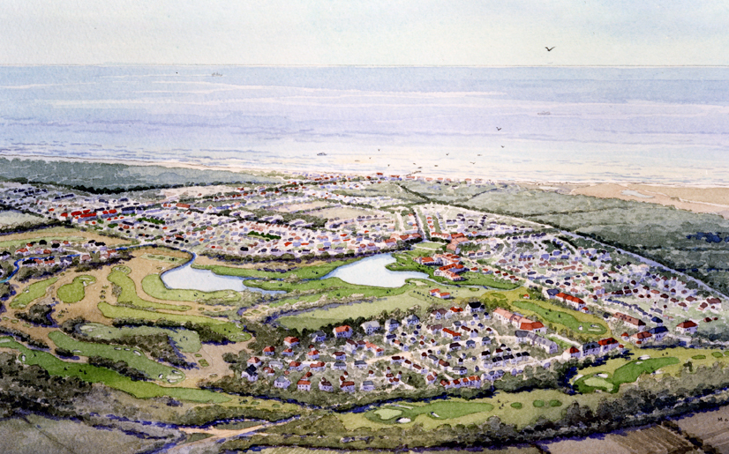
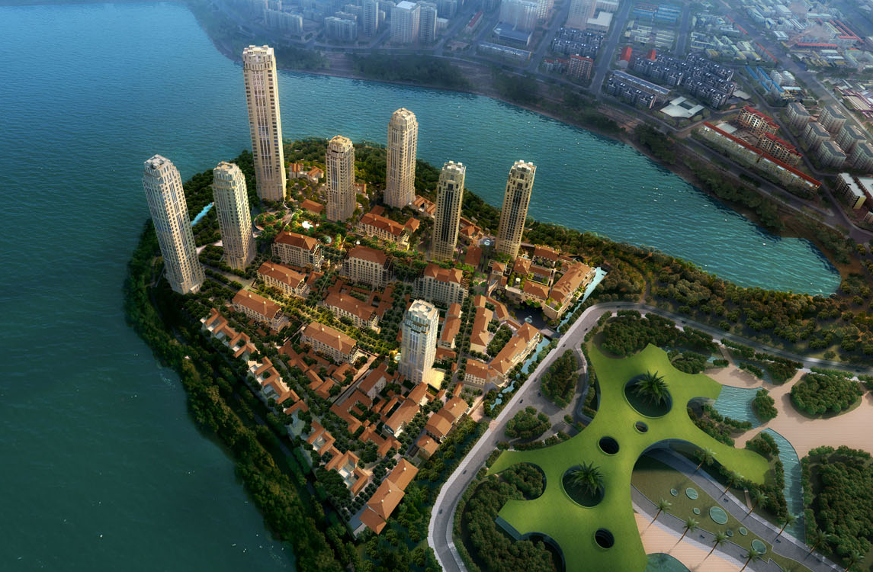
Master Planning
Celebration, Florida
Philadelphia Navy Yard
Heiligendamm, Germany
Heart of Lake, Xiamen, China

Slide 19
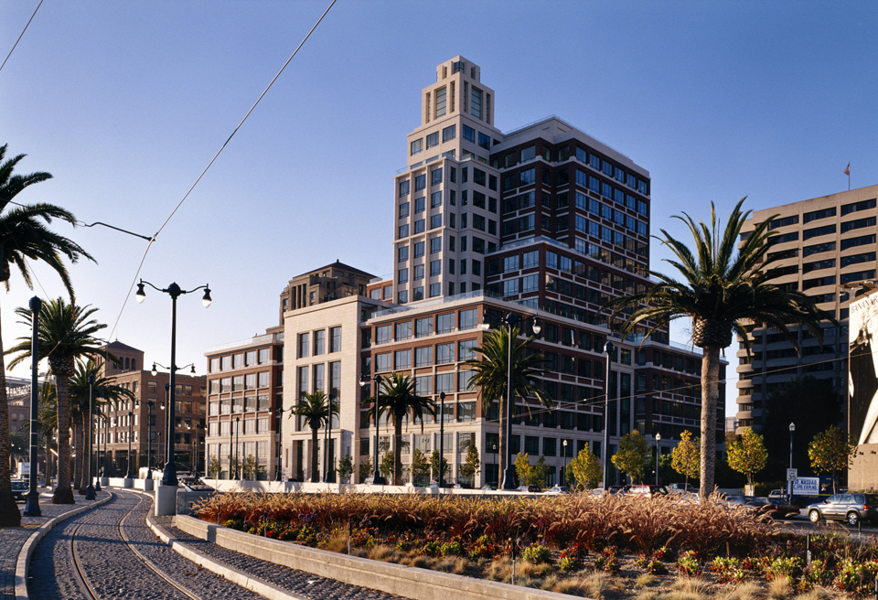
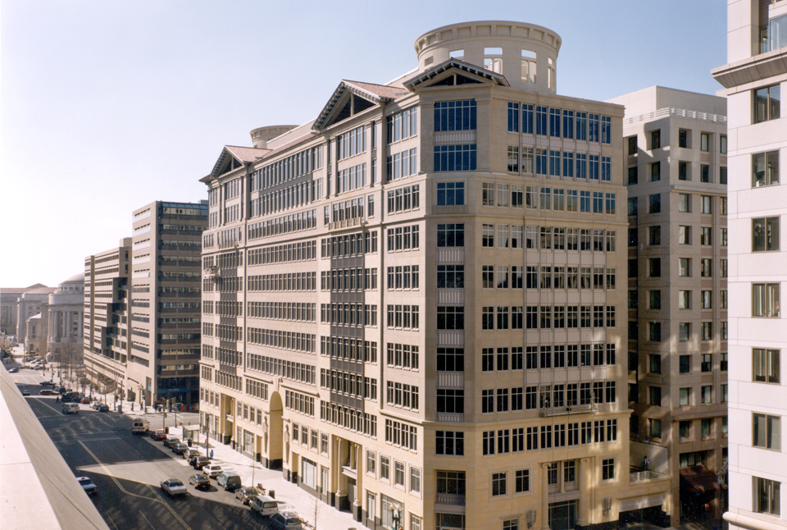
Office
Gap Inc. Offices, San Francisco, California
50 Connaught Road, Central, Hong Kong, China
600 Thirteenth Street N.W., Washington, DC

Slide 20
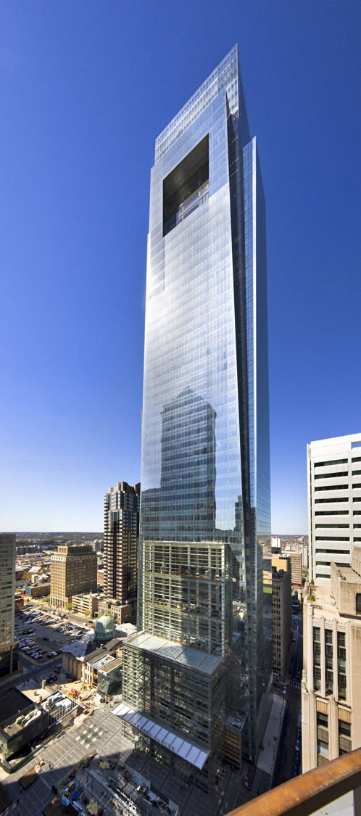
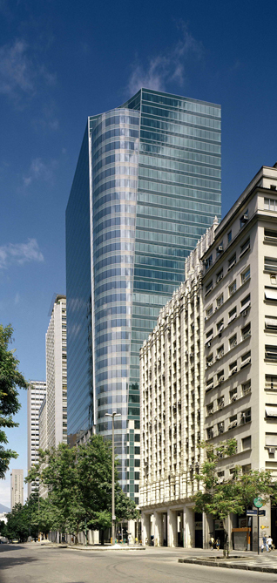
Office
Comcast Center, Philadelphia, Pennsylvania
Torre Almirante, Rio de Janeiro, Brazil
Carpe Diem, Courbevoie, France

Slide 21
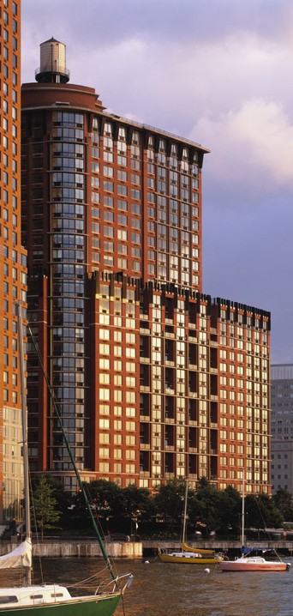
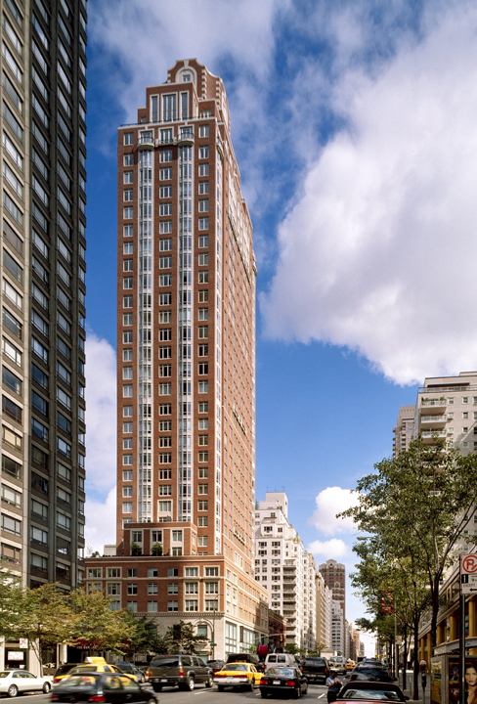
Multi-Family Residential
Tribeca Park, New York
The Chatham, New York
The Clarendon, Boston

Slide 22
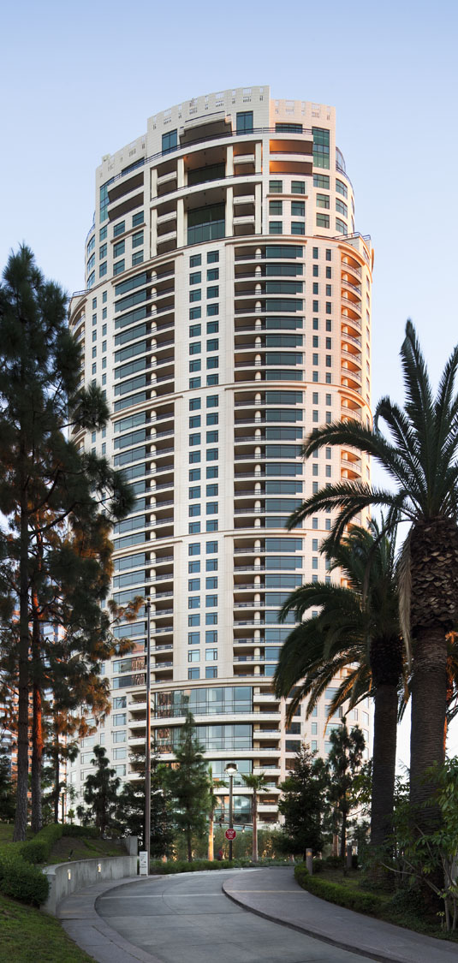
Multi-Family Residential
Fifteen Central Park West, New York
The Century, Los Angeles
One St. Thomas Residences, Toronto

Slide 23
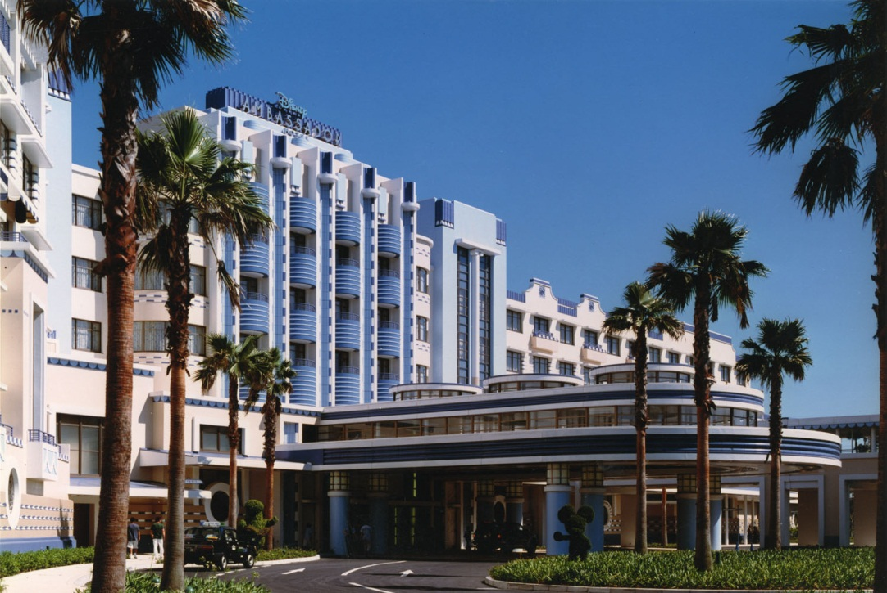
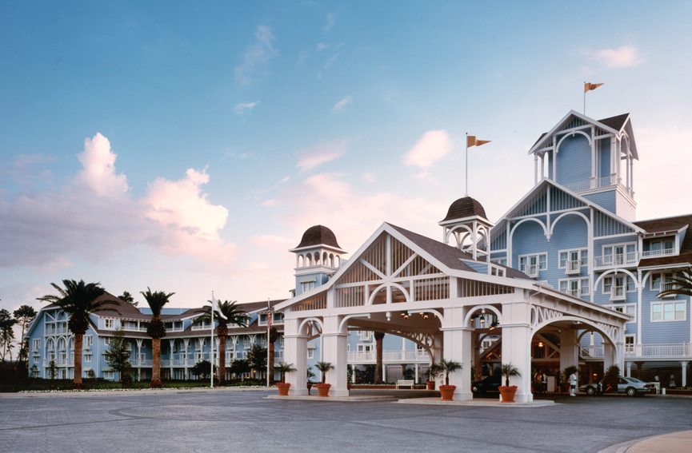
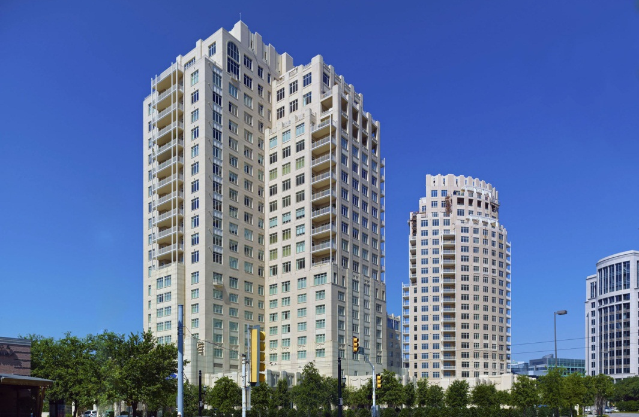
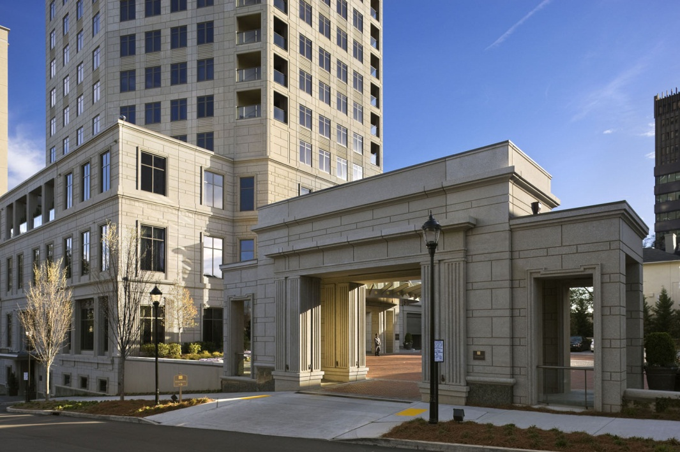
Hospitality
Disney Ambassador Hotel, Tokyo Disney Resort, Japan
Disney’s Yacht and Beach Club, Walt Disney World Resort, Florida
The Residences at the Ritz-Carlton, Dallas, Texas
Mansion on Peachtree, Atlanta, Georgia

Slide 24
Hospitality
The Greenbrier at West Village Golf Resort, Fukushima, Japan
Ocean Course Clubhouse, Kiawah Island, South Carolina
Anglebrook Golf Club, Somers, New York
Talisker Club Park, Park City, Utah

Slide 25
Libraries
Nashville Public Library, Tennessee
Jacksonville Public Library, Florida
Miami Beach Public Library, Florida
Columbus Public Library, Georgia

Slide 26
Cultural
International Quilt Study Center and Museum
The Perkins Visitor Center, Wave Hill
The Norman Rockwell Museum
George W. Bush Presidential Center

Slide 27
University
Spangler Campus Center, Harvard Business School
Smith Campus Center, Pomona College
Rodgers Recreation Center, Salve Regina University
McNair Hall, Jones Graduate School of Business, Rice University

Slide 28
University
Manzanita Hall, Mike Curb College of Arts, CSU, Northridge
Greenspun College of Urban Affairs, University of Nevada, Las Vegas
Park Center for Business and Sustainable Enterprise, Ithaca College
Northrup Hall, Trinity University

Slide 29
Custom Patron Houses
SMALL
MEDIUM
Seaside Cottage, Seaside, Florida
Residence, Kiawah Island, South Carolina
LARGE
ESTATE
House on Lake Michigan
Residence in Montecito, Santa Barbara County, California

Slide 30
Spec Houses
SMALL
MEDIUM
Life Dream House
Dream House for This Old House Magazine
LARGE
LARGE
5020 Iselin Avenue, Villanova Heights
5000 Iselin Avenue, Villanova Heights

Slide 31
Our Office

Slide 32
How We Work in the Office

Slide 33
How We Work with Clients

Slide 34
Precedent Research
RAMSA library
RAMSA team meeting
Office field trip
Dean Stern at Yale

Slide 35
Precedent Research
RAMSA library overflow
RAMSA library locked book room
RAMSA library search engine

Slide 36
Precedent Research
RAMSA slide library
RAMSA slide library
Portfolio image database
iDAM (Intelligent Digital Asset Management)

Slide 37
Precedent Research
Notes:
Thank you.

Slide 38
Precedent Research

Slide 39
Firm Organizational Chart

Slide 40
Michael G. Imber Architect

Slide 48
Allan Shope Architect

Slide 49
Allan P. Shope
Employees: 5
Gross Annual Revenue $1,000,000

Slide 50
Allan Shope Architect (organizational chart)
Allan Shope
Principal
Mark Lee
Staff Architect
Brian Walker Staff Architect
Scott Benedict Staff Architect
Julie Shope Office Manager

Slide 54
The discussion

Slide 55
Gary Brewer Large firm
Michael Imber Medium firm
Allan Shope
Small firm

Slide 56
Questions?

Slide 57
Thank you

