Slide 1
Visioning and Revisioning: Designing for Changing Pedagogy
AIA CAE Spring Conference
Berlin, Germany
17-21 April 2016

Slide 2
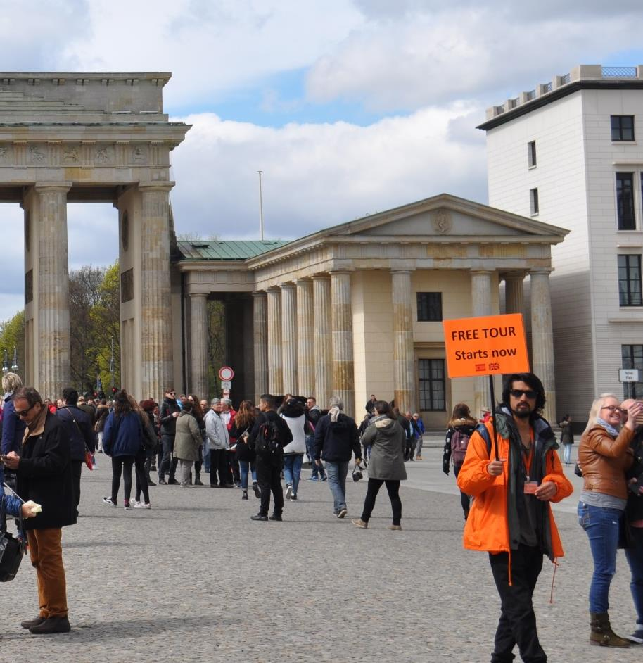

Slide 3
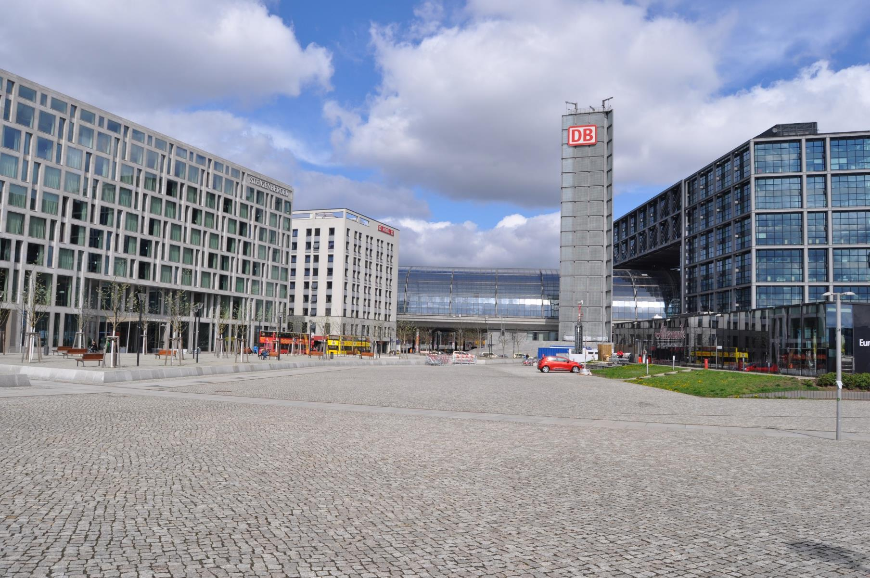

Slide 4
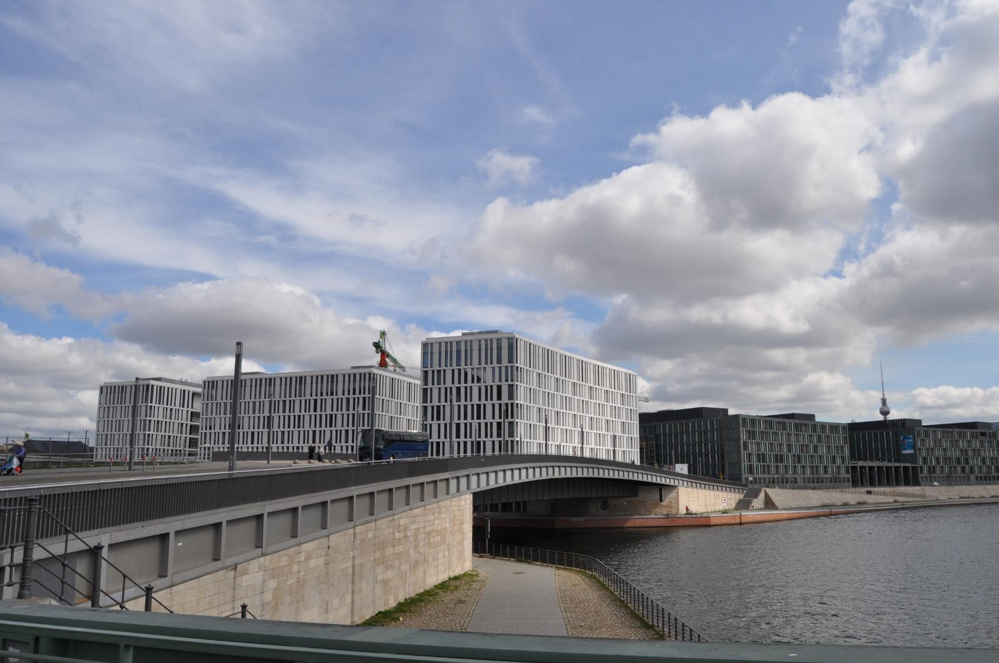

Slide 5
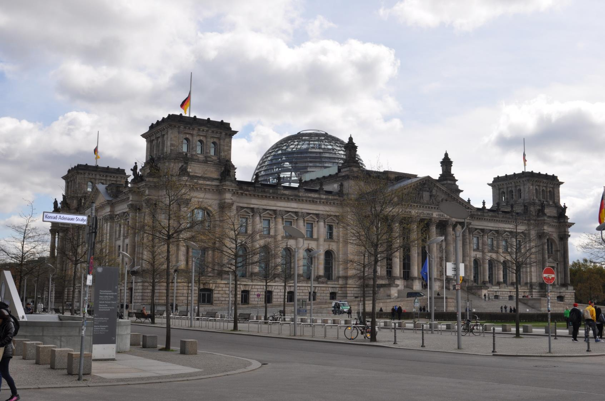
Reichstag (Parliament), 1894, transformation by Norman Foster, 1999

Slide 6
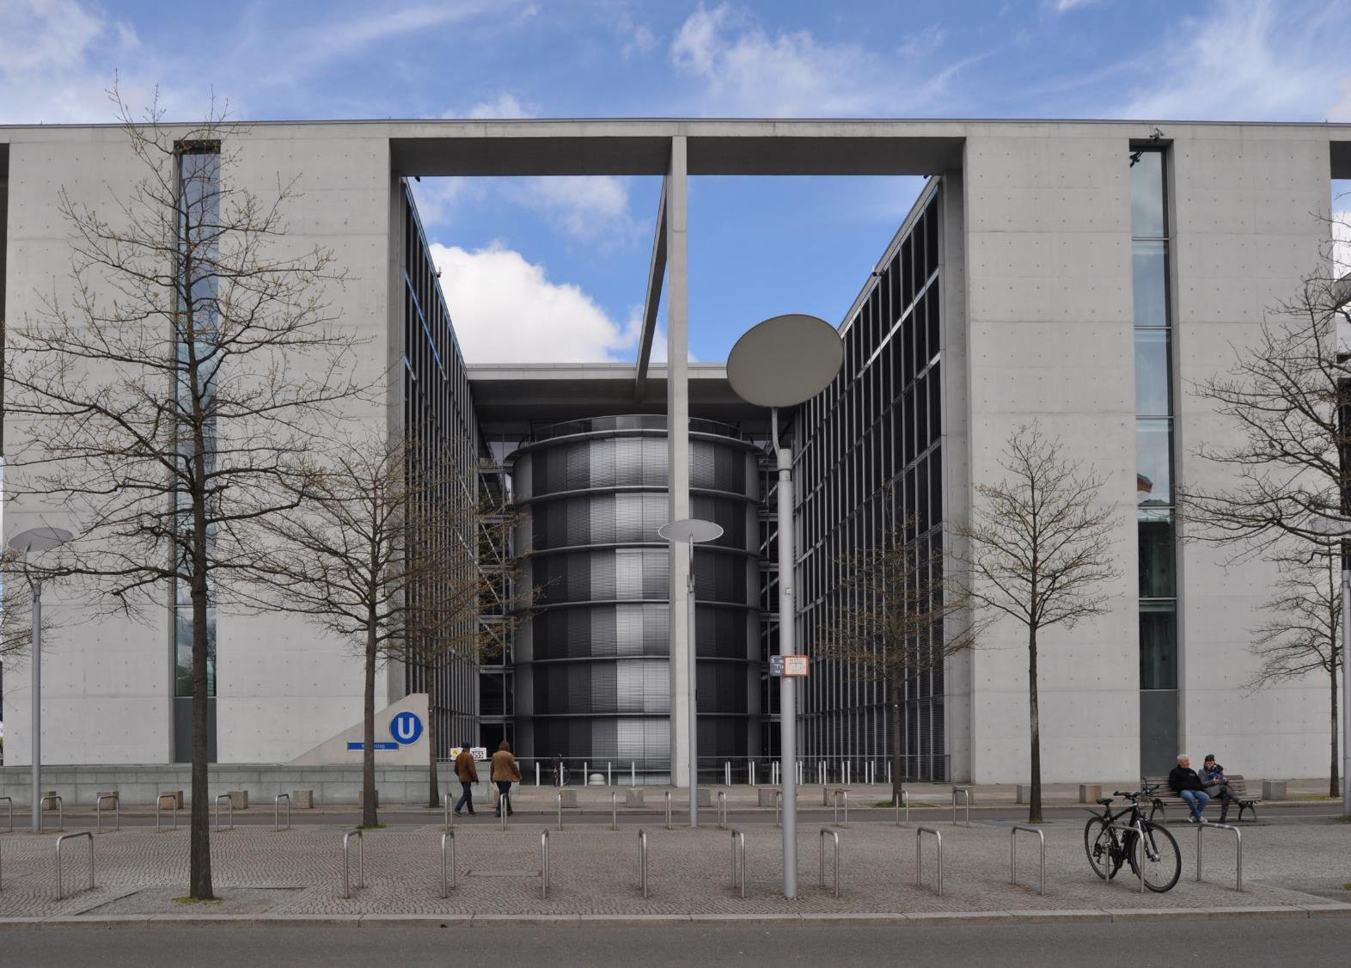
Modern Parliament Buildings

Slide 7
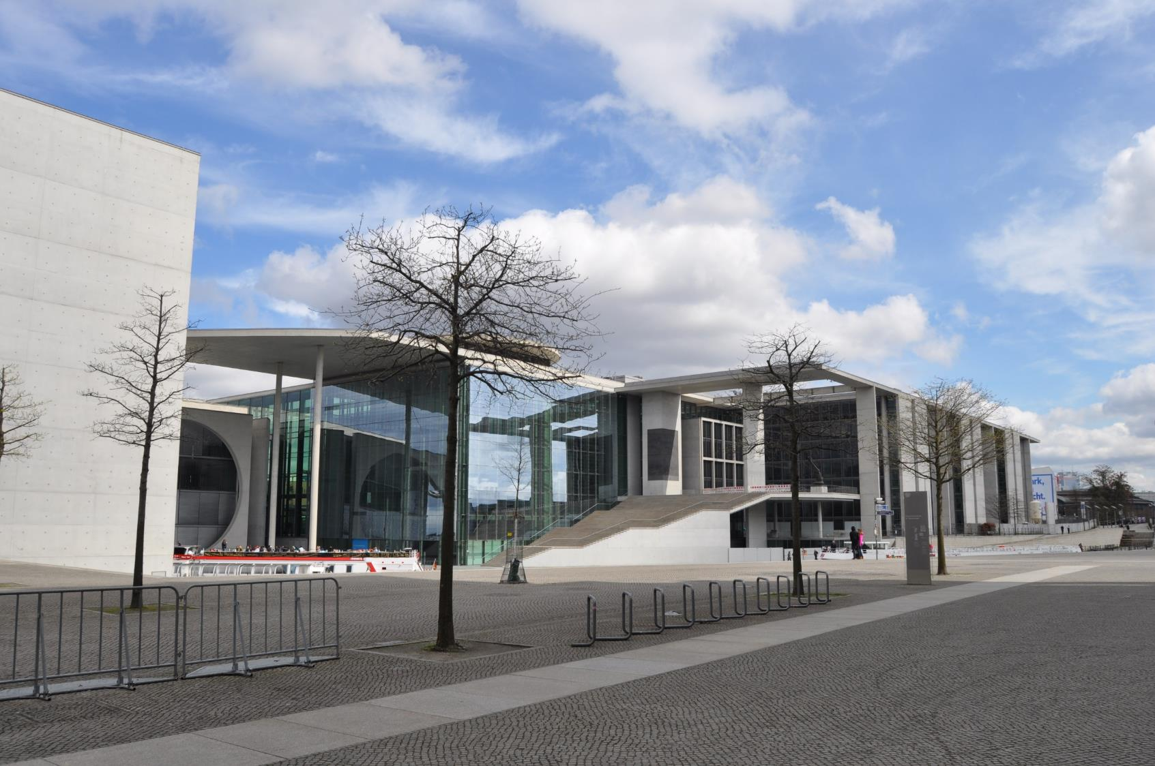

Slide 8
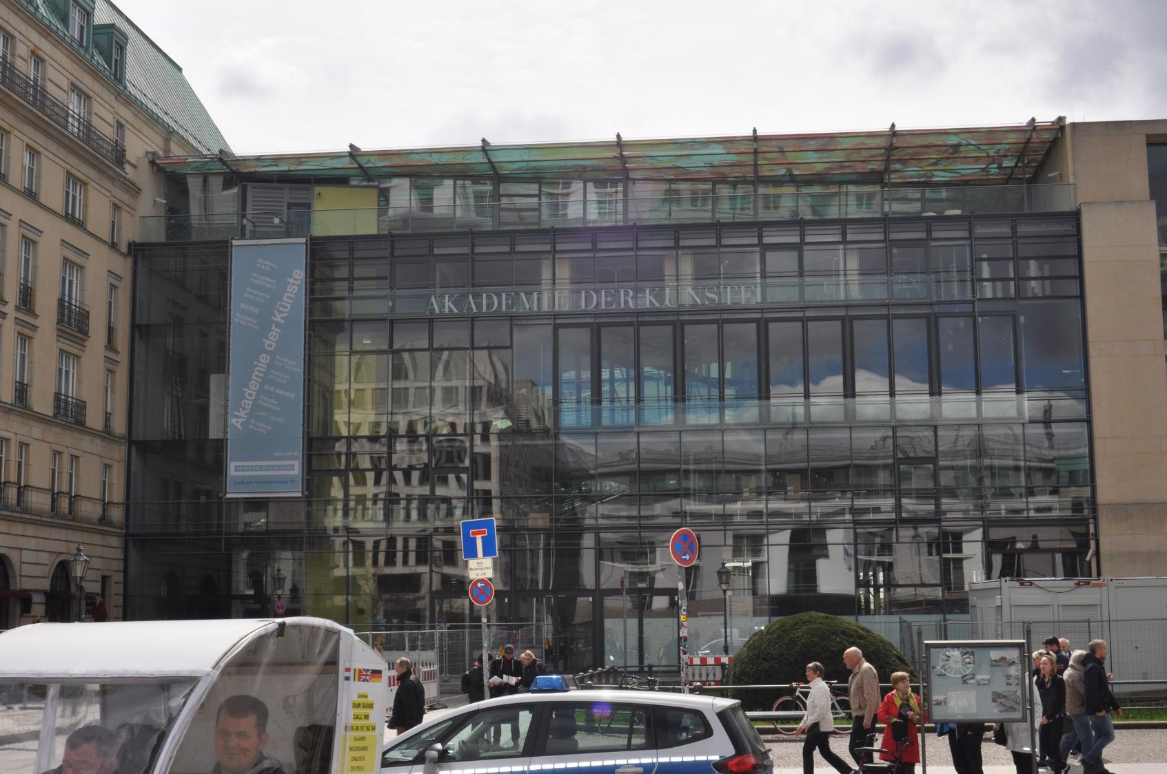
Akademie der Kunste, Pariser Platz, Guenther Behnisch, 2005

Slide 9
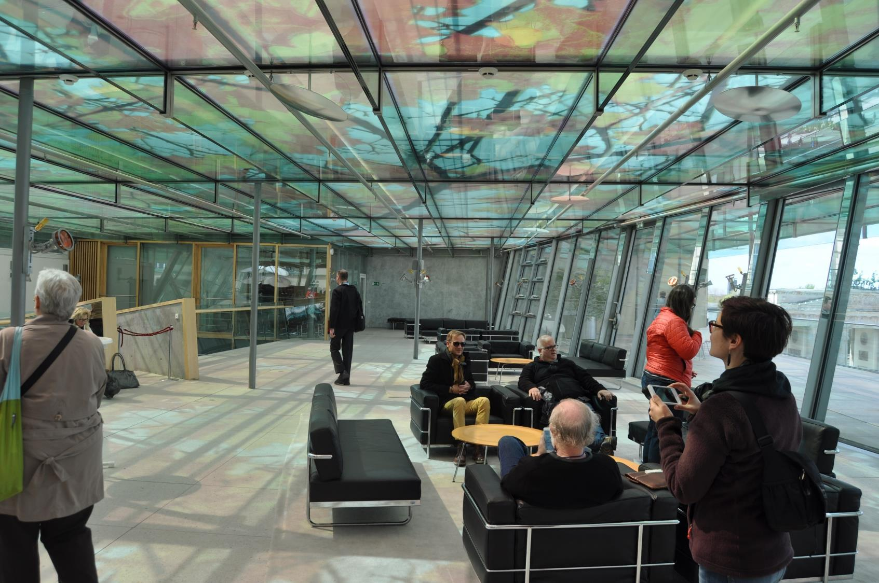

Slide 10
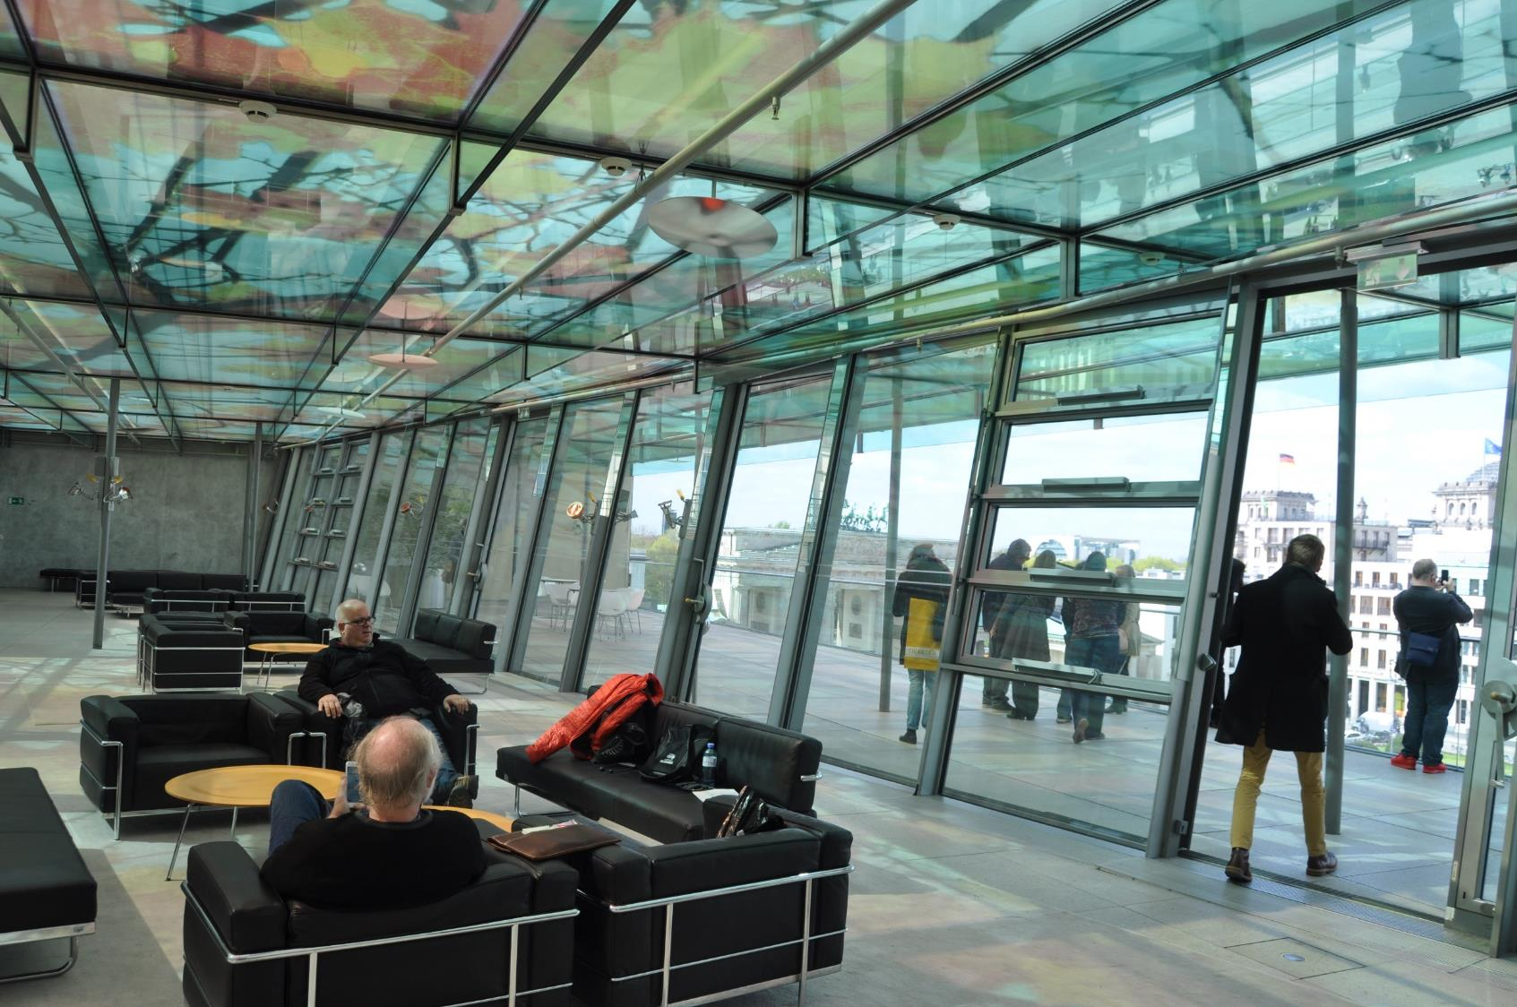

Slide 11
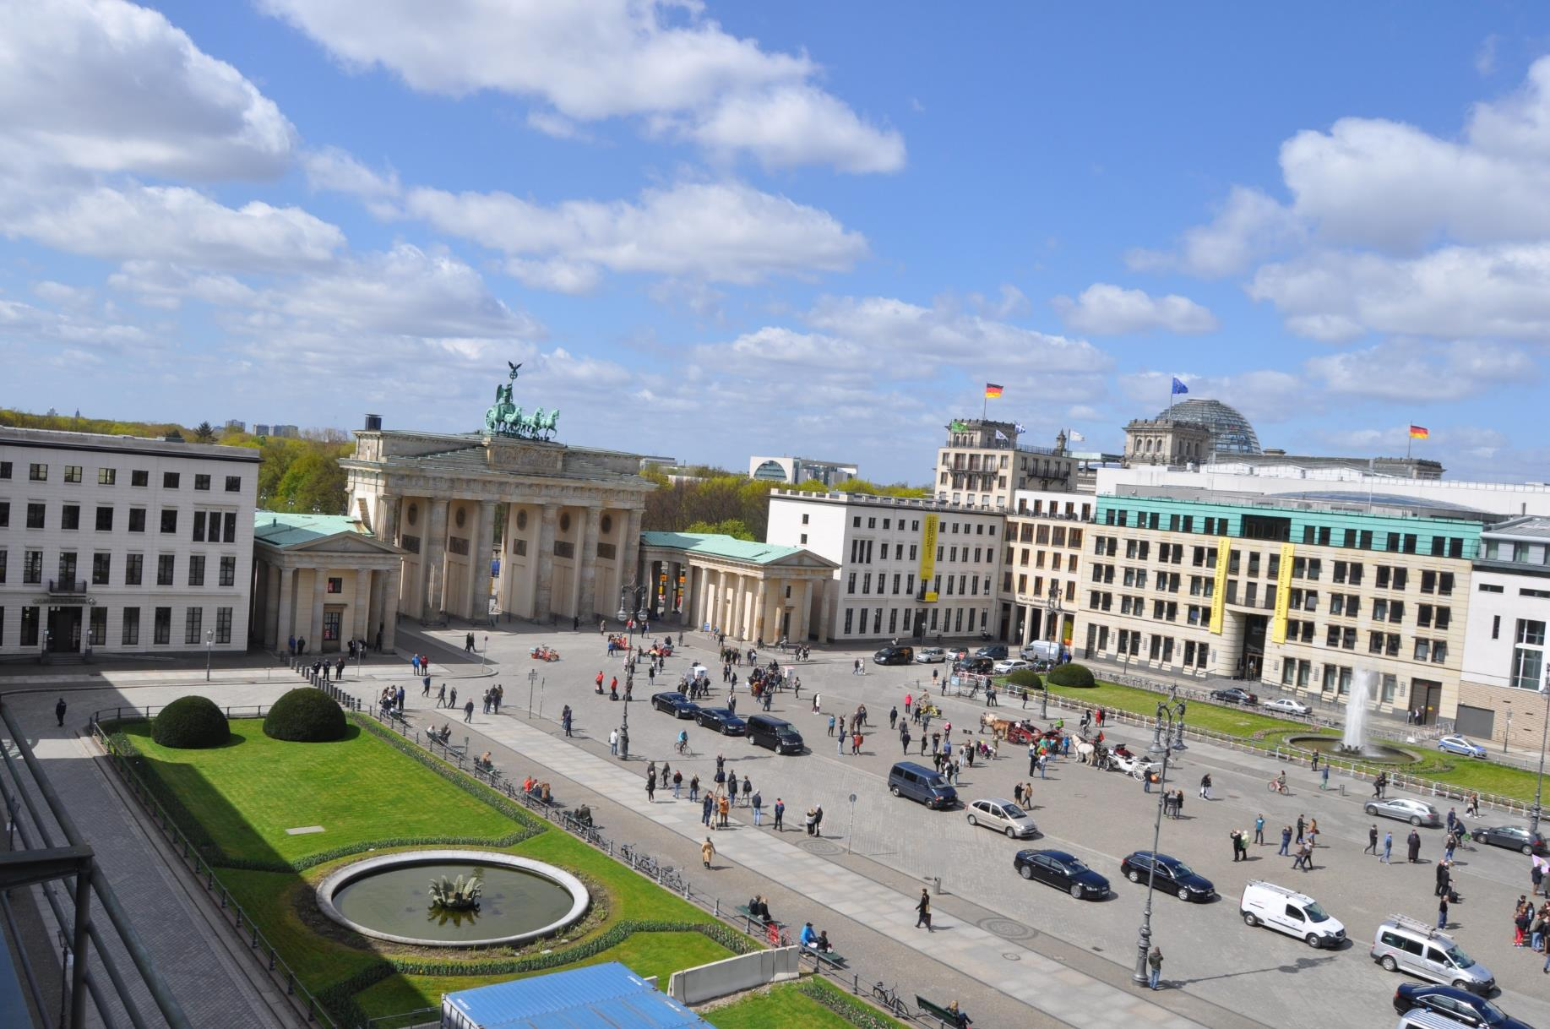

Slide 12
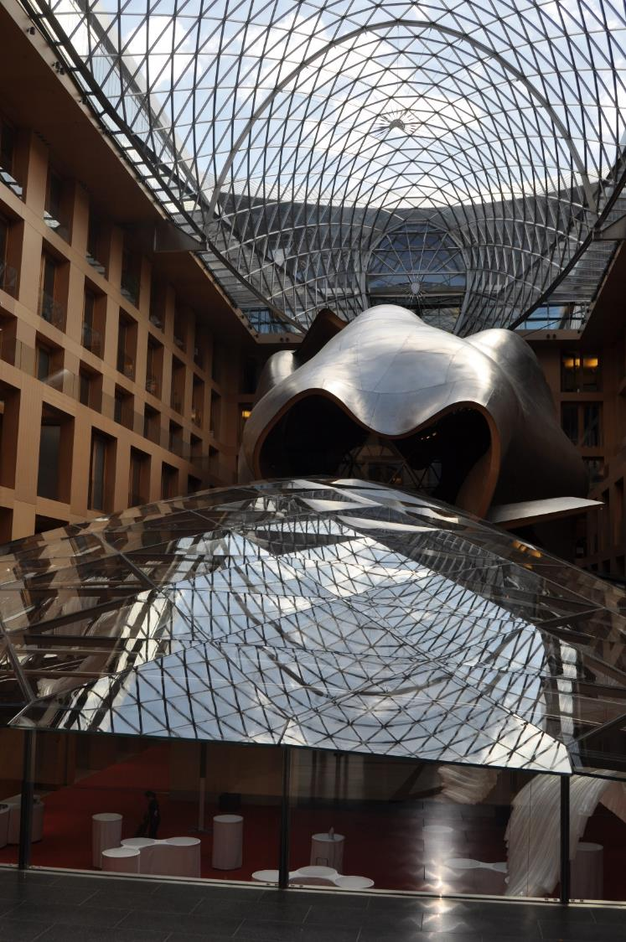
DZ Bank Conference Center, Frank Gehry, 2000

Slide 13
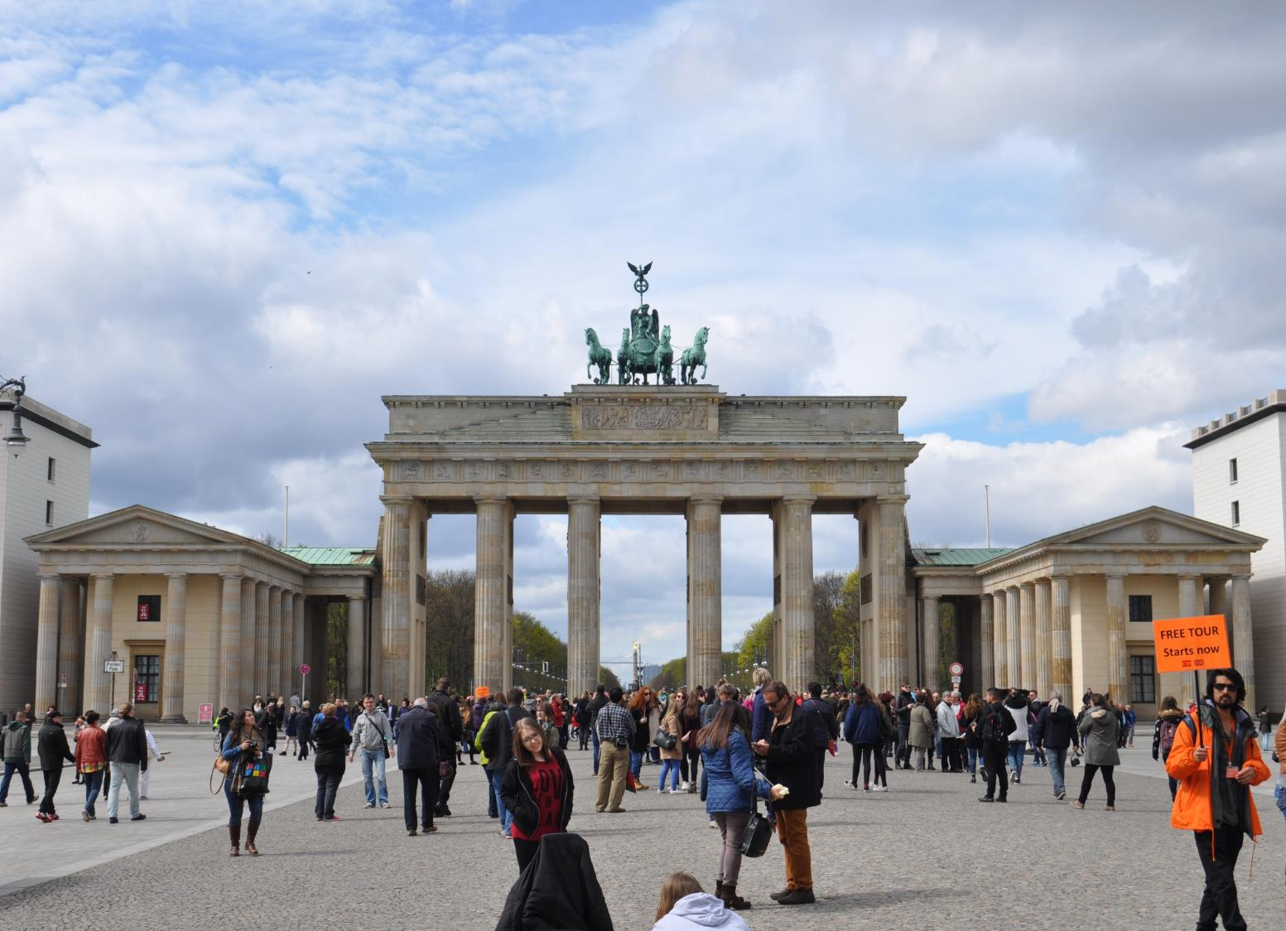
Brandenburg Gate, 1788-91, refurbished 2000

Slide 14
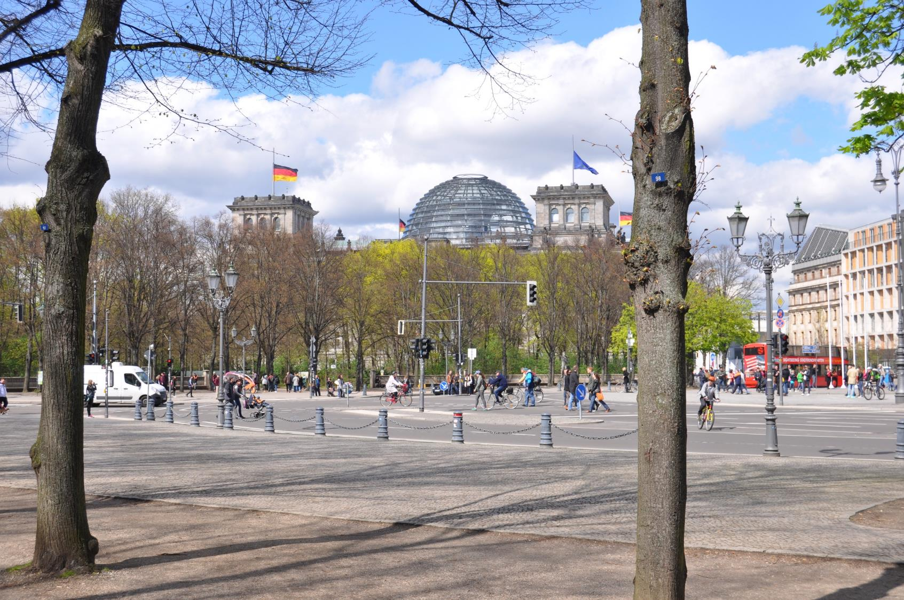

Slide 15
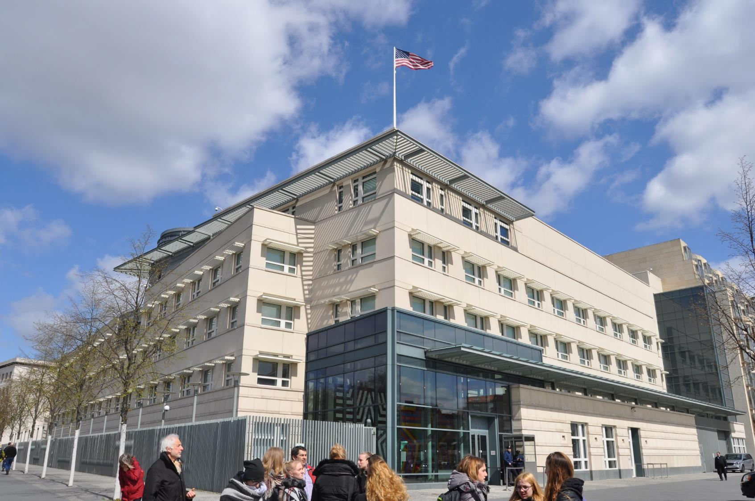
American Embassy in Berlin, Moore Ruble Yudell, 2008

Slide 16
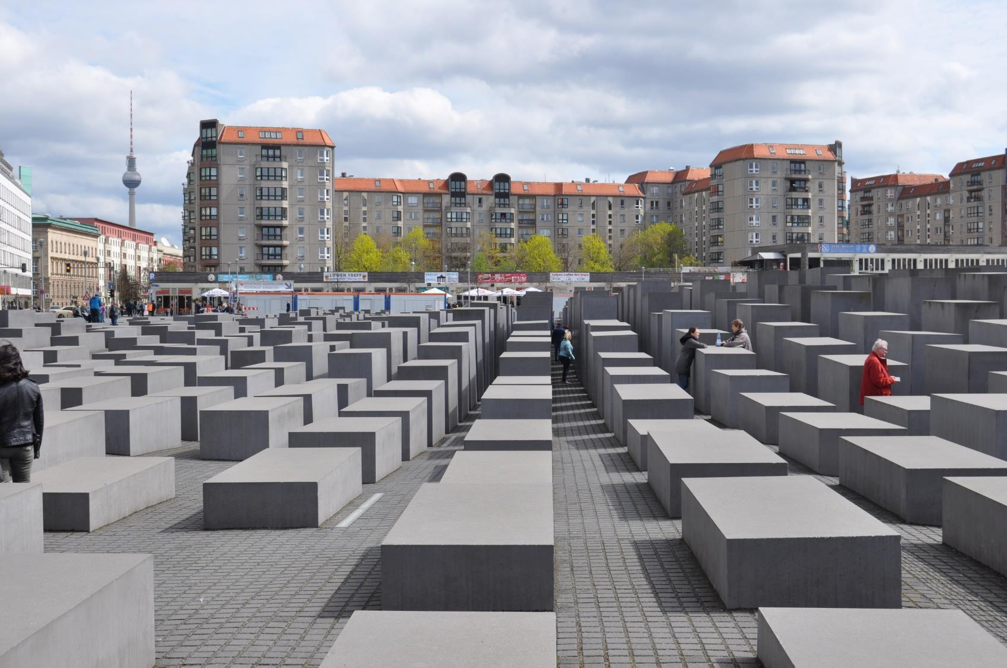
Holocaust Memorial, Peter Eisenman, 2004

Slide 17
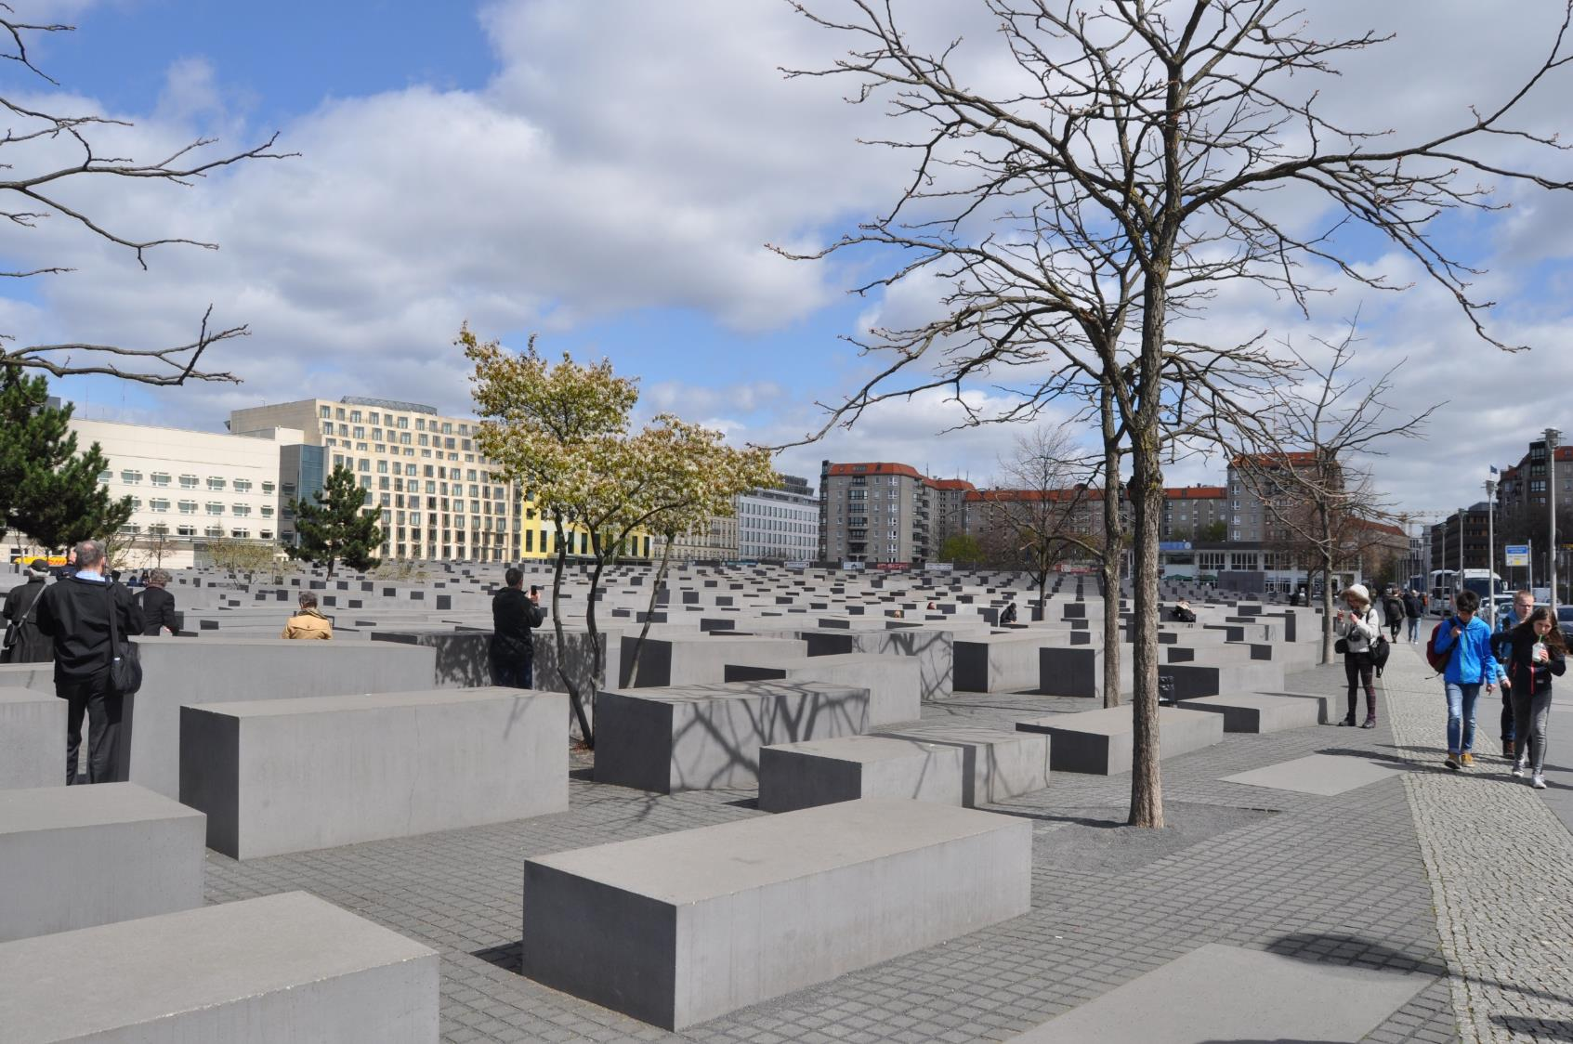

Slide 18
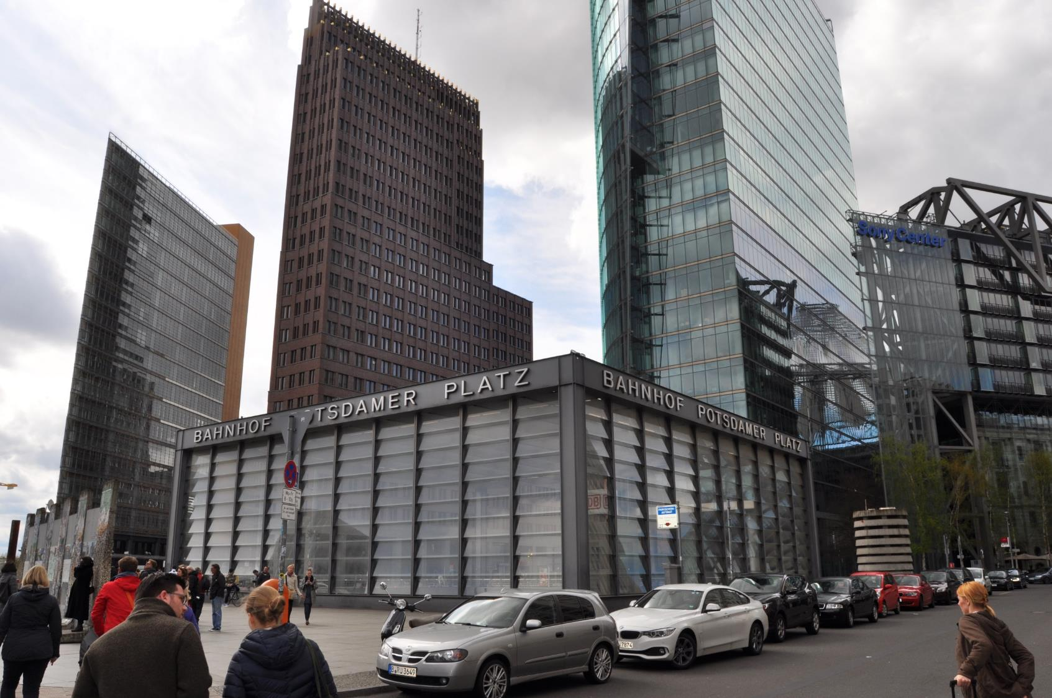
Berlin Rapid Transit Station, Potsdamer Platz

Slide 19
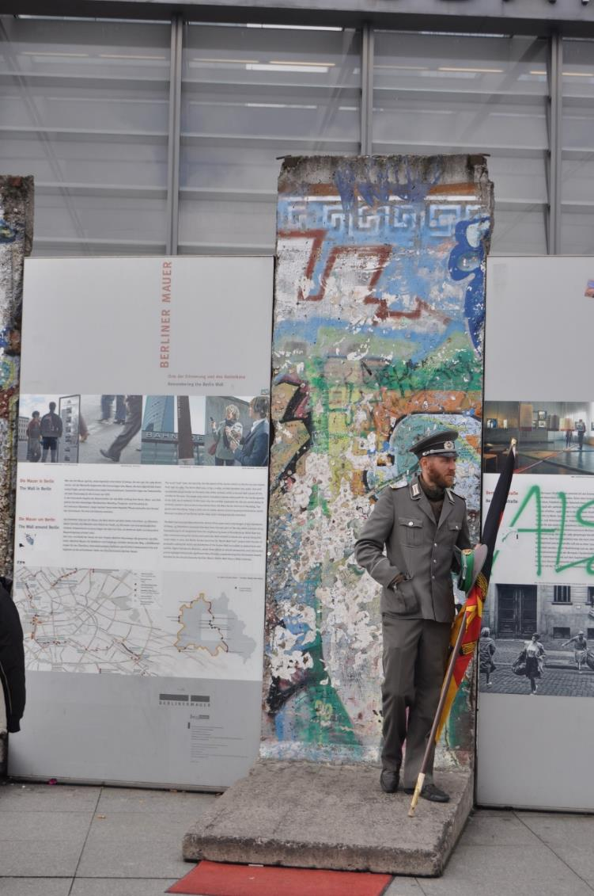
Remembering the Wall

Slide 20
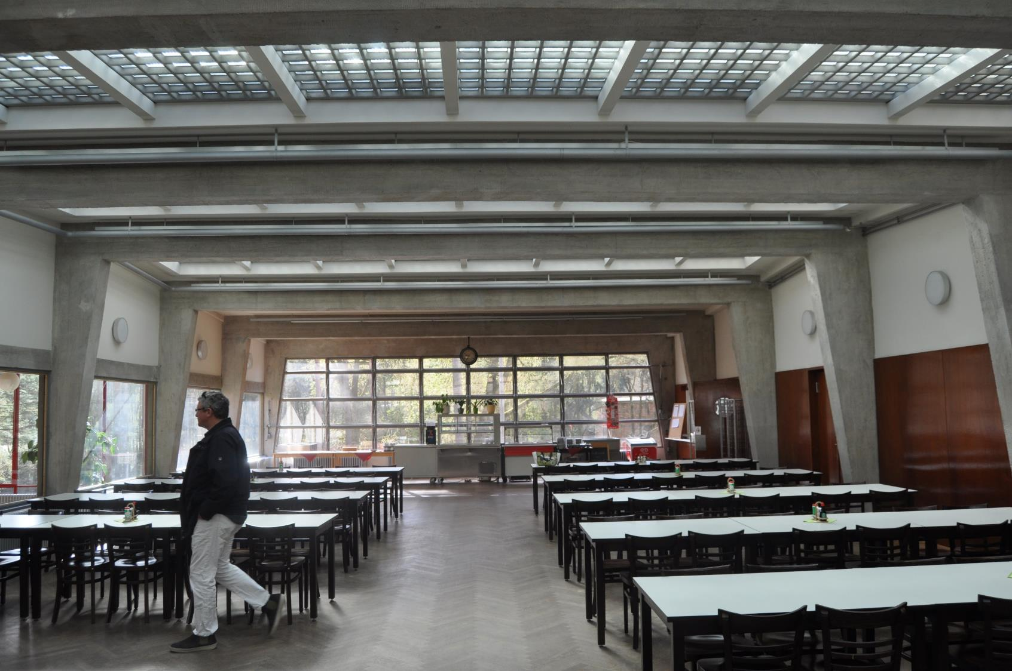
Bundesschule (Trade Unions College) in Bernau, Hannes Meyer (Bauhaus Movement), 1928-30

Slide 21
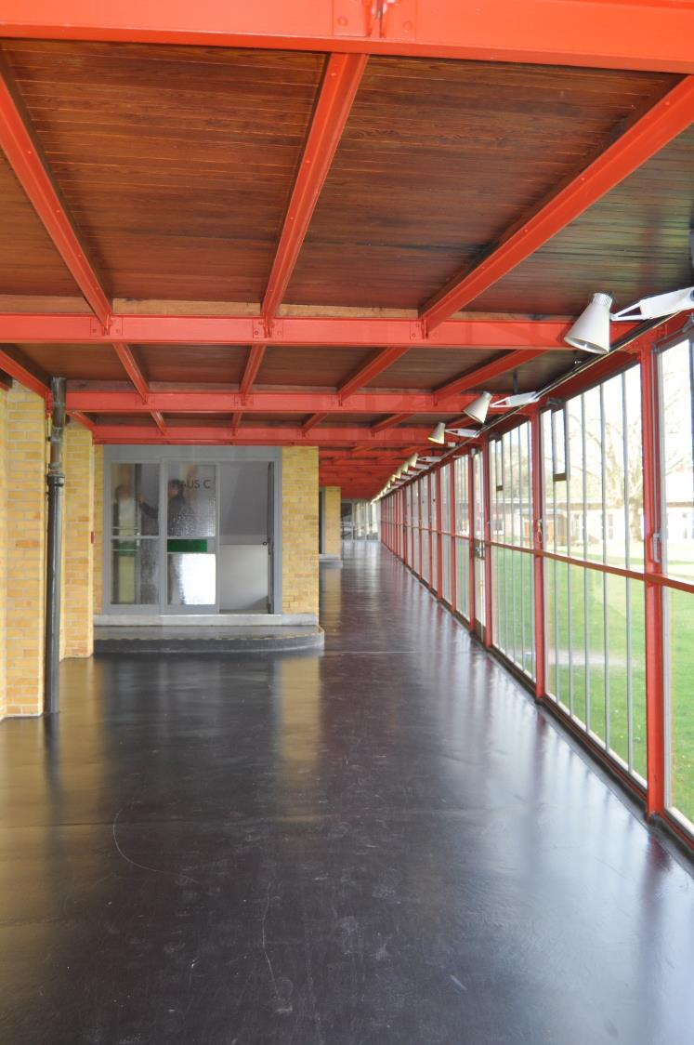

Slide 22
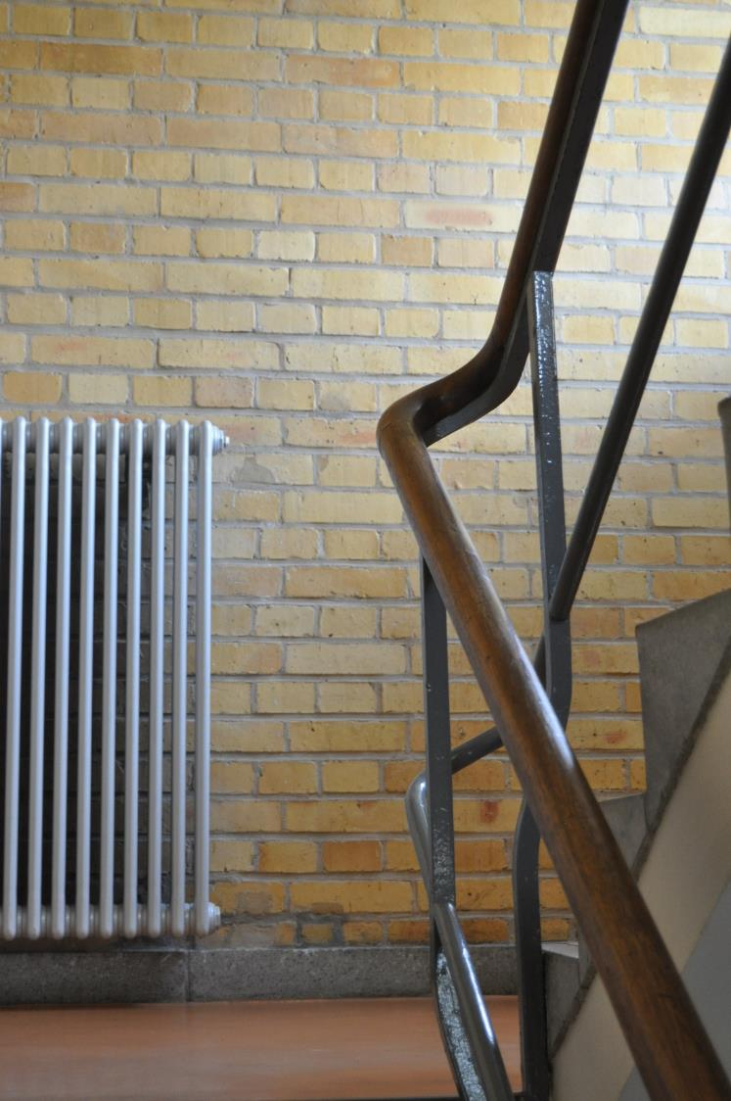
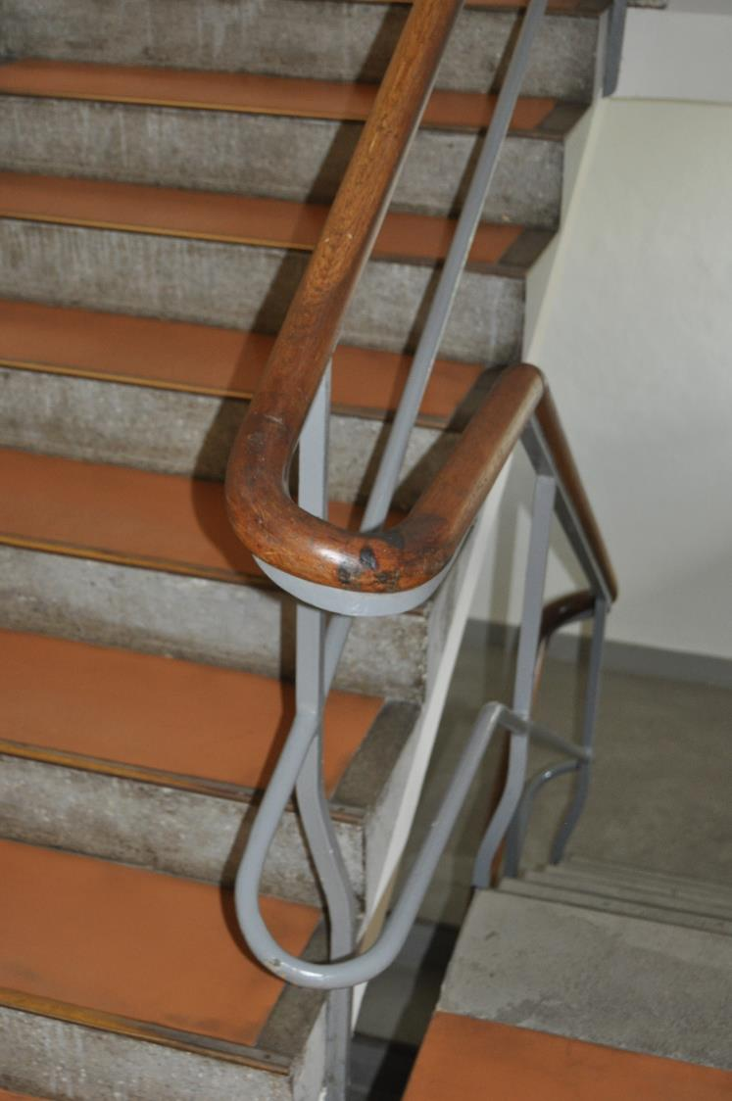

Slide 23
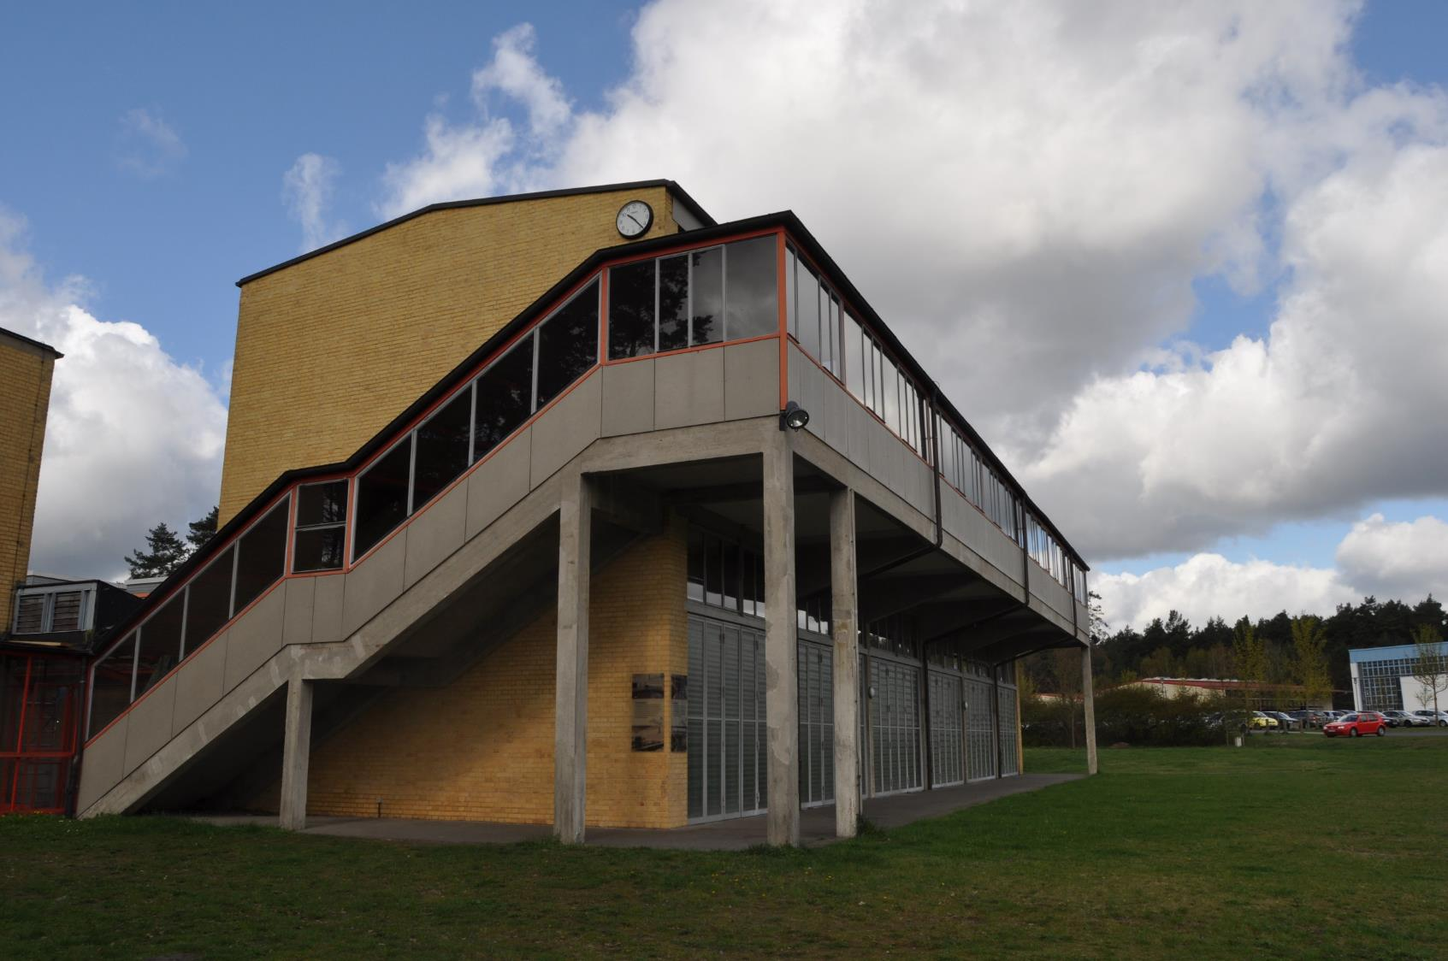

Slide 24
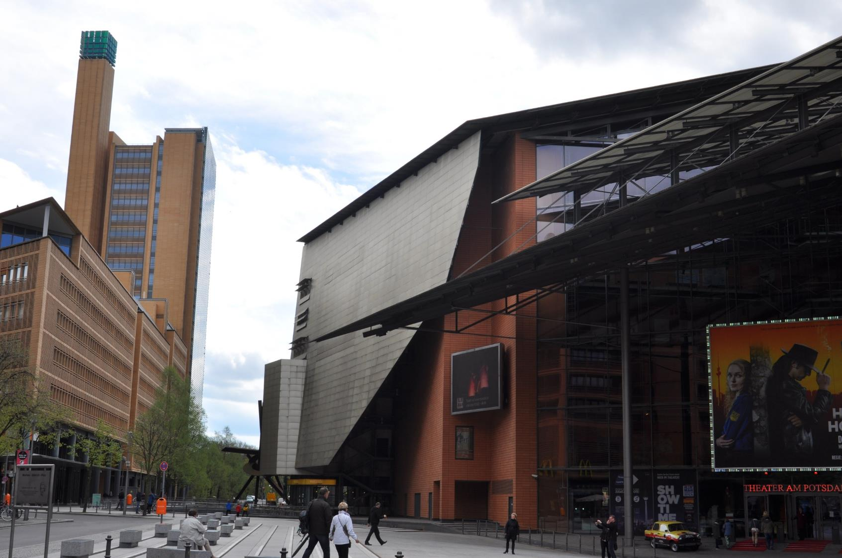
Potsdamer Platz

Slide 25
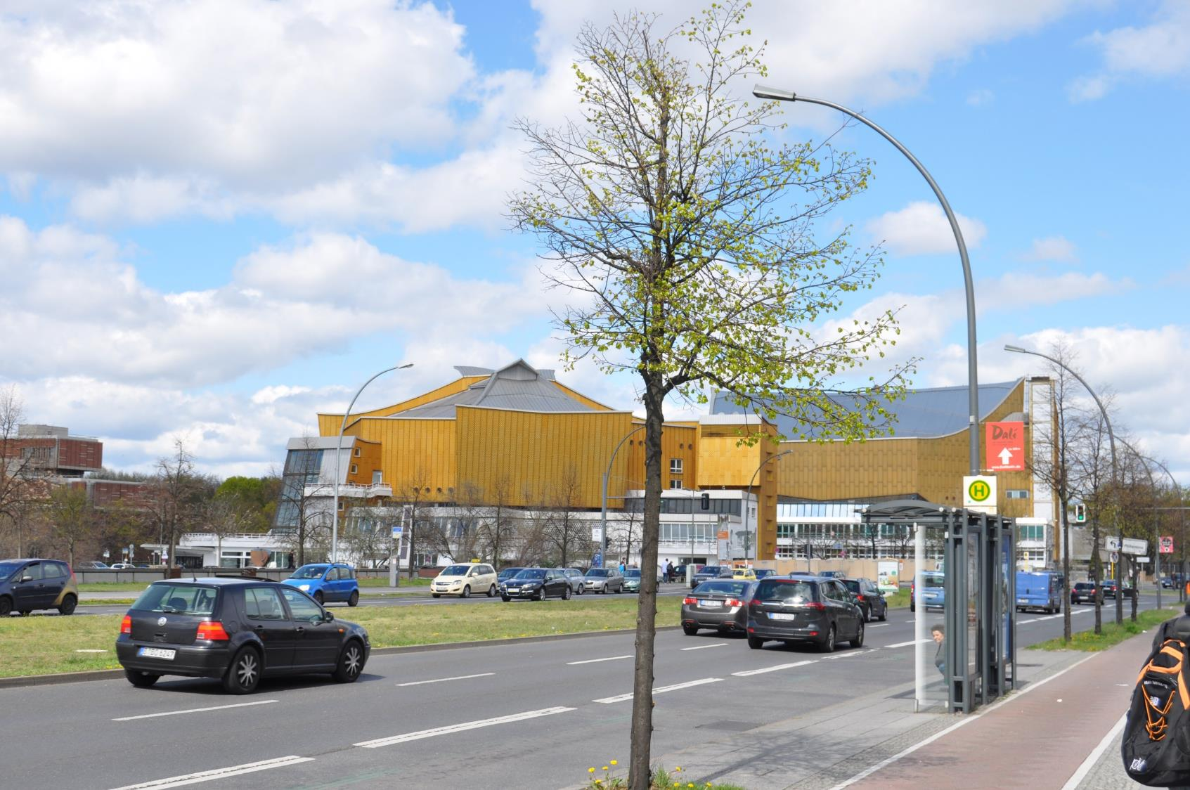
Berlin Philharmonic Concert Hall, Hans Scharoun, 1963

Slide 26
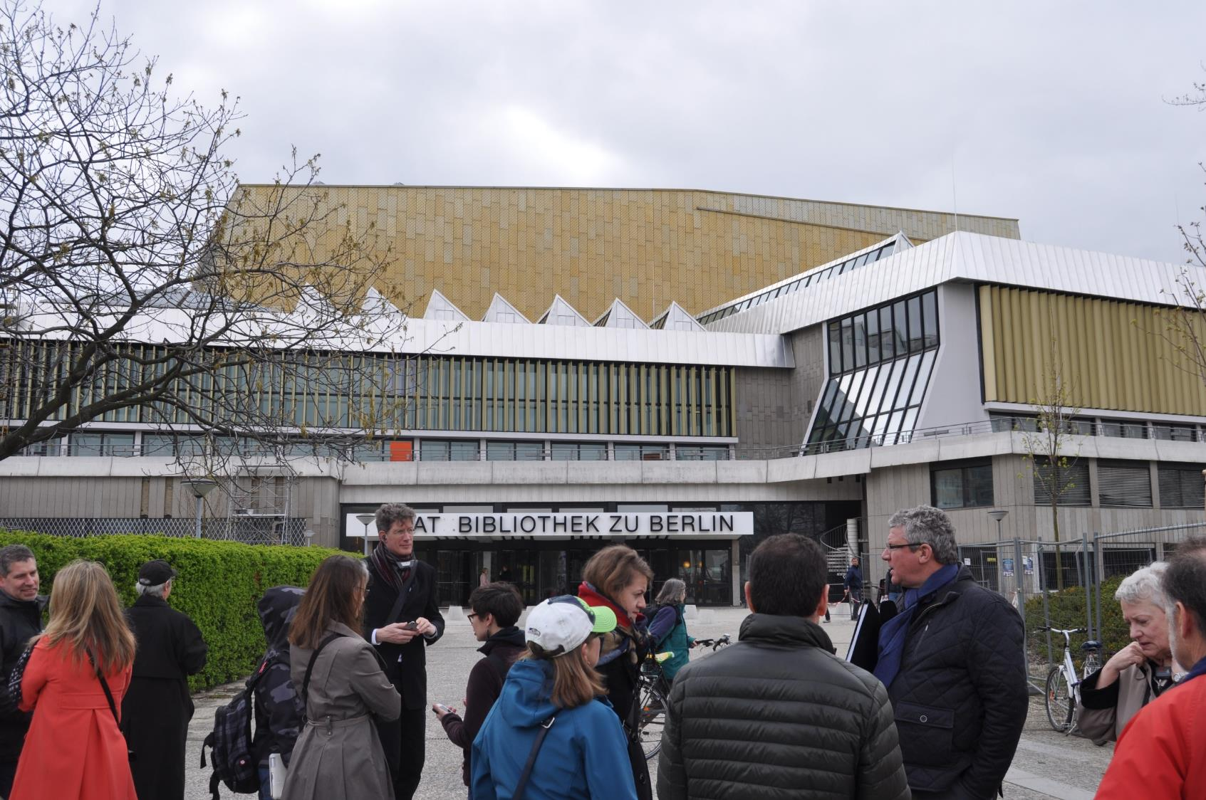
Berlin State Library, Hans Scharoun & Edgar Wisniewski, 1967-1978

Slide 27
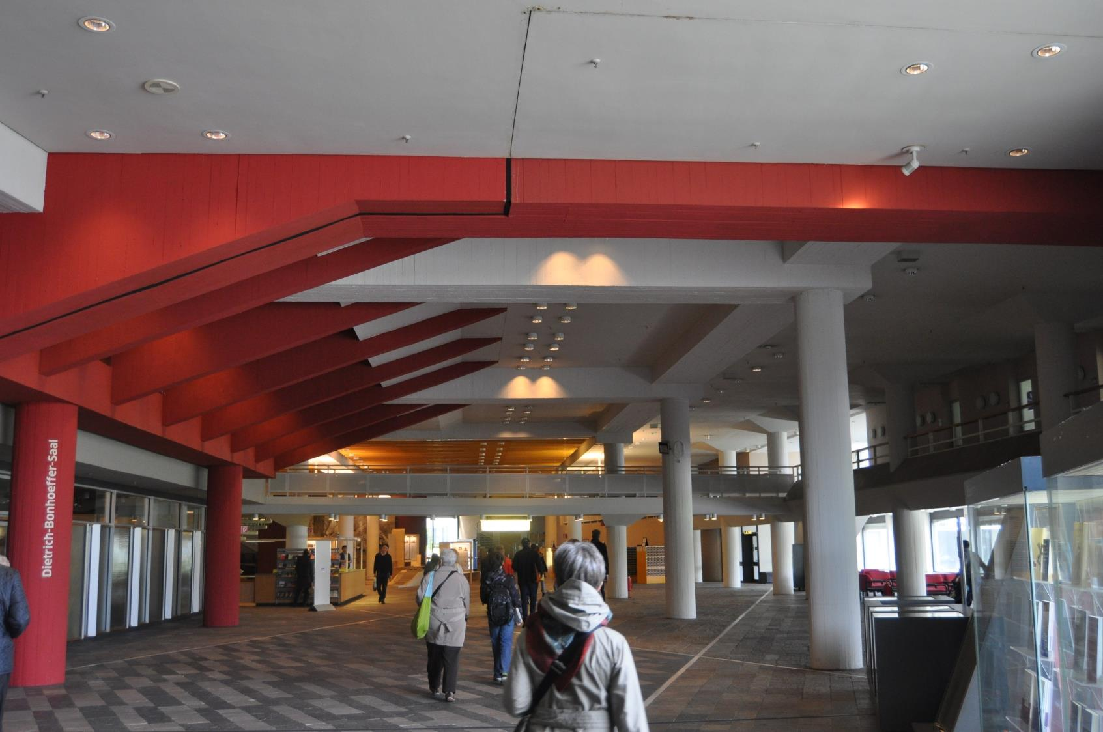

Slide 28
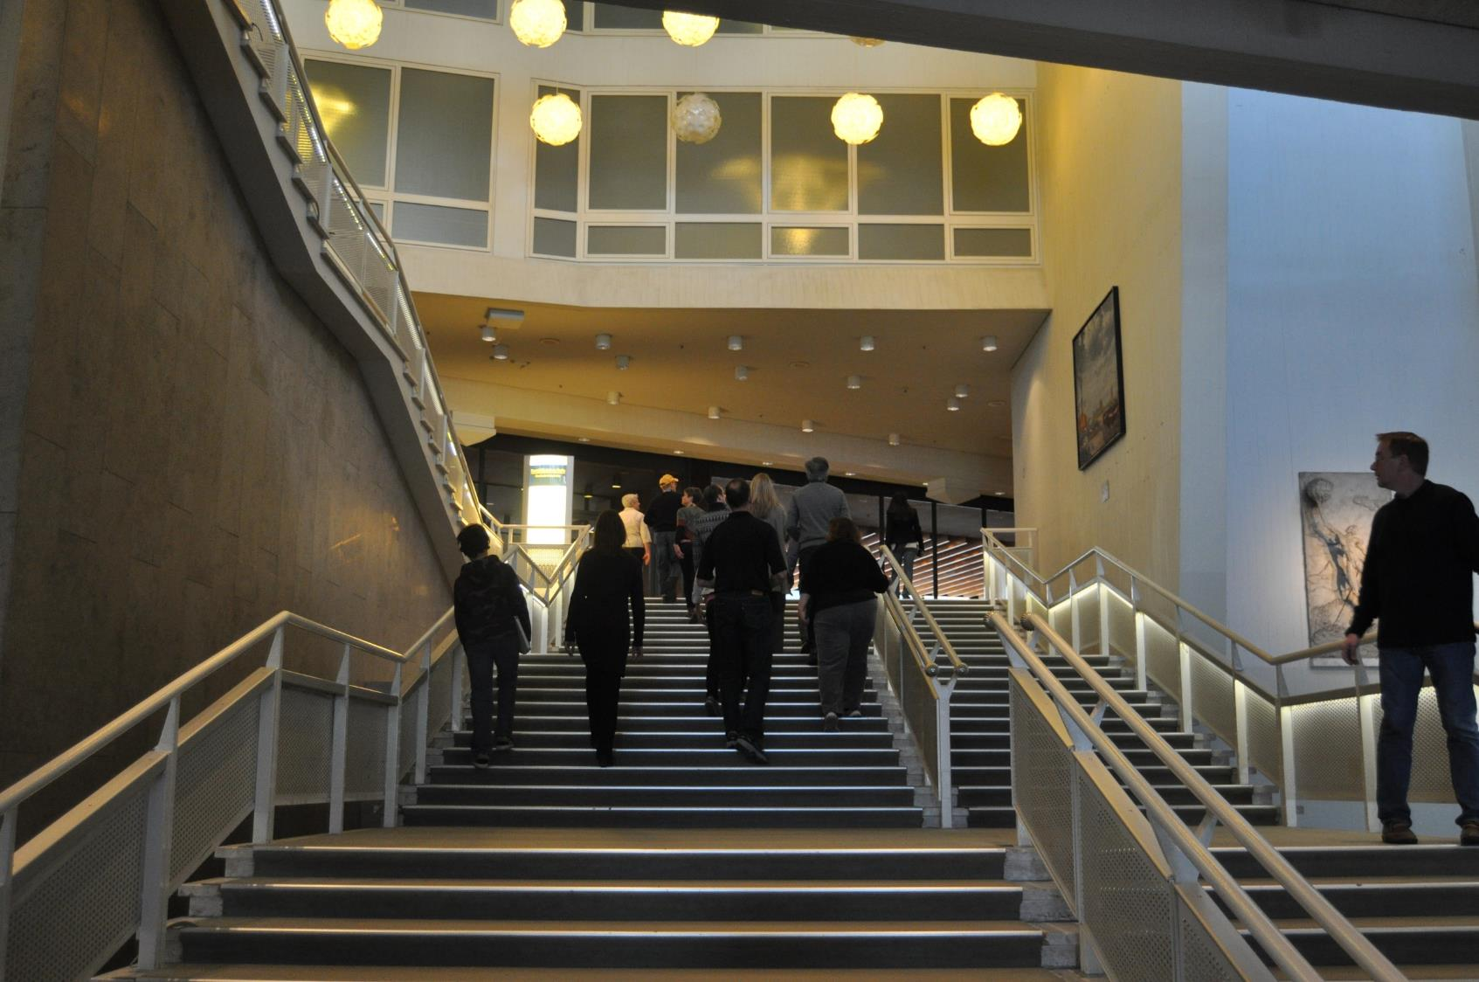

Slide 29
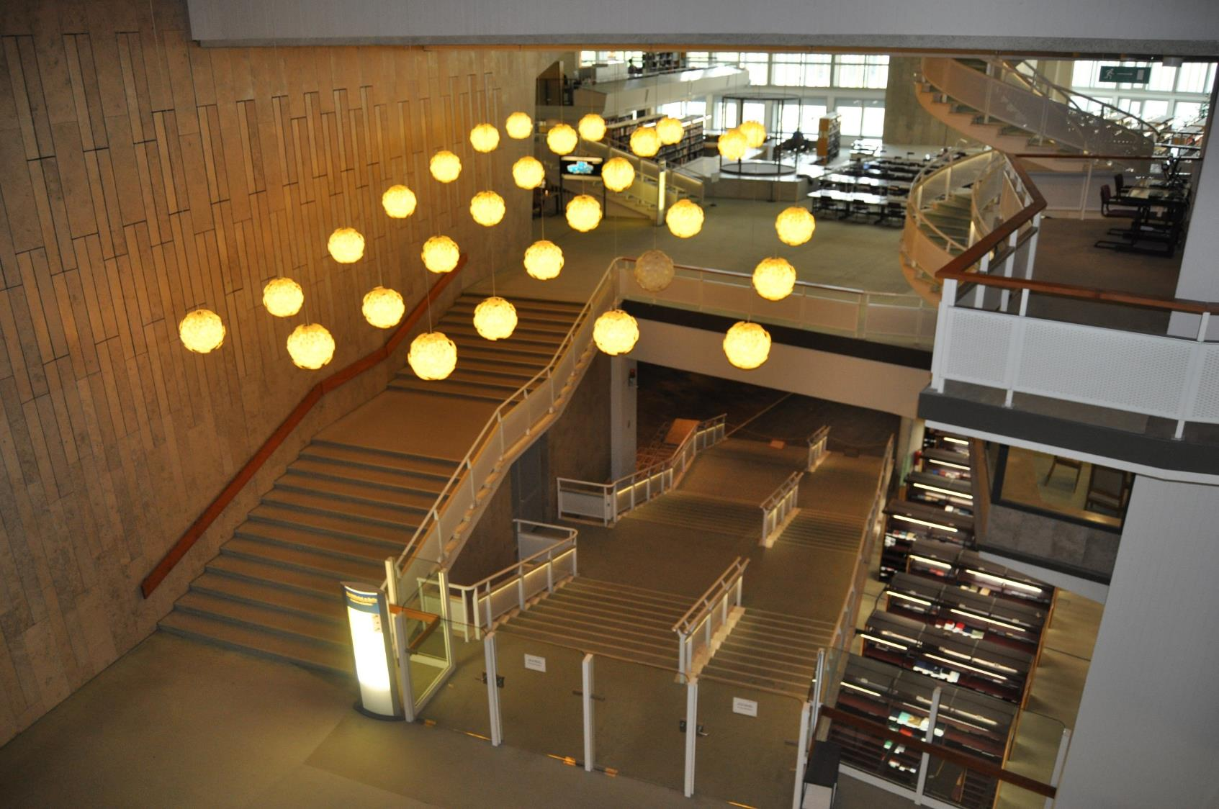

Slide 30
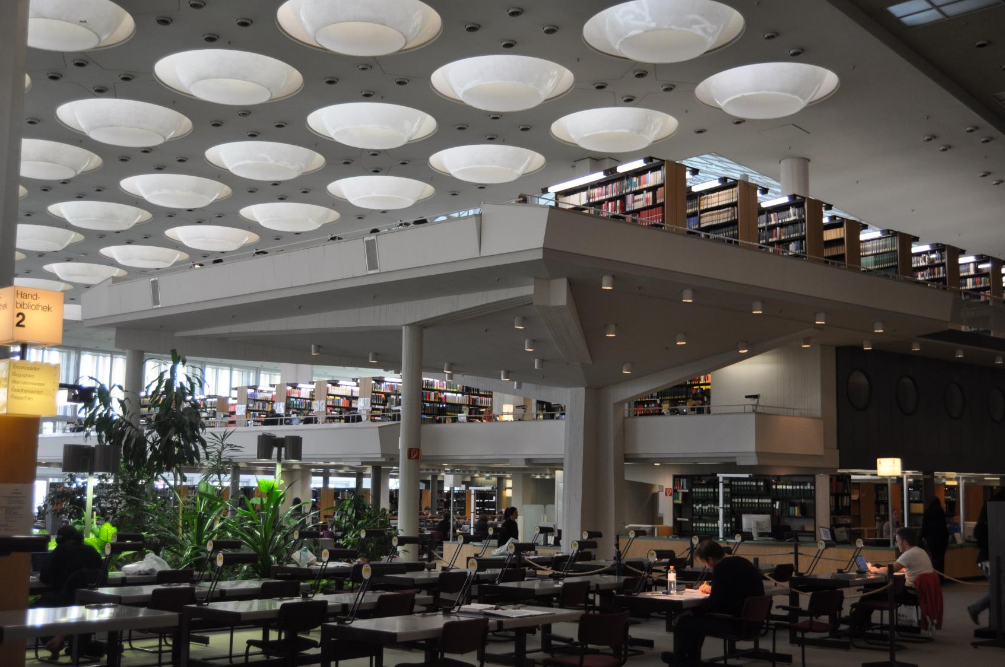

Slide 31
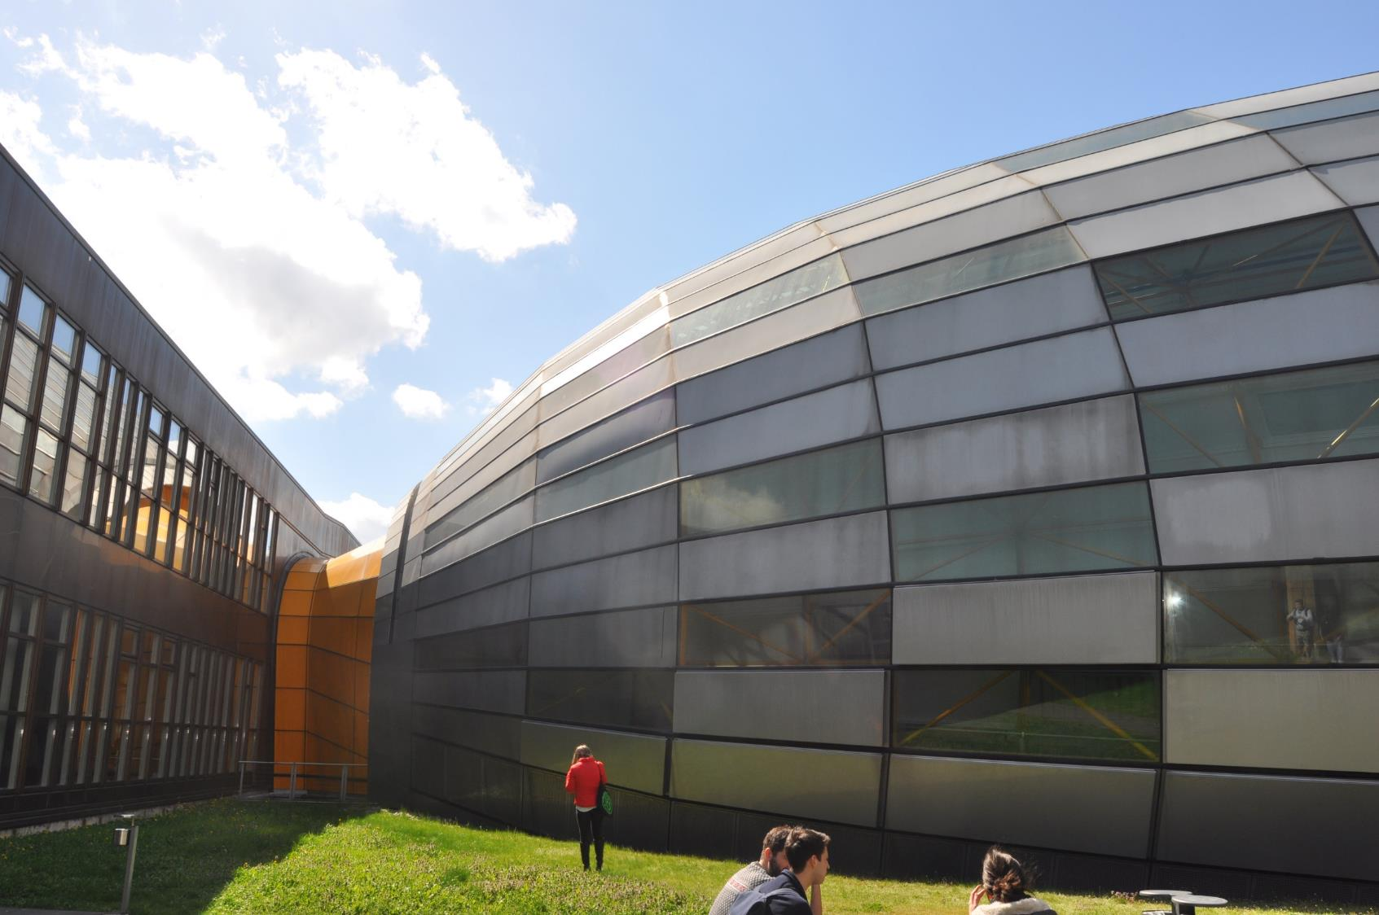
Free University’s Philology Library “The Brain”, Norman Foster, 2005

Slide 32
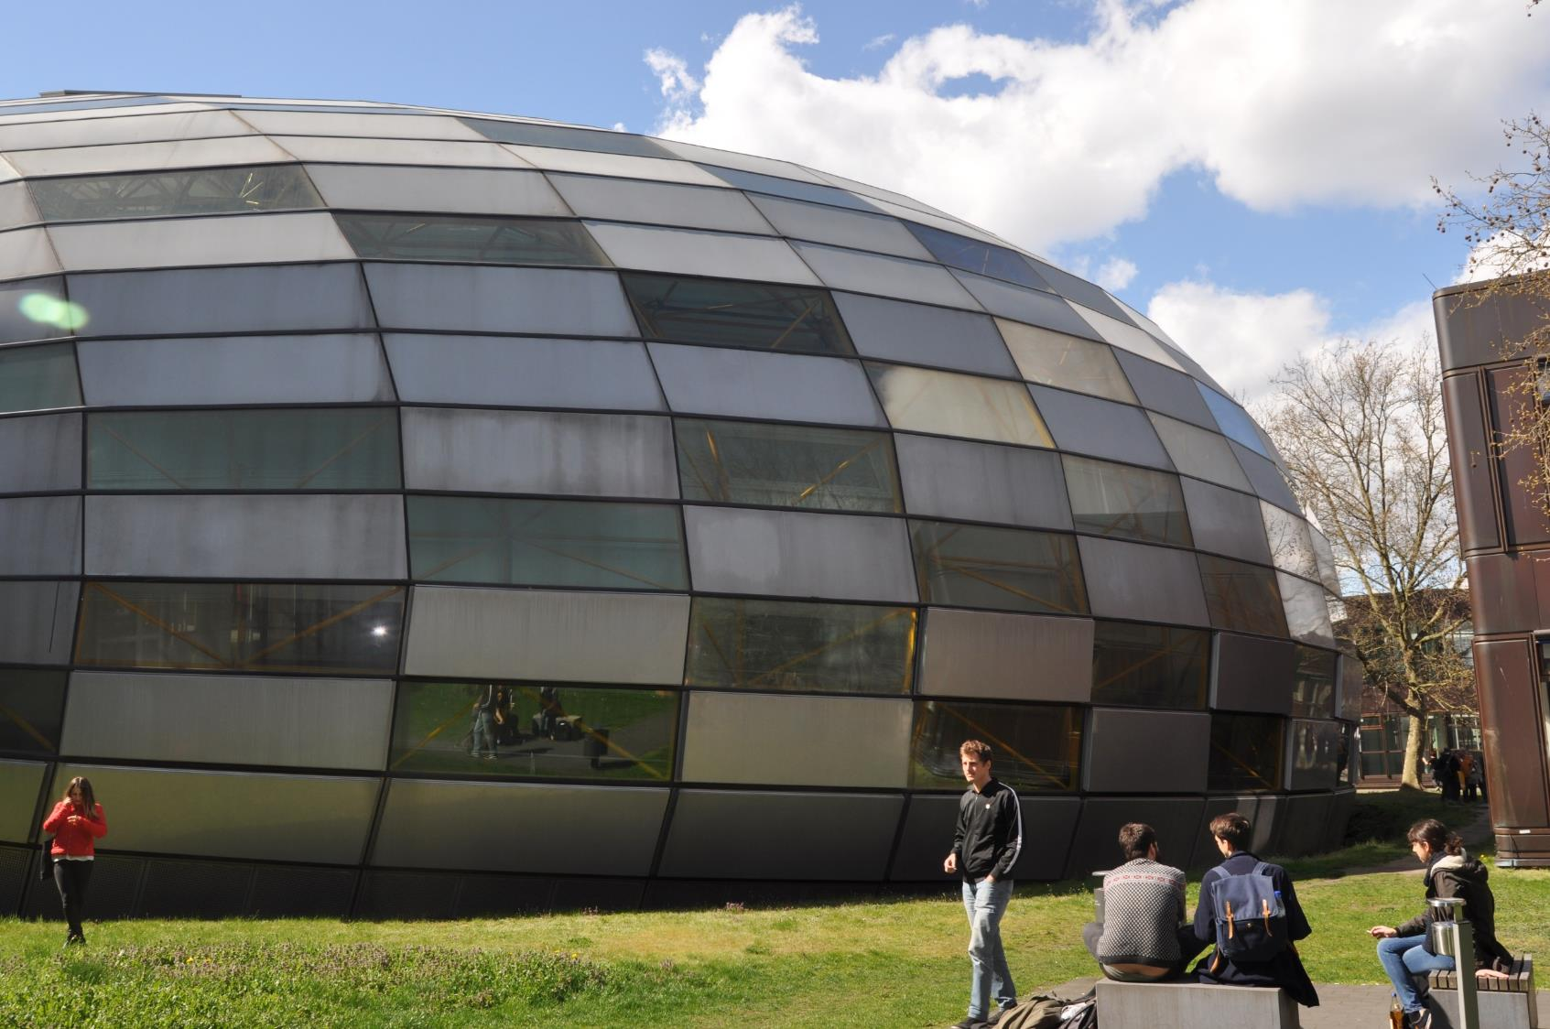

Slide 33
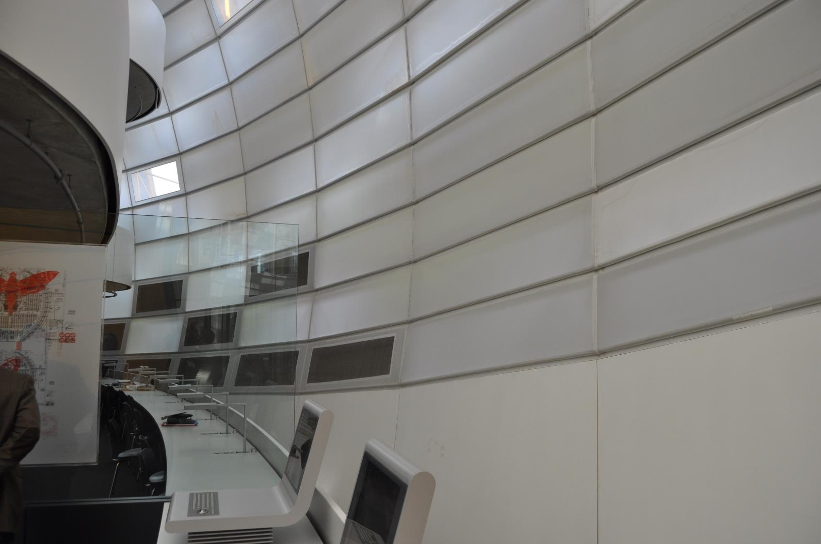

Slide 34
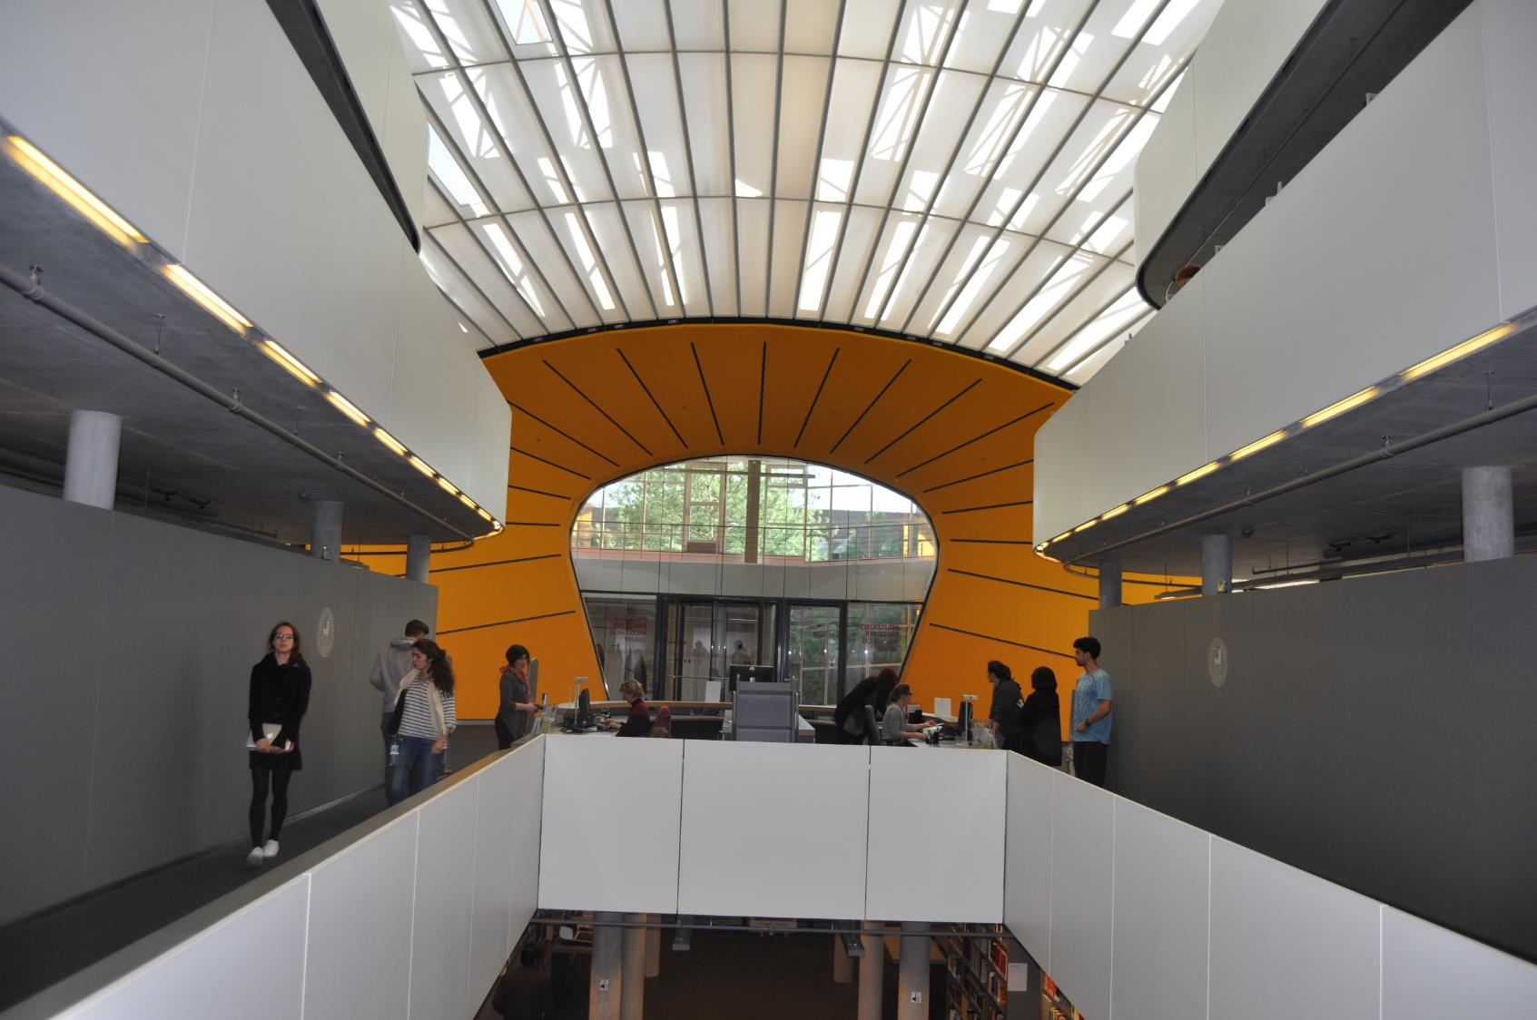

Slide 35
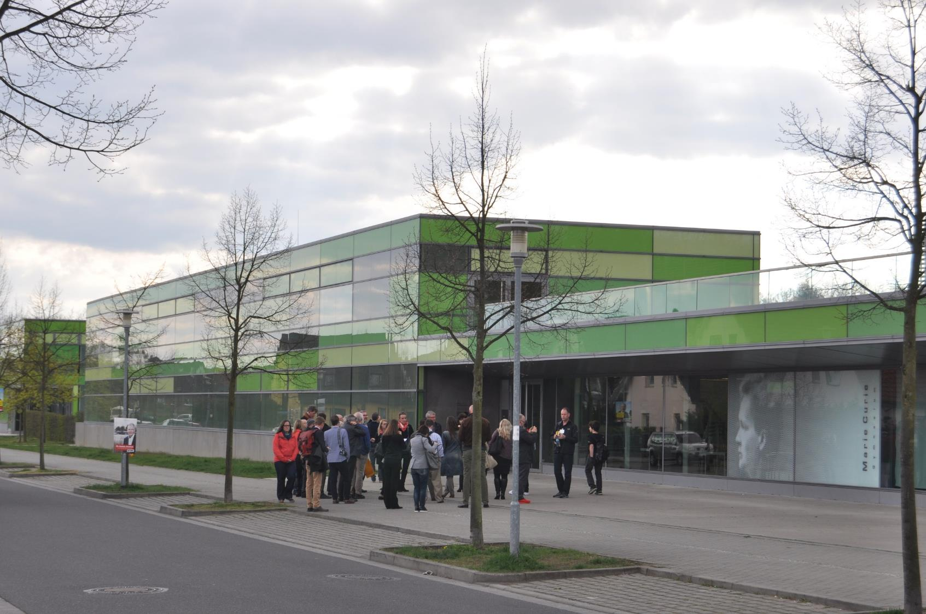
Marie Curie Gymnasium, Gruentuch-Ernst Architects, 2009

Slide 36
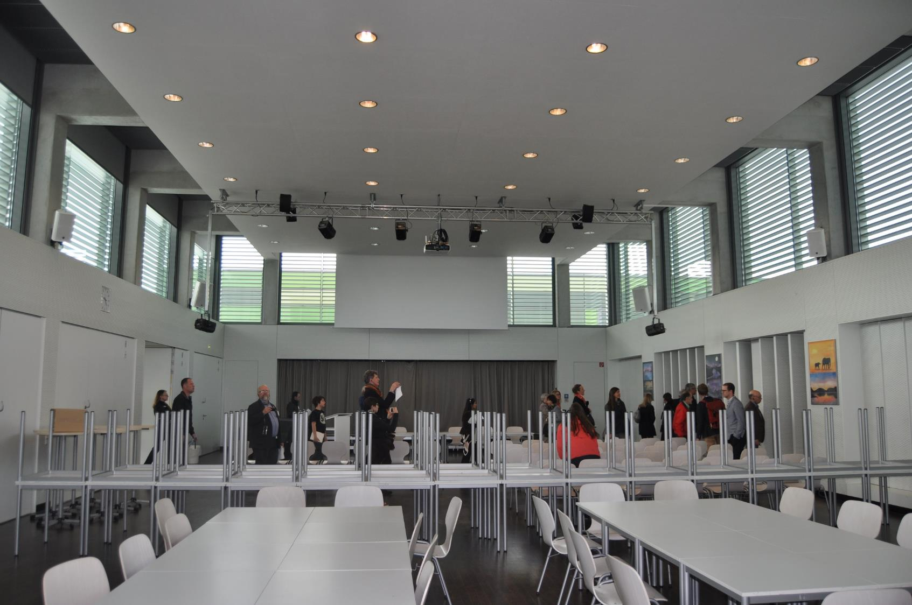

Slide 37
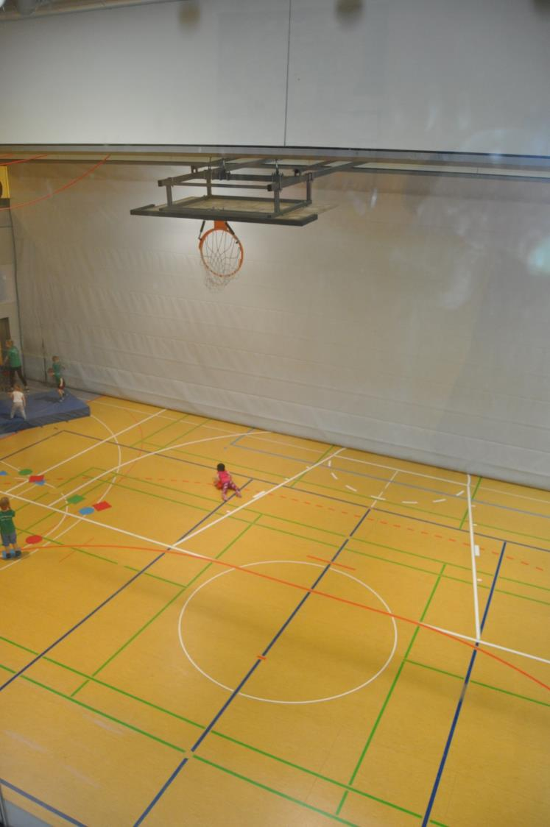
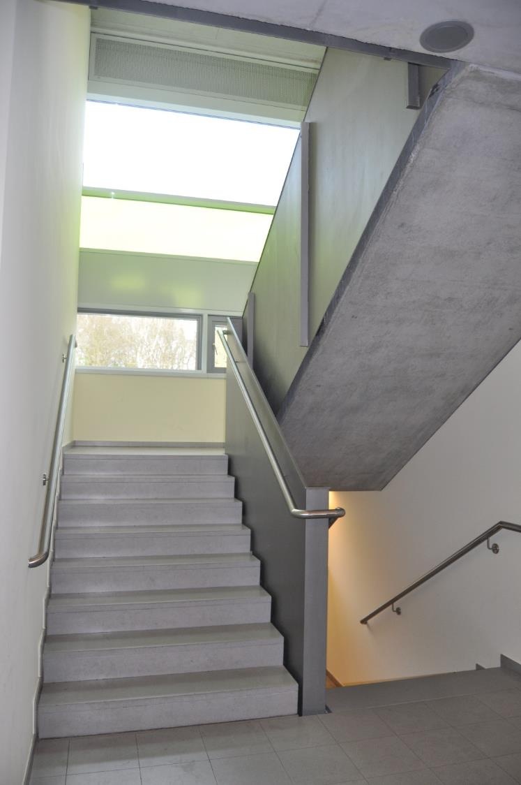

Slide 38
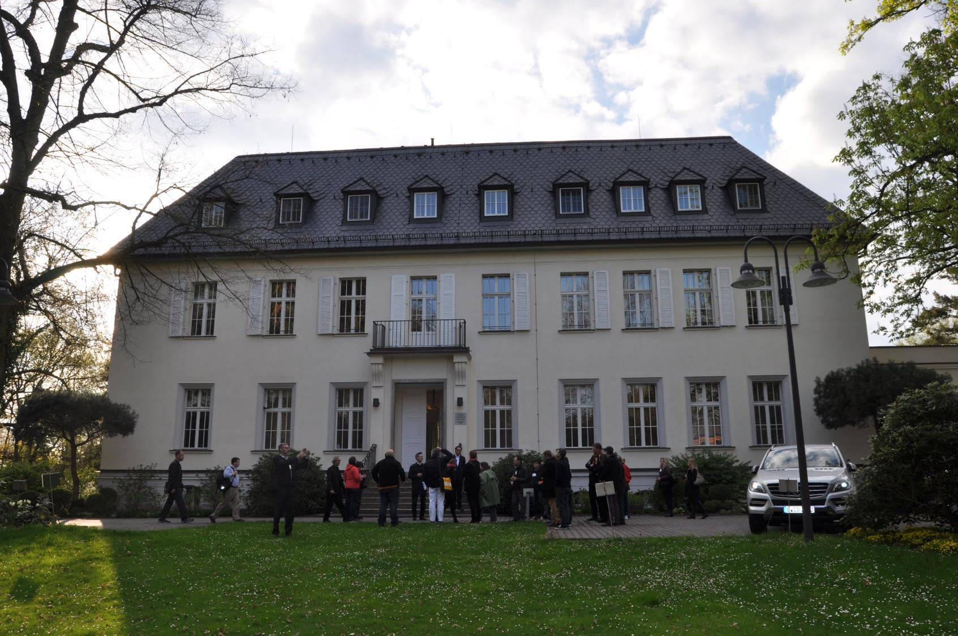
American Academy in Berlin

Slide 39
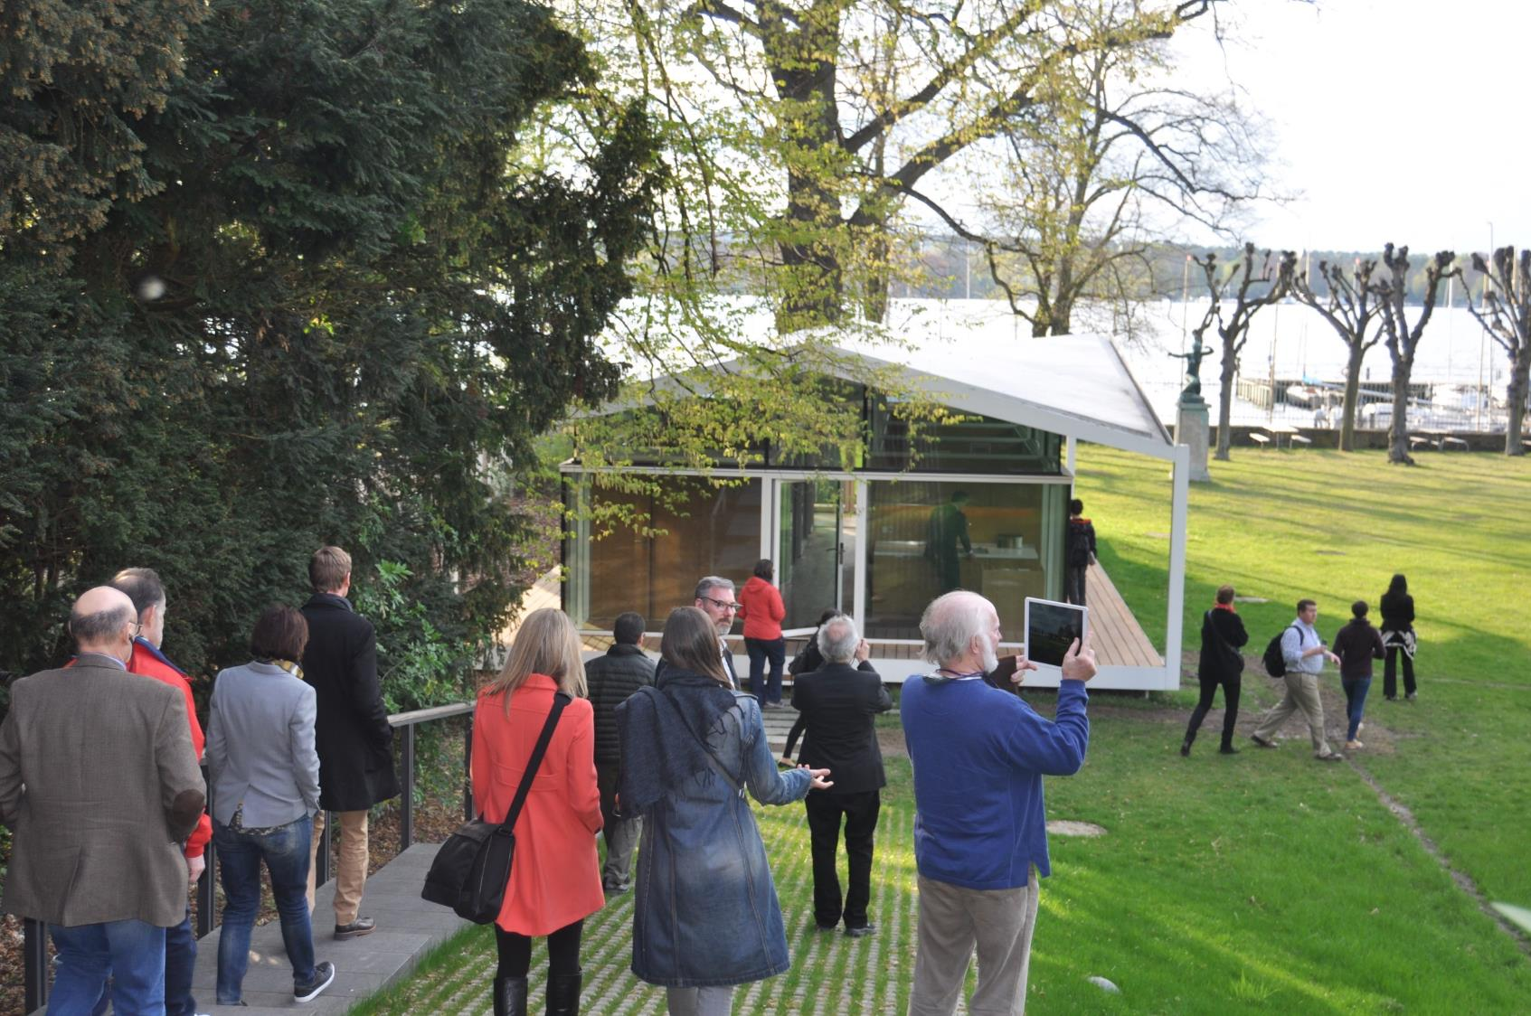
Fellow Pavilion, Barkow Leibinger, 2015

Slide 40
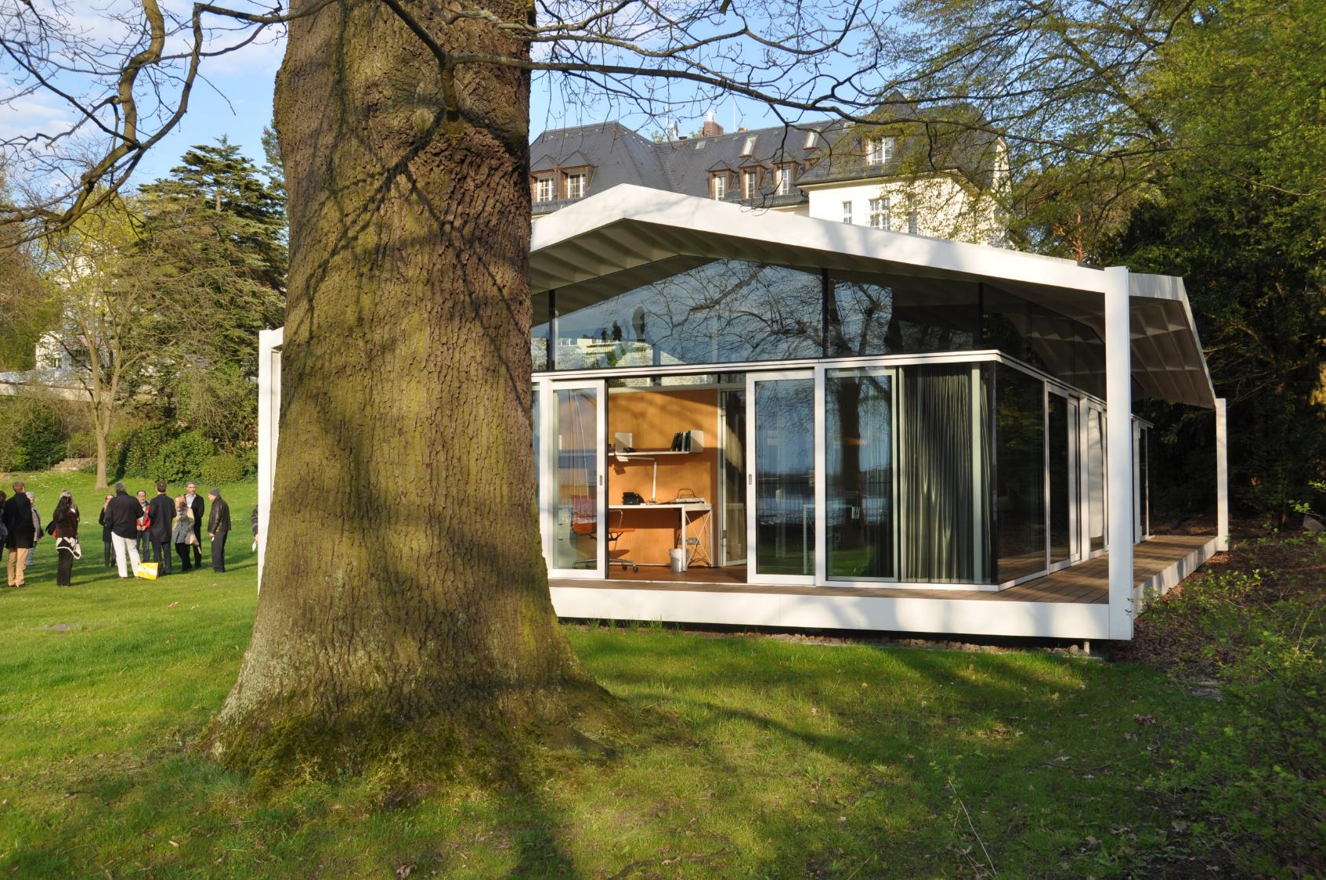

Slide 41
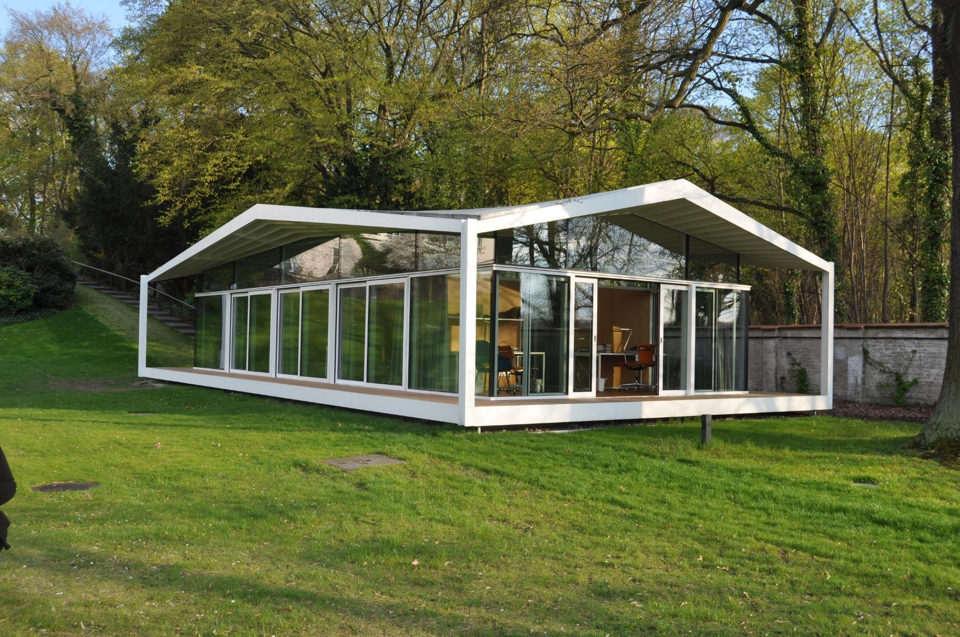

Slide 42
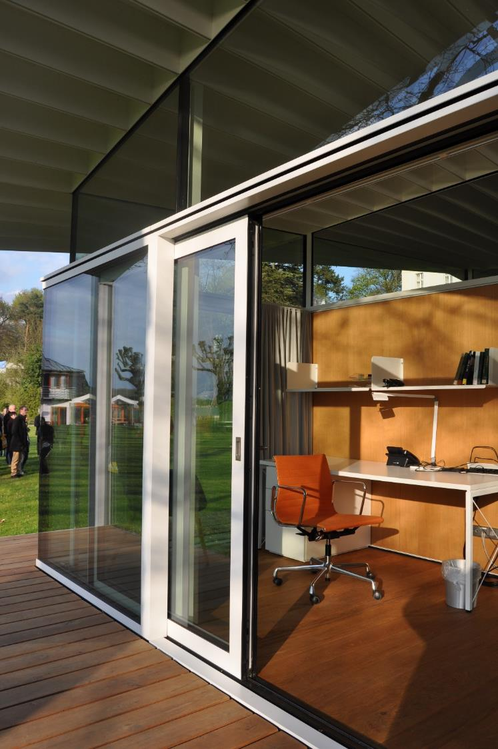
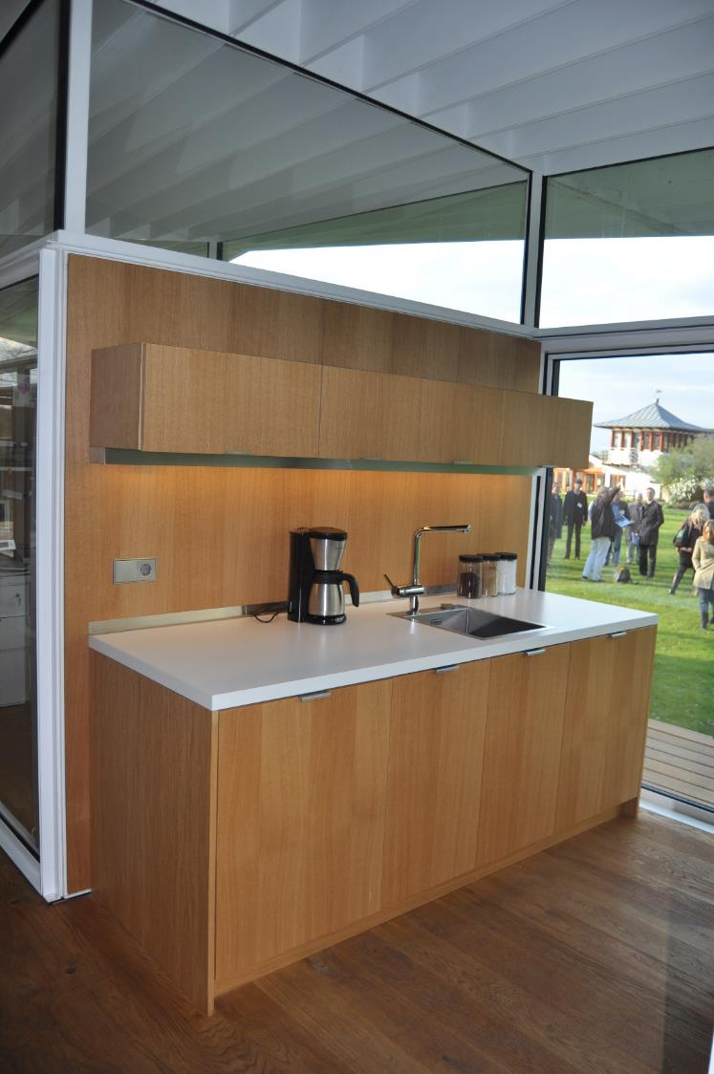

Slide 43
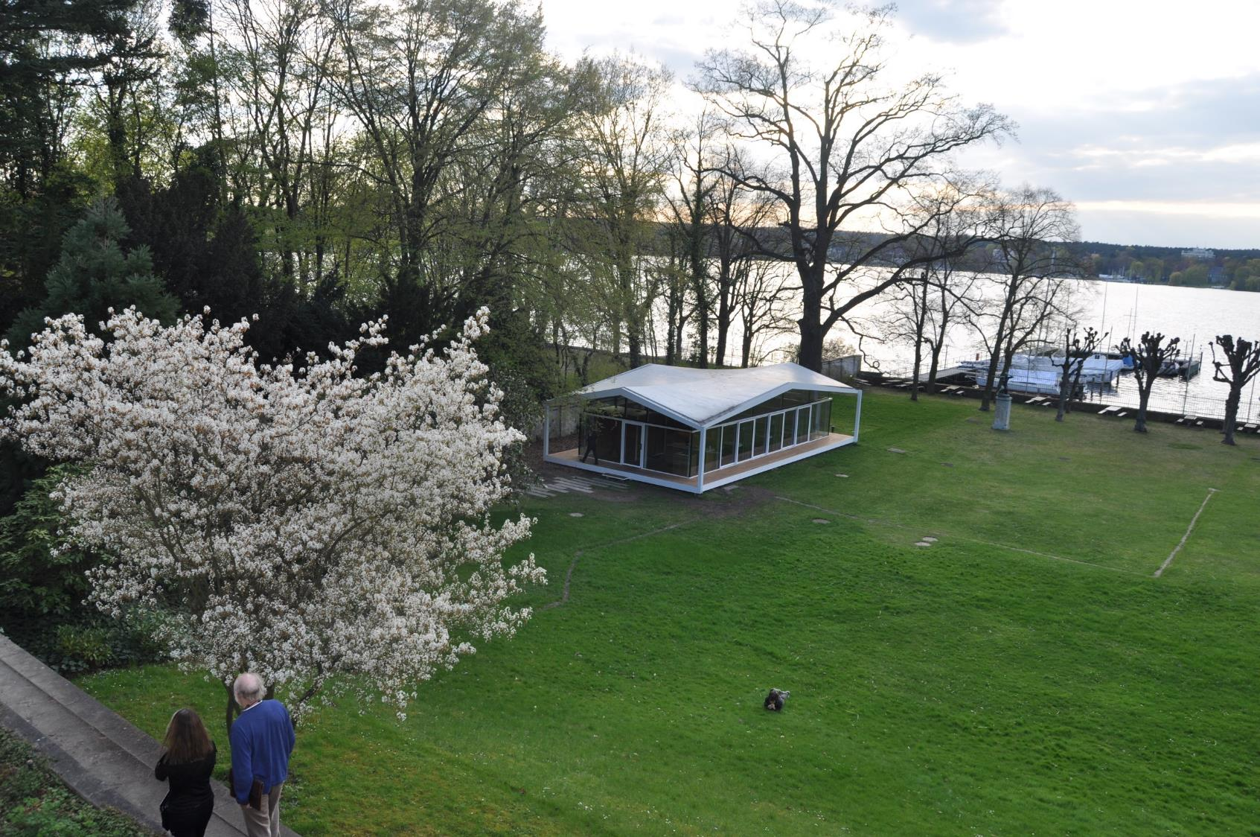

Slide 44
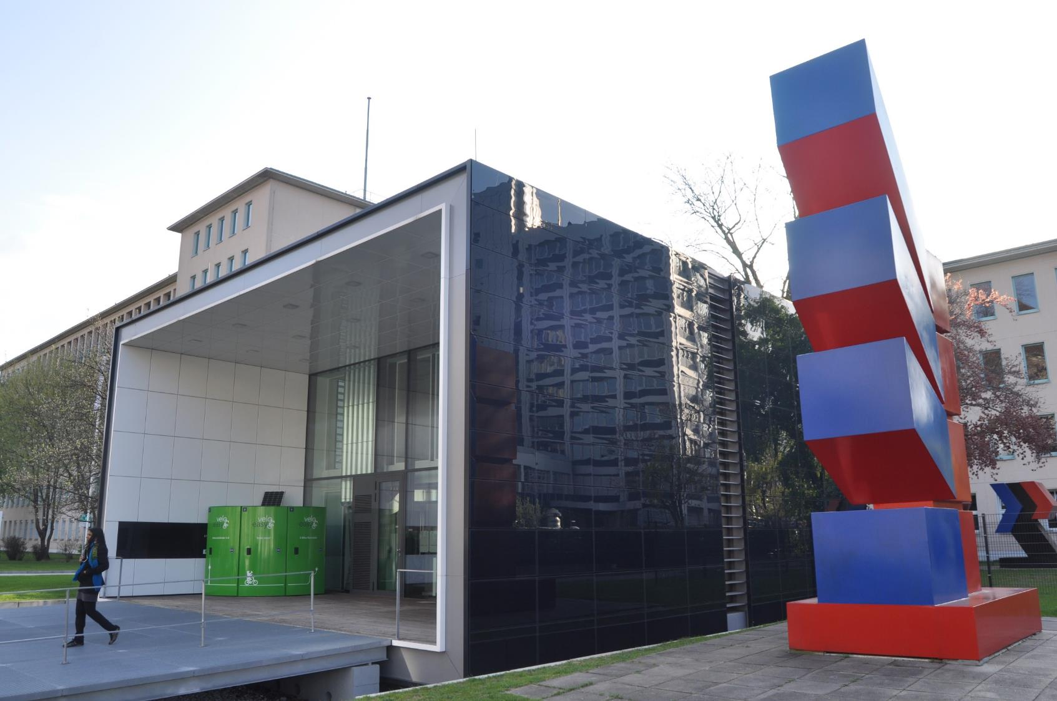
Technical University Berlin, Net Zero House

Slide 45
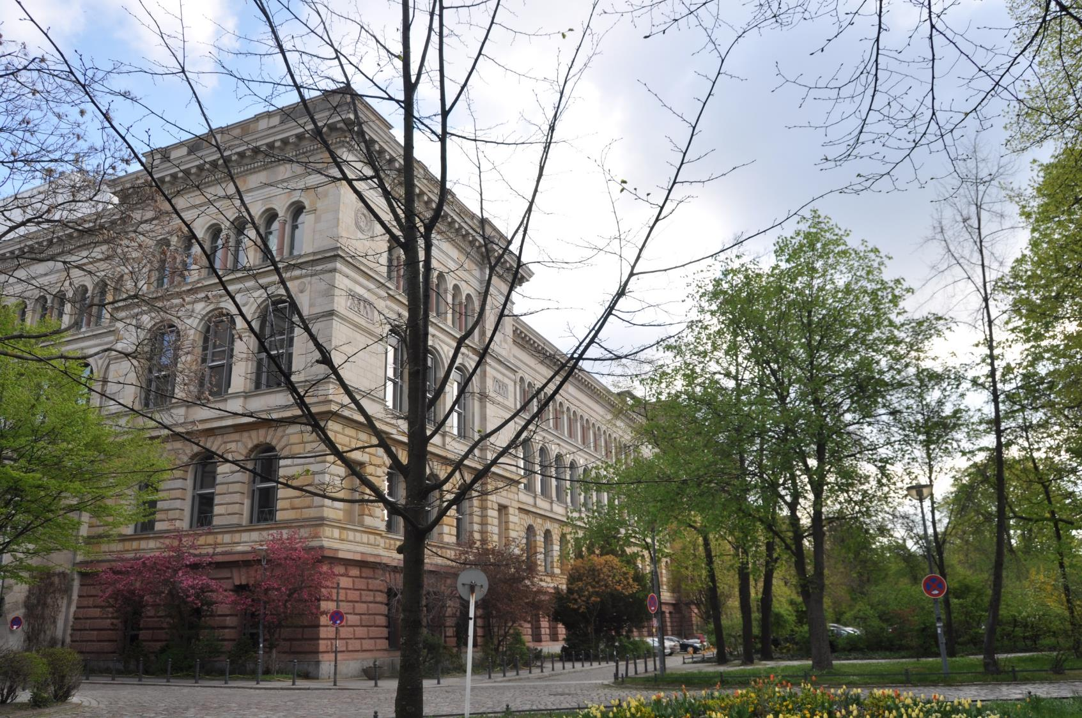
Technical University Berlin, Main Building

Slide 46
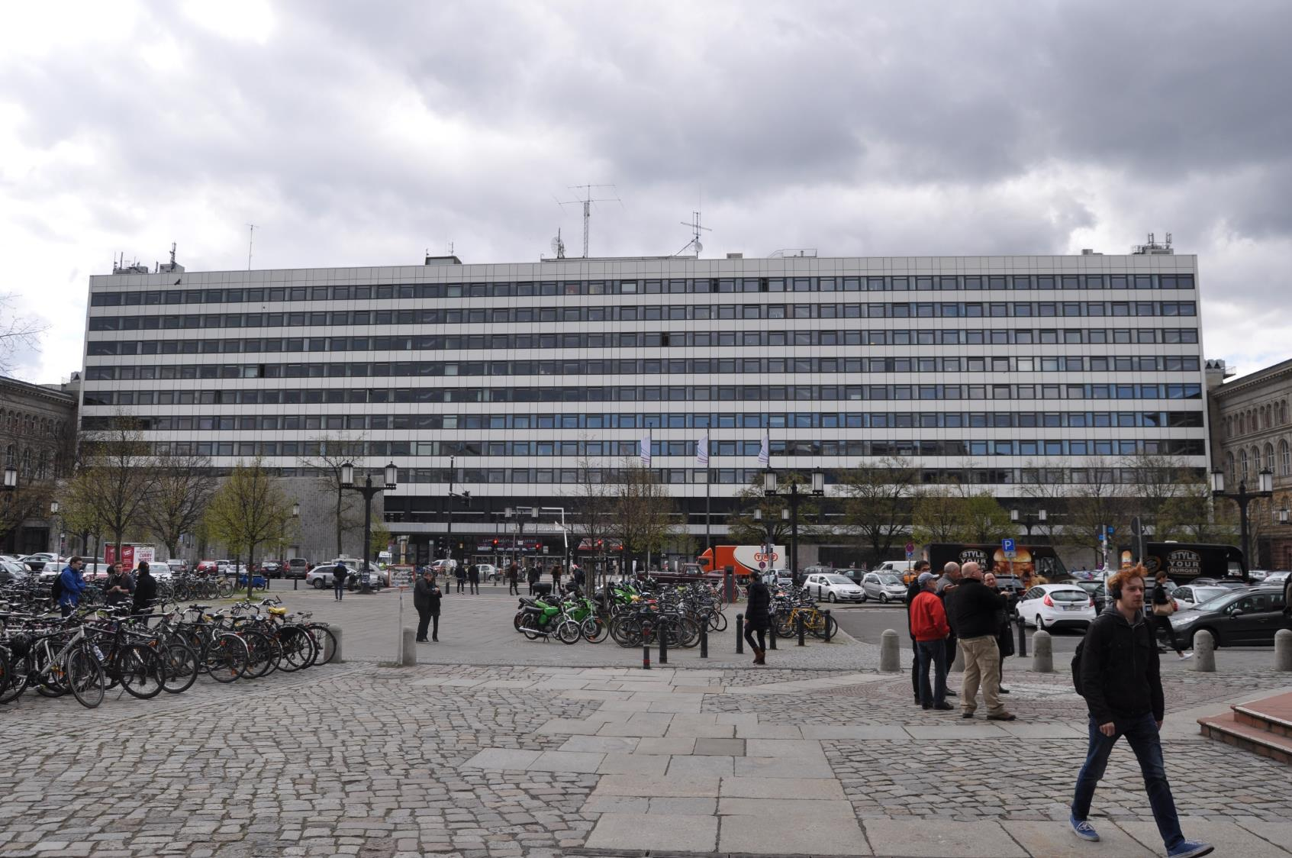
Technical University Berlin, Extension

Slide 47
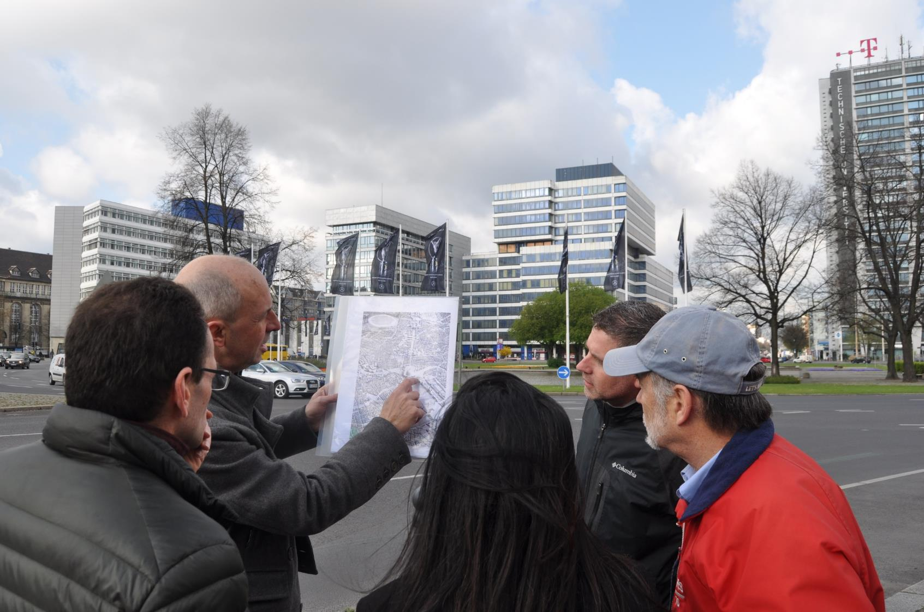

Slide 48
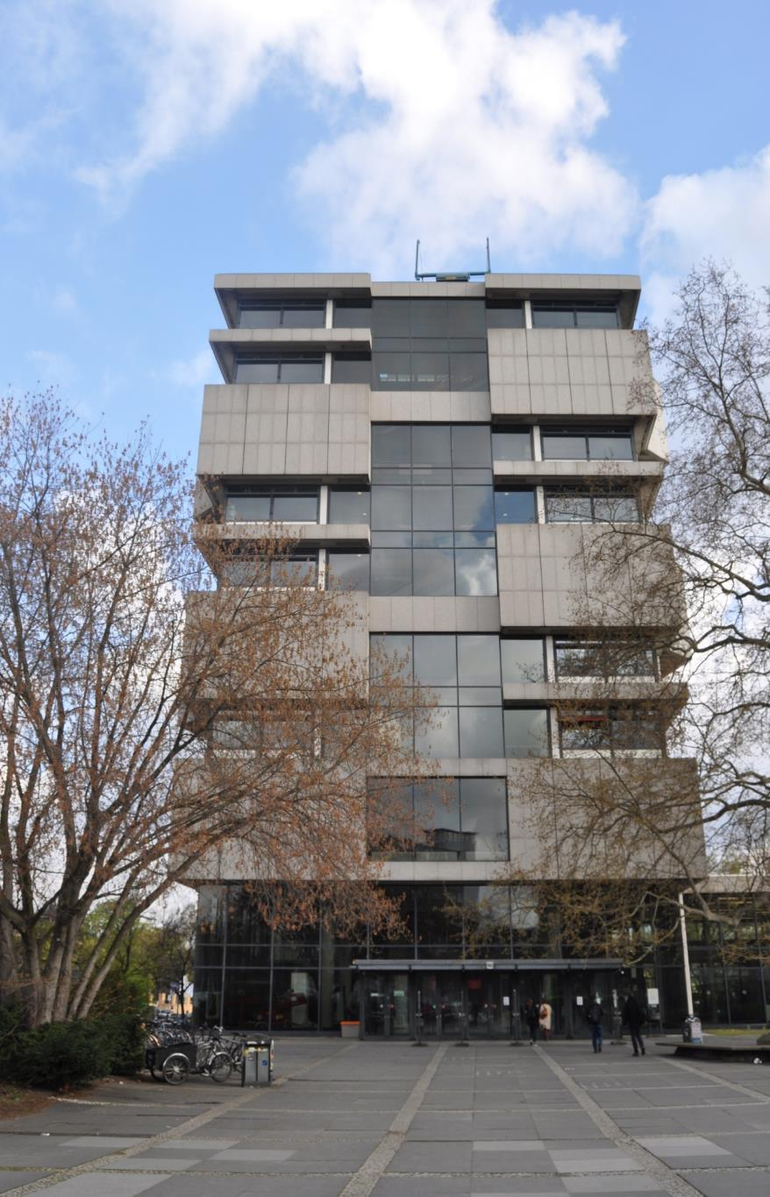
Technical University Berlin, Architecture Building, Bernhard Hermkes, Hans Scharoun, 1962-67

Slide 49
Technical University Berlin, Architecture Building Lobby

Slide 50
Technical University Berlin, Architecture Building Lecture Hall

Slide 51
Technical University Berlin, Architecture Building Stair Hall

Slide 52
Technical University Berlin, Architecture Building Studio

Slide 53
Max Taut School, 1931

Slide 57
German Metalworkers’ Federation Building, Eric Mendelsohn, 1928-30

Slide 60
S-Bahn Train Station

Slide 62
Grimm Center, Humboldt University Library, Max Dudler, 2009

Slide 67
The Jewish Museum Berlin

Slide 69
The Jewish Museum, Daniel Liebeskind, 1999

Slide 73
Shalekhet (Fallen Leaves) by Menashe Kadisjman

Slide 77
W. Michael Blumenthal Academy, Daniel Liebskind, 2012

Slide 80
Altes Museum, Karl Friedrich Schinkel, 1823-30

Slide 81
Reichstag (Parliament), 1894, transformation by Norman Foster, 1999

