Slide 1
School Design for
Violence Prevention
and
Psychosocial Support
FR403
Friday, April 28, 5:00PM
1.00 LU, HSW, GBCI, RIBA

Slide 2
This presentation is protected by U.S. and international copyright laws. Reproduction, distribution, display and use of the presentation without written permission of the speaker is prohibited.

Slide 3
This program is registered with the AIA/CES for continuing professional education. As such, it does not include content that may be deemed or construed to constitute approval, sponsorship or endorsement by the AIA of any method, product, service, enterprise or organization.
The statements expressed by speakers, panelists, and other participants reflect their own views and do not necessarily reflect the views or positions of The American Institute of Architects, or of AIA components, or those of their respective officers, directors, members, employees, or other organizations, groups or individuals associated with them.
Questions related to specific products and services may be addressed at the conclusion of this presentation.

Slide 4
Speakers List
Daniel Lamoreaux, M.A.
Doctoral Candidate, School Psychology
University of Arizona
Brian G. Minnich, AIA, LEED AP BD+C
Project Manager, GWWO, Inc./Architects

Slide 5
Course / Learning Objectives
At the end of the course, participants will be able to describe current research findings in school violence, bullying prevention, and educational environments while citing reliable sources of research statistics.
At the end of the course, participants will be able to leverage current best practices in school facilities design using principles of Crime Prevention Through Environmental Design (CPTED).
At the end of the course, participants will be able to identify the “Four D’s” (Deter, Detect, Delay, Defend) and specific ways in which they are used in safe school design.
At the end of the course, participants will be able to generate context-appropriate ideas for safe school design when given hypothetical school characteristics.

Slide 6
Opening activity: Free-association
“School Safety”

Slide 7
Purpose
Well-designed schools should be:
Physically Secure
+
Psychologically Sensitive
+
Socially Supportive

Slide 8
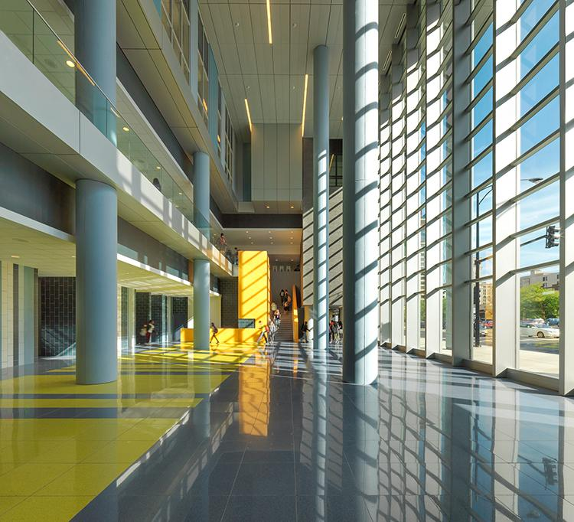
Image Courtesy of Perkins + Will

Slide 9
Presentation Roadmap
School Shooting Statistics
Design to support mental health
School violence and perpetrator characteristics
Design to support social climate
Bullying and Youth Suicide
How to balance all needs: CPTED
What CPTED is, and how to implement it.
Conclusions and Recommendations

Slide 10
School Shootings
Tragic, but rare.
1 - 2% of youth homicides occur on school campuses Robers, Zhang, Morgan, & Musu-Gillette, 2015)
School-based youth homicide rates stable 1992 – 2012. (Robers et al., 2015)
July 2011 to June 2012, 15 school homicides, 1184 homicides off-campus (Robers et al., 2015)

Slide 11
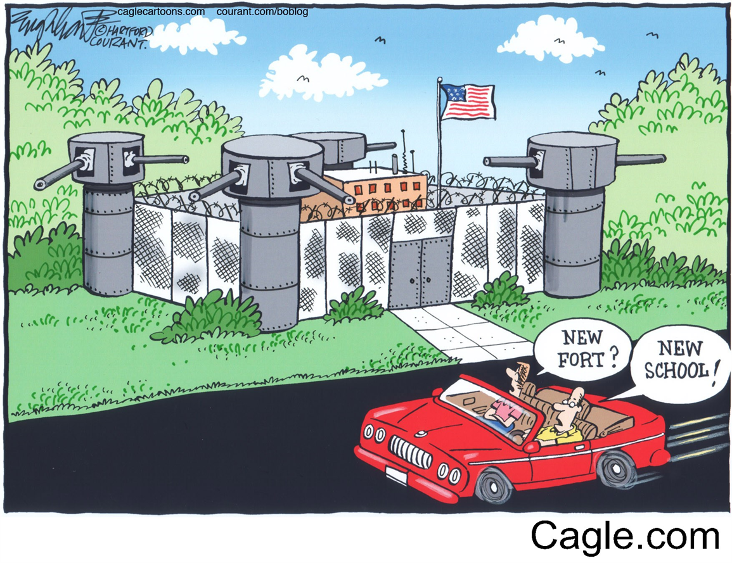

Slide 12
Design for Mental Health
Study of school shooters from 1974 to 2000 (Vossekuil, Fein, Reddy, Borum, & Modzeleski, 2002)
Perpetrator characteristics:
95% of shooters were students of the victimized schools
Nearly ¾ felt bullied or marginalized
¾ Had history of suicide attempts
Bullying and Mental health = common factors

Slide 13
Design for Mental Health
Research suggests the built environment affects mental health (Evans, 2003)
DIRECTLY: crowding, noise, indoor air quality, daylight.
INDIRECTLY
Personal control: flexible, adaptable, adjustable
Restoration: school gardens, nature, “green views”
Social support: interface and connectedness

Slide 14
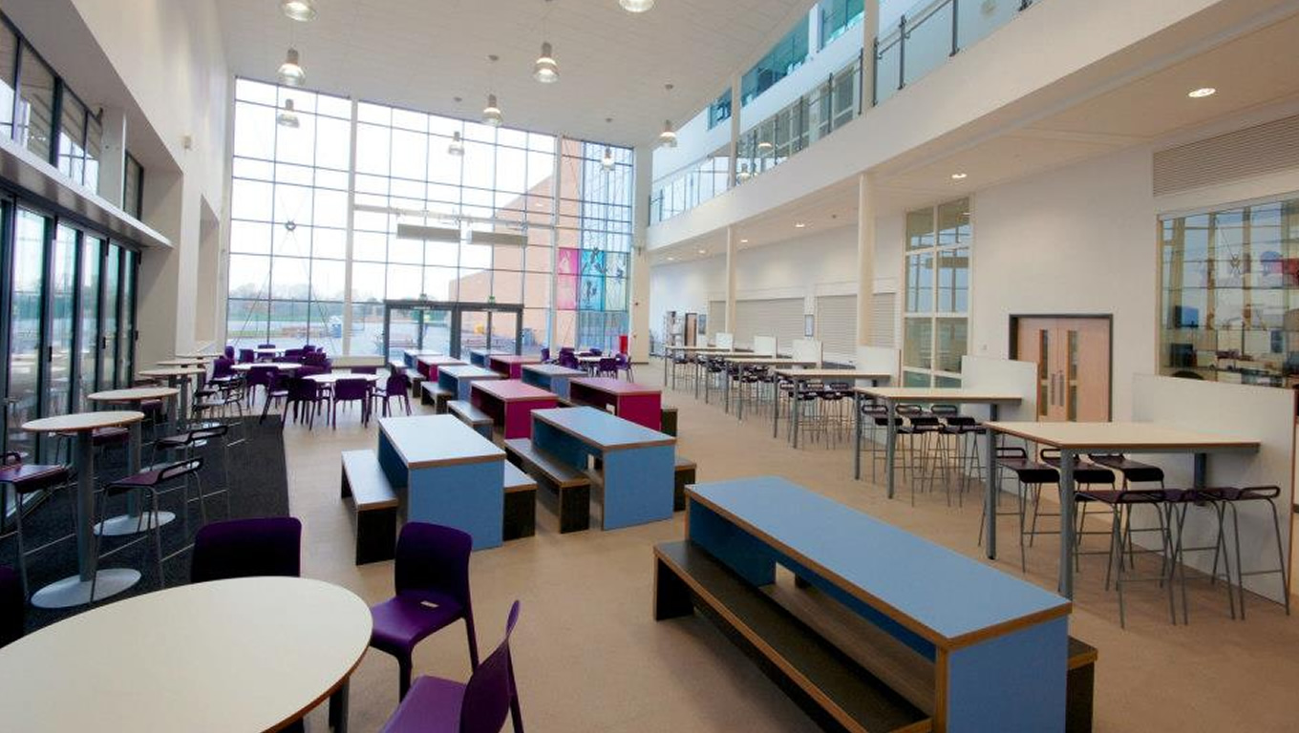
Daylighting

Slide 15
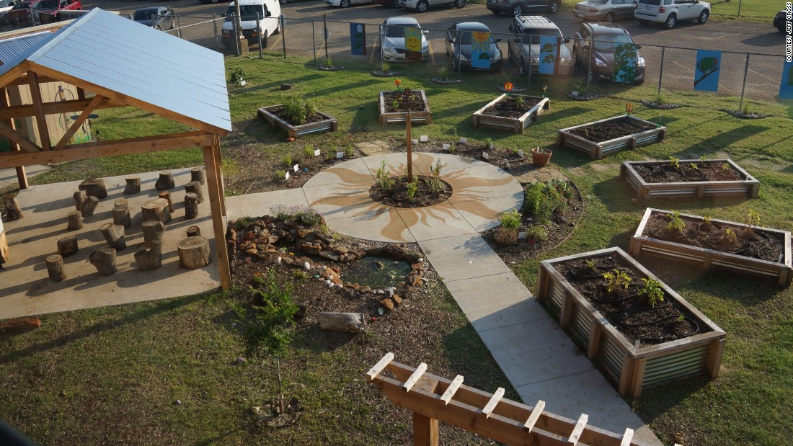
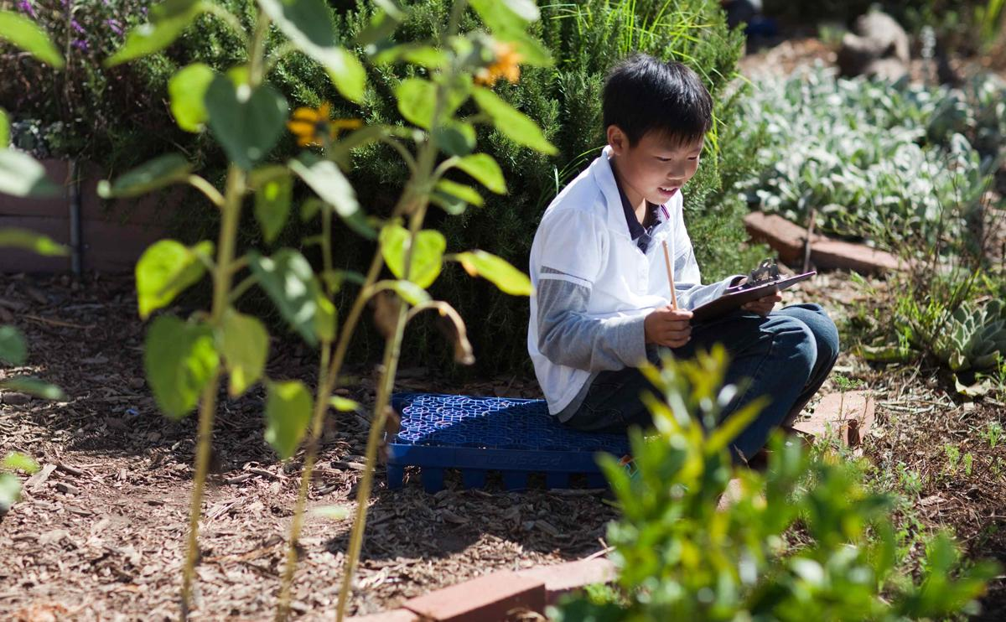
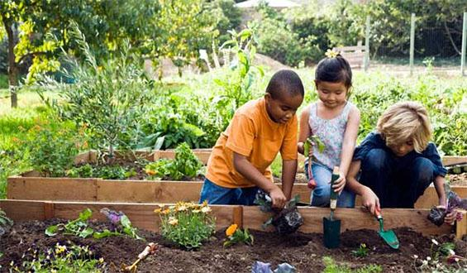
School Garden

Slide 16
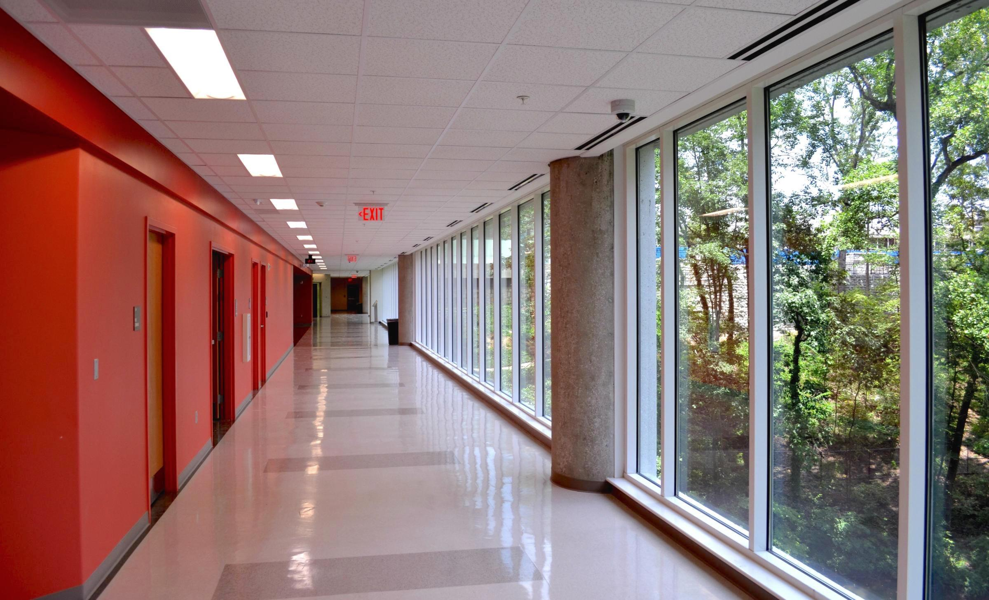
Restorative Green Views

Slide 17
Design for Social Support
Bullying Prevalence: 18% - 30% experience bullying (Rivara & Le Menestrel, 2016)
Suicide: second leading cause of youth deaths (nasponline.org, 2015)
Substantial connection between bullying and suicide (Bauman & Toomey, 2013)
2-4 times greater risk for suicidality (Holt et al. 2015)
More bullying = worse achievement, negative “school climate” (Rivara & Le Menestrel, 2016)

Slide 18
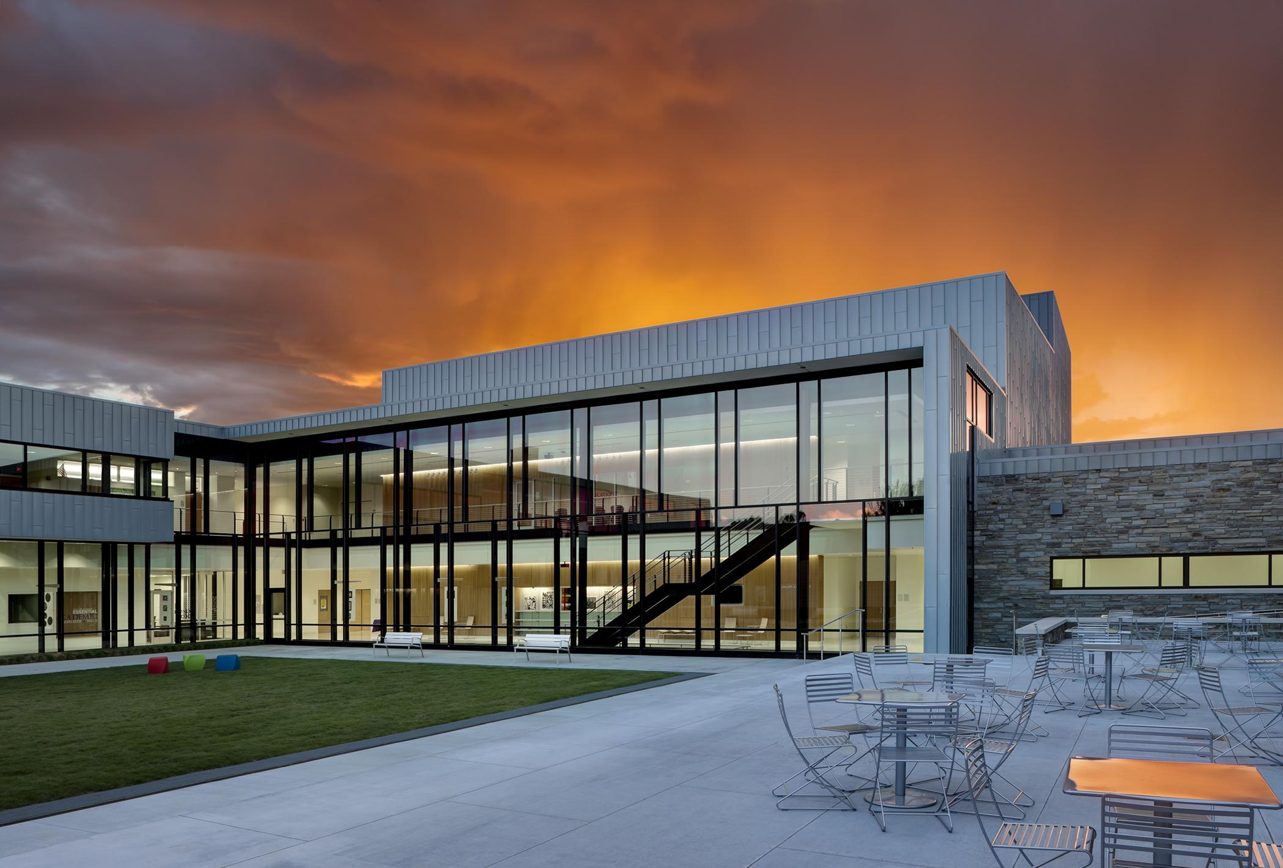
Reduce bullying by making it visible
Image Courtesy of Perkins + Will

Slide 19
Design for Social Support
School Climate = social-emotional health at school-wide level
Positive school climate “includes norms, values, and expectations that support people feeling socially, emotionally and physically safe” (National School Climate Council, 2007)
Positive school climate associated with:
less bullying, fewer discipline referrals, fewer dropouts, greater connectedness, higher achievement scores (National School Climate Council, 2007)

Slide 20
Design for Social Support
How Educators create positive school climate:
School-wide Positive Behavior Intervention and Support (SWPBIS)
Social-emotional learning programs: Second Step
Rewards, behavior intervention
Positive social environment = violence prevention

Slide 21
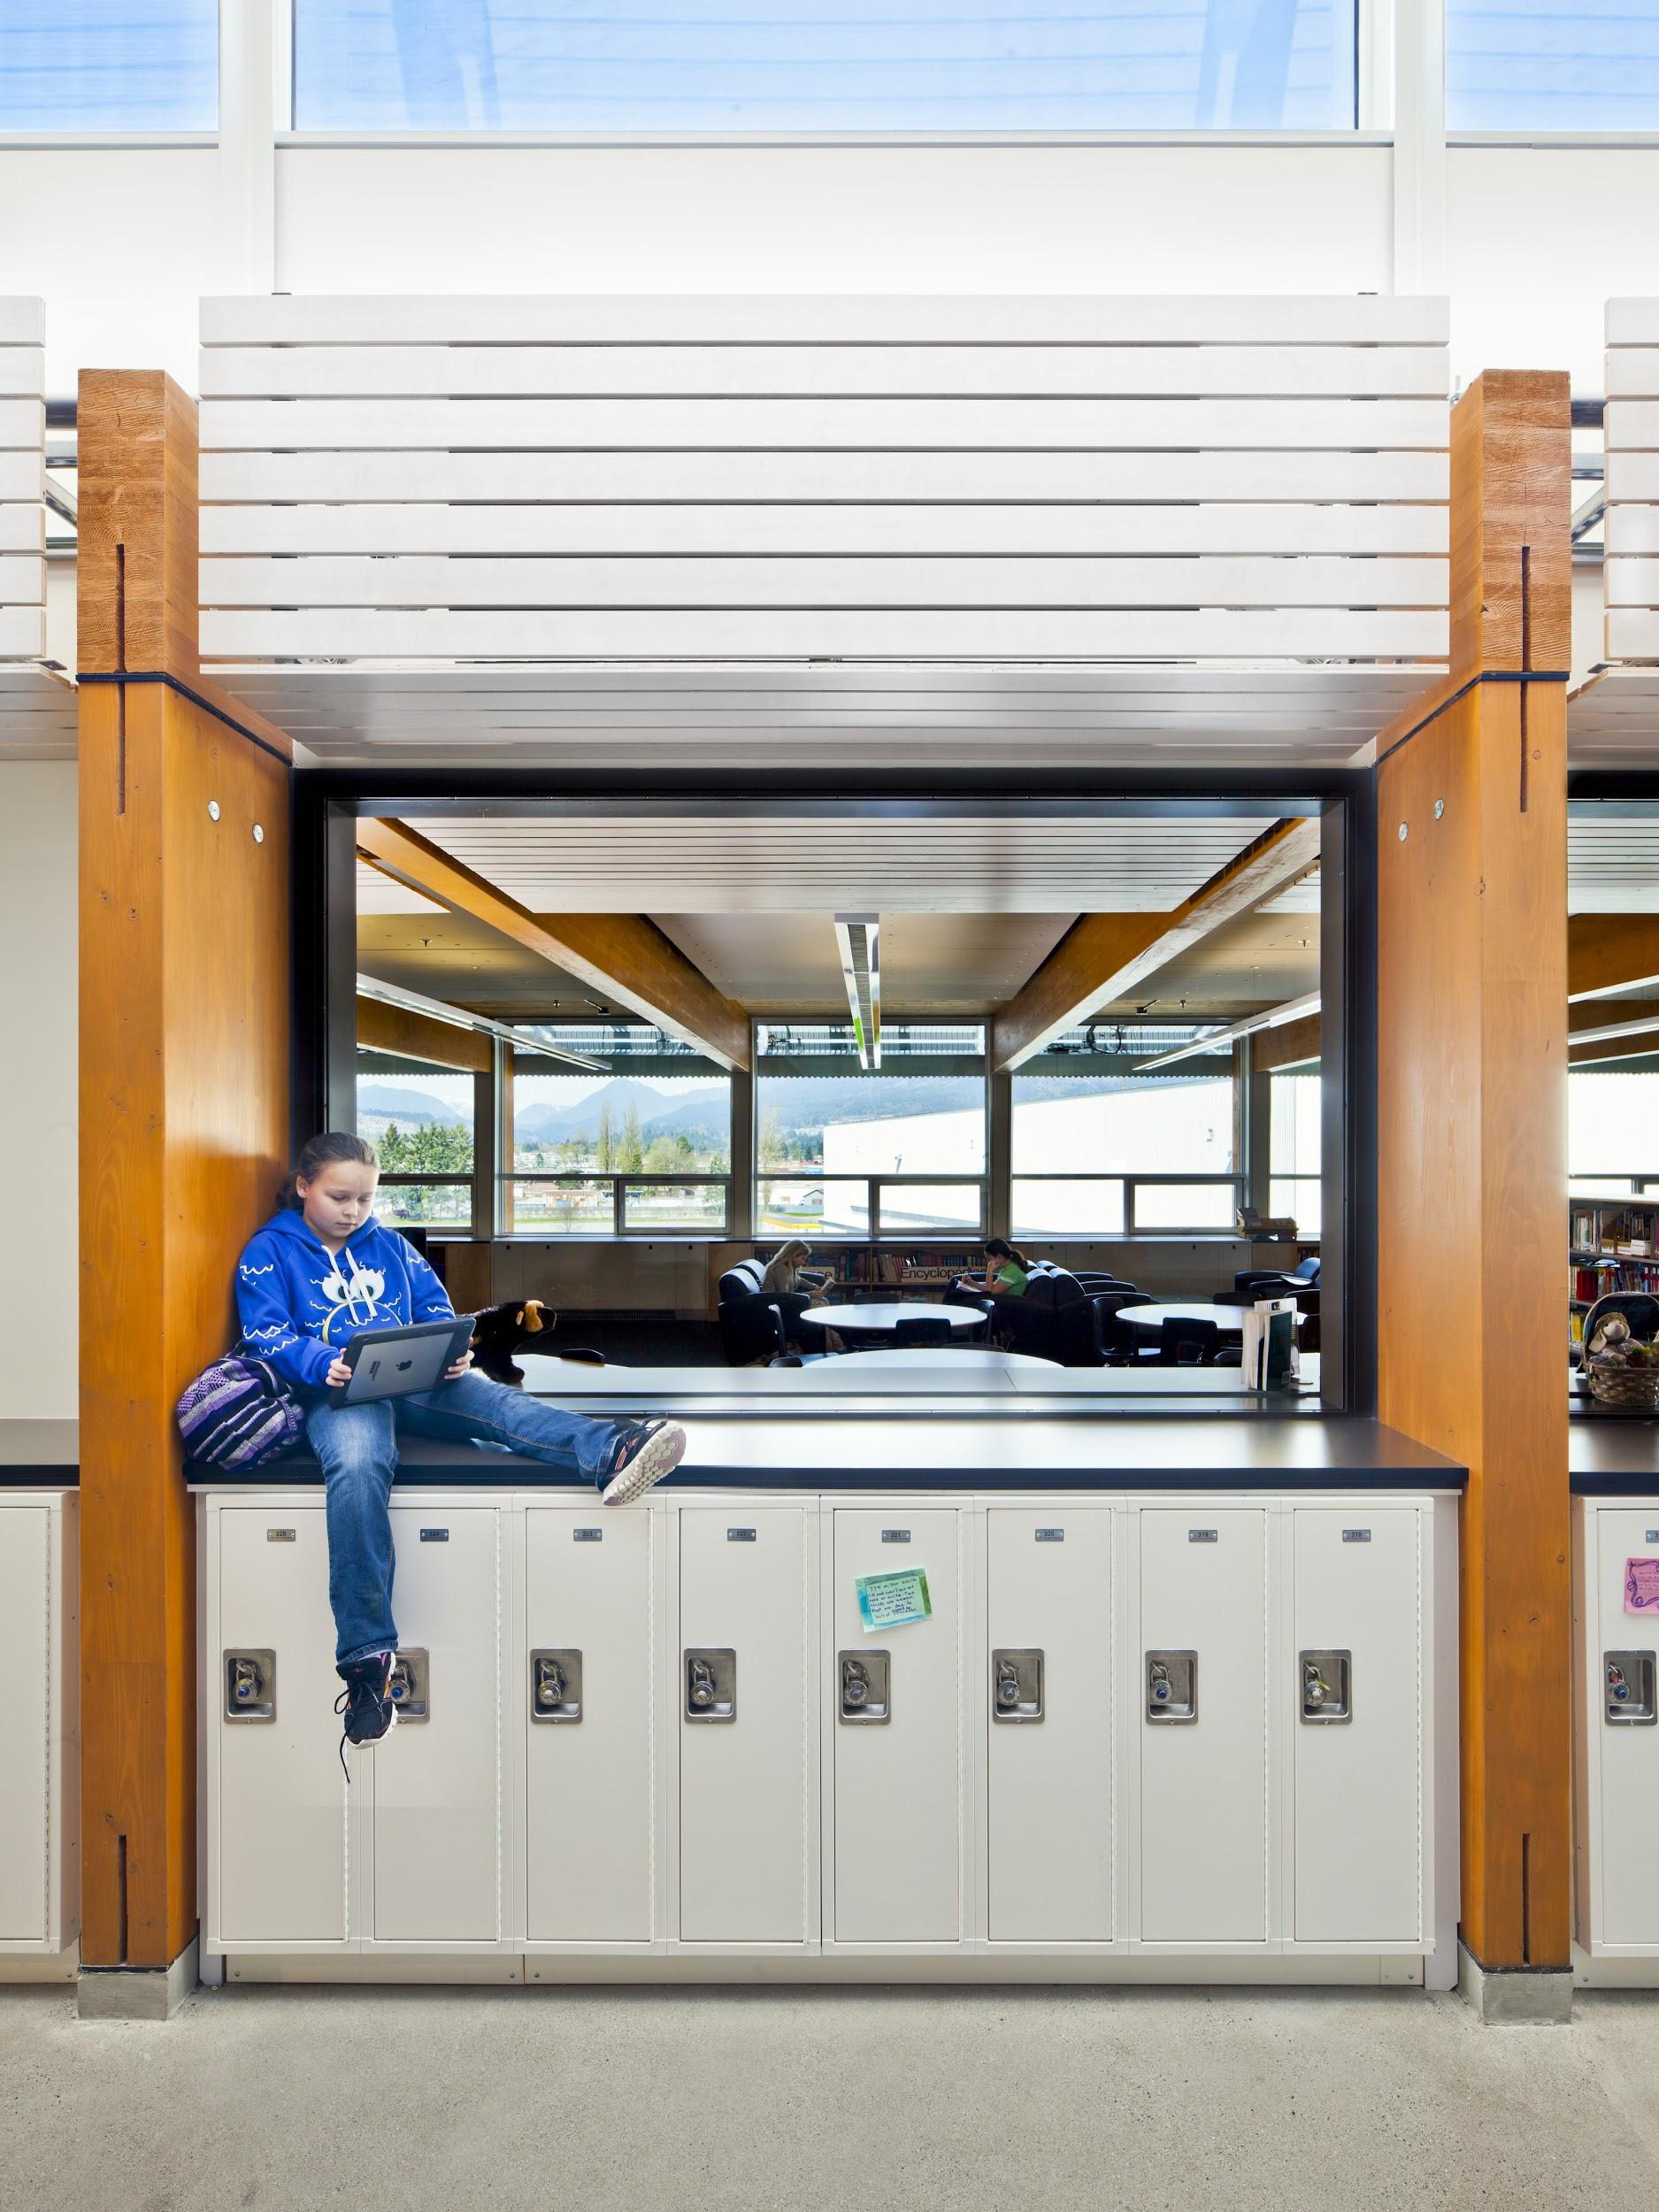
How Architects can support school climate:
Sense of belonging
Image Courtesy of Perkins + Will

Slide 22
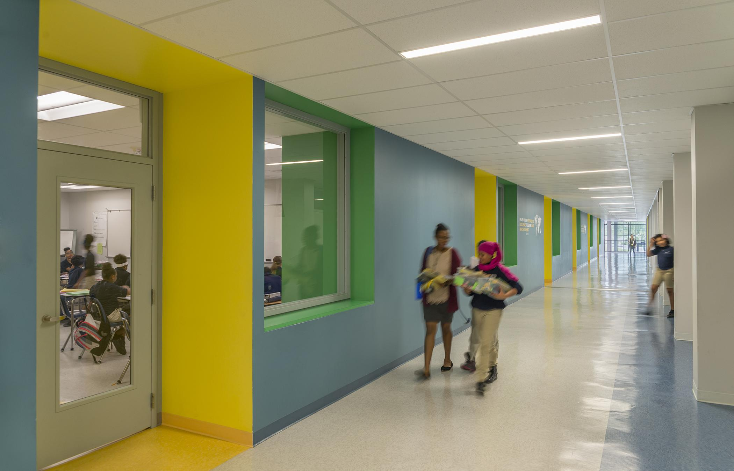
Social connectedness via Visual connectedness
Image Courtesy of Perkins + Will

Slide 23
Other ideas for social support:
Use visual themes to create identity and placeness
accommodate various social settings and group sizes
Small, comfortable “nooks” for quiet/respite
neutral territory for students to congregate
furniture arrangements that encourage social interaction.

Slide 24
Problem:
Security features may adversely impact school climate.
Conflict:
How can we support school safety AND psychosocial wellbeing?
Solution:
Crime Prevention through Environmental Design (CPTED)

Slide 25
Crime Prevention through Environmental Design (CPTED)
CPTED Principles:
Natural Surveillance- open layouts and maximum sight lines to provide constant passive observation.
“See and be seen.”
Access Control: selecting who is allowed in and out of the school.
Territoriality: clear delineation of distinct spaces via visual environmental cues. Use architectural and landscape markers to communicate ownership of a space
Maintenance: indicates ownership of space

Slide 26
The Four D’s
Deter
Detect
Delay
Defend

Slide 27
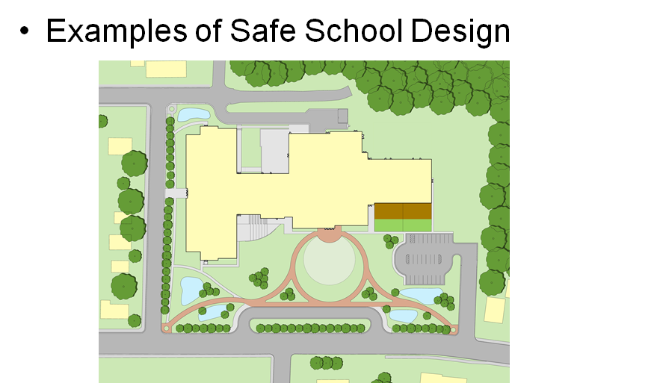
The Four D’s

Slide 28
The Four D’s

Slide 29
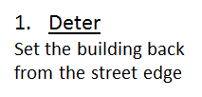
The Four D’s

Slide 30
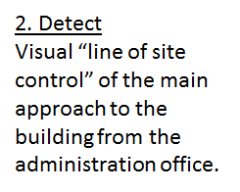
The Four D’s

Slide 31
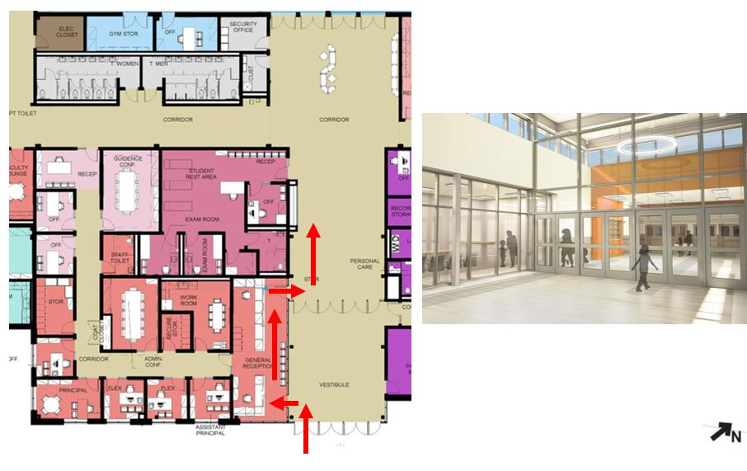
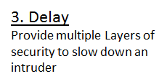
The Four D’s

Slide 32
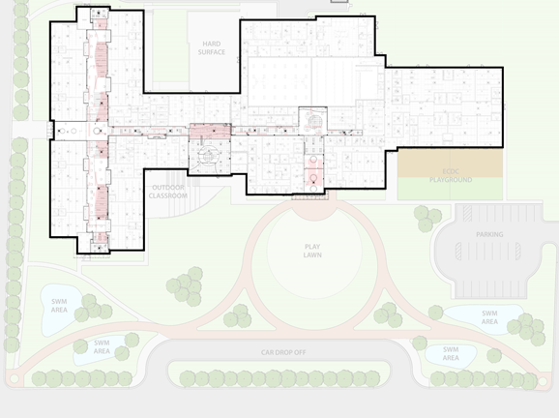
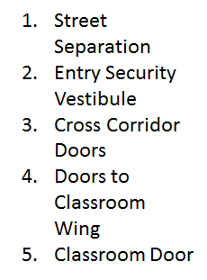
The Four D’s

Slide 33
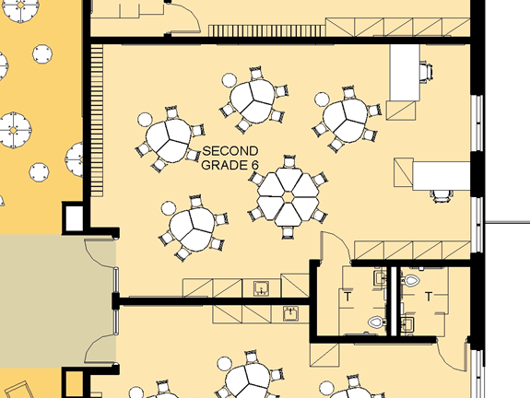
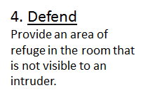
The Four D’s

Slide 34
Why CPTED?
Reasons why CPTED is ideal for balancing safety and psychosocial needs in schools:
Gets away from “fortified school” model
Subtle methods allow for positive social climate
Natural surveillance also supports school connectedness/visual connectivity

Slide 35
Why CPTED?
Cost-effective: costs of building CPTED school similar to current average construction costs (Philpott & Kuenstle, 2007).
Clear framework allows for quasi-standardized implementation

Slide 36
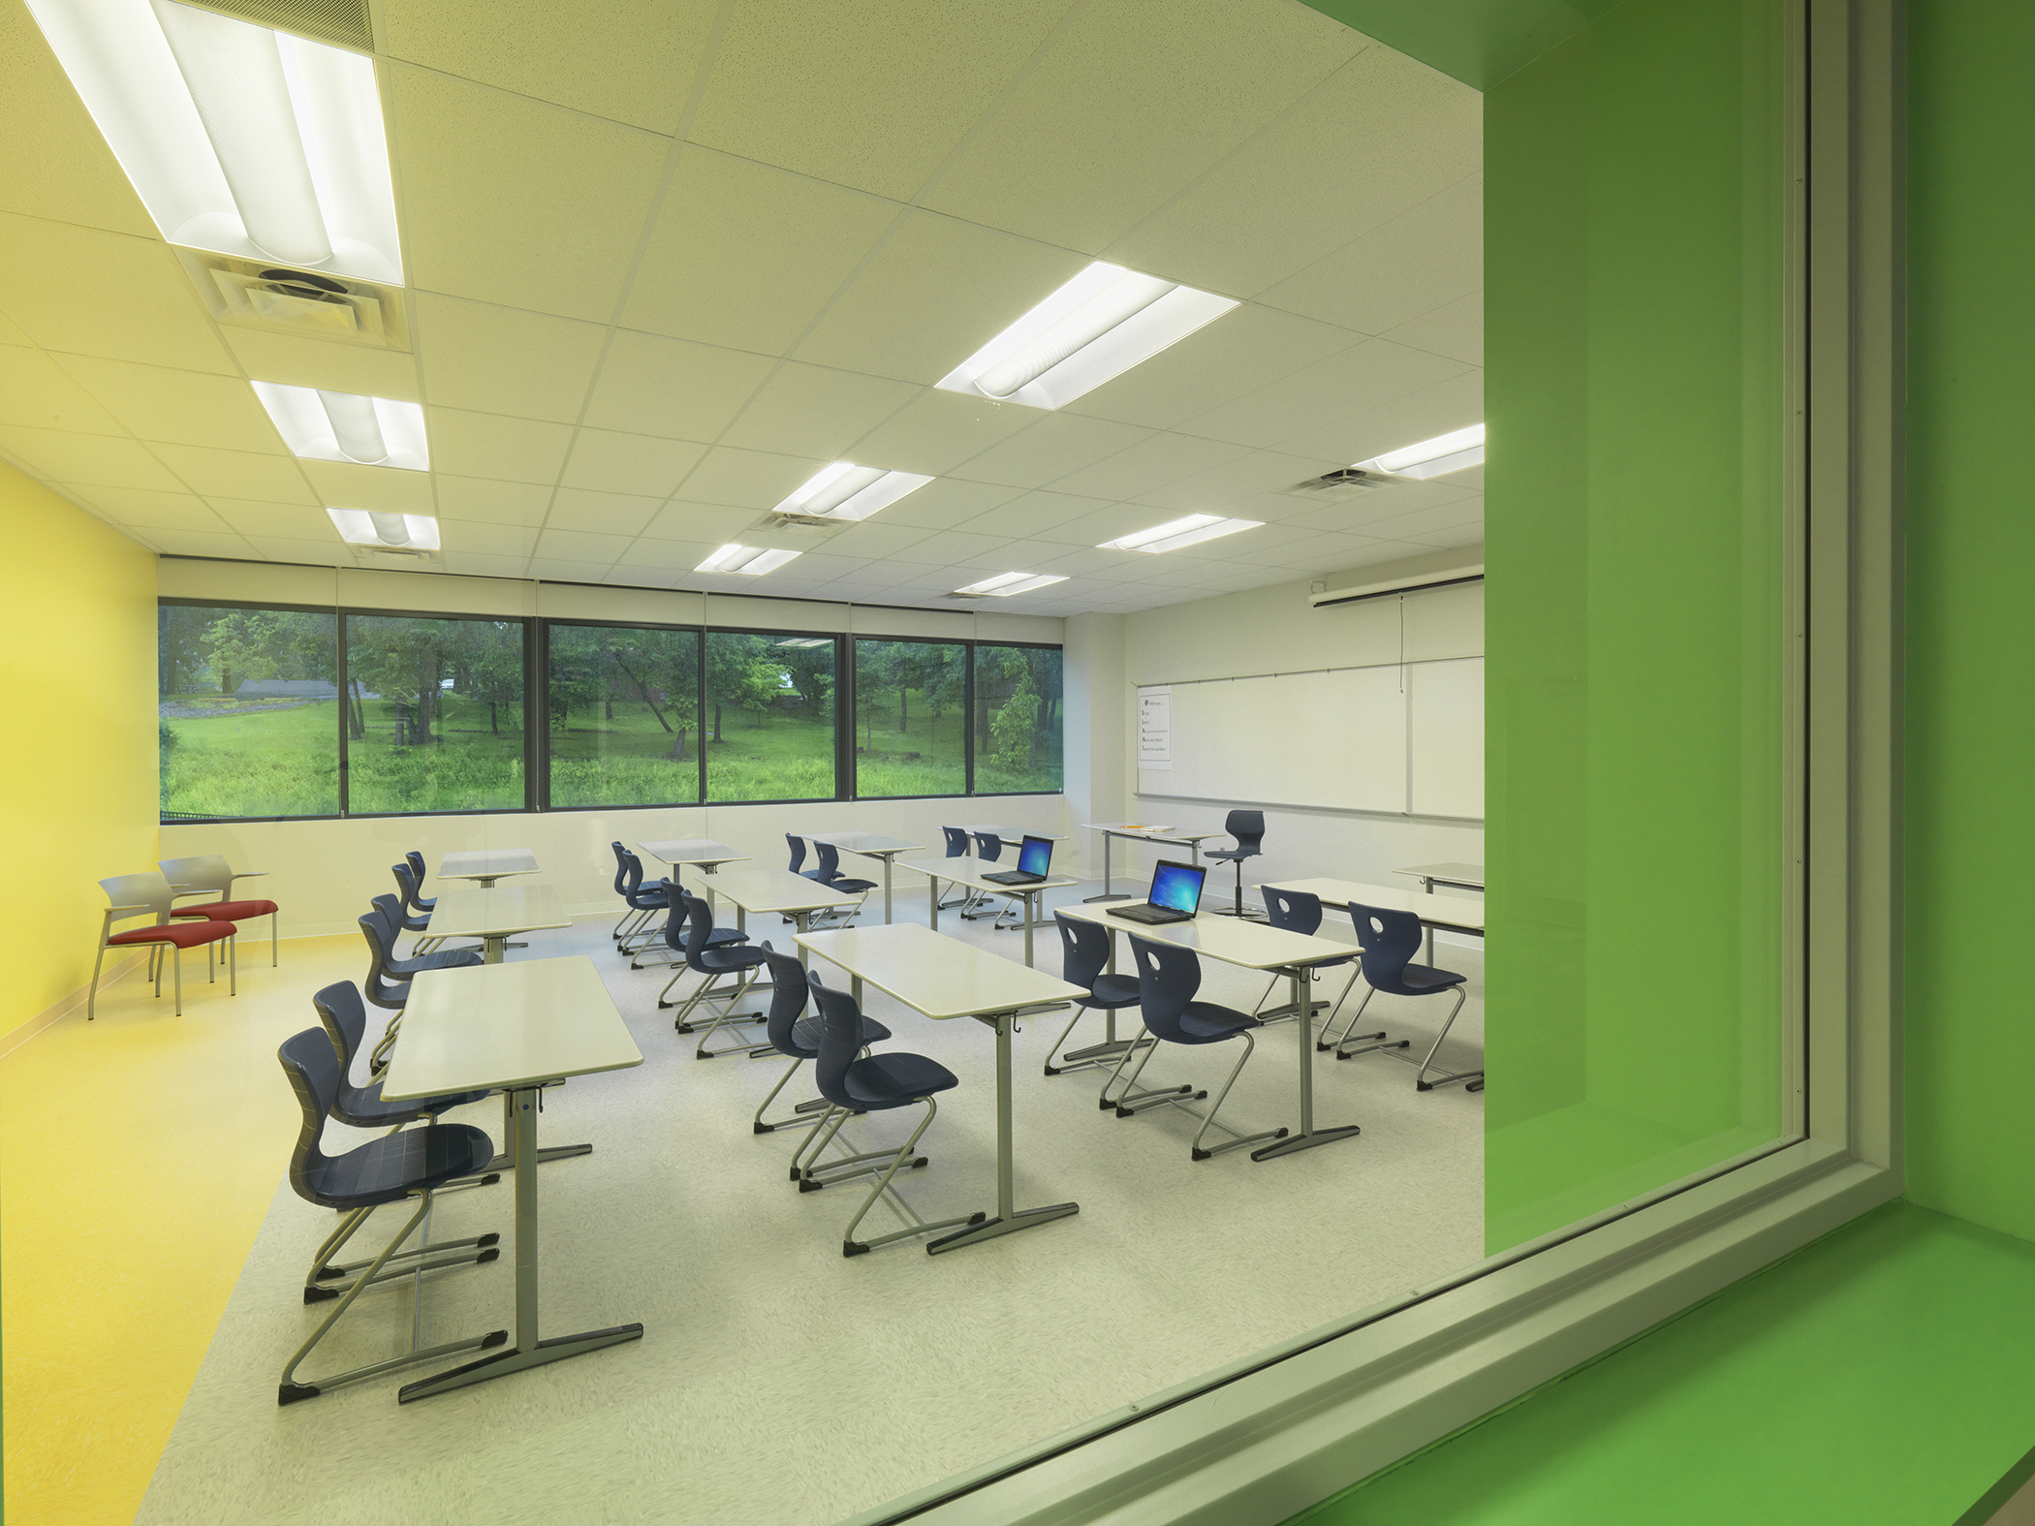
Natural Surveillance
Image courtesy of Perkins+Will

Slide 37
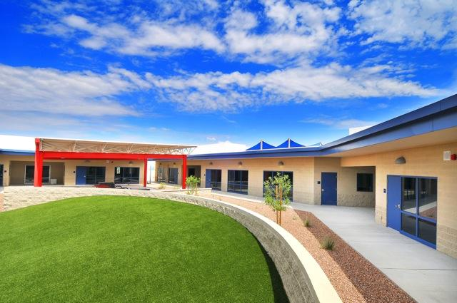
Natural Surveillance
Image credit: http://vahs.vail.k12.az.us/wp-content/uploads/2013/05/Grassy_Hill.jpg

Slide 38
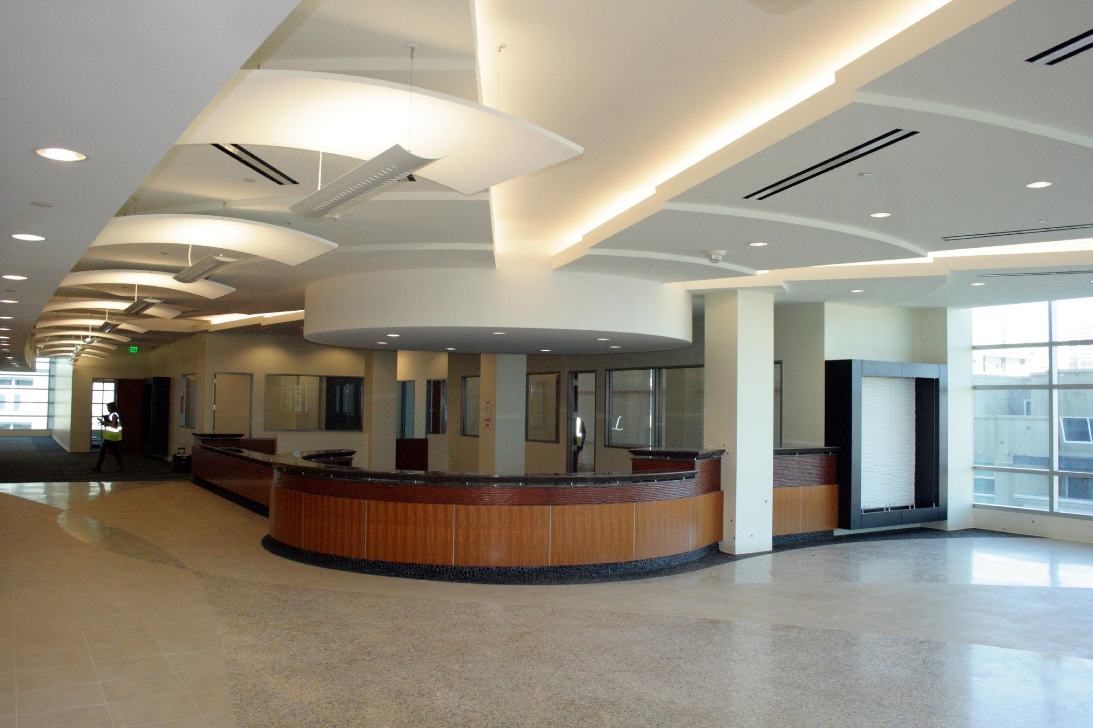
Natural Surveillance
Image credit:http://www.tjsl.edu/sites/default/files/ new_building_12-13_library_circ.jpg

Slide 39
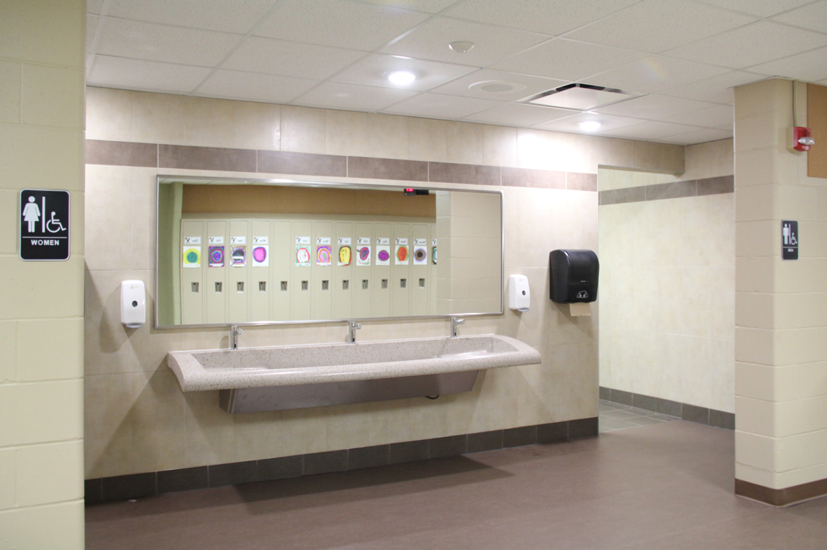
Natural Surveillance
Image credit:http://www.sdsarch.com/projects/50/after/Corridors%20-%20Restroom.jpg

Slide 40
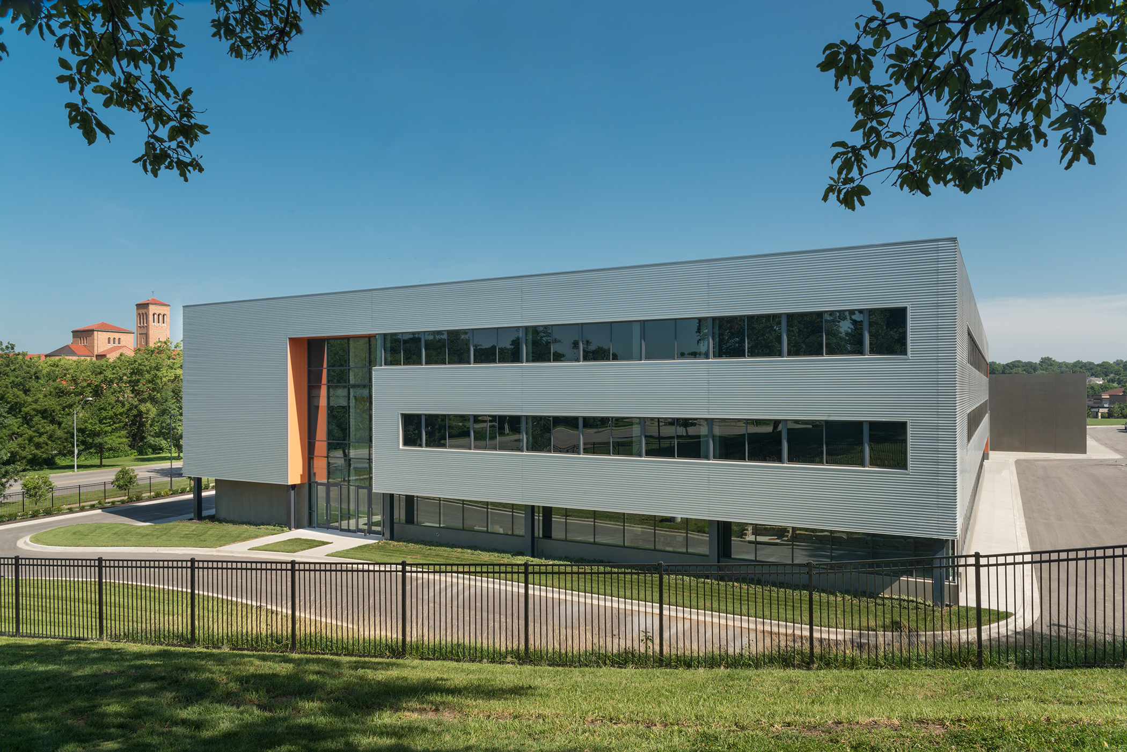
Access Control
Image courtesy of Perkins+Will

Slide 41
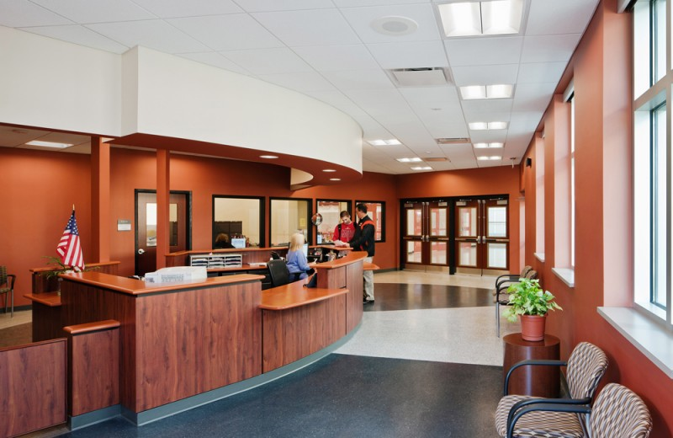
Access Control
Image Credit: http://www.hayesdesign.com/images/projects/bphs05.jpg

Slide 42
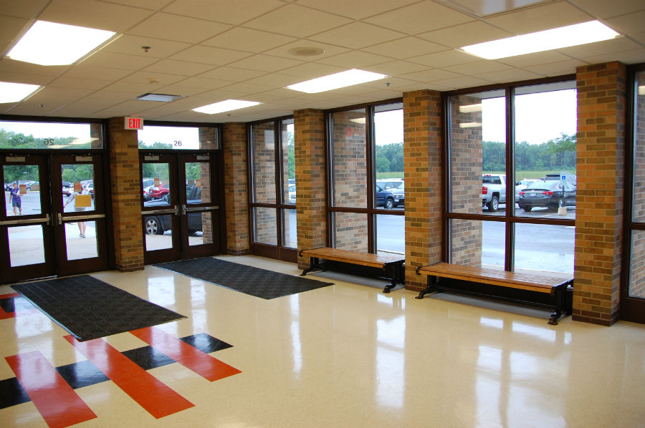
Access Control

Slide 43
Access Control
Image Credit: http://www.grandhaventribune.com/sites/www.grandhaventribune.com/files/styles/large/public/LAKESHORE_TRAFFIC1.jpg?itok=vNG3MdGI

Slide 44
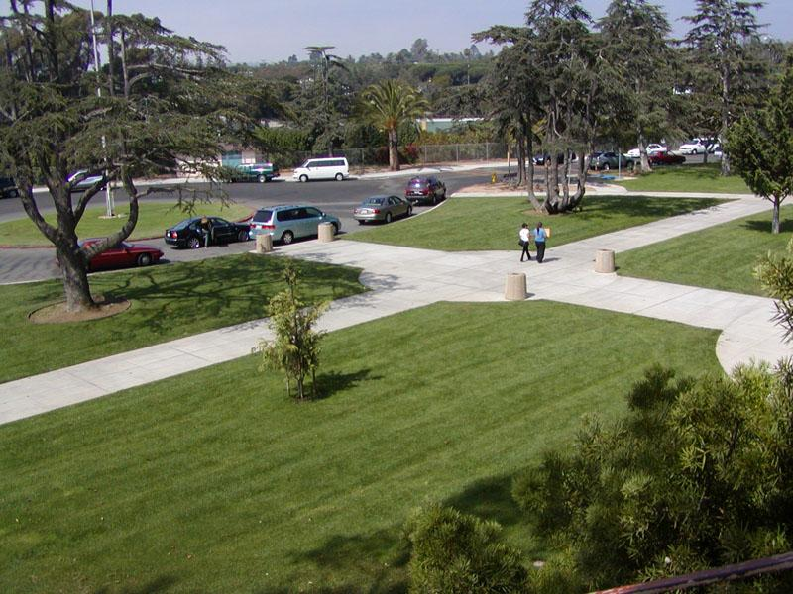
Territoriality/Maintenance
Image Credit: http://www.sbunified.org/districtwp/wp-content/uploads/2013/03/mainentrance1.jpg

Slide 45
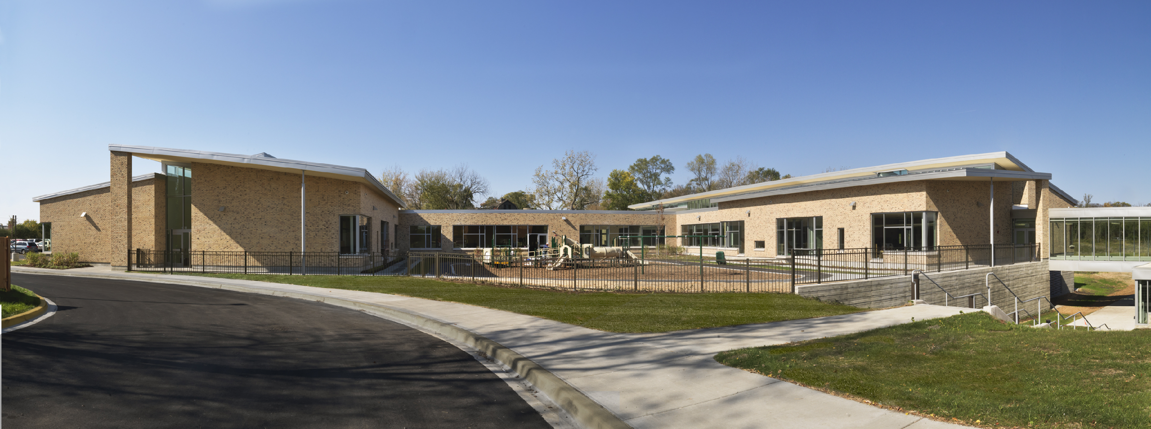
Territoriality/Maintenance
Image courtesy of Perkins+Will

Slide 46
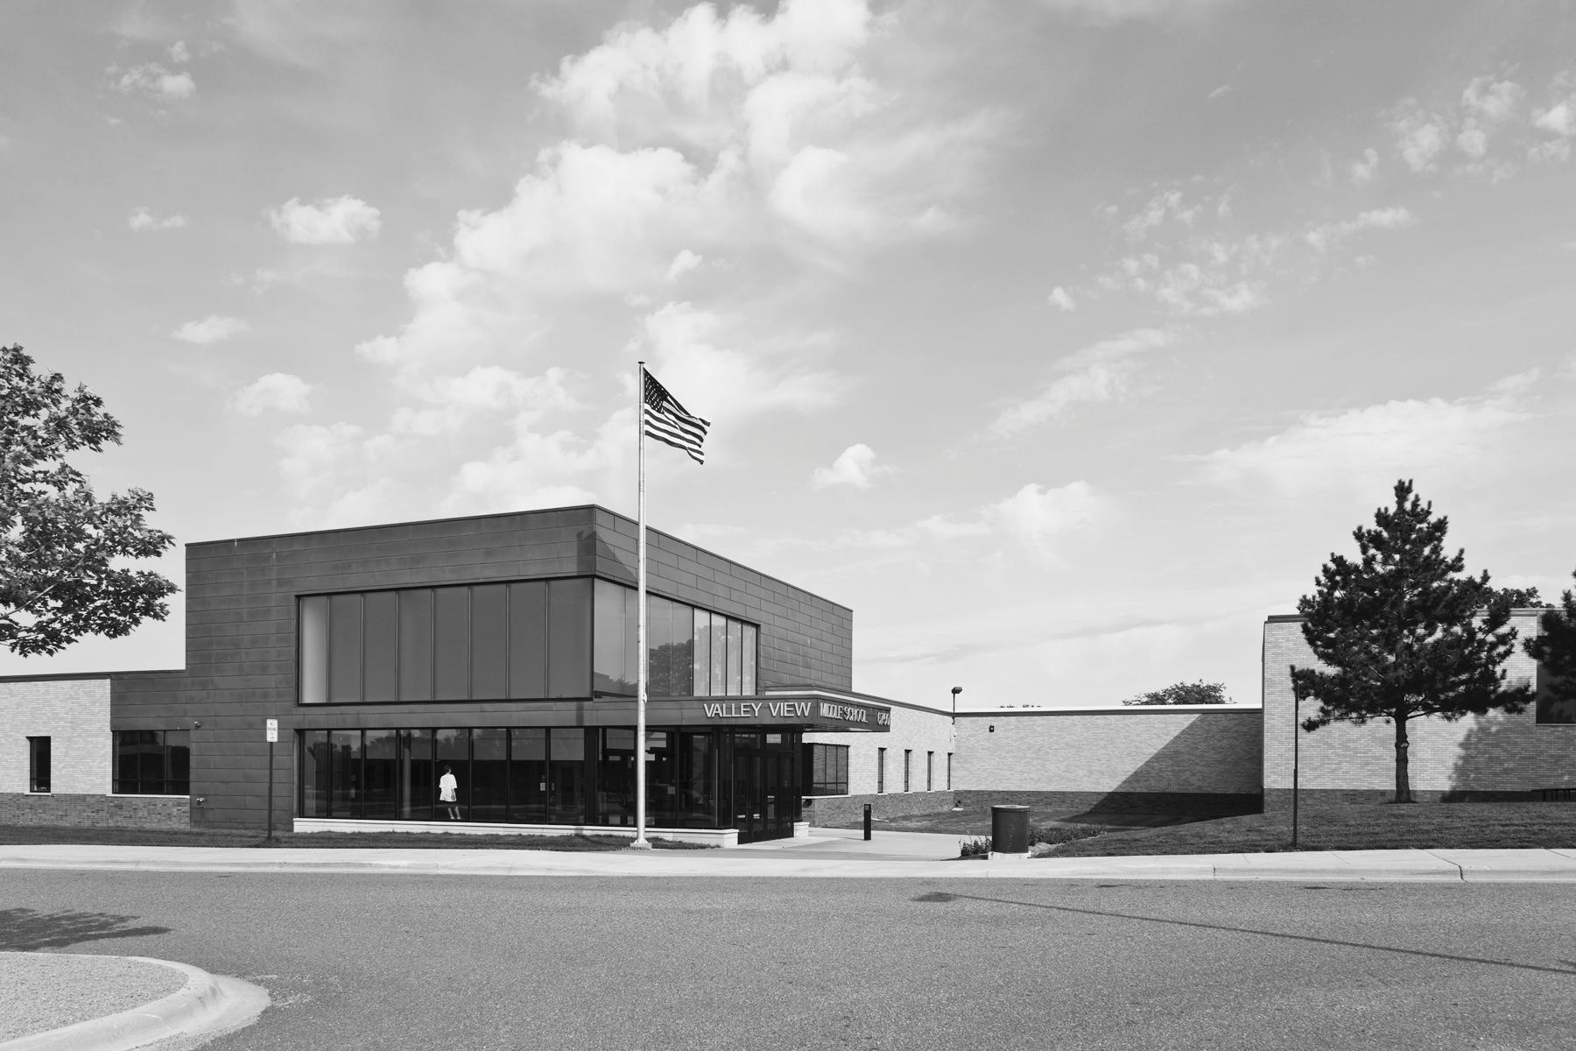
Territoriality/Maintenance
Image courtesy of Perkins+Will

Slide 47
Research on CPTED
Is CPTED effective? YES.
Significant decrease in robberies among retail and public settings (Casteel and Peek-Asa, 2000).
Little to no research on use of CPTED in schools
Lamoreaux, 2017
Students prefer CPTED-designed campuses for safety AND psych comfort

Slide 48
Conclusions & Recommendations
Design that supports positive school climate = violence prevention
Focus on mental/social/emotional health of school
Use CPTED or Four D’s
Security elements should not impinge on comfort/psychosocial needs
Use research-informed or evidence-based design: consult experts and leading sources

Slide 49
Conclusions & Recommendations
Incorporate CPTED, 4 D’s
Reduce “blind spots,” areas with low supervision
Playground equipment that encourages group cooperative play
Fencing and windows allow natural surveillance of campus

Slide 50
Conclusions & Recommendations
Facilitate school connectedness, community, connectivity.
Create school identity, sense of placeness via visual themes.
Example: Erika Mann school
erika mann grundschule - Google Search

Slide 51
CALL TO ACTION
CPTED facilitates design for:
Physical Security
+
Psychological Sensitivity
+
Social Support

Slide 52
Contact Information
Daniel Lamoreaux: djlamoreaux@gmail.com
Brian G. Minnich:
bminnich@gwwoinc.com

Slide 53
Resources
Web Resources
National Clearinghouse for Educational Facilities
http://www.ncef.org/resource-lists/safety-and-security-assessment
Journal of Environment and Behavior (Peer-reviewed research on the built environment)
http://journals.sagepub.com/home/eab
National Institute of Crime Prevention: CPTED training modules
http://www.cptedtraining.net

Slide 54
Resources
Books:
Philpott, D., & Kuenstle, M. W. (2007). Education facility security handbook. Lanham, Md: Government Institutes.
Taylor, A., & Enggass, K. (2009). Linking Architecture and Education: Sustainable design for learning environments. University of New Mexico Press.
The Language of School Design: Design Patterns for 21st Century
Schools, by Nair and Fielding
4. The Third Teacher-
by Canon Design, VS Furniture, and Bruce Mau Design

Slide 56
References
Bauman, S., Toomey, R. B., & Walker, J. L. (2013). Associations among bullying, cyberbullying, and suicide in high school students. Journal of adolescence, 36(2), 341-350.
Unknown author. 2015. Preventing Youth Suicide: Facts and tips. NASPonline. Retrieved from http://www.nasponline.org/resources-and-publications/resources/school-safety-and-crisis/preventing-youth-suicide
Philpott, D., & Kuenstle, M. W. (2007). Education facility security handbook. Lanham, MD: Government Institutes.
Robers, S., Zhang, A., Morgan, R.E., and Musu-Gillette, L. (2015). Indicators of School Crime and Safety: 2014. National Center for Education Statistics, U.S. Department of Education, and Bureau of Justice Statistics, Office of Justice Programs, U.S. Department of Justice. Washington, DC.
Robers, S., Zhang, J., & Truman, J. (2012). Indicators of school crime and safety: 2011 (NCES 2012-002/NCJ 236021). Washington, DC: U.S. Department of Education and U.S. Department of Justice. Retrieved fromhttp://bjs.ojp.usdoj.gov/content/pub/pdf/iscs11.pdf
Vossekuil, B., Fein, R. A., Reddy, M., Borum, R., & Modzeleski, W. (2002). The final report and findings of the Safe School Initiative: Implications for the prevention of school attacks in the United States. US Secret Service and Department of Education, Washington, DC.

Slide 57
Reeves, M. A., Kanan, L. M., & Plog, A. E. (2010). Comprehensive planning for safe learning environments: A school professional's guide to integrating physical and psychological safety, prevention through recovery. New York: Routledge.
Rivara, F., & Le Menestrel, S. (2016). Preventing Bullying Through Science, Policy, and Practice. Washington, DC: The National Academies Press. doi, 10, 23482.
National Association of School Psychologists. (2013). Research on school security: The impact of security measures on students. NASP, Bethesda, MD. Retrieved from http://www.audioenhancement.com/wp-content/uploads/2014/06/school-security-by-NASP.pdf
Evans, G. W. (2003). The built environment and mental health. Journal of Urban Health, 80(4), 536-555.

Slide 58
National School Climate Council. (2007). The School Climate Challenge: Narrowing the gap between school climate research and school climate policy, practice guidelines and teacher education policy. Retrieved from http://www.schoolclimate.org/ climate/advocacy.php
Holt, M. K., Vivolo-Kantor, A. M., Polanin, J. R., Holland, K. M., DeGue, S., Matjasko, J. L., … Reid, G. (2015). Bullying and Suicidal Ideation and Behaviors: A Meta-Analysis. Pediatrics, 135(2), e496–e509. http://doi.org/10.1542/peds.2014-1864

